Slide 1
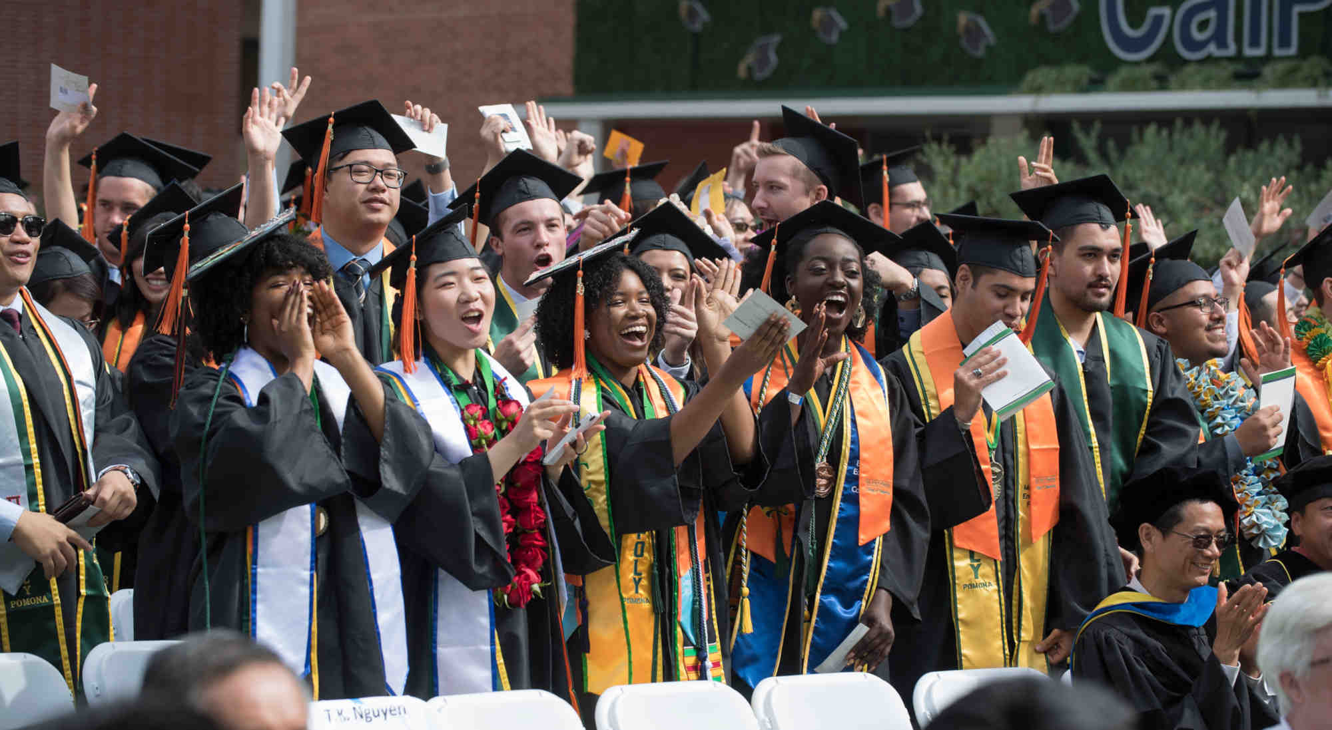
Steps Toward Graduation
Registrar’s Office & Office of Graduate Studies
Camry Carls & Rebecca Rivas

Slide 2
Content
1.Graduation Vs. Commencement
2. Graduation Application Timeline
3. Degree Awarding Process
4. Graduation Checklist
5. Tips for Graduates
6. Diploma/Employment Verification
7. Additional Resources

Slide 3
Graduation Vs. Commencement

Slide 4
Graduation Application Timeline
The Fall 2021 Application Deadline - October 22nd
Late applications accepted via BroncoDirect through the end of the fall semester
Graduation Pre-Checks - Starting in November
Fall 2021 Grades Due – December 15th
Registrar’s Office may begin awarding degrees after January 3rd
Outstanding Requirements Deadline – January 28th

Slide 5
Degree Awarding Process
After January 3rd:
A final review of your record will be completed
If you have met all degree and graduation requirements, your degree will be posted
If you are still missing any requirements and/or required documents for graduation, you will be placed in Pending status at that time
If placed in Pending status, you must resolve your deficiencies by January 28th (Outstanding Requirements Deadline) to be awarded for Fall 2021
If you are unable to resolve your outstanding requirements, your Graduation Application (including the fee) will be rolled over to the next Graduation Term (i.e. Spring 2022)

Slide 6
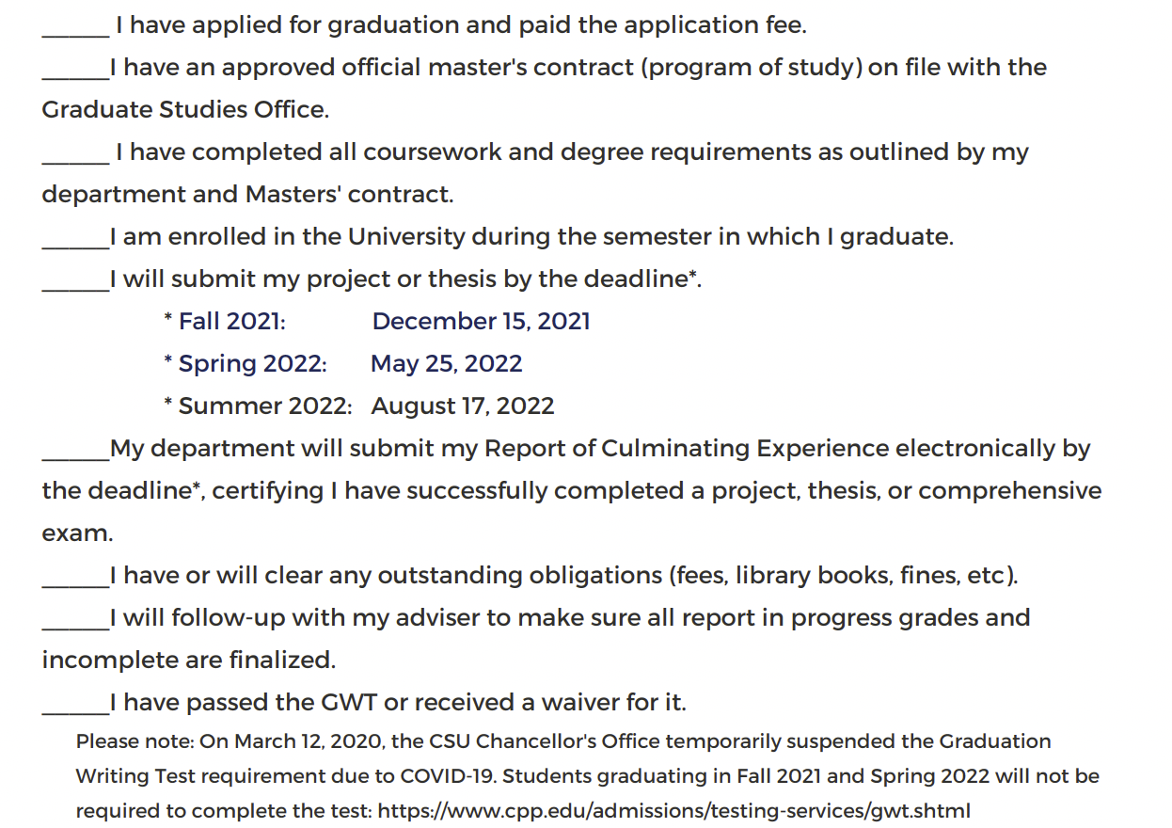
Graduation Checklist
cpp.edu/gradstudies → Current students → Policies and Procedures → Graduation Checklist

Slide 7
Tips for Graduates
Verify on BroncoDirect that you have applied for Fall 2021 Graduation
Confirm with the Graduate Studies Office they have received a copy of your approved Contract/Program of Study – The Registrar’s Office cannot complete your graduation review without one
Ensure your department will submit your Report of Culminating Experience by December 15, 2021
Review your unofficial transcript to check for any outstanding grades which need to be finalized by your instructor(s) – e.g. “RP”, “I”
Review your unofficial transcript to ensure you will have met the minimum 3.00 G.P.A. requirements by the time your fall grades post

Slide 8
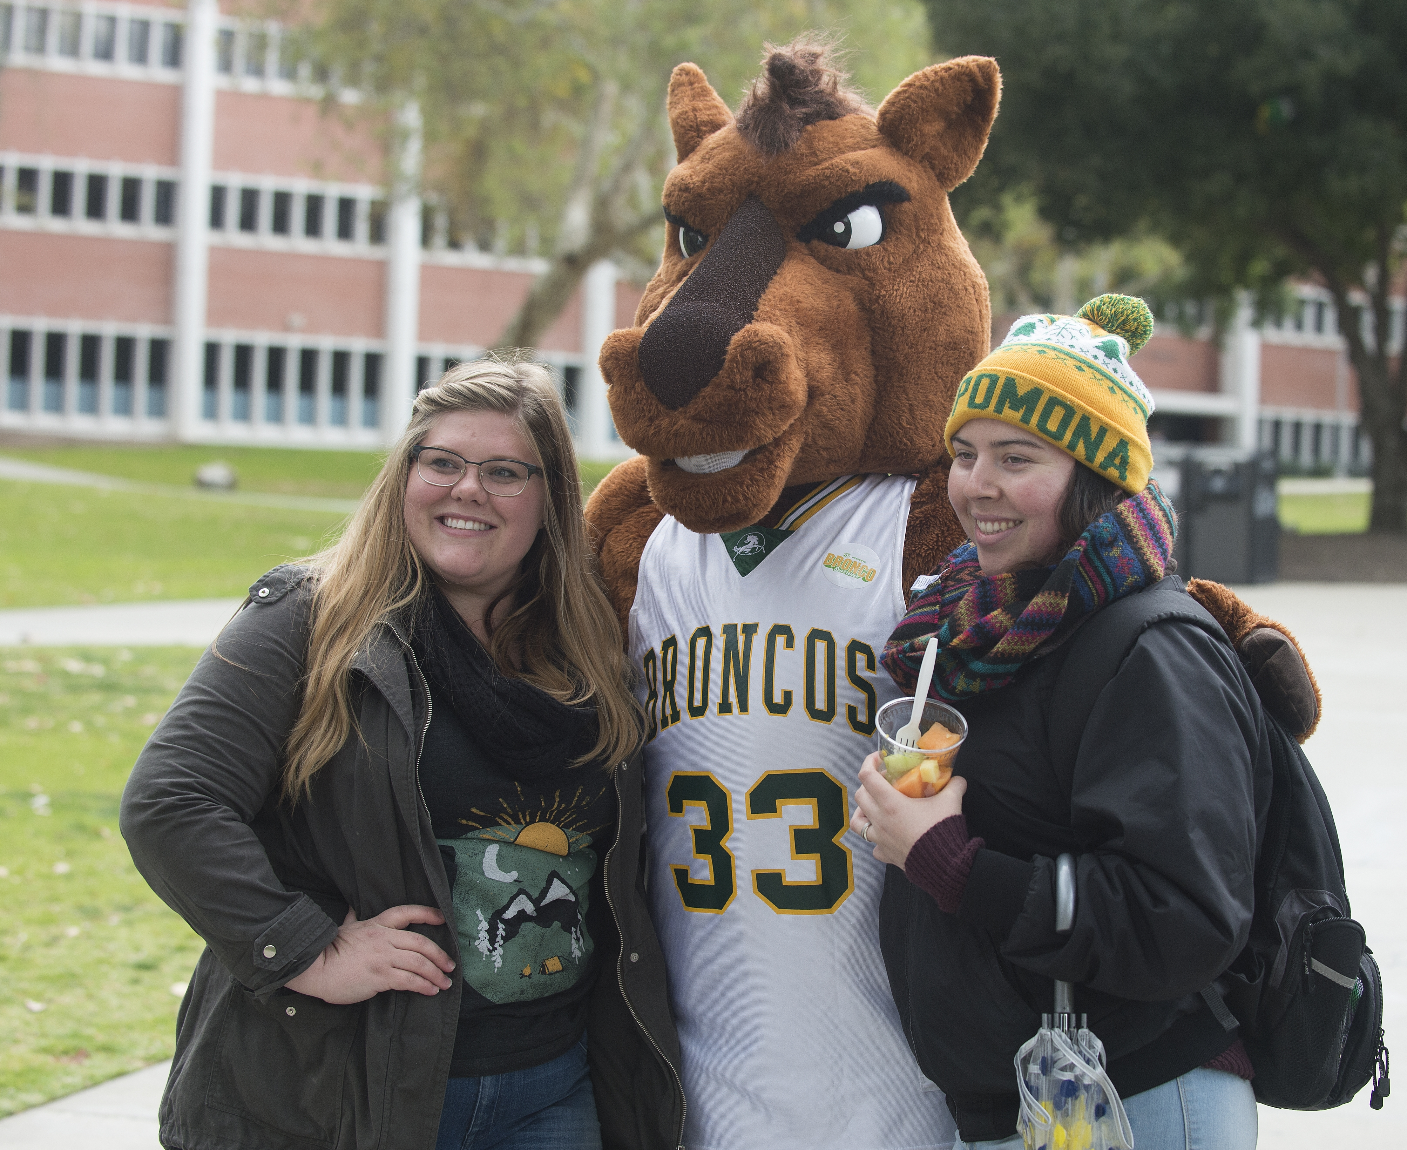
Diploma/Employment Verification
Diplomas
Will be ordered once your degree is posted
Ordered weekly – please allow 14-21 business days to receive
Diplomas sent internationally are not guaranteed to arrive
Questions: diplomas@cpp.edu
Unofficial Transcripts
Degree conferral date automatically displays once degree posts
Current students may access a copy via BroncoDirect
Official Transcripts
Order via The National Student Clearinghouse (NSC)
Visit the Registrar’s Office website for more info: https://www.cpp.edu/registrar//transcripts/index.shtml

Slide 9
Diploma/Employment Verification
Proof of Degree Letter
To be given to a potential employer or institution
Can be issued before your degree is officially awarded as proof of expected graduation
Degree Verification Letter
To be given to a potential employer or institution
Can be issued once your degree has been awarded
Email the Bronco Advising Center to request either letter at bac@cpp.edu

Slide 10
Additional Resources
Graduation Status: tga@cpp.edu
Graduate Studies: Regarding program of study, graduate petitions, project/thesis submission, or graduate student policies: gradstudies@cpp.edu
Registrar’s Office website: https://www.cpp.edu/registrar//index.shtml
Commencement website: https://www.cpp.edu/commencement/
Questions about commencement: commencement@cpp.edu

Slide 11
Q & A

