Slide 1
KERRIGAN
EEG to Speech Diarisation assisted Sentiment for AR/VR

Slide 2
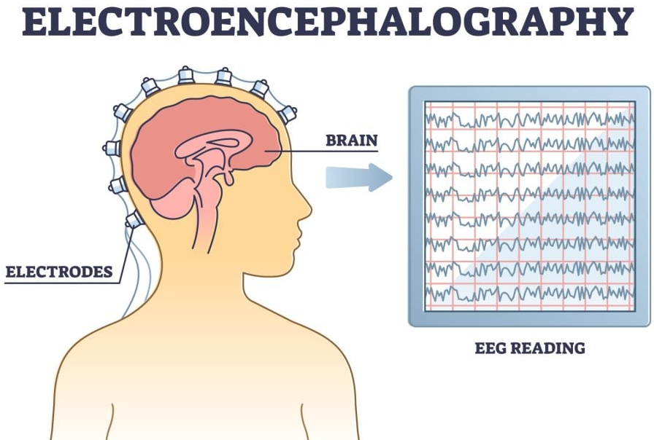
WHAT IS EEG (ELECTROENCEPHALOGRAM)?
Takes electrical neural signals and measures them at the surface of the scalp.
May possibly show certain emotional characteristics
Research into analyzing EEG for higher cognitive functions

Slide 3
WHAT IS OUR PROJECT
We wanted to use EEG to measure how a person feels when they see an image in VR/AR and generative optimal advertisements

Slide 4
THE TWO PARTS
EEG signals to sentiment analysis
Sentiment to generative advertisement

Slide 5
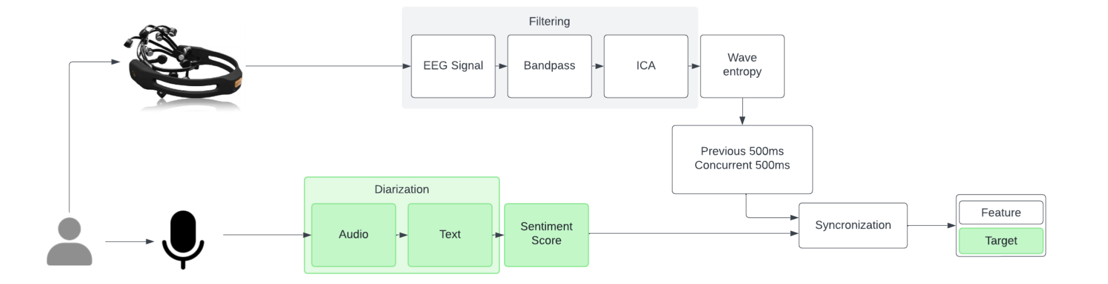
PROGRESS
Research methodology with end goal of EEG to Sentiment

Slide 6
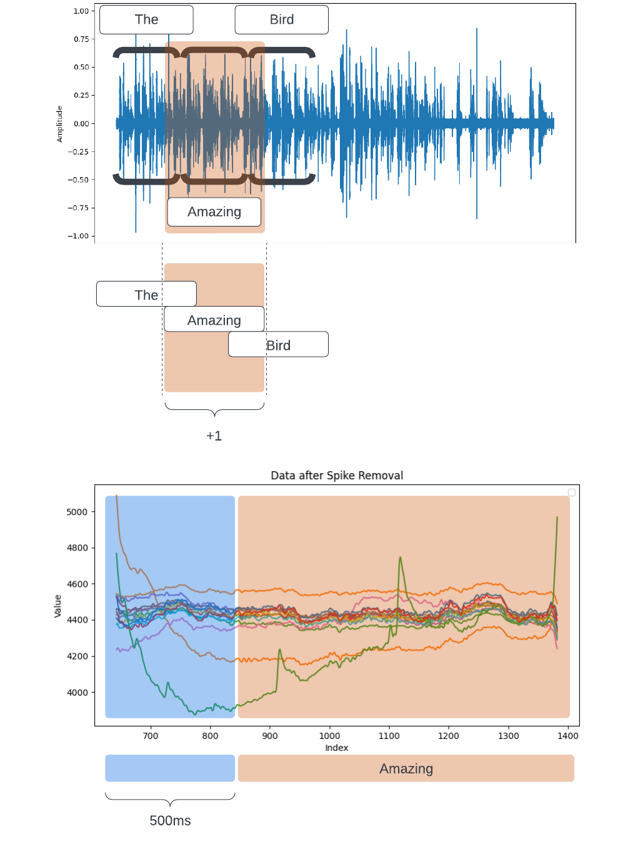
PROGRESS
Model 1
Audio
Text
Machine learning requires data and labels
Sentiment
EEG Label
EEG to Sentiment

Slide 7
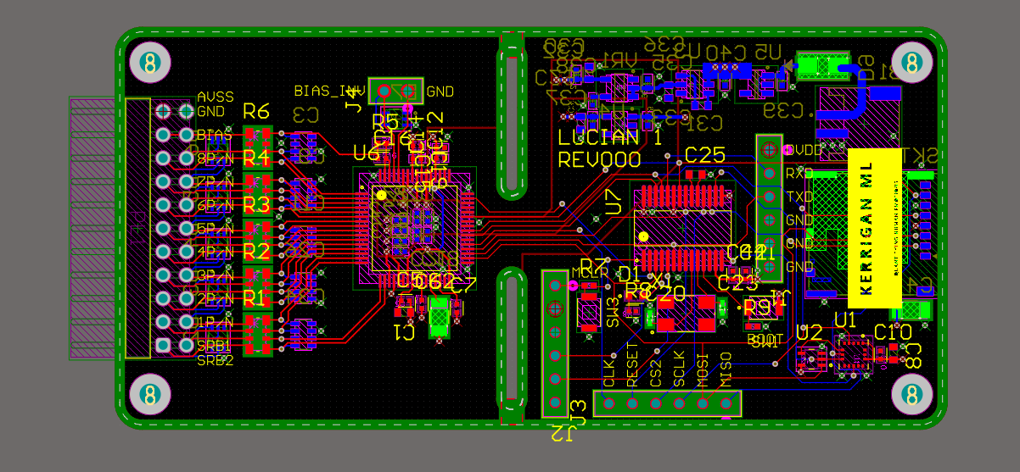
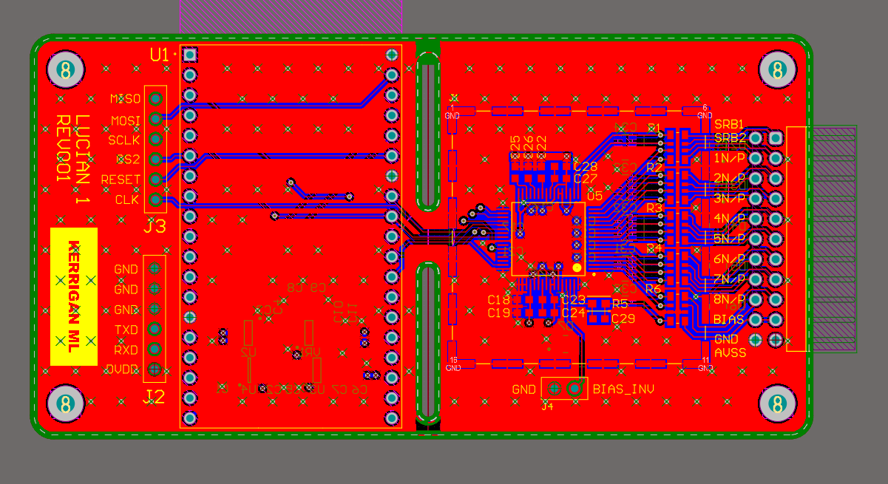
HARDWARE
V1
V2

Slide 8
REALIZATION
Hundreds of studies into EEG sentiment/cognitive use cases
Physics Calculations and signal processing methods indicate the machine learning models may not be actually learning off of neural signals

Slide 9
PROBLEM #1:
HARDWARE
V1
Expensive, time consuming, and inconsistent
V2

Slide 10
PROBLEM #2: EMG OR EEG
7 category test seem to indicate little significant difference between EEG and EMG.
Intuitively, EEG are just higher amplification EMG devices so if there is any learning happening from Neural Data, it should differentiate from EMG.
Type | Accuracy | +/-
EEG | 15% - 39% | 2.6%
EMG | 14% - 37% | 3.43%
Face tracking | 15% - 66% | 1.15%
Audio | 42% - 69% | 1.58%
J. Chen, T. Ro and Z. Zhu, "Emotion Recognition With Audio, Video, EEG, and EMG: A Dataset and Baseline Approaches," in IEEE Access, vol. 10, pp. 13229-13242, 2022, doi: 10.1109/ACCESS.2022.3146729. keywords: {Electroencephalography;Feature extraction;Videos;Support vector machines;Physiology;Emotion recognition;Electromyography;Emotion recognition;data collection;electroencephalography;electromyography},

Slide 11
PROBLEM #2: EMG OR EEG CONTINUED
Combined face tracking seem to also have little improvement and may be because the EEG is really picking up on micro-muscular movement since it is orders of magnitude higher in amplitude.
Type | Accuracy
EEG-LSTM | 86%
Face Track | 89%
Combined | 93.13
H. Jiang, R. Jiao, D. Wu, and W. Wu, “Emotion Analysis: Bimodal Fusion of Facial Expressions and EEG,” Comput. Mater. Contin., vol. 68, no. 2, pp. 2315-2327, 2021. https://doi.org/10.32604/cmc.2021.016832

Slide 12
PROBLEM #3: EEG INDIVIDUALIZATION
Accuracy of Subject-Dependent Classification
Accuracy of Subject-Independent Classification
Subject | KNN | SVM_Linear | SVM_Cubic | LDA | Mean
1 | 0.971 | 0.829 | 0.900 | 0.829 | 0.882
2 | 0.900 | 0.900 | 0.886 | 0.943 | 0.907
3 | 0.986 | 0.971 | 1.000 | 0.857 | 0.954
4 | 0.986 | 0.971 | 0.986 | 0.929 | 0.968
5 | 0.929 | 0.886 | 0.943 | 0.914 | 0.918
6 | 0.671 | 0.829 | 0.829 | 0.657 | 0.746
7 | 0.929 | 0.929 | 1.000 | 0.929 | 0.946
8 | 0.914 | 0.929 | 0.971 | 0.886 | 0.925
9 | 0.957 | 0.943 | 0.957 | 0.929 | 0.946
10 | 0.986 | 0.871 | 0.971 | 0.971 | 0.950
11 | 0.986 | 0.986 | 1.000 | 0.957 | 0.982
12 | 1.000 | 0.971 | 0.986 | 0.929 | 0.971
13 | 0.943 | 0.886 | 0.971 | 0.900 | 0.925
14 | 0.986 | 0.886 | 1.000 | 0.943 | 0.954
15 | 0.957 | 0.986 | 0.986 | 0.957 | 0.971
16 | 0.957 | 0.914 | 0.971 | 0.929 | 0.943
mean | 0.941 | 0.918 | 0.960 | 0.904 | 0.904
Subject | KNN | SVM_Linear | SVM_Cubic | LDA
1 | 0.614 | 0.357 | 0.529 | 0.157
2 | 0.643 | 0.300 | 0.514 | 0.229
3 | 0.871 | 0.357 | 0.643 | 0.243
4 | 0.571 | 0.371 | 0.614 | 0.143
5 | 0.557 | 0.557 | 0.557 | 0.371
6 | 0.586 | 0.657 | 0.771 | 0.457
7 | 0.829 | 0.714 | 0.843 | 0.800
8 | 0.700 | 0.514 | 0.500 | 0.657
9 | 0.671 | 0.543 | 0.586 | 0.329
10 | 0.486 | 0.457 | 0.329 | 0.200
11 | 0.629 | 0.429 | 0.771 | 0.143
12 | 0.743 | 0.529 | 0.429 | 0.271
13 | 0.643 | 0.657 | 0.486 | 0.500
14 | 0.600 | 0.571 | 0.586 | 0.457
15 | 0.743 | 0.643 | 0.600 | 0.700
16 | 0.914 | 0.971 | 0.700 | 0.943
mean | 0.675 | 0.539 | 0.591 | 0.412
Kołodziej, M., Majkowski, A., & Jurczak, M. (2024). Acquisition and Analysis of Facial Electromyographic Signals for Emotion Recognition. Sensors, 24(15), 4785. https://doi.org/10.3390/s24154785

Slide 13
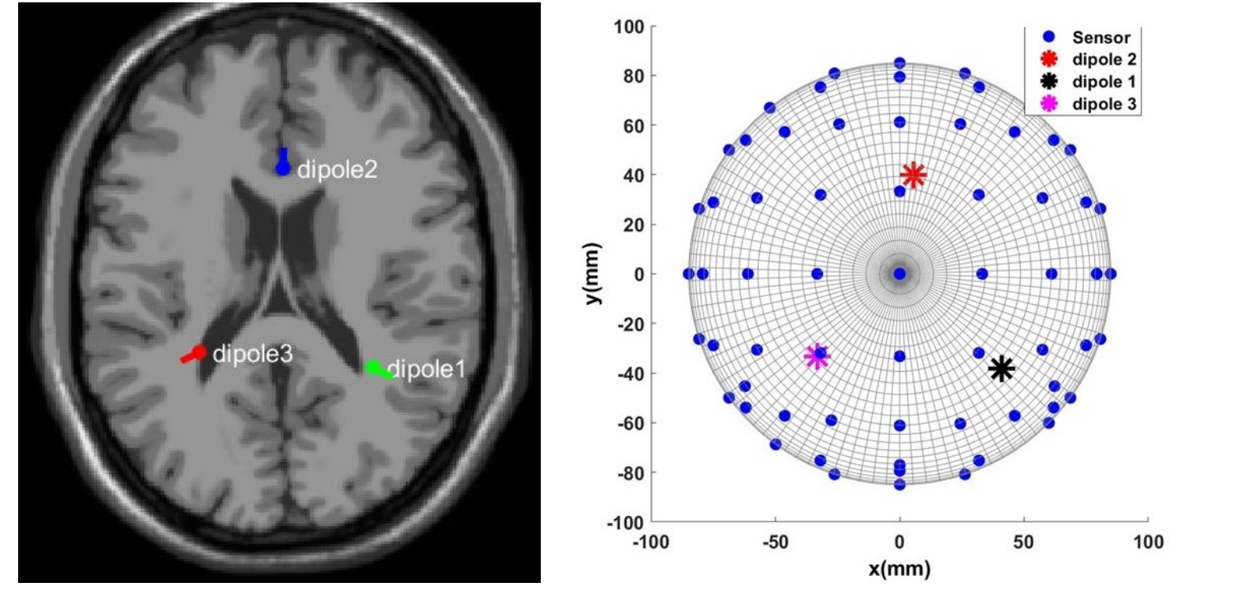
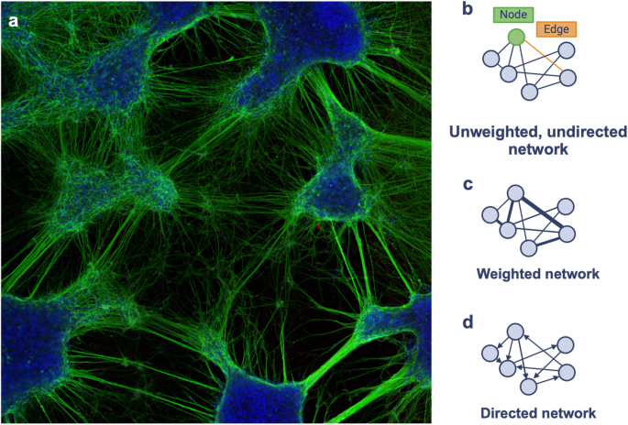
PROBLEM#4: PHYSICS
Dipole estimation is at most 5cm squared resolution (39 million neurons)
Mammals such as the Etruscan Shrew has around 1 million neurons with similar low level cognitive functions
Namazifard, S., & Subbarao, K. (2023). Multiple Dipole Source Position and Orientation Estimation Using Non-Invasive EEG-like Signals. Sensors, 23(5), 2855. https://doi.org/10.3390/s23052855
Hoffmann C, Cho E, Zalesky A, Di Biase MA. From pixels to connections: exploring in vitro neuron reconstruction software for network graph generation. Commun Biol. 2024 May 15;7(1):571. doi: 10.1038/s42003-024-06264-9. PMID: 38750282; PMCID: PMC11096190.

Slide 14
OUR FINDINGS
We can achieve 95% accuracy but as more samples and noise is introduced to the system the model becomes less and less accurate. The dependence is partially solved but is impractical on the consumer side due to high training and data throughput costs

Slide 15
THE PIVOT
Focusing on the second topic

Slide 16
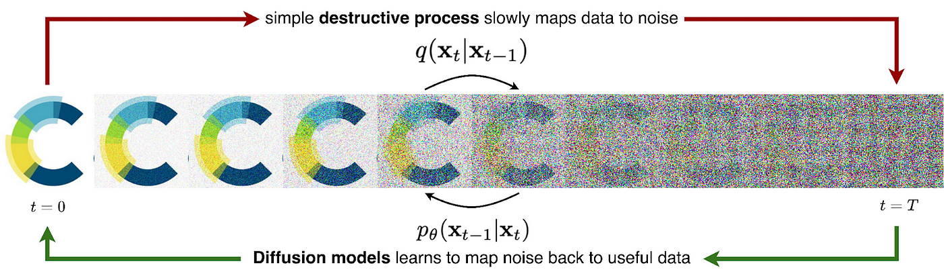

SENTIMENT ANALYSIS FOR GENERATIVE ADVERTISEMENT AND OTHER APPLICATIONS
Diffusion Generation
We can generate text or use 3d augmentation to add, remove, or move elements
Generation + Augmentation

Slide 17
HOW WE ARE DOING IT
Using Google Data Download
Text Augmentation
Survey *A/B testing

Slide 18
PROGRESS
IRB Approval from HBS
Server Setup and fees
Expandability and business survey
Main clients include the people we are generating the ads for and specifically catering towards selling this data analysis to large financial institutions.

Slide 19
THANK YOU
Stephen Chang
Stephen0.0chang@gmail.com

