Slide 1
Team Regulatory Foci - Investigating the influences that affect when one shares on social media.
Patrick Ogaz, Andrea Escobar Vara, Claire Son & Sebastian Hernandez
Advisor: Dr. Jae Min Jung

Slide 2
Outline
Research Motivation
Literature Review
Social Media Sharing Function
Culture
Cultures influence on the sharing function
Regulatory Focus
Self Construal
Culture’s Impact on Timing of Sharing
Hypothesis
Hypothesis 1
Hypothesis 2
Methodology
Study Design
Data Collection
Data Analysis
Notes:
Here we have our outline.

Slide 3
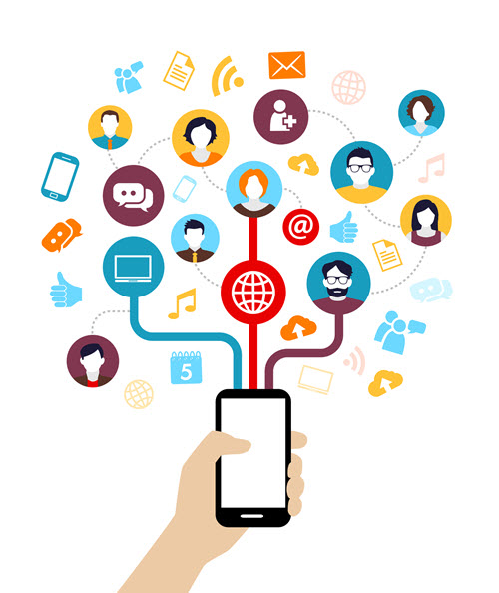
Research Motivation
In the U.S., Twitter users often post their own countdowns to an upcoming event, making pre-posting a popular tool for marketers (Jung et al. Forthcoming).
Previous studies have found that culture affects the manner in which individuals share information (e.g., aspirations, personal data, etc.) within society (Hofstede 2001).
According to an analysis of event marketing campaigns on Bufferapp.com, there were nearly as many posts leading up to an event (40% of total posts) as there were during the event itself (42% of total posts) in the U.S. and Europe.
However, little is known about how culture affects when consumers share an event on social media (Timing of Sharing).
Notes:
Previous studies have found that culture affects the manner in which individuals share information within society. Past studies find there were nearly as many posts leading up to an event as there were during the event in the U.S. and Europe. However, little is known about how culture affects when consumers share an event on social media (Timing of Sharing).

Slide 4
Research Objectives
To investigate how self-construal influences consumers’ timing (before vs. after) of sharing information about an event on social media.
To investigate the role that regulatory foci plays in explaining how self-construal influences the afore-mentioned sharing behaviors.

Slide 5
Culture

Slide 6
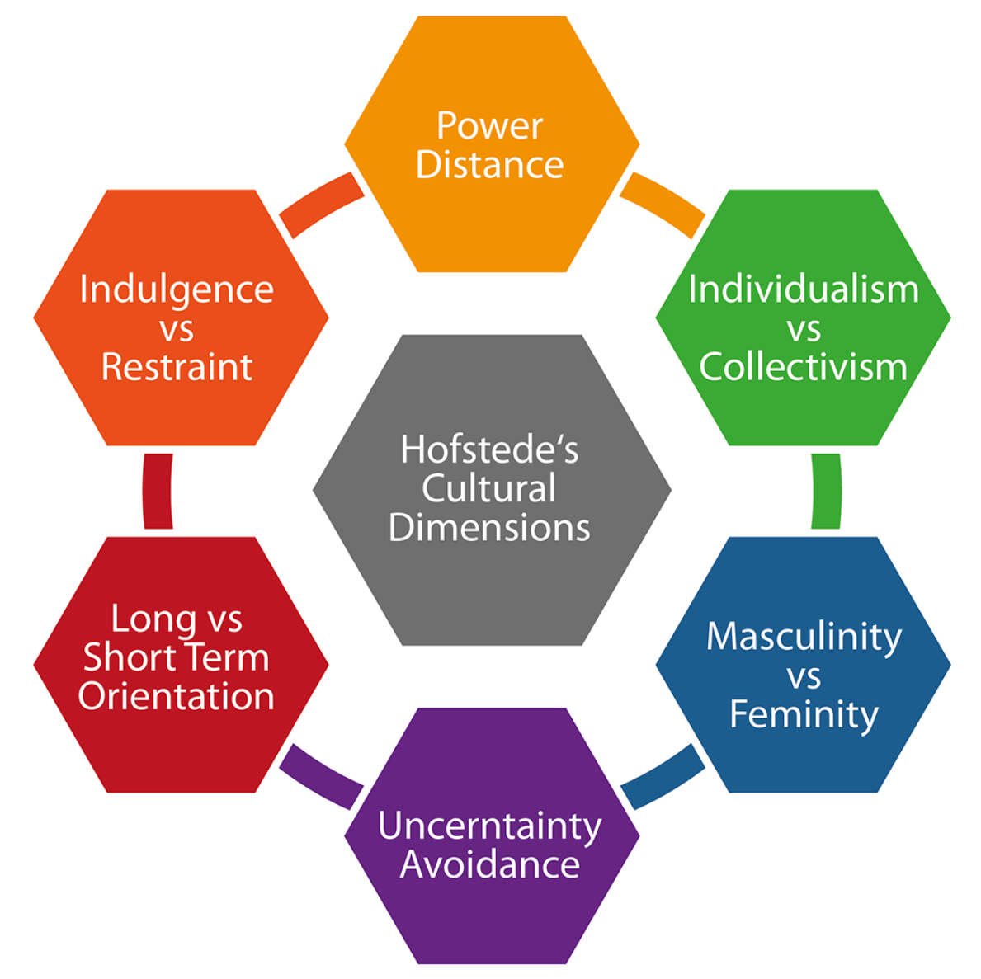
Hofstede’s Cultural Framework (Hofstede, 2001)
Individualism vs. collectivism (INDCOL) is the dimension used the most widely in social science research because it explains people’s cultural differences the most.
Individual interest prevails over collective interests
European countries, US, Canada, Australia
Collective interest prevails over individual interest
The rest of the world (e.g., Asian, South American, Africa)
Notes:
For this study We use Hofstede’s Cultural Framework specifically its dimension individualism vs collectivist this is a dimension used most widely in social science research DO to its ability to explain people’s cultural differences the most

Slide 7
Individualism vs Collectivism
(Hofstede, 2001)
Individualism
Collectivism
Use of the word “I” is encouraged
Independent self
More extravert
Showing happiness is encouraged, and sadness discouraged
Consumption patterns show self-supporting lifestyles
Use of the word “I” is avoided
Interdependent self
More introvert
Showing sadness is encouraged, and happiness is discouraged
Consumption patterns show dependence on others
Notes:
Characteristics that define individualism are the … encouragement of the word “I”, individuals are more extravert and showing happiness is encouraged while sadness is discouraged
characteristics that define collectivist are the avoidance of the word “I”, individuals are more introvert and showing sadness is encouraged while showing happiness is discouraged

Slide 8
Culture (INDCOL) = Self-Construal
Notes:
To better understand the individuals within culture we focus on the self-construal which describes a society in an individual level
As it was explained INDCOL, describes societies and cultures (Hofstede, 1988),
the self-construal is used to describe the individual.
To study societies to an individual level researchers use the self-construal
Why self construal is introduced and why we are going through them?

Slide 9
Self-Construal
Self-construal refers to how individuals define and make meaning of the self (Cross, et al., 2011).
Independent Self-construal
Interdependent Self-construal
(Markus and Kitayama, 1991)
Notes:
Self-construal refers to how individuals define and make meaning of the self (Cross, Hardin, & Gercek-Swing, 2011).
[TRANSITION]
The construal is further defined as independent and interdependent self-construal (Markus & Kitayama,1991) .
[TRANSITION]
Each self-construal aligns with the INDCOL dimension.
The independent self-construal is consistent with individualism and the interdependent self-construal is consistent with collectivism
To study cultures to the individual level

Slide 10
Independent Self-Construal
Society as a medium to promote the well-being of the individual.
American and Western European cultures
Ideals of “self-actualization” and “developing one’s distinct potential” are prominent (Markus and Kitayama, 1991).
Characterized by autonomy and achievement (Heine et al., 1999).
(Lee et al., 2000)
Notes:
Each self construal has specific characteristics that defines them.
For instances The independent self-construal sees society as a medium to promote the well-being of the individual and is most prominent in American and Western European cultures.
Ideals of self-actualization and developing one’s distinct potential are prominent
[TRANSITION]
Based on the mentioned characteristics one can see how this self construal is consistent with individualism
promotion focus =

Slide 11
Interdependent Self-Construal
Prioritize social relationships (Markus and Kitayama, 1991).
Asian, Latin-American, African, and many southern European cultures (Markus and Kitayama, 1991).
Characterized: belonging, fulfilling obligations and responsibilities to others (Heine et al., 1999) .
(Lee et al., 2000)
Notes:
In contrast the interdependent self-construal prioritize social relationships and it is most prominent in Asian, Latin-American, African, and many southern European cultures (Markus & Kitayama, 1991).
Their Goals are characterized by belonging and fulfilling obligations and responsibilities to others (Heine et al., 1999).
[TRANSITION]
These characteristics are consistent with collectivism (Lee et al., 2000).

Slide 12
Regulatory Foci
Notes:
To better understand the behavior of individuals within each culture we dive in into the Regulatory focus, a motivational theory which proposes two distinct foci

Slide 13
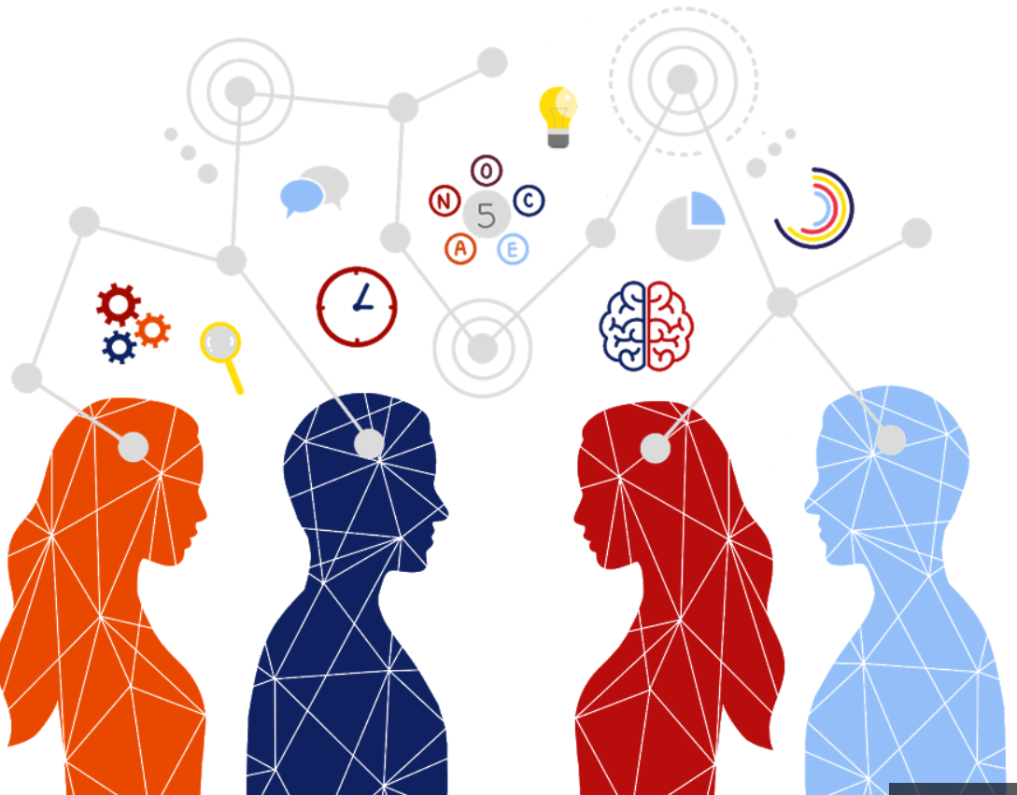
Regularly Focus Theory (Higgins, 1997)
Regulatory focus is a theory of self-regulation that proposes two distinct foci.
Promotion focus that is primarily concerned with maximizing positive outcomes.
Prevention focus that is primarily concerned with minimizing negative outcomes.
Notes:
Promotion foci is primarily concerned with maximizing positive outcomes. while
Prevention foci is primarily concerned with minimizing negative outcomes.

Slide 14
Regularly Focus Theory (Higgins, 1997)
Promotion
Prevention
Emphasizes hopes, accomplishments, and advancements
Views goals as gains
Prefers an eager goal-pursuit strategy
Failure to achieve strong ideals leads to depressive emotions
Emphasizes safety, responsibility, and security
Views goals as duties
Prefers a vigilant goal-pursuit strategy
Failure to achieve actuals oughts leads to anxious emotions
Notes:
Some of the characteristics of promotion focus are the
Emphasis in hopes, accomplishments and advancements and the preference in an eager goal-pursuit strategy
[TRANSITION]
On the other hand Prevention focus has an emphasis in safety, responsibilities and security and it prefers a vigilant goal-pursuit strategy

Slide 15
The Relationship between Culture, Regulatory Foci and Self-Construal
Notes:
Now what exactly is the relationship between culture, regulatory foci and self-construal .

Slide 16
Collective cultures fosters Prevention-oriented motivation (Eastern countries).
Individualistic cultures fosters Promotion-oriented motivation (Western countries).
Collective
Culture
Individualistic
Culture
Interdependent Self-Construal
Independent Self-Construal
(Markus & Kitayama, 1991; Triandis, 1989)
Notes:
Previous research has found that collective cultures fosters preventive-oriented motivation And Individualistic culture fosters promotion-oriented motivation
Now, based on the previous research we can say that
Culture Should shape and determine what time of motivation its members will have so,
[TRANSITION]
A collective culture with individuals with interdependent self-construal will be guided by a prevention focus
[TRANSITION]
And individualistic cultures with individuals with Independent self-construal will be guided by a promotion focus

Slide 17
Why we believe that sharing will differ
Notes:
This next section we review why we believe sharing will differ on social media

Slide 18
Different perspectives regarding the future
People in promotion orientation (independent self-construal) view their future more favorably, whereas prevention (interdependent self-construal) focused individuals did not compare themselves to their future self as much (Corcoran and Peetz, 2014).
By viewing the future more positively than today, it creates the feeling of excitement (over dread or ambivalence).
Notes:
Our second point is different cultural perspectives regarding the future. People in promotion orientation view their future more favorably and compare themselves to this futureself, whereas prevention focused individuals did not compare themselves to their future self as much (Corcoran & Peetz, 2014).
By viewing the future more positively than today, it creates the feeling of excitement (over dread or ambivalence).

Slide 19
Hypothesis 1
Timing of Sharing on Social Media
H1: Consumers with an independent self-construal will share the anticipation of events before the events occur, whereas consumers with an interdependent-self construal will share the retrospection of events on social media at a higher rate after the events end.
Before After
Individualistic / promotion-oriented
e.g. U.S.
Independent
More prevalent in the U.S.
Collectivistic / prevention-oriented
e.g. South Korea
Interdependent
More prevalent in South Korea
Event
Notes:
Consumers with a independent self construal will share anticipation of events before the events occur, whereas consumers with an interdependent self construal will share retrospection of events on social media at a higher rate after the events end.

Slide 20
Hypothesis 2
Mediating Role of Regulatory Foci
H2: The impact of self-construal on the timing of sharing will be mediated (determined) by regulatory foci.
Regulatory Foci (Promotion Orientation)
Prevention Orientation)
Self Construal (Independent or Interdependent)
Timing of sharing
H1a
Notes:
Our next hypothesis is to investigate the mediating role of regulatory Foci, in which we predict the impact of Self-construal on the timing of sharing will in fact be mediated or determined by the regulatory foci.

Slide 21
Expected Contributions
Through our research marketers can better understand why their pre-launch/pre-event marketing efforts can be more effective in certain countries (IND) in comparison to others (COL).
The study can help practitioners better understand the behavior of Collective cultures that underline their affinity to share information after an event. Given this information companies should perform/conduct (if not already a standard practice) a deeper analysis/data collection within COL cultures.
The collected information should provide insights of what features/key elements of the event/marketing campaign align with these consumers.
Notes:
social media service providers should help users share past events easily and hassle free in terms of correctly displaying event date and post date, organizing posts by the time of event date or post date, and linking posts to other related stories online or editing out imperfections of the contents to be shared. These features make it more comfortable for prevention-oriented users to share, and may even encourage them to post earlier (e.g., even during the events) by making them feel safe.
East Asia, users feel more comfortable posting during or after an event, so a successful strategy should include opportunities at events to take photos that users can include on their social media accounts.
For example, when UNIQLO opened its first stores in mainland China, they launched the “Style your life” campaign. Using in-store monitors, shoppers could “try on outfits” by looking at monitors that were equipped with cameras to take pictures of themselves in front of various featured backgrounds. The machine would then send the photo to their WeChat account. By integrating on and off-line elements, UNIQLO was able to grow their brand’s following in China from 400,000 to 1 million at almost six-months later, according to adage.com.
In the other hand the behavior of Collective cultures that have the affinity to share information after an event. Can motivate companies that do not conduct a post event collection of data to do so in order to have deeper insight in their target market

Slide 22
Methodology

Slide 23
Methodology - Study Design
Experiment
One factor design N = 150
Randomly Assigned Stimulus
Self-construal Priming Scenario - influence participants to think from a certain viewpoint
 | Timing of Sharing Scenario
Self-construals | Before/After the event*
Interdependent | *
Independent | ***
*Dependent variable
Notes:
Survey
The intent of our study is to imitate a cross-cultural experiment through a priming manipulation
What is cross-cultural study
What is priming
We propose that self-construal is positively related to the timing of sharing and that regulatory foci mediate the process. We intend to test the hypotheses using a 2 (self-construal: independent vs. interdependent) x 2 (timing of sharing: before vs. after event) factorial design. The participants will be randomly assigned to either self-construal using a scenario approach. Next, they will be randomly assigned to one of two-timing of sharing scenarios. Subsequently, participants will respond to other measures intended to check for manipulations and confounding.

Slide 24
Methodology - Study Design (Cont.)
1.
Screener Questions
2.
Arousal Questions
6.
Measuring Timing of Sharing (DV)
3.
Self-construal Priming
7.
Arousal Questions
4.
Manipulation Check
8.
Chronic Regulatory Focus
5.
Timing of Sharing Scenario
9.
Confounding Check
10.
Demographics

Slide 25
Survey Panel
Utilization of Amazon Mechanical Turk (MTURK) to recruit respondents.
Used CloudResearch Mturk toolkit.
Helped us collect higher quality respondents and slow down data collection to get a more holistic and representative sample.
We had a total of 5 batches of 30 people (dates 1-11 thru 3-/16)
Notes:
We used Amazon Mechanical Turk (MTURK) to recruit respondents.
Used CloudResearch Mturk toolkit.
Helped us collect higher quality respondents and slow down data collection
We had a total of 5 batches of 30 people (dates 1-11 thru 3-/16)

Slide 26
Analysis
Notes:
We cleaned the data - 15-20%

Slide 27
Data Preparation/Pre-analysis
Excluded noticeable outliers
Filtered respondents by those who spent at least 6 minutes and no more than 30 minutes
Did not include responses that were not serious
Created new variables to aid analysis
Recoded necessary items
Dummy coding of self construal groups
Checked all the scales we used had a sufficient reliability score
All adopted/adapted from previous literature
One scale showed to be unreliable
Prevention scale

Slide 28
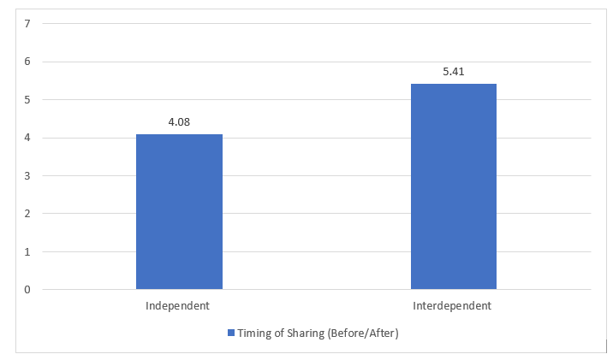
Hypothesis Test 1
Table 1. |  | Timing of Sharing (Before/After)
 |  | M | SD
Self-Construal | Independent | 4.08 | 2.04
 | Interdependent | 5.41 | 2.38
N = 52
N = 56
t(106)= 3.14, P>.005
Note: All of our results are not yet verified since we are still working on our manipulation check

Slide 29
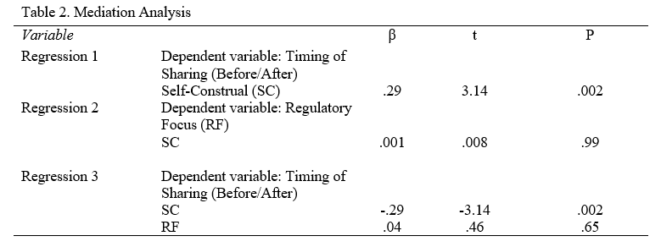
Hypothesis Test 2
Ran well known mediation analysis from Baron and Kenny (1968)
Used dummy coding for self-construal (SC) groups (Independent = 0) (Interdependent =1)
Our results do not support our 2nd hypothesis
Note: All of our results are not yet verified since we are still working on our manipulation check

Slide 30
What needs to be done
Manipulation check
Need to code open end responses for content analysis
Write out the results from our analysis
Complete our manuscript

Slide 31
Appendix a.
Table 1. |  | Timing of Sharing (Before/After)
 |  | M | SD
Self-Construal | Independent | 4.08 | 2.04
 | Independent | 5.41 | 2.38

Slide 32
Appendix b.

Slide 33
Acknowledgements
Advisor Dr. Jae Min Jung
Cal Poly Pomona Office of Undergraduate Research
Learn Through Discovery Projects Hatchery Program
Center for Customer Insights and Digital Marketing
Notes:
We would like to acknowledge those that have greatly assisted with our research.

Slide 34
Bibliography
Aaker, Jennifer L. and Angela Y. Lee (2001), "I Seek Pleasures, We Avoid Pains: The Role of Self Regulatory Goals in Information Processing and Persuasion," Journal of Consumer Research, 28 (1), 33-49.
Aaker, Jennifer L. and Patti Williams (1998), “Empathy Versus Pride - The Influence of Emotional Appeals Across Cultures, “ Journal of Consumer Research, 25 (1), 241 -261.
Berger, Jonah. (2011), “Arousal Increases Social Transmission of Information,” Psychological science, Vol. 22, 891-3.
Chan, Eugene Y. and Najam U. Saqib (2021), “How Long Has It Been-Self-Construal and Subjective Time Perception,”Personality and Social Psychology Bulletin, 1-14.
Corcoran, Katja and Johanna Peetz (2014), “Looking Towards the Past or the Future Self: How Regulatory Focus Affects Temporal Comparisons and Subsequent Motivation,” Self and Identity, 13 (1), 81-99.
Cross SE, Hardin EE, Gercek-Swing B (2011), “The What, How, Why, and Where of Self-construal,” Personality and Social Psychology Review, 15, 142–79.
Heine, Steven J., Hazel R. Markus, Darrin R. Lehman, and Shinobu Kitayama (1999), “Is There a Universal Need for Positive Self-Regard?,” Psychological Review, Vol. 106 (4), 766-794.
Higgins, Edward Tory (1997), “Beyond Pleasure and Pain,” American Psychologist, 52, 1280 -1300.
Hofstede, Geert H. (2001), “Culture’s Consequences: Comparing Values, Behaviors, Institutions, and Organizations across Nations,” Thousand Oaks, CA: Sage Publication.
Jackson, Linda A., and Jin-Liang Wang (2013), “Cultural Differences in Social Networking Site Use: A Comparative Study of China and the United States,” Computers in Human Behavior, 29 (3), 910-921.
Continues on the next page.

Slide 35
Bibliography (cont’d)
Jung, Jae Min, Kyeong Sam Min, Kristen R. Schiele, Anthony Kim, Jing Hu, Xin Liu, Curtis P. Haugtvedt, and James J. Kellaris (Forthcoming), “Cross-Cultural Differences in Social Media Use: Implications for International Social Media Marketing Strategy,” in Handbook of Digital Marketing and Social Media, Annmarie Hanlon and Tracy Tuten, eds. SAGE.
Kietzmann, Jan H., Kristopher Hermkens, Ian P. McCarthy, and Bruno S. Silvestre (2011), “Social Media? Get Serious! Understanding the Functional Building Blocks of Social Media,” Business Horizon, 54 (3), 241-251.
Lee, A. Y., Aaker, J. L., and Gardner, W. L. (2000), “The Pleasures and Pains of Distinct Self-construals: The Role of Interdependence in Regulatory Focus,” Journal of Personality and Social Psychology,J 78(6), 1122-1134.
Lim, Nangyeon (2016). “Cultural Differences in Emotion: Differences in Emotional Arousal Level Between the East and the West,” Integrative Medicine Research, 5 (2), 105-109.
Markus, H., and Shinobu Kitayama (1991), “Culture and the Self: Implications for Cognition, Emotion and Involvement,” Psychological Review, 98, 224-253.
Russell, J. A. (2003), “Core Affect and the Psychological Construction of Emotion,” Psychological Review, 110 (1), 145–172.
Triandis, H. C. (1989). “The Self and Behavior in Differing Cultural Contexts,” Psychological Review, 96, 506—520.
Tsai J.L. (2007), “Ideal Affect: Cultural Causes and Behavioral Consequences,” Perspectives on Psychological Science, Vol. 2(3), 242–59.
Weingarten, Evan, and Jonah Berger (2017), “Fired Up for the Future: How Time Shapes Sharing,” Journal of Consumer Research, 44, 432-447.

Slide 36
Thank You!
Q&A

