Slide 1
Application of Shear Thickening Fluids on Soft Body Armor
Garrett Kawaguchi, Joseph Baur, Ethan Cam, Benjamin Lopez
Advisor: Dr. Brian Ramirez
Department of Mechanical Engineering
April 2023 Project Symposium

Slide 2
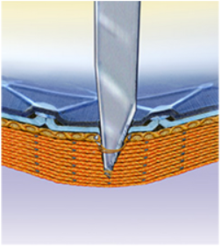
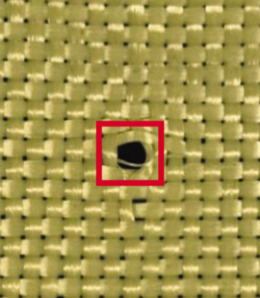
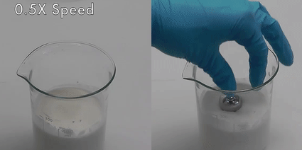
Introduction
Soft Body Armor
Shear Thickening Fluid (STF)
Viscosity proportional to shear rate
Motivation
Lack of stab and puncture protection
No Lvl III soft body armors
Wang, Y. (2016). Ballistic Body Armour Using Shear Thickening Fluids For Enhancing Stab Resistance [1]

Slide 3
Objective
Rate-sensitive material to improve energy absorption
Capable of stopping full power rifle cartridge
>3200J

Slide 4
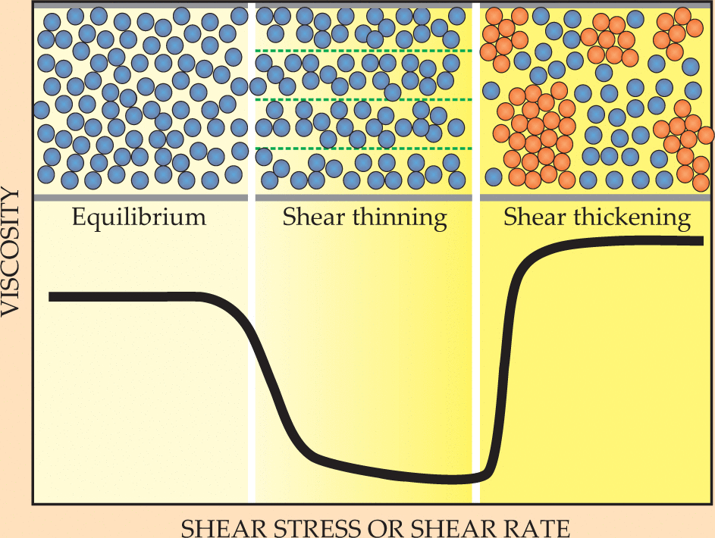
STF Composition
Two unique nanoparticle mixtures:
SiO2 (Silicon Dioxide base)
SiO2 + W (Tungsten additive)
Nanoparticle mixture homogenized in PEG400 at 30 wt%
Ball, R. C., & Melrose, J. R. (1999). Shear thickening in colloidal dispersions [2]
Notes:
Image of beaker with fluid inside

Slide 5
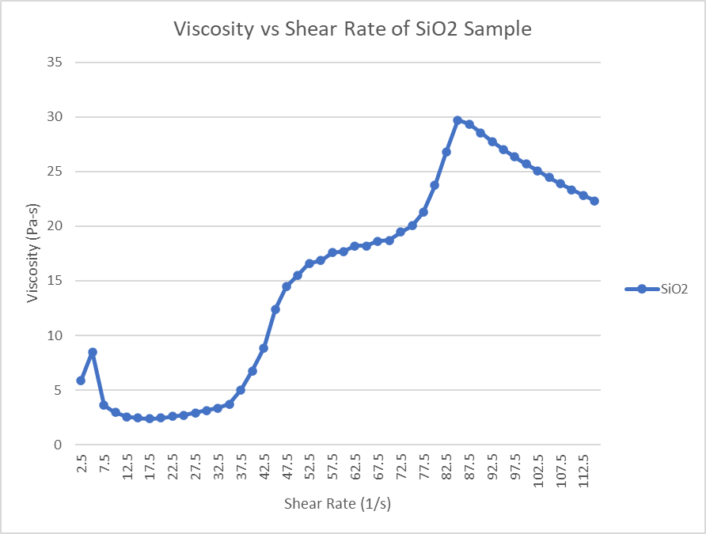
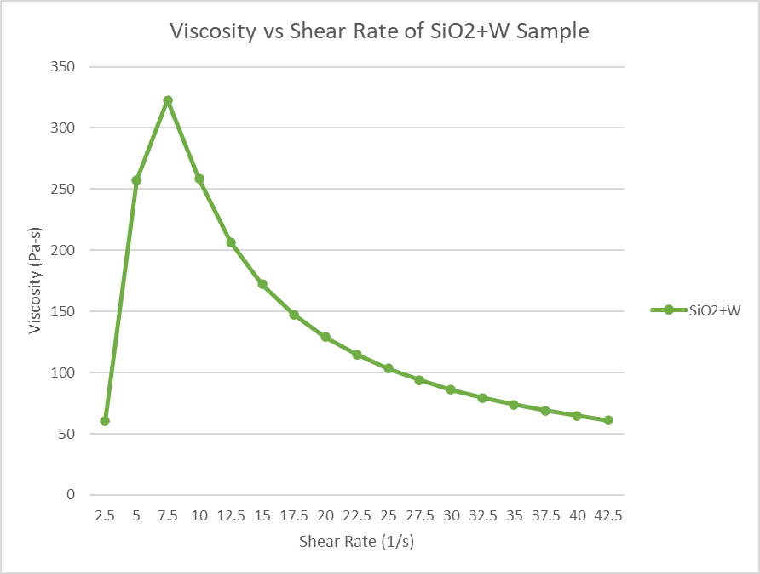
Rheological Testing
SiO2 Peak Viscosity: 29.7 Pa-s
SiO2+W Peak Viscosity: 332.7 Pa-s

Slide 6
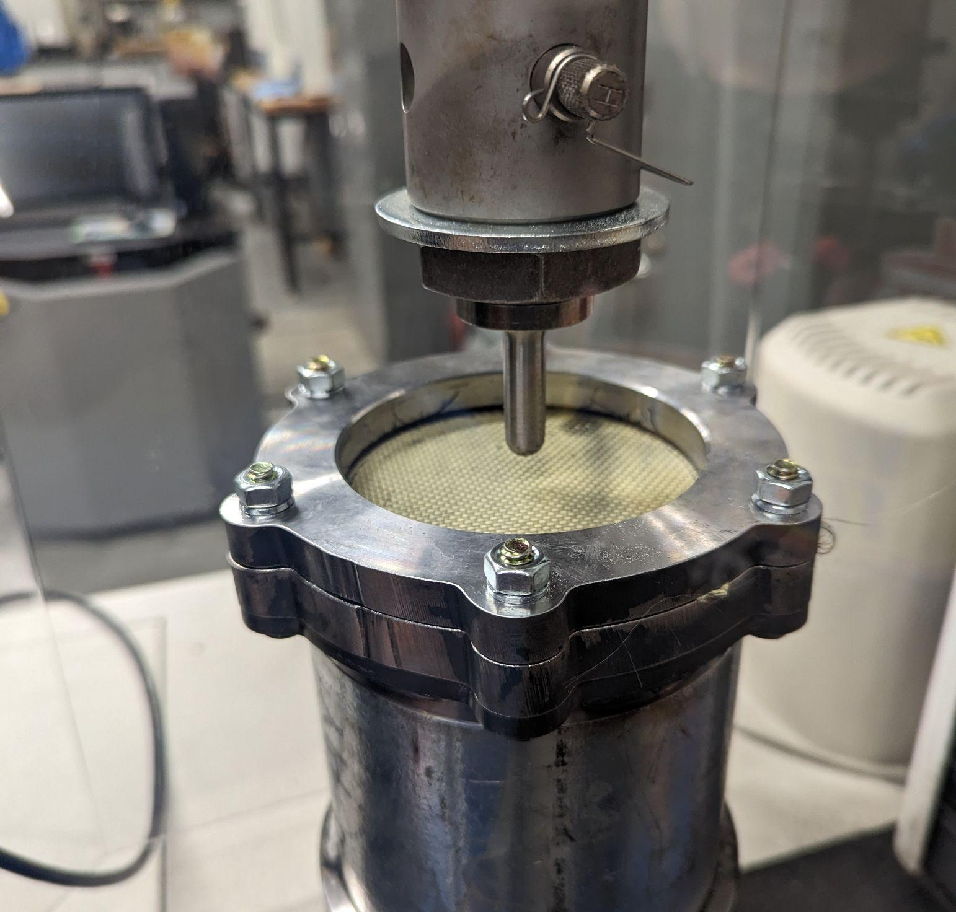
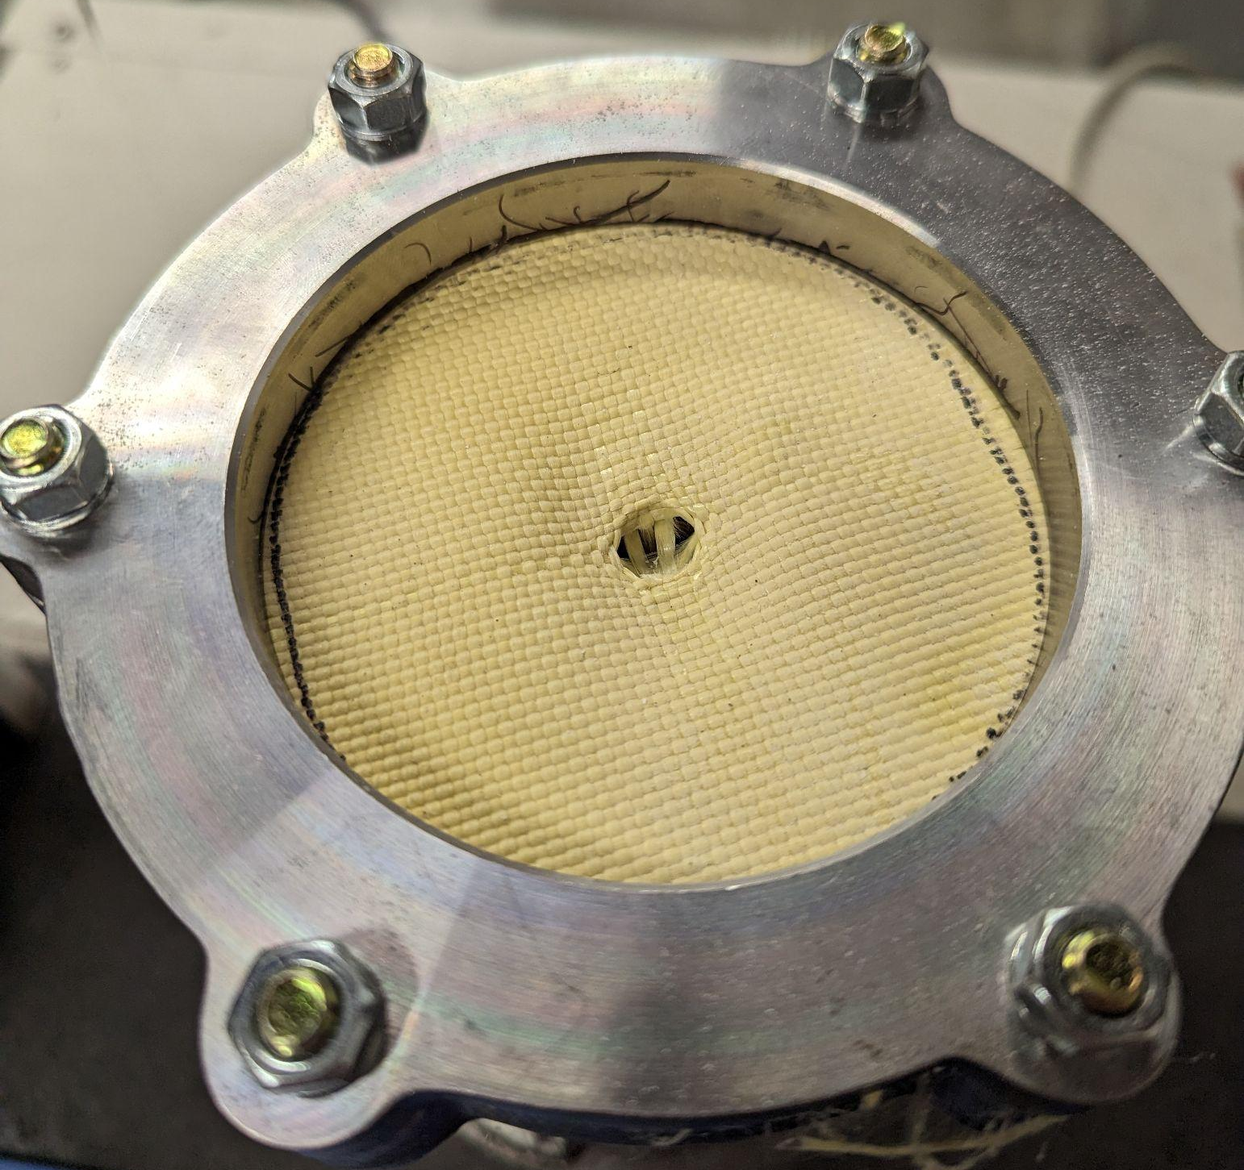
Quasi-Static Experiment: Setup

Slide 7
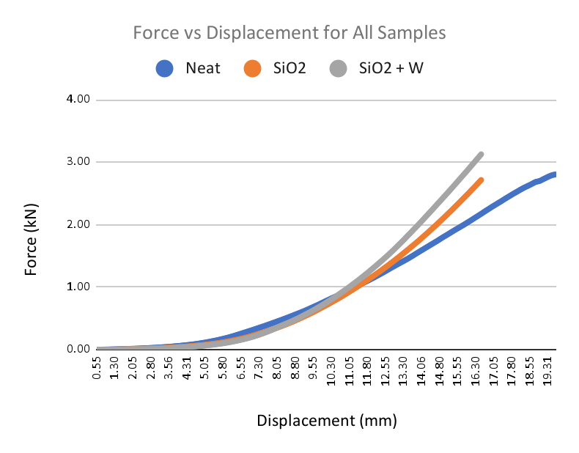
Quasi-Static Stiffness
Material | Initial Average Stiffness (N/mm) | Late Average Stiffness (N/mm)
Neat | 0.468 | 10.21
SiO2 | 0.485 | 17.45
SiO2 + W | 0.395 | 19.85

Slide 8
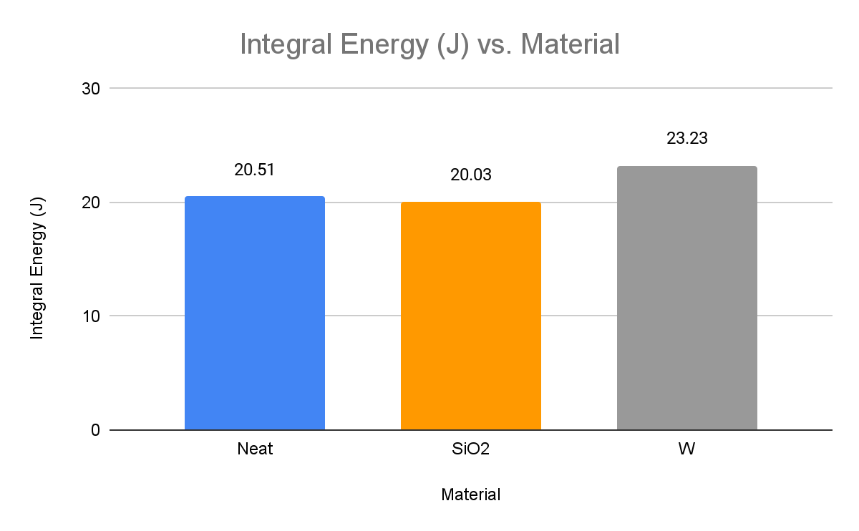
Quasi-Static Energy Absorption
Failure mode for hemispherical quasi-static testing on neat Kevlar
Notes:
Noting: While tests for knife and spike tests were also conducted, lack of impact data means we can only analyze the present hemispherical data

Slide 9
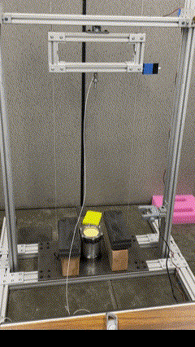
Dynamic Testing - Test Setup
Dynamic testing was performed on a drop tower
Hemispherical indenter and clamping fixture from quasi-static testing were used
Drop height was varied incrementally until fabric failed

Slide 10
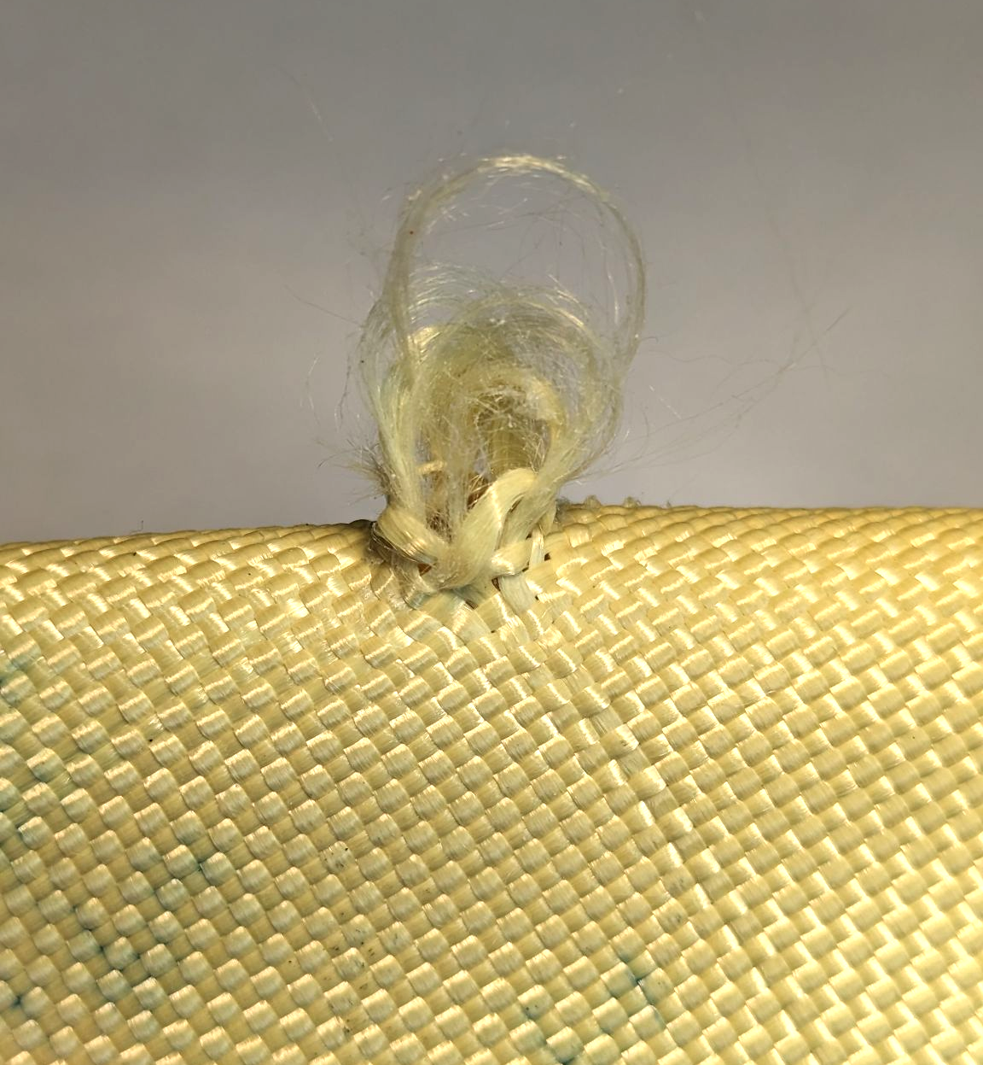
Dynamic Testing - Onset of Failure
Due to slipping within the clamp, fabric could not be tested to complete failure
Rather than seeing complete fiber rupture, we observed fiber pull-out
Fiber pull-out was defined as the onset of failure

Slide 11
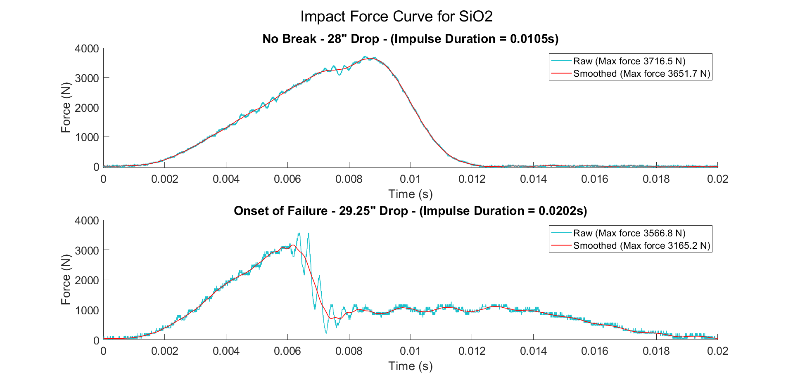
Dynamic Testing - Force Curves
The force curves show the difference between no failure and the onset of failure.
Plateau area of the failure curve can likely be explained by fiber pull-out

Slide 12
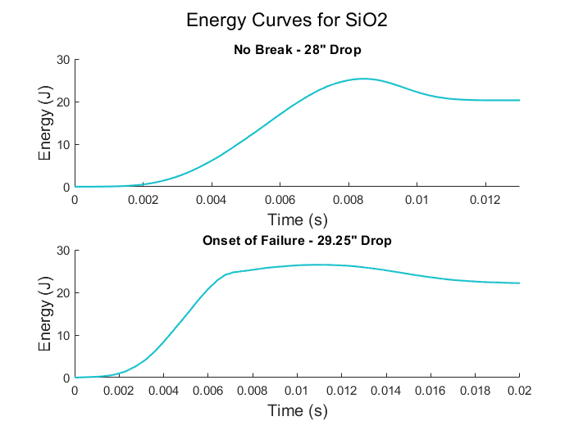
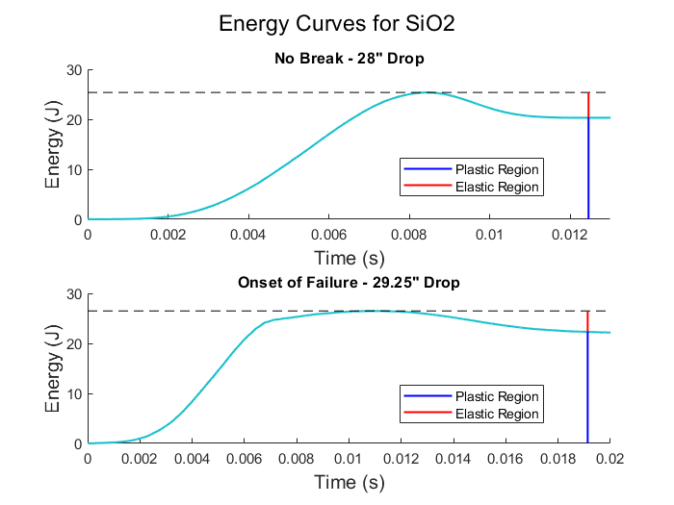
Dynamic Testing - Energy Curves
Failure can be seen by the reduction in the elastic region
The reduction in the elastic region is due to irreversible energy loss during partial fiber fracture

Slide 13
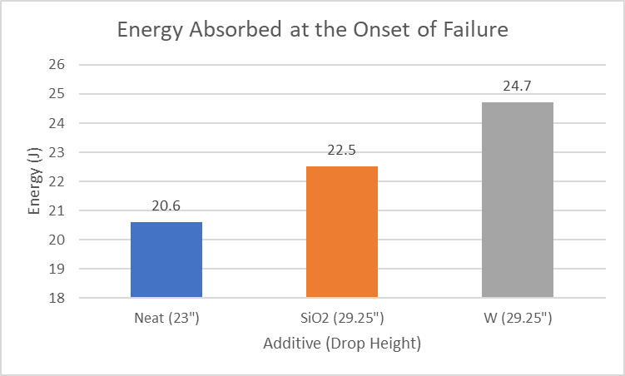
Dynamic Testing - Comparison
Ability to absorb energy increased with the addition of STFs
Unclear if benefits are due to shear thickening or purely the addition of particles
All STF fabrics showed onset of failure at 29.25” drop height

Slide 14
Dynamic Testing
 |  | Energy Absorbed (J) [% Energy Absorbed]
Drop Height (in) | Theoretical Impact Energy (J) | SiO2 | W
23 | 21 | 17.27 [82%] | 17.59 [84%]
28 | 25.56 | 20.71 [81%] | 22.78 [89%]
29.25 | 26.7 | 22.53 [84%] | 24.68 [92%]
Increased magnitude of energy absorption
Notes:
Delete neat column

Slide 15
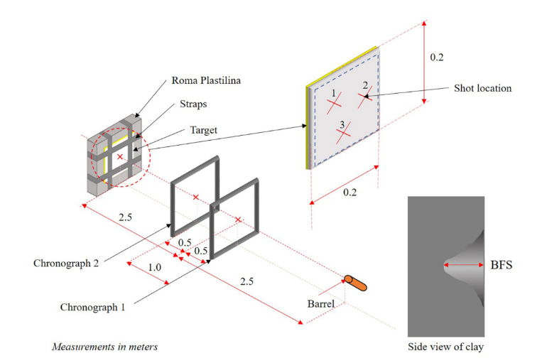
Future Testing
Refine clamping of fabric
Newtonian fluid intercalation using same particles
Run more dynamic testing on samples

Slide 16
Acknowledgments
This research is guided under the mentorship of Dr. Brian Ramirez and is made possible thanks to funding provided by the Cal Poly Pomona Learn Through Discovery Initiative and Projects Hatchery

Slide 17
Thank You
Questions?

Slide 18
AUDIENCE, SYMPOSIUM ATTENDEES
Please evaluate each presentation by using the QR code.
Presentation Title: “Application of Shear Thickening Fluids on Soft Body Armors”.
** Evaluation does not affect project grade.
Session 2
https://www.surveymonkey.com/r/S2023-02

Slide 19
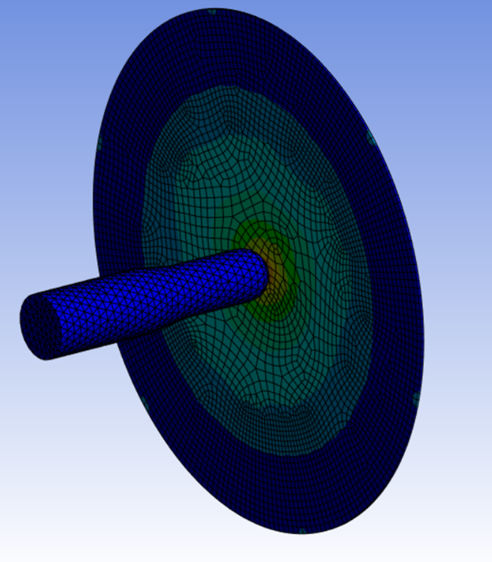
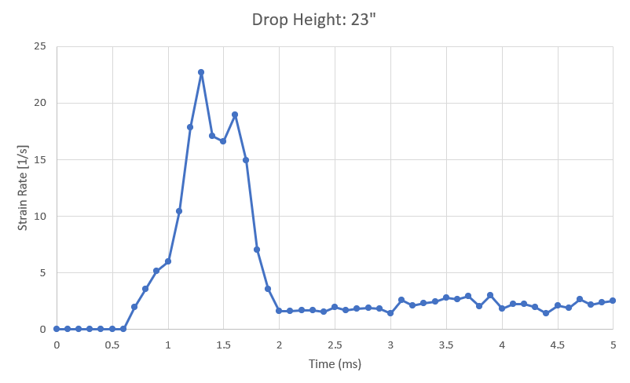
ANSYS: Simulating Strain Rates
Notes:
mesh sizing, refined

