Slide 1
Laser Cutting
Training and Workshop
Innovation Orchard Staff
io@cpp.edu

Slide 2
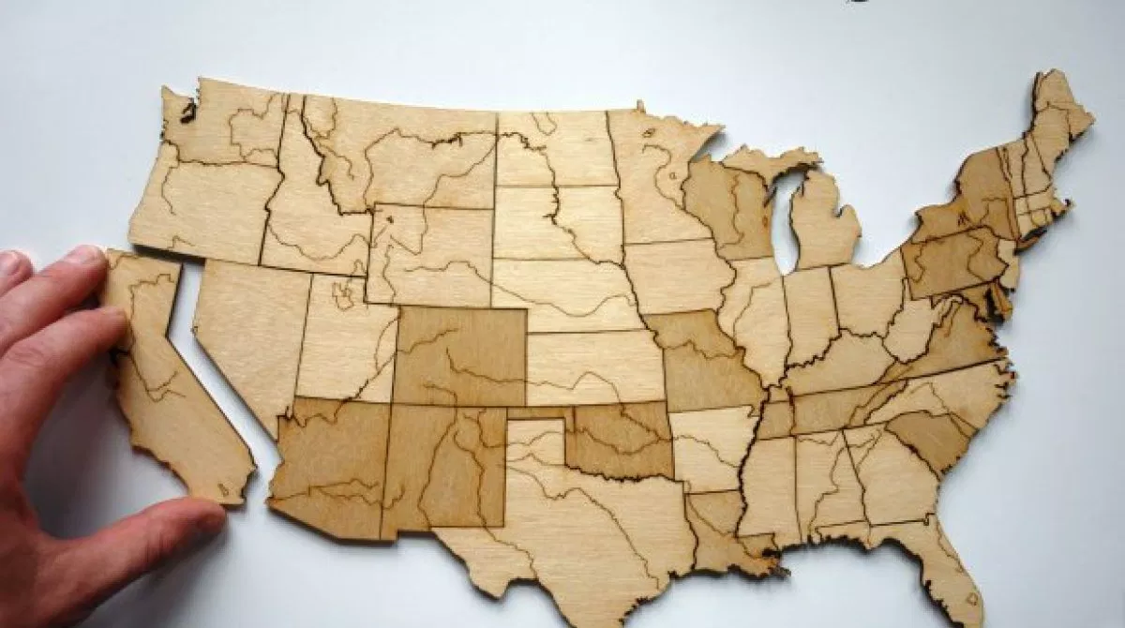
What is Laser Cutting?
Notes:
Ask Majors and prior knowledge to Laser Cutting
Take 2D file (DXF, AI, etc) make it into a cut piece
Laser cutting is an extremely powerful tool to add to your repetoir

Slide 3
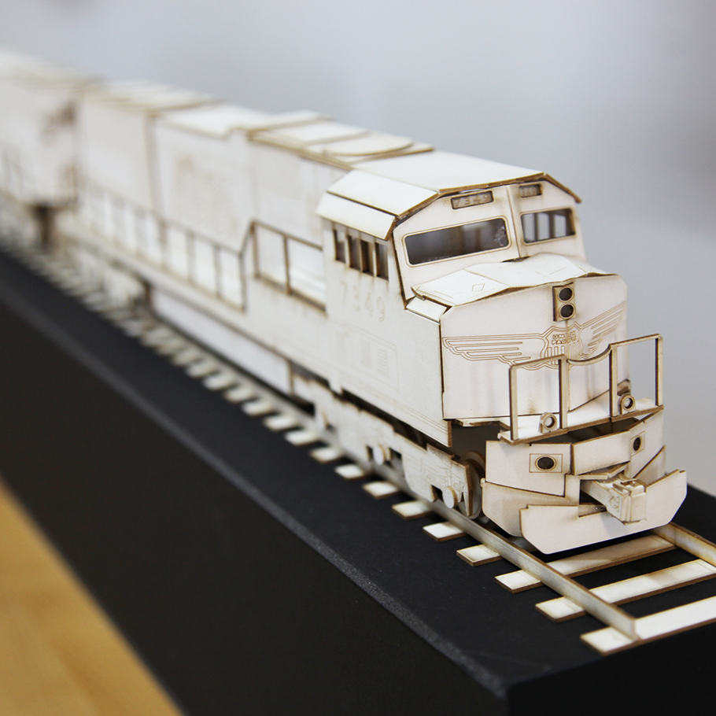
Topics to Help You Succeed in Laser Cutting
4. How laser cutting works
5. Cutting materials
6. Cutting file types
7. RD works
8. Material Thickness and adjusting the lens
9. Dimensional Tolerances/kerf
10. Cutting shapes
11. Etching graphics
12. Rastering images
13. Safety precautions
13. Overview

Slide 4
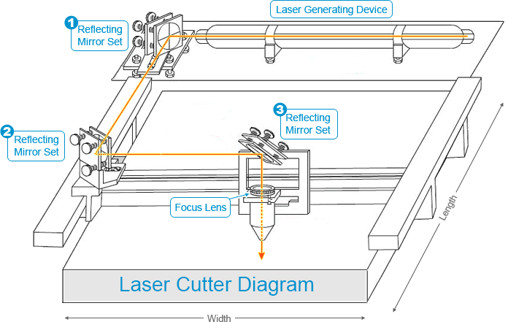
How Laser Cutting Works
Notes:
Fused Deposition Modeling, Fused filament fabrication
Filament: printable material, usually plastic, made into a thread that can be processed through the hotend
Filament is moved through motors
Bodem tube

Slide 5
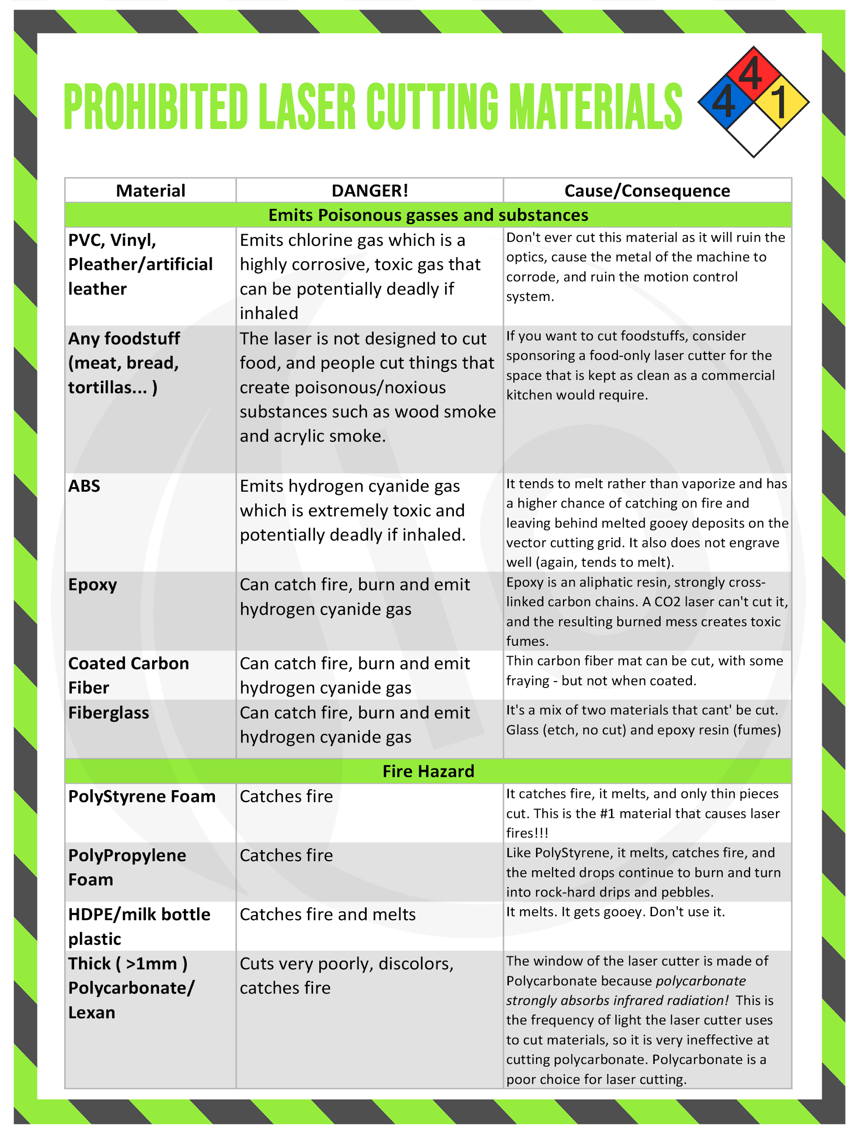
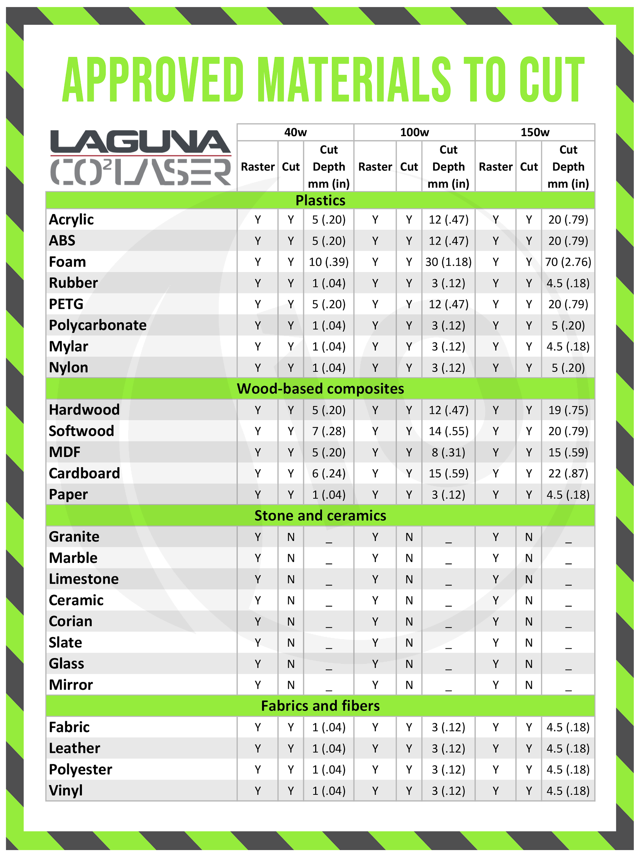
Cutting Materials
For full sheet of cutting depths and approved/prohibited materials, see the charts by the Laser Cutter.
Approved materials
Fibreboard such as MDF, particle board and masonite
Hardwood
Acrylic, thin polycarbonate
Fabrics
Leather
Prohibited Materials
PVC, ABS, HDPE, Vinyl and artificial leather
Epoxy
Food
Styrofoam
Thick polycarbonate
Notes:
PLA (Polylactic Acid): Printable on the Monoprice
Strength: High | Flexibility: Low | Durability: Medium
Difficulty to use: Low
Print temperature: 180°C – 220°C
Print bed temperature: 20°C – 60°C (but not needed)
Shrinkage/warping: Minimal
Soluble: No
Food safety: Refer to manufacturer guidelines
ABS (Acrylonitrile butadiene styrene):
Strength: High | Flexibility: Medium | Durability: High
Difficulty to use: Medium
Print temperature: 210°C – 250°C
Print bed temperature: 80°C – 110°C
Shrinkage/warping:Considerable
Soluble: In esters, ketones, and acetone
Food safety: Not food safe
PETG (Polyethylene Terephthalate “glycol-modified”)
Strength: High| Flexibility: Medium | Durability: High
Difficulty to use: Low
Print temperature: 220°C – 250°C
Print bed temperature: 50°C – 75°C
Shrinkage/warping: Minimal
Soluble: No
TPU (Ninjaflex/Thermoplastic polyurethane)
Strength: Medium | Flexibility: Very High| Durability: Very High
Difficulty to use: Medium (TPE, TPC); Low(TPU)
Print temperature: 210°C – 230°C
Print bed temperature: 30°C – 60°C (but not needed)
Shrinkage/warping: Minimal
Soluble: No
Food safety: Not food safe

Slide 6
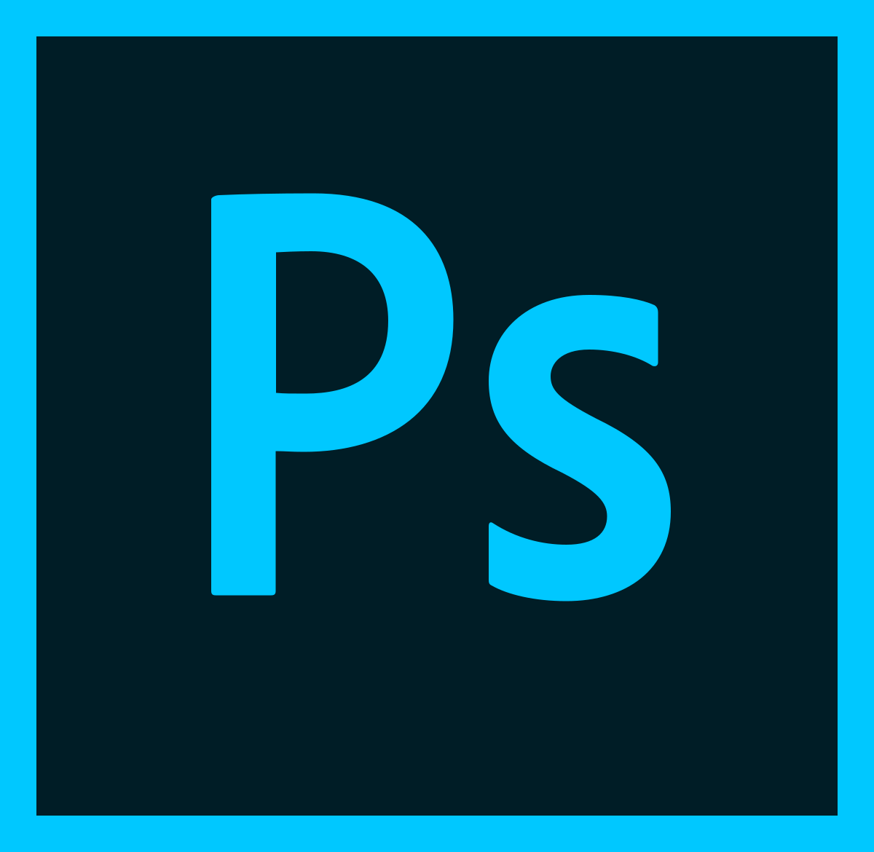
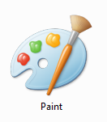
Cutting File Types
The laser cutter can accept many different types of files. The most common types are
PNG, JPEG, BMP, TIFF
Illustrator Files
DXF files
SVG Files
Among others. It is best to use vector based file formats though.
Notes:
Where do I start to print?
STL: Stereolithography, triangles
OBJ:Object
X3D & 3MF(MFE) : Specified obj files
GCODE: Computer numeric control machines

Slide 7
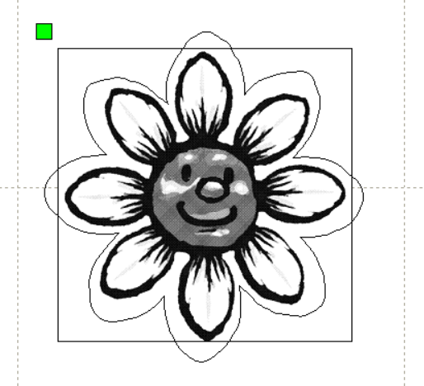
RDworks
Design
You will need a shape or picture of some sort to import into the laser software
Prepare
Setup the program for the thickness and type of material you are cutting
Cut
Send the job to the cutter and watch as it works it’s magic cutting out your design.
Notes:
Slicing: Turning the 3D object file into a layer by layer format that can be converted into code for the Printer to read

Slide 8
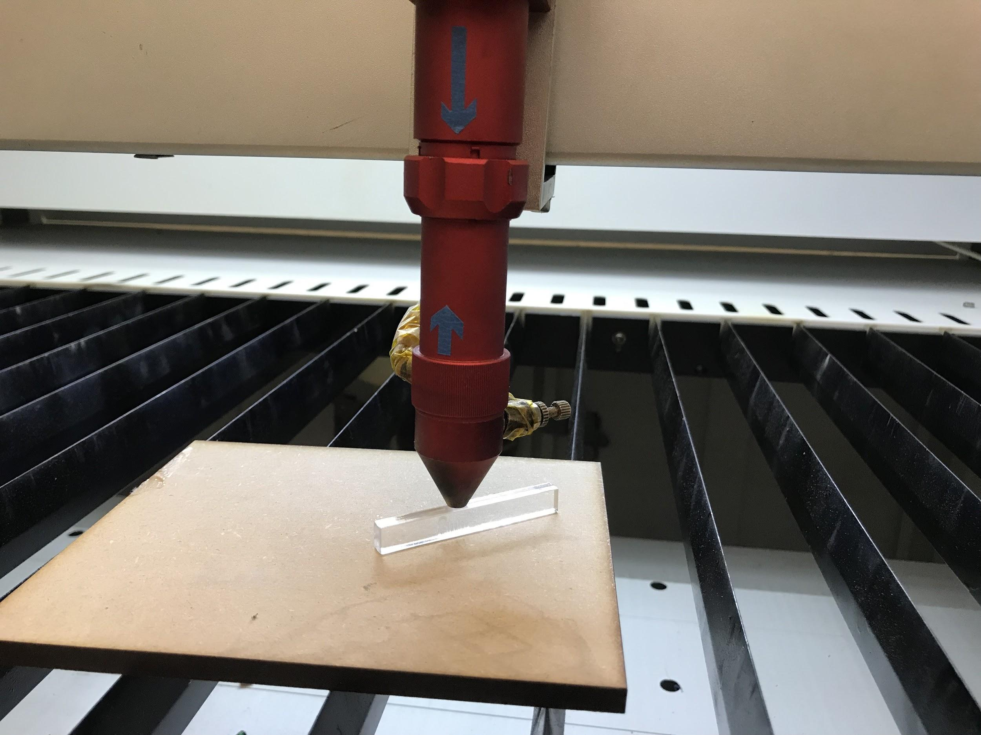
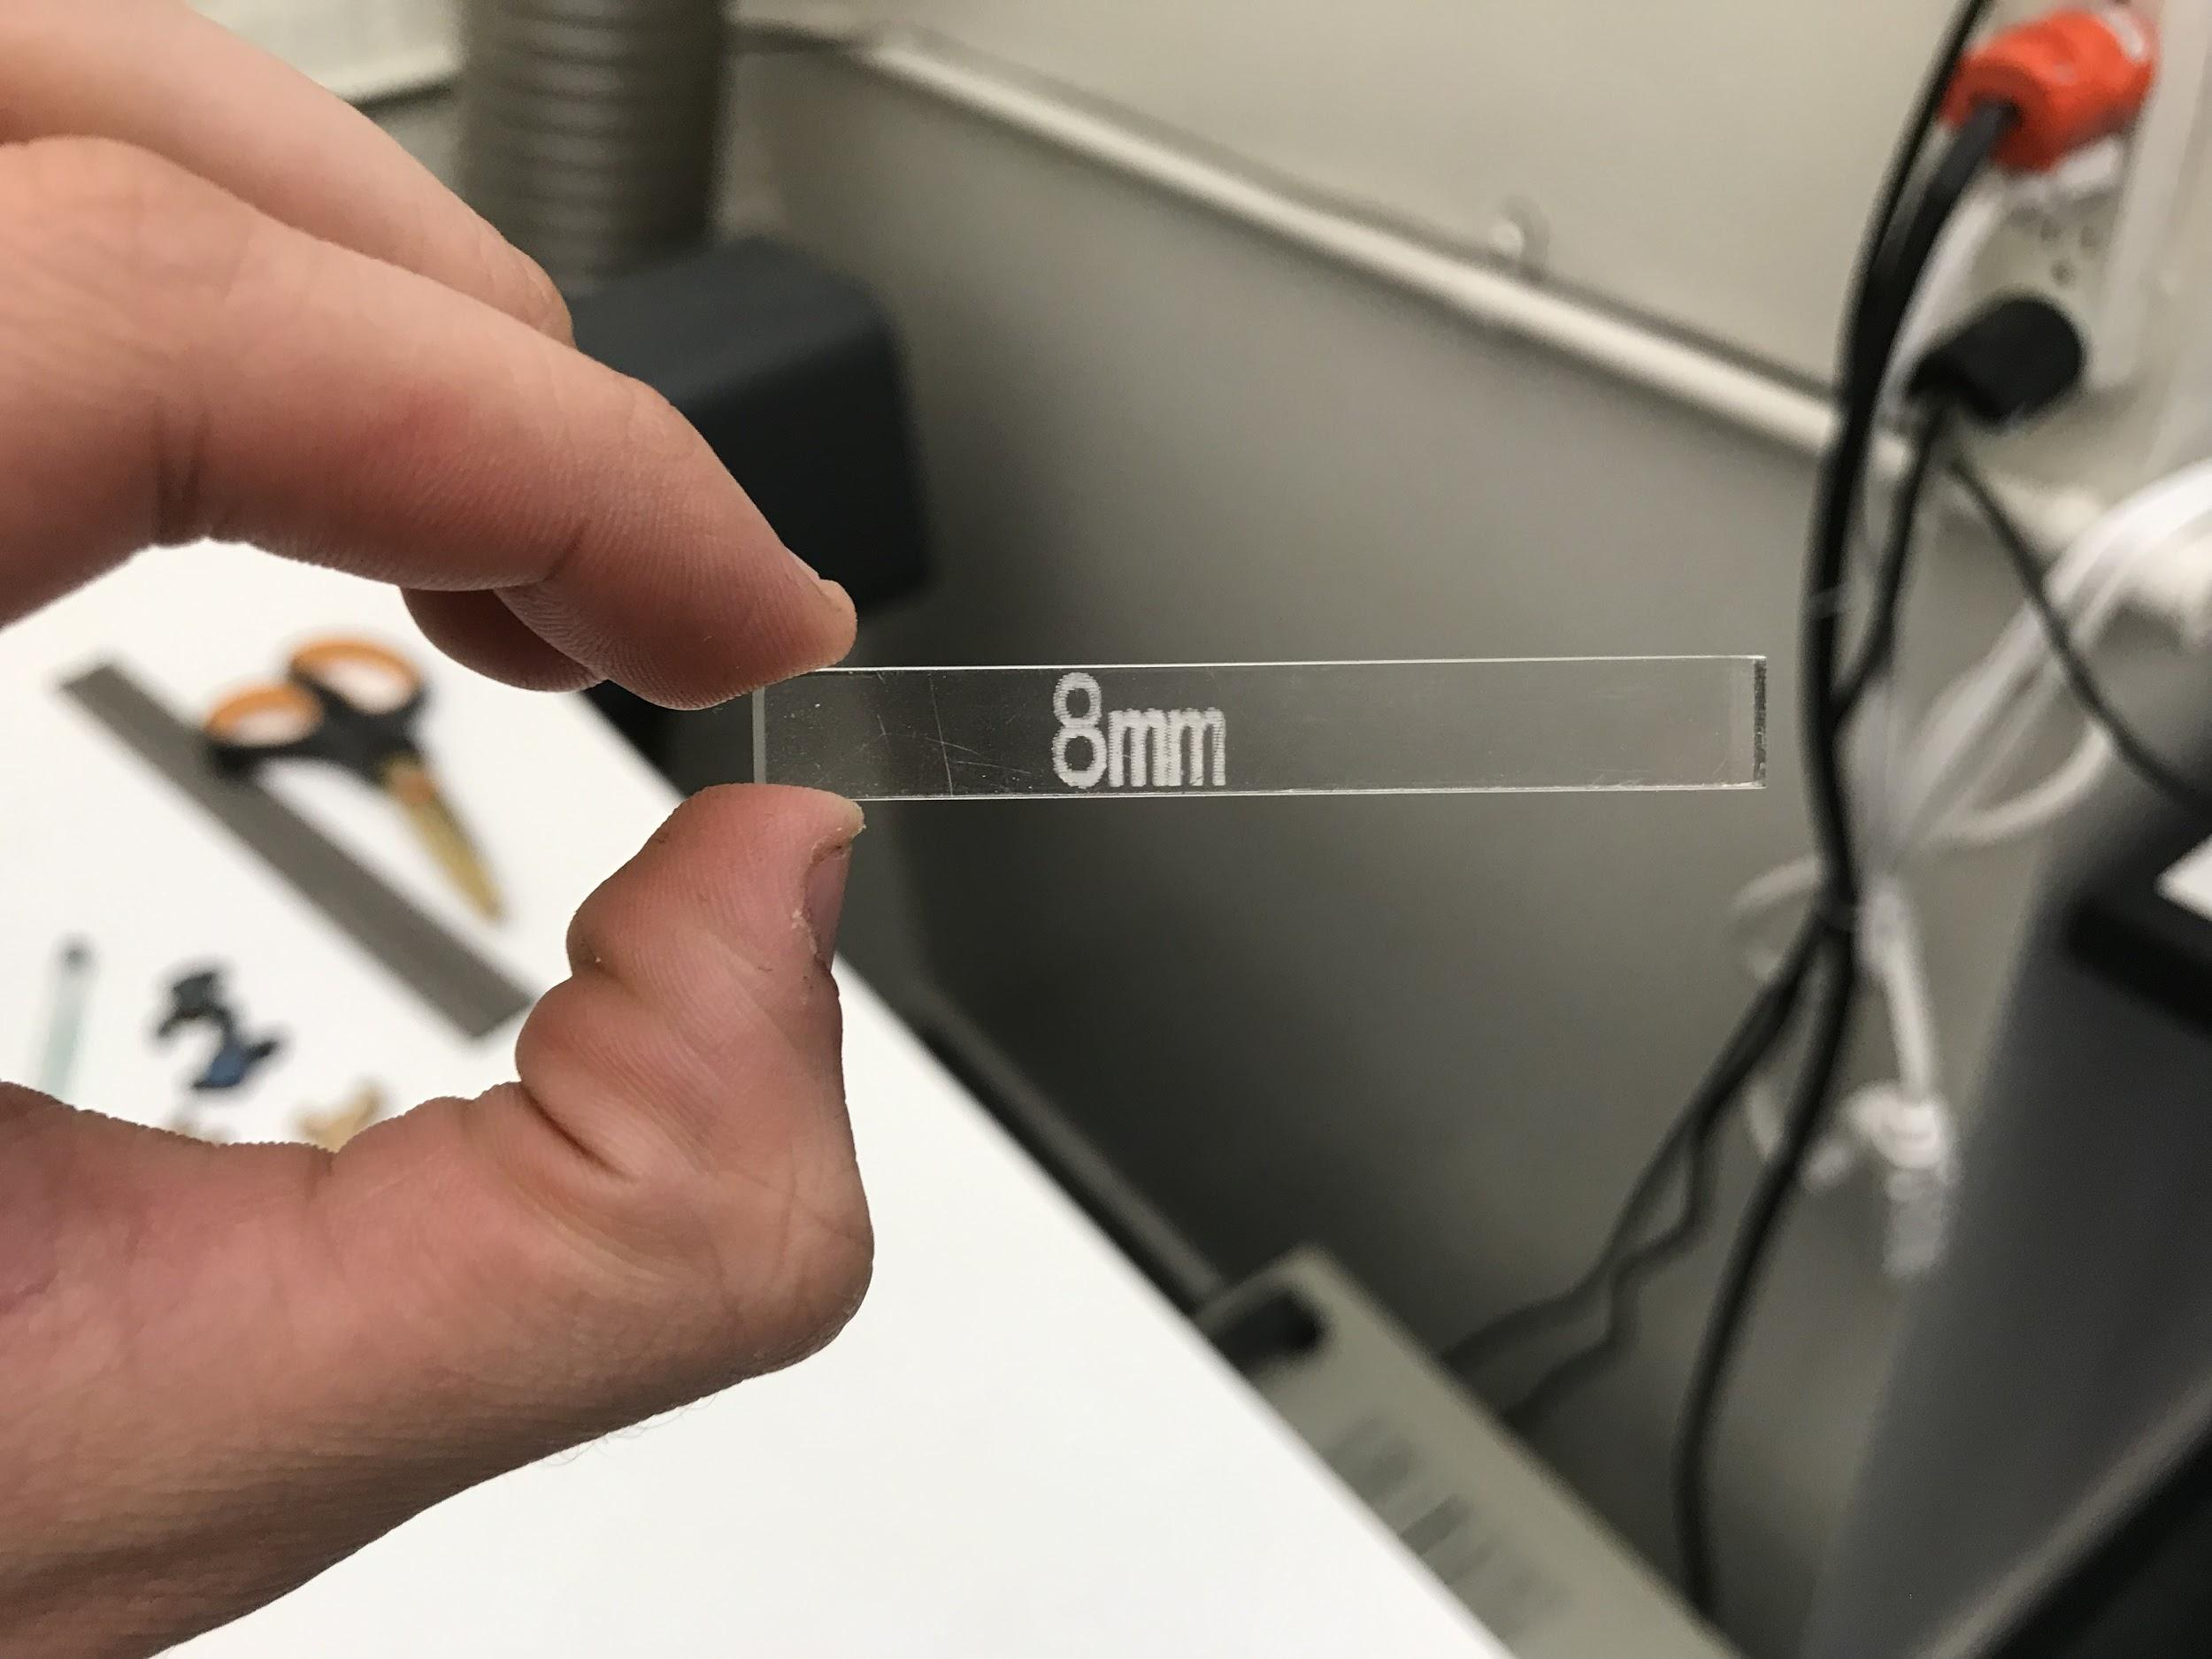
Material Thickness and Adjusting the lens
Max cut thickness
8mm lens spacing
Notes:
Island: Seperate Part
Overhang: Greater than 45 degree angle

Slide 9
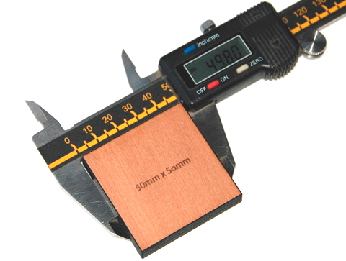
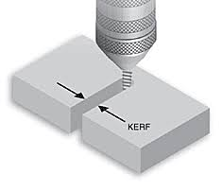
Dimensional tolerances/kerf
Extremely precise
Kerf ranges from 0.08mm-1mm depending on material

Slide 10
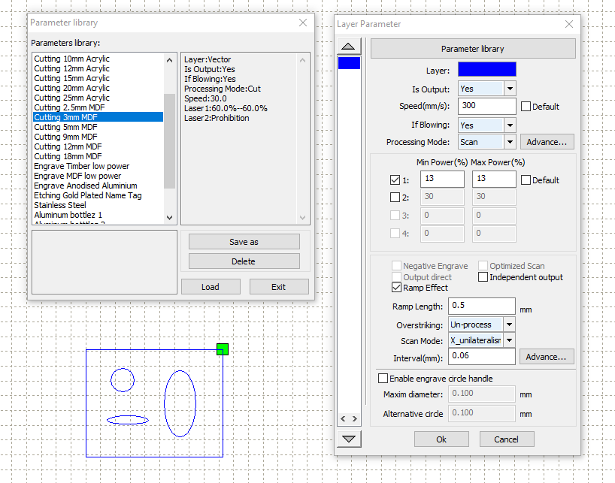
Cutting shapes

Slide 11
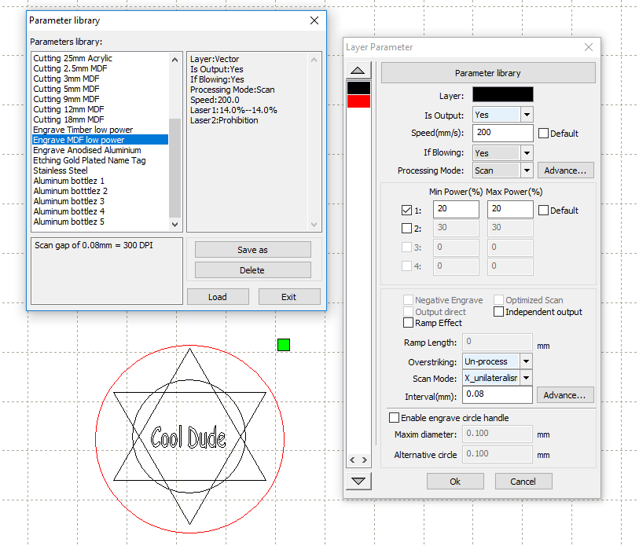
Etching shapes

Slide 12
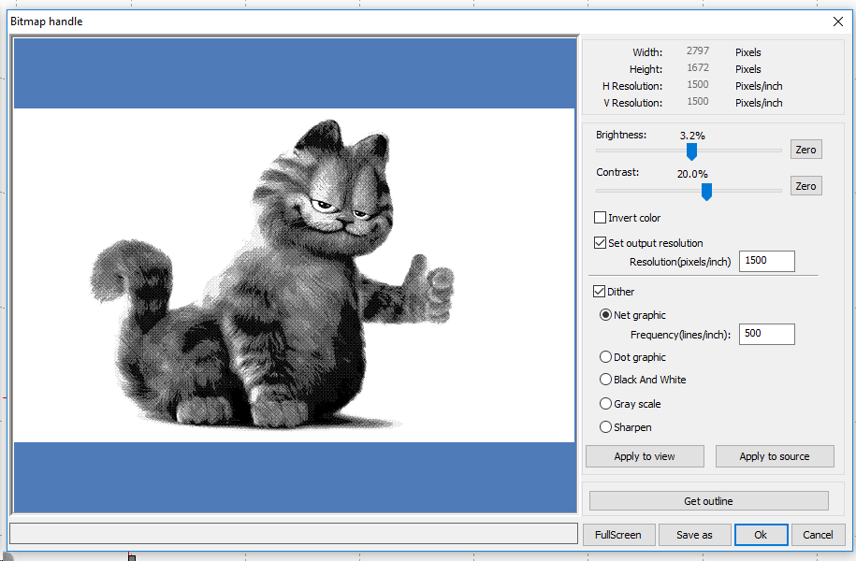
Rastering image
Be sure to get your power settings correct or you’ll get a topo-garfical map

Slide 13
Resolution aka Interval
The smaller the number, the higher the resolution
Typically between 0.04mm and 0.12mm
The closer the lines, the deeper it will etch

Slide 14
How to use the laser cutter
Load materials
Set lens height
Start up RDworks
Import designs
Set the power and speed
Check preview
Press start button

