Slide 1
Red Card Wood Room
Training and Workshop
Innovation Orchard Staff
io@cpp.edu

Slide 2
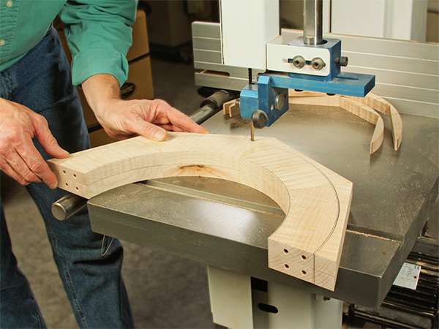
What is this subject?
Notes:
Red Card tools in the Wood Room are the most dangerous tools in the IO. You can get hurt or hurt someone else very easily if you do not know what you are doing. Even after you are experienced, you can still make a dangerous situation by negligence.
After you have viewed this presentation, let us know when you want to use any of the tools listed, and we will show you how to use the tool, then watch you the first time you use it to make sure you are safe.

Slide 3
What This Room is For
Hand operated tools, whether powered or manual.
Space to use power tools that make dust, chips, or loud noise.
Storage of tools and supplies, but not projects.
Notes:
F

Slide 4
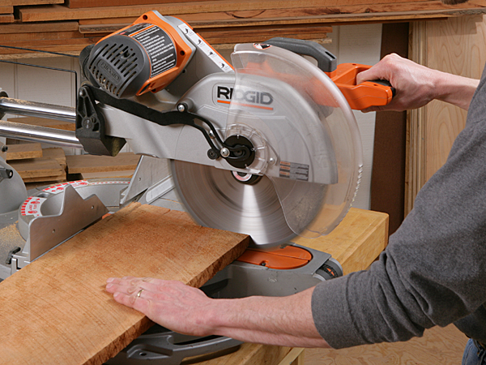
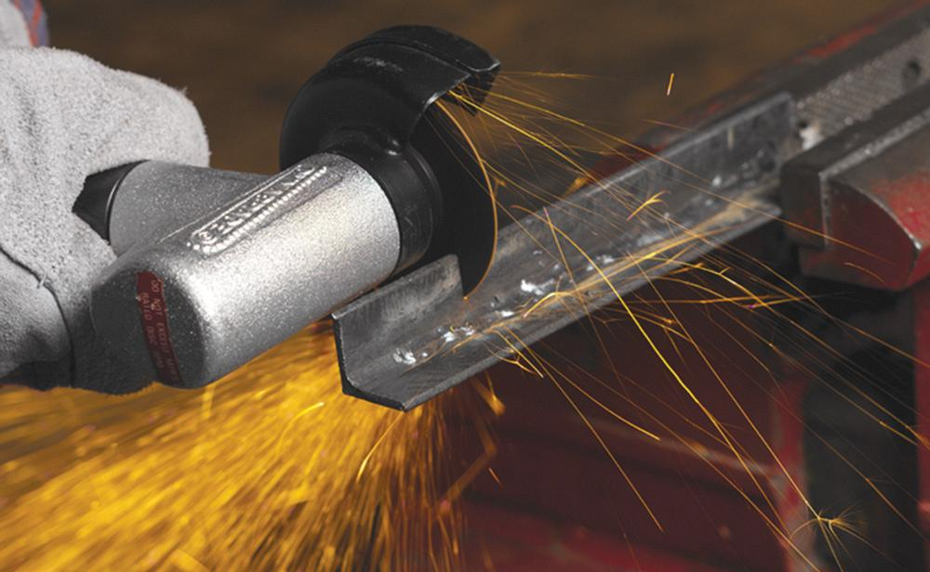
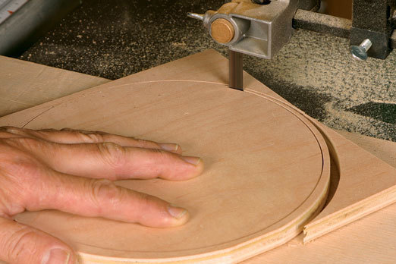
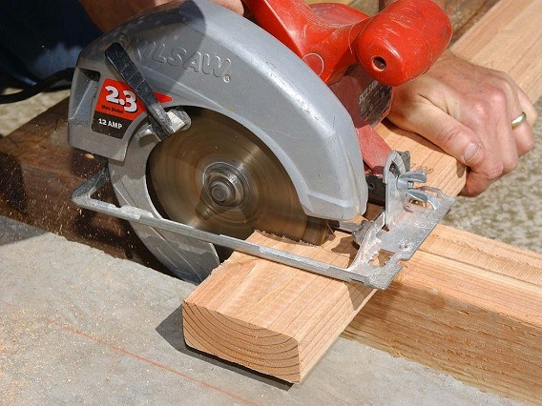
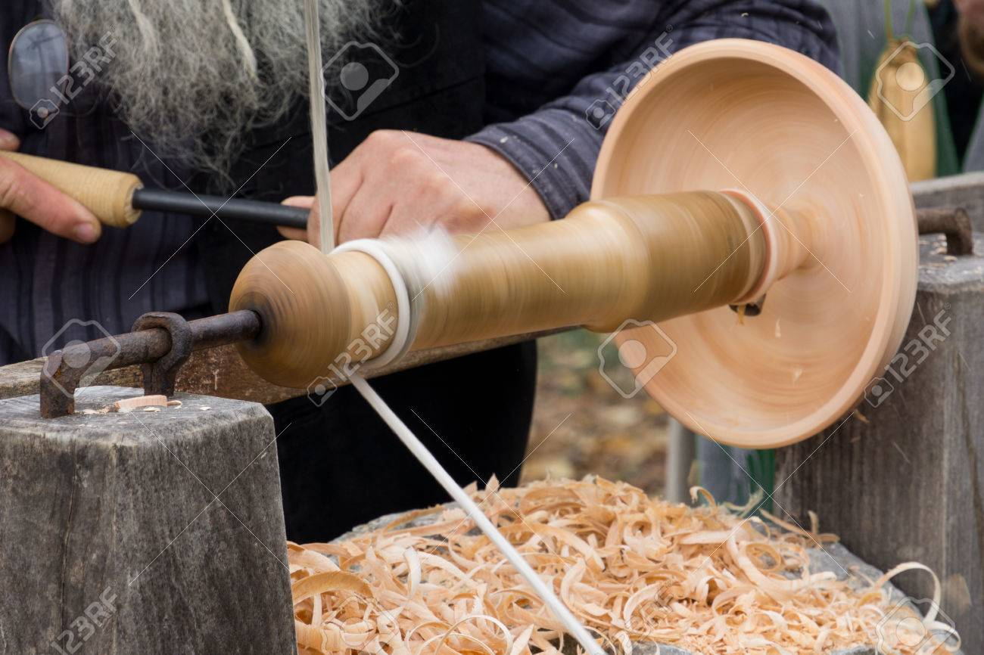
Types of tools and uses
Miter Saw
Angle Grinder
Band Saw
Circular Saw
Lathe
Turning Machine

Slide 5
Safety on red machines
Eye protection is mandatory
Long hair should always be tied up and back
Ear protection is mandatory for tools marked with the ear protection sticker
Keep hands at least 5 inches away from any moving blade at all times
Never start a cut with the blade on the material
Never wear gloves while operating any red equipment

Slide 6
Safety Checklist
Depends on material
Required
Not Required
 | Mini Lathe | Wood Lathe | Router Table | CNC mill/router | Angle Grinder | Circular Saw | Miter Saw | Band Saw
Lung Protection
Eye Protection
Ear Protection
Dust Collector

Slide 7
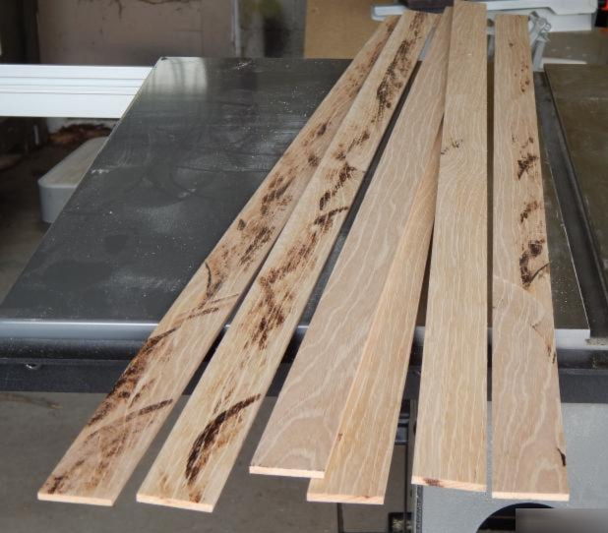
Cutting by hand
Always cut on the side of the line that you didn’t measure
Kerfs are usually about 1/8th of an inch
Never wear gloves while cutting
Do not linger the blade in one spot while cutting
Be aware of where all 10 of your fingers are when cutting.

Slide 8
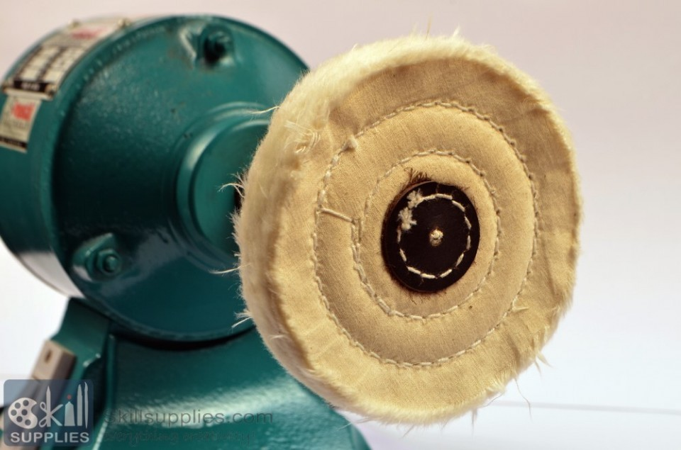
Software
All of the tools in the Wood Room are hand operated.
The closest you will get to software in the Wood Room is the cloth buffing wheel… (*slaps knee and dies laughing*)

Slide 9
Machine Malfunction
If any tools or machines malfunction or break down during operation, stop what you are doing and ask a shop tech.
Do not attempt to fix any hardware issues yourself.

Slide 10
Most Commonly Used Tools Here at the IO
Of the 6 red tools available, the 3 most commonly used tools are the:
Miter Saw
Band Saw
Circular Saw
We will show you how to safely operate these three tools, and at the conclusion of this workshop, you can use them at any time as long as there is a tech immediately present at the IO and you inform them that you are using the tool

Slide 11
Hands-On Tutorial Time
You are now permitted to learn the red machines!
You must complete the introduction for any red machine you wish to use. Please ask a tech for assistance and we will guide you through how to use them.

