Slide 1
Yellow Card Wood Room
Training and Workshop
Innovation Orchard Staff
io@cpp.edu

Slide 2
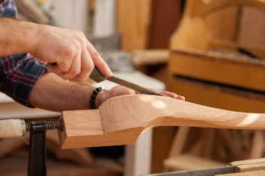
What is this subject?
Notes:
Ask Majors and prior knowledge to Woodworking.
The tools in this presentation will let you make and work on many projects, but it does not give you access to all tools. Generally, the tools listed here are moderately dangerous, but easy to learn how to use.

Slide 3
Basic Rules for ALL Tools
Wear safety glasses at all times
Wear a breathing mask at all times
Keep hair tied back at all times
Roll up long sleeves
Do not wear any jewelry or accessories while operating any machinery
No dangly or loose clothing
Always clean up tool after use

Slide 4
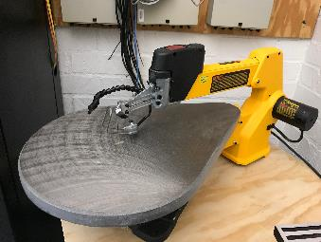
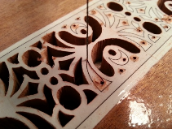
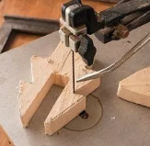
Scroll Saw
Uses and features
Usable on most thin (< half inch) materials
Good for cutting decorative, tightly curved shapes
Super thin blade, ideal for intricate cuts
Warnings
Keep fingers at least 2 inches away from blade at all times
Blade is very fragile, do not make aggressive cuts
Cut slowly
Check frequently to make sure blade is tight
Notes:
https://www.cpp.edu/~io/equipment/index.shtml

Slide 5
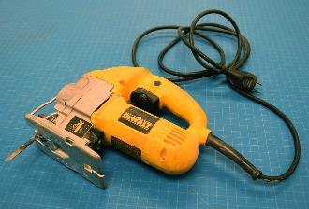
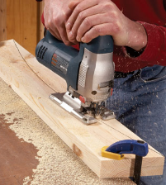
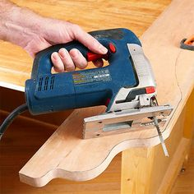
Jigsaw
Uses and features
Usable on most materials < 1.5 inches thick
Good for cutting irregular shapes out of thicker material
Warnings
Keep fingers at least 3 inches away from blade at all times
Clamp down all pieces while cutting
Make sure there is nothing underneath the board while cutting
Do not bend blade
Notes:
Soluble: No
Food safety: Refer to manufacturer guidelines
ABS (Acrylonitrile butadiene styrene):
Strength: High | Flexibility: Medium | Durability: High
Difficulty to use: Medium
Print temperature: 210°C – 250°C
Print bed temperature: 80°C – 110°C
Shrinkage/warping:Considerable
Soluble: In esters, ketones, and acetone
Food safety: Not food safe
PETG (Polyethylene Terephthalate “glycol-modified”)
Strength: High| Flexibility: Medium | Durability: High
Difficulty to use: Low
Print temperature: 220°C – 250°C
Print bed temperature: 50°C – 75°C
Shrinkage/warping: Minimal
Soluble: No
TPU (Ninjaflex/Thermoplastic polyurethane)
Strength: Medium | Flexibility: Very High| Durability: Very High
Difficulty to use: Medium (TPE, TPC); Low(TPU)
Print temperature: 210°C – 230°C
Print bed temperature: 30°C – 60°C (but not needed)
Shrinkage/warping: Minimal
Soluble: No
Food safety: Not food safe

Slide 6
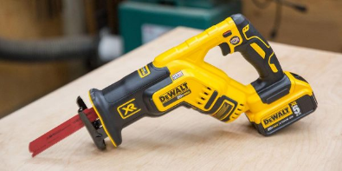
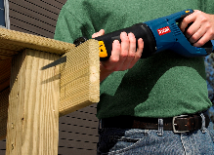
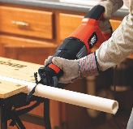
Sawzall
Uses and features
Use for rough cutting anything
Great for cutting stock rods down to size
Warnings
Keep fingers at least 3 inches from blade at all times
Blade can get hot, allow breaks to cool
Be aware of where the blade is
Firmly grasp the sawzall at all times
Notes:
Soluble: No
Food safety: Refer to manufacturer guidelines
ABS (Acrylonitrile butadiene styrene):
Strength: High | Flexibility: Medium | Durability: High
Difficulty to use: Medium
Print temperature: 210°C – 250°C
Print bed temperature: 80°C – 110°C
Shrinkage/warping:Considerable
Soluble: In esters, ketones, and acetone
Food safety: Not food safe
PETG (Polyethylene Terephthalate “glycol-modified”)
Strength: High| Flexibility: Medium | Durability: High
Difficulty to use: Low
Print temperature: 220°C – 250°C
Print bed temperature: 50°C – 75°C
Shrinkage/warping: Minimal
Soluble: No
TPU (Ninjaflex/Thermoplastic polyurethane)
Strength: Medium | Flexibility: Very High| Durability: Very High
Difficulty to use: Medium (TPE, TPC); Low(TPU)
Print temperature: 210°C – 230°C
Print bed temperature: 30°C – 60°C (but not needed)
Shrinkage/warping: Minimal
Soluble: No
Food safety: Not food safe

Slide 7
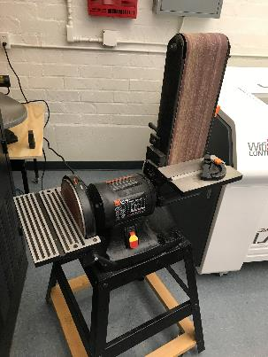
Belt Sander
Uses and features
Used for sanding external curves
Warnings
Keep fingers 2 inches away from sanding surfaces
Produces very fine wood dust
Pinch points at the interface of the sanding plate
Disk Sander: Always sand on ‘down’ spinning half of disk
Notes:
Soluble: No
Food safety: Refer to manufacturer guidelines
ABS (Acrylonitrile butadiene styrene):
Strength: High | Flexibility: Medium | Durability: High
Difficulty to use: Medium
Print temperature: 210°C – 250°C
Print bed temperature: 80°C – 110°C
Shrinkage/warping:Considerable
Soluble: In esters, ketones, and acetone
Food safety: Not food safe
PETG (Polyethylene Terephthalate “glycol-modified”)
Strength: High| Flexibility: Medium | Durability: High
Difficulty to use: Low
Print temperature: 220°C – 250°C
Print bed temperature: 50°C – 75°C
Shrinkage/warping: Minimal
Soluble: No
TPU (Ninjaflex/Thermoplastic polyurethane)
Strength: Medium | Flexibility: Very High| Durability: Very High
Difficulty to use: Medium (TPE, TPC); Low(TPU)
Print temperature: 210°C – 230°C
Print bed temperature: 30°C – 60°C (but not needed)
Shrinkage/warping: Minimal
Soluble: No
Food safety: Not food safe

Slide 8
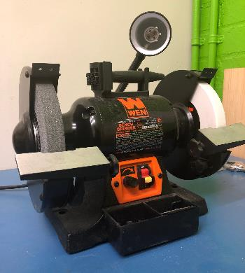
Bench Grinder
Uses and features
Good for shaping small, metal parts and chisels
Good for deburring and adding fillets and chamfers
Warnings
Keep fingers at least 2 inches away from grinding wheels at all times
Pinch points at the interface of the platens
Produces fine metal particulate
Notes:
https://www.cpp.edu/~io/equipment/index.shtml

Slide 9
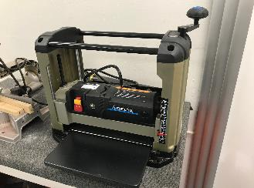
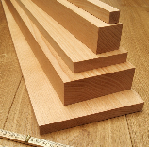
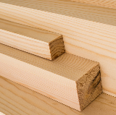
Planer
Uses and features
Flattens one edge of wood stock and makes sides parallel
Good for preparing wood before woodwork
Warnings
Will pull ANYTHING into the blade
Do not wear gloves
Very loud, wear ear protection
Do not push things through the planer
Only plane single boards, never attempt multiple boards at once or irregularly shaped boards
Notes:
https://www.cpp.edu/~io/equipment/index.shtml

Slide 10
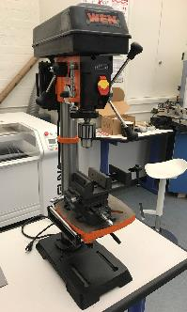
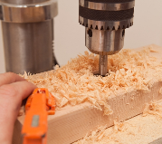
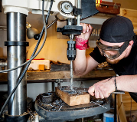
Drill Press
Uses and features
Variable chuck holds different sized bits
Usable for most materials
Good for cutting vertical and angled holes
Warnings
Keep fingers 2 ½ inches away from bit at all times
NEVER wear gloves while operating
Use pecking technique to clear chips for deep holes and to cool bit
Ensure the bit stays cool when cutting metal
Do not cut too aggressively
Notes:
https://www.cpp.edu/~io/equipment/index.shtml

Slide 11
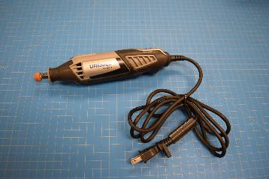
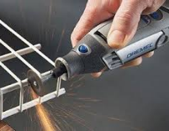
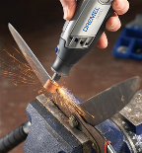
Dremel Rotary Tool
Uses and features
Extremely versatile tool with different attachments for different jobs
You can Grind, Cut, Engrave, Drill, Rout
Warnings
Blade is very fragile, do not make aggressive cuts
Do not touch the blade while it is moving
Watch for sparks and debris
Check frequently to make sure blade is tight and cool
Notes:
https://www.cpp.edu/~io/equipment/index.shtml

Slide 12
Most Commonly Used Tools Here at the IO
Of the 8 yellow tools available, the 3 most commonly used tools are the:
Jig Saw
Belt Sander
Drill Press
We will show you how to safely operate these three tools, and at the conclusion of this workshop, you can use them at any time as long as there is a tech present at the IO

Slide 13
Hands-On Tutorial Time
You are now permitted to learn the yellow machines!
You must complete the introduction for any yellow machine you wish to use. Please ask a tech for assistance and we will guide you through how to use them.

Slide 14
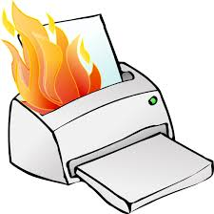
Machine Malfunction
If any tools or machines malfunction or break down during operation, stop what you are doing and ask a shop tech.
Do not attempt to fix any hardware issues yourself.

