Slide 1
Not Merely Players
“I’m not a player, I just crush the patriarchy!”
Team Members:
Alyssa-Kayla “AK” Marquez
Tiana Perez
Advisor:
Maria Cerce
Strategies to DEFY the Patriarchy

Slide 2
Moth Story: Quiet Fire
By Phyllis Marie Bowdwin
A career womxn shares her story about being physically accosted on the street in broad daylight by a mime while on her way to a high power job interview.
Womxn face not only uncomfortable but threatening situations on a daily basis AND bystanders don’t intervene to help.

Slide 3
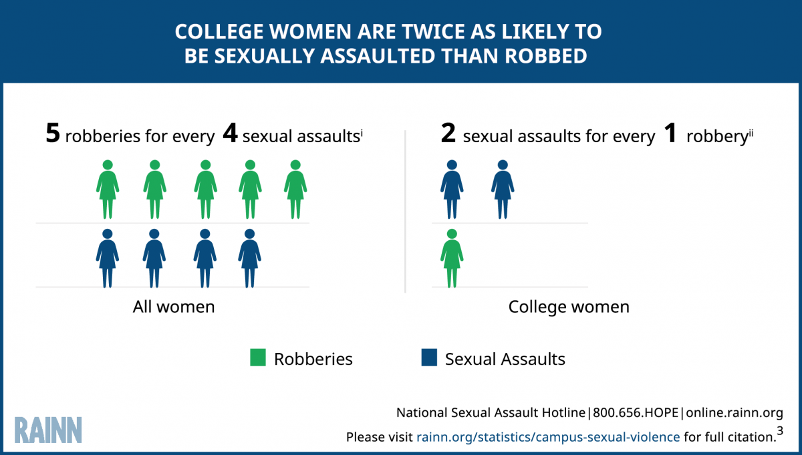
Social Justice Issue:
Source: RAINN Statistics

Slide 4
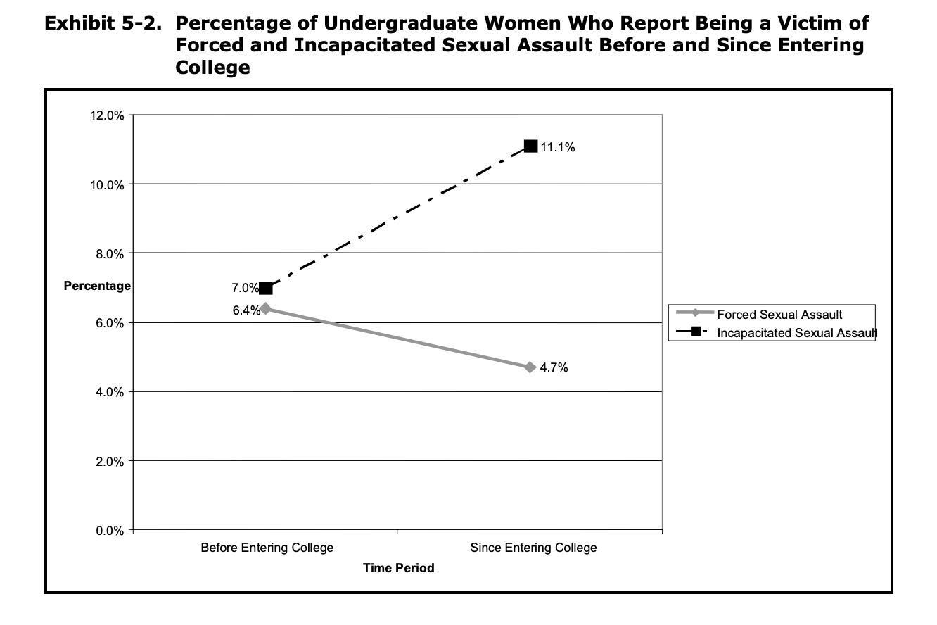
Community Affected
Every 73 seconds, an American is sexually assaulted. (RAINN)
Source: The Campus Sexual Assault (CSA) Study

Slide 5
Important Considerations
Research shows that folx are most likely to go to a peer first to report harassment or sexualized violence.
Folx safety and agency is vital to their success as a student and human being

Slide 6
GOALS
Destigmatize speaking out against sexual harassment
Increase awareness of and access to resources
Shift the culture that enables this harmful behavior
Create a greater understanding of the social construction of gender and gender roles
Explore how shame helps to perpetuate violence

Slide 7
Our Solution
“All the world's a stage, and all the men and women merely players”
- William Shakespeare
MISSION STATEMENT:
I’m not a player, I just crush the patriarchy!

Slide 8
Our Not Merely Players Team

Slide 9
What’s It All About
Cultivating role models in our communities of all genders that can serve as informal peer leaders and positive social influencers
How?
By recruiting leaders across campus clubs and orgs
All interested leader must go through an application and interview process
Accepted peer leaders will receive a stipend, pending ASI funding requests.

Slide 10
Get With the Program
Once accepted, peer leaders will attend various workshops informed and facilitated by our campus partners over the course of Spring Semester.

Slide 11
Thank you!

Slide 12
Works Cited
“Campus Sexual Violence: Statistics.” RAINN, www.rainn.org/statistics/campus-sexual-violence
Christopher P. Krebs, Ph.D. ; Christine H. Lindquist, Ph.D. ; Tara D. Warner, M.A. ; Bonnie S. Fisher, Ph.D. ; Sandra L. Martin, Ph.D. “The Campus Sexual Assault (CSA) Study.” National Institute of Justice, https://www.ncjrs.gov/pdffiles1/nij/grants/221153.pdf
“Victims of Sexual Violence: Statistics. RAINN, https://www.rainn.org/statistics/victims-sexual-violence

