Slide 1
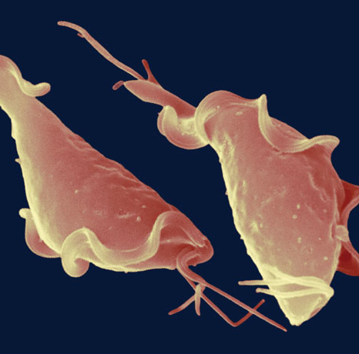
Using CRISPR gene-editing to study how immune cells kill the sexually-transmitted
parasite Trichomonas vaginalis
Team Trichomonas
Jose Moran
Aljona Leka
https://www.sciencenews.org/article/obscure-sexually-transmitted-parasite-immune-system-microbes
Notes:
We are team Trichomonas working with Dr.Mercer, in the Biology Department, and we are studying the interaction between the sexually transmitted parasite Trichomonas vaginalis and immune cells. We are using CRISPR-Cas 9 to study how immune cells kill the parasite Trichomonas Vaginalis.

Slide 2
Trichomonas Vaginalis (Tv)
First discovered by Alfred F. Donné in 1836. ^{[1]}
It is a highly prevalent sexually transmitted infection, affecting roughly 3.8 million people in the U.S per year. ^{[2]}
Increases the risk of secondary infections including HIV. ^{[3]}
Notes:
First a little background on Trichomonas Vaginalis. The parasite was first discovered by French bacteriologist and doctor Alfred F. Donne in 1836. Tv is a highly prevalent sexually transmitted infection, affecting roughly 3.8 million people in the U.S per year, according to CDC. Roughly 70% of infected people do not show symptoms, and therefore do not seek further
treatment. This indicates that infection rates might actually be higher than reported.
Tv can cause severe inflammation and tissue damage at the site of infection, which can exponentially increase the rates of secondary infections and other complications.

Slide 3
Communities most affected by Tv
Tv affects women at much higher rates than men, with harsher consequences such as:
Infertility, spontaneous abortion, and cervical cancers in women. ^{[2]}
Individuals from underserved communities are disproportionately affected by Tv.
African American women have prevalence rates of 13.3% compared to 1.3% in white women. ^{[3]}
Notes:
For most men the infection tends to be asymptomatic, while for women the consequences can be quite harsh. Tv infections are correlated with infertility, spontaneous abortion, and even cervical cancers in women as a result of inflammation and concomitant HPV infection. Even though Tv affects both genders, infections rates are much higher in women, especially for those in underserved communities. According to the CDC African American women have prevalence rates of 13.3% compared to 1.3% in white women.

Slide 4
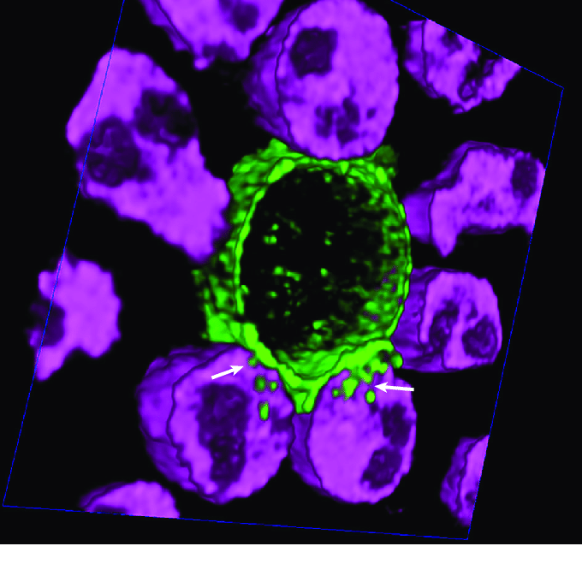
Immune cells and Tv interactions
Neutrophils are the first responders at the site of infection.^{[4]}
Neutrophils attack ​Tv​ through trogocytosis. ^{[4], [5]}
Trogocytosis is the process in which neutrophils take “nibbles” of the parasite’s membrane until it is breached, leading to its death. ^{[4]}
Trogocytosis
https://www.researchgate.net/figure/Human-Neutrophils-Kill-Trichomonas-vaginalis-Using-Trogocytosis-Primary-human_fig1_326072006
Notes:
Neutrophils are immune cells and are part of our immune system, and they are also known to be the foot soldiers of our immune system known to use phagocytosis, where they engulf the pathogen whole, as their main killing mechanism. When Tv invades the human host, neutrophils are the first responders at the site of infection, but in this case they do not use phagocytosis, rather a similar process called trogocytosis, in which neutrophils take “nibbles” of the parasite’s membrane until it is breached, leading to parasite death. The picture is showing neutrophils, in purple, attacking Tv which is in green. Neutrophils are attacking the parasite in groups, and you can notice that there are pieces of the parasite within the neutrophils, showing that neutrophils are indeed taking nibbles of the parasites membrane, and eventually leading to cell death.

Slide 5
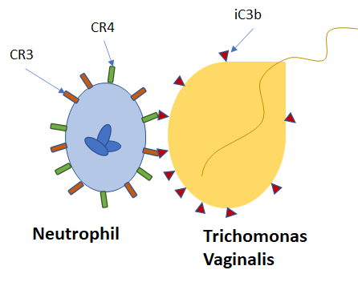
Our Hypothesis
We hypothesize that interaction between surface receptors (CR3, CR4) on neutrophils and complement proteins (iC3b) opsonizing the parasite’s membrane, are responsible for triggering trogocytosis.
Notes:
The process of trogocytosis in neutrophils is yet to be completely understood. It has been shown that the parasite is made more susceptible to neutrophils through complement proteins such as iC3b. iC3b will non-specifically attach to the surface of the parasite and mark it as a pathogen so that the immune system can clear it. It is already known that iC3b interacts with surface receptors CR3 and CR4 found on the membrane of neutrophils (7), to lead to the process of phagocytosis. We believe that the interaction between IC3b marking Tv and the surface receptors on neutrophils, could be involved in triggering not only phagocytosis, but also trogocytosis.

Slide 6
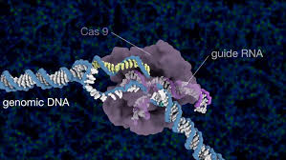
Innovation
Despite the prevalence in Tv, preventative treatments do not exists, and the most common curative treatment, Metronidazole, is a non-specific antibiotic.^{[6]}
Metronidazole does not prevent reinfection and Tv is growing resistant to it.^{[6]}
We plan to use an innovative gene-editing technique, CRISPR-Cas9 to test our hypothesis.
This study would contribute to a Tv-specific preventative treatment (vaccine), which would lead to a better public health policy.
https://innovativegenomics.org/multimedia-library/animated-genome-editing/
Notes:
The current treatment for Tv is a non-specific antibiotic called Metronidazole, which unfortunately does not prevent reinfection, and a more concerning aspect is that Tv is becoming resistant to the antibiotic. Making this route of therapy inefficient and the need for a new solution dire.
We plan to use the innovative gene-editing technique CRISPR-Cas9 to test the relationship between trogocytosis of Tv and the surface receptors found on neutrophils. This study would help by contributing to a Tv specific preventative treatment such as vaccines. which would hopefully lead to a healthier public health policy, and provide underserved communities with some relief.

Slide 7
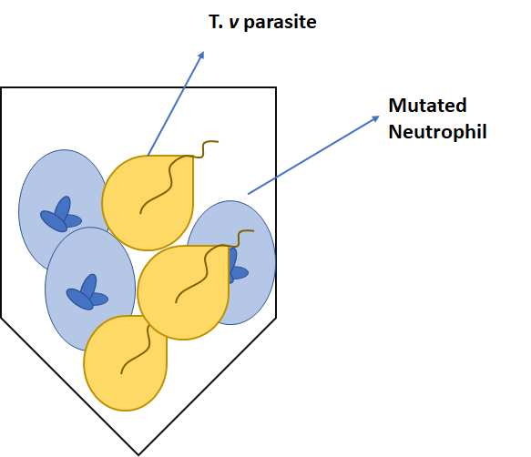
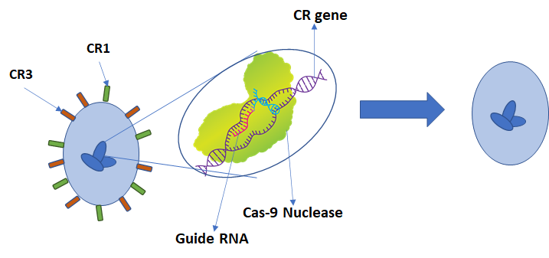
Strategy
We plan to use CRISPR-Cas 9^{[8]} to knock out surface receptors CR3 and CR4 on neutrophils, and study their interaction with the Tv to determine if they are involved in trogocytosis.
Neutrophil
Mutated Neutrophil
4
We are will use CRISPR/Cas-9 to edit the genes responsible for CR3 and CR4, with the help of the Cas-9 nuclease and guide RNA.
After undergoing CRISPR the cells no longer have functioning CR3 or CR4 receptors.
We will incubate the mutated neutrophil cells with Tv and study the interaction between the two, to determine if CR3 and CR4 are involved in trogocytosis.
Notes:
We plan to use CRISPR-Cas 9 to test our hypothesis, by knocking out the CR3 and CR4 surface receptors on neutrophils through CRISPR-Cas 9. CRISPR can introduce mutations in a target gene through the Cas-9 protein, which can cut the DNA at a specific location, guided by a guide RNA, which is complementary to the target gene. Once the neutrophils have undergone the mutation process, we hope the result will be a neutrophil where CR3 and CR4 are either completely lacking or non-functioning. Once our mutants have been generated, we will culture them with our parasite, and study their interaction, through what we call a cytolysis assay where neutrophils and Tv are dyed and cultured together for a set amount of time. We then assess the number of dead parasites. Normal neutrophils will kill Tv when cultured, though trogocytosis. We hope that to neutrophils lacking the CR3 and CR4 receptors, will either show lower trogocytosis levels, or complete abolishment of trogocytosis.

Slide 8
Results
We optimized our cytolysis assay.
We optimized our transfection assay .
CR3 knockout cell lines were not generated.
CR4 knockout cells were generated.
A homogenous CR4 K/O cell-line was not generated, though a heterogenous cell population was.
Notes:
Thus far in this study, we have made progress to our goal of determining if CR3 and CR4 are involved in trogocytic killing of Tv. We have optimized our cytolysis assay which is how we test the killing efficiency of our neutrophil like cells. We have also optimized our transfection assay, which is how we introduced our designed guide RNA that will induce our knockout mutations. We were unable to generate a CR3 knockout line in time, though we did generate CR4 knockout cells. These are in a mixed cell population among cells that did not get CR4 knocked out.

Slide 9
Future Directions
Using Cas9 protein with designed guide RNA instead of plasmid that translates into Cas9 protein with designed guide RNA
Creating CR4 homogenous cell line
Transfecting and generating CR3 knockout cells
Cytolysis assay
Imaging assay
Notes:
Due to the issues in developing these knockout cells lines with plasmids, we might shift towards transfecting with a Cas9 protein that is commercially synthesized with our edited guide RNA. We also hope to create a homogenous CR4 knockout cell line from the mixed population that already exists, as well as generating a CR3 knockout cell line. As we have already optimized the cytolysis assay, we would conduct this assay with our knockout cell lines. We also hope to begin the imaging assay of this trogocytic interaction with our knockout cell lines as well.

Slide 10
References
Campbell, W. (2001). “A Historic Photomicrograph of a Parasite (Trichomonas Vaginalis).” Trends in Parasitology, vol. 17, no. 10, pp. 499–500.
CDC - Trichomoniasis Statistics. (2017, January 31).
Kissinger, P. (2015). "Trichomonas vaginalis: a review of epidemiologic, clinical and treatment issues." Bmc Infectious Diseases 15.
Mercer, F., S. H. Ng, T. M. Brown, G. Boatman and P. J. Johnson (2018). "Neutrophils kill the parasite Trichomonas vaginalis using trogocytosis." PLoS Biol 16(2): e2003885.
Velmurugan R, Challa DK, Ram S, Ober RJ, Ward ES. Macrophage-Mediated Trogocytosis Leads to Death of Antibody-Opsonized Tumor Cells. (2016) Mol Cancer Ther.;15(8):1879–1889. doi:10.1158/1535-7163.MCT-15-0335
Miller, W. C., H. Swygard, M. M. Hobbs, C. A. Ford, M. S. Handcock, M. Morris, J. L. Schmitz, M. S. Cohen, K. M. Harris and J. R. Udry (2005). "The prevalence of trichomoniasis in young adults in the United States." Sexually Transmitted Diseases 32(10): 593-598.
Xu, S. T., J. C. Wang, J. H. Wang and T. A. Springer (2017). "Distinct recognition of complement iC3b by integrins alpha X beta(2) and alpha(M)beta(2).
Lino, C. A., J. C. Harper, J. P. Carney and J. A. Timlin (2018). "Delivering CRISPR: a review of the challenges and approaches." Drug Delivery 25(1): 1234-1257.

