Slide 1
Title Slide Template
Billy Bronco

Slide 2
General Slide Template

Slide 3
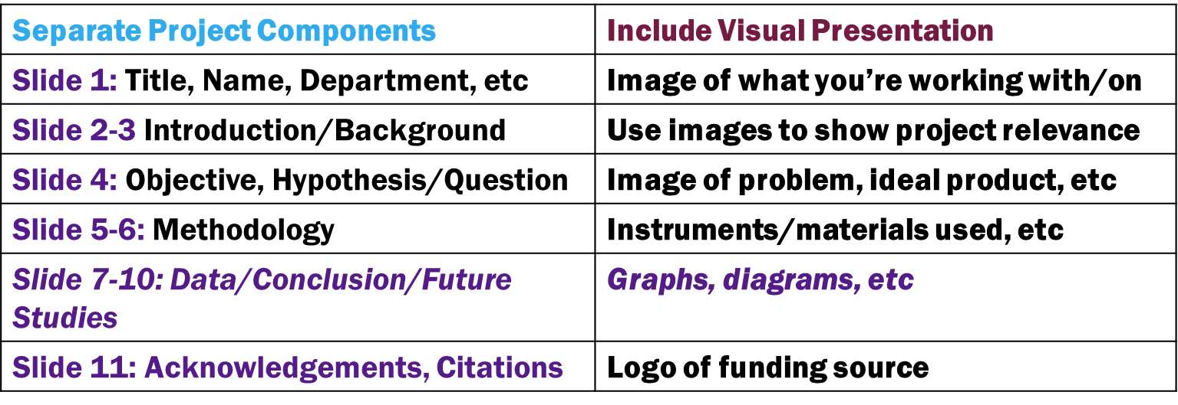
Oral Presentation: Zoom Slide Components/Visuals
Talk to your faculty mentor. They may have additional suggestions based on your project. If you do not have data/conclusion, it is okay to focus on background, objective/hypothesis, and/or methodology.

Slide 4
Oral Presentation Tips
Establish early a clear and unifying point and repeat at least three times during your presentation. Summarize in one to two sentences.
Clearly explain the applicability of your research to your discipline and/or the real world.
Have a story to tell, lead your audience through the discovery process.
The main results of your research should be more than 50% of your presentation
Limit the amount of time spent on introduction and background
Think carefully through how to visually represent your analysis and conclusions
Engage/acknowledge your audience, they will tell if your audio or presentation is not displaying properly.
Back-up your presentation on a USB or cloud drive in case the file is damaged, or you cannot access an account to download it to your computer.

Slide 5
Poster Presentation: Traditional vs Zoom

Slide 6
Poster Presentation: Zoom Slide Components/Visuals
Separate Project Components | Focus on Visual Presentation
Slide 1: Title, Name, Department, etc | Image of what you’re working with/on
Slide 2: Introduction/Background | Use images to show project relevance
Slide 3: Objective, Hypothesis/Question | Image of problem, ideal product, etc
Slide 4: Methods | Instruments/materials used, etc
Slide 5: Data/Conclusion if applicable | Graphs, diagrams, etc
Slide 6: Acknowledgements, Citations | Logo of funding source
Talk to your faculty mentor. They may have additional suggestions based on your project. If you do not have data/conlusion, it is okay to focus on background, objective/hypothesis, and/or methodology.

Slide 7
Poster Presentation Tips
Poster Layout: Consistent and concise. Ask Faculty Mentor for a sample of one done for a prior project.
Poster Colors: Simple color scheme such as black or navy on white
What is the most important aspect of your research?
What parts of your research can be represented visually?
What can you share with your audience to complement your poster?
Clearly explain the applicability of your research to your discipline and/or the real world.
Engage/acknowledge your audience, they will tell if your audio or presentation is not displaying properly.
Back-up your presentation on a USB or cloud drive in case the file is damaged, or you cannot access an account to download it to your computer.

Slide 8
Q&A Preparation: Common Questions
What was the motivation behind your research?
What would you do differently to obtain more accurate results?
If you changed variable X, then would your results have changed?
Do you see any application of this project in XYZ field?
How did you determine your methodology? How do you know that your methods would lead to the most valid results?
Was a timeline necessary for your project? Why or why not?
Does your project have any impact on COVID? (or vice versa)

Slide 9
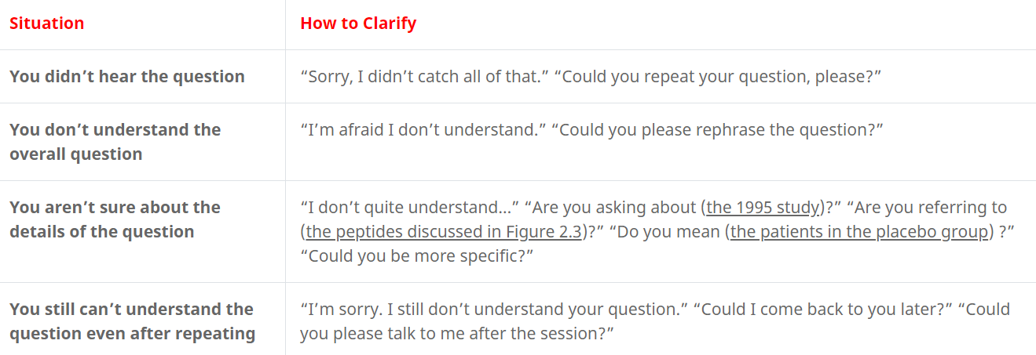
During Q&A Session

Slide 10
During Q&A Session

