Slide 1
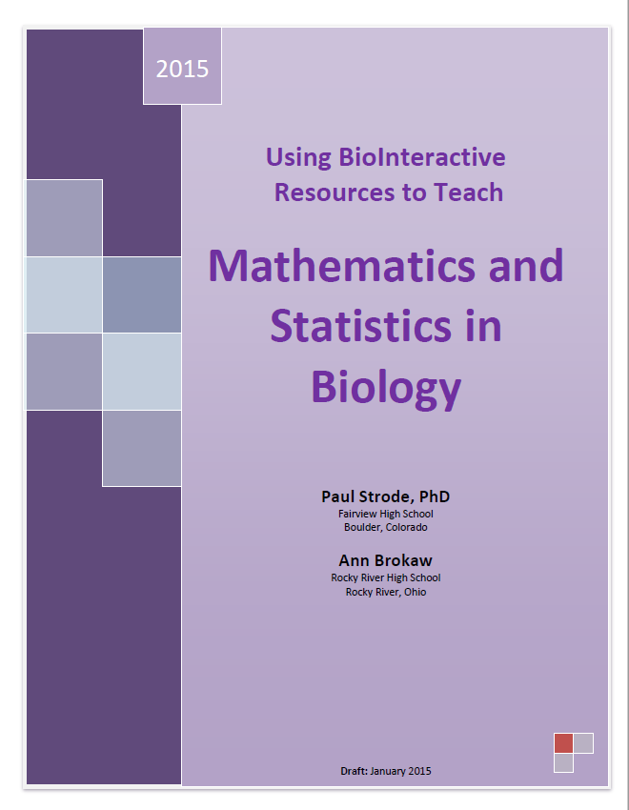
Activities based off of exercises described in Mathematics and Statistics in Biology and spreadsheet tutorials from HHMI BioInteractive

Slide 2
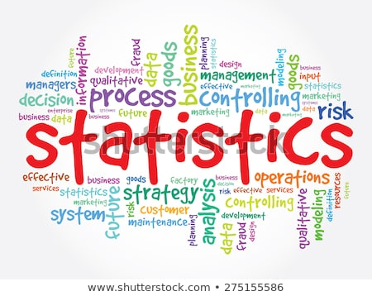
Goals for today
Become familiar with using a spreadsheet for managing, analyzing data
Introduction to descriptive statistics and why they matter for designing experiments
  Measures of central tendency
  Measures of variation
    Visualization using Histograms
    Sum of Squares
    Variance
    Standard Deviation using Sum of Squares
    Standard Error of the Mean
    95% Confidence Interval

Slide 3
Goals
Introduction to descriptive statistics and why they matter for designing experiments
  Making graphs with error bars
Introduction to t tests for hypothesis testing

Slide 4
Why are we doing this?
Learning to manage data and information on a spreadsheet will save you a lot of time
Valuable workplace, research skill
Lets you be more in control of managing your data

Slide 5
Pre-class homework
Make a copy of the file “Google Sheets tutorials,” rename and save in your own Google Drive folder. (Google Sheets Tutorial file link)
Read and complete the following worksheets. Look for tasks highlighted in yellow
Review questions from homework
Basics | Calculating Range
Organize | Filling Cells
Format | Copying Formulae
Formulae | Absolute Reference
Using Ranges of Cells
Sorting
Exercise 1

Slide 6
Need 3 volunteers
Write name on board 4 times while we time you
Now do the same with the non-dominant hand
What research questions come to mind?
Is the dominant hand better at performing fine motor movements than the nondominant hand?
Notes:
Reveal each line on the slide after the task is completed.
After students write with both their dominant and nondominant hand, lead a discussion about research questions that come to mind.

Slide 7
One way to test this question:
Each willing participant flips a coin.
  Heads = dominant hand first,
  Tails = nondominant hand first
With one hand, time hold long it takes to break 10 toothpicks
Record data
Repeat with the second hand
Record data

Slide 8

Collect data!
If doing the activity as a class
Make a new class Google Sheet that students can access with the following columns
If using provided data
See the “Toothpick Time Data” worksheet (tab) in the Google Sheets tutorial.

Slide 9
Visually exploring the data
Create a histogram
  Need to put all the data points into “bins”
  Bins should be all the same size. For example, groups of ten or a hundred.
  Bins should include all of the data, even outliers. If your outliers fall far outside of your other data, consider lumping them in with your first or last bin. This creates a rough histogram —make sure you note where outliers are being included.
  Boundaries for bins should land at whole numbers whenever possible (this makes the chart easier to read).

Slide 10
Visually exploring the data (pt 2)
Create a histogram
  Read and complete the tasks on the following worksheets (tabs) in the Google Sheets tutorial
    “Intro to Histograms”
    “Histogram chart type” and
    “Example 2”
  Note- you may want to paste in your own class data for use in Example 2.

Slide 11
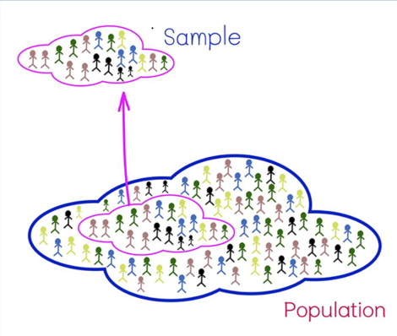
Population vs. Sample
Sample = concrete
Population = theoretical
What is the population we studied with hand experiment?
  All college students?
  College STEM students?
  Students in your age range?
Population; parameter = Greek (e.g. "μ“ for population mean)
Statistic = sample = English or Arabic (e.g. x̄ for sample mean)

Slide 12
Population vs. Sample (pt 2)
What claims might we be able to make with our data?
What claims can we not make with our data?

Slide 13
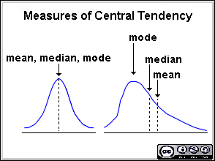
Measures of Central Tendency
Summarize datasets with one number
Describe each of the following and when you might use them
  Mean
  Median
  Mode

Slide 14
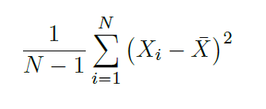
Measures of Variability
Variance- lots of nice mathematical advantages and uses; units are hard to understand

Slide 15
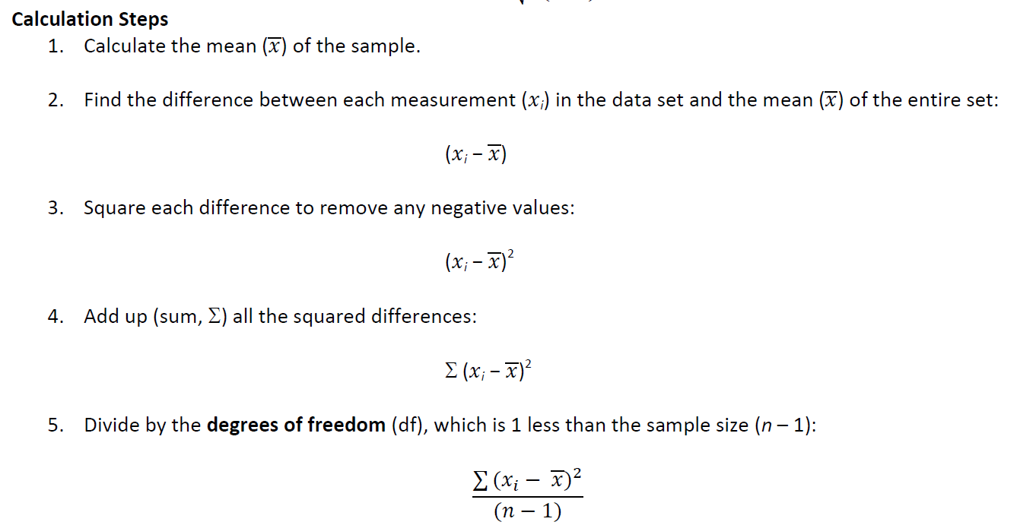
Variance- lots of nice mathematical; units are hard to understand
Compute by hand for dominant hand times, then switch to Excel

Slide 16
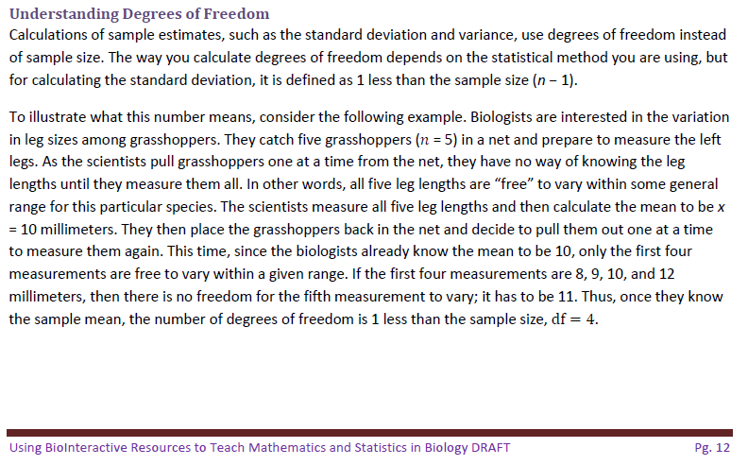

Degrees of Freedom?
www.BioInteractive.org
Notes:
All the new curricula include science practices – including words like: graphs, calculations, analysis, data, statistical analysis, evidence based claims, scientific explanations

Slide 17
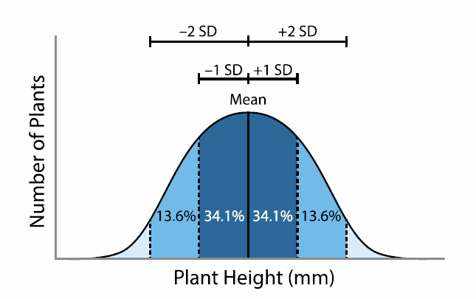
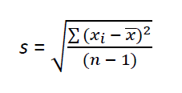
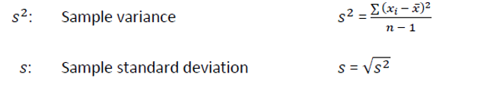
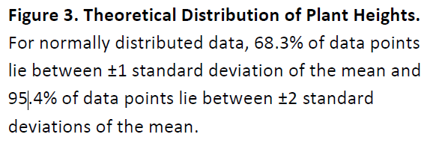
Measures of Variability (pt 2)
Standard deviation- Units we can understand; can be for population or sample
Compute in Google sheets (=std.dev.s) by completing the “Standard Deviation” and “Exercise 3” worksheets (tabs) in the Google Sheets tutorial

Slide 18

Standard error
What if you sampled many times and took the standard deviation of all the sample means? Say 500 times…
Helps reveal uncertainty in sample mean
Don’t need to resample 500 times, can use a formula

Slide 19
Standard error (pt 2)
What the standard error of the mean tells you is that about two-thirds (68.3%) of the sample means would be within ±1 standard error of the population mean and 95.4% would be within ±2 standard errors

Slide 20
95% confidence intervals
A more precise measure of the uncertainty in the mean is the 95% confidence interval (95% CI)
For large sample sizes, 95% CI can be calculated using this formula: 1.96 x SEM (typically rounded to 2 x SEM) for ease of calculation.
95% of all confidence intervals constructed using this procedure should contain the true population mean.
Compute SEM and 95% CI in Google sheets by completing the “Standard Error” worksheet (tab) in the Google Sheets tutorial

Slide 21
Practice
Let’s practice graphing with error bars in Google Sheets!
Practice in Google sheets by completing the “Bar Graph,” “Bar Graph 2,” “Error Bars,” “Error Bars 2,” and “Exercise 4” worksheets (tabs) in the Google Sheets tutorial

Slide 22

Why do we use statistics?
How can we describe each sample?
  Distribution
  Mean, Median, Mode
  Standard Deviaion
  Standard Error of the Mean
  95% Confidence Interval
Inferential Statistics
Is there a difference between these two lakes?
Is that difference significant?
http://labs.geog.uvic.ca/geog226/frLab3.html
Notes:
Click through this slide to highlight the use of inferential statistics and hypothesis testing.

Slide 23
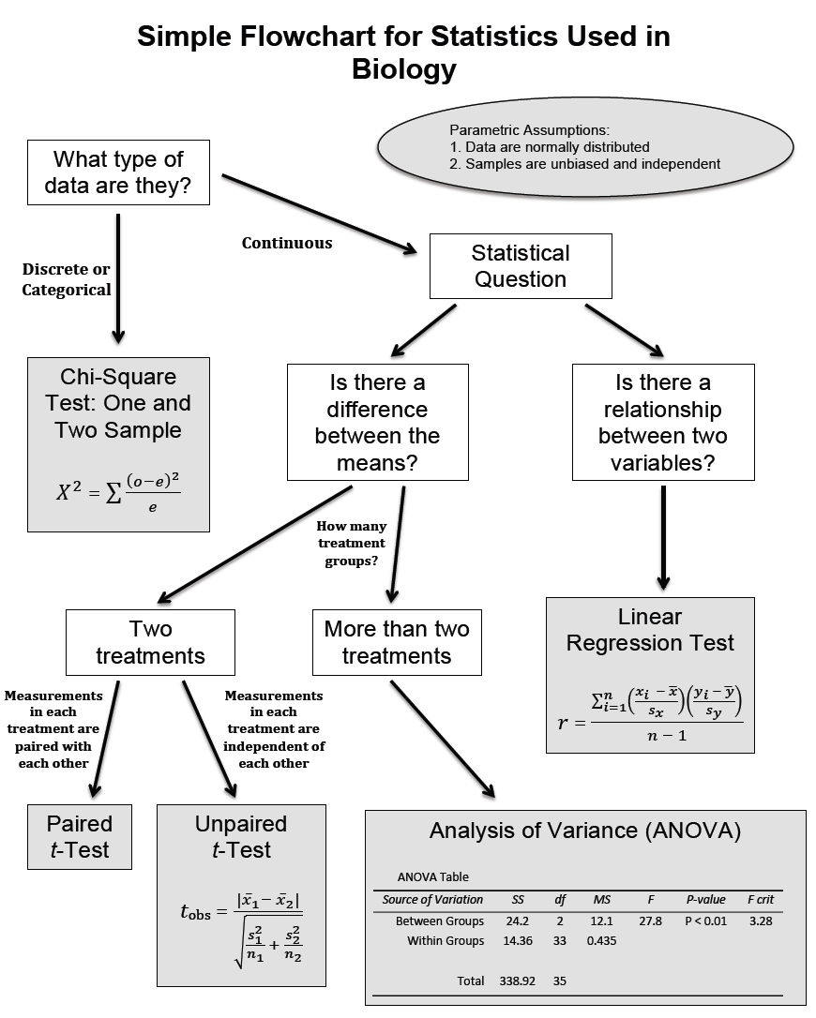
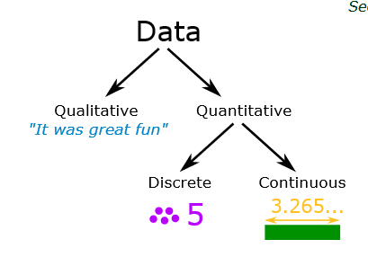
Inferential statistics
Notes:
Inferential statistics help us answer questions such as– yes, there may be a difference in means between two groups. To what extent could that difference be due to chance?
Numerical: can be measured and placed in ascending or descending order.
Discrete: Values or observations that is counted as distinct and separate and can only take particular values.Only a finite number of values is possible, and the values cannot be subdivided meaningfully. (the number of kittens in a litter; number of threads in a sheet, number of stars given for an energy rating)
Continuous: You can measure continuous data. Values or observations may take on any value within a finite or infinite interval
Categorical: Values or observations that can be sorted into groups or categories. (# of people wearing sweatshits, t-shirts, collared shirts, etc.) [ Nominal: You can count but not order or measure nominal data. Examples: Sex, and eye colour.; Ordinal Values or observations can be ranked (put in order) or have a rating scale attached. You can count and order, but not measure, ordinal data. Example: house numbers and swimming level.]

Slide 24
Revisiting the hand data…
We will only explore this one example
Notes:
Inferential statistics help us answer questions such as– yes, there may be a difference in means between two groups. To what extent could that difference be due to chance?
[

Slide 25
Inferential Statistics
T-test
Is the difference between two sample means significant?
Revisiting Hypotheses: Experimental vs. Statistical
H_{o} = H _{naught} = statement to test = null hypothesis
H_{a} = H _{alternative} = alternative hypothesis
Alpha level: what probability of a “false positive” are we willing to accept?
  False positive: We reject the null hypothesis of no difference, but in reality there is no difference
Notes:
Statistical null hypotheses (H_{o} = H naught)= statement to test; typically that there is no difference between groups or that changes to the independent variable will not lead to any significant changed in the dependent variable
Alternative Hypothesis: There is a difference between populations; or the independent variable will affect the dependent variable in a significant way (H1 or Ha)
Alpha level= the maximum probability of a type I error (false positive) that we are willing to accept (typically 0.05, every time you cut the probability in half, you must get 4 x as much data); 10 min

Slide 26
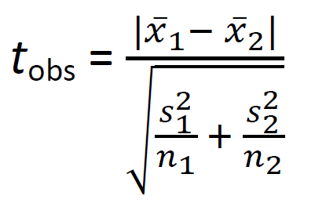
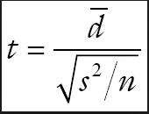
Steps in the T test
Compute a “t” value, sometimes called t-observed (equal variances not assumed)
Compare t-observed to a critical t-value (t-crit).
When t-obs > t-crit, for a given alpha level, you reject the null hypothesis.
Most spreadsheet calculators just return a p-value
t_{obs} for PAIRED

Slide 27
Practice!
For toothpick data
  What is the null statistical hypothesis?
  What is the alternative hypothesis?
  Practice in Google Sheets by completing the “T.Test Function” and “Exercise 5” worksheets (tabs) in the Google Sheets tutorial
  Calculate the p-value
    =t.test(range 1, range 2, tail #, type)
  Decide if we can reject the null statistical hypothesis
Notes:
I will show how to calculate in

