Slide 1
How To Complete all Calworks and Child Care forms
Student Guide
By: Monique Pelayo

Slide 2
*Note: All forms need to have an attached class schedule.

Slide 3
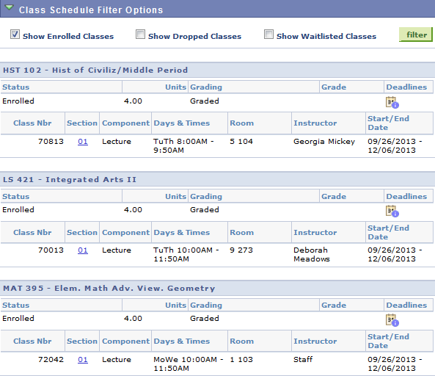
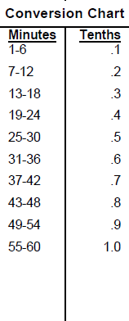
Class Schedule
M Tu W Th F
1.9 1.9
HST 102
1.9 1.9
MAT 395
1.9 1.9
LS 421
1.9 3.8 1.9 3.8
=11.4 ≈ 11.5 Lecture Hours
11.5 Study Hours
23 Hours/Week

Slide 4
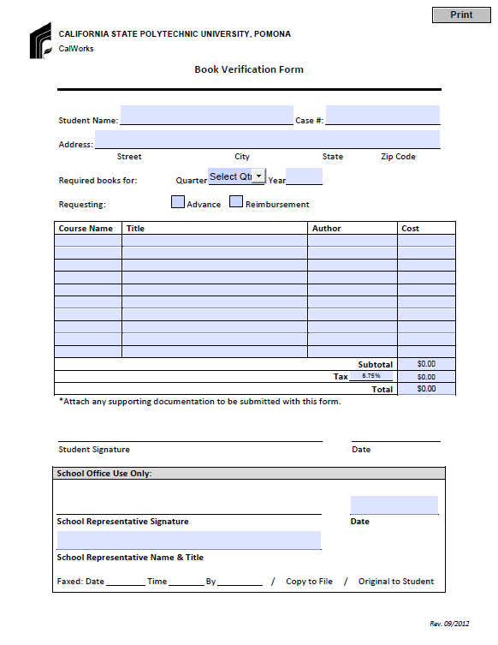
Book Verification Form
How to find Required Texts
Go to cpp.edu
In the search bar type in bookstore
Go to Bronco Bookstore
Scroll over Textbooks and click on Buy/Rent
Select the term the books are being requested for
If the term does not show up ask the student to provide the class syllabus w/ the receipts for the books.
Select the department of the class.
Select the course number.
Select the Section of the class
Print out the Required Text Books
Fill in with your information.
Select the quarter and the Type of Request
EX: Mat 394 Concepts of Math Moore 100.00
Fill in designated areas in the order they appear on the Required textbooks sheet and on the class schedule.
Change to .09 the rest of the Math will be automatically completed.
Attach the Class Schedule with the Time chart on it. Then print out required textbooks for each class.
Tyler J. Evins, Administrative Analyst
Once all information is filled out, please sign and date the form. Make sure to add all other documentation that corresponds with the packet.

Slide 5
Self Reporting Book Verification Form
This form is to be filled out when Self Reporting.

Slide 6
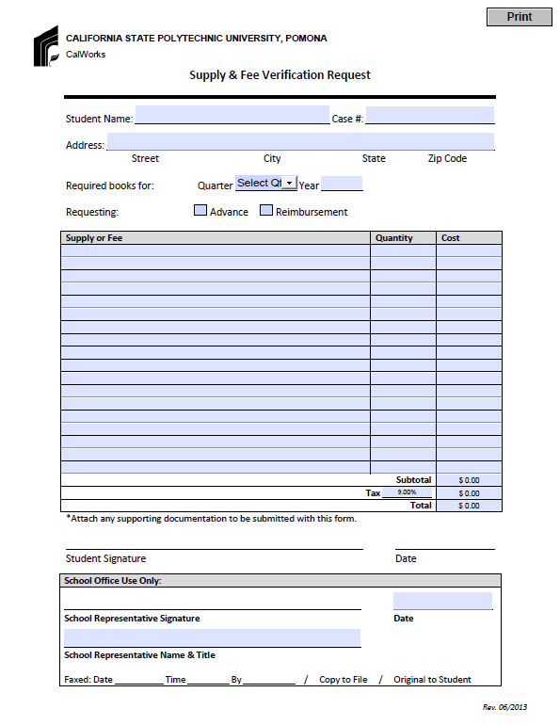
Supply & Fee Verification Form
Fees
Attach
-Class Schedule
-Account Activity
Fill in with your information.
Select the quarter and the Type of Request
Supplies
Attach
-Class Schedule
-Receipts
Fill in designated areas as they appear on the receipt or account activity
Attach the Class Schedule with the Time chart on it.
Once all information is filled out, please sign and date the form. Make sure to add all other documentation that corresponds with the packet

Slide 7
Self Reporting Supply and Fee verification Form
This form is to be filled out when Self Reporting.

Slide 8
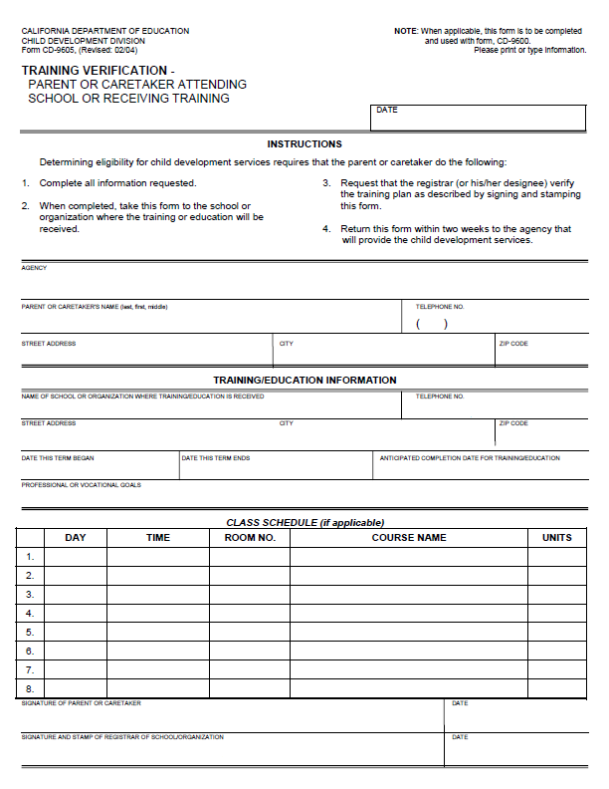
Training Verification
CD-9605
Attach Class Schedule
Fill in with your information.
Cal Poly Pomona
(909) 869-3000
3801 W. Temple Ave. Pomona, 91768
First Day of classes.
Last Day of finals week.
Expected Grad Term.
-The month and year of the quarter you are expected to graduate.
Fill in with your Professional Goal or Major With Sub-Plan
ex: Business Administration With Finance, Real Estate, Law Opt.
*Please See Attached
Schedule.
Once all information is filled out, please sign and date the form. Make sure to add all other documentation that corresponds with the packet

Slide 9
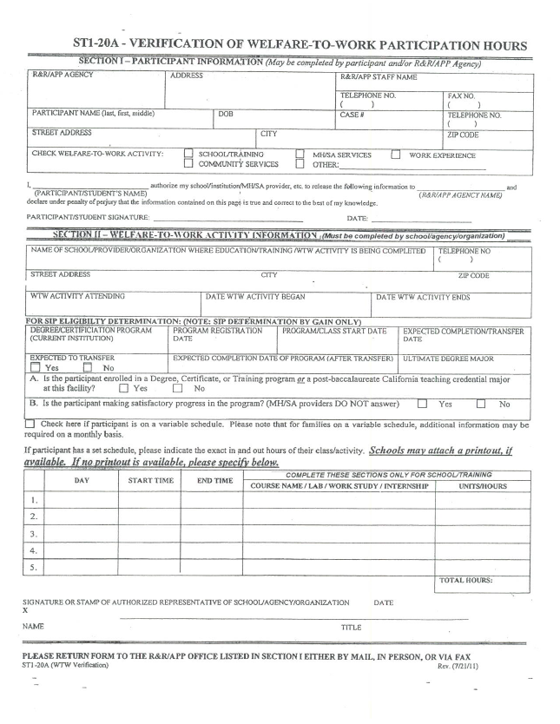
STI-20A- Verification of Welfare to Work Participation Hours
Fill in with your information.
Cal Poly Pomona
(909) 869-3000
3801 W. Temple Ave. Pomona, 91768
Once all information is filled out, Print your name, agency name, sign and date. Make sure to add all other documentation that corresponds with the packet.
School- (Major)
Please fill out all information in this box. If you have any questions please email calworks@cpp.edu.
*Please See Attached
Schedule.
Attach Class Schedule. If Self Reporting, also attach Unofficial Transcript

Slide 10
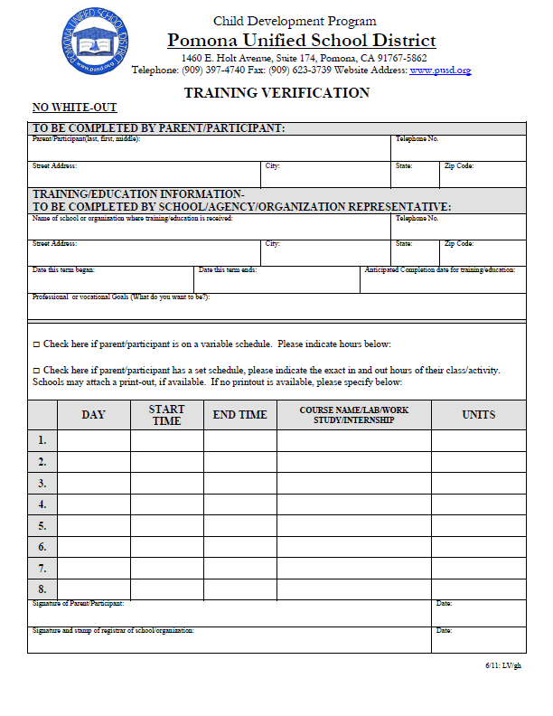
Pomona Unified School District
Training Verification
Please fill out the entire section.
Cal Poly Pomona
(909) 869-3000
3801 W. Temple Ave. Pomona, 91768
First Day of classes.
Last Day of finals week.
Expected Grad Term.
-The month and year of the quarter you are expected to graduate.
Fill in with your Professional Goal or Major With Sub-Plan
ex: Business Administration With Finance, Real Estate, Law Opt.
*Please See Attached
Schedule
Once all information is filled out, please sign and date the form. Make sure to add all other documentation that corresponds with the packet
Attach Class Schedule

Slide 11
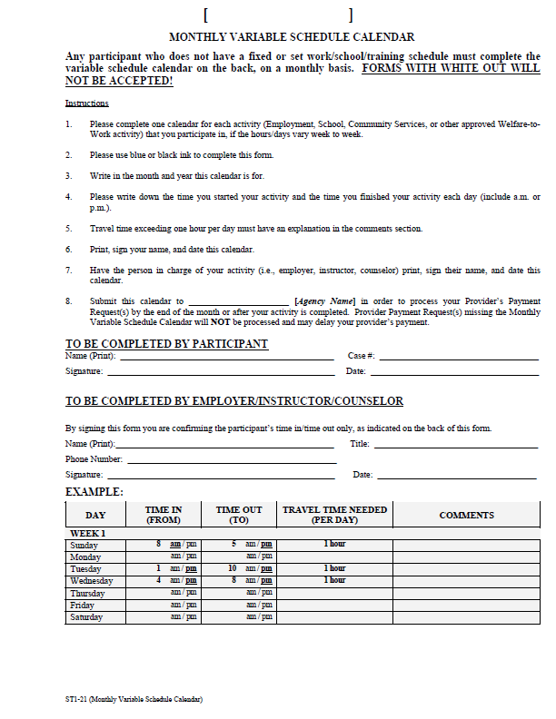
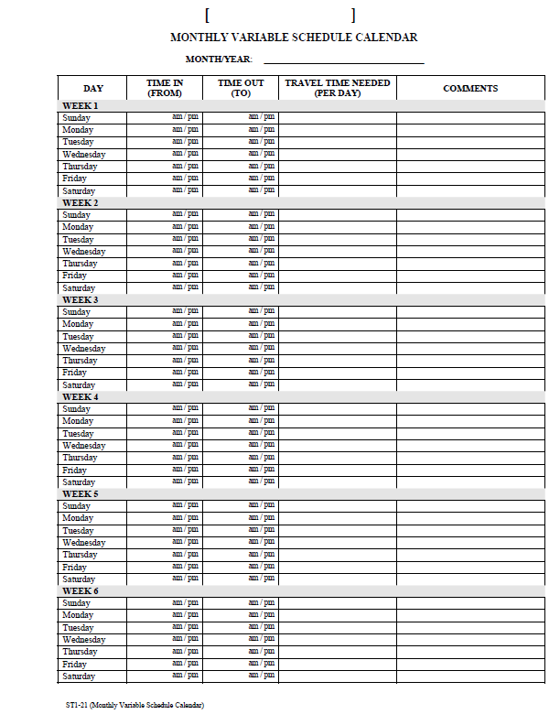
Monthly Variable Schedule
Attach Class Schedule
Follow the instructions. Once all information is filled out, please sign and date the form. Make sure to add all other documentation that corresponds with the packet

Slide 12
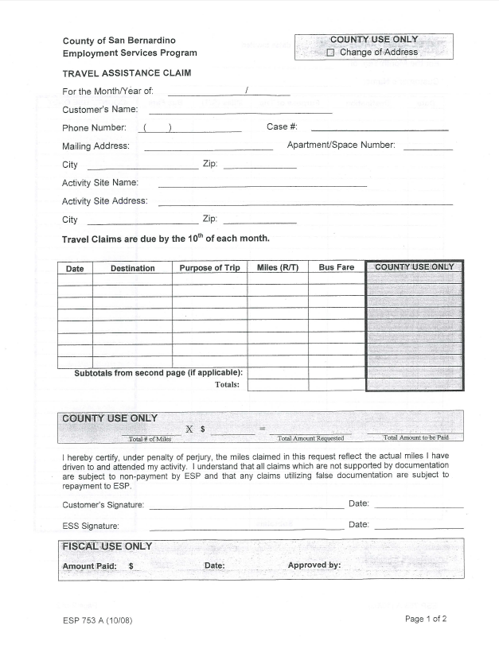
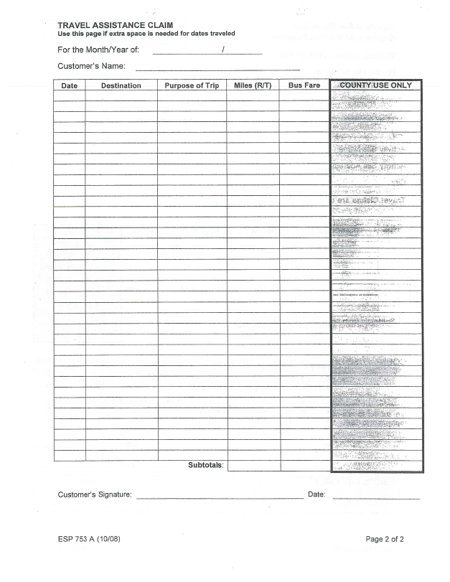
Travel Assistance Claim
This document can be dropped off by you with the Monthly Variable Schedule. All we do with this document is fax it with the Monthly Variable Schedule. This document does not need any processing from our office.

Slide 13
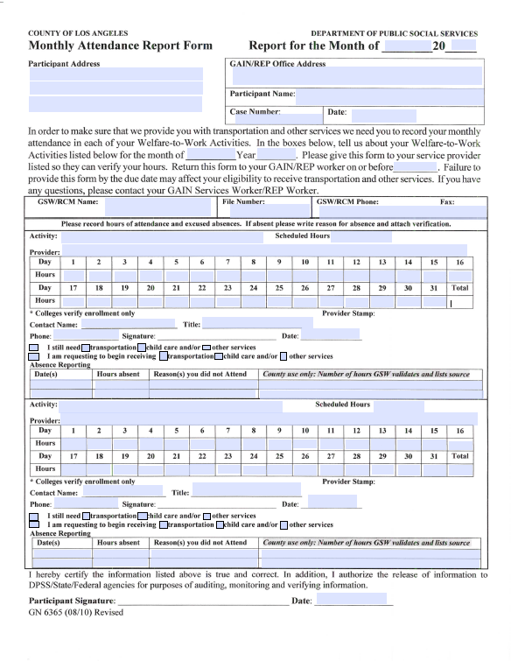
N
Attach Class Schedule
Fill out hours per day you are in class. Verify that your weekly hours add up to a weeks worth of class hours.
Once all information is filled out, please sign and date the form. Make sure to add all other documentation that corresponds with the packet.

Slide 14
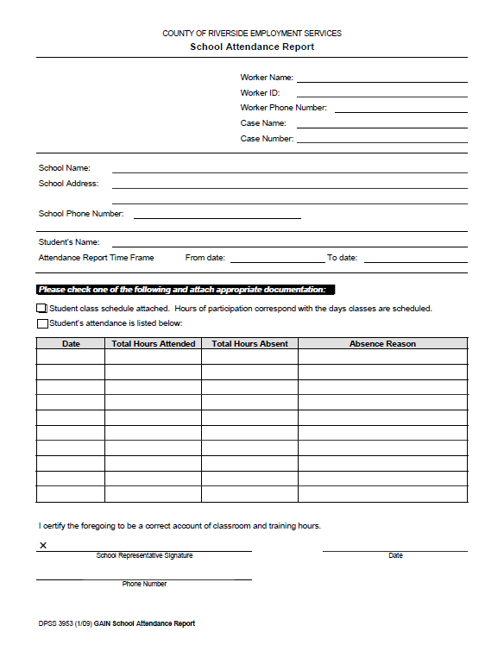
n
Attach Class Schedule
Cal Poly Pomona
3801 W. Temple Ave.
Pomona, CA 91768
(909) 869-3000
*Please See Attached Schedule

Slide 15
Attach Class schedule. If Self Reporting, attach Official Transcript.
Fill out all highlighted sections. Once all information is filled out, please sign and date the form. Make sure to add all other documentation that corresponds with the packet

Slide 16
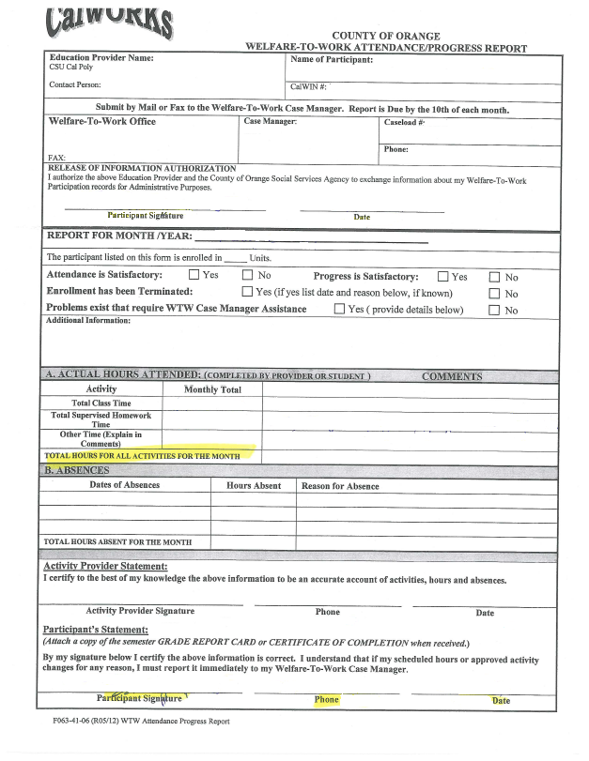
n
Attendance is Satisfactory:
  Yes
Progress is Satisfactory:
  Yes- If grades are posted and are satisfactory, above 2.0.
  No- If you, the student has a disqualification hold.
  Enrollment has been Terminated:
    If you are enrolled in the quarter you are reporting for, you are active, check NO. If you are no enrolled for that quarter, check YES.
Attach Class Schedule. If Self Reporting, also attach unofficial transcript.
This section is filled out by you, the student. If any of the sections are not filled out we will not process your document.
Total Class Time: the amount of hours you complete in class a week multiplied by 4.
Total Supervised Homework time: Do not fill out if you do not have any study hours documented by faculty or staff.
Other Time: This is considered your unsupervised study time. You are allowed to document one hour of study for every hour of lecture time. Multiply times 4. These hours should equal to Total Class Time.
Total Hours For All Activities For The Month: Add both total class time and unsupervised hours and place in this section.
Sign and date at the bottom.

Slide 17
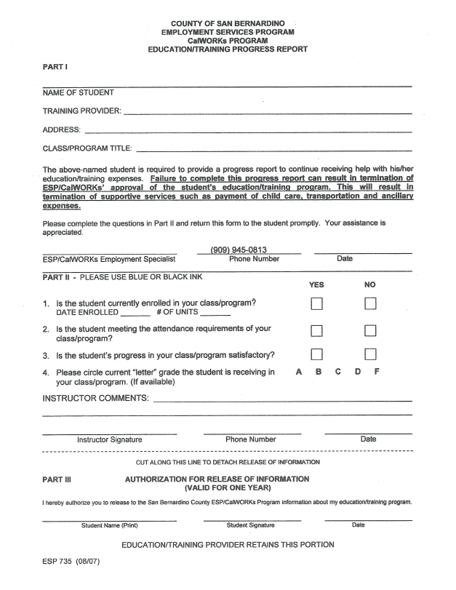
Attach Class Schedule. If Self Reporting also attach Unofficial Transcript.
Training Provider: Cal Poly Pomona
Provider Address: 3801 W. Temple Ave.
Pomona, CA 91768
Class/Program Title: Your Major
Once all information is filled out, please sign and date the form. Make sure to add all other documentation that corresponds with the packet

Slide 18
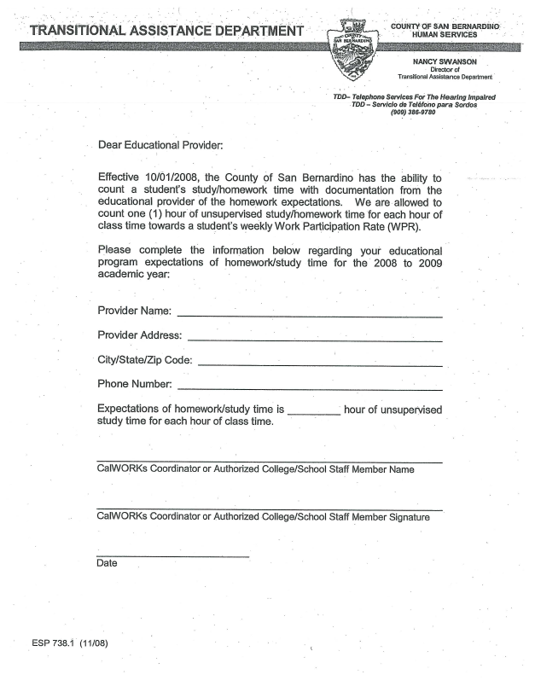
n
Provider Name: Cal Poly Pomona
Provider Address: 3801 W. Temple Ave.
Pomona, CA 91768
Phone Number: (909) 869-3000
Make sure to add your name somewhere visible on the document.

Slide 19
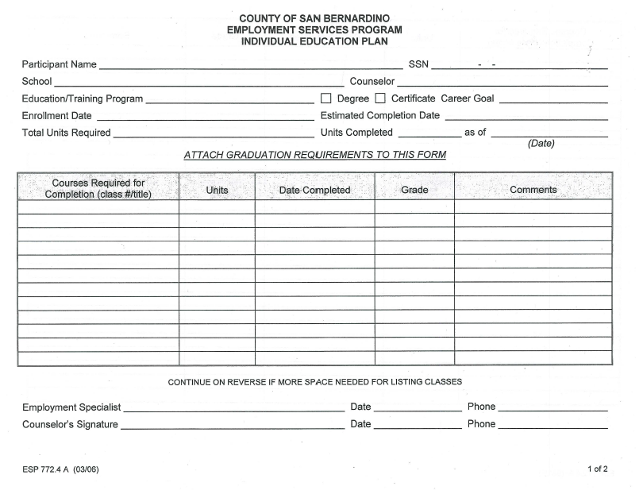
n
These forms must be filled out by your Academic Advisor. You can find your advisor in your Major’s Department.

