Slide 1
Cayuse
Submitting a New IRB Protocol

Slide 2
How to use this tutorial
This tutorial is written in the point of view of a Primary Investigator (PI), if you are not a PI, please know that you will need to adjust a few things.
Use your keyboard’s left/right/up/down arrow (or your mouse/trackpad scroll or the spacebar) to move through the PowerPoint. Instructions are animated.

Slide 3
Before You Begin an IRB Protocol…
Make sure you have the following items ready*:
Supplemental documents in individual document files (i.e. informed consent form(s), authorization(s), recruitment documents, questionnaires, etc.). Files can be in various formats (PDFs, docx) however doc. (Microsoft Word) files are preferred.
Faculty advisor and co-PI(s) CITI training identification number and/or copy of certificate.
Ensure that you and your co-PI(s) have been “authenticated” with the IRB office. If you are unsure, contact the IRB office at irb-office@cpp.edu or visit our website: http://www.cpp.edu/~research/irb/getting-started-with-a-protocol.shtml
*You do not have to finish the IRB protocol in one sitting. All information is saved.

Slide 4
After you have been “authenticated” by the IRB office you may log-in to Cayuse
Copy and paste this link to get to the sign on page: https://cpp.cayuse424.com

Slide 5
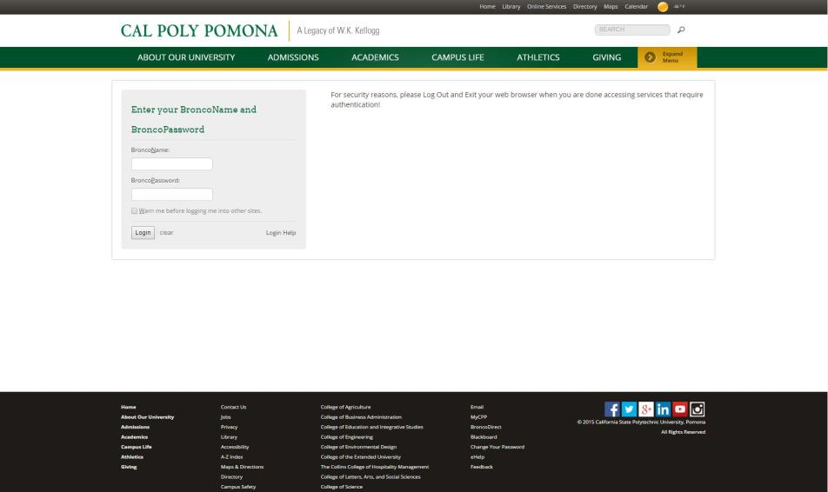
You will be redirected to the Bronco Sign-in page. Use your Bronco Direct credentials

Slide 6
Once logged in, you’re first taken to this page. Click on “Cayuse IRB (Human Studies Compliance)”
Office of Research Compliance v5-2017

Slide 7
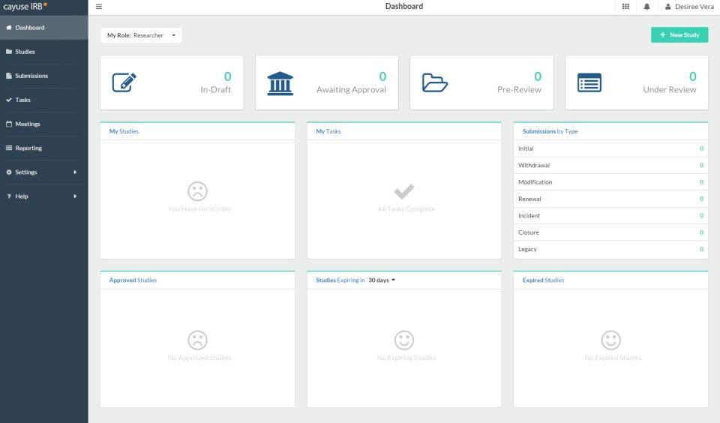
After clicking “Cayuse IRB”, you will be taken to your “Dashboard” where you can see all of your affiliated studies

Slide 8
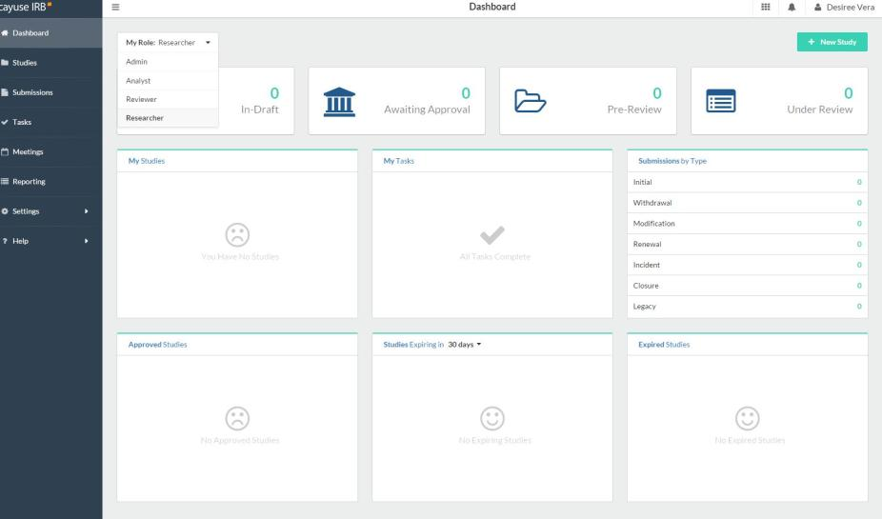
If you are an IRB member, make sure to switch your role to ”Researcher” to submit a new protocol

Slide 9
1. Click on “+ New Study” to begin a new protocol application
2. You will be redirected to another page

Slide 10
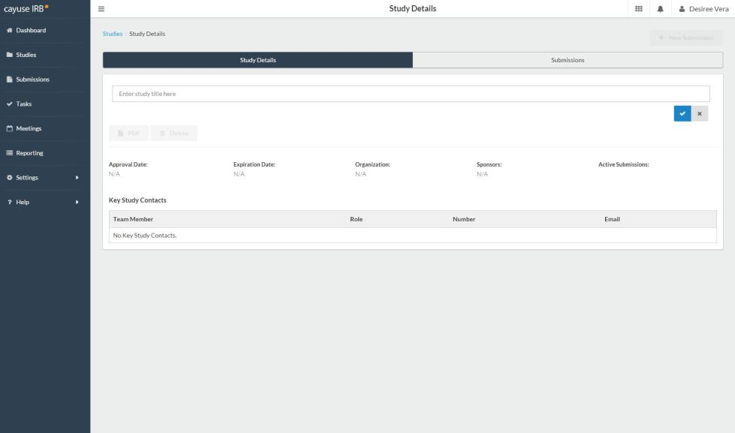
1. Enter the protocol title here
2. Click on the checkmark to move to the next step

Slide 11
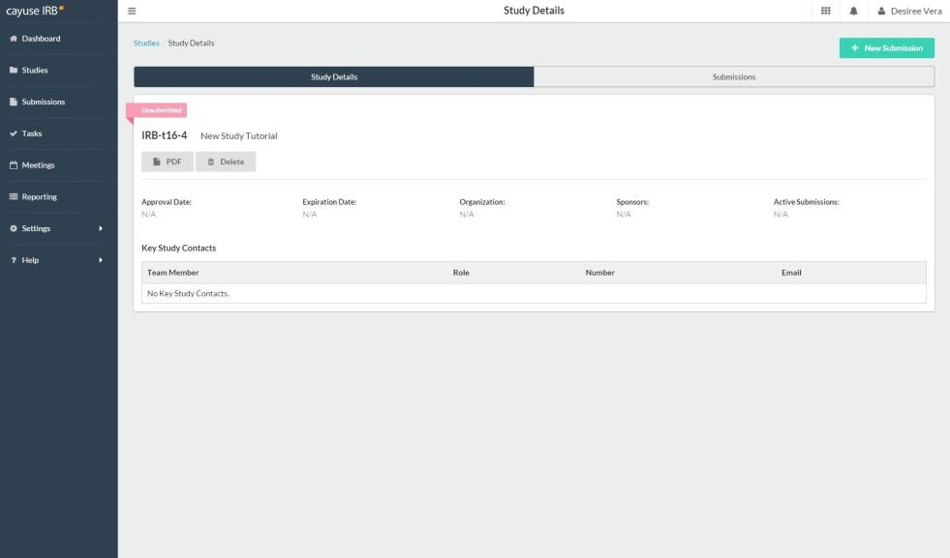
The next step will be to start the IRB protocol. Click “+ New Submission”

Slide 12
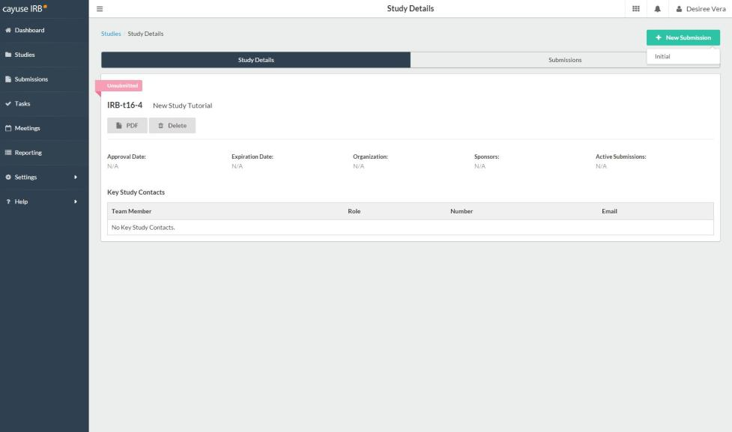
Click on “Initial”

Slide 13
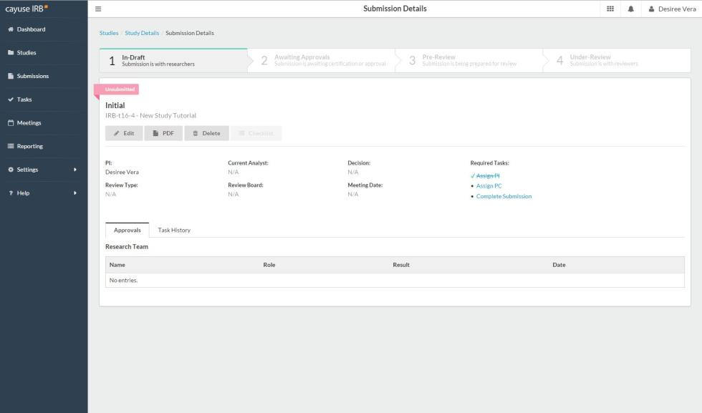
2. Or you can click “Edit” to go directly into the protocol-this is the preferred method.
1. You can check the tasks you need to complete here and you can also click on the tasks to be redirected to that page.

Slide 14
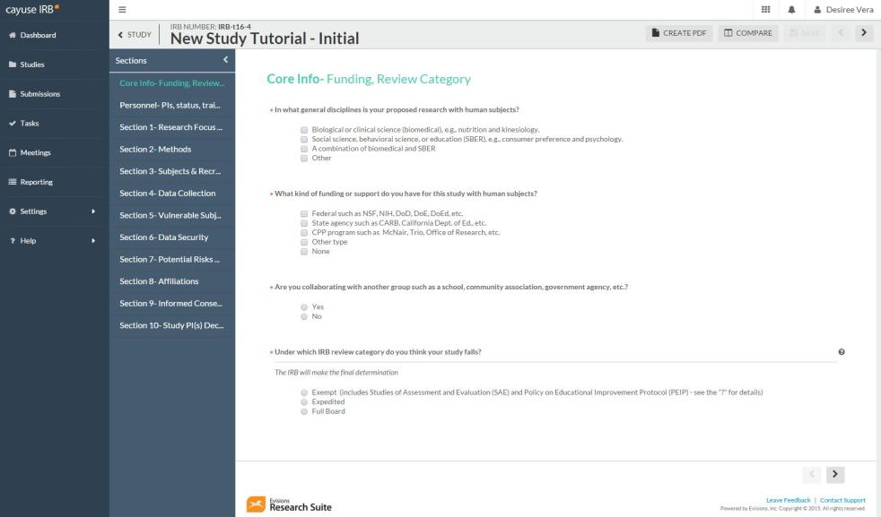
1. Once you click “Edit” or any of your “Tasks”, you will be redirected to the protocol questions.
4. Once a section’s required answers (*)have been answered, a checkmark will appear on the section. All sections must have a checkmark in order to complete final submission.
2. These are the sections of the protocol. You can move through any section by clicking on them and your work will be automatically saved.
3. You can also click on this next button to move through the protocol.

Slide 15
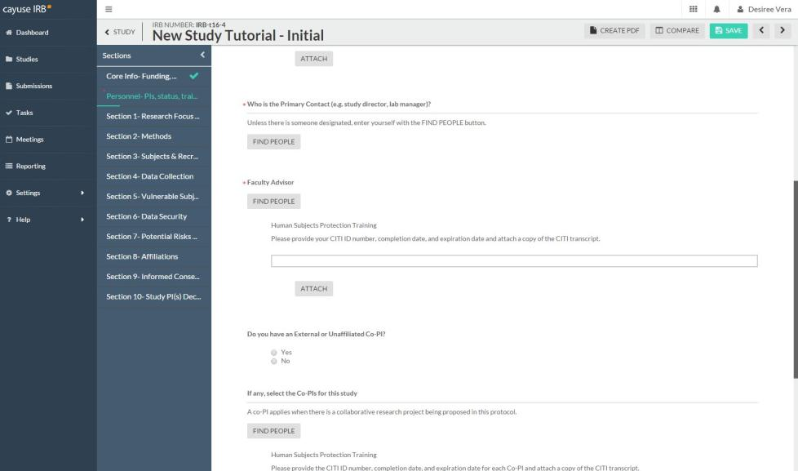
1. For the question “who is the Primary Contact (PC)”, you will enter your name by clicking on the “Find People” button. A small screen will pop up on the screen.

Slide 16
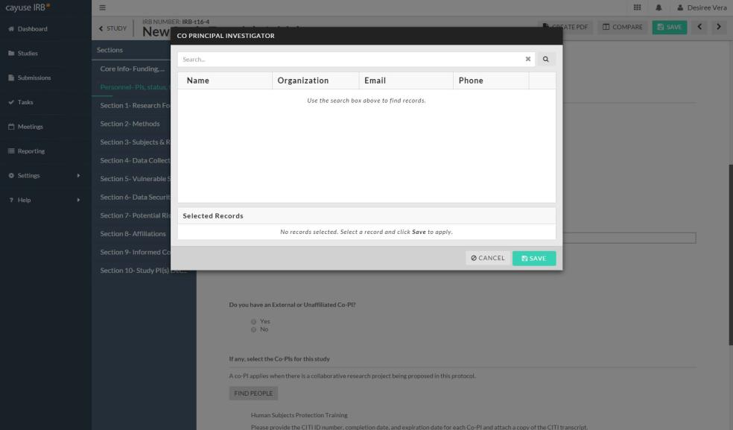
Type in your name and click enter on your keyboard.

Slide 17
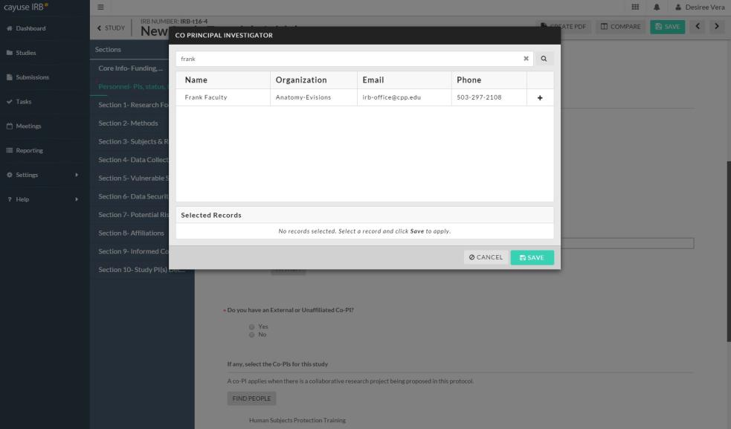
1. Select your name and click “Save”.
2. The same process is needed for faculty advisors and co-PI(s). If you do not find your faculty advisor or co-PI(s) name, please contact the IRB office (irb-office@cpp.edu). They will need to be manually entered into the system which will take 24hrs to become active.

Slide 18
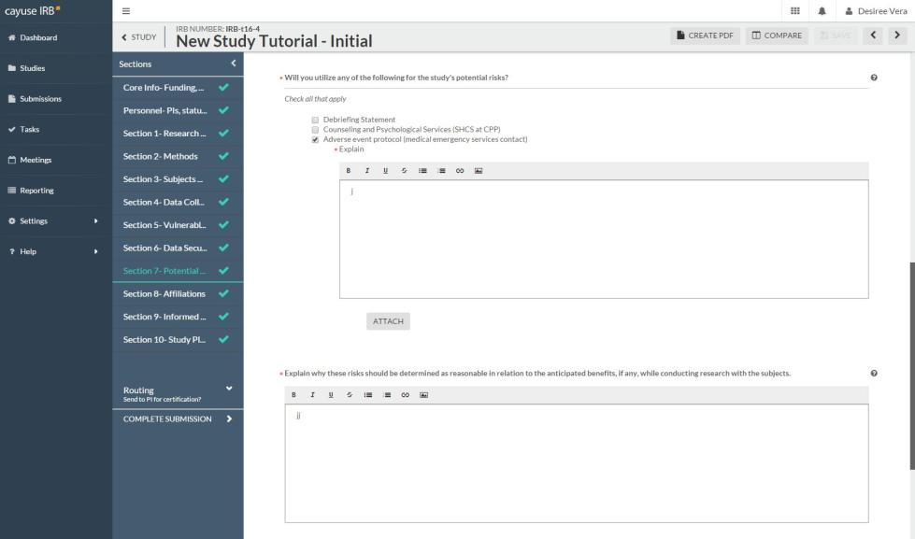
1. Throughout the application you will be asked to attach certain documents
2. Click on “Attach” and a pop up on your screen will appear.

Slide 19
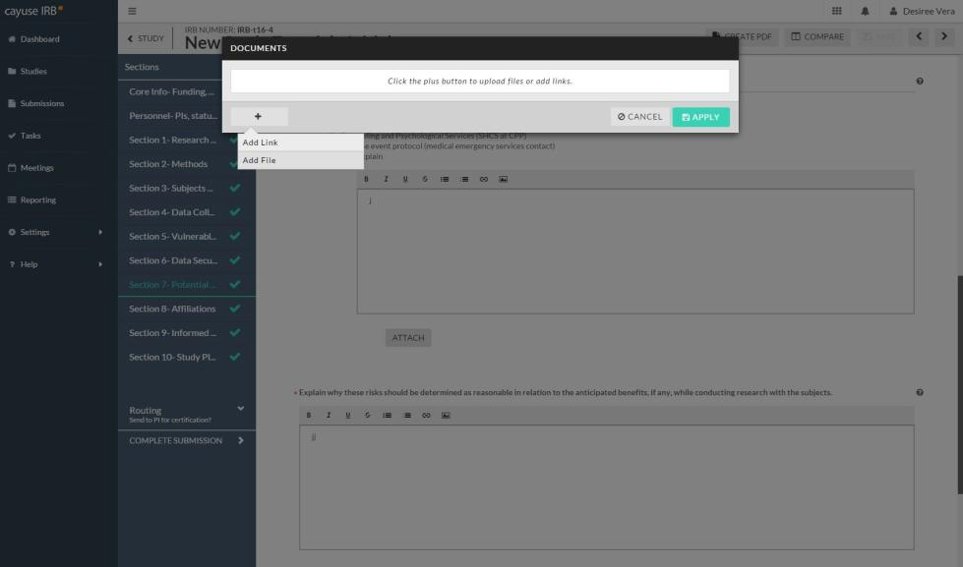
1. Click on the “+” sign to add an attachment.
3. Click “Apply” to attach
2. You can Add Files (Word documents, pdfs, images, etc.) or Add Links

Slide 20
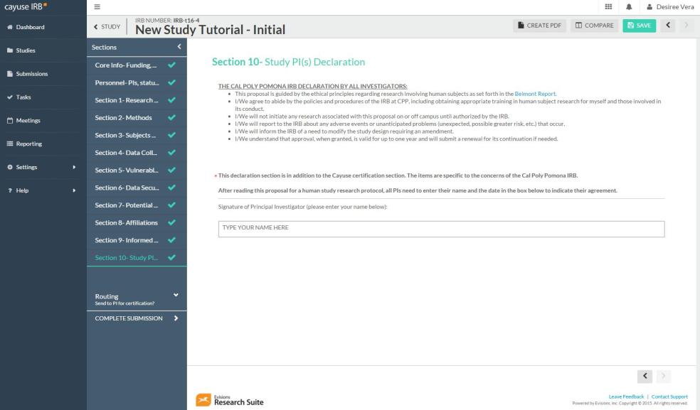
The final section of the application requires you to “sign” after reading the “Declaration”. Please type your name in the box.

Slide 21
2. You can review your application by clicking through the sections or by creating a PDF version of the protocol.
1. Once all of the sections have been completed (all have checkmarks), and you have reviewed your application, you can submit your application.
3. Click on “Complete Submission” when you are ready. You will be redirected to another page.

Slide 22
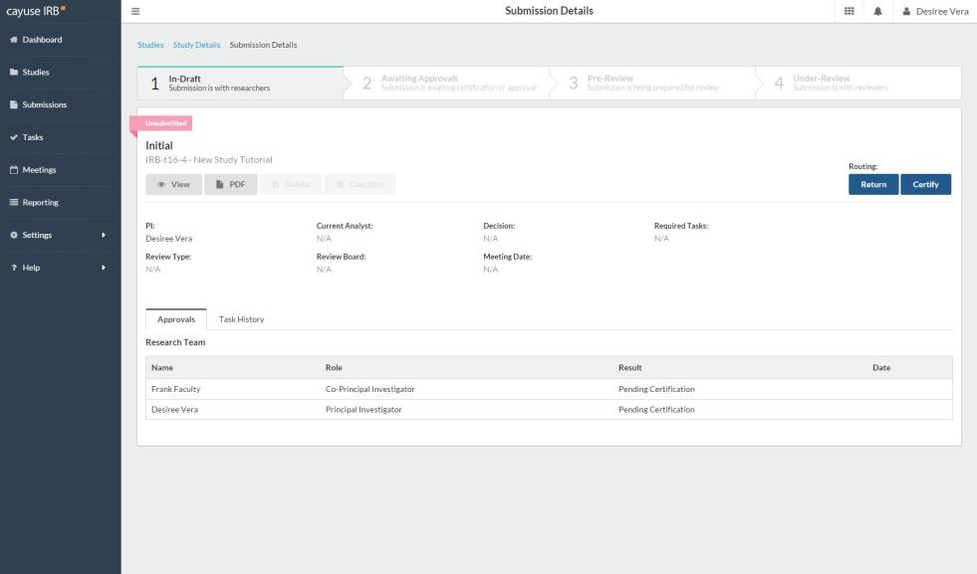
After clicking on the “Complete Submission” button, you will be redirected to this page where you will need to click on “Certify”.
You will need to “Certify” each time you submit revisions, amendments, renewals.

Slide 23
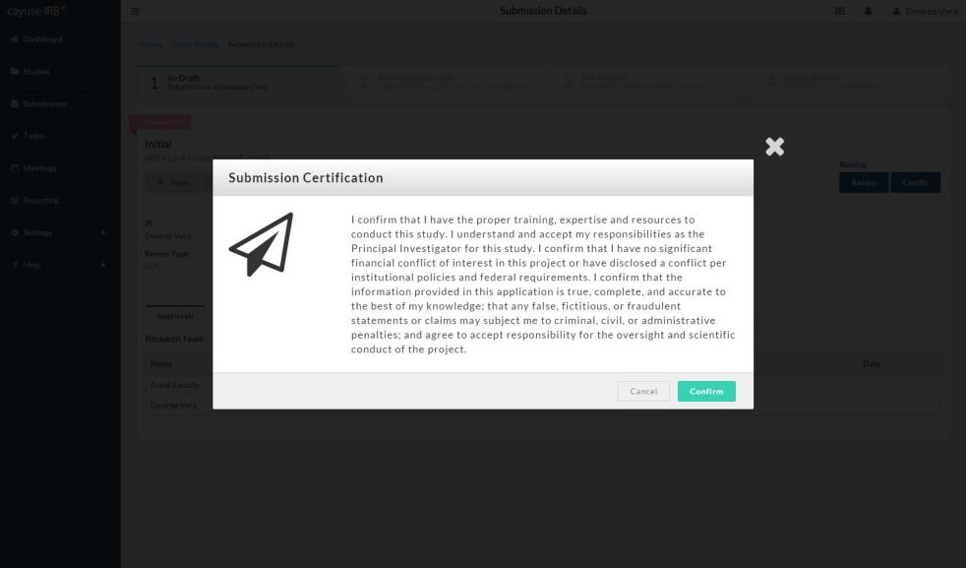
1. Read the Submission Certification and click on “Confirm” if you agree.
2. Selecting “Confirm” will also send your application to the faculty advisor and co-PI(s) that you have listed.

Slide 24
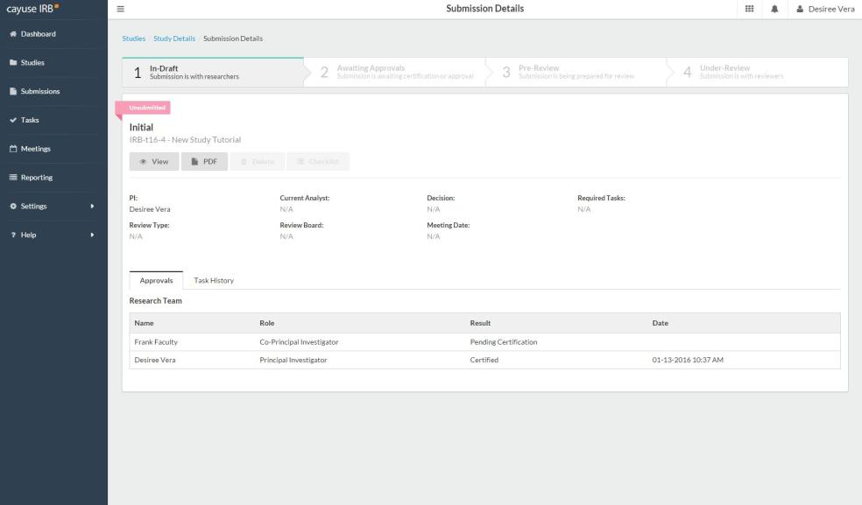
1. Your protocol will remain “Unsubmitted” until your listed faculty advisor or co-PI(s) have logged in and reviewed the application and have “Certified”. They will receive a notification email to do this.
2. Once everyone has “Certified”, the application will be sent to the IRB office to begin the review process.

Slide 25
You can keep track of your studies and where they are in the review process by looking at these sections on your Dashboard.

Slide 26
If you have any issues or questions, please contact the IRB Office: irb-office@cpp.edu or (909) 869-4215 (Maya) and for IRB document examples and links, visit our website at
http://www.cpp.edu/~research/irb/getting-started-with-a-protocol.shtml

