Slide 1
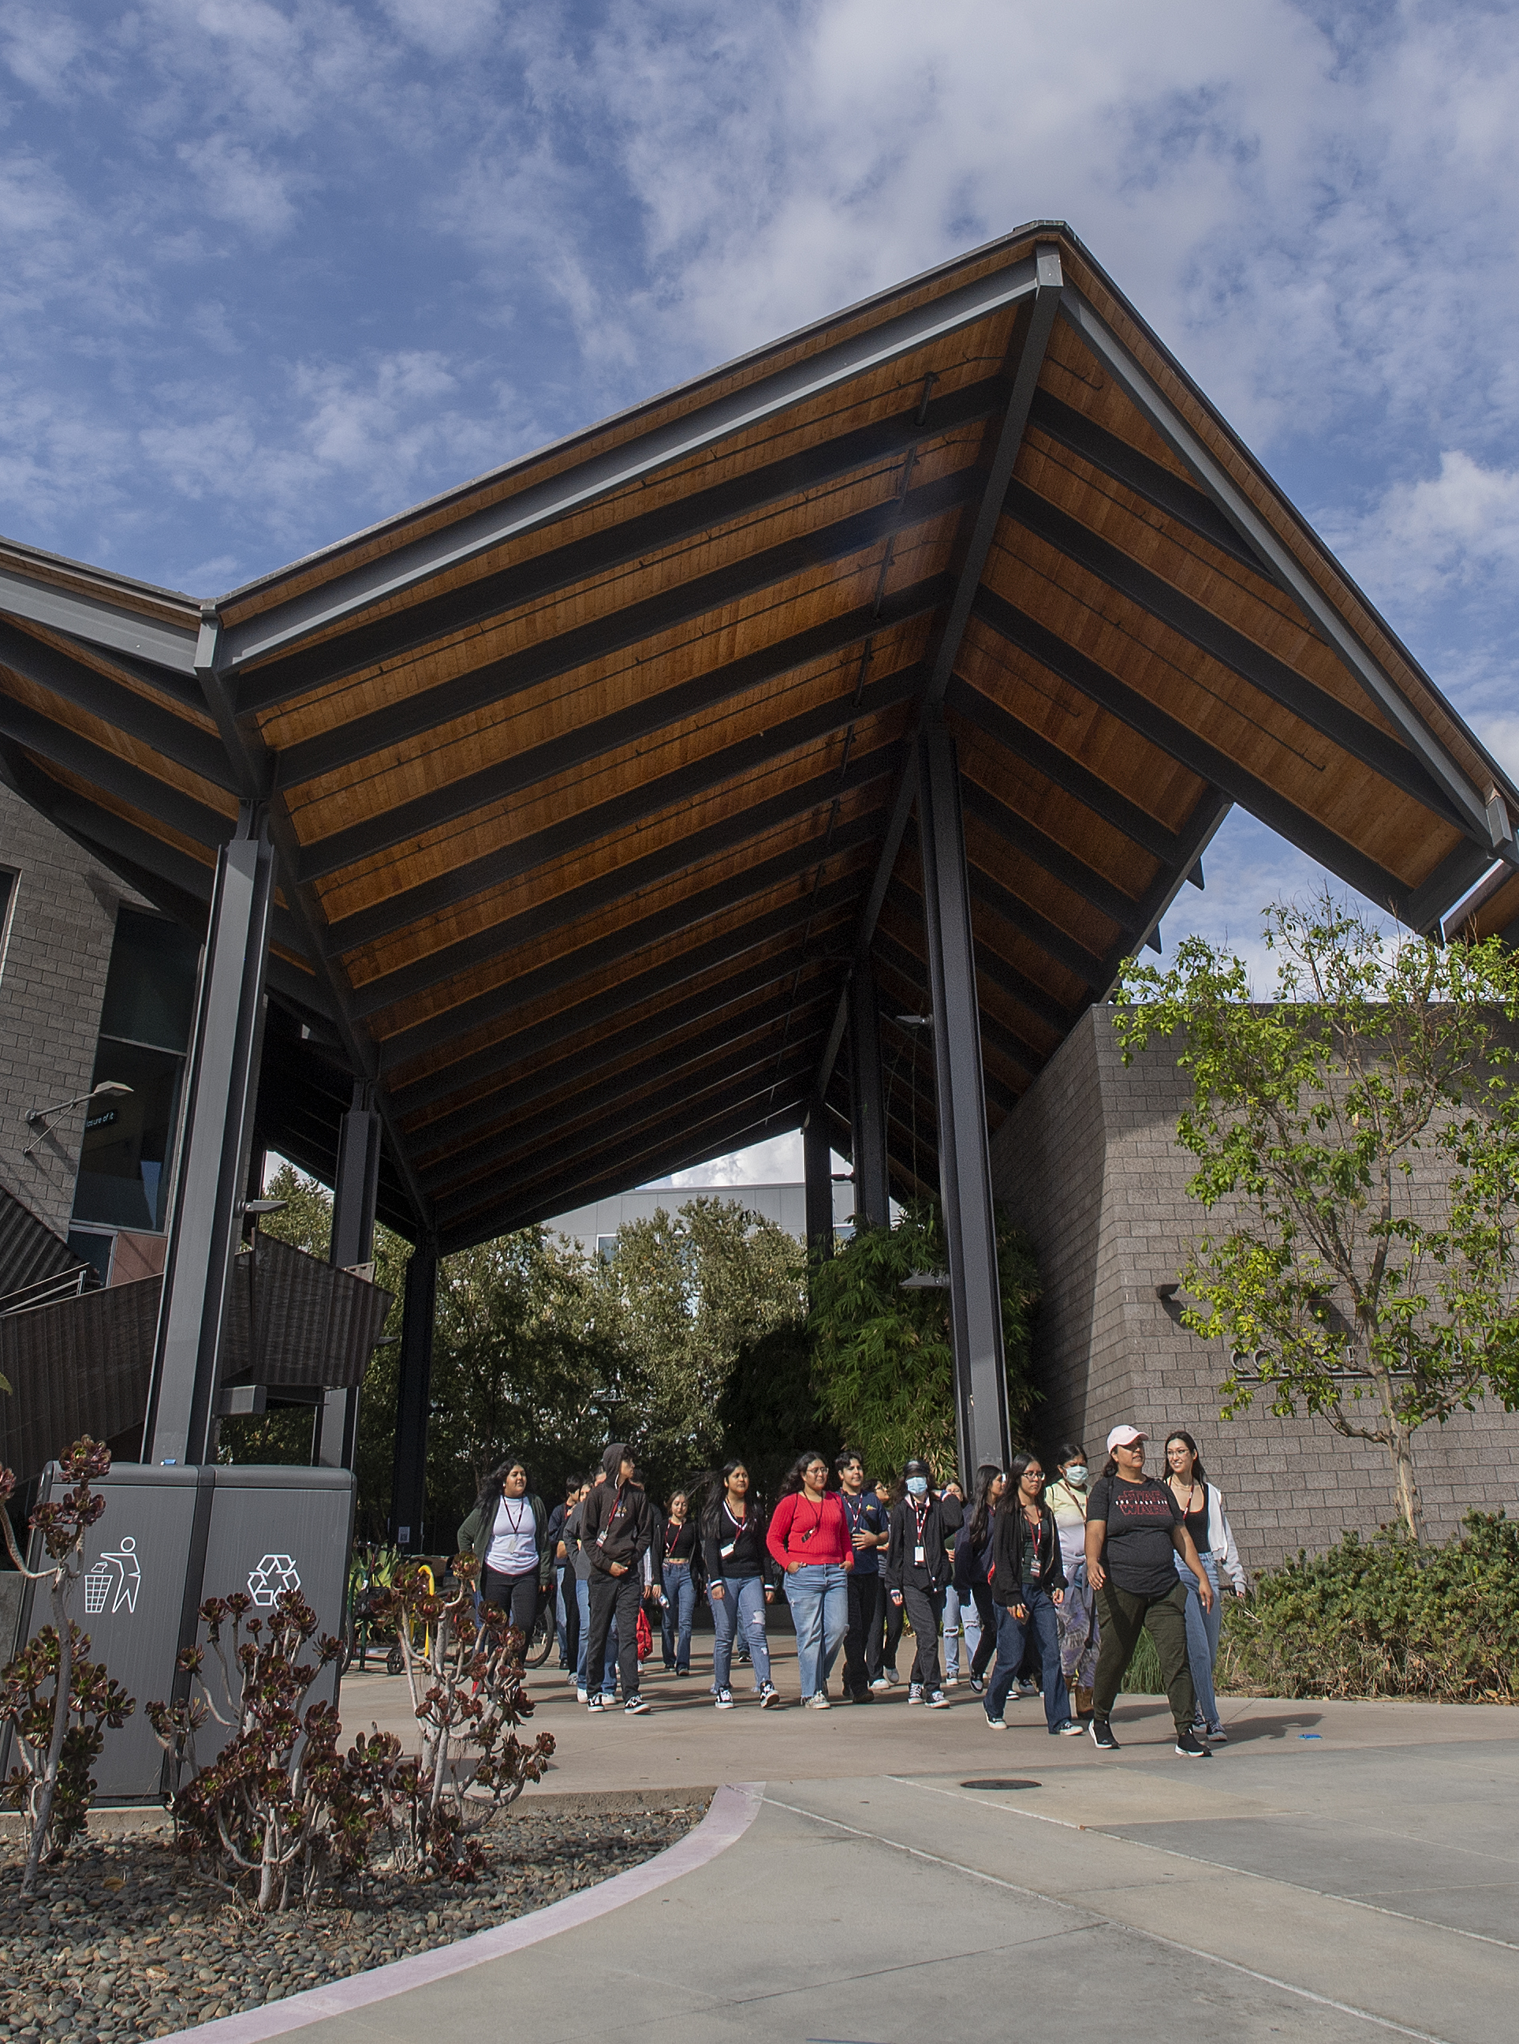

Introduction to IRB Process
Office of Research Compliance
Department of Research and Innovation
September 23, 2025

Slide 2
Agenda
Basis of the IRB
Belmont Report
Federal definitions
IRB structure and Review types
Researcher responsibilities
Faculty advisor and Student PI relationship
Application sections and common pitfalls
Notes:
the IRB’s goal is to protect individuals participating in research by reviewing an investigators protocol application that it upholds ethical standards, regulatory requirements and sound research related to field of studying.

Slide 3
Belmont Report Principals
Respects for persons
Promote autonomy
Protect those with diminished autonomy
Beneficence
Maximize benefits & minimize harm
Justice
Ensure equitable distribution of burden & benefits
Notes:
N ow the Belmont report, an elaborate 3-page document describing the following 3 principles guides the IRB is ensuring individuals are treated as autonomous people
Respect for Persons- individuals are free to make their own decisions of whether to participate in the research or not, based on their own judgement and choices. Also understanding that people with diminished autonomy are entitled to protection. Individuals that are incarcerated, children, or individuals incapacitated by a disability)
Beneficence- The idea of securing someone's well being, it encompasses both individual benefits as well as potential benefits to society ( a favorable risk/benefit assessment)
Justice- There needs to be a fair procedure and outcomes to the selection of the research subjects.

Slide 4
The Cal Poly Pomona IRB
Committees consist of
IRB Chair – Dr. Kellene Isom
IRB Vice Chair – Dr. Greg Placencia
Members – faculty with various backgrounds and expertise, at least one nonscientist and one nonaffiliated member
Notes:
The nonscientist member’s primary concern, is in the non-scientific area; the nonaffiliated/community member provides perspective of values, morals, and life circumstances for that community
The purpose of a diverse membership is to promote respect for the IRB's advice and counsel in safeguarding the rights and welfare of human subjects.
Bonny Burns-Whitmore
Professor, Don B. Huntley College of Agriculture
Nutrition & Food Science Department
Phone: x3793
Email: bburnswhitmo@cpp.edu
Term: November 2025-June 2027
Members:
Anthony Orlando
Associate Professor, College of Business, Finance Real Estate & Law Department
Phone: x unk
Email : aworlando@cpp.edu
Term: Oct 2024- June 2026
Dayna Mitchell
Assistant Professor, College of Education
Phone: 626-222-6051
Email: dlmitchell@cpp.edu
Term: November 2024 – June 2026 (became full June 2025)
Marlo Herrera
Physician Assistant – Student Health Services
Phone: 4000
Email: mherrera@cpp.edu
Term: Jan 2025 – Jan 2028
Deborah S. Klein MSLS AHIP
Medical Librarian (retired)- Unaffiliated
Phone: (909) 625-5510
Email: dsklein@cpp.edu
dkleinclaremont@gmail.com
Term: Oct 2025- Oct 2027
Ericsson Marin
Assistant Professor, College of Science, Computer Science Department
Phone: x unk
Email: santanamarin@cpp.edu
Term: Aug 2025 - June 2027
Kheng Ly-Hoang
Assistant Professor, College of Education
Phone: x 2646
Email: Khengly@cpp.edu
Term: August 2025 – June 2026
Cristina Runnalls (status pending)
Assistant Professor, College of Science, Department of Mathematics
Phone: 909-869-4371
Email: ccrunnalls@cpp.edu
Term: Aug 2025 - June 2027 (letter not sent)
Gabriele Plickert (status pending)
Associate Professor, CLASS, Sociology Department
Phone: 909-869-5531
Email: gplickert@cpp.edu
Term: Aug 2025 – June 2027 (letter not sent)
Alternate:
Soeun Park
Assistant Professor, CLASS
Phone: x 5885
Email: soeunp@cpp.edu
Term: November 2025 – June 2027
Chris Martinez
Community Member- Alternate Unaffiliated
Phone: 909-525-5923
Email: cbm@cpp.edu
moreful88@hotmail.com
Term: October 2025 – Oct 2027
Jeyoung Woo
Associate Professor, College of Engineering, Department of Civil engineering
Phone: 909-869-2471
Email: Jwoo@cpp.edu
Term: Aug 2025 – June 2027

Slide 5
Basic IRB Definitions
Research: a systematic investigation, including research development, testing, and evaluation, designed to develop or contribute to generalizable knowledge.
Generalizable Knowledge: designed to draw general conclusions, inform policy, or generalize findings beyond a single individual or an internal program (e.g., publications or presentations).
Human Subject: means a living individual about whom an investigator (whether professional or student) conducting research:
Obtains information or biospecimens through intervention or interaction with the individual, and uses, studies, or analyzes the information or biospecimens; or
Obtains, uses, studies, analyzes, or generates identifiable private information or identifiable biospecimens.
Take our IRB Determination Survey
Notes:
Include decision tree----- risks, absence of informed consent and risks…
One of the challenges the IRB faces as well as faculty advisors is the assessment of whether the project is considered human subject research to determine if an IRB protocol application submission is necessary as well as to determine whether IRB oversight is necessary.
When is not research? When it is for a classroom project for research training or for program assessment- that will not be published.
This is done by understanding if you the investigator are colleting data from human subjects ( or their private identifiable information) for generalizable knowledge. Considering you may be publishing your work in Bronco Scholar, it is likely your research related activates are considered research, as others may view your published work and continue to build on this gathered data.
It is also important to consider laws, and Cal Poly Pomona policies regarding research related activities.
https://www.cpp.edu/research/research-compliance/irb/docs/cal-poly-hrpp-pp-2018.pdf
*************We advise you keep sufficient documentation of such decisions
Intervention includes both physical procedures by which data are gathered (e.g., venipuncture) and manipulations of the subject or the subject's environment that are performed for research purposes.
Interaction includes communication or interpersonal contact between investigator and subject.
Private information includes information about behavior that occurs in a context in which an individual can reasonably expect that no observation or recording is taking place, and information which has been provided for specific purposes by an individual and which the individual can reasonably expect will not be made public (for example, a medical record). Private information must be individually identifiable (i.e., the identity of the subject is or may readily be ascertained by the investigator or associated with the information) in order for obtaining the information to constitute research involving human subjects.
Generalizable Knowledge: However, research results do not have to be published or presented to qualify the experiment or data gathering as research. The intent to contribute to "generalizable (scholarly) knowledge" makes an experiment or data collection research, regardless of publication.
examples that are not generalizable knowledge:
-Quality assurance/quality improvement projects
-Oral histories and journalism
-Classroom activities
Is it not research
Is it not human subject research

Slide 6
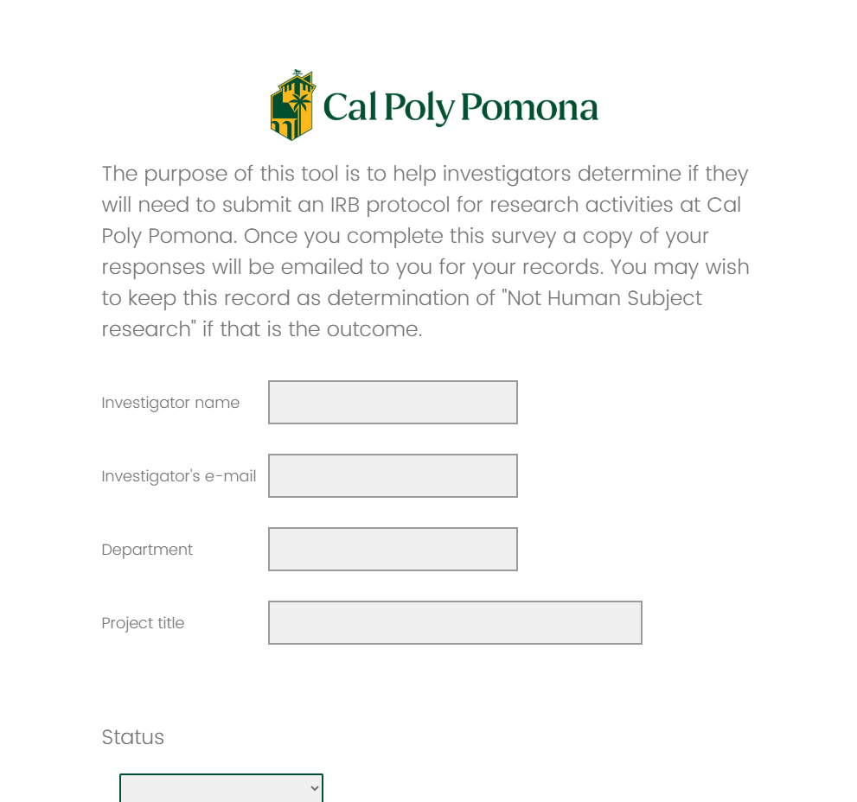
IRB Determination Survey
Not sure if you’re research is Human Subject Research and if it requires IRB oversight?
Take our IRB Determination Survey
Note: The accuracy of the survey results will depend on the honesty and completeness of your responses.
Notes:
Include decision tree----- risks, absence of informed consent and risks…
One of the challenges the IRB faces as well as faculty advisors is the assessment of whether the project is considered human subject research to determine if an IRB protocol application submission is necessary as well as to determine whether IRB oversight is necessary.
When is not research? When it is for a classroom project for research training or for program assessment- that will not be published.
This is done by understanding if you the investigator are colleting data from human subjects ( or their private identifiable information) for generalizable knowledge. Considering you may be publishing your work in Bronco Scholar, it is likely your research related activates are considered research, as others may view your published work and continue to build on this gathered data.
It is also important to consider laws, and Cal Poly Pomona policies regarding research related activities.
https://www.cpp.edu/research/research-compliance/irb/docs/cal-poly-hrpp-pp-2018.pdf
*************We advise you keep sufficient documentation of such decisions
Intervention includes both physical procedures by which data are gathered (e.g., venipuncture) and manipulations of the subject or the subject's environment that are performed for research purposes.
Interaction includes communication or interpersonal contact between investigator and subject.
Private information includes information about behavior that occurs in a context in which an individual can reasonably expect that no observation or recording is taking place, and information which has been provided for specific purposes by an individual and which the individual can reasonably expect will not be made public (for example, a medical record). Private information must be individually identifiable (i.e., the identity of the subject is or may readily be ascertained by the investigator or associated with the information) in order for obtaining the information to constitute research involving human subjects.
Generalizable Knowledge: However, research results do not have to be published or presented to qualify the experiment or data gathering as research. The intent to contribute to "generalizable (scholarly) knowledge" makes an experiment or data collection research, regardless of publication.
examples that are not generalizable knowledge:
-Quality assurance/quality improvement projects
-Oral histories and journalism
-Classroom activities
Is it not research
Is it not human subject research

Slide 7
Minimal risk means that the probability and magnitude of harm or discomfort anticipated in the research are not greater in and of themselves than those ordinarily encountered in daily life or during the performance of routine physical or psychological examinations or tests
Notes:
The federal regulations define “minimal risk” as: “the probability and magnitude of harm or discomfort anticipated in the research are not greater in and of themselves than those ordinarily encountered in daily life or during the performance of routine physical or psychological examinations or tests.”
“Minimal risk” is a term used in the federal regulations for human subject's research and it has become the threshold for identifying studies that require more careful scrutiny (fullboard review), identifying studies that do not need lengthy reviews (expedited review), and identifying studies that do not need review (exempt review).
Expedited review - the process of reviewing a protocol by (usually) one or two members of the IRB because the study has potentially minimal risk to the human subjects. Expedited does not necessarily mean a rapid review, though it usually requires less time to complete than a full review. What constitutes expedited review is extensively defined by federal regulation.
Exempt review - the process of determining, by the IRB office , that a protocol is not subject to either expedited review or full review, as defined in regulations and further in this document. Protocol applications with surveys that collect data in an anonymous fashion are often reviewed by the exempt method. Note: this determination is based on interpretation of federal guidelines by IRB administrators.
Some groups that may need special protections or considerations are:
Pregnant women
Human fetuses
Neonates
Prisoners
Children
Individuals with physical disabilities
Individuals with mental disabilities or cognitive impairments
Economically disadvantaged
Socially disadvantaged
Terminally ill or very sick
Racial or ethnic minorities
Institutionalized persons (for example, persons in correctional facilities, nursing homes or mental health facilities)
Incidental participation from certain groups (prisoners, pregnant people) may still qualify for exempt or expedited review

Slide 8
Protocol Review Types
Exempt
less than minimal risk
Usually anonymous or unidentifiable surveys or interviews
1-2 weeks
Expedited
Less or greater than minimal risk
Collection of data from voice, video
3-6 weeks
Full board
Present more than minimal risks to subjects
Studies involving prisoners, pregnant people, minors, persons with undocumented status, research on illegal activities, incarcerated youth, among others
> 1 month
Notes:
The federal regulations define “minimal risk” as: “the probability and magnitude of harm or discomfort anticipated in the research are not greater in and of themselves than those ordinarily encountered in daily life or during the performance of routine physical or psychological examinations or tests.”
“Minimal risk” is a term used in the federal regulations for human subject's research and it has become the threshold for identifying studies that require more careful scrutiny (fullboard review), identifying studies that do not need lengthy reviews (expedited review), and identifying studies that do not need review (exempt review).
Expedited review - the process of reviewing a protocol by (usually) one or two members of the IRB because the study has potentially minimal risk to the human subjects. Expedited does not necessarily mean a rapid review, though it usually requires less time to complete than a full review. What constitutes expedited review is extensively defined by federal regulation.
Exempt review - the process of determining, by the IRB office , that a protocol is not subject to either expedited review or full review, as defined in regulations and further in this document. Protocol applications with surveys that collect data in an anonymous fashion are often reviewed by the exempt method. Note: this determination is based on interpretation of federal guidelines by IRB administrators.
Some groups that may need special protections or considerations are:
Pregnant women
Human fetuses
Neonates
Prisoners
Children
Individuals with physical disabilities
Individuals with mental disabilities or cognitive impairments
Economically disadvantaged
Socially disadvantaged
Terminally ill or very sick
Racial or ethnic minorities
Institutionalized persons (for example, persons in correctional facilities, nursing homes or mental health facilities)
Incidental participation from certain groups (prisoners, pregnant people) may still qualify for exempt or expedited review

Slide 9
Researcher Responsibility
Notes:
Encourage research participation
Conduct yourself with integrity
Follow University policy and sponsor conditions
Have a growth mindset…..
Benefits of doing research, how that leads to higher graduation rates, share that this is the process for graduate students.
Who know how to start, no one, really… It is all procedural based on a collaboration per field… It is going to he hard, that is ok, it will make you better and stronger

Slide 10
Faculty Advisor and Student Investigator
Faculty Advisor
Qualified by education, training, and/or experience
Recent familiarity and experience with the topic of study
Student Investigator
Getting started with a new protocol ( Faculty Information Sheet)
You and your Co-PI (faculty advisor) should work together to ensure the submission is methodologically sound, accurate, and complete.
Both should have required CITI training:
CPP - Introduction to Human Subjects 101 or
CEIS Mandated Social Science Research
Notes:
When student researchers begin to understand their responsibilities, ethical standards and academic expectations of their culminating project, the advising and mentoring experience is essential, it is an important part of your research success.
IRB Investigator- In the case of a student submitting a protocol as a PI, there must be a responsible RI listed as the co-PI. The IRB recognizes one Responsible Investigator (RI) for each study, who has ultimate responsibility for the research activities. Studies that require skills beyond those held by the co-pi must be modified to meet the investigator's skills or have one or more additional qualified faculty as co-investigator(s).

Slide 11
IRB protocol Application Sections
Research and focus Methods Subjects and Recruitment Data Collection Vulnerable subjects | 6. Data Security 7. Potential Risks 8. Affiliations 9. Informed Consent & Assent Forms 10. Study Declaration
Note: For a successful submission ensure completeness & consistency across all sections.
Notes:
***********************************
The IRB application is an online form that any member assigned as PI/ PC ( primary contact)- Each study must have a assigned Primary Contact as well as a PI. Like other research team members, the PC can work on a submission, but all submissions must be certified by the PI before it is submitted to the IRB office. Faculty/staff members leading a research study can be both the PI and the PC
Research and focus
Methods (understanding their research design and what kind of quantitative, qualitative, or mixed design are they using)
Subjects and Recruitment
Data Collection
Vulnerable subjects
6. Data Security (All data collection and storage devices must be password protected, Non-University devices for use in research should have up-to-date antivirus protection software, Identifiers or keys should be placed in a separate, password-protected or encrypted file, No protected health information or highly sensitive information should be transmitted via email (Examples can include proprietary information, data that is subject to confidentiality requirements, and information with national security implications), the PI must plan for regular back-ups of data in an encrypted format)
7. Potential Risks
8. Affiliations
9. Informed Consent & Assent Forms
10. Study Declaration
All Study related documents.
Consent forms (if applicable)
Recruitment materials (if applicable)
Data collection instruments (surveys, interview questions, participant experiment instructions, etc.)
Other documents such as site approvals, and.

Slide 12
IRB Protocol Application – Section 1 Research Focus
Purpose of the research
Relevance to previous or current scholarly investigations
End GOAL?
Notes:
Common Pitfalls in Research focus section include
Missing references/ lit review to previous or current research in your field of study
Common Pitfalls in Methods section include
What kind of quantitative, qualitative, or mixed design are you using, for example, experimental randomized treatment, correlation, quasi-experimental, case study, etc.? What are the independent variables, interventions, treatments,
For the step-by-step outline think about What events will occur and in what order? How will the information about the study be presented to the participants? Describe it so that the IRB reviewer will understand your research plan.
Remember that obtaining IRB approval is usually step 0 -

Slide 13
IRB Protocol Application - Section 2 Methods
Summarize the overall design of your study
What kind of quantitative, qualitative, or mixed design are you using, for example, experimental randomized treatment, correlation, quasi-experimental, case study, etc.? What are the independent variables, interventions, treatments, etc.?
Provide a step-by-step outline of the activities included in this study
Example:
Step 1: Obtain IRB Approval
Step 2: Post recruitment flyers on bulleting boards
Step 3: Consent participants
Step 4: Experimental procedures/record with survey/audio/include provisions to minimize risks
Step 5: Analyze data using X-method
Step X: you get the idea….
Notes:
Common Pitfalls in Research focus section include
Missing references/ lit review to previous or current research in your field of study
Common Pitfalls in Methods section include
What kind of quantitative, qualitative, or mixed design are you using, for example, experimental randomized treatment, correlation, quasi-experimental, case study, etc.? What are the independent variables, interventions, treatments,
For the step-by-step outline think about What events will occur and in what order? How will the information about the study be presented to the participants? Describe it so that the IRB reviewer will understand your research plan.
Remember that obtaining IRB approval is usually step 0 -

Slide 14
IRB Protocol Application - Section 3 Subject Recruitment
A human subject is a living individual about whom an investigator (whether professional or student) conducting research obtains data through intervention or interaction with the individual or identifiable private information. (Dept. of Health and Human Services, 45 CFR 46)
Describe the characteristics of the subject group(s) that will be used in the study.
Participants in the study will include Indigenous people, activists, residents, who are 18 years old or older.
IRB will need to abide by federal regulations
FERPA
HIPPA
Notes:
Common Pitfalls in subjects and recruitment section include
Recruitment flyers _ ensure the approval statement is added, purpose, time commitment, eligibility, risks and benefits, compensation, and no coercive language ( make sure it is voluntary)
Recruitment is research activity and cannot begin before approval is obtained.
Ancillary approvals
Some projects involve activities that require specialized review outside of the IRB
Research Site Authorizations
Departmental Access to Data
Registrars' office-
FERPA
FERPA (Family Educational Rights and Privacy Act) is a federal law that regulates the disclosure of personally identifiable information- from student education records. Research that involves collecting data in schools and/or accessing information from education records are subject to laws that impact data access, collection procedures, and limit the IRB's ability to waive consent. With a few narrow exceptions, FERPA broadly defines "education records" to mean records that are directly related to a student and maintained by an educational agency or institution or by a party acting for the agency or institution.
Be very specific about what data you are requesting to the IRB and to the registrar (e.g., instead of a generic response such as ‘academic record’, list all items you will collect: GPAs and cumulative GPAs, students’ academic transcript, course and grade history, gender identity, ethnicity, etc.)

Slide 15
IRB Protocol Application - Section 4 Data Collection
Describe the data you will collect
Quantitative vs qualitative data, mixed methods
Indicate the methods you will use to collect data from participants
Paper survey/questionnaires, electronic survey/questionnaires, interview, audio/visual recording, bio-specimens
Resources: CPP Qualtrics, CPP Microsoft forms
Explain where research will be conducted and provide necessary site authorizations
Notes:
Common Pitfalls in subjects and recruitment section include
Recruitment flyers _ ensure the approval statement is added, purpose, time commitment, eligibility, risks and benefits, compensation, and no coercive language ( make sure it is voluntary)
Recruitment is research activity and cannot begin before approval is obtained.
Ancillary approvals
Some projects involve activities that require specialized review outside of the IRB
Research Site Authorizations
Departmental Access to Data
Registrars' office-
FERPA
FERPA (Family Educational Rights and Privacy Act) is a federal law that regulates the disclosure of personally identifiable information- from student education records. Research that involves collecting data in schools and/or accessing information from education records are subject to laws that impact data access, collection procedures, and limit the IRB's ability to waive consent. With a few narrow exceptions, FERPA broadly defines "education records" to mean records that are directly related to a student and maintained by an educational agency or institution or by a party acting for the agency or institution.
Be very specific about what data you are requesting to the IRB and to the registrar (e.g., instead of a generic response such as ‘academic record’, list all items you will collect: GPAs and cumulative GPAs, students’ academic transcript, course and grade history, gender identity, ethnicity, etc.)

Slide 16
IRB Protocol Application - Section 5 Vulnerable Populations
Indicate whether you will be working with vulnerable populations
Children, prisoners, pregnant women, undocumented status, socially/economically vulnerable, illegal activities, & others
Will have to explain PIs experience & training working with vulnerable population
Notes:
Incidental participation of pregnant women or certain vulnerable people is okay because that cannot be controlled.
Common Pitfalls in subjects and recruitment section include
Recruitment flyers _ ensure the approval statement is added, purpose, time commitment, eligibility, risks and benefits, compensation, and no coercive language ( make sure it is voluntary)
Recruitment is research activity and cannot begin before approval is obtained.
Ancillary approvals
Some projects involve activities that require specialized review outside of the IRB
Research Site Authorizations
Departmental Access to Data
Registrars' office-
FERPA
FERPA (Family Educational Rights and Privacy Act) is a federal law that regulates the disclosure of personally identifiable information- from student education records. Research that involves collecting data in schools and/or accessing information from education records are subject to laws that impact data access, collection procedures, and limit the IRB's ability to waive consent. With a few narrow exceptions, FERPA broadly defines "education records" to mean records that are directly related to a student and maintained by an educational agency or institution or by a party acting for the agency or institution.
Be very specific about what data you are requesting to the IRB and to the registrar (e.g., instead of a generic response such as ‘academic record’, list all items you will collect: GPAs and cumulative GPAs, students’ academic transcript, course and grade history, gender identity, ethnicity, etc.)

Slide 17
IRB Protocol Application - Section 6 Data Security
The researcher must provide a plan sufficient to protect personal information from improper use and disclosures. The CPP IRB often recommends storing data on CPP OneDrive due to the technical safeguards it assures.
Confidential: research participation means that the data from the research subject(s) can potentially be identified or linked to a particular individual. Thus, any data collected face-to-face (consumer survey, focus groups, standing in front of a classroom, collecting IP addresses, etc.) is automatically considered in the category of being “confidential”
A strictly anonymous study design is one in which it is impossible to trace data or information back to the research subject from whom it was obtained. In other words, the data cannot be identified to any research participant, not even by the researcher.
Notes:
Common Pitfalls in Research focus section include
Data security Plan: include sufficient administrative, physical, and technical safeguards to protect personal information from reasonable anticipated threats to the security or confidentiality of the information.
CPP OneDrive: is the institution approved cloud-based services to store confidential data since it has firewall, encryption, and double authentication.
Qualtrics and Microsoft forms
“Confidential” research participation means that the data from the research subject(s) can potentially be identified or linked to a particular individual. Thus, any data collected face-to-face (consumer survey, focus groups, standing in front of a classroom, collecting IP addresses, etc.) is automatically considered in the category of being “confidential”
A “strictly anonymous” study design is one in which it is impossible to trace data or information back to the research subject from whom it was obtained. In other words, the data cannot be identified to any research participant, not even by the researcher.

Slide 18
IRB Protocol Application - Section 7 Potential Risks
Minimal risk means that the probability and magnitude of harm or discomfort anticipated in the research are not greater in and of themselves than those ordinarily encountered in daily life or during the performance of routine physical or psychological examinations or tests
All studies have some risk even if they are just minimal risks.
Notes:
Common Misconception is that the is NO risk in a research study. There is always some risk to anything.
Goes back to the basics, think about the risks, no matter how small in your study. This could include: sitting for certain amount of time, how likely are the question to cause emotional distress or even slight discomfort? If the data were to be mishandled, what social, professional, financial, legal (etc) consequences might there be?
Will they be ingesting any food? Think about safety and food handling. Will they be wearing any devices?

Slide 19
IRB Protocol Application - Section 8 Affiliation
Disclose any pre-existing relationships with subjects (participants) or institutions involved in conducting study
Describe mitigation strategy to minimize undue influence/pressure on potential subjects
Notes:
Disclose on consent forms, no benefits where people would be missing out on.
Common Misconception is that the is NO risk in a research study. There is always some risk to anything.
Goes back to the basics, think about the risks, no matter how small in your study. This could include: sitting for certain amount of time, how likely are the question to cause emotional distress or even slight discomfort? If the data were to be mishandled, what social, professional, financial, legal (etc) consequences might there be?
Will they be ingesting any food? Think about safety and food handling. Will they be wearing any devices?

Slide 20
IRB Protocol Application - Section 9 Elements of Informed Consent
Explanation of the purpose(s)
Description of the procedure(s)
Summary of the data to be collected
Description of any foreseeable risks/ discomforts
Description of the benefits to the subject/ including compensation.
Explanation of how the investigator (PI) will maintain confidentiality of records.
Contact information of all PI’s and the IRB office, protocol number
A statement that participation is voluntary, that refusal to participate involves no penalty and that the subject may discontinue at anytime.
Anything else that will help the subject to understand.
Notes:
Background
ICF: This document is an agreement made with human participants that outlines every relevant aspect that is required to make an informed decisions (respects for person)

Slide 21
Submission Timeline
Pre-Review (Administrative Review)
Comments and Revisions
5 – 15 days
Under Review (IRB Member Review)
Comments and Revisions
10 – 15 days (longer if its full-board)
Notes:
Background
ICF: This document is an agreement made with human participants that outlines every relevant aspect that is required to make an informed decisions (respects for person)

Slide 22
Resources
IRB Determination Survey: https://cpp.az1.qualtrics.com/jfe/form/SV_1S7kWiKsqOpS2ma
Subject Librarians: https://www.cpp.edu/library/reference-instruction/contact-subject-librarian.shtml
https://libguides.library.cpp.edu/datamgmt
Library Calendar: https://cpp.libcal.com/
Writing Center: https://www.cpp.edu/lrc/our-team/writing-center.shtml
Bronco Scholar
FAQ's: https://www.cpp.edu/library/digital-collections/bronco-scholarworks/faq.shtml
Qualtrics: https://www.cpp.edu/cba/customer-insights-lab/resources/qualtrics.shtml
Notes:
Common Pitfalls in Research focus section include
* Missing

Slide 23
Resources
More information:
Human subject research: https://www.cpp.edu/research/research-compliance/index.shtml
IRB protocol application process: https://www.cpp.edu/research/research-compliance/irb/protocol.shtml
www.hhs.gov/ohrp/
CITI: https://about.citiprogram.org/
CITI Registration tutorial: https://www.cpp.edu/research/documents/citi-registration-2023.pdf
Cayuse: https://cpp.cayuse424.com/
Members of the IRB - Your college or discipline representative
Notes:
Common Pitfalls in Research focus section include
* Missing

Slide 24
Questions?
IRB Office Contact Information:
IRB Office: IRB-Office@cpp.edu
Ruth Ramirez
Research Compliance Specialist
ruthramirez@cpp.edu | ext. 3771
Elizabeth Mendoza
Research Compliance Officer
emendoza7@cpp.edu | ext. 3713

