Slide 1
Communicating in scientific ways Lesson
How Do Scientists Think and Talk Together?

Slide 2
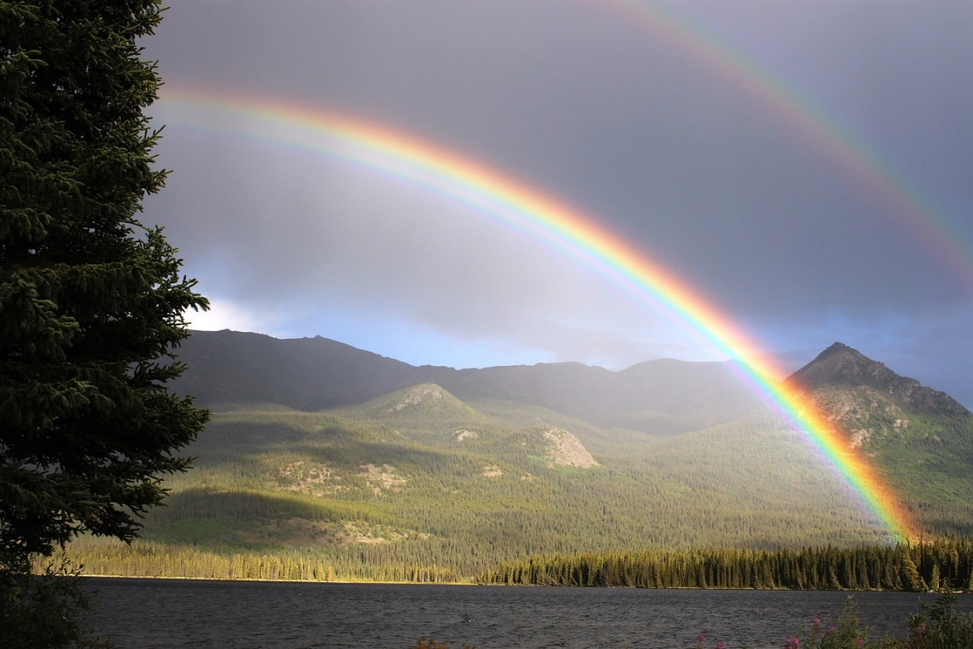
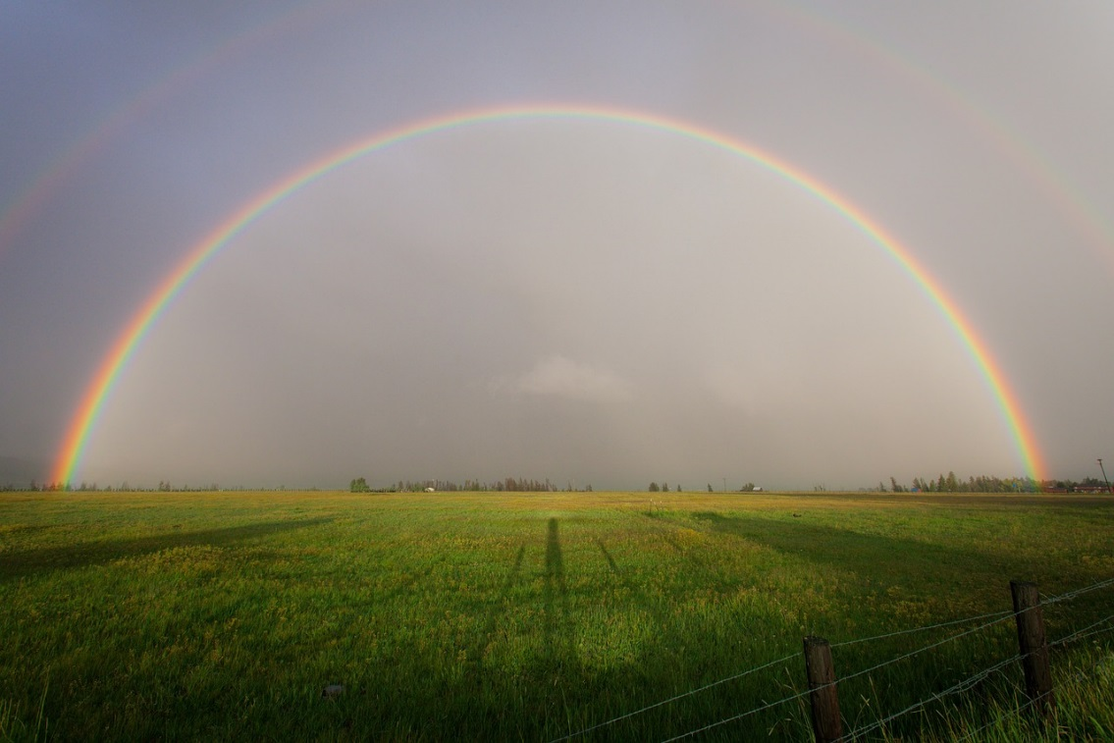
Talking Scientifically about Rainbows
Photo courtesy of Pixabay.com
Photo courtesy of Pixabay.com
Notes:
Public domain—no attribution required.
https://pixabay.com/en/rainbow-rain-arch-palmer-lake-436171/
https://pixabay.com/en/nature-landscape-plains-farm-grass-2609018/

Slide 3
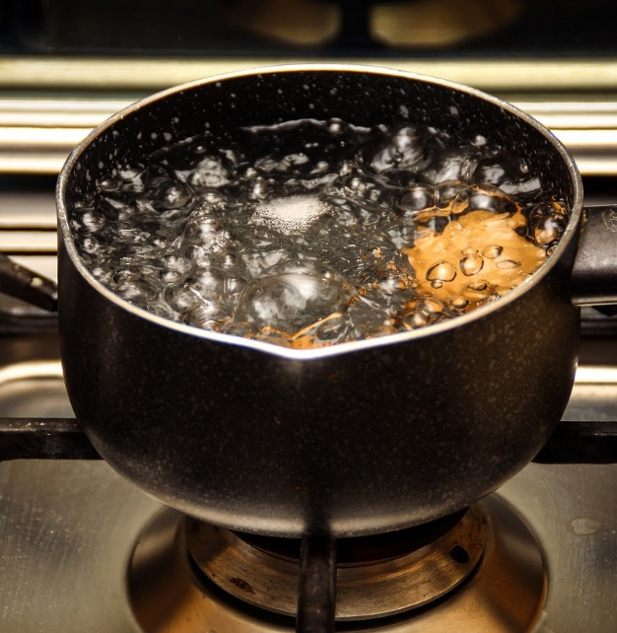
What Happens When Water Boils and Why?
Photo courtesy of Pixabay.com
Link to boiling-water video

