Slide 1




RESPeCT PD pROGRAM
Day 1
RESPeCT Summer Institute
Notes:
5 min
a. Greet participants as they enter the room.
b. Help them find their notebooks and table tents.

Slide 2
Before We Dig In: Essentials
On-time session starts and endings
Sign-in sheets
Restrooms
Sustenance (lunch and snack breaks)
Questions or special needs?
Notes:
20 min for slides 2–14 presentation (averaging approximately 1 min per slide)
a. Give everyone a big welcome to the RESPeCT PD program!
b. Fill participants in on the essential details listed on the slide.

Slide 3
What Is RESPeCT?
Reinvigorating Elementary Science through a Partnership with California Teachers
A partnership built for long-term success!
A professional development program
A leadership development program
A research study
Notes:
Approximately 1 min
a. Emphasize: The RESPeCT project began with three main components:
A professional development program
A leadership development program
A research study
b. The district now sustains RESPeCT as a professional development program.

Slide 4

The RESPeCT Partnership
PUSD
CPP
PUSD:
Pomona Unified School District
CPP:
California State Polytechnic University, Pomona
Photo courtesy of Pixabay.com
BSCS
BSCS:
Biological Sciences Curriculum Study
Notes:
Approximately 1 min
a. The original RESPeCT partners included the following:
Cal Poly: science, science education, and mathematics faculty, as well as the Center for Excellence in Mathematics and Science Teaching (CEMaST)
PUSD: district central administrators, principals, teacher specialists, and teachers
BSCS: an additional partner located in Colorado that provides expertise on science curriculum development, science teacher professional development, and research on science teaching and learning.
Note: Established in 1958, BSCS stands for Biological Sciences Curriculum Study, but the organization now deals with all sciences, not just biology.
Students: Emphasize that students are at the center of this partnership. Their learning is what the project is all about.

Slide 5
The RESPeCT PD Program
  Builds on the successful Science Teachers Learning from Lesson Analysis (STeLLA) program
  Has a significant impact on student learning as demonstrated in two rigorous studies
  Teaches videocase-based lesson analysis
  Facilitates science-content deepening
Notes:
Approximately 1 min
a. Let participants know they’ll be learning more about the RESPeCT PD program and STeLLA teaching strategies as they experience firsthand what it means to perform videocase-based lesson analysis.

Slide 6
The RESPeCT PD Program
Extends the STeLLA approach by
  Addressing grade-level standards in Next Generation Science Standards (NGSS)
  Incorporating Common Core English language arts (ELA) and math standards
  Addressing more explicitly the needs of English language learners (ELLs)
  Addressing all grade levels, K–6
Notes:
Approximately 1 min
a. Read the information on the slide.
b. Emphasize the importance of these additions to the STeLLA approach. By integrating Common Core English language arts (ELA) and math standards into the science curriculum, the RESPeCT PD program enables teachers to invest more time in teaching science. The teaching strategies developed in the RESPeCT PD program are also valuable tools in other subject areas.

Slide 7
Goals of the RESPeCT PD Program
Deepen teachers’ science-content knowledge and knowledge of effective science teaching.
Develop teachers’ analytical skills to improve lesson-plan development and the teaching of science.
Support teachers in the practical use of new knowledge and analytical skills in their classrooms.
Improve students’ science learning.
Achieve sustainability by eventually reaching all
K–6 teachers.
Notes:
Approximately 1 min
a. The bottom line: improving students’ science learning—a goal that has been reached in two previous research studies of this approach.

Slide 8
Summer Institute Study-Group Leaders
Grade [Insert grade level here]
[Insert leader names here]
[Insert leader names here]
Notes:
Approximately 1 min
a. Modify this slide to include the grade level of your study group and the names of the Teacher Leaders who will be facilitating the study-group sessions.
b. Formally introduce yourselves to the group.

Slide 9

The Key
Each of us is key to the success of the
RESPeCT PD program!
Notes:
Approximately 1 min
a. Many people are involved in organizing, planning, and leading this program, but the teacher-participants are the key to its success.

Slide 10
Summer Institute Schedule
Notes:
Note: This is a transition slide.

Slide 11
Summer Institute: A Typical Daily Schedule
8:00 Getting started
8:30 Video-based lesson analysis
10:00 BREAK
10:10 Lesson analysis continued
12:00 LUNCH
12:45 Content deepening
2:00 BREAK
2:10 Content deepening continued
3:00 Wrap-up: homework, summary, reflections
3:30 Adjourn
Notes:
Approximately 1 min
a. A typical daily schedule includes the following:
Time spent on videocase lesson analysis
Time focused on content deepening
Short homework assignments
A morning and an afternoon break, with a 45-minute lunch break

Slide 12
Summer Institute at a Glance
Week 1: Content Area 1 (Sound)
  Student Thinking Lens—strategies to make student thinking visible
  Analysis of video teaching in content area 1
  Analysis of lesson plans to be taught second semester
  Content deepening in content area 1
Week 2: Content Area 2 (Variations in Plants and Animals)
  Science Content Storyline Lens—strategies to create coherence
  Analysis of video teaching in content area 2
  Analysis of lesson plans to be taught in the fall
  Content deepening in content area 2
Notes:
Approximately 1 min
a. During the Summer Institute, each grade level will focus on two content areas, with one week devoted to each area. Participants will deepen their science-content knowledge, study lesson plans in each content area, and analyze videocases of teachers presenting this content.

Slide 13
School-Year Schedule
Fall [Insert year here]
Teach the first lesson set.
Meet three times as a study group (4 hours each).
Meet an additional time to review the second lesson-set plans (2 hours).
Winter/Spring [Insert year here]
Teach the second lesson set.
Meet three times as a study group (4 hours each).
Note: The study group will determine meeting dates and times.
Notes:
Approximately 1 min
a. “The Summer Institute is just the beginning! During the school year, you’ll continue meeting with your grade-level study group.”

Slide 14
Your RESPeCT PD Program Materials
Your science notebook
STeLLA strategies booklet
RESPeCT PD program binder
RESPeCT lesson plans binder
Materials kit (1 per topic)
Notes:
Approximately 1 min
a. Transition slide: “In a moment we’ll break up into grade-level study groups and dig into the RESPeCT PD program! But first let’s review this list of materials you’ll receive in your designated meeting rooms.”

Slide 15
Transition to Grade-Level Study Groups
Any questions before we break up into our grade-level study groups?
Notes:
5 min
a. “Any questions before we head to our grade-level study groups?”
b. Send-off: “Have a great day and be sure to let us know if there is anything we can do to support you in getting the most out of this experience!”

Slide 16
Notebook Setup
Write your name on the front cover of the notebook.
Leave two or three pages for the table of contents. (You’ll add to the TOC each day throughout the program.)
Number your pages. (Front and back pages should be numbered separately.)
Use sticky tabs to divide your notebook into two main sections: Lesson Analysis and Content Deepening. (Each section will comprise about half the notebook.)
Keep a chronological record of your activity in each section. Add a title for each entry and enter in your TOC to easily locate.
Customize and decorate your notebook any way you wish.
Notes:
8 min
a. Welcome participants to the study group and introduce yourself as they arrive.
b. Help participants find their table tents and materials so they can get settled.
c. Direct them to the instructions for setting up their notebooks (Setting Up Your Summer Institute Notebook in the pretabs section of their PD program binders) and get them started working on this task. Interact informally with them and allow them to chitchat as they work.

Slide 17
Getting Started: Introductions
Quick-write exercise:
  Describe your experience learning science in school.
  What do you hope to learn through RESPeCT in the coming year?
Share your responses with a partner.
Introduce each other to the group.
Notes:
15 min
a. Individuals (3 min): Have participants write their responses to the questions on the slide in their notebooks. Emphasize that this is an independent writing exercise.
b. Pairs (3 min): Have participants pair up and share their responses to the questions. Encourage them to learn other things about their partners as well (e.g., school, years of teaching, favorite subjects to teach, hobbies).
Note: If the group has an odd number of participants, pair up with one of them.
c. Whole group (9 min): Have each participant introduce her or his partner, highlighting what that partner hopes to learn from the RESPeCT PD program. Model the first pair of introductions to demonstrate that they should be brief.
Note: If you weren’t able to pair up with someone, simply introduce yourself.
Monitor the time: Introductions should be longer than a sentence, but not the length of a full essay!

Slide 18
RESPeCT PD Program Goals
Business-as-Usual PD
Not closely linked to day-to-day classroom teaching
Rarely see other teachers practice
Learning about content separate from learning about teaching
RESPeCT PD Program
Learn science content in the context of analyzing teaching and student learning.
Engage with one another
in a collaborative analysis of content-specific videocases
of other teachers.
Learn science content in the context of analyzing teaching and student learning.
Notes:
2 min
a. Talk through this slide, emphasizing how RESPeCT PD is different from many other professional development opportunities.

Slide 19
RESPeCT PD Program Goals: Lesson Analysis PD
Business-as-Usual PD
Focus on what to do tomorrow and “cool” activities
Development not sustained over time
Effectiveness measured in terms of teachers’ enjoyment
RESPeCT Lesson Analysis PD
Learn how to select and carry out science activities based on analysis of science content and student thinking and learning.
Be supported in using new teaching knowledge throughout the year.
Measure effectiveness in terms of teacher and student learning.
Notes:
1 min
a. Highlight the goals of RESPeCT lesson analysis PD and how it differs from other professional development opportunities.

Slide 20
Norms for Working Together: The Basics
Purpose: Build trust and develop a productive study group for all participants.
The Basics
Arrive prepared and on time; stay for the duration; return from breaks on time.
Remain attentive, thoughtful, and respectful; engage and be present.
Eliminate interruptions (turn off cell phones, email, and other electronic devices; avoid sidebar conversations).
Make room for everyone to participate (monitor your floor time).
Notes:
3 min
a. “To do this kind of work together, we need to develop a strong study group where everyone feels safe sharing their ideas, questions, confusion, successes, and stumbles. Having a set of agreed-upon norms will help us build such a learning community.”
b. Read over these basic norms.
c. “What do you think? Are there any changes or additions you’d like to suggest?”

Slide 21
Norms for Working Together: The Heart
Purpose: Build trust and develop a productive study group for all participants.
The Heart of RESPeCT Lesson Analysis and Content
Deepening
Keep the goal in mind: analysis of teaching to improve student learning.
Share your ideas, uncertainties, confusion, disagreements, questions, and good humor. All points of view are welcome.
Expect and ask questions to deepen everyone’s learning; be constructively challenging.
Listen carefully; seek to understand other participants’ points of view.
Notes:
5 min
a. “This set of norms moves beyond the basics and targets the heart of RESPeCT PD program goals.”
b. Read the list.
c. “Is anything unclear? Do you have any changes or additions you’d like to suggest? Do you have any concerns about these norms?”
d. Direct participants to handout 1.1 (Norms for Working Together) and pass out the half-page copy of the norms for them to paste on the inside front cover of their notebooks.
e. Ask participants if they’re willing to live with these norms today; then tell them they’ll have an opportunity to revise them tomorrow.

Slide 22
Agenda for Day 1
Focus questions and ideas about effective science teaching
The case for the Science Content Storyline Lens (SCSL)
The case for the Student Thinking Lens (STL)
Content deepening: sound
Lunch
Content deepening (continued)
STL strategies: elicit, probe, and challenge questions
Summary, homework, and reflections
Notes:
Less than 1 min
a. Talk through the agenda for the day.

Slide 23
Today’s Focus Questions
Lesson Analysis
Content Deepening
What are the STeLLA lenses and teaching strategies, and what is the evidence that they will make a difference in your science teaching?
How can we tell if something is making a sound?
How does sound travel from a soundmaker to
our ears?
Notes:
1 min
a. “Each day we’re going to have at least one lesson analysis focus question and one content deepening focus question. These are today’s focus questions.”
b. Read the focus questions on the slide.

Slide 24
Ideas about Effective Science Teaching
What is your image of effective science teaching?
  What does it look like in action?
  What are key features of good science teaching?
Notes:
15 min
a. “Before we explore these questions, let’s create a list of ideas about effective science teaching.”
b. Individuals (3 min): “Take a few minutes to think and write about the questions on the slide.”
c. Whole group (10 min): Go around the group (round-robin) asking everyone to contribute an idea. Write the ideas on a chart paper and title the chart “Effective Science Teaching.”
d. “Throughout the sessions, we’ll revisit this list to add new ideas, clarify our thinking, and make other modifications.”

Slide 25

Lesson Analysis Focus Question
What are the STeLLA lenses and teaching strategies, and what is the evidence that they will make a difference in your science teaching?
Student
Thinking Lens
Science
Content
Storyline Lens
Notes:
2 min
a. “This PD program will focus on two lenses as analytical tools to guide our learning: the Student Thinking Lens and the Science Content Storyline Lens.”
b. “Today we’re going to examine why these two lenses were chosen for our focus.”
c. “Let’s begin with the Science Content Storyline Lens.”

Slide 26
TIMSS Video-Study Questions
What does science teaching look like in different countries?
What can we learn from looking at science-teaching practice in higher-achieving countries?
Notes:
2 min
a. “A large video study of science teaching in different countries revealed the importance of the Science Content Storyline Lens.”
b. “The TIMSS video study explored the research questions on this slide.”
Background info:
TIMSS stands for Trends in Mathematics and Science Study.
TIMSS is known for its achievement studies comparing student performance in math and science internationally.

Slide 27
TIMSS Video-Study Comparisons
The study compared science teaching in the United States with science teaching in these higher-achieving countries:
Australia
Czech Republic
Japan
Notes:
2 min
a. “Australia, the Czech Republic, and Japan are higher-achieving countries in science compared to the United States.”
b. “In these countries, 100 eighth-grade lessons were randomly video recorded. The goal was to describe typical science teaching in each country.”

Slide 28
TIMSS Video-Study Results
Although each higher-achieving country had its own approach, they all had strategies for engaging students with core science concepts and ideas.
In US lessons, content played a less central role, and sometimes no role at all. Instead, lessons engaged students in carrying out a variety of activities.
Notes:
2 min
a. “The TIMSS video study showed these results.”

Slide 29
TIMSS Video-Study Results
Although each higher-achieving country had its own approach, they all had strategies for engaging students with core science concepts and ideas.
In US lessons, content played a less central role, and sometimes no role at all. Instead, lessons engaged students in carrying out a variety of activities.
Notes:
2 min
a. Call attention to the text highlighted in red to emphasize the difference between US science lessons and science lessons in higher-achieving countries.

Slide 30
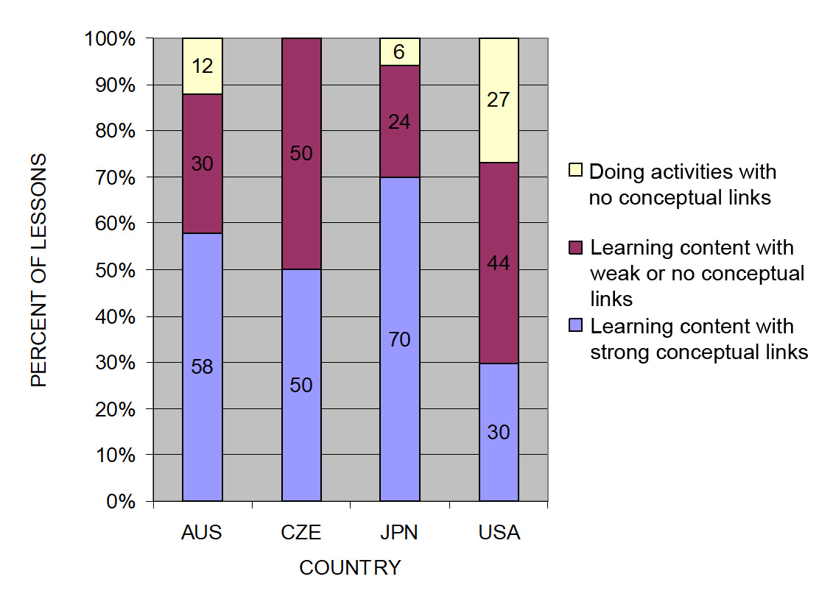
TIMSS: Conceptual Links
Source: TIMSS study
Notes:
3 min
a. Ask: “What do you notice from this graph? What do you make of this data?”
b. Emphasize: “In the US, more than a quarter of the lessons had no science content; whereas in the other countries, the majority of the randomly selected lessons (or typical lessons) had content with strong conceptual links.”
c. Example of a lesson with no science content: “What’s a science lesson with no content? In this research, a lesson with at least one complete statement of a science idea was scored as ‘learning content.’ Lessons with ‘no content’ had only topic-level mentions of science concepts. For example, one teacher started a lesson by telling students to take out their rockets and get to work. They had directions to follow, but the teacher’s only focus in his interactions with students was on how to build the rockets. At the end of the lesson, he told students to clean up and then dismissed them. This is a lesson with no science content!”
Other key ideas to highlight:
Each higher-achieving country engaged students with core science concepts and ideas (more consistently than the US).
All the higher-achieving countries linked ideas and activities (more consistently than the US).
In US lessons, the focus was on performing activities with less attention to content and even less attention to linking activities and science ideas.

Slide 31
What Makes a Difference?
Watch two video clips of 8th-grade science:
  A US classroom
  A Japanese classroom
What did you notice about these two classrooms?
In which classroom are students more likely to learn? Why do you think so?
Link to TIMSS US video clip: 1.1_TIMSS_US_lesson3_c1
Link to TIMSS Japan video clip: 1.2_TIMSS_Japan_lesson_c1_1
Notes:
20 min
a. Direct participants to the transcripts for Video Clips 1.1 and 1.2 (handouts 1.2 and 1.3) before showing each clip.
b. Show US classroom video: Ask participants to focus on what is going on with the science content and storyline.
c. Discuss: “What did you notice?”
Key ideas to emphasize and link back to the results include the following:
The teacher focuses on the activity and the procedure needed to complete the activity.
The teacher and students place no real focus on important science ideas.
There’s only a topic-level mention of science ideas (“pulleys,” “effort distance,” “resistance force”).
d. Show Japanese classroom video: Ask participants to focus on what is going on with the science content.
e. Discuss: “What did you notice?”
Key ideas to emphasize and link back to the results include the following:
Content ideas are made clear to students (focus question, pairs talk) before doing any activity.
Students are asked to talk about science ideas, not just procedures.
The lesson purpose is made clear to students.
f. Ending discussion: “In which classroom are students more likely to learn science concepts? Why?”
Note: Participants may be critical of both classrooms because student thinking isn’t made visible. This is true, but bring their focus back to the science content and storyline. They should see a clear distinction between the science content storylines in the Japanese and US lessons. Students in the Japanese classroom are more likely to learn because science-content ideas are made visible, and students are engaged in thinking about these ideas, not just science activities.

Slide 32
The TIMSS Findings Show …
Each higher-achieving country engaged students with core science concepts and ideas.
All the higher-achieving countries linked ideas and activities.
In US lessons, the focus was on performing activities with less attention to content and even less attention to linking activities and science ideas.
Notes:
1 min
a. Use this slide and the next to summarize key ideas from the TIMSS video study.

Slide 33
What Can We Learn from the Research?
A coherent science content storyline can …
make science ideas more prominent in science lessons,
  strengthen connections among science-content ideas,
  strengthen connections between science-content ideas and activities, and
improve lesson coherence by shaping science lessons as stories that make sense to students.
For more insights, see TIMSS Educational Leadership article, “What Science Teaching Looks Like: An International Perspective” (handout 1.4 in binder).
Notes:
1 min
a. After reading this slide, share with participants that the Science Content Storyline Lens addresses the need uncovered in the TIMSS video study: to strengthen the links between science ideas and lesson activities.
b. Encourage participants to read handout 1.4 (TIMSS Educational Leadership article) for further insight.

Slide 34
Discussion Questions
What new features can we add to our earlier description of effective science teaching?
Are there any ideas we should add to our list, modify, or delete?
Notes:
5 min
a. “What features on our list of ideas about effective science teaching are consistent with the TIMSS video-study findings?”
b. “Are there any ideas you’d like to add to our list, delete, or modify?”
Note: Use a different color to add/delete/modify ideas. Encourage participants to keep an open mind about changing their ideas. Provide opportunities for them to reflect on any changes and the reasons for those changes.
c. Transition: “During week 2 of the Summer Institute, we’ll focus on strategies for creating a strong, coherent science content storyline. This week, we’ll focus on the Student Thinking Lens. Right now, let’s consider the reasons for focusing on the Student Thinking Lens.”

Slide 35
Lesson Analysis Focus Question
What are the STeLLA lenses and teaching strategies, and what is the evidence that they will make a difference in your science teaching?
Student
Thinking
Lens
Science
Content
Storyline
Lens
Notes:
Less than 1 min
a. “At this point, we’ll transition from a focus on the Science Content Storyline Lens (SCSL) to the Student Thinking Lens (STL).”
b. “We’ll be focusing on the Student Thinking Lens the rest of the day and throughout this week.”

Slide 36
Research on How Students Learn
Respond in your notebooks to the following question:
    Imagine that a seed is planted in the ground and grows into a tree. Where does most of the matter come from that makes up the wood and leaves of the tree?
We won’t share our responses with the whole group.
Notes:
3 min
a. Individuals: Have participants answer the question on the slide in their science notebooks.
Background for PD leaders: Participants will likely have the same misconceptions revealed in the video, but they may not yet be comfortable sharing their confusion. At this point, don’t ask them to share their ideas with the group. It will be interesting to see if some of them voluntarily share their “wrong” ideas after they see the video.

Slide 37
Minds of Our Own
Minds of Our Own is a video that visually summarizes a large body of research on student learning in science classrooms.
As you watch, think about the following questions:
How do Harvard graduates answer the question about the mass of a tree? Is their response the same as or different from yours?
Does this give you any new ideas about effective science teaching?
Link to Minds of Our Own video clip.
Notes:
10 min
a. Read the information and instructions on the slide.
b. Watch the Minds of Our Own Lessons From Thin Air video. Total viewing time is approximately 10 minutes. (https://www.learner.org/series/minds-of-our-own/2-lessons-from-thin-air/?jwsource=cl)
MIT/Harvard interview—start at segment 3:30 and end at 5:40.
John preinterview, class, and post interview—start at segment 7:50 and end at 16:45.
Note: If time is short, stop after Phil Sadler. If you have enough time, you can show the entire segment from 3:30 to 16:45.

Slide 38
Discussion Questions
What did you notice in the Minds of Our Own video?
What does research on learning say to us about effective science teaching?
What new features can we add to our description of effective science teaching?
Notes:
15 min
a. There’s a lot to talk about in this video! Here are some additional questions you might pose:
Did John’s ideas about photosynthesis change through instruction?
What did the teacher say about his instruction?
What did the experts say?
How do the Harvard students’ responses compare with your own? What ideas does this give you about your own science learning experiences?
Key idea to emphasize: Research shows that we not only need to engage students in more thinking and sensemaking, but we also need to listen to their ideas—especially when they’re wrong—and use them to guide our instruction.
b. Modify the chart of ideas about effective science teaching as participants share features from the research.

Slide 39
What Can We Learn from the Research?
A Student Thinking Lens can …
reveal, support, and challenge student thinking throughout instruction;
provide opportunities for students to analyze and interpret data, as well as construct arguments and explanations;
engage students in making connections between ideas and activities; and
provide structures to teach students how to communicate in scientific ways.
For more insights, see “Synthesis of Research from How Students Learn: Science in the Classroom” (handout 1.5 in binder).
Notes:
2 min
“This slide nicely summarizes some of the ways we get students thinking and make their thinking visible.”
Note: Encourage participants to read handout 1.5 (“Synthesis of Research from How Students Learn: Science in the Classroom”) for further insight.
b. Transition: “Today we’ll start learning some particular strategies for making student thinking more prominent in science lessons.”
Background for PD leaders: The STeLLA conceptual framework addresses the need uncovered in this and other studies on how people learn and, more specifically, how students learn science.
If students’ initial knowledge is not engaged, they may fail to grasp the new concepts and information that are taught and may distort the new information to make it fit their prior experience.
This idea of learning with understanding has two parts: (1) factual knowledge must be placed in a conceptual framework (a big idea or a set of big ideas) organized in ways that enable students to use and apply that knowledge to make predictions, solve problems, explain new situations, and so forth; and (2) multiple representations that are rich in science ideas and details give concepts meaning.
This idea helps students monitor their developing understandings, engaging them in reflecting on their learning experiences, their changing ideas, and their remaining questions and musings.

Slide 40

SOUND
SCIENCE CONTENT DEEPENING Grade 1
Notes:
Less than 1 min
a. “Now let’s begin our content deepening session on sound.”
Note: Throughout this content deepening phase, refer as needed to the Sound Content Background Document, Common Student Ideas about Sound, and the learning goals for students and teachers.

Slide 41
Content Deepening Focus Questions
How can we tell if something is making a sound?
How does sound travel from a soundmaker to our ears?
Notes:
2 min
a. “Today’s content deepening work will focus on how sound is produced, how it travels from a soundmaker to our ears, and how it’s received or heard.”
b. Introduce the focus questions on the slide.
c. “The science ideas we learn about in this session will help us answer these questions.”
d. Have participants write the focus questions in their science notebooks and draw a box around each one. This will reinforce the practice they’ll follow with students. Make sure they leave space below each question to write a response.

Slide 42
Content Deepening: Focus Question 1
How can we tell if something is making a sound?
In your science notebook, write your initial ideas for answering this question.
Notes:
6 min
a. Individuals: Ask participants to write down their initial ideas for answering the first focus question.
b. Whole group: Invite participants to share their ideas with the group. Record participants’ ideas on chart paper during this share-out. Highlight any ideas that refer to objects vibrating to make sounds and/or how these vibrations may be seen or felt in addition to hearing the sounds.
c. Ask probe questions to clarify participants’ ideas and make their thinking visible. Examples:
“Can you say more about that?”
“What do you mean by …?”
d. Emphasize the following key ideas:
Objects must vibrate to produce sounds.
These vibrations travel as sound waves to our ears, and we hear or perceive them as sound.

Slide 43
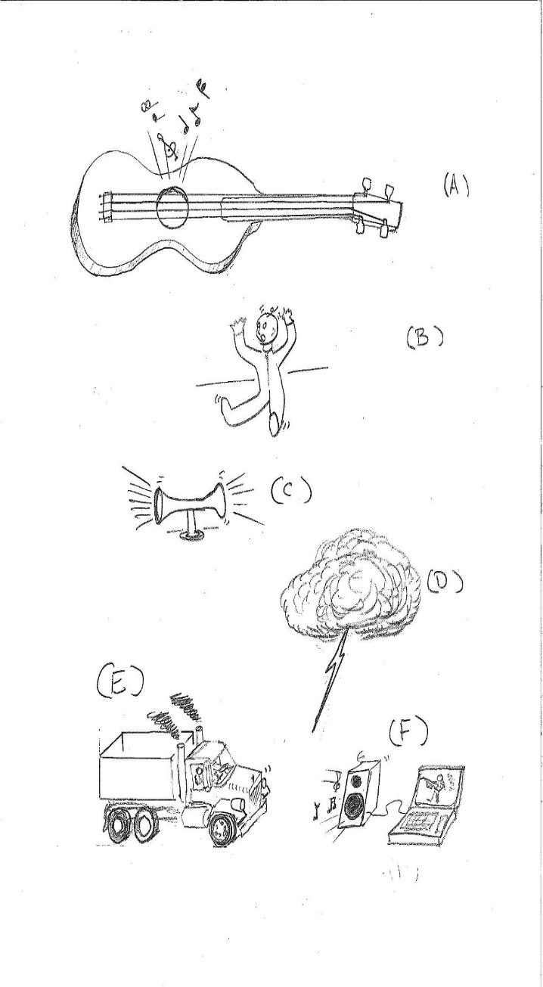
Investigation 1: Evidence of Sound
For each object on the handout, indicate which sense(s) you could use as evidence that an object is making a sound. Place a check mark in the upper-
left corner of the corresponding box.
Questions to think about:
If a soundmaker were right in front of you, what senses could you use to determine whether something is producing a sound?
If you covered your ears very tightly, would the object still make a sound?
Courtesy of Hector Mireles
Notes:
6 min
a. Distribute handout 1.6 (Soundmakers) and introduce the different types of soundmakers:
A guitar string that has been plucked
A baby crying
A blaring horn
A clap of thunder from a lightning bolt
A diesel-truck’s engine
A loudspeaker connected to a laptop
b. “For each scenario on your handout, think about how sound is produced and how you might detect evidence of sound in each soundmaker using your senses of hearing, sight, and touch.”
c. “Then for each object, place a small check mark in the upper-left corner of the corresponding box or boxes to indicate which sense or senses you could use as evidence that the object is producing a sound. Make sure to leave plenty of space to record your evidence later.”
d. “As you consider each soundmaker, think about the two questions on the slide. The second question is an especially interesting one to ponder.”
Key science ideas:
Objects must vibrate to make sounds.
In addition to hearing a sound, we may be able to see and/or hear a soundmaker vibrating.

Slide 44

Investigation 1: Evidence of Sound
Pair up and compare your check marks on the handout. Then work toward a consensus on the senses you would use to detect evidence of sound in each object.
After the group discussion, pair up again and talk about the evidence of sound you would identify for each object using your senses. Then record your evidence on the handout.
Courtesy of Hector Mireles
Notes:
20 min
a. Pairs: Have participants pair up with an elbow partner and compare which senses they checked off for each soundmaker on their handouts. Direct them to work toward a consensus on the senses they would use to detect evidence of sound or vibrations in each object.
b. Whole group: Display the handout on a document reader and ask participants which senses they selected for each object on their handouts. Work toward a consensus. For example:
Objects I can hear vibrate:
A blaring horn
A clap of thunder from a lightning bolt
Objects I can see vibrate:
A guitar string
A loudspeaker
Objects I can feel vibrate:
A baby crying
A loudspeaker
A diesel-truck’s engine
c. Pairs: Next, have participants pair up again with the same partners and talk about the evidence of sound they would identify for each object using their senses. If participants are struggling, ask elicit and probe questions to generate the correct response for the first object:
My evidence of sound for the plucked guitar string is that I can see the string vibrate.
d. Individuals: Based on the pairs work, have participants record their evidence of sound for each object on their handouts.
e. Whole group: Invite participants to share their evidence of sound for each object on the handout. Ask probe questions to clarify participants’ thinking (e.g., “Can you say more about that?” “What do you mean by …?”). Highlight ideas about objects vibrating to produce sounds and how these vibrations may be seen or felt in addition to hearing the sounds.
Note: In each scenario, the object must be vibrating to make a sound.
Evidence of sound/vibrations:
A guitar string that has been plucked
Evidence: The string vibrates.
I would be able to hear, see, and feel the string vibrate.
A baby crying
Evidence: The baby’s vocal cords vibrate.
I would feel the baby’s vocal cords vibrating if I touched the baby’s throat.
A blaring horn
Evidence: The air vibrates when pressurized air is force through a hole.
I would hear the sound. I might also feel the horn vibrate if I were next to it.
A clap of thunder from a lightning bolt
Evidence: The air vibrates when the lightning causes sudden heating.
I would hear the sound of thunder.
A diesel-truck’s engine
Evidence: The engine vibrates when the cylinders fire.
A diesel engine always vibrates a little. If I leaned on the truck, I would hear and feel the engine vibrate.
A loudspeaker connected to a laptop
Evidence: The speaker vibrates when the laptop sends an electrical signal.
I would feel the speaker vibrate if I touched it. I might also be able to hear and see it vibrate.

Slide 45
Reflect: Content Deepening Focus Question 1
How can we tell if something is making a sound?
Answer the focus question in your science notebook.
Then read sections 1–3 in the Sound Content Background Document.
Revise your answer based on the reading.
Discuss the focus question with an elbow partner and come up with an ideal response.
Notes:
10 min
a. Review the focus question on the slide and ask participants to answer the question in their science notebooks.
b. Individuals: Next, have participants silently read sections 1–3 in the Sound Content Background Document (lesson plans binder). Then ask them to revise their answers to the focus question based upon what they learned from the reading.
c. Pairs: Ask participants to discuss their answers with an elbow partner and reach a consensus on an ideal response to the focus question.
Ideal response: Other than hearing the sound, you can tell that something is making a sound because it vibrates. You may also be able to see and feel the vibrations.
d. Whole group: Invite pairs to share their ideal responses with the group. Ask probe questions to clarify participants’ ideas and make their thinking visible (e.g., “Can you say more about that?” “What do you mean by …”?).
e. Have participants turn to the overview page of Sound lesson 1a in their lesson plans binders and read the ideal student response to the focus question.
f. Remind participants that an object must vibrate to make a sound.

Slide 46

Key Science Ideas
To produce a sound, an object must vibrate.
We can tell that something is making a sound if it vibrates.
In addition to hearing the sound, we may also be able to see and/or hear an object vibrate.
Notes:
1 min
a. Highlight the key science ideas on the slide that answer the first content deepening focus question.
b. Emphasize that ideas and evidence from the investigations helped to shape the answer to this question.
c. Ask participants, “Does everyone agree that these key ideas answer our focus question? Would you like to add or revise anything?”

Slide 47
Content Deepening: Focus Question 2
How does sound travel from a soundmaker to our ears?
Notes:
Less than 1 min
a. Review the focus question on the slide.
b. “Next, we’ll investigate how sound moves from a vibrating object to our ears.”

Slide 48
Investigation 2: Four Ingredients of Sound
Source: A vibrating object causes the air around it to vibrate.
Air: These vibrations (disturbances in the air) create waves that travel through the air in all directions away from the source.
Ears: When these waves reach our ears, they cause our eardrums to vibrate.
Brain: Our vibrating eardrums send signals to our brains, and our brains interpret the vibrations as sound.
Notes:
1 min
a. Introduce the four ingredients of sound on the slide: the source of the sound, air, ears, and brain.
b. “Next, we’ll examine these four ingredients in a real-life scenario.”

Slide 49
Investigation 2: Four Ingredients of Sound
Brain
Ears
Air
Source
Courtesy of Hector Mireles
Notes:
20 min
a. Highlight the four ingredients of sound on the slide.
b. “When a dog barks, its vocal chords vibrate and cause the air around it to vibrate. We represent sound as circles that move away from the source and get bigger as they travel outward. These vibrations travel on waves to our ears, and our brains interpret the vibrations as a barking sound. We’ll talk about this in more detail later.”
c. Distribute handout 1.7 (Sound on the Move) and go over the directions. Then make a sound with a tuning fork by tapping it on your hand or the bottom of your shoe. (Don’t tap the tuning fork on a hard surface, since that might damage it.)
d. Ask participants, “Based on what you’ve learned so far about the four ingredients of sound, how do you think the sound from this tuning fork moves to your ears?”
e. Pairs: Have participants pair up with an elbow partner and talk about where they think the sound will move. Challenge participants to think about how sound travels and then compare their ideas to the diagram on the slide.
f. Individuals: After pairs have shared their ideas, have participants write their predictions on the handout and draw circles (waves) showing where they think the sound from the tuning fork will move.
g. Whole group: Invite a few participants to share their predictions and reasoning with the group.
h. Note that these are only predictions, and that you’ll revisit them later in the session.

Slide 50
Investigation 2: Four Ingredients of Sound
Brain
Ears
Air
Source
Courtesy of Hector Mireles
Notes:
10 min
a. “Next, we’ll explore some key science ideas about how sound moves from a source to our ears.”
b. Source: “Anything that vibrates causes the air around it to vibrate. In the slide diagram, the source of the vibrations is the dog, or more precisely, the vocal chords inside the dog. If you hugged this dog while it was barking, you’d be able to feel its vocal tract vibrating.”
Key ideas to emphasize:
All sounds originate at the vibration (oscillator). This causes a pressure disturbance in the air (or water) around the vibrating object.
The sound can be heard if the vibrating object oscillates higher than 20 times a minute—or 20 hertz (Hz), which is a very low hum—but no higher than 20,000 times per minute—or 20 kilohertz (kHz), which is a very high-pitched sound like scratching a chalkboard.
Sounds are unique if they have a resonator that chooses a few frequencies over the others.
Dogs make different dog sounds because each breed has a unique physiology. A dachshund, for example, sounds different from a German shepherd because of resonance.
It takes energy to sustain a vibration. For example, we get tired if we talk or sing for long periods of time.
c. Air: “Sound (vibrations) travels through the air in the form of waves.”
Key ideas to emphasize:
The vibrating source causes air-pressure disturbances that propagate through the air as pressure waves.
Sound waves travel away from the source in all directions, just like waves moving away from a pebble tossed into a pond.
Sound must travel through a medium, such as air or water. There can be no sound wave without a medium.
Sound waves cause vibrations (disturbances) in the air to travel in all directions. The air stays where it is; only the vibrations travel through the air.
Sound waves are a way of transporting a little bit of energy.
d. Ask probe and challenge questions to elicit the following key ideas from participants about where the sound waves in the slide diagram can go.
The sound waves in the diagram can …
travel to empty spaces, which means that nobody receives that portion of the disturbance;
reach the man’s ears, which means that two ears receive a portion of the disturbance;
reach the bird’s ears, which means that two more ears receive another portion of the disturbance; or
reach the tree on the other side of the dog, which means the tree receives yet another portion of the disturbance.
e. Ears: “If the sound waves reach your eardrums, they will vibrate at the same frequency as the vibrations of the original oscillator.”
Key ideas to emphasize:
Sound is a pressure wave, so it can make a very light object move when the pressure wave reaches it.
Eardrums vibrate when pressure waves hit them.
Eardrums vibrate in response to very, very small changes in air pressure.
We can perceive a change in air pressure when we ride an elevator up to a higher floor in a building.
We can feel a change in air pressure when we descend rapidly in an airplane.
The greater the change in pressure, the louder the sound is.
We have two ears that help us determine the source of a sound. This protected our ancestors from predators!
Less of the sound wave reaches our eardrums the farther away we are from the source of a sound. This makes the sound softer.
f. Brain: “When sound waves reach our ears, they make our eardrums vibrate. These vibrations produce electrical signals that travel to our brains, and our brains interpret these signals as sound.”
Key ideas to emphasize:
Our brains remember exactly what a dog sounds like and interpret the electrical signals accordingly. A different set of amplifying parts of an animal will be identified as a different animal.
Each person makes a unique sound, which is why babies can recognize their parents’ voices.
Our brains tell us which ear hears more, and that helps us determine where a sound is coming from.
We each have a keen recognition of combined tones (e.g., music).
If a sound reaches a nonliving thing or a living thing without a brain (like a tree), the object perceives no sound.

Slide 51
Reflect: Content Deepening: Focus Question 2
How does sound travel from a soundmaker to our ears?
Notes:
3 min
a. Review the focus question on the slide.
b. Individuals: “Think about what you’ve learned so far about how sound moves from a soundmaker to our ears. Then jot down your ideas for answering this question in your science notebooks.”
c. “At the end of our content deepening session, you’ll have an opportunity to revise your answers.”

Slide 52
Main Learning Goals
Sound is produced when objects vibrate very quickly back and forth, causing the air around them to vibrate. These vibrations or air disturbances create sound waves.
Sound waves begin at the source of a sound and travel in all directions away from the source.
When sound waves reach our ears, our eardrums vibrate, and our brains interpret these vibrations as sound.
https://www.youtube.com/watch?v=27a26e2CnuM
Notes:
2 min
a. Read the main learning goals on the slide.
b. “Next, we’ll watch a short video clip on sound waves. Then we’ll drive home these learning goals by exploring more about how sound is produced and how sound waves move through the air to our eardrums.”
c. Show the YouTube video What Is Sound?
d. Highlight key ideas about sound waves from the video clip. Ask participants if they have any questions or comments.

Slide 53
How Do Vibrations Move?
What did the longitudinal waves look like as they moved through the Slinky?
How did the hand move?
How did the wave travel?
How did the ribbon move?
What can you conclude about longitudinal waves based on the Slinky video?
  https://www.youtube.com/watch?v=GIkeGBXqWW0
Notes:
25 min
a. Introduce the questions on the slide and have participants copy them into their notebooks.
b. Show the YouTube video Longitudinal Waves Using a Slinky.
Note: You may want to replay the video a few times so that participants can look more closely at various parts of the model and take notes to help them answer the questions on the slide.
c. Individuals: After the video demonstration, have participants answer the slide questions in their notebooks. As needed, replay the video clip and ask probe and challenge questions to support participants as they work through each question.
d. Next, conduct your own Slinky demonstration. Ask a volunteer to hold one end of the Slinky as you quickly move it forward and backward with your hand.
e. Ask the volunteer the following questions during the demonstration:
“Am I pushing your hand or the Slinky?”
“So how come you can feel the vibrations in your hand?”
f. After the demonstration, ask participants the following questions:
Where did the vibrations start?
What moved down the Slinky?
Can you describe how the vibrations moved down the Slinky?
Can you relate this to the ribbon in the video clip?
g. Individuals: Have participants read section 4 in the content background document. Then ask them to revise their responses to the slide questions based on the ideas presented in the reading.
h. Whole group: Invite participants to share their revised answers with the group. Encourage participants to listen carefully to one another’s ideas and be ready to agree or disagree, add their own ideas, and ask questions.

Slide 54
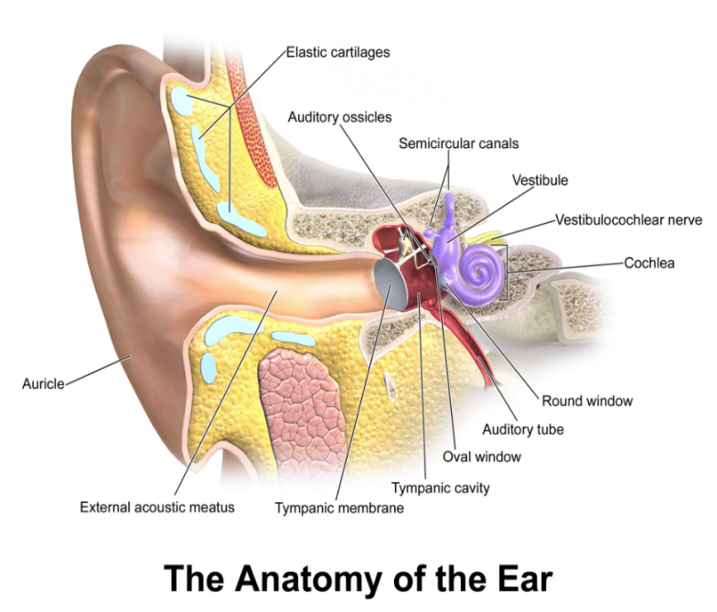
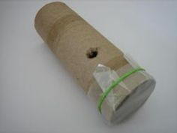
Characteristics of Good Sound Receivers
Have a large opening to collect sound.
Have a resonance space containing a volume of air in which sound can resonate.
Have an object (membrane) that can vibrate at a frequency humans can hear (20–20,000 Hz).
Kazoo
Photo courtesy of BSCS
Photo courtesy of BSCS
Notes:
3 min
a. Have participants locate lesson handout 6.1 (The Ear) in their lesson plans binders and refer to them as needed as you walk them through the information on the slide.
b. “Both of the objects on this slide are good sound receivers. The tree in the earlier diagram wasn’t a good sound receiver because it didn’t do anything with the sound waves that reached it.”
Note: You might want to show the diagram on slide 49 again. Point out the sound waves that moved from the dog to the tree and note that the sound waves enter the tree, but the tree isn’t able to perceive them because it doesn’t have an eardrum to transmit signals or a brain to translate them into sound.
c. “The human ear and a homemade kazoo are good sound receivers for three important reasons:
“They each have a large opening that can catch or collect a portion of the incoming sound wave. In a human ear, this opening is the outer ear or auricle, and in the kazoo, it’s the end of the tube without the wax paper.
“Both the human ear and the kazoo have a resonance space containing a volume of air in which sound can resonate. This space prefers one dominant frequency. The resonance space in the human ear is called the external acoustic meatus or ear canal. The resonance space in the kazoo is just past the opening.
“The human ear and the kazoo also have an object that vibrates. The human ear has a tympanic membrane or eardrum that vibrates at a frequency humans can hear (20–20,000 Hz). The kazoo has wax paper attached to one end that simulates an eardrum.”
d. Point out that when sound waves or vibrations reach the eardrum, the eardrum vibrates. These vibrations are converted to electrical signals or impulses that the auditory nerve transports to the brain. The brain then interprets these signals as sound, such as music or a barking dog!

Slide 55

Investigation 3: Sound Receivers
The human ear is an excellent sound receiver!
It collects sound
It resonates sound.
It has a membrane that vibrates.
It converts vibrations
to signals the brain
interprets as sound.
Photo courtesy of BSCS
Photo courtesy of BSCS
Notes:
8 min
a. “The human ear is an excellent sound receiver! It collects and resonates sound, it has a tympanic membrane or eardrum that can vibrate, and it converts these vibrations to signals the brain can interpret as sound.”
b. To illustrate how the human ear receives sound, distribute homemade kazoos to several volunteers.
c. Direct the volunteers to put the open end of the cardboard rolls against their mouths and make a sound like an owl. Then ask participants to describe what they hear.
d. Next, direct the volunteers to hum into their kazoos. Then ask participants to describe what they hear.
e. Following the demonstration, ask participants, “How are kazoos and human ears similar? How are they different?”
f. Probe and challenge participants’ thinking to highlight the key ideas on the slide.

Slide 56
Characteristics of Good Soundmakers
  Oscillators:
    Must be free to vibrate
    Should vibrate at a rate of 20–20,000 Hz for the human ear to hear it
  Resonators:
    Must have a large volume of air (resonance space) near an oscillator
    Must have one frequency with a greater amplification than other frequencies
Notes:
1 min
a. Read through the information on the slide and highlight the characteristics of good soundmakers.
b. Note that a musical sound or note has a few strong frequencies that we can hum along with. Noise, on the other hand, has an infinite number of frequencies that resonate at the same time. Rushing air causes noise and sounds like “shshshshshsh.”
c. “We’ll talk more about the distinctions between musical sound and noise in a later content deepening session.”

Slide 57
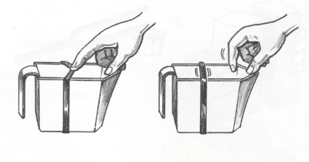
Investigation 4: Soundmakers
  Is a plastic container with a rubber band across the opening a good soundmaker?
  The rubber band is an
  oscillator. It’s bound to
  the container, but it’s
  free to vibrate.
  The measuring cup is
  a resonator. It has
  resonance space (a volume of air) near the oscillator and “sings” to one or two strong frequencies.
  Together, they produce a musical sound!
Photo courtesy of BSCS
Notes:
10 min
a. “We used kazoos to simulate how the human ear receives sound. Now let’s investigate how sound is produced.”
b. Introduce the plastic container with a rubber band stretched across the opening.
c. Make a sound by plucking the rubber band with your finger (see image on slide). Then ask participants to share their observations. Did they see the soundmaker vibrate? What did they hear?
d. Next, have a volunteer stretch the rubber band around his or her fingers and try to match the tension of the rubber band around the container. Then ask another volunteer to make a sound by plucking the rubber band.
e. After this demonstration, ask participants to share their observations. Did they see the soundmaker vibrate? What did they hear? Did the volunteer feel the rubber band vibrate?
f. Then have participants compare the two soundmakers. Ask, “What is the difference between a rubber band vibrating around fingers and a rubber band vibrating around a plastic container?”
g. Emphasize the key points on the slide that explain what makes the plastic container and rubber band a good soundmaker.
h. Next, make a sound with the tuning fork.
First, strike the tuning fork against your knee, and hold it up in the air. Ask participants what they hear. (The tuning fork will vibrate, but participants will find it hard to hear.)
Next, strike the tuning fork against your knee and hold it upright on a file cabinet, a table, or any large, firm object. Ask participants what they hear. (The tuning fork will resonate the sound.)
i. “Think about the sound the tuning fork produced each time it vibrated. The first time, it was hard to hear, but the second time, we could hear the sound clearly. Why do you think the tuning fork was such a poor soundmaker the first time and such a good soundmaker the second time?”

Slide 58
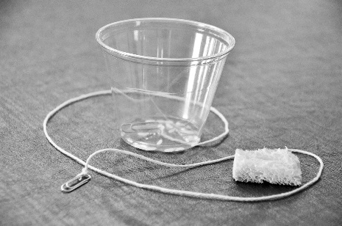
Investigation 5: Can Sound Create Motion?
What happens to the grains of rice in your clucker cup when you make a sound with the clucker?
What happens to the grains of rice on top of the kazoo’s wax paper when the clucker makes a sound?
What does this tell you about sound and motion?
Photo courtesy of BSCS
Photo courtesy of BSCS
Notes:
20 min
a. “We just saw that the tuning fork with an amplifier allowed the sound to resonate and travel in all directions from the soundmaker. Next, we’ll see whether the energy of sound can create motion.”
b. Show participants a clucker (from lesson 2a) and demonstrate how it works.
c. “Now I’d like you to make your own cluckers and see if they can make grains of rice move.”
d. Distribute the materials for the cluckers; then walk participants through assembling them.
e. After participants assemble their cluckers, have them place several grains of rice in their cups and make a sound with their cluckers. Then ask participants what happens to the grains of rice.
f. “Now let’s see if the grains of rice move if I place them on top of the wax paper covering one end of a kazoo and then make a sound with the clucker.”
Note: To make sure everyone sees the wax paper vibrating, you may want to use a document camera to magnify the surface of the kazoo. Alternatively, you could repeat the demonstration several times.
g. Following the demonstration, invite participants to share their observations. Challenge participants to make connections between the wax paper vibrating and their eardrums vibrating.
h. Emphasize that the wax paper on the kazoo illustrates what happens when sound waves or vibrations from a soundmaker travel through the air and reach their eardrums.
i. “So just as sound waves from the clucker caused the wax paper to vibrate, which in turn made the rice grains on the paper jump around, sound waves cause our eardrums to vibrate.”

Slide 59
Reflect: Content Deepening: Focus Question 2
How does sound travel from a soundmaker to our ears?
Notes:
6 min
a. Review the focus question on the slide.
b. Individuals: Ask participants to reflect on what they learned about sound and motion during the content deepening session and then revise their previous answers. Remind them to support their ideas with evidence from today’s investigations.
c. Whole group: Invite a few participants to share their ideas and evidence with the group.
d. Following this discussion, revisit the first focus question, How can we tell if something is making a sound? and ask participants to share any new insights they’ve gained from today’s content deepening work.
e. Discuss the predictions participants made earlier about where the sound from the tuning fork would move (handout 1.7, Sound on the Move). Ask whether their predictions match the results of today’s investigations.

Slide 60
Key Science Ideas
To produce a sound, an object must vibrate.
These vibrations cause the air around the object to vibrate.
Vibrations move throughout the air in waves in all directions away from the soundmaker.
When these sound waves or vibrations reach our ears, they make our eardrums vibrate.
These vibrations produce electrical signals that travel to the brain, and our brains interpret the vibrations as sound.
Notes:
Less than 1 min
a. Highlight the key science ideas on the slide that answer the first content deepening focus question.
b. Emphasize that ideas and evidence from the investigations helped to shape the answer to this question.
c. Ask participants, “Does everyone agree that these key ideas answer our focus question? Would you like to add or revise anything?”

Slide 61
Homework
Review section 4 in the content background document.
Read Sound: Learning Goals for Students and Teachers in your lesson plans binder (pretabs section).
Notes:
Less than 1 min
a. “To prepare for our next session, please review section 4 in the content background document and read the learning goals for students and teachers in your lesson plans binders.”
b. Have participants copy the homework assignment into their science notebooks.

Slide 62
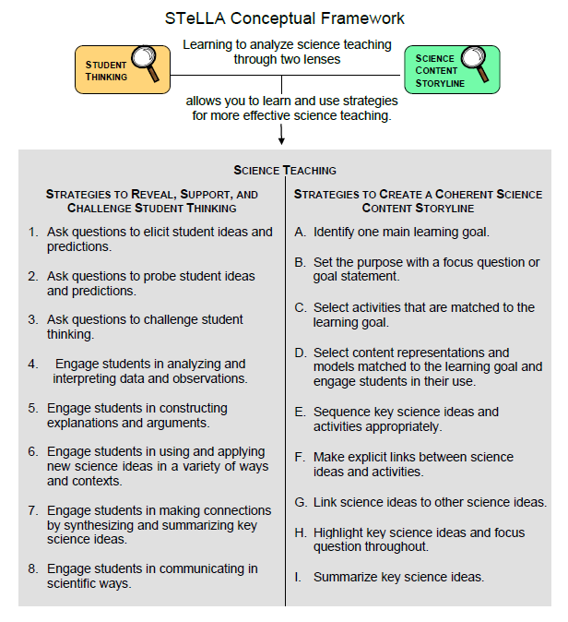
Lesson Analysis Focus Question
What are the STeLLA lenses and teaching strategies, and what is the evidence that they will make a difference in your science teaching?
Notes:
1 min
a. Read the focus question on the slide.
b. “This visual on this slide tells us a little about the first part of our focus question: What are the STeLLA lenses and teaching strategies? As you can see, there are eight specific science teaching strategies to support the Student Thinking Lens.”
c. Acknowledge: “I know you have existing frameworks (ideas and language) regarding teaching and learning, and I expect you’ll continuously draw from them during the Summer Institute.”

Slide 63
Lesson Analysis Focus Question
What are the STeLLA lenses and teaching strategies, and what is the evidence that they will make a difference in your science teaching?
Notes:
1 min
a. “Today we’ll begin learning about three of the Student Thinking Lens teaching strategies.”
b. Read the strategies highlighted on the slide.
c. “These three types of questions will help reveal, support, and challenge student thinking.”
d. Emphasize: “Even though we’re studying the strategies this summer, you’ll better understand them as you start trying them out in your teaching next fall.”

Slide 64
Strategies 1, 2, and 3: Questions That Elicit, Probe, and Challenge Student Thinking
Student Thinking Lens: Strategies to reveal, support, and challenge student thinking.
  Strategy 1: Ask questions to elicit student ideas and predictions.
  Strategy 2: Ask questions to probe student ideas and predictions.
  Strategy 3: Ask questions to challenge student thinking.
Read and fill in the purpose and key features of each strategy on your Z-fold summary chart. Then share your charts with a partner.
Notes:
20 min
a. Orient participants to the STeLLA strategies booklet. Forecast that you’ll come back to this resource repeatedly to ensure consistent use of ideas, meaning, and language that match the STeLLA conceptual framework.
b. Individuals: Have participants read about all three strategies and write on their blank STL Z-fold summary charts the purpose(s) and key features of each strategy. State that in the future, they’ll do this kind of reading and writing as homework.
c. Pairs: Have participants pair up and share their Z-fold summary charts. Encourage them to provide evidence from the readings to support their ideas and ask each other questions consistent with the norms for working together, such as “Where did you find that?” or “I interpreted that differently.”

Slide 65
Elicit Questions
What are the purpose and key features of questions that elicit student ideas and predictions?
  Which question from the examples in the strategies booklet do you think would elicit the highest number of different student responses in your classroom? Why do you think so? (Cite ideas from the strategies booklet.)
Notes:
5 min
a. As a group, discuss the purpose and key features of questions that elicit student ideas and predictions. Write these features on chart paper and hang the chart where it can be referenced later.
b. Sample chart:
Key Ideas about Elicit Questions
Purpose: To reveal student’ ideas, predictions, misconceptions, and experiences before they learn about the content.
Key features:
Asked anytime, but often at the beginning of a lesson
Phrased in everyday language that students can understand even before studying the related content
Addressed to multiple students (usually the whole class)
Reveals a variety of student ideas
Useful to teachers in adapting instruction
Useful to students so they see that others have different ideas
Can be a prediction
Can set up a discrepant event

Slide 66
Probe and Challenge Questions
Probe Questions
What are the purpose and key features of questions that probe student ideas and predictions?
Challenge Questions
What are the purpose and key features of questions that challenge student thinking?
  Remember to cite ideas from the strategies booklet!
Notes:
13 min
a. Small groups (5 min): Split participants into two groups—one group for probe questions, and one group for challenge questions. Have each group create a chart of the purpose and key features of the assigned strategy from the STeLLA strategies booklet (not from experience).
b. Whole group (8 min): Share the charts with the entire group. Encourage participants to add to, delete from, and modify them as needed to ensure they’re accurate and match the language in the strategies booklet.

Slide 67
Elicit versus Probe Questions
  What are some key differences between questions that elicit and questions that probe student ideas and predictions?
Notes:
5 min
a. Turn and Talk: “Discuss this question with an elbow partner.”
b. Whole-group share-out: Have participants share their ideas with the group.
Key ideas about elicit questions versus probe questions:
Elicit questions are addressed to the whole class; probe questions are addressed to individual students.
Elicit questions are used before students have studied a concept; probe questions can be asked at any time.
Elicit questions start a discussion; probe questions follow up on something a student has already said.

Slide 68
Elicit/Probe Questions versus Challenge Questions
  What are some key differences between questions that elicit and probe student ideas and predictions and questions that challenge student thinking?
Notes:
5 min
a. Turn and Talk: “Discuss this question with your elbow partner.”
b. Whole-group share out: Have participants share their ideas with the group.
Key ideas about elicit/probe questions versus challenge questions:
Elicit and probe questions focus on understanding students’ existing ideas rather than trying to change students’ thinking.
In contrast, challenge questions are designed to push students’ thinking toward more-scientific understandings and support them in changing their thinking.

Slide 69
The RESPeCT Lesson Plans Binder
What comes before the lessons?
  Scope and sequence
  Learning goals
  California NGSS
  Student pretest/posttest
  Features analysis chart
  Working with English language learners (ELLs) in science
Overview of lesson format and structure:
  Lesson overview
  Lesson outline
  Detailed lesson plan
Notes:
5 min
a. Foreshadow: “In a moment, we’ll review the details of a homework assignment related to the lesson plans you’ll be teaching in the upcoming school year.”
b. “But before we look at the assignment, let’s review the organization and contents of the lesson plans binder.”
c. Use the slide to guide participants through the binder contents.

Slide 70
Let’s Summarize Today’s Work!
We thought about what constitutes effective science teaching.
We examined the rationale for the Science Content Storyline Lens and analyzed the US and Japanese video clips from the TIMSS video study.
We examined the rationale for the Student Thinking Lens and watched the video of the Harvard and MIT graduates and John and his teacher.
We deepened our understandings of sound.
We read and talked about the purposes and key features of elicit, probe, and challenge questions.
Notes:
5 min
a. Remind participants of the various activities they’ve been involved in today.
b. Foreshadow: Let participants know that you’re going to ask them to reflect on what they’ve learned from these activities.

Slide 71
How Did Today’s Work Help You Think about Our Focus Questions?
What are the STeLLA lenses and teaching strategies, and what is the evidence that they will make a difference in your science teaching?
How can we tell if something is making a sound?
How does sound travel from a soundmaker to our ears?
Notes:
10 min
Note: If time is running short, you may want to skip the Turn and Talk or the entire slide.
a. Turn and Talk: “Discuss these questions with an elbow partner.”
b. Whole-group share-out: Invite participants to share their ideas with the group.

Slide 72
Extended Homework
Locate handout 1.8 (Extended Homework: RESPeCT Lesson Plan Analysis) in your PD program binder.
Between now and Friday, read the scope and sequence for the set of lessons and your assigned lesson plan in the lesson plans
binder.
Be prepared to share your findings about
your assigned lesson plan in a study-group conversation on Friday.
Notes:
5 min
a. Assign each participant one of the lessons in the Sound lesson-plan sequence. In this content area, six of the lessons have two parts (a and b), and lesson 3 has one part. Each teacher should take responsibility for one 2-part lesson, and one teacher should be responsible for lesson 3. So Teacher 1 will study lessons 1a and 1b; Teacher 2 will study lessons 2a and 2b; Teacher 3 will study lesson 3, Teacher 4 will study lesson 4a and 4b, and so forth.
b. If the study group is small, figure out who will be assigned an extra lesson (or when you, as the PD leader, will cover any extra lessons).
c. If the study group is large, assign lessons to more than one teacher later in the sequence.
d. Go over the homework sheet (handout 1.8) with participants. If time allows, have them read the assignment sheet before discussing.

Slide 73
Reflections on Today’s Session
Complete the Daily Reflections sheet.
What were your first reactions to the STeLLA claim that it’s important to plan and analyze science teaching through the Student Thinking Lens and the Science Content Storyline Lens? What was convincing or not so convincing for you and why?
What new science idea or question did the content deepening session get you thinking about?
Provide feedback about today’s session and the program so far (likes, dislikes, questions, concerns, suggestions).
Notes:
5 min
a. Review the questions on the Daily Reflections sheet (handout 1.9).
b. Ask participants to think about these questions and write down their reflections.

