Slide 1
RESPeCT PD pROGRAM
Day 4
RESPeCT Summer Institute
Notes:
5 min
a. Take care of any housekeeping issues.

Slide 2
Agenda for Day 4
Day-3 reflections
Importance of STL strategy 5: constructing explanations
Introducing Student Thinking Lens strategy 6
Lesson analysis: STL strategy 6
Review: STL strategies 1–6
Sound lesson plans review
Lunch
Content deepening: sound
Summary, homework, and reflections
Notes:
3 min
a. Talk through the agenda for the day.

Slide 3
Trends in Reflections
Lesson Analysis | Science Content Learning
Notes:
5 min
a. Give participants an opportunity to review your feedback on their reflections from day 3 and offer reactions, comments, or follow-up questions.

Slide 4
Today’s Focus Questions
Why is it necessary to engage students in using and applying new science ideas in a variety of ways and contexts?
How will the Student Thinking Lens strategies help you teach the Sound lessons?
Why do we hear sound?
What does nonstandard measurement look like?
Notes:
1 min
a. Introduce the focus questions that will guide today’s work.
b. “Like STeLLA strategies 4 and 5, the goal of strategy 6 is to move student thinking forward toward deeper understandings of science ideas.”

Slide 5
Notes:
1 min
a. Draw participants’ attention to the new strategy highlighted on the slide.
b. “Strategy 6 is the third STL strategy that is a type of activity designed to move student thinking forward.”

Slide 6
The Importance of Engaging Students in Constructing Scientific Explanations
Read handout 4.1 and your group-specific handout. Then complete the assigned task:
Group 1: Analyze a student explanation (handout 4.2).
Group 2: Summarize benefits for students of constructing scientific explanations (handout 4.3).
Group 3: Summarize the benefits for teachers of engaging students in constructing scientific explanations (handout 4.3).
Notes:
25 min
Note: If you need some time to catch up on day-3 activities, you can skip this slide. However, this activity is beneficial for reviewing strategy 5 (constructing explanations) and helping participants understand why explanation building is such important work in science and beyond.
Timing note: For this segment, allot 5 minutes for reading, 10 minutes to prepare for a group share-out, and 10 minutes for the share-out.
a. Divide participants into three groups or pairs. Assign each group a number (1, 2, 3).
b. Direct participants to three handouts:
Importance of Engaging Students in Constructing Scientific Explanations (handout 4.1 in PD program binder) (This handout describes what groups are to do with the following two handouts.)
Student Work from Zembal-Saul Book What’s Your Evidence? (handout 4.2 in PD binder) (Group 1’s task is linked to this handout.)
Benefits of Engaging Students in Constructing Scientific Explanations (handout 4.3 in PD binder) (Tasks for Groups 2 and 3 are linked to this handout.)
c. After participants have read the specific handouts for their groups and completed their assigned tasks, invite them to share out.

Slide 7
The CERA Framework for Constructing Scientific Explanations
Next, we’ll watch video clip of a 3rd-grade teacher instructing students how to construct scientific explanations.
Think about ideas this clip gives you for helping your students learn to construct scientific explanations by making a claim, supporting it with evidence and reasoning, and considering alternative explanations and strategies (CERA).
Link to Introducing the CER video clip.
Notes:
10 min
Note: This activity is optional but powerful.
a. “Let’s watch how one 3rd-grade teacher taught her students to construct scientific explanations. This is the teacher whose student writing Group 1 just read about. The class in this video clip has been studying simple machines (such as pulleys and levers).”
b. “We’re not going to analyze this video clip in terms of STeLLA strategies. Instead, think about ideas this clip gives you as to how you might introduce your students to the CERA framework for constructing scientific explanations, which involves making a claim, supporting it with evidence and reasoning, and considering alternative explanations and strategies.”
c. After watching the clip, discuss participants’ reactions and any ideas it gave them about how they might help their students learn to construct strong scientific explanations.
Note: Make sure participants are aware that in addition to using the CERA framework as a tool for teaching students how to develop scientific explanations and arguments (STeLLA strategy 5) in the classroom, they will be using the same framework for videocase-based lesson analysis of their science teaching in RESPeCT study groups throughout the school year.

Slide 8
Introducing STL Strategy 6
Engage students in using and applying new science ideas in a variety of ways and contexts.
What are the purpose and key features of this strategy?
Why do you think use-and-apply questions or activities are often shortchanged in science teaching?
Notes:
20 min
a. Small groups (10 min): Divide participants into two groups to make charts highlighting the purpose and key features of strategy 6: Engage students in using and applying new science ideas in a variety of ways and contexts. Encourage participants to refer to the STeLLA strategies booklet and STL Z-fold summary chart for this activity.
b. Whole group (10 min): Have groups present their charts in a whole-group share-out and compare them. Ask participants, “What differences and similarities do you notice when comparing your charts with those of other groups?”
Key ideas:
Strategy 6 is a time for “strategic telling” and making sure students are using science ideas accurately.
A use-and-apply question or activity occurs after students have experienced/encountered a new science idea. It provides an opportunity for students to use and apply the idea in a new context or novel way and/or link two or more ideas together.
A common misconception is that use-and-apply questions or activities assess student learning. Teachers often talk about asking these kinds of questions on tests. However, according to research findings published in How People Learn (National Academy of Sciences, 2000), application is part of the learning process, or developing a conceptual framework. If application is treated like assessment, students may encounter a use-and-apply question on a test without ever having had the opportunity to practice this way of thinking as part of their learning.

Slide 9
Lesson Analysis: Focus Question 1
Why is it necessary to engage students in using and applying new science ideas in a variety of ways and contexts?
Notes:
Less than 1 min
a. Highlight the focus question that will guide the lesson analysis work during this phase.

Slide 10
Lesson Analysis: Review Lesson Context
Read the lesson context for this video clip at the top of the transcript (handout 4.4 in your PD program binder).
Notes:
2 min
a. “Read the lesson context at the top of the video transcript (handout 4.4 in your PD program binders).”
b. Make sure participants understand the science content and activity that are the focus of this video clip.
Note: Refer to the Sound Content Background Document as needed throughout the lesson analysis.

Slide 11
Lesson Analysis: Identify Strategy 6
What makes this a use-and-apply task? (Focus on task.)
What do you notice about the types of questions the teacher asks during the clip?
Link to video clip: 4.1_mspcp_gr1_sound_doody_L8_c1
Notes:
25 min
a. “As you watch the video, think about what makes activity in this clip a use-and-apply task. What science ideas should students be using and applying in each scenario? Also notice what kinds of questions the teacher asks.”
b. Show the video clip.
c. Individuals: “Think about the questions on the slide and mark the transcript as you identify the use of strategy 6.”
d. Whole group: Discuss participants’ responses to the questions.
Ideal observations:
This is a use-and-apply task because it doesn’t introduce any new science ideas or practices. Instead, students use what they’ve learned about sound waves and how they’re represented to arrange sample sound waves in order from loudest to quietest.
During a use-and-apply task, the teacher should ask many probe and challenge questions. Challenge questions should be open ended enough to reveal whether students understand the science content. Probe questions should help the teacher determine whether students are using science ideas accurately. Additional challenge questions should push students’ thinking forward toward more-scientific understandings, as well as encourage students to add more detail to their answers and connect their thinking to science ideas.
In this clip, the teacher asks challenge questions and at times follows up with probe questions but stops asking questions before students are able to make a connection to the science idea that the size of a sound wave determines the level of sound produced.
Examples of leading questions in which the teacher does the cognitive work for students:
Video segment 00:06:18: “Are they higher or what? What’s that word you were just labeling with?
Segment 00:06:25: “You guys are in line from what? The ….”
Segments 06:32 and 06:35: “I didn’t say line them up the biggest. What did I say?”; “The loudest to the ….”

Slide 12
Lesson Analysis: Analyze Strategy 6 and Reflect
Analyze:
What student thinking is revealed by engaging students in using and applying new science ideas? By providing a claim, evidence, and reasoning?
Reflect:
What did you learn about strategy 6 from watching and analyzing this video clip?
Notes:
25 min
a. Individuals: “For the analysis question on the slide, study the video transcript and come up with a claim, evidence, and reasoning to support your claim.”
b. Whole-group share-out: As participants share their claims, evidence, and reasoning, encourage them to challenge one another by asking questions, disagreeing, and suggesting improvements or alternative explanations and arguments. (Refer to the norms at the heart of the RESPeCT program.)
c. Reflect (1 min): Give participants time to think about the reflection question on the slide.
d. Whole-group discussion. Discuss the reflection question as a group. Make sure participants note specifically what they learned about strategy 6 from watching and analyzing this video clip.
Possible claim: The student volunteers were able to correctly line up the sound waves from loudest to quietest, but some students struggled to articulate why they were arranged that way.
Evidence: 05:21; 05:26
Reasoning: Students recognized that the order was correct, but they didn’t necessarily attribute the height of the crest to the volume of the sound.
Alternative: The teacher could ask another student to explain his or her diagram and then ask questions to help students compare all of the diagrams.

Slide 13
Check Your Understanding of Strategy 6
Jot down your responses to this multiple-choice quiz:
Use-and-apply tasks are used [before/during/after] new science ideas are introduced.
For difficult content ideas, students might need to practice applying new ideas in [one/two/many] different contexts.
[True/false]: Use-and-apply questions or activities are used primarily for student assessment at the end of a unit.
It’s appropriate for teachers to ask [elicit/probe/challenge] questions during a use-and-apply activity.
Teachers should [never/judiciously/always] tell students about science ideas they are missing or stating inaccurately.
Notes:
5 min
Note: This activity is optional if time is running short.
a. “To check your understanding of STL strategy 6, jot down your responses to this multiple-choice quiz.”
b. Have participants discuss their answers either in pairs or as a group. (If time is short, just read the answers aloud.)
Answer key:
After
Many
False
Challenge (and probe)
Judiciously (defined as “good or discriminating judgment; wise, sensible, or well advised”)

Slide 14
Reflect: Lesson Analysis Focus Question 1
Why is it necessary to engage students in using and applying new science ideas in a variety of ways and contexts?
Notes:
3 min
a. Individuals (1 min): “Think for a moment about how you would answer the focus question on the slide.”
b. Whole-group share-out (2 min): Have a few participants share their ideas.
Ideal response:
The first time students try using and applying new science ideas, they’ll struggle and make mistakes. Use-and-apply tasks can help you diagnose where students are having difficulties so you can clarify the concepts. Only after multiple attempts to use and apply new science ideas do students truly begin to understand and internalize them.
By using and applying new science ideas in a variety of ways and contexts, students learn firsthand how important and useful the ideas are in explaining a variety of phenomena in the world around them.

Slide 15
Lesson Analysis: Focus Question 2
How will the Student Thinking Lens strategies help you teach the Sound lessons?
Notes:
Less than 1 min
a. Transition: “We’ll now shift our attention to the second lesson analysis focus question and spend some time summarizing what we’ve learned so far about Student Thinking Lens strategies 1–6. Then we’ll review the Sound lesson plans and highlight how these strategies are used in the lessons you’ll start teaching in January.”

Slide 16
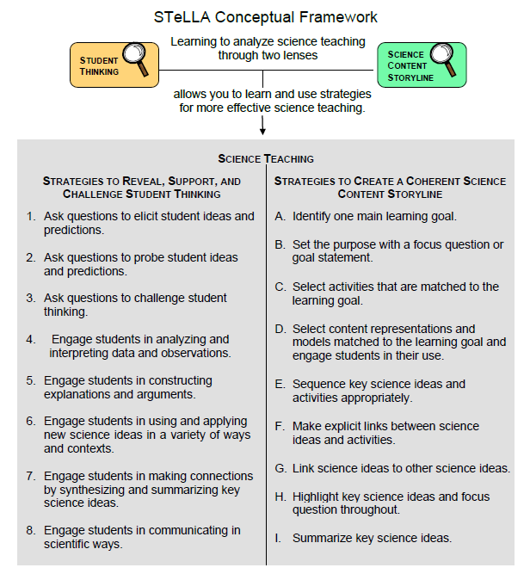
Notes:
Less than 1 min
a. “These are the Student Thinking Lens strategies we’ve explored so far. You’ll get practice using them as you teach the lessons on variations in plants and animals and the lessons on sound next year.”

Slide 17
Review: Student Thinking Lens Strategies
Review the STL summary chart in the STeLLA strategies booklet and discuss these questions:
What pattern(s) do you see in this arrangement (organization) of the STL strategies?
How does this arrangement (organization) highlight the differences and similarities among the Student Thinking Lens strategies?
Notes:
3 min
Individuals: Have participants review STL strategies 1–6 on the summary chart in the strategies booklet (Summary of STeLLA Student Thinking Lens Strategies).
Whole group: Discuss the questions on the slide.
Key ideas:
Strategies 1–3 are types of questions, and strategies 4–6 are activities designed to move student thinking forward toward more-scientific understandings.
Some strategies are used at any time during the lesson (e.g., probe questions); others are used at specific times (e.g., elicit questions used before students have been introduced to new science ideas; use-and-apply activities used after students have been introduced to new science ideas).
Each strategy has it’s own specific purpose(s), but the strategies are closely connected to one another. That is, these strategies aren’t used in isolation; they’re complementary.

Slide 18
Lesson Analysis: Review Lesson Context
Read the lesson context for this video clip at the top of the transcript (handout 4.5 in your PD program binder).
Notes:
1 min
a. “Read the lesson context at the top of the video transcript (handout 4.5 in your PD program binders).”
b. Make sure participants understand the science content and activity that are the focus of this video clip.

Slide 19
Lesson Analysis: Identify Student Thinking Lens Strategies
What Student Thinking Lens strategies can you identify in this video clip?
After watching the video, study the transcript (handout 4.5) and fill in handout 4.6 (Identifying Student thinking Lens Strategies).
Be ready to share your findings with the group, including any missed opportunities.
Link to video clip: 4.2_mspcp_gr1_sound_derose_L2_c1
Notes:
30 min
Note: If absolutely necessary, you can skip this video analysis.
a. Orient participants to handout 4.6, Identifying Student Thinking Lens Strategies.
b. Make sure participants understand the context of the video clip (from the transcript).
c. Show the video clip.
d. Individuals: “Study the video transcript and complete handout 4.6, Identifying Student Thinking Lens Strategies.”
e. Whole group: “What STL strategies did you find in the transcript? Did you spot any missed opportunities?”
Note: See PD Leader Master: Identifying Student Thinking Lens Strategies (Answer Key) for possible responses and examples from the video clips. Participants may come up with different responses.

Slide 20
RESPECT PD Program School-Year Plan
Summer Institute
Content deepening: Variations in Plants and Animals and Sound |  | Lesson analysis: Introduction to the STeLLA framework and strategies
Fall Study-Group Sessions
Fall Teaching Rounds 1 and 2 | Use the STeLLA strategies while teaching lessons on variations in plants and animals. Analyze student thinking and science content storylines using video from our own classrooms. Deepen content knowledge of traits and variations through lesson video analysis. |  | Variations in Plants and Animals
Spring Study-Group Sessions
Spring Teaching Rounds 1 and 2 | Use the STeLLA strategies while teaching lessons on sound. Analyze student thinking and science content storylines using video from our own classrooms. Deepen content knowledge about sound through lesson video analysis. |  | Sound
Notes:
1 min
a. “Before we share our reports about each of the Sound lesson plans and how they support you in practicing these Student Thinking Lens strategies, let’s review the plan for the school year.”
b. “In the fall you’ll teach the Variations in Plants and Animals lessons, and we’ll meet in our study group to analyze video clips and student work from these lessons. This analysis will help us deepen our understandings of the STeLLA strategies, the science content, the lesson plans, and our students’ thinking and learning.”
c. “Starting in January, you’ll teach the Sound lessons, and we’ll meet in our study group to analyze video clips and student work from these lessons. Do you have any questions?”
d. Important reminder: “Remember that we’re analyzing video clips of our own classroom teaching to help us all learn, not to evaluate and critique one another. Everyone is learning to use both new strategies and new lesson plans, so it’s predictable that our first attempts at teaching these lessons will have rough spots. We need to appreciate and acknowledge the courage each of us is demonstrating in sharing our initial efforts to teach these lessons. Please be assured that our analyses of the videos will focus on the strategies, the science content, and most importantly, how students are making sense of the lessons. We’re not going to focus on rough spots or management problems. We’re here to support one another and to learn and grow as science teachers.”

Slide 21
The RESPeCT Lesson Plans as a Study Tool: Part 1
The RESPeCT lesson plans are study tools designed to support your learning and for our study group to analyze.
This has two implications.
These lessons don’t represent a complete unit. You may need to add lessons to help your students achieve all the learning goals, and …
Notes:
2 min
a. Read through the information on this slide.
b. Elicit and respond to any comments or questions from participants.

Slide 22
The RESPeCT Lesson Plans as a Study Tool: Part 2
As a study tool, the lesson plans are highly scripted to model how they might be implemented.
Study this script in your lesson planning.
Adapt the plans and PowerPoint slides to make them work for you and your students (but don’t add or drop main activities).
You don’t have to be tied to the script as you teach! Using the slides as a guide can help free you from the script.
Notes:
2 min
a. Read through the information on the slide.
b. Elicit and respond to any comments or questions from participants.

Slide 23
Lesson Plan Conversation
The science content storyline across lessons
Review the main learning goal for each lesson sequentially.
The science content storyline within lessons (5–8 min for each two-part lesson)
How does this lesson fit into the arc of all the lessons?
What are the main learning goal and focus question?
What is the main activity (or activities)?
How will the activity help students better understand the learning goal for the day?
What STeLLA strategies are highlighted in the activity?
What concerns or suggestions do you have regarding the activity?
Practical issues and questions
Notes:
60 min in conjunction with next slide
a. For step 1 on the slide, have participants describe the main learning goal for their assigned two-part lesson (parts A and B) and how it connects to lessons that precede and follow it. (5 min)
b. For steps 2 and 3, have participants report on their assigned two-part lesson.
Note: Rather than walking through every step in the lesson plan, participants should present the big picture using the questions in step 2 on the slide. They should bring up details only when they have some concern, question, or suggestion about a modification.
c. As participants give their reports, mark on a chart the Student Thinking Lens strategies that are highlighted in each lesson. (Use the chart on the next slide as a model.)
Note: Encourage participants to pick just one or two Student Thinking Lens strategies that are highlighted in the lesson. (Several strategies may be used in a lesson.)
d. Highlight the following ideal pattern and how STL strategies work together across lessons:
Elicit and probe strategies are very important in lesson 1.
Probe and challenge strategies are used throughout all the lessons.
Strategies 4 and 5 are highlighted in the middle lessons.
Strategy 6 is highlighted toward the end of the lesson, after students encounter new science ideas but before final unit assessments.
Timing note: Make sure you limit the time allotted for each lesson so you can get through them all. If you have 6 two-part lessons, you’ll have approximately 8 minutes for each lesson (4 minutes for part A, and 4 minutes for part B). If your lesson series has more than 6 two-part lessons, you’ll have to decrease the time for each lesson.

Slide 24
STL Strategies Highlighted in Sound Lessons
 | 1a | 1b | 2a | 2b | 3 | 4a | 4b | 5a | 5b | 6a | 6b | 7a | 7b
1. Elicit
2. Probe
3. Challenge
4. Analyze/ Interpret
5. Explain/ Argue
6. Use/Apply
Notes:
60 minutes in conjunction with slide 22
a. Use this slide in conjunction with the previous slide.

Slide 25
Sound
SCIENCE AND MATH CONTENT DEEPENING Grade 1
Notes:
Less than 1 min
a. “Our content deepening work for this session will focus using and applying ideas about sound and exploring the concept of nonstandard measurement as it relates to Common Core math standards.”
Note: Refer to the Sound Content Background Document and Common Student Ideas about Sound as needed throughout this phase.

Slide 26
Content Deepening: Focus Question 1
Why do we hear sound?
Notes:
1 min
a. Read the focus question on the slide.
b. Ask participants to write this question in their science notebooks and draw a box around it. This reinforces the practice they’ll follow with students.
c. “To help us answer this question, we’ll use everything we’ve learned about sound this week to explain what happens to sound in various scenarios.”

Slide 27
Falling-Tree Scenario
Courtesy of Hector Mireles
If a tree falls in the forest and nobody is there to hear it, is there a sound?
Notes:
8 min
a. “First, let’s consider some use-and-apply scenarios to review what we’ve learned so far about sound.”
b. Distribute handout 4.7 (Falling-Tree Scenario). Then ask participants, “Do you think a tree makes a sound if it falls in the forest, but no one is there to hear it?”
c. Individuals: “Answer this question on your handouts using the science ideas we’ve learned about this week. Include evidence from our investigations to support your ideas. You may refer to what you’ve written in your science notebooks, as well as other available resources. As you consider this question, think about the key ingredients of sound we’ve talked about. Which of these ingredients are present in this scenario?”
d. Pairs: “Now I’d like you to share your ideas and evidence with an elbow partner.”
e. Whole group: Invite a few participants to share their answers with the group. Record key ideas and evidence on chart paper.
Note: The answer to this question depends on how you define sound. This is an interesting question that will likely generate rich discussion.
Key ideas:
Sound requires specific ingredients, such as a vibrating object (such as cracking wood), air surrounding the object through which the sound waves or vibrations can travel, ears that can receive the sound waves, eardrums that can vibrate, and a brain that can interpret the vibrations as sound. Healthy ears can register pressure waves as sound with the help of the brain.
It would seem that there is no perfect answer to this question. We know that humans and animals perceive pressure waves or vibrations as sound, and to hear sound, a brain has to process it as such. Without eardrums and a brain, the only ingredients of sound in this scenario are the vibrations or pressure waves created when the tree falls, and vibrating air that carries the sound waves away from the source. When the sound waves reach the neighboring trees, however, they are unable to perceive these vibrations as sound because they lack eardrums and brains.

Slide 28
Baseball Scenario
When a batter hits a baseball, who hears the sound? Who receives more sound energy? Why?
Courtesy of Hector Mireles
Notes:
8 min
a. Distribute handout 4.8 (Baseball Scenario).
b. “When a batter hits a baseball, who hears the sound? Which person in this scenario receives more sound energy? Can you illustrate why?”
c. Individuals: “Answer these questions on your handouts and include evidence from our investigations to support your ideas. Think about what happens to the sound waves as they move away from the source.”
d. Pairs: “Now share your ideas and evidence with an elbow partner.”
e. Whole group: Invite a few participants to share their answers with the group. Record key ideas and evidence on chart paper.

Slide 29
Spaceship Scenario
Courtesy of Hector Mireles
If spaceships engaged in a battle in outer space, would the pilots hear the roar of each other’s engines? Why or why not?
Notes:
8 min
a. Distribute handout 4.9 (Spaceship Battle).
b. “If spaceships engaged in a battle in outer space, do you think the pilots would hear the roar of each other’s engines? Why or why not?”
c. Individuals: “Answer these questions on your handouts and include evidence from our investigations to support your ideas. Think about the key ingredients of sound again.”
d. Pairs: “Now share your ideas and evidence with an elbow partner.”
e. Whole group: Invite a few participants to share their answers with the group. Record key ideas and evidence on chart paper.
Ideal response:
Outer space doesn’t have an atmosphere, and there is no way for pressure waves to travel through a space without air. So even if there were vibrations (oscillations) and humans with ears and brains inside the spaceships, sound can’t travel through outer space. So the pilots wouldn’t hear the roar of each other’s engines.

Slide 30
Broken-Guitar Scenario
Predict what will happen to the sound of this broken guitar.
Courtesy of Hector Mireles
Notes:
8 min
a. Distribute handout 4.10 (Broken-Guitar Scenario).
b. “A beautiful guitar is ripped open in such a way that the entire top portion containing the strings, frets, tuner, and bridge is separated from the body of the guitar. What do you think will happen to the sound of this broken guitar?”
c. Individuals: “Write your predictions on your handouts and try to include evidence from our investigations to support your ideas.”
d. Pairs: “Now share your ideas and evidence with an elbow partner.”
e. Whole group: Invite a few participants to share their answers with the group. Record key ideas and evidence on chart paper.
Ideal response:
Since the soundmaker (oscillator) no longer has a resonator, the sound of the strings would be much softer (muted). Resonators amplify sound, making it louder. Without a resonator, any sound the guitar makes won’t be amplified. The sound would still be somewhat musical, like plucking a stretched rubber band, but it wouldn’t be very pleasant.

Slide 31
Reflect: Content Deepening Focus Question 1
Why do we hear sound?
Notes:
5 min
a. Review the focus question on the slide.
b. Individuals: Have participants answer the question in their science notebooks using what they’ve learned about sound this week.
c. Whole group: Invite a few participants to share their responses. Record key ideas and evidence on chart paper.

Slide 32
Measurement
Courtesy of Pixabay.com
Courtesy of Pixabay.com
Notes:
Less than 1 min
a. “Next, our content deepening work will focus on measurement as it relates to the Common Core math standards.”

Slide 33
Content Deepening: Focus Question 2
What does nonstandard measurement look like?
Notes:
1 min
a. Read the focus question on the slide.
b. Ask participants to write this question in their science notebooks.

Slide 34
Just for Fun!
Notes:
Less than 1 min
a. Begin this new focus with a smile by reading the student explanation on the slide.

Slide 35
Common Core Math Standards
Measurement and Data
CCSS.Math.Content.1.MD.A.2
Express the length of an object as a whole number of length units, by laying multiple copies of a shorter object (the length unit) end to end; understand that the length measurement of an object is the number of same-size length units that span it with no gaps or overlaps. Limit to contexts where the object being measured is spanned by a whole number of length units with no gaps or overlaps.
Notes:
Less than 1 min
a. Ask a volunteer to read aloud the 1st-grade Common Core math standard for measurement and data.
b. “The activities we engage in throughout this session will help us deepen and develop our understandings of this standard.”

Slide 36
Courtesy of www.Clker.com
Notes:
Less than 1 min
a. “Rulers are the standard tools of measurement that 1st graders use, but in this session, we’ll develop the idea of measurement using nonstandard measuring tools.”

Slide 37
Your Ideas about Measurement
Why do we measure?
What types of tools do we use to measure?
What are some units we use?
How is measurement learned?
How is measurement taught?
Would you be able to more accurately mark off 10 yards or 10 meters?
Courtesy of Pixabay.com
Notes:
8 min
a. Read the first three questions on the slide.
b. Invite participants to share their ideas for answering these questions and record them on chart paper.
c. Think-Pair-Share: “Now I’d like you to pair up with an elbow partner and talk about the last three questions on the slide. Be prepared to share your ideas with the group.”
d. Whole group: Invite participants to share their answers for the last three questions. Record key ideas on chart paper.

Slide 38
How Would You Measure a Room?
Without using any standard measurement tools, come up with a way to accurately measure your classroom or a room in your home.
As you undertake this task, keep track of all the decisions you make along the way.
Source from teachervision.com
Notes:
10 min
a. Introduce the task on the slide to get participants thinking about nonstandard measurement and the decisions they would have to make to accurately measure a room.
b. Individuals: Ask participants to jot down their ideas in their science notebooks and list all of the decisions they would need to make to accomplish the task.
c. Pairs: Have participants share their ideas with an elbow partner and compare their lists of decisions.
d. Whole group: Invite a few participants to share how they would measure a room without using any standard measurement tools. Ask these questions:
Does the number of decisions involved in this relatively simple task surprise you?
Did anyone consider measuring the volume or surface area of the room?
Did anyone consider the angles of the room?

Slide 39
Developing the Concept of Length
Becoming aware of attributes
Comparing
Quantifying and measuring
Notes:
8 min
a. “Students go through three stages as they develop the concept of length: (1) becoming aware of attributes, (2) comparing, and (3) quantifying and measuring.”
b. Think-Pair-Share: “Think about what each of these stages looks like and consider which stage your students are currently in. Then share your thoughts with an elbow partner.”
c. Whole group: Discuss participants’ ideas about what each stage of development looks like and ask them what stage their own students are in.
Key ideas:
Level 1: Students are aware that some things are long, short, wide, close, near, far, deep, and so on. They might be aware that a pencil is the same length even if they move it to another location.
Level 2: Student can compare the same attribute in different objects, such as the lengths of two pencils.
Level 3: Students can quantify the length, height, size, or other attribute of an object using standard or nonstandard measurement.

Slide 40
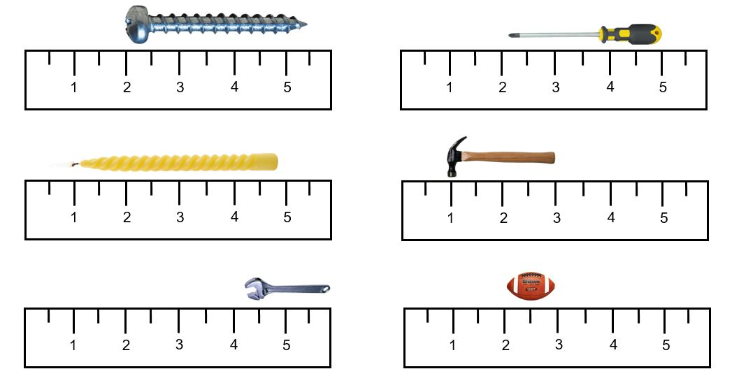
Challenges of Rote Understanding
“Many students use measurement instruments or count units in a rote fashion.” (Clements & Battista, 1992)
Some students will be convinced that this measurement is 5 units.
Photos courtesy of Pngimg.com
Reference
Clements, D.H., & Battista, M.T. (1992). Geometry and spatial reasoning. In Handbook of research on mathematics teaching and learning (pp. 420-464). New York: Macmillan.
Notes:
4 min
a. Individuals: Ask participants to think about how some students might respond to the task on the slide. What is the misconception that needs to be overcome?
b. Whole group: Discuss some of the challenges associated with rote understanding of measurement.

Slide 41
Nonstandard Units of Measurement
Courtesy of Cal Poly Pomona
Notes:
4 min
a. Discuss the nonstandard units of measurement on the slide.
b. Ask participants, “What other nonstandard units of measurement have you used in your class?”

Slide 42
Nonstandard Units of Measurement
How would you quantify the lengths of these pencils?
Photo courtesy of Cal Poly Pomona
Notes:
5 min
a. “How would quantify the lengths of these pencils?”
b. Record participants’ ideas on chart paper.
Note: Participants should observe that the length of one pencil is four large paper clips, and the length of the other pencils is six small paper clips.
c. “Working with nonstandard units of measurement can be challenging, but why?”
d. Consider the value of standard units of measurement.

Slide 43
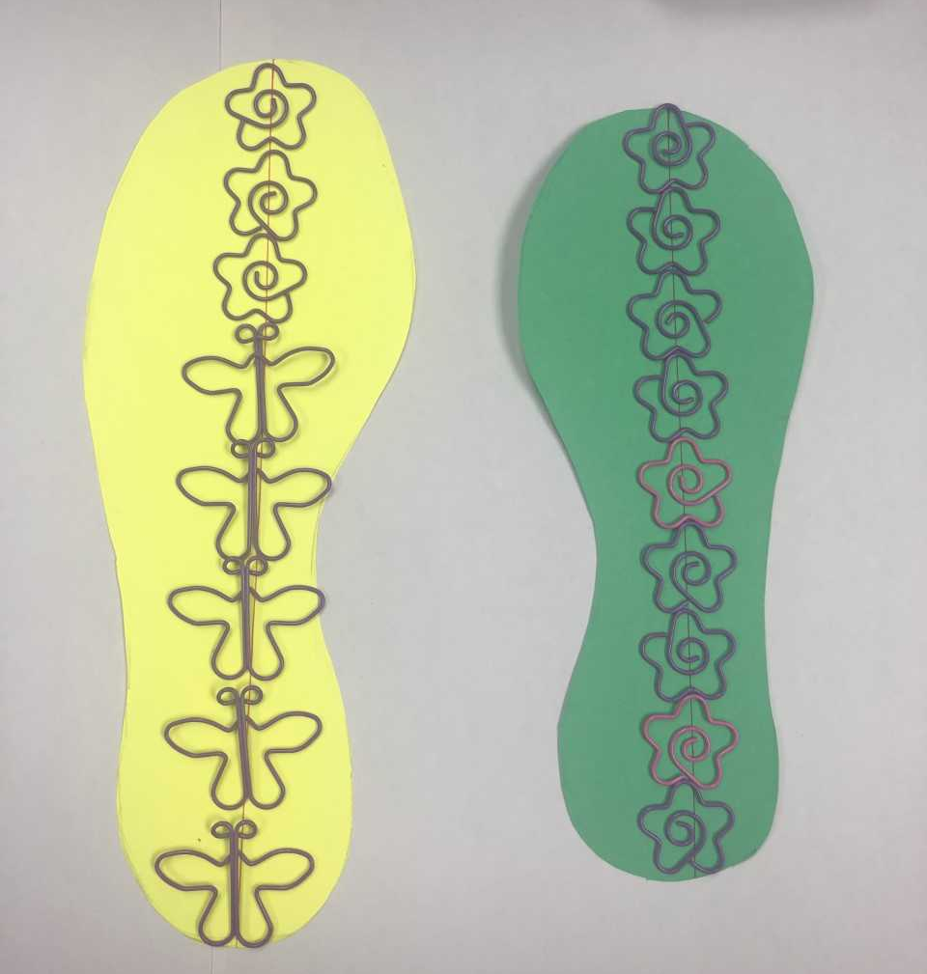
What about These Units of Measurement?
Photo courtesy of Cal Poly Pomona
Notes:
4 min
a. “How would you support the student who measured the yellow footprint using two different units of measurement?”
b. Elicit participants’ ideas about what a unit is and record them on chart paper.
c. Note that identifying a unit is one of the challenges of using nonstandard measurement.

Slide 44
What Does Measurement Mean?
According to the National Council of Teachers of Mathematics (2000), “Measurement is the assignment of a numerical value to an attribute of an object, such as the length of a pencil. At more-sophisticated levels, measurement involves assigning a number to a characteristic of a situation, as is done by the consumer price index.”
Students begin to develop understandings of measurement by making simple comparisons, such as comparing two objects to figure out which is longer and which is shorter.
Notes:
4 min
a. Read the basic and advanced definitions of measurement on the slide.
b. Ask participants how they might support students’ in developing early understandings of measurement in the science lessons.

Slide 45
Teaching Students to Measure
For students to assign a numerical value to a specific attribute of an object, they must first be able to identify the attribute and then compare the attribute against some kind of unit.
To develop measurement sense in students, teachers should present problems that involve estimating and then measuring lengths.
Notes:
Less than 1 min
a. Walk participants through information on the slide.

Slide 46
Courtesy of Cal Poly Pomona
Notes:
2 min
a. Ask participants to examine and evaluate the sample measurement worksheet on the slide.
b. Invite participants to share their observations and comments. Ask specifically what they think about including an estimate column on the data chart.
c. Note that early in the year, teachers can include pictures for each of the objects to help students identify them more easily.

Slide 47
Using Nonstandard Units of Measurement
Work silently with your partner to estimate the length and width of a sheet of paper in nonstandard units. How many paper clips or ladybugs long and wide is the paper? Record this estimate in your notebook.
Then work silently using one of the nonstandard measuring tools (the paper clips or the ladybug tape) to measure the length and width of the paper. Record these measurements in your notebook.
Courtesy of Pixabay.com
Notes:
6 min
a. “To deepen our understandings of nonstandard measurement, let’s practice using nonstandard units to measure a standard piece of notebook paper. To measure the paper, you and a partner will use large paperclips or ladybug tape.”
b. Pairs: Have participants pair up with an elbow partner. Then give each pair several large paper clips and a few strips of ladybug tape (from handout 4.11).
c. “First, estimate the length and width of the paper in nonstandard units and write your estimate in your notebooks. Then use one of the nonstandard measuring tools to measure the length and width of the paper. Record your measurements in your notebooks.”

Slide 48
Using Nonstandard Units of Measurement
Compare your measurements with another team’s measurements.
Was your estimate exactly right?
Did your team’s measurements match the measurements of the other team exactly?
Why do you think the measurements might not be exactly the same? What are the challenges in measuring accurately?
Courtesy of Pixabay.com
Notes:
6 min
a. Pairs: Have participants share their results with another team.
b. Whole group: Ask participants the following questions:
Was your estimate exactly right?
Did your team’s measurements match the measurements of the other team?
Why do you think the measurements might not be exactly the same? What are the challenges?

Slide 49
Standard or Nonstandard Units?
We often use standard units of measurement. These units are standard because they’re always the same size, and they’re universally available.
Sometimes we use nonstandard units of measurement. These units are nonstandard because we invent them, and they’re unknown outside our local context.
It’s acceptable to use standard or nonstandard units of measurement in the classroom depending on your immediate objectives.
Notes:
3 min
a. Read the information about standard and nonstandard units of measurement on the slide
b. “When do you think it’s appropriate to use standard units of measurement? What about nonstandard units?”
c. As participants share their ideas, record them on chart paper.

Slide 50
“You” Units
If you know your birth length, use it to figure out how many “you” units represent your current height.
Your students are likely more than twice their birth length.
Photo courtesy of Pixabay.com
Source from teachervision.com
Notes:
2 min
a. “How many of you know your birth length? If so, here’s a challenge for you: Calculate your current height in original ‘you’ units.”
b. Give participants a minute or two to consider how to use nonstandard “you” units (including fractional units) to calculate their current height.
c. Invite participants to share their results. Then ask them whether this would be a valuable activity for their students.

Slide 51
Challenge: Measuring Distance
Choose a couple of objects or spaces to measure, such as the distance between two objects in the room.
Complete at lease three rows of the handout using your feet as a nonstandard measurement tool.
Questions to think about:
What challenges would your students encounter?
How would you support them?
Notes:
10 min
a. “Next, we’ll measure the distance between objects or spaces in the room using nonstandard units of measurement.”
b. Distribute handout 4.12 (Measuring Distance) and walk participants through the instructions.
c. Pairs: Have participants pair up with an elbow partner to complete the handout.
d. Direct participants to use their own feet as a nonstandard measurement tool for at least three measurements.
e. “As you’re working on this activity, think about the challenges your students might encounter and how you would support them.”
f. Whole group: Following the activity, invite pairs to share their results. Then discuss the challenges students might encounter with the activity and how participants would support students.

Slide 52
How Would You Modify the Activity?
How would you modify this activity to support your students in developing measurement sense and achieving the Common Core standards?
What other Common Core math standards could be incorporated into the activity?
Notes:
3 min
a. Introduce the questions on the slide and ask participants to consider how they would modify the activity and/or the handout to better support their students in developing measurement sense and achieving the Common Core standards.
b. Elicit ideas from participants and record them on chart paper.
Key ideas to highlight:
To work independently, younger students usually need picture cues for the objects they’re going to measure. They could draw pictures of these objects on their handouts.
After record their feet measurements, students should share the results with the class.
It’s appropriate for 1st- and 2nd-grade students to use tally marks or materials such as markers to record the number of units used.
Other math standards that could be incorporated into the activity are adding and comparing.
The handout might also need to be modified.

Slide 53
Reasoning with Units
Which unit would be appropriate for a specific measurement task?
A book
A whiteboard
A truck
A bee
Which unit would yield the most accurate result?
Photos courtesy of Pixabay.com
Notes:
6 min
a. Read the questions on the slide.
b. Think-Pair-Share: Have participants take a moment of think time to consider how they would use each unit of measurement. Then ask them to share their ideas with an elbow partner.
c. Whole group: Invite participants to share their ideas with the group. Record key ideas on chart paper.

Slide 54
Measurement Challenges
Whether to use standard or nonstandard measurement units for a specific task
Using the same unit(s) throughout a task
For repeated measurements, a major challenges is placing the measurement tool (such as a ruler) in the exact spot where the previous measurement ended. Even slight placement errors are multiplied as the task progresses. For example, when measuring a 20-foot wall, even a small overlap or gap of a quarter inch multiplied by the 20 times the ruler is moved turns into a rather substantial error of five inches by the time the measurements are completed.
Notes:
4 min
a. Read through the measurement challenges on the slide.
b. Pairs: Have participants pair up and discuss how they might solve each challenge.
c. Whole group: Invite participants to share their ideas for solving some of the challenges associated with implementing the measurement standard.

Slide 55
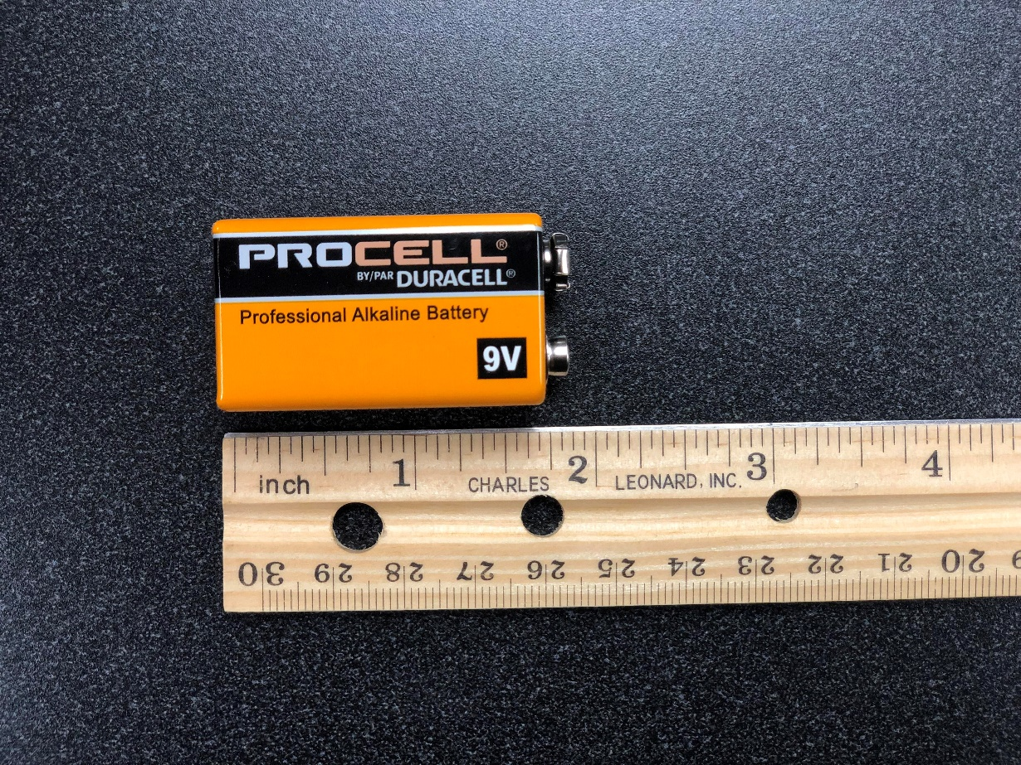
Attending to Precision
Which mark on the ruler is closest to the right edge of the battery?
Is a measurement of 2 inches close enough, or should the answer be more precise, such as 1⁷⁄₈ inches or exactly 1¹⁴⁄₁₆ inches?
Photo courtesy of Cal Poly Pomona
Notes:
2 min
a. “One important Common Core practice standard is attending to precision. How can we achieve this standard in our teaching and support our students in attending to precision as well?”
b. Present the scenario on the slide and elicit participants’ ideas about how they would attend to precision using nonstandard measurement tools in this scenario and support their students in this practice.

Slide 56
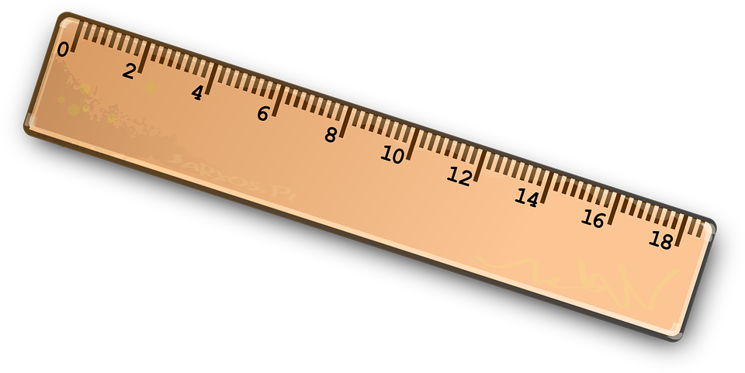
Working with Measurement Tools
The markings on some wooden or plastic rulers begin at the very edge of the ruler. But that isn’t always the case.
It’s essential that students learn to examine their rulers to determine where the markings begin and then measure accordingly.
Photo courtesy of Pixabay.com
Courtesy of Pixabay.com
Notes:
2 min
a. Read the information on the slide.
b. Elicit ideas from participants about how they can support students in learning to work with measurement tools. Also discuss how this relates to the practice standard of attending to precision.

Slide 57
Reflect: Supporting Students
When working with measurements, students encounter many issues at once: recognizing the attribute, identifying the unit, deciding on the level of precision, and making mental calculations.
How can you best support your students in developing measurement sense?
Jot down your ideas in a quick write.
Photo courtesy of Pexels.com
Notes:
3 min
a. Present the quick-write challenge and question on the slide.
b. Individuals: Ask participants to reflect on the question for a moment and then jot down their ideas in a quick write.
c. Whole group: Invite participants to share their ideas with the group. Record key ideas on chart paper.

Slide 58
Where Does Measurement Fit?
Research shows that students need experiences that help them understand why measurement is necessary and helpful.
How does measurement relate to science content? Where does it fit?
How can we incorporate this math standard into our science lessons?
Notes:
1 min
a. “How does measurement relate to science content? Where does it fit? How can we incorporate this math standard into our science lessons?”
b. Relate the Common Core measurement standard to the science content and elicit ideas of how participants could incorporate it into the lessons.

Slide 59
Reflect: Content Deepening Focus Question 2
What does nonstandard measurement look like?
Notes:
5 min
a. Review the focus question on the slide.
b. Individuals: Have participants answer the question in their science notebooks using what they’ve learned about sound this week.
c. Whole group: Invite a few participants to share their responses. Record key ideas and evidence on chart paper.

Slide 60
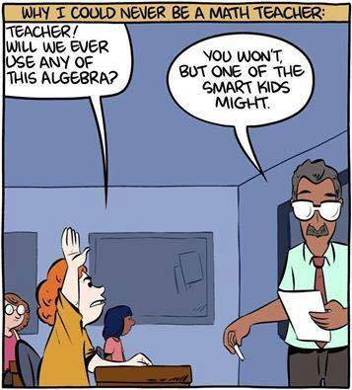
End with a Smile!
Courtesy of Mark Holloway, Flickr
Notes:
Less than 1 min
a. “Since we started our content deepening session with a smile, let’s wrap it up the same way!”

Slide 61
Today’s Focus Questions
Why is it necessary to engage students in using and applying new science ideas in a variety of ways and contexts?
How will the Student Thinking Lens strategies help you teach the Sound lessons?
Why do we heart sound?
What does nonstandard measurement look like?
Notes:
2 min
a. Review today’s focus questions.
b. Individual think time (1 min): Ask participants to reflect on these questions and think about how they might revise their answers.

Slide 62
Let’s Summarize!
Lesson Analysis Strategy 6
What new understandings did you develop?
What do you still have questions about?
Lesson Plans Review
What new insight(s) did you gain?
What do you still have questions about?
Content Deepening
What did you learn?
What do you still have questions about?
Notes:
5 min
a. Individual think time (1 min): Give participants a minute to think about the questions on the slide and consider questions they still have. Challenge them to formulate a statement summarizing what they learned in each area.
b. Whole-class share-out: Have participants share at least two different statements about each of the areas on the slide. Elicit more if time allows.

Slide 63
Homework
Read in the STeLLA strategies booklet:
Student Ideas and Science Ideas Defined
Introduction to the Science Content Storyline Lens
Science Content Storyline Lens, STeLLA Strategy A: Identify One Main Learning Goal
Complete strategy-A column on the Coherent Science Content Storyline Strategies Z-fold summary chart (front binder pocket).
Notes:
3 min
a. “Next week we’ll focus on the Science Content Storyline Lens strategies and explore a new content area: variations in plants and animals. To prepare, complete the homework tasks listed on the slide.”
b. Make sure participants copy the assignment into their science notebooks.”

Slide 64
Reflections on Today’s Session
Complete the Daily Reflections sheet (handout 4.13 in PD program binder).
This weekend you bump into a friend who knew you were attending RESPeCT this week. What would you tell this friend you’ve learned about the STeLLA Student Thinking Lens strategies and their potential impact on your teaching practice and/or student learning?
What do you understand better about sound after this week’s session? What helped clarify your understanding?
Notes:
5 min
a. Give participants time to reflect on today’s session and write their responses to the questions on the Daily Reflections sheet (handout 4.13 in PD program binder).

Slide 65
Norms for Working Together: The Basics
Purpose: Build trust and develop a productive study group for all participants.
The Basics
Arrive prepared and on time; stay for the duration; return from breaks on time.
Remain attentive, thoughtful, and respectful; engage and be present.
Eliminate interruptions (turn off cell phones, email, and other electronic devices; avoid sidebar conversations).
Make room for everyone to participate (monitor your floor time).
Notes:
Hidden slide: Available for use at any time as needed.

Slide 66
Norms for Working Together: The Heart
Purpose: Build trust and develop a productive study group for all participants.
The Heart of RESPeCT Lesson Analysis and Content Deepening
Keep the goal in mind: analysis of teaching to improve student learning.
Share your ideas, uncertainties, confusion, disagreements, questions, and good humor. All points of view are welcome.
Expect and ask questions to deepen everyone’s learning; be constructively challenging.
Listen carefully; seek to understand other participants’ points of view.
Notes:
Hidden slide: Available for use at any time as needed.

