Slide 1
RESPeCT PD pROGRAM
Day 5
RESPeCT Summer Institute
Notes:
5 min
a. Take care of any housekeeping issues.

Slide 2
Agenda for Day 5
Day-4 reflections
Focus questions
Review of strategy 6: use and apply
What is the Science Content Storyline Lens (SCSL)?
Introducing SCSL strategy A
Lesson analysis: SCSL strategy A
Lunch
Content deepening: variations in plants and animals
Summary, homework, and reflections
Notes:
2 min
a. Talk through the agenda for the day.

Slide 3
Trends in Reflections
Lesson Analysis | Science Content Learning
Notes:
5 min
a. Give participants time to review your feedback on their reflections from day 4 and offer reactions, comments, or follow-up questions.

Slide 4
Norms for Working Together: The Basics
Purpose: Build trust and develop a productive study group for all participants.
The Basics
Arrive prepared and on time; stay for the duration; return from breaks on time.
Remain attentive, thoughtful, and respectful; engage and be present.
Eliminate interruptions (turn off cell phones, email, and other electronic devices; avoid sidebar conversations).
Make room for everyone to participate (monitor your floor time).
Notes:
5 min
a. Review the norms as a group.
b. Ask: “Any comments or suggested changes? How are we doing with applying these norms?”

Slide 5
Norms for Working Together: The Heart
Purpose: Build trust and develop a productive study group for all participants.
The Heart of RESPeCT Lesson Analysis and Content Deepening
Keep the goal in mind: analysis of teaching to improve student learning.
Share your ideas, uncertainties, confusion, disagreements, questions, and good humor. All points of view are welcome.
Expect and ask questions to deepen everyone’s learning; be constructively challenging.
Listen carefully; seek to understand other participants’ points of view.
Notes:
5 min
a. Review these norms as a group.
b. Ask: “Any comments or suggested changes? Which of these norms do you think we could get better at applying individually and as a group?”
c. Remind participants: “These norms will become increasingly important during the Summer Institute and throughout the academic year as we analyze one another’s classroom videos and learn together.”

Slide 6
Notes:
2 min
a. Transition: This slide marks the transition from the STL strategies to the Science Content Storyline Lens strategies.
b. “Throughout the PD program, we’ll continue learning about the Student Thinking Lens (STL) strategies, but today we’ll transition to the Science Content Storyline Lens strategies.”
c. Highlight the SCSL strategies on the slide.

Slide 7
Focus for the Week
Content area 2: variations in plants and animals (VPA)
Science Content Storyline Lens
Strategies A, B, C, D, F, G, H, and I
Video-based lesson analysis (VPA lessons)
VPA lesson plans review (last day)
Academic-year schedule (last day)
Video recording
Study-group sessions
Notes:
1 min
a. “This week we’ll focus on a new content area: variations in plants and animals. We’ll also examine the Science Content Storyline Lens strategies and the VPA lessons you’ll be teaching in the fall, analyze video clips of those lessons, and deepen your science-content knowledge related to the lesson plans.”
b. “On the last day of the RESPeCT PD program, we’ll review the lesson plans and the schedule for the academic year.”
c. “You may notice that we skip strategy E: Sequence key science ideas and activities appropriately. This strategy will be addressed during the school year as you teach the STeLLA lesson plans and analyze how they’re sequenced within each lesson and across lessons.”

Slide 8
Today’s Focus Questions
What is the Science Content Storyline Lens (SCSL)?
Why is one main learning goal essential for science content storyline coherence?
How do traits in living things help us understand how they’re grouped and related?
How are trait variations important for the survival of living things?
How can we represent patterns of trait variation among individuals of a species?
Notes:
1 min
a. Introduce the focus questions that will guide today’s work.

Slide 9
Check Your Understanding of Strategy 6
Jot down your responses to this multiple-choice quiz:
Use-and-apply tasks are used [before/during/after] new science ideas are introduced.
For difficult content ideas, students might need to practice applying new ideas in [one/two/many] different contexts.
[True/false]: Use-and-apply questions or activities are used primarily for student assessment at the end of a unit.
It’s appropriate for teachers to ask [elicit/probe/challenge] questions during a use-and-apply activity.
Teachers should [never/judiciously/always] tell students about science ideas they are missing or stating inaccurately.
Notes:
7 min
Note: Display this slide only if it wasn’t used on day 4.
a. “To check your understanding of STL strategy 6, jot down your responses to this multiple-choice quiz in your science notebooks.”
b. Have participants discuss their answers either in pairs or as a group. (If time is short, just read the answers aloud.)
Answer key:
1. After
2. Many
3. False
4. Challenge (and probe)
5. Judiciously (defined as “good or discriminating judgment; wise, sensible, or well advised”)

Slide 10
Use and Apply Your Content Deepening Knowledge
Scenario: You’re peacefully knitting a pair of socks in your living room, when all of a sudden, a fire truck races by your house, and the blaring siren jolts you out of your peaceful state. How did the sound travel from the siren to your ears?
Use and apply what you learned about sound last week to answer this question. Jot down your explanation in bullet points and make sure to use science ideas to support your answer.
Share your ideas with a partner and note any questions that arise.
Notes:
8 min
a. Think-Pair-Share (3 min): “Think about the scenario on the slide. Use and apply what you learned about sound last week to explain how the sound of the siren traveled to your ears. Jot down your explanation in bullet points in your notebooks, making sure to use science ideas to support your answer. Then share your ideas with an elbow partner and note any questions that arise.”
b. Whole-group share-out (4 min): “What ideas did you have for solving this use-and-apply scenario?”
Ideal response:
When an object vibrates, it causes the air around it to vibrate. This vibrating air travels from the object (the siren) through the air to my ears and causes my eardrums to vibrate. My vibrating eardrums send a signal to my brain, and my brain interprets the vibrations as a loud siren that startled me from my peaceful state.

Slide 11
Planning Science Lessons: Quick Write
What is generally your thinking process when you plan your science lessons?
Be prepared to share your ideas with the group.
Notes:
6 min
Note: This activity is a lead-in for thinking about specific SCSL strategies. When planning science lessons, are participants thinking primarily about (1) SCSL issues, such as learning goals, (2) student misconceptions (an STL issue), which is a great start but doesn’t include SCSL strategies, or (3) activities and/or classroom management and timing issues?
a. Individuals: Direct participants to take 2–3 minutes to write down the key things they think about when planning science lessons.
b. Whole group: Ask participants to share their reflections with the group.
c. Tell participants: “The Science Content Storyline Lens strategies should provide some new or additional ways of thinking about planning your science lessons.”

Slide 12
Lesson Analysis: Focus Question 1
What is the Science Content Storyline Lens (SCSL)?
What is a science content storyline, and why is it important?
What is challenging about developing a science content storyline?
Notes:
7 min
a. Small groups: Direct half the group to focus on the first bulleted question on the slide, and the other half to focus on the second. Allow groups 2 minutes to think about their assigned questions as they review “Introduction to the Science Content Storyline Lens” in the STeLLA strategies booklet.
b. Whole group: Have each group share their ideas and responses for these questions.
c. As you listen to participants, make sure that what they’re saying is consistent with the strategies booklet. If you aren’t sure they’re interpreting the text accurately, ask them to identify the specific text they are drawing from.

Slide 13
The TIMSS Video Study Findings and the Science Content Storyline Lens
Source: TIMSS study
Notes:
2 min
a. Emphasize the research basis for the Science Content Storyline Lens and its importance. Remind participants that the data on the slide was presented on day 1 of the PD program.
b. Ask: “What does this graph reveal about US science lessons compared with higher-achieving countries?”
Ideal response: According to the study, US science lessons didn’t do as well linking science ideas to lesson activities; in fact, many lessons were activity focused and included significantly fewer science ideas compared to other countries.
c. Summarize: Point to strategies F and G on the STeLLA strategies poster: Make explicit links between science ideas and activities (strategy F) and link science ideas to other science ideas (strategy G). These strategies and the idea of a Science Content Storyline Lens grew out of the TIMSS research findings.
d. “Today we’ll begin our study of the Science Content Storyline Lens, with a focus on strategy A: Identify one main learning goal.”

Slide 14
Lesson Analysis: Focus Question 2
Why is one main learning goal essential for science content storyline coherence?
Notes:
1 min
a. Read the focus question on the slide.

Slide 15
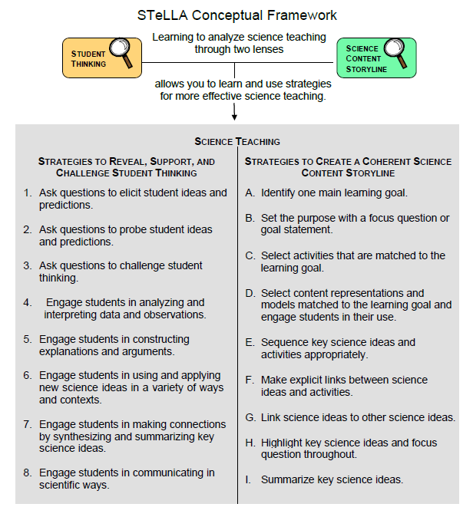
Notes:
1 min
a. “Now let’s dig into SCSL strategy A!”
b. “As you can see, strategy A is the first of nine Science Content Storyline Lens strategies. It appears first because it’s the foundation on which all the other SCSL strategies are built. This will become clearer as we delve into the other strategies and see how important it is that each of them is matched to the lesson’s main learning goal.”

Slide 16
Purpose and Key Features of Strategy A
Review your SCSL Z-fold summary chart and share with a partner the purpose and key features of strategy A: Identify one main learning goal.
Remember to cite passages from the STeLLA strategies booklet.
Be prepared to share with the group.
Notes:
25 min
a. Pairs: “Share with a partner what you wrote on your Science Content Storyline Lens Z-fold summary chart about the purpose and key features of strategy A.”
b. Whole group: Have one or two participant volunteers lead the group in creating a chart that describes the purpose and key features of strategy A.
c. Transition: “Next, we’ll review the difference between a science idea and the main learning goal of a lesson. Then you’ll practice identifying and clarifying this distinction.”

Slide 17
A Main Learning Goal Is …
A big science idea that you want students to learn
A big idea that shows the relationship among science ideas
The focus of the lesson (or series of lessons)
Stated in a complete sentence (for planning purposes)
Stated by the teacher, a student, a text, or a multimedia resource
A support for teacher planning
Notes:
1 min
a. “This slide lists some key ideas about the definition of a main learning goal.”
b. Read through the ideas.
c. Emphasize: “Notice the parenthetical reference to ‘lessons’ in the third bullet point. Each lesson should have only one main learning goal, but you might need two or more lessons to help students accomplish a difficult goal. So it’s often necessary to spend more than one lesson on a specific learning goal.”

Slide 18
A Main Learning Goal Is NOT …
A topic or phrase
An activity
A question
A performance task or objective
A supporting detail, definition, or fact
A student misconception or idea that isn’t scientifically accurate
Notes:
1 min
a. Review what is not considered a main learning goal.

Slide 19
Definitions: One Main Learning Goal and Science Ideas
Read these sections in the STeLLA strategies booklet: (1) STeLLA Strategy A: Identify One Main Learning Goal, and (2) Student Ideas and Science Ideas Defined.
Based on these readings, what are the differences between a main learning goal and a science idea?
Notes:
10 min
a. Have participants locate these two readings in the strategies booklet: (1) STeLLA Strategy A: Identify One Main Learning Goal, and (2) Student Ideas and Science Ideas Defined.
b. “After you read these sections in the strategies booklet, we’ll discuss the differences between a science idea and a main learning goal.”
c. Individuals (3 min): Give participants time to read the specified sections in the strategies booklet.
d. Whole group (7 min): Discuss the question on the slide.
e. Emphasize: “While you might incorporate several science ideas that support the main learning goal of a lesson, be careful not to plan an ‘all about’ lesson with too many different science ideas that will likely come across to students as a bunch of disconnected facts to be memorized.”

Slide 20
Practice Identifying Student Ideas and Science Ideas
Identify any student ideas and science ideas in this list:
Traits and variations
Characteristics of plants or animals of the same group are exactly the same, with no noticeable differences.
Students observe patterns in data on leaf length.
Traits are characteristics that a group of plants or animals of the same kind have in common.
The leaves of plants of the same kind can vary in length.
Trait variations can help individual plants or animals of the same kind survive.
Notes:
5 min
a. “Next, we’ll practice identifying student ideas and science ideas just to make sure you understand the way we’re defining these terms.”
Note: As needed, refer participants to the section in the strategies booklet where student ideas are defined (Student Ideas and Science Ideas Defined).
b. Individuals: “First, identify examples of science ideas on the slide. If you need help, refer to the document in your lesson plans binders titled Common Student Ideas about Variations in Plants and Animals. Then identify examples of student ideas on the slide.”
c. Whole group: Discuss participants’ responses and the correct answers (see answer key).
Answer key:
Student ideas: 2
Science ideas: 4, 5, 6
Neither: 1, 3

Slide 21
Practice Identifying Student Ideas and Science Ideas in a Class Discussion
Identify one student idea and one science idea in this class discussion:
T: Who can tell me what you learned today about variations?
S: Different and same.
T: Tell me more about what you mean.
S: I learned that plants of the same kind look the same.
T: OK.
S: Even though the plants may look the same, they can have differences in the size of their leaves that can help them live better than ones with shorter leaves.
Notes:
5 min
a. “It’s a little trickier to recognize student ideas and science ideas in class discussions because students sometimes give only one- or two-word answers to teacher questions. But if you link the teacher’s question with the student’s response, you can sometimes find a science idea or a student idea.”
Note: In the RESPeCT PD program, we encourage students to speak in complete sentences as much as possible.
b. “Let’s practice linking the teacher’s question with student responses in the sample discussion on the slide.”
c. Pairs: “Work with a partner to see if you can identify one student idea and one science idea in this discussion.”
d. Whole-group share-out: Have participants share the ideas they identified in the sample discussion Then review the answers (see answer key below).
e. Emphasize: “Here’s some food for thought: To make student thinking more visible, why not require students to speak in complete sentences during classroom discussions about science ideas?”
Answer key:
Student ideas:
Plants of the same kind look the same.
“Different and same” is not a complete sentence or a fully articulated idea.
Science ideas:
“Even though the plants may look the same, they can have differences in the size of their leaves that can help them live better than ones with shorter leaves.”

Slide 22
Science Ideas That Support the Main Learning Goal
Main learning goal: Trait variations in plants or animals of the same kind affect which plants or animals survive and which don’t.
Supporting ideas:
Plants or animals of the same group have many similar traits (characteristics).
Plants or animals of the same kind have the same basic features or traits, but traits can vary from individual to individual. These variations can be observed and described.
Trait variations can help a plant or animal survive.
Notes:
6 min
a. Display only the main learning goal on the slide.
b. Pairs: “Work with a partner to come up with two or three science ideas that might support the development of this main learning goal. Use the VPA content background document and the Common Student Ideas chart as resources.”
c. Whole group: Have pairs share the supporting science ideas they came up with.
d. Next, reveal the list of possible supporting science ideas one by one on the slide and compare them with participants’ ideas.
e. Highlight: “Some of these supporting science ideas could also be a lesson’s main learning goal.”

Slide 23
Practice Identifying Main Learning Goals
Small groups or pairs: Use the criteria in Analysis Guide A (handout 5.1 in binder) to analyze a list of candidate main learning goals related to variations (handout 5.2: Practice Identifying One Main Learning Goal).
Select candidates from the list that you think are good main learning goals for the focus of the lesson and record the reasons for your choices on handout 5.2.
Whole group: Discuss and justify your selections.
Notes:
10 min
a. Direct participants to locate handout 5.1 (Analysis Guide A: Identifying One Main Learning Goal) and handout 5.2 (Practice Identifying One Main Learning Goal) in their PD program binders.
b. Small groups/pairs: Have participants form small groups or pairs and use the criteria from Analysis Guide A to analyze the list of possible learning goals on handout 5.2.
c. Direct participants to write yes or no on the handout to indicate whether the statement is or is not a good candidate for a lesson’s main learning goal. Then have them state the reason for each assessment using criteria from the analysis guide.
d. Whole-group share-out: Have participants share and discuss their selections.
e. Be sure to highlight what distinguishes a main learning goal from supporting science ideas, topics, phrases, activities, or questions.
f. Also use this discussion to clarify science content.
Note: For answers, see the PD Leader Master: Practice Identifying One Main Learning Goal (Answer Key).

Slide 24
Lesson Analysis: Strategy A
Next, we’ll watch a sequence of three video clips from a single lesson on variations in plants and animals.
Analysis question for all three clips: Does this lesson have one main learning goal?
Follow-up questions:
If yes, what is it?
If no, what do you think is happening in the lesson?
Notes:
1 min
a. Make sure participants understand that they will be viewing a sequence of three video clips from the same lesson on variations in plants and animals.
b. “For all three clips, we’ll answer the analysis question, Does this lesson have one main learning goal?”
c. “If the answer is yes, what is the learning goal? If no, why do you think that’s the case? What do you think is happening in the lesson?”

Slide 25
Lesson Analysis: Review Lesson Context, Video Clip 1
Read the lesson context on the video transcript (handout 5.3 in PD program binder).
As you watch the clip, keep the analysis question in mind: Does this lesson have one main learning goal?
If yes, what is it?
If no, what do you think is happening in the lesson?
Link to video clip 1: 5.1_mspcp_gr.1.tav_griffin_L8_c1
Notes:
5 min
a. Have participants read the lesson context at the top of the video transcript (handout 5.3 in PD program binder). (Less than 1 min)
b. Read the information on the slide. (Less than 1 min)
c. Show the video clip. (4 min)

Slide 26
Lesson Analysis: Analyze the Video, Video Clip 1
Study the video transcript and write down any science ideas the students and/or the teacher put on the table.
Pair up and compare the science ideas you identified. Then discuss the analysis question: Does this lesson have one main learning goal?
If yes, what is it?
If no, what do you think is happening in the lesson?
As a group, discuss what the main learning goal might be. Support your answers using your analysis of the science ideas you identified.
Notes:
25 min
a. Before participants analyze the video transcript, remind them of these key points: (1 min)
A science idea is a full-sentence idea that students could take away as something they learned during the lesson.
Science ideas are sometimes identified by linking the teacher’s question with the student’s response.
b. Individuals (8 min): “Study the video transcript and write in your notebooks any science ideas you identify in the discussion.”
c. Pairs (5 min): “Pair up and compare the science ideas you identified. Then discuss the questions on the slide.”
d. Whole-group share-out (11 min): Have participants share what they think might be the main learning goal of this lesson, using their analyses of the science ideas they identified.
e. List the possible learning goals on chart paper.
f. Let participants know they’ll revisit this list of possible main learning goals for the lesson after they watch the remaining video clips.
Science ideas:
Video segment 0:03:33: “Will some of [the dandelions] … survive to produce new seeds?”
Possible main learning goal: “Variations in plants and animals of the same kind help them to survive [long enough] so they can produce babies” (segment 0:00:02).

Slide 27
Lesson Analysis: Review Lesson Context, Video Clip 2
Read the lesson context on the video transcript (handout 5.4 in PD binder).
As you watch the clip, keep the analysis question in mind: Does this lesson have one main learning goal?
If yes, what is it?
If no, what do you think is happening in the lesson?
Link to video clip 2: 5.2_mspcp_gr.1.tav_griffin_L8_c2
Notes:
5 min
a. Have participants read the lesson context at the top of the video transcript (handout 5.4 in PD binder). (Less than 1 min)
b. Review the instructions on the slide. (Less than 1 min)
c. Show the video clip. (4 min)

Slide 28
Lesson Analysis: Analyze the Video, Video Clip 2
Study the video transcript and write down any student ideas and science ideas you identify.
Pair up and compare the student ideas and science ideas you identified. Then discuss this question: Are these ideas consistent with the possible main learning goal you identified for video clip 1?
As a group, discuss the possible main learning goal for this lesson. Make sure to support your answers using your analysis of the science ideas you identified.
Notes:
25 min
a. Review the definitions of a science idea and a student idea. Remind participants that students can express correct science ideas and inaccurate student ideas at the same time. (1 min)
b. Individuals (8 min): “Study the video transcript and write in your notebooks any student ideas and science ideas you identify.”
c. Pairs (5 min): “Pair up and compare the student ideas and science ideas you identified. Then discuss the question on the slide.”
d. Whole-group share-out (11 min): Have participants share out what they think might be the main learning goal of this lesson, using their analyses of the science ideas they identified to support their suggestions.
e. List the possible learning goals on chart paper.
f. Let participants know they’ll revisit this list of possible main learning goals for the lesson after they watch one more video clip.
Student ideas:
Video segment 0:00:11: “I think the small one [dandelion] will … will survive because the lawnmower only cuts off, like, half of [it].”
Segment 0:00:29: “Maybe the wind … will blow off the seeds and blow them to a new place and grow.”
Segment 0:05:46: “Because dandelions make the new seed.”
Science ideas:
In several instances, the teacher asks students to clarify their thinking about what happens to the dandelions after the lawn is mowed, but the science ideas aren’t fully explained. For example, at segment 0:04:21, the teacher repeats another student’s idea (“He doesn’t think that the big dandelion is gonna survive”), but the student doesn’t explain why at this point.
Are the ideas consistent with the MLG in clip 1?
Yes. In this clip, students complete drawings that show what they think will happen when the grass in the park is mowed. This scenario was introduced in clip 1.

Slide 29
Lesson Analysis: Review Lesson Context, Video Clip 3
Read the lesson context on the video transcript (handout 5.5 in PD binder).
As you watch the clip, keep the analysis question in mind: Does this lesson have one main learning goal?
If yes, what is it?
If no, what do you think is happening in the lesson?
Link to video clip 2: 5.3_mspcp_gr.1.tav_griffin_L8 _c3
Notes:
5 min
a. Have participants read the lesson context at the top of the video transcript (handout 5.5 in PD binder). (Less than 1 min)
b. Review the instructions on the slide. (Less than 1 min)
c. Show the video clip. (4 min)

Slide 30
Lesson Analysis: Analyze the Video, Video Clip 3
Study the video transcript and write down any student ideas and science ideas you identify.
Pair up and compare the student ideas and science ideas you identified. Then discuss this question: Are these ideas consistent with the possible main learning goal you identified for clips 1 and 2?
As a group, discuss the possible main learning goal for this lesson. Make sure to support your answers using your analysis of the science ideas you identified.
Notes:
24 min
a. Individuals (8 min): “Study the video transcript and write in your notebooks any student ideas and science ideas you identify.”
b. Pairs (5 min): “Pair up and compare the student ideas and science ideas you identified on the transcript. Then discuss the question on the slide.”
c. Whole-group share-out (11 min): Have participants share what they think might be the main learning goal of this lesson, using their analyses of the science ideas they identified to support their suggestions.
d. List the science ideas and possible learning goals on chart paper.
e. Ask: “Did the three video clips develop coherence across the lesson or include too many ideas that didn’t support the main learning goal?”
Student ideas:
The dandelions will survive because they’ll bend.
Science ideas:
The tall dandelion won’t survive.
The tall dandelion won’t produce seeds.
The short dandelion will survive and produce seeds.
Since only the short dandelion survives to produce seeds, there will be only short dandelions in the park the next year.

Slide 31
One Main Learning Goal?
Based on your analysis of the three video clips, does this lesson have one main learning goal? What do you think it is?
Use the criteria questions in Analysis Guide A to analyze the main learning goal identified in these clips.
Are there any supporting science ideas that don’t closely match the main learning goal?
Notes:
15 min
a. Whole group: Discuss the first question on the slide and reach a consensus on the main learning goal for the lesson.
Ideal response: Variations in the length of the dandelion stem (trait) and the environment (mower) affect which plants survive long enough to produce babies (seeds), and thus which variation (short stem) becomes more common in the next generation.
b. Pairs: Have participants work in pairs to answer the criteria questions in Analysis Guide A for this agreed-upon main learning goal. Also have them identify any supporting science ideas that don’t closely match the main learning goal.
c. Whole group: Discuss participants’ responses to the questions in Analysis Guide A and the final question on the slide.
Science ideas:
The tall dandelion doesn’t survive because the mower cuts off its flower, so there won’t be any seeds.
The small-stemmed dandelion survived with its flower.
The trait that varied was the stem.
The variation was the stem length.
The dandelions with the short-stemmed variation are more likely to survive the mower, so they’re more likely to disperse new seeds.
Is the MLG consistent in clips 1, 2, and 3:
Yes, the learning goal overlaps in all three clips during this use-and-apply activity.

Slide 32
Examine Variations in Plants and Animals: Lesson 5a
Locate the scope and sequence chart for the VPA lessons (lesson plans binder, pretab section).
Examine the main learning goal for lesson 5a. Then read the supporting science ideas in the Science Content Storyline column.
Why do you think these ideas are included in this lesson storyline?
Notes:
5 min
Note: This slide is optional if time is running short. It’s designed to help participants see how the lesson plans are written to highlight the main learning goal and science ideas that support the main learning goal.
a. Have participants examine the main learning goal for lesson 5a in the scope and sequence chart of their lesson plans binder. Then have them review the supporting science ideas in the Science Content Storyline column.
b. Ask: “Why do you think these ideas are included in this lesson storyline?”

Slide 33
Variations in Plants and Animals
SCIENCE CONTENT DEEPENING Grade 1
Notes:
Less than 1 min
a. “Now let’s begin our investigation of variations in plants and animals.”
Note: Throughout this content deepening phase, refer as needed to the content background document and Common Student Ideas about Variations in Plants and Animals.

Slide 34
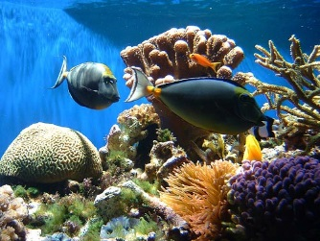
Unit Central Question
How do differences (variations) in plants or animals of the same kind help them survive so they can produce young (babies or seeds)?
Photo courtesy of Pexels.com
Notes:
Less than 1 min
a. Introduce the unit central question on the slide and point out that this is the same question students will think about during the VPA lesson sequence.
b. “This week, we’ll explore science ideas about variations in plants and animals that will help us answer this question.”
c. Have participants write the unit central question in their science notebooks and draw a double-lined box around it to reinforce the practice they’ll follow with their students.

Slide 35
Content Deepening: Focus Question 1
How do traits of living things help us understand how they’re grouped and related?
Photo courtesy of Pexels.com
Notes:
2 min
a. Introduce the focus question on the slide.
b. Have participants copy the question into their science notebooks.
c. Then elicit some initial ideas from participants and record them on chart paper.

Slide 36
Thinking about Differences
What comes to mind when you hear the word diversity or variation?
Photo courtesy of Only_Point_Five
Photograph by Richard Foster
Notes:
2 min
a. “What do you think of when you hear words like diversity or variation? Let’s hear some of your ideas.”
Note: This elicit question is designed to uncover participants’ initial ideas. Don’t try to correct their ideas at this point or lead them to the right answers.
b. As participants share their ideas, record them on chart paper. Ask probe questions to clarify their thinking.

Slide 37
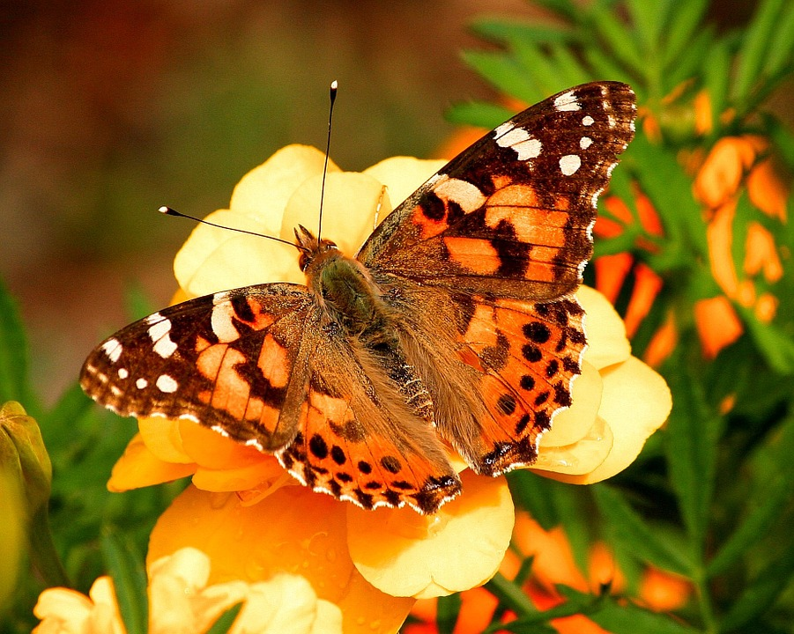
Traits and Trait Variations in Butterflies
As you watch the video clip, identify examples of traits and variations among painted lady butterflies.
Record your observations and ideas in your notebook.
Photo courtesy of Pixabay.com
Link to YouTube video clip: https://www.youtube.com/watch?v=63B1lnqPa8k
Notes:
5 min
a. “As you watch a video clip about the life cycle of painted lady butterflies, look for examples of traits and trait variations in the butterflies and record your observations in your notebooks.”
b. Show the YouTube video from the beginning to segment 4:27.
c. Invite one or two participants to share their observations of butterfly traits and variations with the group.
Observations:
Some traits that vary are the size and shape of the caterpillars, the timing of the silk-button formation, and the timing of butterflies emerging from the chrysalis.

Slide 38
Traits and Trait Variation in Butterflies
What traits did all of the individual butterflies share?
Photo courtesy of Pixabay.com
Notes:
Less than 1 min
a. “What traits did all of the individual butterflies in the video share?”
Possible responses:
The number of legs
The number of body segments
The number of eyes
The life cycle
The basic pattern of colors in the same life stages.

Slide 39
Levels of Life
In the video clip, we identified trait variations among individual butterflies, but life has many levels of organization.
What do you think the phrase “levels of life” means?
Notes:
1 min
Note: This slide marks a transition into a discussion of trait variation at different levels of life.
a. “In the video clip, we identified several trait variations among individual butterflies, but life has many levels of organization.”
b. “What do you think the phrase “levels of life” means?”
c. Invite a few participants to share their initial ideas.

Slide 40
Levels of Life
Notes:
40
1 min
a. “Biologists study life at various levels of organization. Let’s briefly review the levels of life on the slide.”
b. Walk participants through the various levels of life on the slide, but don’t dwell on the details or differences between levels at this point.
c. “Variations can be observed at all of these levels, with the exception of the biosphere, since it’s unlikely we’ll find other biospheres in the universe.”
d. “Each higher level of life may have properties that aren’t necessarily predictable from lower levels. For example, cells may have certain functions and accomplish things that we wouldn’t necessarily be able to predict based on knowing which organelles and molecules make up the cells.”

Slide 41
Levels of Life
Biologists study diversity and variation across many levels of life, including …
Different ecosystems
Different species
Different populations of the same species
Different individuals within a population or species
Different life stages within an individual
Different cells within an individual
The lessons in this unit will focus mainly on variation among individuals within a population or series.
Notes:
Less than 1 min
a. “Biologists study diversity and variation across many levels of life, such as across different ecosystems, species, populations within a species, individuals within a population or species, life stages within an individual, and cells within an individual.”
b. Emphasize that the lessons in this unit will focus mainly on variation among individuals within a population or species.

Slide 42
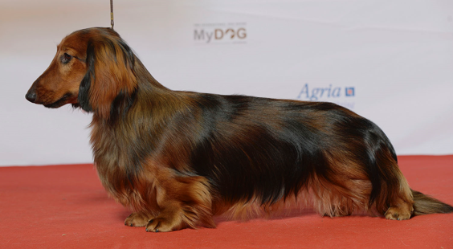
What Is a Trait?
Photo courtesy of Томасина / Wikimedia Commons
Look at this dachshund. What traits can you see? What are some traits you can’t see?
Pairs: Come up with a definition of a trait.
Read section 2 (Defining Traits) in the content background document. Then revise your definition based on this new information.
Notes:
8 min
a. “Look at this photo of a dachshund. What traits do you see? What are some traits you can’t see?”
b. As participants share their observations, record five or six traits on chart paper.
c. Individuals: Ask participants to come up with a concise working definition of a trait. Direct them to write this definition in their notebooks.
d. Whole group: Invite a few participants to share their definitions with the group. As time allows, ask probe questions, such as “What do you mean when you say …?” “Can you define this more precisely?” and “Can you elaborate on that idea?”
e. After the discussion, have participants locate the content background document in their lesson plans binders and read the section titled “Defining Traits.” Then give them a minute or two to revise their definitions based on this information. Their revisions should be in their own words.
f. Emphasize from the reading that traits are features or characteristics of organisms that may be visible or hidden. They aren’t just physical features; they can also be behaviors, molecular characteristics like DNA, chemical pathways, or developmental pathways.

Slide 43
Categories of Traits
Work with a partner to create a thinking map showing categories of traits. Come up with at least one example for each category.
Notes:
6 min
Pairs (3 min): “Now I’d like you to work with an elbow partner to create a thinking map showing categories of traits. Come up with at least one example for each category. Your examples may include traits of dachshunds and other kinds of organisms.”
b. Whole-group discussion (3 min): “What categories of traits and examples did you come up with?”
Note: Ideally, pairs should come up with most or all of the following categories of traits and cite at least one example for each category:
External physical traits (e.g., fur color, eye color, hair length)
Internal physical traits (e.g., brain size, bone structure)
Behavioral traits (e.g., mother feeding offspring with milk)
Molecular traits (e.g., DNA)
Developmental pathways (e.g., stages of butterfly life)
Chemical pathways (e.g., how food is broken down and used)

Slide 44
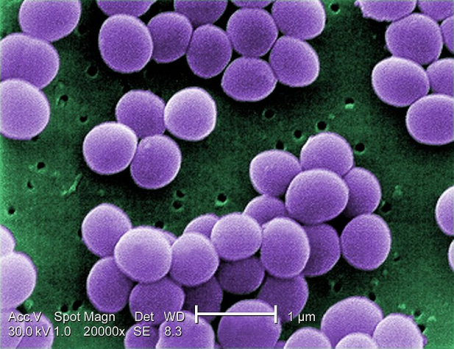
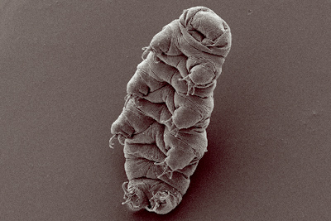
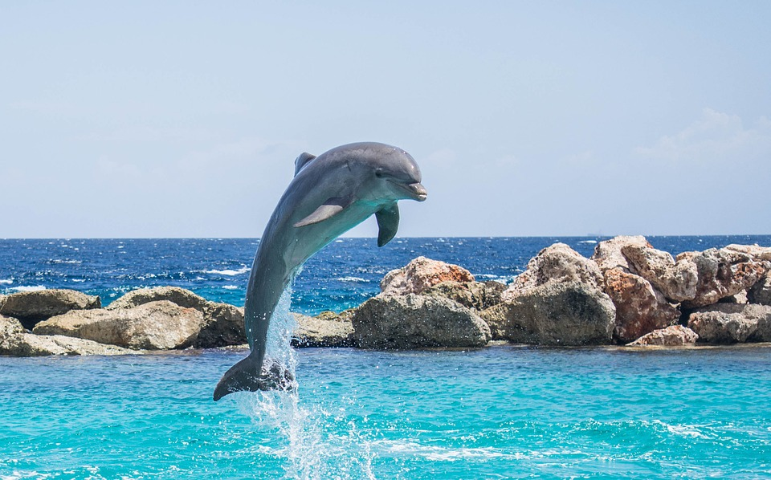
Identifying and Categorizing Traits
Photograph by Richard Foster
Courtesy of Raeky/ Commons Wikimedia
Courtesy of Goldstein lab / Commons Wikimedia
Photo courtesy of Pixabay.com
Notes:
7 min
Note: Hide the photographs during the synonym discussion. Then reveal one photo at a time in the following order: (1) dolphin, (2) tardigrade (water bear), (3) Staphylococcus aureus bacteria, and (4) human beings. Don’t reveal the next organism in the sequence until participants have listed traits for the current organism.
“What synonyms can you think of for the word trait? Let’s try to come up with three or four.”
Write the synonyms on the board; then ask participants which ones their students are most likely to use.
Next, reveal one photograph at a time (see note above) and ask participants to come up with three traits for each of the following organisms:
A dolphin
A tardigrade or water bear. (Note: These amazing organisms can survive in temperatures between −458 ºF to about 300 ºF, and they can live 30 years without food or water.)
A bacteria called Staphylococcus aureus. (Note: Some forms of this bacteria are resistant to antibiotics (methicillin-resistant Staphylococcus aureus) and cause outbreaks in schools and hospitals. Biologists categorize bacteria using common traits, such as the kinds of foods they eat and the chemicals they break down.)
Human beings
List the organisms on chart paper and record the traits participants come up with.
“Now let’s try to categorize these traits using the categories we listed earlier: physical traits, behavioral traits, molecular traits, developmental pathways, or chemical pathways.”

Slide 45
What’s in a Name?
Traits help biologists identify related groups of organisms.
Below are some groups of organisms. In your small group, come up with some traits that distinguish organisms in your assigned group from organisms in other groups.
Plant | Sunflower
Mammal | Conifer
Vertebrate | Fish
Reptile | Bird
Notes:
6 min
a. “Traits help biologists identify related groups of organisms like the ones on this slide. Let’s see if we can identify traits that distinguish each of these groups from other groups of organisms.”
b. Small groups (3 min): Have participants divide up into small groups of two or three. Then assign each pair or threesome one group of organisms on the slide to investigate. To find information about their assigned organism, participants may use a search engine on their smartphones. Direct them to come up with a list of traits that distinguish their group of organisms from other groups on the chart.
c. Whole-group discussion (3 min): Invite a few participants to share the traits they listed for their assigned group of organisms. Ask probe questions to find out why they think these traits distinguish their group of organisms from other groups.
d. “Why might the elicit question ‘What’s in a name?’ be useful to ask from a teaching and learning perspective?”

Slide 46
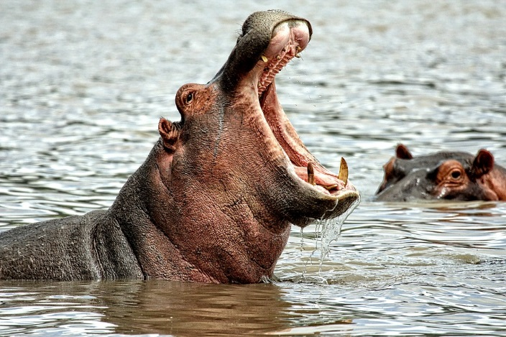
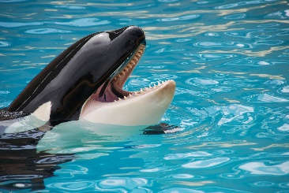
Assign Organisms to Groups
Which group or groups would you assign each organism to based on traits? What’s your evidence?
Photo courtesy of Pixabay.com
Photo courtesy of Pexels.com
Plant | Sunflower
Mammal | Conifer
Vertebrate | Fish
Reptile | Bird
Notes:
5 min
Note: Initially, display only the questions at the top of the slide.
a. “Next, we’ll use our knowledge of traits to assign different organisms to groups.”
b. Reveal the image of the hippo and the chart of organisms.
c. “Look at the organism chart on the slide and think about where you would place the hippo based on specific traits. Which group would be the most specific, or least inclusive? What evidence supports your decision?”
d. Next, reveal the image of the orca whale and ask participants to assign the organism to the least inclusive group on the chart based on specific traits. Make sure participants back up their answers with evidence.
e. Highlight the traits that hippos and the orcas have in common. Then ask, “What are some differences between these organisms? How might these differences help the two species live in its environment?”
Ideal responses:
Similarities: Hippos and whales are both mammals. This means they’re vertebrates with hair, they breathe air and have four-chambered hearts, they make heat internally, and females make milk. Both hippos and whales are large and heavy and have very little hair. Interestingly, they’re closely related in evolutionary history.
Differences:
Whales live in a water environment, while hippos live on land, although they also spend quite a bit of time walking or floating in water (but not swimming).
Hippos have legs (for walking and running); whales have fins (for swimming).
Hippos are herbivores that eats plants, whereas whales are carnivores that eat fish, seals, sharks, and other organisms.
Hippos have smaller teeth for grinding food and larger teeth for cutting food; whales use their teeth only for cutting food, and they swallow smaller fish whole.
The coloring of hippos and orcas is quite different. Orcas are black and white, while hippos are bluish gray or black with pink skin around the eyes and ears and on the belly.
Orcas form pods and are highly social, while hippos aren’t social at all.

Slide 47
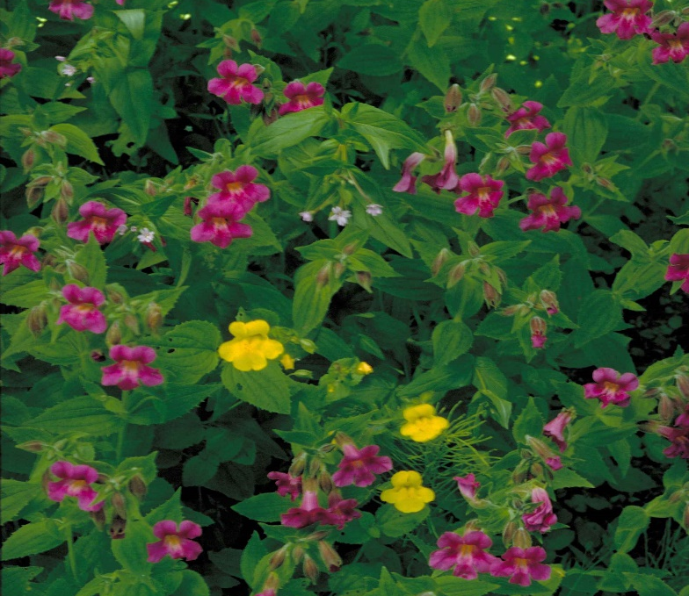
Assign Organisms to Groups
Assign each organism to a group or groups and state your evidence.
Plant | Sunflower
Mammal | Conifer
Vertebrate | Fish
Reptile | Bird
Photo courtesy of Pixabay.com
Photograph by Barnes Dr. Thomas G
Notes:
4 min
Note: Initially, display only the instructions and chart at the top of the slide and the image of the sequoia tree.
a. Ask participants to assign the sequoia tree to the most specific (least inclusive ) group based on traits and include their evidence.
b. Next display the image of the monkeyflower bush and ask participants to assign the organism to the most specific (least inclusive) group based on traits. Make sure they support their choices with evidence.
c. Highlight the traits these plants have in common. Then ask, “What are some differences between sequoias and monkeyflower bushes? How might these differences help the two species live in its environment?”
Ideal responses:
Similarities: Both the sequoia tree and the monkeyflower bush are plants. This means they’re multicellular, make their own food, have cell walls made of cellulose, produce and use a specific type of molecule called chlorophyll for photosynthesis.
Differences: Sequoia trees are conifers, which have needles instead of leaves and produce pine cones. They also don’t lose their needles in winter. Monkeyflower bushes aren’t conifers. They’re also much smaller than sequoias and produce colorful flowers.

Slide 48
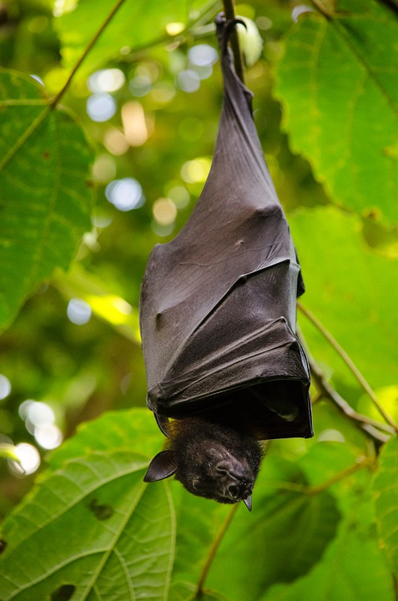
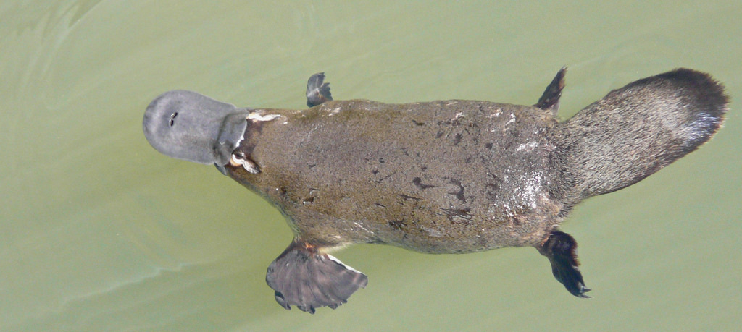
Assign Organisms to Groups
Assign each organism to a group or groups and state your evidence.
Plant | Sunflower
Mammal | Conifer
Vertebrate | Fish
Reptile | Bird
Photo courtesy of Brisbane City Council
Photo courtesy of Brisbane City Council
Notes:
4 min
Note: Initially, display only the instructions and chart at the top of the slide and the platypus photo.
a. Ask participants to assign the platypus to the most specific (least inclusive) group based on traits and include their evidence.
Next display the photo of the bat and have participants assign the organism to the most specific (least inclusive) group based on traits. Make sure they support their choices with evidence.
Highlight the traits these animals have in common. Then ask, “What are some differences between platypuses and bats? How might these differences help the two species live in its environment?”
Ideal responses:
Similarities: Both platypuses and bats are mammals. This means they’re vertebrates with hair, they breathe air and have four-chambered hearts, they make heat internally, and females make milk.
Differences:
Platypuses are semiaquatic; bats aren’t.
Platypuses eat insect larvae, worms, and shrimp; bats primarily eat insects, as well as fruits, flower nectar, and blood.
Platypuses are egg-laying mammals; bats deliver their offspring.
Platypuses have legs; bats have webbed wings.
Platypuses live only in Australia and Tasmania; bats are present throughout most of the world.

Slide 49
Shared Traits That Define Related Groups
Key science idea: Shared traits help biologists define groups of organisms related by common ancestry.
Plants: Multicellular; make their own food; cell walls made of cellulose; use specific type of chlorophyll
Animals: Multicellular; eat other organisms for food; no cell walls
Vertebrates: Most have a backbone; spinal cord; top of spinal cord becomes a brain
Mammals: Vertebrates with hair; breathe air; four-chambered hearts, make heat internally; females make milk
Reptiles: Vertebrates with dry scales; lungs; eggs with many membranes (amniotic eggs)
Notes:
Less than 1 min
a. “This slide and the next list some of the shared traits that define groups of organisms.”
b. Instead of reading all of the traits, list two traits and then highlight the key science idea: Shared traits help biologists define groups of organisms related by common ancestry.

Slide 50
Shared Traits That Define Related Groups
Key science idea: Shared traits help biologists define groups of organisms related by common ancestry.
Fish: Vertebrates with gills; paired fins; scales; aquatic
Birds: Reptile-like vertebrates; feathers; make heat internally; two legs covered in scales; two wings
Conifers: Vascular land plants that make seeds and cones
Sunflowers: A group of species in the flowering plant family Compositae; calyces modified to structures called pappi; anthers connate (forming tubes) and styles modified to function as brushes in a specialized pollen presentation mechanism; ovaries, each containing a single basal ovule; production of sesquiterpene lactone
Notes:
Less than 1 min
a. List two of the traits on the slide and note that some traits become quite specialized in sunflowers.
b. Then highlight the key science idea again: Shared traits help biologists define groups of organisms related by common ancestry.

Slide 51
Common Ancestry
What do we mean when we say that organisms within a group are related by common ancestry?
Answer this question in your science notebook and be prepared to share your ideas with the group.
Notes:
1 min
a. “What do you think we mean when we say that organisms within a group are related by common ancestry?”
b. As participants share their ideas, record them on chart paper.
c. “Common ancestry explains why organisms have many shared features and one might think they are closely related.”
Note: During this discussion, make sure participants understand that heredity is involved and that these two different groupings are related to evolutionary relationships.

Slide 52
Make a Claim
Choose one of the organisms on handout 5.6 (Traits and Groups).
Review the traits for each group of organisms on the handout. Then make a claim stating which group your organism belongs to.
Support your claim with evidence.
Explain your scientific reasoning using science ideas about traits and groupings.
Notes:
10 min
Note: Participants may refer to their resources (e.g. STeLLA strategies booklet) to complete this activity.
a. “For this next activity, you’ll work with a partner to develop a claim stating which group you think an organism belongs to and supporting your claim with evidence and reasoning.”
b. Have participants pair up; then give each pair a copy of handout 5.6 (Traits and Groups).
c. Pairs: Review the instructions on the slide and handout. Then answer any questions before pairs begin working on the tasks.
d. Whole group: Invite pairs to share their claims, evidence, and reasoning. Ask challenge questions as needed, such as “Can you use science ideas we’ve been talking about to further support your claim?” Encourage other participants to agree or disagree, add on, or ask questions.
e. Emphasize that developing an explanation by making a claim and supporting it with evidence and reasoning is an important skill in the NGSS and Common Core and is one of the Student Thinking Lens strategies they’ll explore in more detail later in the PD program. For now, note that one of the most difficult parts of developing an explanation is linking the claim to scientific reasoning and underlying science ideas. For example, the scientific reasoning that explains why dolphins are mammals is that all mammals at one point in time shared a common ancestor. This common ancestor must have had traits (such as having hair and a four-chambered heart, breathing air, generating heat, and making milk) that it passed on to the groups that evolved from it. This reasoning relates to one of the teacher learning goals for this session: One reason groups of organisms share so many features is common ancestry.
Ideal responses:
Question 2 (least inclusive group):
Dolphin: mammal
Lamprey: vertebrate (Note: The lamprey is interesting because it’s classified as a vertebrate but lacks a true backbone. Instead, it has a similar structure made out of cartilage.)
Snail: Animal
Penguin: Bird
Questions 3 and 4 (sample claim, evidence, and reasoning):
I claim that the penguin is a bird. My evidence is that penguins have the following traits of birds: They have vertebrae, feathers, two legs covered in scales, and two wings, and they make heat internally. My reasoning is that scientists put organisms into groups that share certain traits. Scientists believe that these traits have been passed down to them through common ancestors. Penguins have the same traits and the same ancestors as other organisms in the birds group. They aren’t mammals because they don’t share common ancestors or the traits of mammals, such as having hair or making milk.

Slide 53
Main Learning Goal?
What do you think a main learning goal might be for the activities we just completed?
Individuals of the same kind of plant or animal are recognizable as similar but can also vary in many ways.
Notes:
2 min
Note: At first, show only the question at the top of the slide.
a. Read the question on the slide and record participants’ ideas on chart paper.
b. Then reveal the main learning goal on the slide. Emphasize that this is also a learning goal for the VPA lessons.
c. Briefly discuss how well the previous activities aligned with this learning goal.

Slide 54
Reflect: Content Deepening Focus Question 1
How do traits of living things help us understand how they’re grouped and related?
Notes:
3 min
a. Review the focus question on the slide.
b. Individuals: Have participants answer this question in their science notebooks.
c. Whole group: Invite one or two participants to share their answers and reasoning with the group.

Slide 55
Key Science Ideas
Traits are features or characteristics that help biologists identify related groups of organisms.
Organisms have physical traits, molecular traits, behavioral traits, chemical pathways, and developmental pathways.
Organisms in a group share certain traits.
One reason groups of organisms share so many features is common ancestry.
All of the organisms that evolved from a common ancestor inherit shared traits.
Notes:
Less than 1 min
a. Highlight the key science ideas on the slide.

Slide 56
Content Deepening: Focus Question 2
Why are trait variations important for the survival of living things?
Notes:
Less than 1 min
a. Read the focus question on the slide.
b. Ask participants to write the question in their science notebooks.

Slide 57
Traits and Survival
Select three species from the same group of organisms (such as a hummingbird, a crow, and a red-tailed hawk).
Identify traits that differ among the species and how these differences might affect the survival of each species.
Plant | Sunflower
Mammal | Conifer
Vertebrate | Fish
Reptile | Bird
Notes:
7 min
Note: Don’t spend too much time on this activity, since participants should understand the reasoning involved. To stay within the allotted time, you may need to reduce the number of species participants examine.
a. “The purpose of this next activity is to set the stage for understanding the origins of traits in different species.”
b. Direct participants to pair up for this activity.
c. Pairs: “Select three species from the groups of organisms listed on the slide. For example, you might choose a hummingbird, a crow, and a red-tailed hawk. Identify traits that differ among the species and describe how these differences might affect the survival of each organism. For example, you might describe differences in the beaks, feet, and body size among the hummingbird, crow, and red-tailed hawk. Then describe how these trait variations might help each species survive in its environment. For example, the hawk is an active predator with a sharp, hooked beak that helps it tear apart and eat its prey. This trait enables the hawk to tear apart its prey, giving it a survival advantage.”
d. Whole group: Invite one pair of participants to share their descriptions and explanations with the group.

Slide 58
Reflect: Content Deepening Focus Question 2
Why are trait variations important for the survival of living things?
Notes:
3 min
a. Review the focus question on the slide.
b. Individuals: Ask participants to answer the question in their science notebooks and support their ideas with evidence from the activity they just completed.
c. Whole group: Invite one or two participants to share their explanations and evidence with the group.

Slide 59
NGSS Performance Standards
1-LS3.B. Variation of Traits
Individuals of the same kind of plant or animal are recognizable as similar but can also vary in many ways. (1-LS3-1)
1-LS1.A: Structure and Function
All organisms have external parts. Different animals use their body parts in different ways to see, hear, grasp objects, protect themselves, move from place to place, and seek, find, and take in food, water and air. Plants also have different parts (roots, stems, leaves, flowers, fruits) that help them survive and grow (1-LS1-1)
Notes:
Less than 1 min
a. Highlight the NGSS performance standards on the slide.

Slide 60
What Is a Species?
How would you define the word species?
Notes:
1 min
a. “How would you define the word species?”
b. As participants share their ideas, record them on chart paper.

Slide 61
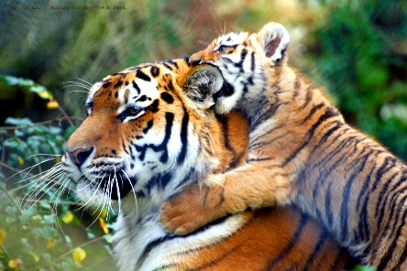
Defining a Species
Photo courtesy of Wikipedia.com
Photograph by Brent Dantley
A species is a group of individuals that can mate and produce fertile offspring under natural conditions.
Notes:
Less than 1 min
a. How many species do you see on the slide?
Note: Participants should identify two species: lion and tiger.
b. Read the definition on the slide and indicate that this is a common definition of a species.

Slide 62
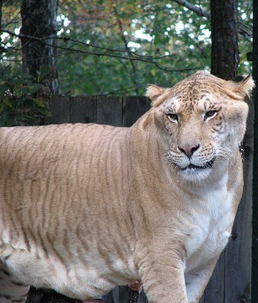
A “Special” Level of Life
Species: A group of individuals that can mate and produce fertile offspring under natural conditions.
Photo courtesy of Wikimeida.org
A liger is a cross between a lion and a tiger.
Notes:
Less than 1 min
a. “The animal on this slide is called a liger, which is a cross between a lion and a tiger. Ligers don’t exist naturally in the wild but are the result of crossbreeding practices. Due to crossbreeding, ligers often have birth defects and die prematurely.”
b. “Based on this evidence, do you still think lions and tigers represent two different species?”
c. Emphasize the words “under natural conditions” in the definition of species. Note under natural conditions lions and tigers don’t overlap and mate, so it’s reasonable to classify them as two different species. However, defining species can be very difficult, especially since the common definition does not apply to special groups of organisms like bacteria or ligers.

Slide 63
Summary Statements
Focus questions:
How do traits of living things help us understand how they’re grouped and related?
Why are variations in traits important for the survival of living things?
Think about the big ideas we’ve explored so far in this content deepening session and write two or three concise sentences in your science notebooks describing these ideas.
Notes:
3 min
a. Revisit the focus questions on the slide.
b. Individuals: “Think about the big ideas we’ve explored so far in this content deepening session and write two or three concise sentences in your notebooks describing these ideas.”
c. Whole group: Invite one or two participants to share their sentences with the group.

Slide 64
Content Deepening: Focus Question 3
How can we represent patterns of trait variation among individuals of a species?
Notes:
3 min
a. Read the focus question on the slide.
b. Individuals: Ask participants to write the focus question in their science notebooks and jot down their initial ideas.
c. Whole group: “What ideas do you have for ways we can represent patterns of trait variation with a species?”
d. “To gather information that will help us answer this question, we’ll explore trait variation within a species of plant.”

Slide 65
Celebrate Variation!
Work with a partner to identify about 15 or 20 individual plants of the same species and a trait you would like to measure. Examples of traits you could measure:
The length of the longest stem on 10 rosemary plants
The length of the biggest leaf on 15 rose stems
The height of the flower on 20 dandelions
The length of 20 different pea pods
Measure this trait for every individual in your sample population. Then record the data on the Plant Species Measurement table in your handout.
Notes:
20 min
a. “To find trait-variation patterns among individuals of a species, we need to work like scientists. This means collecting data on a specific trait from a sample population and then recording the data on a table. That’s what we’re going to do next.”
b. Walk participants through the steps on the slide; then distribute handout 5.7 (Celebrate Variation!). Have participants record their data on the Plant Species Measurements table in their handouts.
Option to save time: To save time, instead of having participants collect their data outside, bring in samples of the same kind of fruit, vegetable, or plant (e.g., 20 bananas, 20 carrots, 20 green beans) for participants to measure.

Slide 66
Create a Histogram
Determine the range in your sample by finding the difference between the largest and smallest measurement.
Divide the resulting range into 4 to 6 intervals.
Count the number of measurements that fall into each interval and record this data on the frequency distribution table in your handout (page 2).
Use the data in your frequency distribution table to create a histogram (bar graph) on your handout that illustrates the results. (See the sample histogram on page 1.)
Notes:
15 min
a. “Now that you and your partner have collected and recorded your data, let’s go over the steps for creating a histogram.”
b. Walk participants through the steps on the slide. Then display the sample frequency distribution table and histogram on the next two slides.
Note: As pairs work on their histograms, be available to answer questions and give direction as needed.
c. After participants have created their histograms, ask them to copy them onto chart paper and then display all the histograms for participants to see.

Slide 67
Sample Frequency Distribution Table
Length Range | Number of Individuals in That Range
6–10 mm | 2
11–15 mm | 6
16–20 mm | 10
21–25 mm | 4
26–30 mm | 3
31–35 mm | 1
Notes:
Less than 1 min
a. Show participants the sample frequency distribution table and note that it also appears in their handouts.

Slide 68
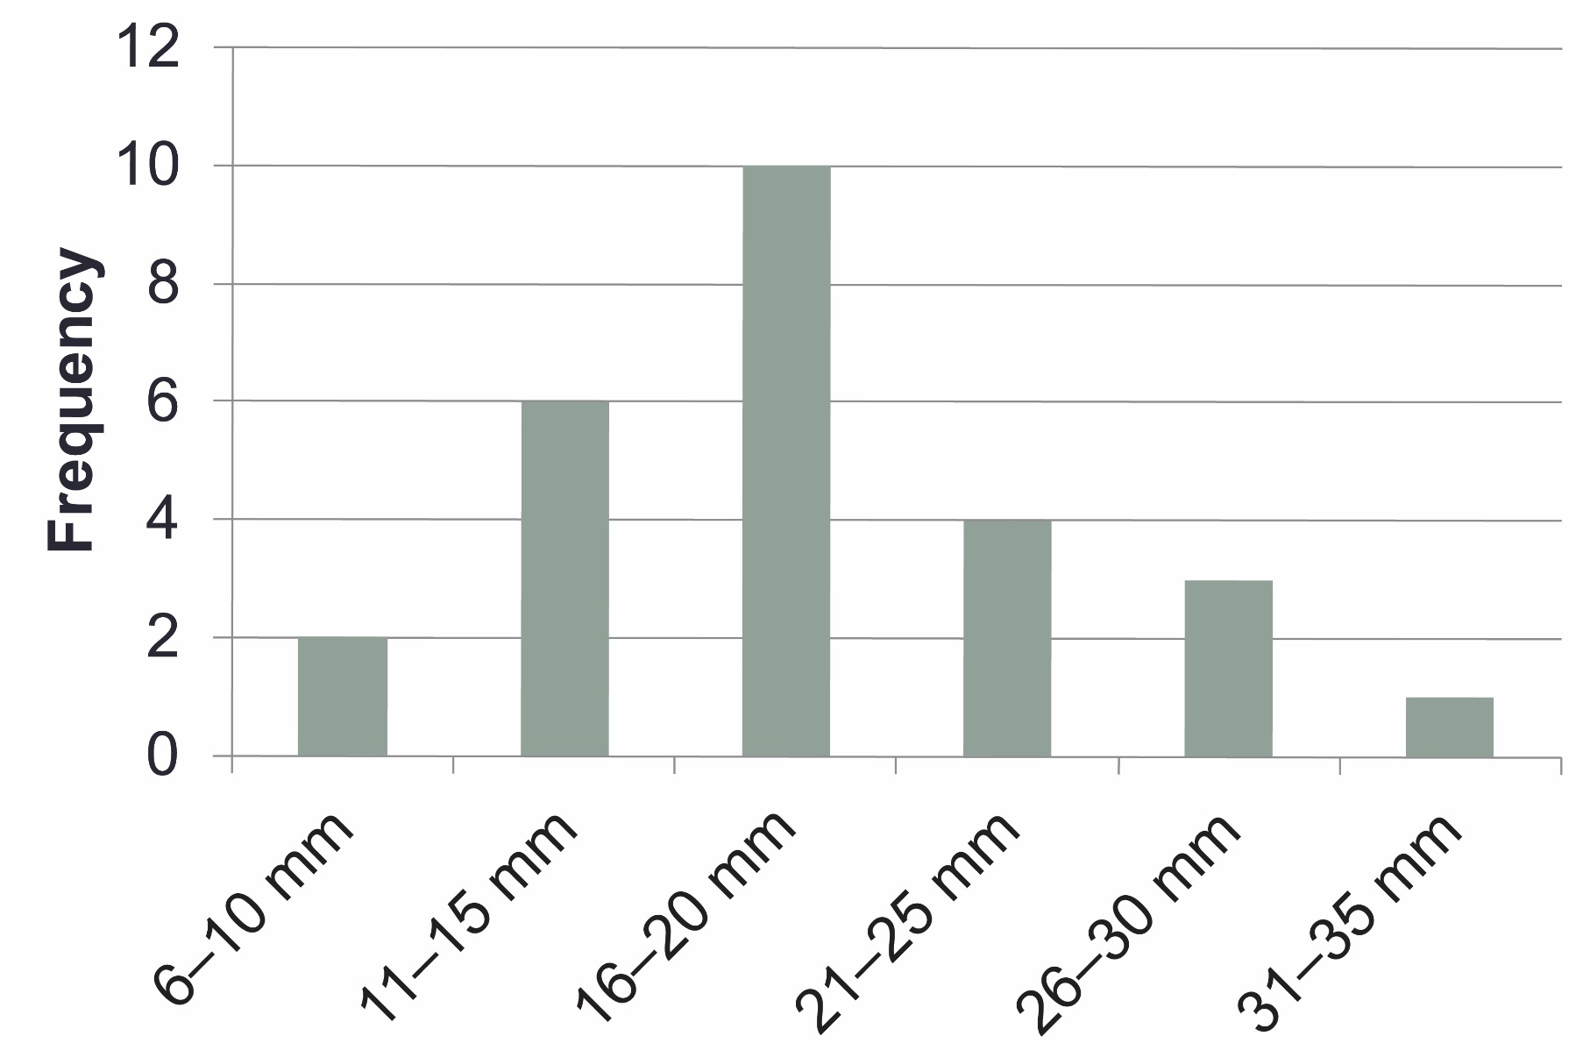
Sample Histogram
Notes:
Less than 1 min
a. Show participants this sample histogram and note that it also appears in their handouts. Highlight the information that should appear on the x- and y-axes.

Slide 69
Interpreting the Results
Sketch a copy of your histogram in your science notebook or on your worksheet.
Draw lines pointing out what you see in the data and use short phrases to describe your observations.
Then draw lines and use short phrases describing what you think the results mean.
Answer the questions on page 3 of your handout independently.
Notes:
7 min
a. Have participants complete the first three steps on the slide. Then have a brief group discussion about their observations and explanations.
b. During this discussion, keep participants focused on what they see in the data (observations of patterns) and what they think the results mean (inferences). Use probe questions to clarify their thinking as needed.
c. Highlight that a common trait-variation pattern is a bell-shaped curve that scientists call continuous variation. Later in the session, participants will contrast this trait-variation pattern with another pattern.
d. “What would the bar graph look like if the trait in our sample showed no variation?”
Note: Participants should recognize that the bar graph would have only one bar.
“Now I’d like you to answer the questions on page 3 of your handouts, using what you already know about traits. Work on this task independently.”

Slide 70
Our Ideas and Questions about Inheritance
Let’s list our ideas and questions about trait inheritance on two charts:
Our Current Ideas about Inheritance
Our Questions about Inheritance
We’ll review and update these ideas and questions periodically.
Notes:
4 min
a. “Let’s list our ideas and questions about trait inheritance on two charts so we can review and update them during our content deepening sessions this week. A similar strategy will be used in lesson 1 to help students keep track of their ideas and questions throughout the unit.”
b. “What do you think accounts for the differences in traits among individuals of the same species? Which types of traits are inherited, and what role might the environment play in some of the differences among individuals?”
Note: Keep this discussion brief.

Slide 71
Main Learning Goal?
What do you think a main learning goal might be for the measuring activity we just completed?
The traits of individuals of the same kind can vary, and some of those traits can be measured. Certain traits help individual plants and animals survive.
Identify some supporting science ideas for this learning goal.
Notes:
2 min
Note: At first, show only the question at the top of the slide.
a. Read the question on the slide and record participants’ ideas on chart paper.
b. Then reveal the main learning goal on the slide. Emphasize that this is also a learning goal for the VPA lessons.
c. Briefly discuss how well the previous activities aligned with this learning goal. Then ask participants to identify some supporting science ideas for this learning goal
d. Emphasize that one way teachers can support this learning goal is by developing histograms and determining what any trait-variation patterns mean.

Slide 72
Reflect: Content Deepening Focus Question 3
How can we represent patterns of trait variation among individuals of a species?
Notes:
3 min
a. Review the focus question on the slide.
b. Individuals: Ask participants to reflect on the question and record their current ideas in their science notebooks.
c. Whole group: Invite one or two participants to share their ideas with the group.

Slide 73
Key Science Ideas
Traits are features or characteristics that help biologists identify related groups of organisms.
Plants or animals of the same group share similar traits that we can recognize. They also have variations in traits that can help them survive.
Some traits in plants or animals of the same kind can be measured, and we can use these measurements to confirm how much variation exists in a trait.
Patterns of trait variation among individuals of a species can be represented in different ways, such as on frequency distribution tables and histograms.
Notes:
Less than 1 min
Review the key science ideas on the slide.

Slide 74
Today’s Focus Questions
What is the Science Content Storyline Lens (SCSL)?
Why is one main learning goal essential for science content storyline coherence?
How do traits in living things help us understand how they’re grouped and related?
How are trait variations important for the survival of living things?
How can we represent patterns of trait variation among individuals of a species?
Notes:
1 min
a. Review the focus questions addressed during today’s session.

Slide 75
Summary: Today’s Lesson Analysis Work
Reflect on today’s session:
STL strategy 6: use and apply
The Science Content Storyline Lens (SCSL)
Science ideas and student ideas
SCSL strategy A: Identify one main learning goal
Based on our work today, do you have any suggestions for modifying our image of effective science teaching?
Notes:
3 min
a. Individual think time (1 min): Ask participants to reflect on the work they accomplished during today’s lesson analysis and think about the question on the slide.
b. Whole-group share-out (2 min): Invite participants to share their ideas for modifying the image of effective science teaching based on today’s work. Revise the chart as needed.

Slide 76
Summary: Today’s Content Deepening Work
Name one main learning goal for today’s content deepening work.
OR
Name one supporting science idea you learned today about variations in plants and animals.
OR
Name one common student idea (misconception) about variations.
Notes:
3 min
a. Individual think time (1 min): Present the options on the slide and give participants 1 minute to come up with a statement that summarizes today’s content deepening work in one of these areas.
b. Whole-group round-robin (2 min): Go quickly around the room and have each participant share one summarizing statement. Push for complete sentences!

Slide 77
Homework
Read in the STeLLA strategies booklet:
SCSL strategy B: Set the purpose with a focus question or goal statement
SCSL strategy C: Select activities that are matched to the learning goal
SCSL strategy I: Summarize key science ideas
STL strategy 7: Engage students in making connections by synthesizing and summarizing key science ideas
Fill in the appropriate columns on your SCSL Z-fold summary charts.
Notes:
3 min
a. Review the homework assignment on the slide and have participants write it in their notebooks.
b. Make sure participants are clear about the reading and writing tasks.

Slide 78
Extended Homework
Locate handout 5.8 (Extended Homework) in your PD program binder.
Between now and Friday, read the scope and sequence for the VPA lesson plans and your assigned lesson(s) in the lesson plans binder.
Be prepared to share your findings in a study-group conversation on our last day.
Notes:
3 min
a. Go over the information on this slide.
b. Have participants review the Extended Homework assignment sheet (handout 5.8), which provides further details about the assignment.
c. In the VPA lesson-plan sequence, lesson 1 has four parts (A–D); lessons 2, 3, and 4 have two parts (A and B); lesson 5 has three parts (A–C); and there are two supplemental math lessons. Assign each two-part lesson to one participant; then assign lessons 1a/b to one participant and lessons 1c/d to another participant. Assign lesson 5 (parts A, B, and C) to one participant and have one or two participants review the supplemental math lessons.
d. Ask if there are any questions about the assignment.
e. Emphasize: The group share-out on the last day of the PD program (day 8) should focus on the assignment-sheet questions (section 2). Participants won’t have time to share all the details of each lesson plan.

Slide 79
Reflections on Today’s Session
Reflect on lesson analysis: In what way(s) did our lesson analysis work and/or our study of SCSL strategy A (one main learning goal) stretch your thinking? Give an example to support your response.
Reflect on content deepening: Describe how our content deepening work today helped you clarify a science-content idea.
Feedback: Provide feedback about today’s session and the program so far (likes, dislikes, questions, concerns, suggestions).
Notes:
7 min
a. Allow at least 5 minutes for participants to think about today’s session and write their reflections and feedback on the Daily Reflections sheet (handout 5.9 in PD program binder).

