Slide 1
RESPeCT PD pROGRAM
Day 6
RESPeCT Summer Institute
Notes:
5 min
a. Take care of any housekeeping issues.

Slide 2
Agenda for Day 6
Day-5 reflections
Review: science content storyline
Today’s focus questions
Lesson analysis: STeLLA strategies B, I, and 7
Content deepening: variations in plants and animals
Lunch
Content deepening (continued)
Lesson analysis: SCSL strategy C
Summary, homework, and reflections
Notes:
5 min
a. Go over the agenda for the day.

Slide 3
Trends in Reflections
Lesson Analysis | Science Content Learning
Notes:
7 min
a. Give participants time to review your feedback on their reflections from day 5 and offer reactions, comments, or follow-up questions.

Slide 4
Review: Science Content Storyline
In your notebooks, jot down …
things you remember from yesterday’s session,
ideas that seem important to you, and
question you have.
Be prepared to share one idea and question with the group.
3
2
1
Notes:
10 min
a. Point out the three tasks on the slide. Allow 4–5 minutes for participants to write their responses in their science notebooks.
b. Have each participant share one idea about the science content storyline that she or he thinks is really important.
c. Then ask participants to share their questions. If you can answer them quickly, go ahead and do so. If a question needs a more detailed response, write it down and schedule a time to address it.

Slide 5
Today’s Focus Questions
How can we begin and end a lesson to help students develop a coherent science content storyline?
How can selecting appropriate science activities help students develop a coherent science content storyline?
How can trait variations affect which plants or animals of the same kind survive long enough to reproduce?
Notes:
2 min
a. Introduce today’s focus questions.

Slide 6
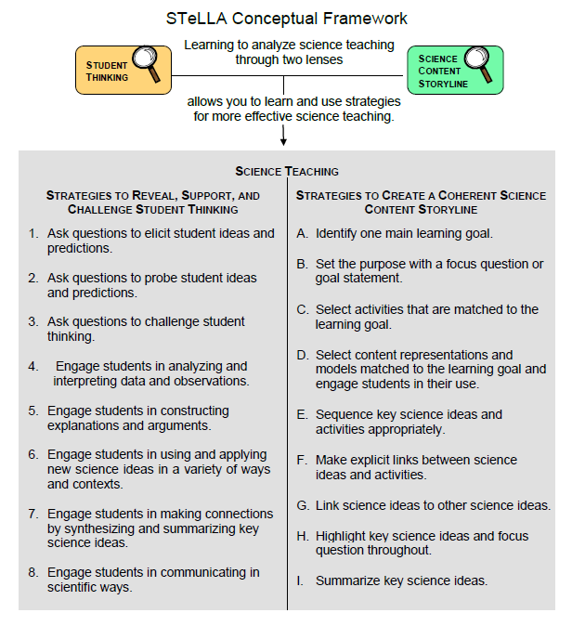
Notes:
1 min
a. “Today we’ll be looking at four new STeLLA strategies. Three of them are Science Content Storyline Lens strategies, and one is a Student Thinking Lens strategy. Throughout the session, think about how these strategies are different from one another and how they are closely linked to each other.”

Slide 7
Lesson Analysis: Focus Question 1
How can we begin and end a lesson to help students develop a coherent science content storyline?
Notes:
Less than 1 min
a. “Now let’s dig into our first focus question.”

Slide 8
Strategies B, I, and 7: Purposes and Key Features
Group 1: What are the purpose and key features of strategy B?
Why is a focus question or goal statement important for science content storyline coherence?
Group 2: What are the purpose and key features of strategy I?
Why is summarizing key science ideas important for science content storyline coherence?
Group 3: What are the purpose and key features of strategy 7?
How does strategy 7 compare with strategy I?
All groups: Make sure to cite ideas from the STeLLA strategies booklet in your answers.
Notes:
25 min
a. Pairs (3 min): Direct participants to retrieve their Z-fold summary charts and share with a partner what they learned from their homework assignment about STeLLA strategies B, I, and 7.
b. Small groups (12 min): Divide participants into three small groups and have them make charts that capture the purposes and key features of the three strategies.
Note: Challenge participants to imagine themselves in a Teacher Leader role. Ask them, “How would you explain these strategies to the teachers you’re leading?”
c. Whole group (10 min): Have small groups share their charts in a whole-group share-out.
Key ideas:
Make sure participants understand that a focus question is designed to do more than just get students interested in the lesson. It gets them thinking about a phenomenon or something else they’ve never thought about before. It also reveals important things about the knowledge and experiences they’re bringing to the lesson, it conceptually situates the learning, and it’s referred to throughout the lesson.
STeLLA strategies B, I, and 7 are like bookends that mark the beginning and end of a lesson. The science ideas used in the summary should match the focus question from the beginning of the lesson, and both the focus question and the summary should match the lesson’s main learning goal.

Slide 9
Discussion Questions: Strategy B
What is the difference between focus questions and goal statements?
Which do you think would be more useful in engaging student interest and making their thinking visible—focus questions or goal statements?
Notes:
7 min
a. Whole group: Discuss the questions on the slide as a group.
Key ideas:
A focus question is designed to be answered using the lesson’s main learning goal and supporting science ideas. A goal statement describes the main science idea to be learned.
Focus questions are always used in RESPeCT lesson plans because they’re useful in engaging student interest, making their thinking visible, and eliciting initial ideas at the beginning of a lesson. When posed at the end of a lesson, focus questions challenge students to use new ideas developed during the lesson.

Slide 10
Discussion Questions: Strategies I and 7
What are various ways a lesson or unit can be synthesized and/or summarized?
How are strategies I and 7 similar and different?
SCSL strategy I: Summarize key science ideas.
STL strategy 7: Engage students in making connections by synthesizing and summarizing key science ideas.
Notes:
7 min
a. Whole group: Discuss the first question on the slide. Participants can refer to the information on strategy 7 in the STeLLA strategies booklet to identify a variety of ways in which key science ideas in a lesson can be synthesized.
b. Emphasize: “Toward the end of a unit, an entire lesson may be devoted to strategy 7, which engages students in synthesizing and summarizing science ideas across several lessons.”
c. Discuss the second question on the slide.
Key ideas:
In strategy I, the teacher creates a summary of key science ideas in the lesson. Strategy 7, however, engages students in synthesizing and summarizing key science ideas in the lesson. When students themselves perform this work, it makes their thinking visible, engages them in active sensemaking, and reveals to the teacher any misunderstandings or gaps in knowledge. Using both strategies brings coherence to a science lesson and is a powerful way to end it.
In strategy 7, summarizing involves making connections between key science ideas, which helps students synthesize the main learning goal or big idea in a lesson.
Summaries should focus on key science ideas, not activities; that is, focusing on “what we learned” versus “what we did.”
For a variety of reasons, a lesson sometimes ends before the main learning goal has been fully developed. However, summarizing work should still take place. For example, the teacher might say, “Our focus question today was How do plants get their food? What have we found out so far?” After students respond, the teacher could reply, “Yes, so far we’ve discovered that water and soil aren’t food for plants. But we still haven’t figured out what is food for plants. We’ll continue working on this question next time.”

Slide 11
Video-based Lesson Analysis
Next we’ll analyze a video clip from the beginning and end of a lesson on variations in plants and animals.
Notes:
Less than 1 min
a. Transition: This slide marks the transition to video-based lesson analysis.

Slide 12
Lesson Analysis: Strategy B
In Analysis Guides B and I (handout 6.1), review the four criteria for strategy B: Setting the purpose.
Read the lesson context at the top of the video transcript (handout 6.2).
Watch the video clip, keeping in mind the criteria for strategy B.
Analyze the transcript using the analysis guide.
How well does the beginning of this lesson match the criteria for strategy B?
Share and compare your analyses.
Link to video clip 1: 6.1_mspcp_gr.1.tav_bernstein_L1_c2
Notes:
20 min
a. Have participants locate Analysis Guides B and I (handout 6.1 in PD program binder) and spend 1 or 2 minutes reading the criteria for strategy B: Setting the purpose.
b. Ask: “Do you have any questions about these criteria?”
c. Emphasize: “Keep the criteria for strategy B in mind as you watch a video clip from the beginning of a lesson about variations in plants and animals.”
d. Individuals: Give participants a couple of minutes to read and think about the lesson context at the top of the video transcript (handout 6.2).
e. Whole group: “How well does the beginning of this lesson match the criteria for strategy B?”
Note: During the discussion, be on the lookout for opportunities to clarify science-content ideas.
Ideal responses for questions from Analysis Guide B:
Implied main learning goal? At video segment 0:01:02, the teacher introduces the unit central question: “How do differences … in plants and animals of the same kind help them to survive?” and at segment 0:02:18, the teacher introduces the lesson focus question, “How are birds alike and different?” The implied main learning goal is that animals (birds) of the same group are similar but not exactly the same.
Uses everyday language? Yes. The focus question uses everyday language (How are birds alike and different?)
Scientifically accurate? The focus question is presented in a scientifically accurate way that’s age appropriate for students.
Goal statement? Not applicable.

Slide 13
Lesson Analysis: Strategy I
In Analysis Guides B and I (handout 6.1), review the six criteria for strategy I: Summarizing key science ideas.
Review the lesson context at the top of the video transcript (handout 6.3).
Watch the video clip, keeping in mind the criteria for strategy I.
Analyze the transcript using the analysis guide.
How well does the end of this lesson match the criteria for strategy I?
Share and compare your analyses.
Link to video clip 2: 6.2_mspcp_gr.1.tav_bernstein_L1_c3
Notes:
20 min
a. Allow participants 1 or 2 minutes to read the six criteria in the analysis guide for strategy I: Summarizing key science ideas.
b. Ask: “Do you have any questions about these criteria?”
c. Emphasize: “Keep the criteria for strategy I in mind as you watch the next clip from the end of the same VPA lesson.”
d. Individuals: Give participants a couple of minutes to read and think about the lesson context at the top of the video transcript (handout 6.3).
e. Show the video clip.
f. Whole group: “How well does the end of this lesson match the criteria for strategy I? How well does the summary statement match the beginning of the lesson?”
Note: During the discussion, be on the lookout for opportunities to clarify science-content ideas.
Ideal responses for questions from Analysis Guide I:
Summary statement/activity? Yes, the teachers engages students in a summarizing activity by asking them to select one trait of an animal (bird) or plant and draw a variation or difference they observed.
Conceptual understanding? The summary activity focuses on the big idea that plants or animals of the same kind have traits that can vary. The teacher will be able to evaluate how well students understand the concepts by reviewing their drawings.
Matched to the MLG and FQ? The science idea in the summary activity is matched to the focus question.
Scientifically accurate? The summary activity is presented in a scientifically accurate way that’s age appropriate for students.
Sensemaking? Students are in the process of selecting the trait they wish to focus on. It’s unclear whether they’re engaged in sensemaking because the video stops before we can see what happens.
Improvements? The summary activity could be improved by getting more students involved. Before students draw the trait variations they selected, the teacher could ask one or two students to come to the front of the class, point to the traits they selected and describe the differences or variations in those traits.

Slide 14
The VPA Lesson Plans: Reading and Analysis
Examine the main learning goal, the lesson focus question, and the lesson summary for your assigned VPA lesson plan (parts A and B).
Answer these questions in your notebooks, keeping in mind the analysis-guide criteria for strategies B and I:
What do you notice?
What do you wonder about?
Notes:
10 min
Note: This slide can be abridged or skipped if time is running short.
a. Read the instructions on the slide and assign a two-part lesson plan (parts A and B) to each participant.
Note: Some of the VPA lessons have more than two parts (lessons 1 and 5), so you’ll need to decide how you want to divide them up among participants.
b. Ask participants if they have any questions about the assignment.
c. Individual reading-and-analysis time (5 min): “Answer the slide questions in your notebooks, keeping in mind the analysis-guide criteria.”
d. Whole-group discussion (5 min): Briefly discuss participants’ observations and questions for their assigned lesson plans.
Note: Participants should see a close match between the main learning goal, the lesson focus question, and the summary. However, also welcome critiques and suggestions for improvement. Just make sure critiques are based on good understandings of the strategies involved.

Slide 15
Variations in Plants and Animals
SCIENCE CONTENT DEEPENING Grade 1
Notes:
Less than 1 min
a. Transition: This slide marks the transition to the content deepening work on variations in plants and animals.
Note: Throughout this content deepening phase, refer as needed to the content background document and Common Student Ideas about Variations in Plants and Animals.

Slide 16
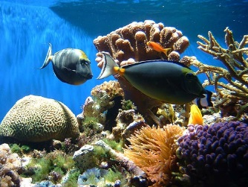
Unit Central Question
How do differences (variations) in plants or animals of the same kind help them survive so they can produce young (babies or seeds)?
Photo courtesy of Pexels.com
Notes:
Less than 1 min
a. Review the unit central question on the slide.

Slide 17
Review
Focus questions from our last session:
How do traits of living things help us understand how they’re grouped and related?
Why are trait variations important for the survival of living things?
How can we represent patterns of trait variation among individuals of a species?
Notes:
1 min
a. Review the focus questions on the slide from the previous content deepening session.
b. “First, let’s review the science ideas from our last session that answer these questions.”
c. Elicit key ideas from the previous session that helped participants answer these questions.

Slide 18
Key Science Ideas
Plants or animals of the same group share similar characteristics or traits that we can recognize.
Plants or animals of the same group also have variations in traits that can help them survive.
Some traits in plants or animals of the same kind can be measured, and we can use these measurements to confirm how much variation exists in a trait.
Patterns of trait variation among individuals of a species can be represented in different ways, such as on frequency distribution tables and histograms.
Notes:
Less than 1 min
Review the key science ideas on the slide.

Slide 19
Role-Play: VPA Lesson 1
Pair up and decide who will be Teacher 1 and Teacher 2 for this role-play.
Teacher 1: Review lessons 1a and 1d, select a 7-minute segment from one lesson to teach, and gather the necessary materials listed on the overview page.
Teacher 2: Review lessons 1b and 1c, select a 7-minute segment from one lesson to teach, and gather the necessary materials.
If you aren’t the one teaching, you’ll be the student.
Notes:
8 min
Note: To allow more time for the investigations from VPA lessons 3 and 4, you may want to scale back the role-plays for lessons 1 and 2 or omit one of them.
a. Orient participants to the role-play and walk them through the instructions on the slide. You may also want to go over how the lesson plans are organized (overview page, general outline, and main lesson plan) and what each section contains.
b. Emphasize that the lesson plans are meant to be used only as a guide to help teachers prepare for a lesson, not as a script to follow. These idealized plans demonstrate how the lessons might be implemented using embedded STeLLA strategies.
c. Share any important lessons you may have learned from teaching these lessons.

Slide 20
Role-Play: VPA Lesson 1
Prepare for the role-play:
Student role: Review the Common Student Ideas document (resources section of binder) and be ready to use these ideas when you’re the student.
Teacher role: Review the anticipated student responses and practice asking each other elicit and probe questions.
Act out the role-play with your partner; then switch roles.
Notes:
15 min
a. Read through the instructions on the slide and answer any questions about the role-play.
b. Have participants pair up and complete the tasks on the slide.
c. Make sure to give pairs adequate time to prepare for and act out their role-plays.

Slide 21
Review: VPA Lesson 1
In what ways did the activity in each lesson (1a–d) align with the corresponding focus question(s)?
How well matched were the activity and main learning goal in each lesson?
What strategies are used to help students summarize the key ideas in each lesson?
How well does the content in each lesson align with the content deepening work from last time?
What level of life (biology) varied in each lesson?
Notes:
8 min
a. Read the questions on the slide.
b. Have participants split up into small groups; then assign one question to each small group.
c. Small groups: Direct groups to discuss their assigned question, develop an answer, and record their answers and ideas in their notebooks.
Note: Encourage participants to refer to the purposes and key features of SCSL strategies A, B, and C in their strategies booklets that are highlighted in the first three questions.
d. Whole-group share-out: Invite groups to share their ideas for answering their assigned question.
e. Highlight the level-of-life variations across different species explored in lessons 1a–d.

Slide 22
Role-Play: VPA Lesson 2
Pair up and decide who will be Teacher 1 and Teacher 2 for this role-play. The person not teaching will be the student.
Teacher 1: Review lesson 2a select a 10-minute segment to teach, and gather the materials.
Teacher 2: Review lesson 2b, select a 10-minute segment to teach, and gather the materials.
Students: Come up with 3 challenge questions the teacher might ask to move your thinking forward.
Practice asking each other elicit, probe, and challenge questions.
Act out the role-play; then switch roles.
Notes:
20 min
a. “In VPA lesson 2, students will explore trait variations within a species.”
b. Walk participants through the instructions on the slide.
c. “If you’re the student in the role-play, look through the lesson and come up with three challenge questions the teacher might ask to move your thinking forward. It’s often difficult to come up with challenge questions spontaneously, so your job as a student is to think of challenge questions that relate to ideas you’d expect your students to struggle with. Make sure to share these questions with your partner before you begin the role-play.”
d. Share any important lessons you may have learned from teaching the lesson.
e. Have participants pair up and complete the tasks on the slide.
f. Make sure to give pairs adequate time to prepare for and act out their role-plays.

Slide 23
Review: VPA Lesson 2
In what ways did the activity in each lesson (2a and 2b) align with the corresponding focus question(s)?
How well matched were the activity and main learning goal in each lesson?
What strategies are used to help students summarize the key ideas in each lesson?
How well does the content in each lesson align with the content deepening work from last time?
Notes:
7 min
a. Read the questions on the slide.
b. Have participants split up into small groups; then assign one question to each small group.
c. Small groups: Direct groups to discuss their assigned question, develop an answer, and record their answers and ideas in their notebooks.
Note: Encourage participants to refer to the purposes and key features of SCSL strategies A, B, and C in their strategies booklets that are highlighted in the first three questions.
d. Whole-group share-out: Invite groups to share their ideas for answering their assigned question.

Slide 24
Common Core Math Standards
Order three objects by length; compare the lengths of two objects indirectly by using a third object (1.MD.A.1)
Express the length of an object as a whole number of length units, by laying multiple copies of a shorter object (the length unit) end to end; understand that the length measurement of an object is the number of same-size length units that span it with no gaps or overlaps. Limit to contexts where the object being measured is spanned by a whole number of length units with no gaps or overlaps. (1.MD.A.2)
Organize, represent, and interpret data with up to three categories; ask and answer questions about the total number of data points, how many in each category, and how many more or less are in one category than in another. (1.MD.C.4)
Notes:
1 min
a. Read the 1st-grade Common Core math standards for measurement and data on the slide.
b. Note that these standards will be addressed in the supplemental math lessons in the VPA unit.

Slide 25
Math Connections!
Read through supplemental math lessons 1 and 2 in your lesson plans binder. Then answer these questions in your science notebooks:
What activity do students engage in?
What materials are needed for this activity?
How well does the activity fit the unit central question?
How is the activity relevant to the math concepts your 1st graders learn about?
Notes:
8 min
a. Introduce the task and questions on the slide.
b. Individuals: Have participants answer the questions in their science notebooks.
c. Whole group: Invite participants to share their answers to the questions.
d. Ask participants, “How could you emphasize the math concepts outside the science lessons?”

Slide 26
Let’s Summarize!
Read section 3 (Variation in Traits) in the content background document.
Write a sentence in your notebook summarizing key ideas from the reading.
Be prepared to share your summary statement with the group.
Notes:
4 min
a. Individuals: Have participants read section 3 (Variation in Traits) in the content background document and then write a sentence in their notebooks summarizing key ideas from the reading.
b. Whole group: Invite a few participants to share their summary statements with the group.

Slide 27
Content Deepening Focus Question
How can trait variations affect which plants or animals of the same kind survive long enough to reproduce?
Notes:
1 min
a. “Next, we’ll investigate ideas about trait variations from VPA lesson 3. The evidence we gather will help us answer our content deepening focus question, How can trait variations affect which plants or animals of the same kind survive long enough to reproduce?”
b. Ask participants to write the question in their science notebooks.

Slide 28
Lesson-3 Focus Questions
Will bigger or smaller cottonwood-tree seeds be more likely to survive and grow when the wind carries them away? Why do you think so?
Notes:
1 min
a. Introduce the focus questions from VPA lesson 3 on the slide.
b. Ask participants how these questions relate to the content deepening focus question, How can trait variations affect which plants or animals of the same kind survive long enough to reproduce?
c. Note that a more specific focus question was chosen for students because it’s likely to be more engaging and easier for them to answer.

Slide 29
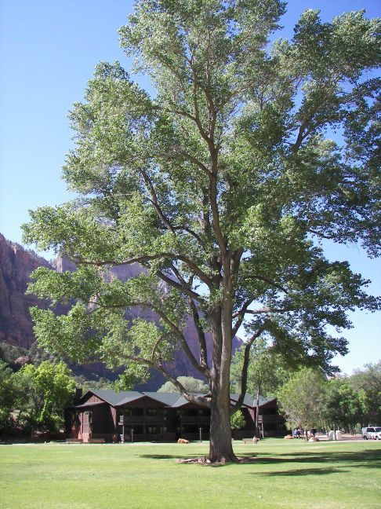
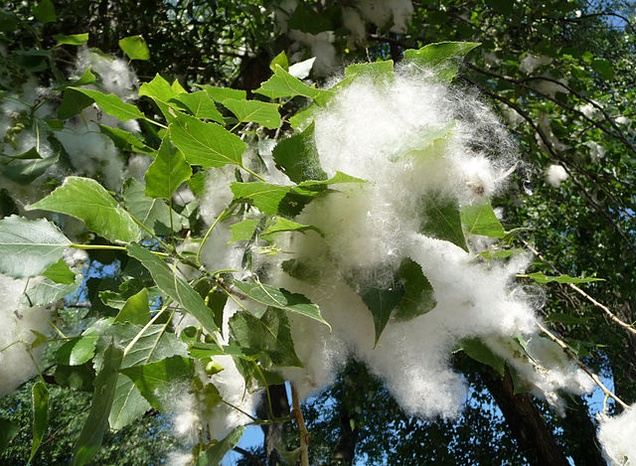
What Is a Cottonwood Tree?
Photograph by George Chernilevsky/Wikimedia Commons
Photograph by Amy Gaiennie/Wikimedia Commons
Notes:
5 min
Note: Some of the following content was taken from VPA lesson 3a.
a. “The tree on this slide is a cottonwood tree. Why do you think it’s called a cottonwood tree?”
b. “Who can describe what this tree looks like? What are some of its traits?”
c. As participants share their ideas, record them on chart paper.
d. “Now look carefully at the fluffy, white stuff on the leaves. What do you think it is?”
e. After participants share their ideas, explain that the white stuff isn’t cotton but is actually where the seeds are located. Note that cottonwood seeds are attached to structures that resemble tufts of cotton. These tufts, which are actually the fruit of the tree, allow the seeds to travel long distances on wind currents before landing on the ground. In other words, the fruit contains or holds the seeds in cottonwood trees and dandelions. This entire structure is called a seed because it’s easier for 1st graders to understand, even though the term isn’t technically correct.
f. “Next, let’s list some traits and variations of cottonwood-tree seeds. What are some possible traits?”
g. As participants share their ideas, record them on chart paper.
h. “Now let’s list some possible variations in cottonwood-seed traits.”
i. Record participants’ ideas on chart paper.
Possible cottonwood-seed traits:
Seeds are made of a cotton-like material.
Seeds are white.
Seeds are fluffy.
Seeds are attached to a “ball” of cotton-like material.
Possible cottonwood-seed variations:
Seed shape
Seed weight
Seed size (including the ball of cotton material)

Slide 30
Cottonwood Seeds Blowing in the Wind
Let’s watch a short video clip of cottonwood-tree seeds blowing in the wind.
Photograph by George Chernilevsky/Wikimedia Commons
Link to video clip: https://youtu.be/9Cgvjm04EVg
Notes:
1 min
a. Show the YouTube video clip of cottonwood seeds blowing in the wind.
b. Following the clip, invite participants to briefly share their comments and observations.

Slide 31
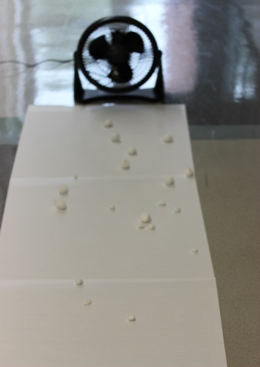
Cottonwood-Seed Model
What does the fan represent?
What do the cotton balls represent?
What does the paper on the floor represent?
What does the line on the paper marked “Tree” represent?
Photo courtesy of BSCS
Notes:
7 min
a. Have participants locate VPA handout 3.4 in their lesson plans binders and read through the protocol for the cottonwood-seed investigation.
b. While participants are reading, set up the cottonwood-seed model based on the instructions in the handout.
c. Ask participants what different parts of the model represent in the natural world.
Fan = wind blowing the cottonwood seeds
Large cotton balls = large cottonwood seeds
Small cotton balls = small cottonwood seeds
Butcher paper on the floor = the ground
Line on the paper marked “Tree” = where the tree is standing
d. Run through the demonstration for participants so they understand how to drop the cotton balls in front of the fan. Also explain and demonstrate the method you want them to use to mark where the cotton balls land on the paper.

Slide 32
What Do You Think Will Happen?
Will the bigger or smaller cotton balls (cottonwood seeds) travel farther when the wind blows them? Why do you think so?
Write your predictions in your notebook using this sentence starter:
I predict the [bigger or smaller] cotton balls will travel farther on the wind because …
Notes:
2 min
a. Read the question on the slide.
b. Individuals: Ask participants to write their predictions in their science notebooks using the sentence starter.
c. Whole group: Invite two participants with different predictions to share them with the group and include their reasoning.

Slide 33
How Far Will the Cotton Balls Fly?
Photo courtesy of BSCS
Notes:
15 min
a. Before starting the investigation, review how participants should drop their cotton balls in front of the fan to ensure consistent results.
b. Give each participant five large cotton balls and five small cotton balls to drop in front of the fan. Then walk participants through the investigation, following the steps on handout 3.4.
c. Have the first participant drop each cotton ball in front of the fan one at a time and then mark where it lands on the butcher paper using the method you demonstrated earlier. Participants should drop one large cotton ball in front of the fan and mark where it lands and then drop a small cotton ball and mark where it lands, and then repeat the same steps for the remaining cotton balls.
d. Have other participants continue this procedure one at a time until everyone has dropped their cotton balls and marked where they landed.
e. After the activity, display the butcher paper where everyone can see the results.
Note: The end of the paper closest to the fan should be labeled “Tree” so participants can easily see which cotton balls or seeds landed closer to the parent tree and which landed farther away.
f. Ask participants to examine where the large and small cotton balls (or cottonwood seeds) landed and describe any patterns they observe.
Note: Participants should observe that the smaller cotton balls traveled farther from the fan than the larger cotton balls. These results reflect what happens when the wind blows large and small cottonwood seeds away from the parent tree. The larger seeds typically land closest to the tree, and the smaller seeds travel farther away from the tree.

Slide 34
Reflect: Lesson-3 Focus Questions
Lesson-3 focus questions: Will bigger or smaller cottonwood-tree seeds be more likely to survive and grow after the wind carries them away? Why do you think so?
Think about the results of our investigation. Then complete this sentence in your science notebook:
I think [bigger or smaller] cottonwood-tree seeds are more likely to survive and grow into new cottonwood trees because …
Notes:
5 min
a. Review the focus questions for VPA lesson 3 on the slide.
b. Individuals: Ask participants to think about the results of the cottonwood-seed investigation and then answer the questions in their notebooks using the sentence starter on the slide.
c. Whole group: Invite a few participants to share their responses with the group. Make sure they include evidence from the investigation to support their ideas.

Slide 35
Lesson-4 Focus Question
What helps some cottonwood-tree seeds survive and grow while other seeds don’t?
Notes:
Less than 1 min
a. Introduce the focus question from VPA lesson 4 on the slide.
b. “To help us answer this question, we’ll explore how trait variations determine which cottonwood seeds survive and which don’t.”

Slide 36
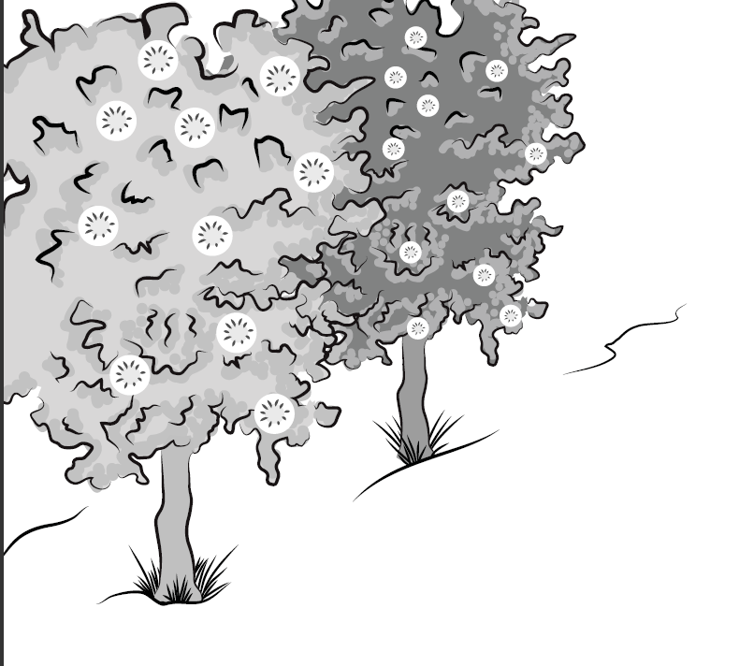
A Story about Two Cottonwood Trees
Notes:
2 min
a. “Listen to this story about two cottonwood trees and their seeds.”
b. “Two cottonwood trees live side by side at the edge of a forest. It’s late in the summer, and the trees have produced a lot of seeds that hang from their branches. One cottonwood tree produces small seeds, and the other cottonwood tree produces big seeds. All the seeds need is a strong gust of wind to come along and carry them away.”
c. Explain that wind is stronger than the air from a fan, so real cottonwood-tree seeds would travel farther than the cotton balls did in the cottonwood-seed model.

Slide 37
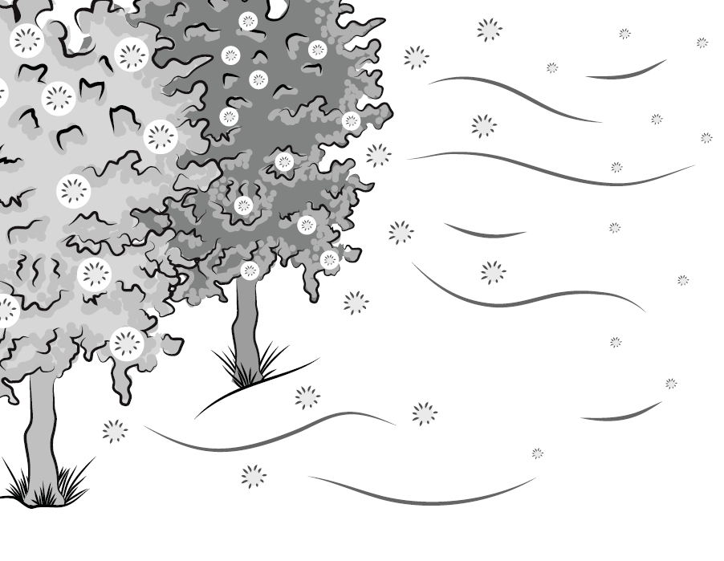
The Wind Starts to Blow!
Notes:
Less than 1 min
a. “All of a sudden, the wind starts to blow, and the seeds take off! Where are they headed? How far will they fly?”

Slide 38
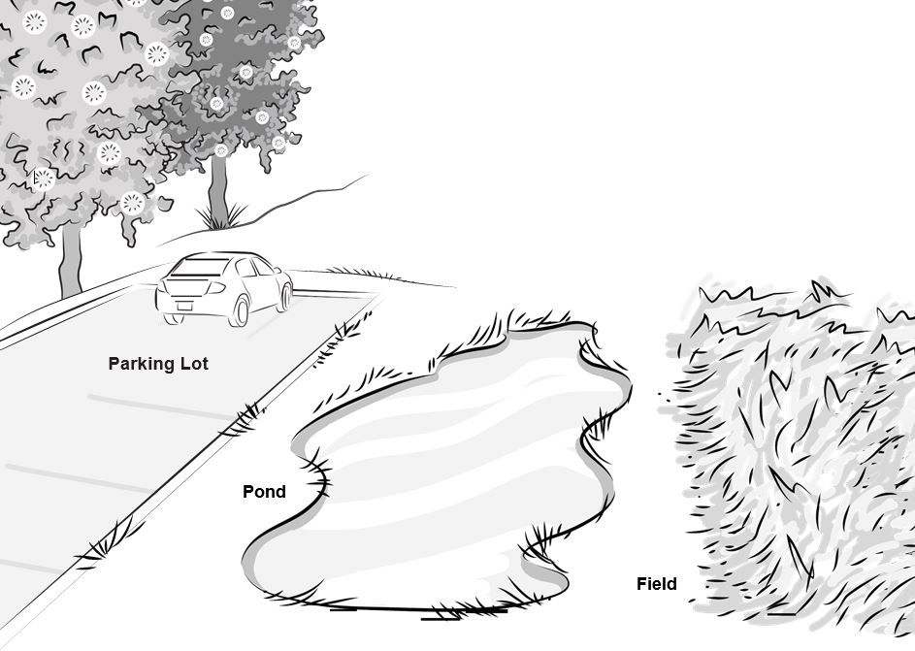
Where Will the Cottonwood Seeds Land?
Which of the cottonwood-tree seeds will land in a place where they can survive and grow into new cottonwood trees? Why?
Notes:
12 min
a. “Not far from the edge of the forest are three very different environments: a parking lot, a pond, and an open field. The parking lot is closest to the edge of the forest, the pond is a little farther away, and the open field is just beyond the pond. Which of the cottonwood-tree seeds will land in a place where they can survive and grow into new cottonwood trees?”
b. After finishing the story, have participants write the questions on the slide in their science notebooks.
c. Pairs: Ask participants to pair up with an elbow partner and discuss the questions. Then have them record their ideas and reasons in their science notebooks.
d. Whole group: “Let’s hear your ideas and reasoning. Where do you think the big and small cottonwood seeds will land? Which of the three environments will give the seeds a better chance of surviving and growing into new cottonwood trees?”
e. After participants share their ideas, have them turn to lesson 4a in their lesson plans binders and review the prediction strategy the teacher uses with students to show where they think the big and small cottonwood seeds will land and which environment will give them a better chance of surviving. Then ask participants to look through the rest of the lesson and review how students are asked to record and share their predictions.
Note: If time allows, have participants read through lesson 4b and summarize key science ideas about the environment based on the lesson content.
f. Invite participants to share their comments and observations.

Slide 39
Reflect: Lesson-4 Focus Question
What helps some cottonwood-tree seeds survive and grow while other seeds don’t?
Notes:
7 min
a. Review the focus question on the slide.
b. Individuals: Have participants answer the question in their science notebooks and include evidence from today’s investigation to support their ideas.
c. Then have participants read the ideal student response to the focus question and the science content storyline on the overview page of lesson 4a. Afterward, give them time to revise their responses, if desired.
d. Whole group: Invite participants to share their ideas and evidence with the group.

Slide 40
Reflect: Content Deepening Focus Question
How can trait variations affect which plants or animals of the same kind survive long enough to reproduce?
Notes:
8 min
a. Review the focus question on the slide.
b. Pairs: Ask participants to pair up with an elbow partner and share their ideas for answering the question. Make sure they include evidence from today’s investigation to support their ideas. Then have them record their answers in their notebooks.
c. Whole group: Invite a few participants to share their ideas and evidence with the group.
d. As participants share their responses, record key ideas on chart paper. Remind others to listen carefully to the responses and be prepared to agree, disagree, or add ideas from the investigations.
e. If time allows, have participants review the student and teacher learning goals in their lesson plans binders (pretabs section). Then discuss which goals have been addressed in the content deepening sessions so far.

Slide 41
Lesson Analysis: Focus Question 2
How can selecting appropriate science activities help students develop a coherent science content storyline?
Notes:
1 min
a. Read the focus question on the slide.
b. “To help us answer this focus question, we’re going to explore STeLLA strategy C: Select activities that are matched to the learning goal.”

Slide 42
Strategy C: Purpose and Key Features
According to the strategies booklet, what are the purpose and key features of strategy C: Select activities that are matched to the learning goal?
Notes:
25 min
a. Ask participants to locate the section on strategy C in the STeLLA strategies booklet.
b. Have one participant lead the group in creating a chart that summarizes the purpose and key features of strategy C: Select activities that are matched to the learning goal.
c. Ask: “What does the strategies booklet say about science activities that are fun and engaging for students?
Ideal responses:
Activities should be selected because they can support students in understanding the main learning goal, not because they’re fun or easy to do.
Avoid activities that are only topically related (e.g., something about plants); instead, activities should focus on a specific science idea that is closely linked to the main learning goal (e.g., Plants get their food by making it out of carbon dioxide, water, and light energy).
Activities should not just be interesting supplements to the science content storyline; they should help develop it.
d. Follow-up: “Think back on science-lab activities in high school or college. Did these activities play a key role in helping you better understand the science concepts presented in textbooks or lectures? Or were they more like add-on activities that were only loosely related to the science concepts being taught?”

Slide 43
Lesson Analysis Question
Main learning goal: Plants or animals of the same group share similar characteristics or traits that we can recognize. They also have variations in traits that help them survive.
Focus questions: How are sunflowers alike and different? What traits and variations do they have?
Analysis question: Is the activity well matched to the main learning goal?
Notes:
2 min
a. For this lesson analysis, participants will view a set of three video clips from one VPA lesson.
b. Review the main learning goal and focus questions on the slide. Then introduce the analysis question: Is the activity well matched to the main learning goal?

Slide 44
Lesson Analysis: Strategy C
Write this main learning goal at the top of Analysis Guide C (handout 6.4):
Plants or animals of the same group share similar characteristics or traits we can recognize. They also have variations in traits that help them survive.
For this analysis, we’ll watch three video clips from the same VPA lesson.
Before each clip: Read the lesson context at the top of the corresponding video transcript.
After each clip: Complete part 1 of the analysis guide.
Links to video clips: 6.3_mspcp_gr.1.tav_bernstein_L2_c2; 6.4_mspcp_gr.1.tav_bernstein_L2_c3; 6.5_mspcp_gr.1.tav_bernstein_L2_c4
Notes:
60 min
Note: Refer to the VPA content background document as needed throughout this lesson analysis.
a. Have participants locate Analysis Guide C (handout 6.4) in their PD binders and write the main learning goal for the selected VPA lesson at the top. Then orient them to part 1 of the analysis guide.
b. Before each video clip: Have participants read the lesson context at the top of the corresponding video transcript (handout 6.5 for clip 3, handout 6.6 for clip 4, and handout 6.7 for clip 5).
c. Show each video clip.
d. After each clip (individuals or pairs): Allow time for participants to review the analysis guide, write down science ideas revealed in the activity, and assess how well matched these ideas are to the main learning goal.
Note: For sample responses to the analysis-guide questions, see PD Leader Master: Analysis Guide C: Selecting Activities Matched to the Learning Goal (Answer Key).

Slide 45
Lesson Analysis: Strategy C
Discuss these questions with a partner:
Were the activities well matched to the learning goal? Provide evidence to support your response.
Suggest ways to improve the match between the activities and the main learning goal (part 2, Analysis Guide C).
Be prepared to share your ideas in a group discussion.
Notes:
10 min
a. Pairs: “Discuss the questions on the slide and be ready to share your ideas with the group.”
b. Whole group: Discuss how well the activities in the video clips matched the main learning goal and ask participants to offer suggestions for improving the match.
Key ideas:
During clip 1, students still seemed to be having difficulty with the concept of traits, so adding variation to the mix was confusing. We need to make sure that students understand that plants or animals of the same group or kind (species) share recognizable traits, and that students are able to demonstrate this understanding by describing traits in pictures before talking about variations in those traits, which is the primary focus of the main learning goal.
These activities didn’t focus on the link between trait variation and the ability of individual plants or animals to survive long enough to produce babies or seeds.
It’s unclear in the video clips whether students analyze the flower data they collected.
Note: Also see PD Leader Master: Analysis Guide C: Selecting Activities Matched to the Learning Goal (Answer Key).

Slide 46
Lesson Analysis: Strategy C
Study the video transcripts again and gather evidence to answer these questions:
What kept students focused on the main learning goal?
What distracted students from the learning goal?
Notes:
5 min
a. Read the questions on the slide.
b. Individuals: Direct participants to look for evidence in the video transcripts that will help them answer these questions.
c. Whole group: Ask one or two participants to share their ideas and evidence in response to the questions.

Slide 47
Practice: Strategy C
Main learning goal: Plants or animals of the same group share similar characteristics or traits we can recognize. They also have variations in traits that help them survive.
Candidate activities:
Students draw a monster. Then they compare their drawings and group them according to similarities.
Students bring pictures of their pets to class and identify similarities and differences among them.
Questions:
How well does the activity match the main learning goal?
How might the activity be changed to better match the main learning goal?
Notes:
7 min
Note: This activity may be skipped if time is running short.
a. Individuals (2–3 min): “Think about how well the activities on the handout are matched to the main learning goal. Be prepared to give a rationale for your choices.”
b. Whole group: Invite participants to share their ideas and reasoning with the group.
Ideal responses:
Neither activity is well matched to the main learning goal.
Both activities should focus not just on similarities and differences but on variations in traits that help individual plants or animals survive.

Slide 48
Today’s Focus Questions
How can we begin and end a lesson to help students develop a coherent science content storyline?
How can selecting appropriate science activities help students develop a coherent science content storyline?
How can trait variations affect which plants or animals of the same kind survive long enough to reproduce?
Notes:
Less than 1 min
a. Remind participants of today’s focus questions.

Slide 49
Summarize Today’s Work
Hold up three fingers when you have all of these in mind:
One idea you’re taking away about strategy C: Select activities that are matched to the learning goal
One idea you’re taking away about strategies B, I, and 7:
Set the purpose with a focus question or goal statement (strategy B)
Summarize key science ideas (strategy I)
Engage students in making connections by synthesizing and summarizing key science ideas (strategy 7)
One science idea about variations that you’re taking away from today’s content deepening work.
Notes:
7 min
a. Individuals: Read the instructions on the slide and give participants enough time to come up with three ideas to summarize today’s work.
b. Whole group: In a round-robin, invite participants to share a key idea for each category on the slide. (Allow participants to pass if they wish.)

Slide 50
Homework
In the STeLLA strategies booklet, read about SCSL strategy D:
Select content representations and models matched to the learning goal and engage students in their use.
Fill in the appropriate column on your SCSL Z-fold summary chart.
Notes:
Less than 1 min
a. Go over the homework assignment and have participants write it in their notebooks.
b. Make sure participants understand each part of the assignment.

Slide 51
Reflections on Today’s Session
How are STeLLA strategies B, I, 7, and C related to one another?
What new insights or questions have emerged about trait variations in plants and animals?
Only two more days are left of our time together at the Summer Institute. What burning questions do you think should be answered before the end of the week?
Notes:
7 min
a. Allow participants at least 5 minutes to think about today’s session and write their reflections and feedback on the Daily Reflections sheet (handout 6.8 in PD program binder).

