Slide 1
RESPeCT PD pROGRAM
Day 7
RESPeCT Summer Institute
Notes:
5 min
a. Take care of any housekeeping issues.

Slide 2
Agenda for Day 7
Day-6 reflections
Focus questions
Introducing SCSL strategy D
Sample analysis of content representations
Lesson analysis: SCSL strategy D
Lunch
Content deepening: variations in plants and animals
Summary, homework, and reflections
Notes:
5 min
a. Talk through the agenda for the day.

Slide 3
Trends in Reflections
Lesson Analysis | Science Content Learning
Notes:
5 min
a. Give participants time to review your feedback on their reflections from day 6 and offer reactions, comments, or follow-up questions.

Slide 4
Norms for Working Together: The Basics
Purpose: Build trust and develop a productive study group for all participants.
The Basics
Arrive prepared and on time; stay for the duration; return from breaks on time.
Remain attentive, thoughtful, and respectful; engage and be present.
Eliminate interruptions (turn off cell phones, email, and other electronic devices; avoid sidebar conversations).
Make room for everyone to participate (monitor your floor time).
Notes:
2 min
a. Review the norms and ask participants to think about areas where they could improve individually or as a group.
b. “How do you think we’re doing individually and as a group applying these norms? Do you have any comments or suggestions about areas where we could improve?”

Slide 5
Norms for Working Together: The Heart
Purpose: Build trust and develop a productive study group for all participants.
The Heart of RESPeCT Lesson Analysis and Content Deepening
Keep the goal in mind: analysis of teaching to improve student learning.
Share your ideas, uncertainties, confusion, disagreements, questions, and good humor. All points of view are welcome.
Expect and ask questions to deepen everyone’s learning; be constructively challenging.
Listen carefully; seek to understand other participants’ points of view.
Notes:
5 min
a. Review the norms that are at the heart of the RESPeCT program and ask participants to think about areas where they could improve individually or as a group.
b. Emphasize: “We’re doing quite well with our norms, but as we approach the fall, I hope to see our interactions evolving so that you feel comfortable interacting less through your PD leaders as the ‘teachers’ and direct more of your questions and comments to one another, challenging each other, piggybacking on each other’s ideas, and listening carefully to one another so that everyone is contributing to the kind of productive analysis that will help us figure out ways to strengthen our students’ science learning.”
c. Offer an opportunity for participants to comment on how the group is doing with these norms. Ask, “Are there any areas where we could improve? Any suggested changes?”

Slide 6
Today’s Focus Questions
How do you know when a content representation is appropriate and matched to the main learning goal?
How can we engage students in using content representations and models in meaningful ways?
How can we design experiments to test for genetic and environmental causes of trait variation?
How would biologists explain how a trait changes within a population over time?
Notes:
1 min
a. Introduce the focus questions on the slide.

Slide 7
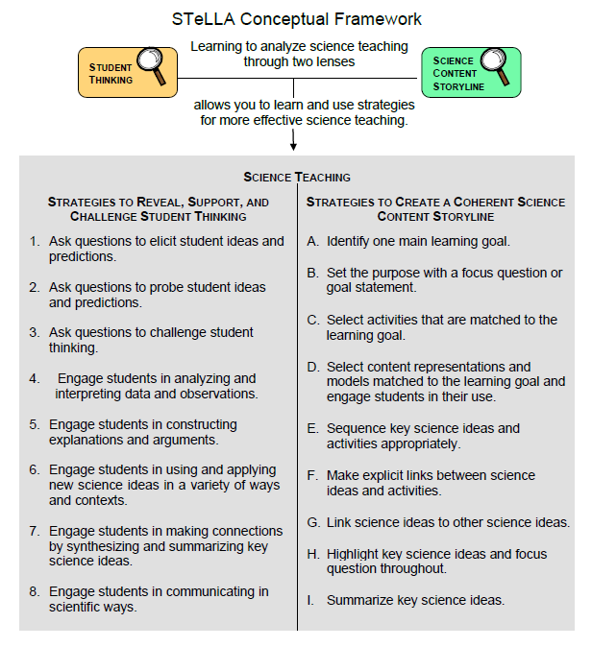
Notes:
2 min
a. “We’ll be focusing on STeLLA strategy D today. Notice that this SCSL strategy has two parts. The first part—select content representations and models matched to the learning goal—sounds similar to strategy C—select activities that are matched to the learning goal. The second part focuses on engaging students in the use of content representations. This ensures that students aren’t just looking at diagrams or models but are actively engaging with them.”

Slide 8
Lesson Analysis: Focus Question 1
How do you know when a content representation is appropriate and matched to the main learning goal?
Notes:
Less than 1 min
a. “Now let’s explore the first part of strategy D and our first focus question.”
b. Read the focus question on the slide.

Slide 9
SCSL Strategy D: Purpose and Key Features
What are the purpose and key features of this strategy?
Cite ideas and examples from the STeLLA strategies booklet and your SCSL Z-fold summary chart.
Notes:
25 min
a. Small groups (13 min): Divide participants into two groups and have each group make a chart identifying the purpose and key features of strategy D described in their SCSL Z-fold summary charts and the STeLLA strategies booklet.
b. Whole group (12 min): Have groups report out. Then ask, “What differences do you notice between the two charts?”
Key ideas:
Content representations can help students envision things that are too big or too small for them to see firsthand in the classroom, or processes that take place too quickly or slowly for them to perceive.
Content representations give students access to different ways of making sense of key science ideas.
If content representations or models are closely matched to the main learning goal, they can be especially useful in helping students see how the science content storyline fits together.
There are many different types of content representations (analogies, metaphors, and visual representations, such as diagrams, charts, graphs, concept maps, models, and role-plays).
Content representations can reveal and challenge student thinking if students are involved in creating, modifying, and analyzing the representations (instead of just listening to the teacher explain them).

Slide 10
Strategy D: Discussion Questions
How is this strategy similar to or different from selecting activities matched to the learning goal (strategy C)?
How might good content representations be especially helpful for English language learners?
Notes:
10 min
a. Whole group: Discuss the questions on the slide.
Key ideas:
Slide question 1: Both strategy C and strategy D emphasize that all activities must be matched to the main learning goal. Strategy D, however, emphasizes a very important kind of activity: content representations. It also emphasizes that teachers should actively engage students in creating, modifying, and using content representations.
Slide question 2: Good content representations can benefit all students, but they especially benefit ELL students because they present science ideas in pictures, images, and other visual formats in addition to words.

Slide 11
Analysis Guide for Strategy D
Read Analysis Guide D (handout 7.1 in your PD program binder).
Keep this question in mind: What do you notice about how this guide is organized?
Notes:
6 min
a. Have participants locate Analysis Guide D in their PD program binders (handout 7.1).
b. Individuals : “As you read the analysis guide, keep in mind the discussion question on the slide.”
c. Whole group: Discuss the question on the slide.
Key ideas:
This analysis guide focuses on the main learning goal by having participants review it first.
The guide is divided into three parts. Part 1 focuses on how well matched the content representation is to the main learning goal. Part 2 focuses on how well engaged students are in using the content representation.
The guide ends with identifying ways to improve the content representation and its use in a lesson (part 3).

Slide 12
Content Representation 1: Three Environments
Read the main learning goal and description of the content representation in Analysis Guide D1 (page 1 of handout 7.1).
Notes:
2 min
a. Set the context: “Now we’re going to analyze a content representation to see how well it’s matched to the stated learning goal.”
b. Have participants read the main learning goal and description of the content representation in Analysis Guide D1 (page 1 of handout 7.1).

Slide 13
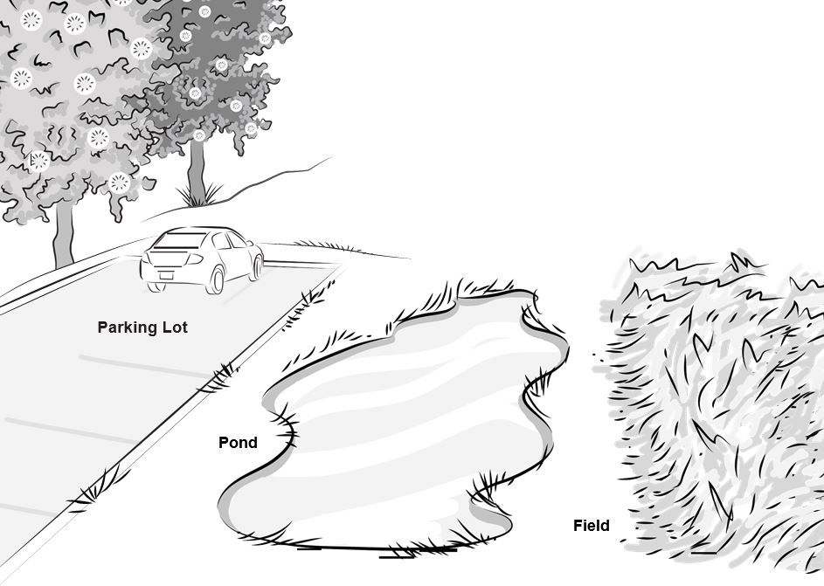
Content Representation 1: Three Environments
Notes:
8 min
a. Individuals: Have participants work independently on part 1 of Analysis Guide D1. Let them know that they can also find the slide diagram in their lesson plans binders (handout 4.4, Three Environments).
b. Pairs: “Now pair up and discuss your answers to the analysis questions.”
c. Emphasize that the content representation participants are analyzing is not just the image but the entire activity.

Slide 14
Does Content Representation 1 Match the Main Learning Goal?
How did you answer these questions from part 1 of the analysis guide?
Is the content representation scientifically accurate?
Is it closely matched to the main learning goal?
Does it present science ideas to students in comprehensible ways?
Does it reinforce/introduce any misconceptions?
Does it address common misconceptions?
Does it contain distracting details?
Notes:
10 min
a. Whole group: Discuss participants’ responses to the questions in part 1 of Analysis Guide D1.
b. Ask: “How might this content representation be improved? Would you use it with your students?”
Observations:
The content representation is scientifically accurate and closely aligned to the learning goal.
Ideally, students would think about the cottonwood-seed model used in VPA lesson 3 and the link to the idea that smaller cottonwood seeds would blow farther away from the parent tree, land in the open field, and grow into new cottonwood trees.
Students may think bigger means better, so the larger seeds would have a better chance of surviving regardless of where they land.
Take-home message: Trying to address all six criteria in the analysis guide is a balancing act or trade-off. To make complex science ideas meaningful and comprehensible to students, the content representation needs to be simplified, but simplifications can sometimes be misleading in terms of scientific accuracy. The important thing is for teachers to be aware of such problems so they can be addressed.

Slide 15
Content Representation 2: A Dandelion Story
Read the main learning goal and description of the content representation in Analysis Guide D2 (page 2 of handout 7.1).
Use your experience with this content representation to complete part 1 of the analysis guide.
Notes:
5 min
a. Set the context for analyzing another content representation.
b. Have participants turn to Analysis Guide D2 (page 2 of handout 7.1) and read the main learning goal and description of the content representation.

Slide 16
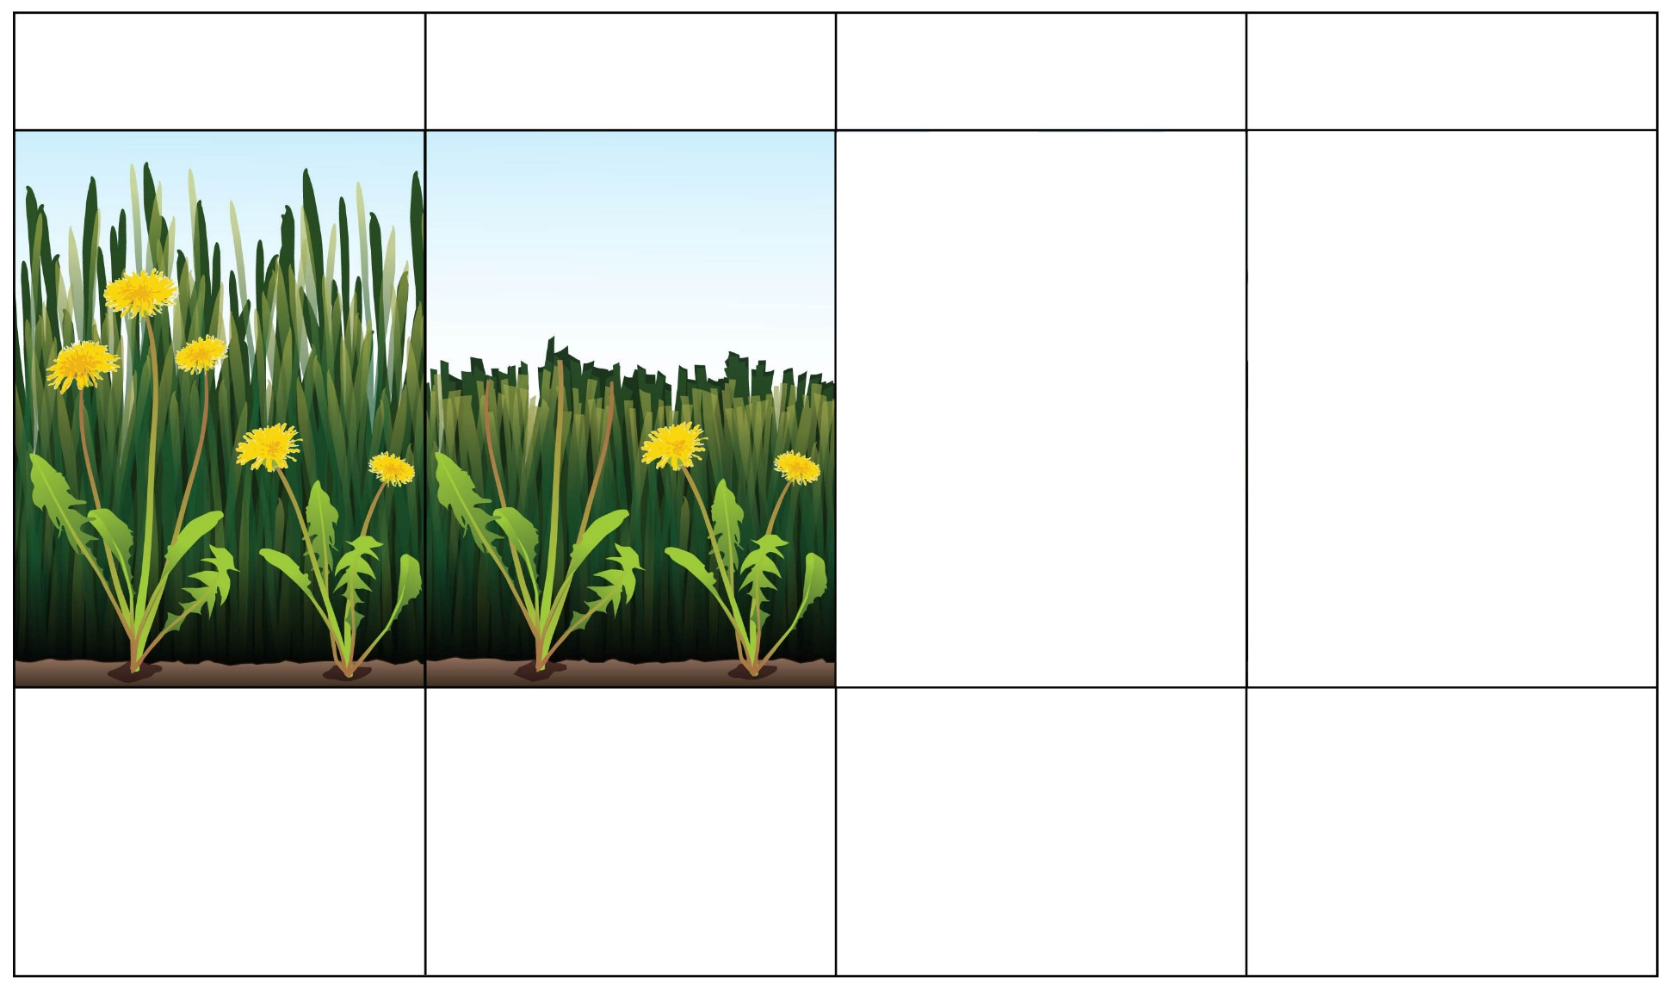
Content Representation 2: A Dandelion Story
Box 1
Box 2
Box 3
Box 4
Dandelions in the Park—before Mowing
Dandelions in the Park—after Mowing
Dandelions make new seeds.
Next year: What do the dandelion plants look like?
Courtesy of BSCS
Notes:
7 min
a. Individuals: Have participants work independently on part 1 of Analysis Guide D2. Let them know that they can also find the chart on the slide in their lesson plans binders (handout 5.2, What Will Happen to the Dandelions?).
Note: If time is short, just do partner work.
b. Pairs: “Now pair up and discuss your answers to the analysis questions.”

Slide 17
Does Content Representation 2 Match the Main Learning Goal?
How did you answer these questions from part 1 of the analysis guide?
Is the content representation scientifically accurate?
Is it closely matched to the main learning goal?
Does it present science ideas to students in comprehensible ways?
Does it reinforce/introduce any misconceptions?
Does it address common misconceptions?
Does it contain distracting details?
Notes:
10 min
a. Whole group: Discuss participants’ responses to the questions in part 1 of Analysis Guide D2.
b. Ask: “How might this content representation be improved? Would you use it with your students?”
Observations:
Ideally, students will recognize that the mower will cut off the flowers of the taller dandelion, leaving only the flowers on the shorter dandelions to produce seeds that will fly away and grow into new dandelions. So the next generation of dandelions will have only short stems.
Students need to understand that the lawn mower will cut off the flowers of the taller dandelion. During the field test, however, many students thought that the flowers of both the taller and shorter dandelion plants would survive because the taller dandelion would bend, and the flowers wouldn’t be cut off.
The storyboard for this activity is somewhat incomprehensible in its present form. It could be modified so that both the first and second frames are completed for students.
Note: Box 2 on PowerPoint slide 16 is overlaid with a white frame that can be removed to show the image underneath.
Take-home message: Trying to address all six criteria in the analysis guide is a balancing act or trade-off. To make complex science ideas meaningful and comprehensible to students, the content representation needs to be simplified, but simplifications can sometimes be misleading in terms of scientific accuracy. The important thing is for teachers to be aware of such problems so they can be addressed.

Slide 18
Content Representation 3: Cottonwood- Seed Model
Read the main learning goal and description of the content representation in Analysis Guide D3 (page 3 of handout 7.1).
Notes:
5 min
Note: If time is running short, this content representation can be skipped.
a. Have participants turn to Analysis Guide D3 (page 3 of handout 7.1) and read the main learning goal and description of the content representation.

Slide 19
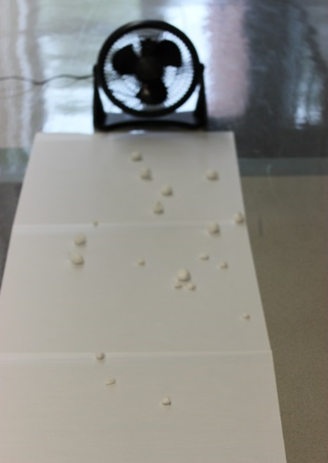
Content Representation 3: Cottonwood-Seed Model
Photo courtesy of BSCS
Notes:
7 min
a. Individuals: Have participants work independently on part 1 of Analysis Guide D3.
Note: If time is short, just do partner work.
b. Pairs: “Now pair up and discuss your answers to the analysis questions.”

Slide 20
Does Content Representation 3 Match the Main Learning Goal?
How did you answer these questions from part 1 of the analysis guide?
Is the content representation scientifically accurate?
Is it closely matched to the main learning goal?
Does it present science ideas to students in comprehensible ways?
Does it reinforce/introduce any misconceptions?
Does it address common misconceptions?
Does it contain distracting details?
Notes:
10 min
a. Whole group: Discuss participants’ responses to the questions in part 1 of Analysis Guide D3.
b. Ask: “How might this content representation be improved? Would you use it with your students?”
Observations:
The model is scientifically accurate to a degree.
The model is closely matched to the learning goal.
The model can be confusing for students, since there is nothing to represent the tree except a line on the butcher paper marked “Tree.” The fan represents wind, and students act like the tree when they drop their cotton balls.
Take-home message: Trying to address all six criteria in the analysis guide is a balancing act or trade-off. To make complex science ideas meaningful and comprehensible to students, the content representation needs to be simplified, but simplifications can sometimes be misleading in terms of scientific accuracy. The important thing is for teachers to be aware of such problems so they can be addressed.

Slide 21
Lesson Analysis: Focus Question 2
How can we engage students in using content representations and models in meaningful ways?
Notes:
Less than 1 min
Transition slide: “Next we’ll watch a video clip of strategy D in use during a lesson on variations in plants and animals. In addition to completing part 1 of Analysis Guide D4, we’ll focus on parts 2 and 3: How well engaged are students in using the content representation? And what suggestions do you have for improving the content representation and its use with students?”

Slide 22
Lesson Analysis 1: Strategy D
Read the context for the video clip at the top of the transcript (handout 7.2).
Read the main learning goal and description of the content representation at the top of Analysis Guide D4.
Watch the video clip, keeping in mind the criteria for strategy D (part 1 of the analysis guide).
Work with a partner to complete part 1 of the analysis guide.
Share your responses with the group.
Link to video clip: 7.1_mspcp_gr.1.tav_bernstein_L3_c3
Notes:
35 min
a. Orient participants to Analysis Guide D4 and the transcript for video clip 1 (handout 7.2 in PD binder).
b. Have participants read the main learning goal and description of the content representation at the top of the analysis guide.
c. Show the video clip.
d. Pairs: Have participants pair up and complete part 1 of the analysis guide.
e. Whole group: Discuss participants’ responses to the questions in part 1 of the guide.
Observations:
The model is scientifically accurate to a degree.
The model is closely matched to the learning goal.
The model can be confusing for students, since there is nothing to represent the tree except a line on the butcher paper marked “Tree.” The fan represents wind, and students act like the tree when they drop their cotton balls.

Slide 23
Lesson Analysis 1: Strategy D
Part 2
Are students engaged in modifying or creating the content representation?
Are students engaged in analyzing the meaning of the content representation?
Are students engaged in critiquing the content representation?
Part 3
What did you learn from watching the video clip that might suggest ways to improve the content representation?
Notes:
35 min
a. “Now we’re going to turn our attention to part 2 of strategy D, which engages students in using content representations. We’ll also consider ways the content representation could be improved.”
b. Individuals: “Study the video transcript again and think about parts 2 and 3 of Analysis Guide D4. Be ready to share evidence that supports your conclusions.”
c. Pairs: “Compare your conclusions about student engagement with the content representation.”
d. Whole group: Review participants’ responses to parts 2 and 3 of the analysis guide. Challenge participants to support their answers with evidence from the video transcript.
e. If it didn’t already come up in the discussion, ask participants, “How might the teacher have engaged these students in analyzing or critiquing the representation?”
Ideal responses for Analysis Guide D, Part 2:
Students don’t modify or create the content representation.
Students don’t critique the content representation.
Students analyze the meaning of the content representation, but only on a superficial level.
Ideal response for Analysis Guide D, Part 3:
Students need to understand what each part of the model represents. The use of an analogy map with drawings may support student understandings of this model.

Slide 24
Strategy D: Synthesize and Summarize
What new ideas do you have about these aspects of today’s lesson analysis work?
How to select content representations
How to engage students in using content representations
Did our content-representation work give you any new insights?
Notes:
20 min
a. Individuals (10 min): Have participants work on the slide questions. Encourage them to use their resources (e.g., the strategies booklet, their Z-fold summary charts, the content background document, notes they’ve taken).
b. Whole group (10 min): Have participants share their new ideas for each question in a round-robin format, if time allows. Otherwise, have a couple of volunteers share their ideas for each question.

Slide 25
Variations in Plants and Animals
SCIENCE CONTENT DEEPENING Grade 1
Notes:
Less than 1 min
a. “Next, we’ll continue our content deepening work on variations in plants and animals.”
Note: Throughout this content deepening phase, refer as needed to the content background document and Common Student Ideas about Variations in Plants and Animals.

Slide 26
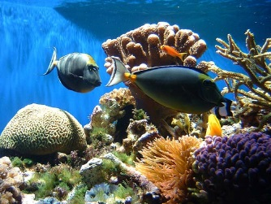
Unit Central Question
How do differences (variations) in plants or animals of the same kind help them survive so they can produce young (babies or seeds)?
Photo courtesy of Pexels.com
Notes:
Less than 1 min
a. Review the unit central question on the slide.

Slide 27
Our Last Content Deepening Session
What did we do in our last content deepening session that relates to STeLLA strategy D?
Photo courtesy of BSCS
Photo courtesy of BSCS
Notes:
3 min
a. Ask participants what they did in the previous content deepening session that relates to strategy D: Select content representations and models matched to the learning goal and engage students in their use.
b. Then ask participants, “How well does the cottonwood-seed model match the main learning goal of VPA lesson 3: Trait variations in plants or animals of the same kind affect which individual plants or animals survive and which don’t?”
c. “Next, we’ll revisit some of the science ideas we learned about last time.”

Slide 28
Review: Trait Variations
Courtesy of Pixabay.com
Notes:
1 min
a. “This living graph is similar to the graphs you created during the Celebrate Variation activity in our first session.”
b. Ask participants how this graph relates to the investigations they conducted in previous sessions on trait variation.

Slide 29
Review: Types of Traits
Traits are features or characteristics that help biologists identify related groups of organisms.
Types of traits:
Physical traits
Behavioral traits
Molecular traits
Chemical pathways
Developmental pathways
Notes:
Less than 1 min
a. Review the definition of traits on the slide and the different types of traits found in living things.

Slide 30
Novelty-Seeking Behavioral Trait
Novelty-seeking behaviors are the tendency for people to be interested in and seek out new and sometimes risky experiences.
Do you have this trait? Let’s find out!
Notes:
5 min
a. “One type of behavioral trait involves seeking out new and sometimes risky experiences. This trait is referred to as novelty-seeking behavior.”
b. “Do you think you have this trait? Let’s find out!”
c. Distribute handout 7.3 (Novelty-Seeking-Behavior Survey) and read the question at the top of the page. Then ask participants to begin the survey.
d. After participants have completed their surveys, direct them to calculate their scores by counting the number of yes responses and giving themselves one point for each yes.
e. Whole-group share-out: Invite participants to share the results of their surveys with the group.

Slide 31
Novelty-Seeking Behavioral Trait
Notes:
5 min
a. Orient participants to the sample bar graph on the slide and ask the following questions:
“How does this graph show variation for the novelty-seeking behavioral trait?”
“To what extent do you think behavioral traits like novelty seeking are passed from parents to offspring?”
Note: If time allows, invite participants to reflect on how their own novelty-seeking score relates to the sample data.
b. Elicit a variety of ideas from participants for the second question.
c. Emphasize: “Biologists recognize two major origins of trait variation: (1) inherited changes that are encoded in genes and DNA, and (2) environmental causes that include life experiences, the chemical environment in the womb, and formal learning experiences.”
d. “Next, we’ll consider how scientists identify the causes of trait variation in populations of living things.”

Slide 32
Content Deepening: Focus Question 1
How can we design experiments to test for genetic and environmental causes of trait variation?
Notes:
1 min
a. Read the focus question on the slide.
b. Ask participants to write the question in their science notebooks and jot down their initial ideas.

Slide 33
Inherited Traits
Read section 5 (Inherited Traits) in the content background document (resources section in lesson plans binder).
Answer these questions in your notebook based on the reading:
What answer to the focus question appears in the reading?
What role do mutations play in causing trait variation?
Notes:
6 min
a. Individuals: Have participants read section 5 (Inherited Traits) in the content background document and answer the questions on the slide in their notebooks.
b. Whole group: Invite participants to share their responses.
Ideal responses:
Question 1: After measuring and analyzing beak depth in finches, researchers discovered that beak depth is an inherited trait. Parents with larger beaks that survived a drought passed on this trait to their offspring.
Question 2: The text says, “Variation can also occur because of mutations, or changes, in the DNA sequence. In some cases, a change happens within a gene sequence. Since genes contain the instructions for the production of proteins in the body, this change affects the specific proteins that are made, which can have a positive or negative effect, or no effect at all.”

Slide 34
NGSS Standards: Inheritance and Variation of Traits
1-LS3-1: Make observations to construct an evidence-based account that young plants and animals are like, but not exactly like, their parents. [Clarification Statement: Examples of patterns could include features plants or animals share. Examples of observations could include leaves from the same kind of plant are the same shape but can differ in size; and, a particular breed of dog looks like its parents but is not exactly the same.] [Assessment Boundary: Assessment does not include inheritance or animals that undergo metamorphosis or hybrids.]
Notes:
Less than 1 min
a. Read the NGSS standard for grade 1 on the slide.
b. Note that this standard is the performance expectation for 1st graders related to inheritance.

Slide 35
NGSS Standards: Inheritance and Variation in Traits
Disciplinary Core Ideas for Grade 1
LS3.A: Inheritance of Traits.
Young animals are very much, but not exactly like, their parents. Plants are also very much, but not exactly like, their parents. (LS3.A)
LS3.B: Variation of Traits.
Individuals of the same kind of plant or animal are recognizable as similar but can also vary in many ways. (LS3.B)
Notes:
Less than 1 min
a. Read the NGSS Disciplinary Core Ideas for grade 1 on the slide.
b. Then advance to the core ideas for grade 3 on the next slide.

Slide 36
NGSS Standards: Inheritance and Variation in Traits
Disciplinary Core Ideas for Grade 3
LS3.A: Inheritance of Traits.
Many characteristics of organisms are inherited from their parents. (3-LS3-1)
Other characteristics result from individuals’ interactions with the environment, which can range from diet to learning. Many characteristics involve both inheritance and environment. (3-LS3-2)
LS3.B: Variation of Traits.
Different organisms vary in how they look and function because they have different inherited information. (3-LS3-1)
The environment also affects the traits that an organism develops. (3-LS3-2)
Notes:
2 min
a. Read the NGSS Disciplinary Core Ideas for grade 3 on the slide.
b. Note that students will revisit the content from grade 1 in grade 3. The lessons for grade 1 don’t address inheritance, but one of the lessons in grade 3 does. Today’s content deepening work will cover inheritance to give participants the background they need to teach the disciplinary core ideas related to inheritance and prepare them to teach the grade-3 lessons, if necessary.
c. Ask participants, “How does our discussion about novelty-seeking behavior relate to these core standards?” [Answer: The standards talk about how both genetics and the environment can influence variation in traits.]
d. “We haven’t yet discussed how to determine the extent to which genetics and the environment influence a trait, but to prepare for answering this more difficult question, we’ll investigate inherited traits passed from parents to offspring.”

Slide 37
Review Focus Question 1
How can we design experiments to test for genetic and environmental causes of trait variation?
Notes:
3 min
a. “One of the most powerful ways to approach this focus question is to explore traits in siblings who share identical DNA but were raised in different environments. By investigating traits in identical twins who were raised apart, we can determine whether genetics or the environment causes variation in a particular trait.”
b. “What might we learn from such a research approach? What might the results tell us?”
c. Emphasize that if a trait of identical twins shows variation, environmental differences must be the cause, since the twins share the same DNA.

Slide 38
Investigation 1: Genetics or Environment?
Height of Twin 1
Height of Twin 2
What would a graph look like for a trait in which all the variation is due to genetics?
What would a graph look like for a trait in which all the variation is due to environment?
Notes:
7 min
a. “Think about a graph that shows variations in height for 100 pairs of identical twins. For each pair, Twin 1’s height would be plotted on the y-axis, and Twin 2’s height would be plotted on the x-axis. The height for Twin 1 might be 172 cm, and the height for Twin 2 might be 165 cm.”
b. Whole group: Walk participants through the hypothetical example of twin height variation and discuss the questions on the slide. Elicit a variety of predictions and ideas.
c. Individuals: Have participants draw two graphs in their science notebooks to illustrate their predictions. One graph should show genetics as the causal factor in the twins’ height variations, and the other graph should show environment as the causal factor.

Slide 39
Investigation 2: Genetics or Environment?
All of the twins’ height variation is due to genetics.
Height of Twin 1
Height of Twin 2
Notes:
Less than 1 min
a. “This slide shows what a graph would look like if genetics caused all of the trait variation in the identical twins. Does your graph reflect these results?”
b. “In this case, the height of one twin always matches the height of the other twin. The height trait shows a predictable pattern based on the identical genetic makeup of each twin, and environment plays no role at all in this trait.”

Slide 40
Investigation 1: Genetics or Environment?
All of the twins’ height variation is due to environment
Height of Twin 1
Height of Twin 2
Notes:
Less than 1 min
a. “This slide shows what a graph would look like if environment caused all of the trait variation in the identical twins. Does your graph reflect these results?”
b. “In this case, there is no identifiable pattern in the height trait of twins raised in different environments. None of the variation in this trait can be predicted based on the environment of each twin, and genetics plays no role in the variation.”

Slide 41
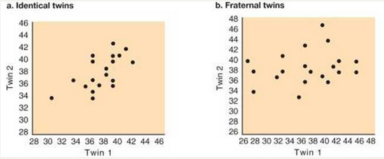
Investigation 1: Genetics or Environment?
This graph shows the association between the novelty-seeking scores of identical twins who were raised apart.
Notes:
7 min
a. “Now let’s look at novelty-seeking behavior among twins who were raised apart.”
b. “What does this graph tell us about the cause of variation in the novelty-seeking trait? Do you think the cause is genetics, the environment, or possibly both? How do you know?”
c. Pairs: Ask participants to discuss these questions with an elbow partner.
d. Whole group: Invite pairs to share their ideas and evidence with the group.
Ideal response:
The data show some relationship between the novelty-seeking scores for identical twins raised apart. This means that both genetics and the environment are involved in causing variation in this trait. This is true of many traits, as the NGSS Disciplinary Core Ideas indicate: “Many characteristics involve both inheritance and environment.”

Slide 42
Investigation 1: Genetics or Environment?
Studies suggest that about 40% of the variation in novelty-seeking behavior is controlled by genetics.
Twin and adoption studies suggest that 30 to 60% of the variation in many personality traits is due to inherited factors.
However, little is known about the genes involved or how they differ between people.
Little is also known about how genes interact with the developing brain and with environmental and experiential factors to generate behavior.
Notes:
Less than 1 min
a. Share the information on the slide about the causes of variation in behavioral traits like novelty seeking.

Slide 43
Investigation 1: Genetics or Environment?
In the twin studies, genetics was the constant, since the twins’ DNA was identical, and the environment varied.
Another way to determine the extent to which genetics and the environment cause variation in traits is to make environment the constant and let genetics be the variable.
Let’s find out how scientists have applied this approach to plants.
Notes:
Less than 1 min
a. Show the first point on the slide.
b. “In our previous examples, researchers measured trait variations in identical twins raised apart. In both the height and novelty-seeking studies, genetics was fixed or constant, and the environment varied.”
Show the second point on the slide.
“Another way to determine the extent to which genetics and the environment cause variation in traits is to make environment the constant factor and genetics the variable.”
“Let’s find out how scientists have applied this approach to plants.”

Slide 44
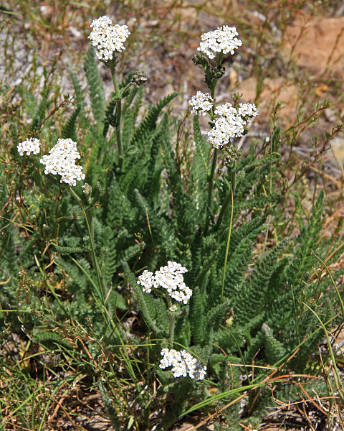
Investigation 1: Genetics or Environment?
Yarrow (Achillea lanulosa)
Photo courtesy of Wikimedia.org
Notes:
Less than 1 min
a. “In their research on trait variation in plants, scientists have found it especially useful to apply the approach we just discussed: keeping the environment constant and allowing genetics to vary. One of the plants scientists have studied is yarrow, a common landscape plant that grows throughout California.”

Slide 45
Investigation 1: Genetics or Environment?
Photo courtesy of Wikimedia.org
Photo courtesy of Wikimedia.com
Notes:
8 min
a. “Many decades ago, researchers traveled east to west across Northern California collecting plants at various elevations, from sea level to more than 10,000 feet. They noticed that the plants from higher elevations were quite short, and the plants from lower elevation were very tall. The researchers wondered whether genetics or the environment caused this variation in plant height. To answer this question, they gathered seeds from all of the plants they collected and grew them in the same garden at sea level. The experiment was designed with environment as the constant and genetics as the variable.”
b. “What do you think the results of the experiment would look like if genetics caused all of the variation in the height trait? What would the results look like if the environment caused all of the variation?”
c. Turn and Talk: “Share your ideas and reasoning with an elbow partner. Then write your predictions in your science notebooks.”
d. Whole group: Invite a few participants to share their predictions and reasoning with the group.

Slide 46
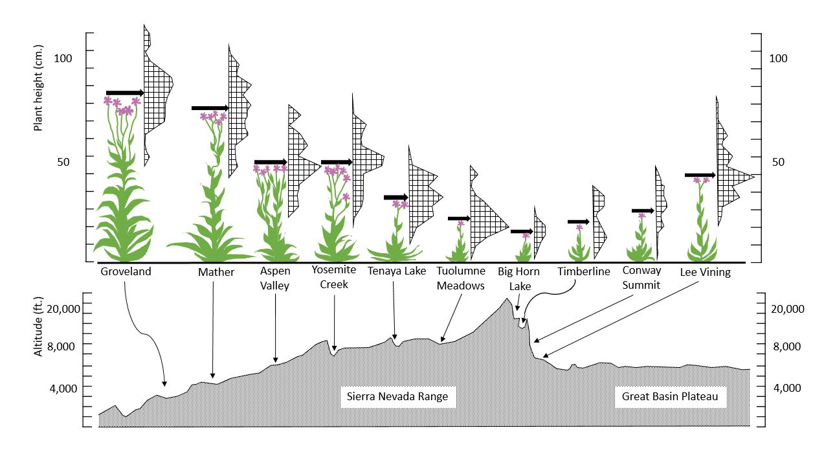
Investigation 1: Genetics or Environment?
Make a claim (with evidence) about whether genetics or the environment caused this variation.
Courtesy of Cal Poly Pomona
Notes:
10 min
a. “This slide shows the results of the plant experiment. Remember that all of the plants were grown in the same garden at sea level. The graph at the top of the slide shows plant height, and the graph at the bottom shows where the seeds originally came from.”
b. Individuals: “Study these graphs and then write a claim in your notebooks about whether genetics or the environment caused the variation in plant height. Make sure to include evidence and reasoning to support your claim.”
c. Whole group: Invite participants to share their claims, evidence, and reasoning with the group.
Ideal claim and evidence:
Claim: The variation in plant height seems to be strongly influenced by genetics.
Evidence: The evidence is that the height of plants grown in the common garden varied based on where the seeds came from. The seeds from higher elevations (e.g., Big Horn Lake) yielded the shortest plants, whereas the seeds from lower elevations (e.g. Groveland) yielded the tallest plants.

Slide 47
NGSS Standards: Inheritance and Variation in Traits
Grade 1 | Grade 3
LS3.A: Inheritance of Traits Young animals are very much, but not exactly, like their parents. Plants also are very much, but not exactly, like their parents. (1-LS3-1) LS3.B: Variation of Traits Individuals of the same kind of plant or animal are recognizable as similar but can also vary in many ways. (1-LS3-1) | LS3.A: Inheritance of Traits Many characteristics of organisms are inherited from their parents. (3-LS3-1) Other characteristics result from individuals’ interactions with the environment, which can range from diet to learning. Many characteristics involve both inheritance and environment. (3-LS3-2) LS3.B: Variation of Traits Different organisms vary in how they look and function because they have different inherited information. (3-LS3-1) The environment also affects the traits that an organism develops. (3-LS3-2)
Notes:
5 min
a. Review the NGSS Disciplinary Core Ideas for grades 1 and 3 on the slide.
b. Have participants write a brief summary of how the previous investigation deepened their understandings of these core ideas.

Slide 48
Ideas That Explain How Populations Change over Time
Change in populations over time
Variations affect which living things survive.
Environments can change.
All living things show variation for some traits.
Babies inherit traits from their parents.
Notes:
Less than 1 min
a. Read the information on the slide and review how the investigations participants have completed so far can help them explain how populations of living things change over time.
b. “Our next investigation will add another key idea to this growing list.”

Slide 49
Investigation 2: Counting Seeds
Assumptions:
All of the seeds from a piece of fruit survive, become adults, and make their own fruits.
The piece of fruit we have represents the last fruit of its kind on Earth.
All plants will die at the end of each year.
Each plant produces the same number of fruits per year.
One apple tree will produce 850 apples.
Notes:
10 min
a. Initially, show only the first assumption on the slide.
b. “In this investigation, we’ll use a mathematical model to test five assumptions about survival in plants.”
c. Read the first assumption on the slide and then reveal and read the other assumptions one at a time.
d. Have participants pair up with an elbow partner. Then distribute one copy of handout 7.4 (Counting Seeds) to each pair.
e. “To complete this handout, you’ll need one more piece of information: the number of apple seeds.”
f. Give each pair of participants an apple and cut it so they can count the number of seeds.
g. Ask participants to calculate the number of apple trees and the number of seeds for four generations and record this data on the handout.
h. Participants should notice that the numbers of trees and fruits increase rapidly. Have them complete several calculations on the handout; then display the Excel spreadsheet (handout 7.5, Increasing Seeds) and perform the remaining calculations. If you enter 5 for the number of seeds per fruit (row 5) under Generation 0 (column 3), the rest of the numbers for that column should fill in automatically. Then enter the number of fruits per plant (850 per assumption 5) in row 3 for Generation 1 and enter 5 seeds in row 5 for Generation 1. Continue this for all four generations.
i. Have participants record the remaining spreadsheet data on their handouts.

Slide 50
Investigation 2: Counting Seeds
Not all of these seeds will grow into apple trees!
New science idea: More offspring are born than survive.
Notes:
Less than 1 min
a. Show only the first point on the slide.
b. Ask, “Can you image what would happen if all of these apple seeds survived?”
c. Emphasize: Not all of these seeds will grow into apple trees!
d. Reveal the second point on the slide and introduce the new science idea: More offspring are born than survive.

Slide 51
Ideas That Explain How Populations Change over Time
Change in populations over time.
Variations affect which living things survive.
Environments can change.
All living things show variation for some traits.
Babies inherit traits from their parents.
More offspring are born than survive.
Notes:
Less than 1 min
a. Revisit the graphic on the slide that explains how populations of living things change over time.
b. Emphasize the new idea that has been added: More offspring are born than survive.
c. “In our final investigation, we’ll use all of these ideas to help us explain how changes in populations of living things happen over time.”

Slide 52
Reflect: Content Deepening Focus Question 1
How can we design experiments to test for genetic and environmental causes of trait variation?
Notes:
7 min
a. Review the focus question on the slide.
b. Individuals: Ask participants to answer the question in their science notebooks using evidence from the investigations to support their ideas.
c. Whole group: Based on the previous investigations, briefly summarize the key ways experiments can be designed to test for genetic and environmental causes of trait variation.
Key ideas:
Measure specific traits in parents and offspring.
Measure specific traits in populations by making either genetics or the environment the constant and making the other factor a variable.
Use a mathematical model to test assumptions about inheritance and survival.

Slide 53
Content Deepening: Focus Question 2
How would biologists explain how a trait changes within a population over time?
Notes:
Less than 1 min
a. Read the focus question on the slide.
b. “This focus question will guide the rest of our content deepening work today and into our next session.”
c. Have participants write this question in their science notebooks.

Slide 54
Investigation 3: Explaining Changes over Time
Goal: To develop a full explanation for change in populations over time using evidence and major principles of natural selection
Notes:
Less than 1 min
a. Read the goal on the slide.
b. “The science ideas we explore and the evidence we gather during the next investigation will help us accomplish this goal.”

Slide 55
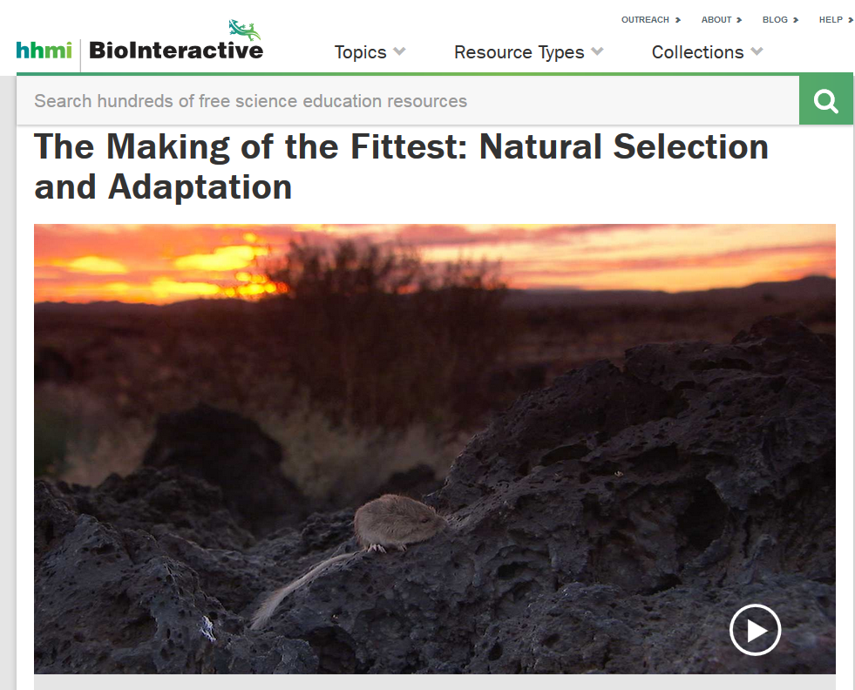
Investigation 3: Explaining Changes over Time
Used with permission from Howard Hughes Medical Institute
http://www.hhmi.org/biointeractive/making-fittest-natural-selection-and-adaptation
Notes:
10 min
a. “In this investigation, we’ll explore the evolution of fur color in rock pocket mice.”
b. Distribute handout 7.6 (Developing an Explanation for Mouse Fur Color) and have participants read the introduction silently.
c. Watch the beginning of The Making of the Fittest: Natural Selection and Adaptation and pause the video at the 2:37 time segment, where Dr. Nachman says, “Almost all of them.”
d. Individuals: Have participants complete step 2 on the handout using the science ideas about variation in traits that they’ve learned about so far.
e. Pairs: Have participants share their responses with an elbow partner.
f. Whole group: Discuss participants’ answers to questions 2a and 2b on the handout.
Notes:
Question 2a: Participants aren’t yet expected to have a fully developed answer to this question, so don’t discuss all of the elements of a complete answer at this point. Participants will revisit this question later in the activity when they examine the Natural-Selection Explanation Table (handout 7.7). Then they should be able to provide a complete explanation that incorporates the major principles of natural selection as follows:
Variation: Within a population of mice living on the lava flow, some individuals had the dark fur trait and others did not.
Inheritance: The variations in mouse fur color are inherited (passed from parents to offspring). The origin of the variation stems from random genetic mutations.
Selection: More offspring are born than can survive, leading to competition within a species. In certain environments, individual mice that have dark fur will survive and leave more offspring than mice with tan fur.
Adaptation: The frequency of the mice with dark fur and the alleles that cause dark fur will increase in the population over generations. In this case, the population will change from one with most individuals having tan fur to one with most individuals having dark fur.
Question 2b: Address the common student misconception that new traits arise as needed. The mutation for dark-colored fur in rock pocket mice didn’t occur simply because the mice needed it. Instead, the new trait arose due to random genetic mutations. Clarify that explanations for change based on the needs or wants of an individual are common but aren’t scientifically accurate. Direct participants to the Common Student Ideas document in the resources section of their lesson plans binders.

Slide 56
Investigation 3: Explaining Changes over Time
Constructing a Natural-Selection Explanation
Principle | Definition | Evidence
Variation | (See handout for definitions.)
Inheritance
Selection
Adaptation
Notes:
20 min
a. Distribute handout 7.7 (Natural-Selection Explanation Table). Point out that an acronym for the natural-selection principles is VISA.
b. Individuals: Have participants read the definitions on the handout and sections 6 and 7 on natural selection in their content background documents.
c. Pairs: “Pair up with an elbow partner and summarize how the information in the content background document and your experiences in our content deepening sessions support the definitions in the handout.”
d. “In our next content deepening session, we’ll watch the rest of the video and identify evidence for each natural-selection principle. You’ll record this evidence on your handout.”

Slide 57
Reflect: Content Deepening Focus Question 2
How would biologists explain how a trait changes within a population over time?
Notes:
Less than 1 min
a. Revisit the focus question on the slide.
b. “In the last activity, you summarized the progress we’ve made in answering this focus question. We’ll continue exploring this question in our next session.”

Slide 58
Content Representation: Plant Experiment
Locate Analysis Guide D5 in handout 7.1 (last page of handout).
Read the main learning goal at the top of the page.
Notes:
5 min
Note: If time is running short, work as a group on part 1 of Analysis Guide D.
a. “Locate Analysis Guide D5 on the last page of handout 7.1. Then read the main learning goal at the top of the page.”

Slide 59
Content Representation: Plant Experiment
Courtesy of Cal Poly Pomona
Notes:
6 min
a. Individuals: “Write a brief description of this content representation at the top of your analysis guide. Then answer the questions in part 1.”

Slide 60
Does the Content Representation Match the Main Learning Goal?
How did you answer these questions from part 1 of the analysis guide?
Is the content representation scientifically accurate?
Is it closely matched to the main learning goal?
Does it present science ideas to students in comprehensible ways?
Does it reinforce/introduce any misconceptions?
Does it address common misconceptions?
Does it contain distracting details?
Notes:
5 min
a. Whole group: Go over participants’ responses to the questions in part 1 of the analysis guide.
Ideal responses:
Scientifically accurate? Yes, the content representation is scientifically accurate.
Closely matched to the MLG? Yes, the content representation is closely matched to the learning goal; however, additional information on environmental variation is also included.
Comprehensible to students? The CR image is only for teachers so this question doesn’t apply.
Reinforces misconceptions? Hopefully not.
Addresses misconceptions? People tend to think that variation is either all genetic or environmental, but most traits are a mix of both, so this content representation may help correct this misconception.
Distracting details? The supplemental information on environmental variation could be distracting.

Slide 61
Summarizing Today’s Work
Think about the Science Content Storyline Lens strategies we’ve studied so far:
Think about your science-content-learning work today.
Reflect: What ideas or questions do you want to remember from today and refer back to?
A—Identify one main learning goal.
B—Set the purpose with a focus question or goal statement.
C—Select activities that are matched to the learning goal.
D—Select content representations and models matched to the learning goal and engage students in their use.
I—Summarize key science ideas.
Notes:
6 min
a. Individuals (4 min): Ask participants to think about the first two tasks on the slide and respond to the reflection question in their notebooks.
b. Whole group (2 min): Ask for volunteers to share an idea or question from their responses to the reflection question.

Slide 62
Homework
Read about SCSL strategies F, G, and H in the STeLLA strategies booklet and complete the Z-fold summary chart for these strategies.
Be ready to share your assigned lesson in the VPA lesson series.
Bring your calendar for the academic year so we can schedule the dates for our school-year study-group meetings!
Notes:
3 min
a. Review the homework assignment and have participants write it in their notebooks.
b. Make sure participants understand the assignment.
c. “We won’t address strategy E about sequencing science ideas and activities until the school year, since you’ll learn a lot about sequencing from teaching the RESPeCT lesson plans.”

Slide 63
Reflections on Today’s Session
What are your reactions to the strategy of selecting content representations and models that are matched to the lesson’s main learning goal?
What is something new you’ve learned about variations in plants and animals? Did your content-representation analyses support this learning in any way?
Provide feedback about today’s session and the PD program so far (likes, dislikes, questions, concerns, and suggestions).
Notes:
6 min
a. Allow at least 5 minutes for participants to think about today’s session and write their reflections and feedback on the Daily Reflections sheet (handout 7.8 in PD program binder).

Slide 64
Norms for Working Together: The Basics
Purpose: Build trust and develop a productive study group for all participants.
The Basics
Arrive prepared and on time; stay for the duration; return from breaks on time.
Remain attentive, thoughtful, and respectful; engage and be present.
Eliminate interruptions (turn off cell phones, email, and other electronic devices; avoid sidebar conversations).
Make room for everyone to participate (monitor your floor time).
Notes:
Hidden slide—available for use as needed.

Slide 65
Norms for Working Together: The Heart
Purpose: Build trust and develop a productive study group for all participants.
The Heart of RESPeCT Lesson Analysis and Content Deepening
Keep the goal in mind: analysis of teaching to improve student learning.
Share your ideas, uncertainties, confusion, disagreements, questions, and good humor. All points of view are welcome.
Expect and ask questions to deepen everyone’s learning; be constructively challenging.
Listen carefully; seek to understand other participants’ points of view.
Notes:
Hidden slide—available for use as needed.

