Slide 1
RESPeCT PD pROGRAM
Day 8
RESPeCT Summer Institute
Notes:
5 min
a. Take care of any housekeeping issues.

Slide 2
Agenda for Day 8
Day-7 reflections
Focus questions
Introducing SCSL strategies F, G, and H
Lesson analysis: SCSL strategies F, G, and H
VPA Lesson plan review
Fall overview and study-group scheduling
Lunch
Content deepening: variations in plants and animals
Wrap-up and celebration!
Notes:
2 min
a. Talk through today’s agenda.

Slide 3
Trends in Reflections
Lesson Analysis | Science Content Learning
Notes:
5 min
a. Give participants time to review your feedback on their reflections from day 7 and offer reactions, comments, or follow-up questions.

Slide 4
Today’s Focus Questions
How can science content storyline coherence be enhanced by explicitly implementing STeLLA strategy F (Make explicit links between science ideas and activities), strategy G (Link science ideas to other science ideas), and strategy H (Highlight key science ideas and focus question throughout)?
How will the Student Thinking Lens and Science Content Storyline Lens strategies help you teach the VPA lessons in the fall?
How would biologists explain how a trait changes within a population over time?
Why do we use graphs?
Notes:
2 min
a. Introduce the focus questions that will guide today’s work.

Slide 5
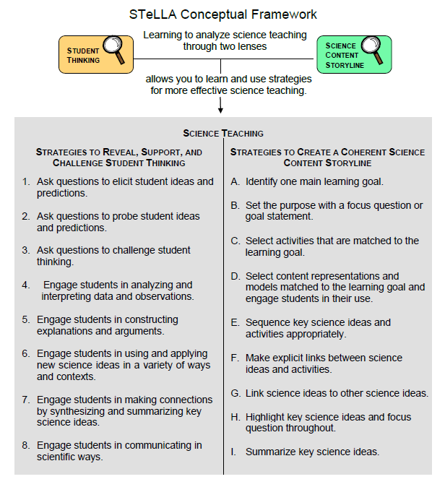
Notes:
1 min
a. “Today we’ll focus on three Science Content Storyline Lens strategies, all of which make explicit links to science ideas:
Strategy F explicitly links science ideas to activities that students are doing.
Strategy G explicitly links science ideas to other science ideas.
Strategy H explicitly highlights key science ideas and links them back to the focus question.”
b. “We won’t address strategy E about sequencing science ideas and activities until the school year, since you’ll learn a lot about sequencing from teaching the RESPeCT lesson plans.”

Slide 6
Lesson Analysis: Focus Question 1
How can science content storyline coherence be enhanced by explicitly implementing STeLLA strategy F (Make explicit links between science ideas and activities), strategy G (Link science ideas to other science ideas), and strategy H (Highlight key science ideas and focus question throughout)?
Notes:
Less than 1 min
a. Read the focus question on the slide.

Slide 7
SCSL Strategies F, G, and H: Purposes and Key Features
Group 1:
What are the purposes and key features of strategy F?
Why is this strategy important for science content storyline coherence?
Group 2:
What are the purposes and key features of strategy G?
Why is this strategy important for science content storyline coherence?
Group 3:
What are the purposes and key features of strategy H?
Why is this strategy important for science content storyline coherence?
Notes:
30 min
a. Small groups: Divide participants into three groups to make charts that capture the purposes and key features of strategies F, G, and H. Direct groups to refer to their Z-fold summary charts and the STeLLA strategies booklet.
b. Whole group: Have small groups share their charts with the entire group.
c. Challenge participants to imagine themselves in their Teacher Leader roles. Ask them, “How would you explain these strategies to the teachers you’re leading?”

Slide 8
SCSL Strategies F, G, and H: Discussion Question
What’s similar and different about these three strategies?
Notes:
10 min
Note: This slide may be skipped if similarities and differences were addressed in the previous discussion.
a. Individuals (3 min): “Look at your three strategy charts, your Z-fold summary charts, and the strategies booklet as you think about the question on the slide.”
b. Whole group: Have participants share their ideas about the three strategies.
Key ideas about strategies F, G, and H:
1. Similarities:
These strategies are all focused on linking complete sentence-length science ideas: Strategy F links science ideas to activities, strategy G links science ideas to other science ideas, and strategy H highlights key science ideas and links them to the focus question throughout the lesson.
All of these strategies emphasize making the links explicit, not just assuming that students will see the intended links.
All of these strategies can and should occur throughout the lesson.
2. Differences:
Strategy F explicitly links science ideas to student activities.
Strategy G explicitly links science ideas to other science ideas.
Strategy H explicitly highlights key science ideas and links them back to the focus question.

Slide 9
Preparing for Video-based Lesson Analysis
Read Analysis Guide F, part 1.
What is the difference between the main learning goal and supporting science ideas?
What is similar about the main learning goal and supporting science ideas?
Notes:
5 min
a. “Next we’re going to watch a series of three classroom video clips from one lesson on variations in plants and animals. The first clip takes place before students start working on the mouse activity. The second clip shows students while they’re working on the activity, and the third clip shows the teacher following up with students after the activity. Our focus for this analysis will be strategy F.”
b. Have participants locate Analysis Guide F (handout 8.1) in their PD program binders.
c. Tell participants that part 1 of the guide provides the context for the video clips.
d. Individuals: “Read part 1 of the analysis guide and be prepared to discuss the two questions on the slide.”
e. Whole group:
Discuss the questions on the slide.
Ask whether participants have any questions about the activity they’ll be observing in the video clips.
Key ideas:
Difference between the main learning goal and supporting science ideas: The main learning goal is the big idea that is the focus of the lesson. Supporting science ideas are smaller, connected ideas that build upon each other to support the main learning goal.
Similarity between the main learning goal and supporting science ideas: The main learning goal and supporting science ideas are all expressed as complete-sentence science ideas (not as topics, phrases, or activities).

Slide 10
Lesson Analysis: Strategy F
For each of the video clips, read the context at the top of the transcript and then watch the clip:
Video clip 1: setup for the activity
Video clip 2: during the activity
Video clip 3: follow-up to the activity
For each clip, use the criteria in part 2 of Analysis Guide F to analyze how well science ideas were linked to the activity.
Links to video clips: 8.1_mspcp_gr.1.tav_griffin_L7_c1;
8.2_mspcp_gr.1.tav_griffin_L7_c2;
8.3_mspcp_gr.1.tav_griffin_L7_c3
Notes:
60 min—15 min/clip
Note: These video clips are from an earlier version of the lesson plan.
a. Have participants review part 2 of Analysis Guide F. After they watch each video clip, ask them to study the corresponding transcript, answer the questions in part 2 of the analysis guide, and then analyze the links between science ideas and activities that were (or were not) made before, during, or after the activity.
b. Have participants read the context for video clip 1 at the top of the transcript (handout 8.2 in PD program binder).
c. Show video clip 1 and then guide participants through these tasks:
Individuals: “Study the video transcript and then complete part 2, section 1 of the analysis guide, Setup for the Activity.”
Whole group: Ask participants to share their analyses of the video clip.
d. Have participants read the context for video clip 2 at the top of the transcript (handout 8.3 in PD binder).
e. Show video clip 2 and then guide participants through these tasks:
Individuals: “Study the video transcript and then complete part 2, section 2 of the analysis guide, During the Activity.”
Whole group: Ask participants to share their analyses of the video clip.
f. Have participants read the context for video clip 3 at the top of the transcript (handout 8.4 in PD binder).
g. Show video clip 3 and then guide participants through these tasks:
Individuals: “Study the video transcript and complete part 2, section 3 of the analysis guide, Follow-up to the Activity.”
Whole group: Ask participants to share their analyses of the video clip.
Sample analysis for video clip 1:
Certain variations in fur color will help some mice survive better in their environment than others.
Sample analysis for video clip 2:
Certain variations in fur color will help some mice survive better in their environment than others.
Mice with black fur are harder for predators to see against the black lava.
Mice with black fur are more likely to survive than the tan or white mice.
Sample analysis for video clip 3:
Certain variations in fur color will help some mice survive better in their environment than others.
Mice with black fur are harder for predators to see against the black lava.
Mice with black fur are more likely to survive than the tan or white mice.
Since black mice have a better chance of surviving, they’ll be more likely to have babies.
Over time, there will be more black mice than white or tan mice in this environment.

Slide 11
Lesson Analysis: Strategies F, G, and H
Strategy F:
Find examples in the video transcripts where students are linking science ideas to a lesson activity.
Suggest one specific way to strengthen strategy F in this lesson.
Strategy G:
Find examples where two or more science ideas are being linked together.
Suggest one specific way to strengthen strategy G in this lesson.
Strategy H:
Find an example where the teacher is highlighting key science ideas or referring back to the focus question.
Suggest one specific way to strengthen strategy H in this lesson.
Notes:
20 min
Note: If time is running short, have participants work only on part A of their assigned tasks.
a. Assign participants one of the strategies (F, G, or H) to analyze for this activity and then go over the directions on the slide. Emphasize the importance of using the STeLLA strategies booklet and strategy charts as resources.
b. Individuals: “Study the transcripts for video clips 1–3 and search for examples of your assigned strategy being used during the lesson. Be ready to share your ideas with the group, and make sure to support your answers with evidence.”
c. Whole group: Have participants share their findings. Encourage listeners to agree or disagree, ask clarification questions, and add on.
Observations:
Strategy F: During both the activity setup and follow-up, the teacher refers to the focus questions to help build a coherent science content storyline.
Strategy G: The teacher strengthens links by referring to the focus question in all three clips (e.g., at the beginning of each clip).
Strategy H: The teacher does a great job referring to the focus questions in the clips. However, her use of strategy H could be strengthened if she wrote key science ideas on chart paper as students bring them up.

Slide 12
Summary: Strategies F, G, and H
Use linking strategies to make the science ideas explicit to the whole class (strategies F and G).
Engage students in linking science ideas to activities before, during, and after an activity (strategy F).
Engage students in linking science ideas to other science ideas (strategy G).
Highlight key science ideas throughout the lesson (strategy H).
Keep returning to the focus question throughout and at the end of the lesson (strategy H).
Notes:
Less than 1 min
a. Read the summary statements on the slide or give participants time to read them silently.
b. Ask participants whether they have a brief comment or question about the summary.

Slide 13
Lesson Analysis: Focus Question 2
How will the Student Thinking Lens and Science Content Storyline Lens strategies help you teach the VPA lessons in the fall?
Notes:
Less than 1 min
a. Read the focus question on the slide.

Slide 14
VPA Lesson Plan Conversation
The science content storyline across lessons
Review the main learning goal for each lesson sequentially.
The science content storyline within lessons (5–7 min for each two-part lesson)
How does this lesson fit into the arc of all the lessons?
What are the main learning goal and focus question?
Describe the main activity (or activities).
How will the activity help students better understand the learning goal for the day?
What STeLLA strategy/strategies are highlighted in this activity?
What concerns or suggestions do you have about this activity?
Practical issues and questions
Notes:
60 min (in conjunction with next two slides)
Note: Create charts like the samples on the next two slides so that participants can view both as they report out.
Timing note: Make sure you limit the time for each lesson conversation so you can get through them all. Aim for 5–7 minutes for each lesson.
a. Give a brief overview of the science content storyline across lessons and then begin the lesson conversation.
b. For step 1 on the slide, review the main learning goal for each lesson sequentially and how it connects to the lesson before and after it. (5 min)
c. For steps 2 and 3, ask each participant to report on her/his two-part lesson, which was assigned on day 5.
Note: Encourage participants to present the big picture using the questions in step 2 on the slide, not to walk through every step in their lesson plans. They should bring up details only when they have some concern, question, or suggestion about a modification.
d. As participants give their reports, fill in the charts you’ve created, checking off the main strategies highlighted in each lesson. (See the chart format on next two slides.)
Note: Encourage participants to pick just one or two Student Thinking Lens strategies and one or two Science Content Storyline Lens strategies that are actually highlighted in the lesson. (Each lesson uses several strategies.)
Ideal pattern to highlight for the Student Thinking Lens strategies:
Elicit, probe, and challenge strategies are found throughout the lessons, whereas strategies 4–6 are found predominantly in later lessons.
Ideal pattern to highlight for the Science Content Storyline Lens strategies:
Strategy A is very important, since other SCSL strategies are linked to it.

Slide 15
STL Strategies Highlighted in the VPA Lessons
Lesson | 1a | 1b | 1c | 1d | 2a | 2b | 3a | 3b | 4a | 4b | 5a | 5b | 5c | Math 1 | Math 2
1. Elicit
2. Probe
3. Challenge
4. Analyze/ Interpret
5. Explain/ Argue
6. Use/Apply
7. Synthesize/ Summarize
Notes:
a. As participants report out, complete this chart, indicating with check marks the STL strategies highlighted in the lessons.
b. Discuss the reasons certain strategies appear at specific times in the lesson sequence. (See ideal patterns on slide 14 and refer to the summary charts in the STeLLA strategies booklet as needed.)

Slide 16
SCSL Strategies Highlighted in the VPA Lessons
Lesson | 1a | 1b | 1c | 1d | 2a | 2b | 3a | 3b | 4a | 4b | 5a | 5b | 5c | Math 1 | Math 2
A. Identify Main Learning Goal
B. Set Purpose and Focus Question
C. Match Activity to MLG
D. Match Content Reps to MLG
F. Link Activity to Science Ideas
G. Link Science Ideas
H. Highlight Key Science Ideas and Focus Question
I. Summarize Key Science Ideas
Notes:
a. As participants report out, complete this chart, indicating with check marks the SCSL strategies highlighted in the lessons.
b. Discuss the reasons certain strategies appear at specific times in the lesson sequence. (See ideal patterns on slide 14 and refer to the summary charts in the STeLLA strategies booklet as needed.)

Slide 17
Overview of Study-Group Sessions
Purpose: To practice, analyze, and learn from the use of the STeLLA strategies in your science teaching.
Review the focus of each study-group session:
What is the main focus for fall study-group sessions 1–3?
What is the purpose of the 2-hour meeting in December/January?
What is the main focus for spring study-group sessions 4–6?
Notes:
5 min
a. Have participants locate handout 8.5—Overview of School-Year RESPeCT Study Groups—in their PD program binders.
b. Emphasize: “The purpose of the study-group sessions is to practice, analyze, and learn from the use of the STeLLA strategies in your teaching of the VPA lessons in the fall and the Sound lessons in the spring.”
c. Talk participants through Study Groups 1–3 on the handout.
d. Pause for questions and a summary task. Ask participants, “What is the main focus for fall study-group sessions 1–3?”
e. Talk participants through the 2-hour meeting in December/January and Study Groups 4–6 on the handout.
f. Pause for questions and a summary task. Ask participants, “What is the purpose of the 2-hour meeting in December/January?” and “What is the main focus for spring study-group sessions 4–6?”

Slide 18
Teaching the VPA Lessons
Before teaching lesson 1, give your students the classroom pretest.
Teach all the lessons and have one lesson video recorded.
Give your students the classroom posttest.
Hold on to your students’ pre-post tests! You’ll analyze them in preparation for Study Group 3.
Notes:
10 min
a. Before going over this slide, have participants locate the VPA classroom pre-post test in their lesson plans binders (pretabs section).
The classroom pre-post test: “This test is in your lesson plans binder. After you administer the test to your students, you’ll need to save all of them, since you’ll be analyzing them as part of our study-group work in the fall.”
b. Review the steps on the slide.
c. Emphasize: “It’s very important to follow these steps in order and save all of your classroom pre-post tests. Don’t return them to students until after Study Group 3.”

Slide 19
Scheduling School-Year Study Groups
Proposed meeting day/time: Wednesdays 2:00–6:00 p.m.
Meeting place: In our classrooms, rotating from school to school
Possible dates for our study-group sessions:
Study Group 1: [insert possible date]
Study Group 2: [insert possible date]
Study Group 3: [insert possible date]
2-hour meeting to review Sound lessons: [insert possible date]
Study Group 4: [insert possible date]
Study Group 5: [insert possible date]
Study Group 6: [insert possible date]
Notes:
15 min
Note: Include on this slide some possible dates for six 4-hour study-group meetings and the 2-hour meeting that occurs between Study Groups 3 and 4.
a. Suggest possible dates for the study-group sessions, starting with the Wednesday afternoon slot from 2:00 to 6:00 p.m.
Note: As you schedule the meetings, keep in mind that you’ll need some time between the end of the school day and the beginning of the meeting to get to the location and set up everything.
Study Group 1: Early October. Round-1 teachers should have their classroom video recordings completed at least three weeks before this session. You will need three weeks to watch the classroom video(s), select the ones you’ll use during the study groups, and prepare the video-clip selections and transcripts.
Study Group 2: Mid-November. Round-2 teachers should have their classroom video recordings completed at least three weeks before this session. You will need three weeks to watch the classroom video(s), select the ones you’ll use during the study groups, and prepare the video-clip selections and transcripts.
Study Group 3: Early December. This session can occur anytime after Study Group 2 and before the holiday break.
2-hour meeting: December/January. The purpose of this meeting is to review the Sound lesson plans in preparation for teaching them.
Study Group 4: Early February. Round-1 teachers should have their classroom video recordings completed at least three weeks before this session. You will need three weeks to watch the classroom video(s), select the ones you’ll use during the study groups, and prepare the video-clip selections and transcripts.
Study Group 5: March. Round-2 teachers should have their classroom video recordings completed at least three weeks before this session. You will need three weeks to watch the classroom video(s), select the ones you’ll use during the study groups, and prepare the video-clip selections and transcripts.
Study Group 6. April. This session can occur anytime after, but preferably within a month of, Study Group 5.

Slide 20
Variations in Plants and Animals
SCIENCE AND MATH CONTENT DEEPENING Grade 1
Notes:
Less than 1 min
a. “Now let’s continue our content deepening work on variations in plants and animals.”
Note: Throughout this content deepening phase, refer as needed to the content background document and Common Student Ideas about Variations in Plants and Animals.

Slide 21
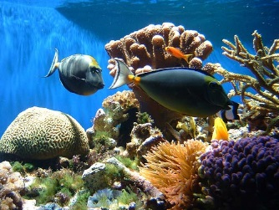
Unit Central Question
How do differences (variations) in plants or animals of the same kind help them survive so they can produce young (babies or seeds)?
Photo courtesy of Pexels.com
Notes:
Less than 1 min
a. Review the unit central question on the slide. Remind participants that this question will guide student thinking throughout the VPA lesson sequence.

Slide 22
Content Deepening: Focus Question 1
How would biologists explain how a trait changes within a population over time?
Notes:
Less than 1 min
a. Review the focus question on the slide.
b. “Today, we’ll continue exploring this question from our previous content deepening session.”

Slide 23
Explaining Changes over Time
Goal: To develop a full explanation for change in populations over time using evidence and major principles of natural selection
Notes:
Less than 1 min
a. Review the goal from the previous session.
b. “The science ideas we learn about today and the additional evidence we gather will help us accomplish this goal.”

Slide 24
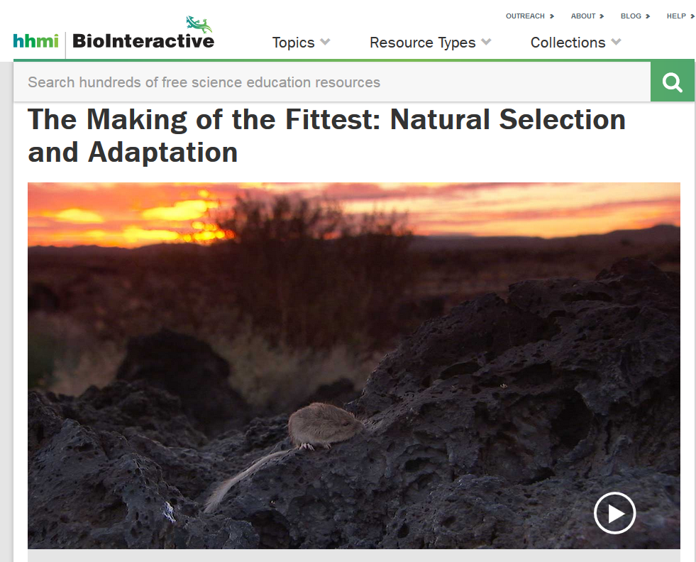
Investigation 1: Explaining Changes over Time
Used with permission from Howard Hughes Medical Institute
http://www.hhmi.org/biointeractive/making-fittest-natural-selection-and-adaptation
Notes:
10 min
a. “Next, we’ll watch the rest of the short film The Making of the Fittest: Natural Selection and Adaptation.”
Note: You may want to start over at the beginning of the video or continue from the 2:37 time mark.
b. Have participants locate their Natural-Selection Explanation Table (handout 7.7) from the previous session.
c. “As you watch the video, look for evidence that supports each principle of natural selection on the handout for changes in the fur-color trait in the rock pocket mouse population. Record this evidence on the handout.”
d. Show the video.
e. Following the video, distribute handout 8.6 (Transcript for The Making of the Fittest: Natural Selection and Adaptation).
f. Individuals: “Now read through the video transcript and identify evidence that supports each principle on the handout for the pocket mouse population and add any new evidence to the handout.”

Slide 25
Investigation 1: Explaining Changes over Time
Constructing a Natural-Selection Explanation
Principle | Definition | Evidence
Variation | (See handout for definitions.)
Inheritance
Selection
Adaptation
Notes:
6 min
a. Whole-group discussion: Compare the evidence participants collected from the video and the transcript.

Slide 26
Investigation 1: Explaining Changes over Time
Constructing a Natural-Selection Explanation
Principle | Definition | Evidence
Variation |  | The black rock pocket mice and the tan rock pocket mice in the video are the same species. In this population, one black mouse is born for every 100,000 tan mice.
Inheritance |  | New mutations cause black fur color (segment 3:24). Many genes control fur color (4:29). Most genes are identical, but dark and light rock pocket mice differ in one gene: MC1R (segment 4:55).
Selection |  | A survival advantage of 1% for dark rock pocket mice on a dark background would result in 95% of the mice being dark in 1,000 years. A survival advantage of 10% would cause the same change in the mouse population in only 100 years.
Adaptation |  | The video suggests that there are more dark-colored rock pocket mice on the dark lava flows than light-colored rock pocket mice. The same phenotype evolved in different groups of mice on different lava flows, and the genetic bases for these changes in phenotype are different.
Notes:
5 min
a. Review the evidence on the slide.
b. Individuals: Ask participants to compare the evidence on the slide with the evidence they recorded on their handouts and identify any information they didn’t consider in their own analyses.
c. Whole group: “What evidence do you see on this table that you didn’t consider?”

Slide 27
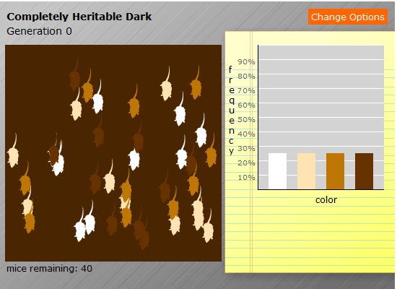
Investigation 2: Predator-Prey Simulation
Write the following heading in your science notebook:
Simulation 1: Dark background; mouse fur color inherited; color variation present
Courtesy of BSCS
Notes:
15 min
Note: You should already have set up the “Predator and Prey” interactive in advance (see instructions on overview page). If you didn’t log into the simulation earlier, do so now.
a. Introduce the predator-and-prey simulation in the BSCS Across the Sciences online course.
b. Ask participants to write the following information in their science notebooks:
Simulation 1: Dark background; mouse fur color inherited; color variation present.
c. Select Option 1 in the simulation menu (click on the Change Options button) and have participants sketch the initial graph in their notebooks.
d. Run the simulation for one round of hunting. Then direct participants to sketch the resulting graph in their notebooks.
e. Run the simulation again for a second round of hunting and have participants sketch the resulting graph.
f. Following the simulation, ask participants, “What claim can you make based on the data in the graphs? Make sure to include your evidence.”
g. “What do you think will happen if the mouse’s environment changes? Let’s find out!”
h. Ask participants to write the following information in their science notebooks:
Simulation 2: Light background; mouse fur color inherited; color variation present
i. Select Option 2 in the simulation menu (light background) and have participants sketch the initial graph in their notebooks. Complete two rounds of hunting and direct participants to sketch the resulting graphs in their notebooks.
j. Then ask participants to make a claim supported with evidence from the graphs that answers the question, “What happens if the environment changes?”

Slide 28
Investigation 2: Predator-Prey Simulation
What would happen if the fur-color variation wasn’t inherited or there was no variation in this trait at all?
Courtesy of BSCS
Courtesy of BSCS
Notes:
10 min
a. “What would happen if the fur-color variation wasn’t inherited or there was no variation in this trait at all? That’s what we’ll explore next.”
b. Select Option 3 (variation not inherited) and run the simulation again.
c. Then select Option 4 (no variation) and run the simulation.
d. Have participants add evidence from these simulations to the Natural-Selection Explanation Table (handout 7.7).

Slide 29
Lines of Evidence for Evolution
How do we know that evolution has occurred?
Fossil record
Structural similarities among organisms
Biogeography
Similarities among embryos different types of embryos
Similarities among DNA sequences of different organisms
Observations of evolutionary changes in the laboratory and in the wild
Notes:
6 min
Note: Initially show only the question at the top of the slide.
a. Individuals: “Now take out your content background documents and read the last four paragraphs of section 7, Natural Selection and Evolution. As you read, think about the lines of evidence that support the argument for change over time through natural selection.”
b. Whole group: Discuss the lines of evidence for change over time through natural selection presented in the reading and summarized on the slide. During this discussion, record participants’ ideas on chart paper.
Note: Reveal one line of evidence on the slide at a time as you present it.

Slide 30
Use and Apply Key Science Ideas
Evolution by natural selection depends on context.
Use the science ideas you’ve learned about to explain what this statement means.
Notes:
6 min
a. Read the statement on the slide.
b. Individuals: “Use the science ideas you’ve learned about to explain what this statement means. Write your explanations in your notebooks and make sure to include evidence and reasoning.”
c. Whole group: Invite participants to share their explanations, evidence, and reasoning with the group. Record participants’ ideas on chart paper.
Key ideas:
Natural selection is highly dependent on context.
A trait that works well in one environment may not work well in a different environment. This argues against evolution being goal directed and moving toward perfection.

Slide 31
Reflect: Content Deepening Focus Question 1
How would biologists explain how a trait changes within a population over time?
Notes:
5 min
a. Review the focus question on the slide.
b. Individuals: Have participants answer the question in their science notebooks using evidence from today’s investigations and the investigations from the previous content deepening session to support their ideas.
c. Whole group: Invite a few participants to share their ideas and evidence with the group.

Slide 32
Reflect: Unit Central Question
How do differences (variations) in plants or animals of the same kind help them survive so they can produce young (babies or seeds)?
Photo courtesy of Pexels.com
Notes:
5 min
a. Review the unit central question.
b. Individuals: “Answer this question in your science notebooks using the science ideas and evidence about variations in plants and animals that we’ve gathered this week.”
c. Whole group: Invite a few participants to share their answers and evidence with the group.

Slide 33
Presenting Data
Courtesy of Pixabay.com
Courtesy of Pixabay.com
Dr. Laurie Riggs
Lriggs@cpp.edu
Courtesy of Cal Poly Pomona
Courtesy of Pixabay.com
Notes:
Less than 1 min
a. “Next, we’ll engage in some math content deepening and explore ideas about data presentation.”

Slide 34
Content Deepening: Focus Question 2
Why do we use graphs?
Notes:
Less than 1 min
a. Introduce the focus question on the slide.
b. Have participants write the question in their science notebooks.

Slide 35
What Do You Know about Graphs?
What do you already know about graphs and why we use them?
Is it important to know which type of graph to use and how to read and/or interpret it?
Notes:
1 min
a. Discuss the questions on the slide and record participants’ ideas on chart paper.
b. Emphasize: “We want our students to be graph literate and comfortable using graphs.”

Slide 36
What Does This Graph Depict?
1989
1999
Claim: Oil consumption in the US doubles.
Notes:
2 min
a. “What does the graph on this slide depict? Is it an accurate representation?”
Ideal answer: The graph falsely depicts that the oil consumption from 1989 to 1999 more than doubled.
b. “What do you think is missing from this graph?”
Ideal answer: It has no legend or units.
c. “In this content deepening session, we’ll consider the importance of presenting data as clearly and accurately as possible. We’ll also look at some deceptive statistics and talk about the implications for clarity.”

Slide 37
What Does Statistics Involve?
The study of statistics involves math and relies on numerical calculations. It also relies on how the numbers are chosen and how the data are presented and interpreted.
Notes:
Less than 1 min
a. “Let’s think for a moment about what statistics involves.”
b. Read the information on the slide.
c. “So if statistics relies on how numbers are chosen and how the data are presented and interpreted, can statistics be misleading or even deceptive? Next, we’ll consider how statistics were presented and interpreted in different scenarios and see if we can identify a major flaw in each scenario.”

Slide 38
Scenario 1: Ice-Cream Sales
A new advertisement for Ben and Jerry's ice cream introduced in late May of last year resulted in a 30% increase in ice-cream sales for the following three months. Thus, the advertisement was effective.
Fact: Ice-cream consumption generally increases in the months of June, July, and August, regardless of advertisements.
The major flaw in this scenario is called a history effect and leads people to interpret outcomes as the result of one variable when another variable (in this case, seasonal timing) is actually responsible.
Notes:
4 min
Note: Initially, display only the scenario at the top of the slide.
a. Introduce the scenario on the slide.
b. “What is the major flaw in how the statistics in this scenario were presented and interpreted?”
c. Think-Pair-Share: Ask participants to think about this question for a moment and then share their ideas with an elbow partner.
d. Whole group: Reveal the rest of the information on the slide and briefly discuss the major flaw in how the statistics were presented and interpreted.

Slide 39
Scenario 2: Churches and Crime
When there are more churches in a city, there is more crime. Thus, churches lead to crime.
Fact: Bigger cities with larger populations have more churches and more crime. Larger populations explain why there are more churches and higher crime rates.
Major flaw: People erroneously believe that there is a causal relationship between two primary variables rather than recognizing that a third variable may be responsible.
Notes:
3 min
Note: This slide may be skipped if time is running short.
a. Display only the scenario at the top of the slide.
b. Ask participants, “What is the major flaw in how the data in this scenario were presented and interpreted?”
c. Think-Pair-Share: Ask participants to think about this question for a moment and then share their ideas with an elbow partner.
d. Whole group: Reveal the rest of the information on the slide and briefly discuss the major flaw in how the statistics were presented and interpreted.

Slide 40
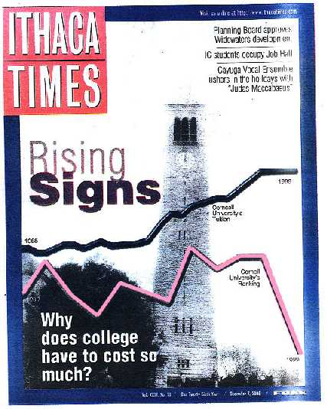
Deceptive Displays
Courtesy of Ithaca Times
Notes:
Less than 1 min
a. “Next, we’ll consider deceptive displays of data.”
b. “This cover of the December 7, 2000, issue of the Ithaca Times shows what may be the most misleading graphs ever published. I have never seen so many graphical sins in a single image!”

Slide 41
Deceptive Displays
Courtesy of Ithaca Times
Notes:
1 min
a. “On the cover of the magazine is the question, ‘Why does college have to cost so much?’ Superimposed on an image of Cornell University are two lines showing the university’s tuition rate and ranking from the 1960s to 1999.”
b. Ask participants, “What message does this graphic convey? How should we interpret it?”

Slide 42
Deceptive Displays
Courtesy of Ithaca Times
Notes:
Less than 1 min
a. “Let’s take a closer look at the graphic on the magazine cover. The top black line shows Cornell’s tuition rising steadily between 1965 and 1999, and the bottom red line shows the university’s ranking rising and falling repeatedly before plummeting to an all-time low in 1999.”
b. “The clear impression is that students are paying more for a college education at Cornell but are receiving far less in terms of quality.”

Slide 43
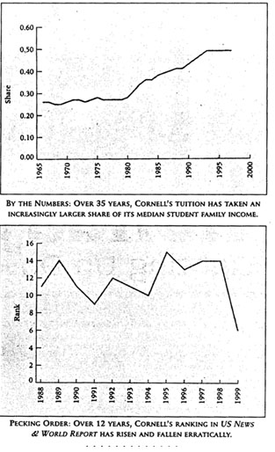
Deceptive Displays
Courtesy of Ithaca Times
Notes:
2 min
a. “Now look at each graph in context.”
b. Ask participants, “What do you notice? What is each graph saying?”

Slide 44
Three Big Problems
The tuition graph covers a 34-year period, and the ranking graph covers an 11-year period, but on the magazine cover, they’re placed on the same horizontal scale.
The vertical scales for tuition and ranking couldn’t possibly have common units, but the ranking graph is placed under the tuition graph on the cover, creating the impression that cost exceeds quality.
Here’s the masterstroke: The sharp “drop” in ranking on the graph actually represents the fact that Cornell's ranking improved from 15th to sixth during this 11-year period!
Notes:
1 min
a. “Here are three big problems with the tuition and ranking graphs:
“The tuition graph covers a 34-year period, and the ranking graph covers an 11-year period, but on the magazine cover, they’re placed on the same horizontal scale.
“The vertical scales for tuition and ranking couldn’t possibly have common units, but placing the ranking graph under the tuition graph on the cover creates the impression that cost exceeds quality.
“Here’s the masterstroke: The sharp “drop” in ranking on the graph actually represents the fact that Cornell's ranking improved from 15th to sixth during this 11-year period!”
b. “What are the implications of failing to examine data presentations with a critical eye? What are the implications for our students?”

Slide 45
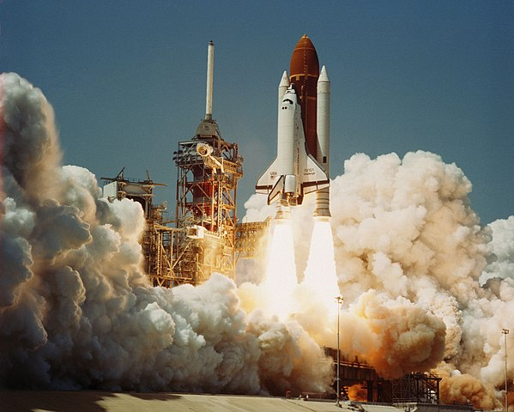
The Challenger Disaster
Courtesy of Cal Poly Pomona
Photo courtesy of Wikipedia.org
Notes:
Less than 1 min
a. “The way data is presented can not only be misleading or deceiving; it can also cost lives! Do you remember the Challenger disaster in 1986?”
b. “In 1997, Edward R. Tufte, one of the world's leading experts in the visual presentation of information, demonstrated how poor data presentation contributed to the explosion of the space shuttle, which led to the deaths of seven astronauts.”

Slide 46
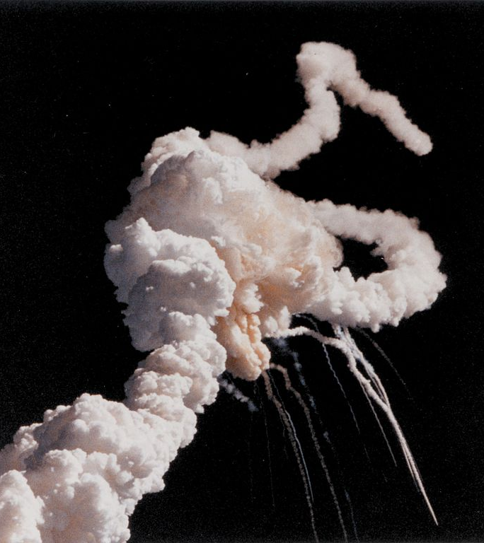
The Challenger Disaster
Tufte’s argument: If the data had been presented more clearly, NASA officials would have understood the extreme risk of O-ring failure in cold temperatures and surely would have postponed the launch!
Photo courtesy of Kennedy Space Center/Wikipedia Commons
Notes:
Less than 1 min
a. “Tufte's argument was compelling: Had the data been presented more clearly, NASA officials would have understood the extreme risk of O-ring failure in cold temperatures and surely would have postponed the launch. The data was available well before the launch, but it was never presented in a way that highlighted the problem or made it apparent.”

Slide 47
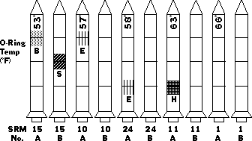
The Challenger Disaster
Source: Tufte, Edward R. (1997). Visual explanations: Images and quantities, evidence and narrative. (pp. 27–54). Cheshire, CT: Graphics Press.
Notes:
2 min
a. “After analyzing the thirteen charts submitted to NASA, Tufte concluded that the chart makers had failed to demonstrate a clear causal link between cold temperature and O-ring damage. They had accurately assessed the problem, but the way they presented the data failed to communicate the severity of the risk to NASA officials.”
b. “Graphics were another major flaw in the presentation. The first chart, like the one shown on this slide, included a legend with symbols of various types of damage to the O-rings, but the legend didn’t appear on subsequent charts that showed serious O-ring damage. Had the legend appeared on every chart, NASA officials would have been able to quickly and accurately assess the damage.”

Slide 48
The Challenger Disaster
Space Shuttle Challenger Historical Launch Data Temperatures and O-ring Condition
Source: Tufte, Edward R. (1997). Visual explanations: Images and quantities, evidence and narrative. (pp. 27–54). Cheshire, CT: Graphics Press.
Notes:
4 min
a. “Let’s examine a different presentation of the O-ring data.”
b. Distribute handout 8.7 (Space Shuttle Challenger Historical Launch Data: Temperatures and O-ring Condition).
c. “This graph shows historical temperature data and O-ring condition for the Challenger . It also tells us that the forecast temperatures for the Challenger launch were between 26 and 29 degrees Fahrenheit. The O-ring damage is plotted along the vertical axis on the graph, and the temperature data is plotted along the horizontal axis.”
d. “What does the graph tell us? At which temperature did the most damage occur?”
e. “Based on this scatter-plot data for the 24 previous Challenger launches, would you predict a problem for the upcoming launch? Why or why not?”
Key observations:
Over the years, Challenger’s O-rings had persistent problems at cooler temperatures. Every launch below 66 degrees resulted in O-ring damage.
At or above 66 degrees, only three launches experienced some O-ring erosion.
A launch forecast of 29 degrees is 5.7 standard deviations from the average temperature for previous launches!
The graph data clearly shows that there were serious risks of O-ring damage for a launch at 29 degrees.

Slide 49
The Best Way to Display Data
What is the best way to display data?
What are some effective ways you’ve displayed data in your classroom?
Notes:
2 min
a. “What is the best way to display data? What are some effective ways you’ve displayed data in your classrooms?”
b. Elicit ideas from participants and record them on chart paper.
c. Emphasize: “The best way to display data can depend on the type of data you collect and what you need to learn from the data. Different types of graphs tell us different things.”

Slide 50
Types of Graphs
What types of graphs and charts are you familiar with? Can you name a few?
Notes:
Less than 1 min
a. “What types of graphs and charts are you familiar with? Can you name a few?”
b. As participant’s share their ideas, record them on chart paper.
Possible responses:
Histogram
Bar graph
Line graph or chart
Scatter-plot or scatter graph
Pie chart
Stem-and-leaf plot or diagram
Box-and-whisker plot or box plot

Slide 51
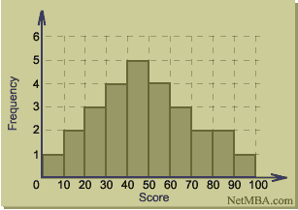
Histograms
Histograms show interval data.
Courtesy of NetMBA.com
Notes:
Less than 1 min
a. “Let’s look at some different types of graphs and charts.”
b. “A histogram is similar to a bar graph, but it’s used for interval data and relates to only one variable. Who can tell me what interval data are?”
Answer: Interval data are a type of data measured along a scale, and each data point is equidistant from another data point.

Slide 52
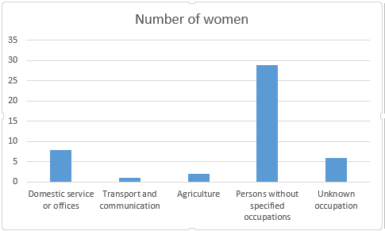
Bar Graphs
How are bar graphs different from histograms?
Courtesy of Mattallen8/ Wikimedia Commons
Notes:
Less than 1 min
a. “How are bar graphs different from histograms?”
b. Point out that bar graphs show categorical data and typically have space between the bars. Categorical data are simply data that can be categorized. Color, grade, and size (small, medium, and large) are some examples of categories.

Slide 53
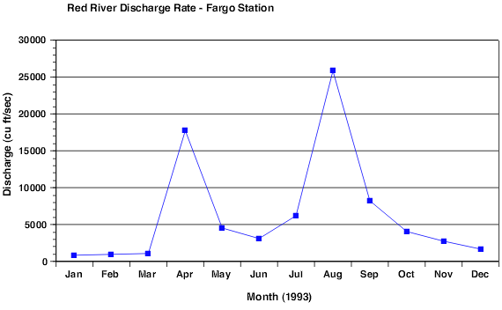
Line Graphs
Courtesy of North Carolina State University
Line graphs help us see more clearly the rate of change (slope) between individual data points. This data could have also been presented as a bar graph.
Notes:
Less than 1 min
a. Read the information on the slide.
b. Ask participants, “How are line graphs similar to bar graphs?”

Slide 54
Scatter Plots
Courtesy of North Carolina State University
Notes:
1 min
a. “What does a scatter plot help us see?”
b. Point out that a scatter plot or diagram plots two variables along two axes and shows the pattern of relationships among the data points. The line on the graph is called a trend line or line of best fit and shows the general pattern of the data.

Slide 55
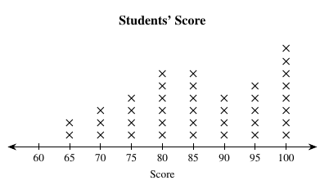
Line Plots
A line plot is a graph that shows data frequency along a number line.
Courtesy of Safwat.alshazly/Wikimedia Commons
Notes:
Less than 1 min
a. “A line plot is a graph that shows data frequency along a number line. Students can learn to make this kind of graph at an early age.”
b. “What challenges might students encounter when making a graph like this?”

Slide 56
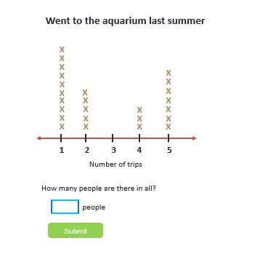
What Does This Graph Tell Us?
Courtesy of Cal Poly Pomona
Notes:
Less than 1 min
a. “What does this graph tell us?”

Slide 57
Stem-and-Leaf Plot
A stem-and-leaf plot or diagram is similar to a dot plot, but the number line is usually vertical, and digits are used instead of dots.
5 | 4 6 7 9
6 | 3 4 6 8 8
7 | 2 2 5 6
8 | 1 4 8
9 |
10 | 6
Examples:
Stem “5” Leaf “4” means 5.4
Stem “6” Leaf “3” means 6.3
Stem “6” Leaf “4” means 6.4
STEM
LEAVES
Notes:
Less than 1 min
a. Review the information on the slide.
b. “This type of graph is also similar to a histogram placed on its side, but it can display more information. You also see the exact data points rather than just the intervals.”

Slide 58
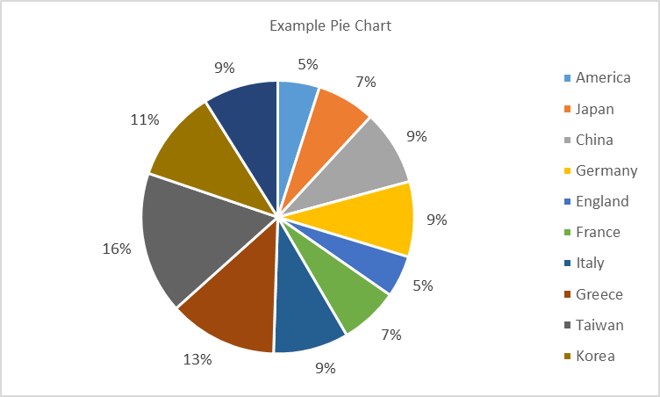
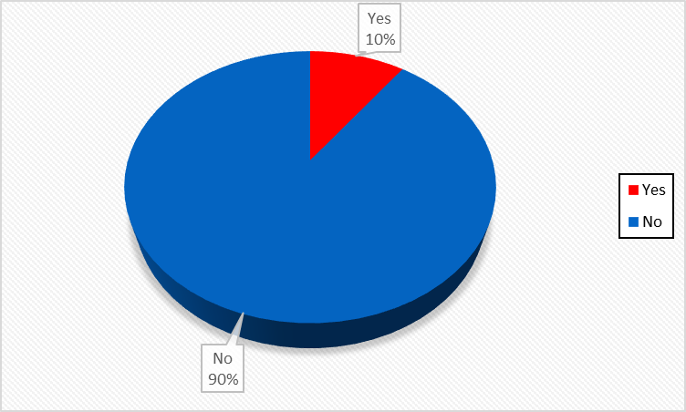
Circle Graphs or Pie Charts
Circle graphs represent categorical data as percentages.
Courtesy of Cal Poly Pomona
Notes:
Less than 1 min
a. “Circle graphs or pie charts represent categorical data as percentages. Students can use pie charts to compare data in terms of percentages or fractions of the whole.”
b. “How is a circle graph similar to a bar graph?”
c. Highlight some of the categories and percentages of the circle graph on the slide.

Slide 59
Link to web site: https://nces.ed.gov/nceskids/createagraph/
Notes:
2 min
a. “The National Center for Education Statistics has some very nice resources for students on its website. Let’s look at some of the graphs they can create and the graphing tutorial they can use.”
b. Quickly tour the NCES Kids’ Zone Create a Graph web site and show participants how to use the Create a Graph Tutorial (https://nces.ed.gov/nceskids/help/user_guide/graph/index.asp).

Slide 60
Let’s Learn by Doing!
Is it OK to text on a cell phone while you’re driving?
What if we wanted to see how distraction affects reaction time?
Notes:
Less than 1 min
Note: If time is running short, skip this activity and move on to slide 67 (reflect on the content deepening focus question).
a. “Is it OK to text on a cell phone while you’re driving? What if we wanted to see how distraction affects reaction time?”
b. “Next, we’ll apply what we’ve been learning about graphs and collect some data on reaction time that we can display.”

Slide 61
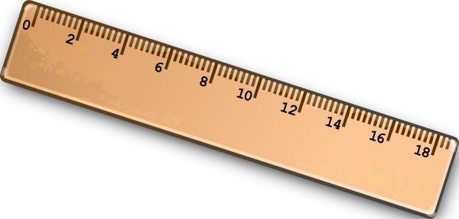
Investigation: Catch a Falling Ruler
In this experiment, you and a partner will test reaction time by catching a falling ruler with and without a distraction.
Courtesy of Pixabay.com
Notes:
1 min
“This experiment is simple. You and a partner will test reaction time for catching a ruler with and without a distraction. One partner will drop a ruler 10 times, and the other partner will try to catch it. You’ll record the measurements you collect and then switch roles. First, you’ll perform the experiment without any distractions, and then you’ll perform it again with a distraction.”
b. Have participants pair up with an elbow partner. Then give each pair a 30-cm ruler.

Slide 62
Investigation: Catch a Falling Ruler
Instructions:
Partner 1: Hold the ruler near the 30-cm mark and let it hang vertically.
Partner 2: Place your thumb and index finger on either side of the 0-cm mark without touching the ruler.
Partner 1: Without warning, let the ruler go. (Hint: To prevent Partner 2 from anticipating when you’ll drop the ruler, vary the timing.)
Partner 2: Try to catch it as quickly as possible when it drops.
Partner 1: Measure just above the first finger where Partner 2 caught the ruler and record the data in your notebook.
Perform the test 10 times with Partner 1 dropping the ruler and Partner 2 catching it. Then calculate and record the mean average of the 10 drops.
Then switch roles. (Partner 2 drops the ruler, and Partner 1 catches it.)
Notes:
15 min
a. Walk participants through the instructions on the slide. Then pair up with a volunteer and model for participants how to drop the ruler and collect the data.
b. Have pairs practice at least one drop per person before they begin the investigation.
c. As pairs practice, circulate around the room and make sure everyone is following the instructions correctly.
Note: If the ruler drops to the ground without being caught, have pairs record a score of 30, since 0 would be perfect score.
d. After pairs have completed all of the trials and recorded their results, have them repeat the same investigation. But this time, direct the partner dropping the ruler to distract the other partner by asking questions that will make him or her think (e.g., “What did you have for dinner last night?” or “What is 12 + 3 − 7?”). Each partner should perform 10 drops and record the measurement for each drop and the mean average of the results.

Slide 63
Discuss the Results
Compare your mean averages for each set of 10 drops with and without distraction.
Discuss your findings with another pair.
Question: What type of graph or chart would you use to display your data?
Notes:
3 min
a. After the investigation, have pairs compare their mean averages for each set of 10 drops with and without distraction.
b. Then have pairs briefly discuss their findings with another pair of participants.
c. Next, discuss as a group what type of graph or chart they would choose to display their data.

Slide 64
Sample Data Display
Courtesy of Cal Poly Pomona
Notes:
Less than 1 min
a. “The sample bar graph on this slide is one way we could display our data.”
b. “What does the graph tell us? Is reaction time better with or without a distraction? How do you know?”
Ideal response: The graph shows that in all but one instance (Juan), reaction time is better without a distraction.

Slide 65
Interpreting Data
Notes:
Less than 1 min
a. “What does this circle graph or pie chart tell us? What does it help us see?”
Ideal response: The graph helps us see that a larger percentage (83%) of test subjects had better reaction times without distraction than with distraction. So we can conclude that reaction time is better without distraction.

Slide 66
Curiosity Zone
Do reaction times vary …
for people of different ages (children versus adults)?
if you use your dominant hand versus your nondominant hand?
if you’re alert or tired?
for men or women?
depending on your mood?
after an alcoholic drink?
Notes:
1 min
a. Briefly discuss other factors on the slide that might influence reaction time.

Slide 67
Reflect: Content Deepening Focus Question 2
Why do we use graphs?
Notes:
4 min
a. Review the focus question on the slide.
b. Individuals: “Answer this question in your science notebooks and support your ideas with evidence from today’s investigations.”
c. Whole group: Invite a few participants to share their ideas and evidence with the group.

Slide 68
Today’s Focus Questions
How can science content storyline coherence be enhanced by explicitly implementing STeLLA strategy F (Make explicit links between science ideas and activities), strategy G (Link science ideas to other science ideas), and strategy H (Highlight key science ideas and focus question throughout)?
How will the Student Thinking Lens and Science Content Storyline Lens strategies help you teach the VPA lessons in the fall?
How would biologists explain how a trait changes within a population over time?
Why do we use graphs?
Notes:
5 min
a. Give participants a couple of minutes to think about today’s focus questions and then answer them in their notebooks.
b. If time allows, have a share-out of ideas.

Slide 69
Summarizing Science Content Storyline Lens Strategies
What does the organization of the summary chart in the STeLLA strategies booklet highlight about the Science Content Storyline Lens strategies?
Do you want to make any revisions or additions to our chart on effective science teaching?
Notes:
10 min
Note: Display one question at a time on the slide.
a. “This week we focused on the Science Content Storyline Lens and strategies. Let’s synthesize and summarize our learning by looking at the summary chart in your strategies booklet—Summary of the STeLLA Science Content Storyline Lens Strategies.”
Note: Participants may also refer to their SCSL Z-fold summary charts for this activity.
b. Individuals: “Look at this summary chart and how it’s organized. What do you think the organization highlights? Write your observations in your notebooks.”
c. Whole group: “What did you notice about the organization of this chart? What does it highlight about the science content storyline strategies?”
d. Reveal the second discussion question on the slide and invite participants to suggest additions or changes to the Effective Science Teaching chart.
Key ideas:
Many of the SCSL strategies must be completed during the lesson planning stage. For example, the main learning goal and activities that match them must be selected ahead of time.
Strategies B, F, G, H, and I are moves the teacher makes while teaching the lesson, but planning and anticipating how these strategies will help develop the lesson is critical to success.
The RESPeCT lesson plans provide examples of how strategies B, F, G, H, and I might be used during the lessons.
Strategies F, G, and H should be applied throughout the lesson. Strategy B is used at the beginning of a lesson, and strategy I is used at the end.
Each strategy has its own distinct purpose(s), but all of them contribute to creating a coherent science content storyline.

Slide 70
Let’s Celebrate!
Design your own end-of-program celebration and insert any comments or instructions here.
Notes:
15 min
a. Decide how you’ll celebrate the end of the RESPeCT PD program, and modify the slide accordingly. Here are a few ideas:
Have refreshments and toast the group’s success with a bubbly, nonalcoholic drink.
Have everyone write on an index card a “golden nugget” that represents something they’re taking away from the Summer Institute experience. Pass around a bowl filled with chocolates wrapped in gold paper, and have participants take a piece of chocolate when they drop their cards in the bowl. After the bowl is passed around, share the golden nuggets with the group.
Take a group photo.

Slide 71
Thank You!
Thank you for participating in the RESPeCT PD program!
Notes:
Less than 1 min
a. Before dismissing participants, thank them for participating in the RESPeCT PD program.

