Slide 1
Sound Lesson 1a
How Can We Tell If Something Is Making a Sound?

Slide 2
What Sounds Do You Hear?
What sounds do you hear first thing in the morning?
What sounds do you hear at school?
What sounds do you hear when you get home from school?
What sounds do you hear when you’re outside playing?

Slide 3
Let’s Describe Sound
What are some other words for sound?
What words can we use to describe different sounds?

Slide 4
Unit Central Question
Why do we hear sound?

Slide 5
Today’s Focus Question
How can we tell if something is making a sound?

Slide 6
What Is Evidence?
Evidence is what we find out or understand that helps us know something.
Hearing a sound with our ears is evidence that something is making a sound!
Scientists use evidence to figure out how the world works.

Slide 7
Tapping Pencils Together
What evidence of sound can you find if I tap two pencils together?
Watch and listen carefully as I tap the pencils together.
Look for evidence that the pencils are making a sound.
Talk with an elbow partner about any evidence of sound you noticed.
Be prepared to share your evidence!

Slide 8
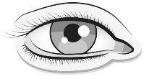
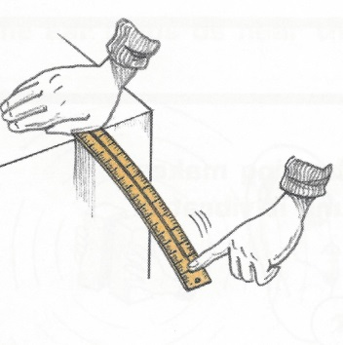
Soundmakers Data Table
My Evidence of Sound Is That … | I Hear … | I See … | I Feel …
Push down on the ruler with your finger and then let go.
Courtesy of BSCS

Slide 9
Ruler Investigation: Evidence of Sound
Work with your partner to set up your ruler just like I did. (You can also look at the picture on your handout.)
Take turns making sounds with your ruler.
Use your ears, eyes, and hands to find evidence that the ruler is making a sound.
Use all three of your senses!
Talk with your partner about what you hear, see, and feel.

Slide 10
What Evidence Did you Find?
My Evidence of Sound Is That … | I Hear … | I See … | I Feel …
Push down on the ruler with your finger and then let go.
Courtesy of BSCS

Slide 11
A New Vocabulary Word!
Scientists use the word vibrate to describe objects that move back and forth quickly.
Objects vibrate when they make sounds.

Slide 12
Let’s Summarize!
Our focus question: How can we tell if something is making a sound?
Share one kind of evidence with your partner that would help you know whether an object is making a sound. Use this sentence starter:
My evidence of sound is that ________.
Make sure each of you shares a different kind of evidence!

Slide 13
Next Time
Today we gathered evidence that pencils and rulers make sounds.
Next time, we’ll explore another kind of soundmaker.
Do you think we’ll be able to hear, see, and feel evidence of sound for this soundmaker, too? Why or why not?

