Slide 1
Sound Lesson 3
How Does Sound Move from a Vibrating Object to Our Ears?

Slide 2
Our Unit Central Question
Why do we hear sound?

Slide 3
Let’s Review What We’ve Learned
What have we learned so far about sound?
What evidence have we found?

Slide 4
Today’s Focus Question
How does sound move from a vibrating object to our ears?

Slide 5
Make a Prediction
How do you think sound moves from a vibrating tuning fork to our ears?

Slide 6
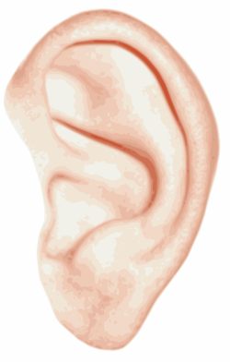
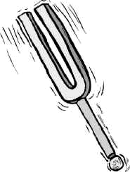
Draw a Picture
Draw a picture on your handout (Sound on the Move) to show how you think sound moves from a vibrating tuning fork to our ears?
Courtesy of BSCS

Slide 7
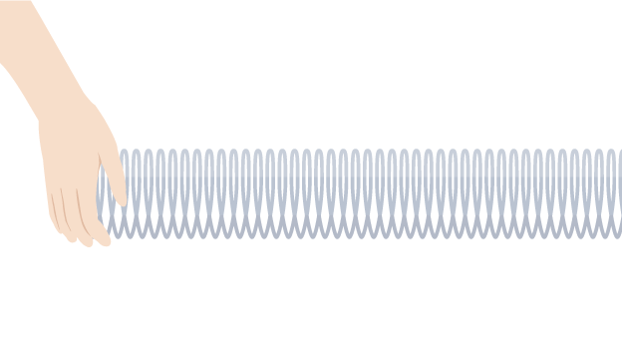
A Slinky Model
Scientists use models to help them understand things they can’t see.
Today we’ll use a Slinky model to help us understand how sound moves from a soundmaker to our ears.
Courtesy of BSCS

Slide 8
Turn and Talk
Share with an elbow partner what you saw when I was moving the Slinky back and forth.
Courtesy of BSCS

Slide 9
What Did You Observe?
Where did the vibrations start?
Where did the vibrations go?
Where did the vibrations end up?
Courtesy of BSCS

Slide 10
Key Science Idea
Sound vibrations move through the air from a soundmaker to our ears.

Slide 11
How Does Sound Move?
Share your drawing with an elbow partner.
Explain how you think sound moves from the tuning fork to your ears.
Courtesy of BSCS

Slide 12
Let’s Summarize!
Our focus question: How does sound move from a vibrating object to our ears?
Let’s create a sound story to answer this question.
Use the word vibrate, vibrating, or vibrations when you share your ideas.

Slide 13
How Does Sound Move?
How do you think sound moves from a tuning fork to our ears without a Slinky?
Courtesy of BSCS

Slide 14
Next Time
In our next lesson, we’ll use a different model to help us think about how sound moves from a soundmaker to our ears.

