Slide 1
Sound Lesson 4a
How Does Sound Move from a Soundmaker to Our Ears? What Is Our Evidence?

Slide 2
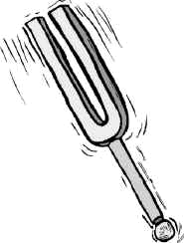
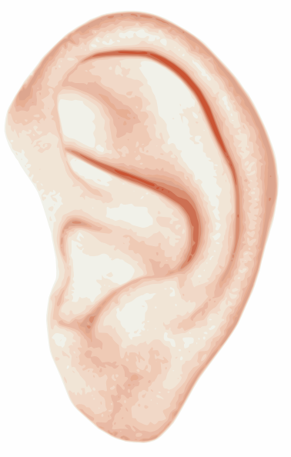
Review: How Does Sound Move?
What is the tuning fork doing?
How does the sound move from the tuning fork to our ears?
Images courtesy of BSCS

Slide 3
Today’s Focus Questions
How does sound move from a soundmaker to our ears? What is our evidence?

Slide 4
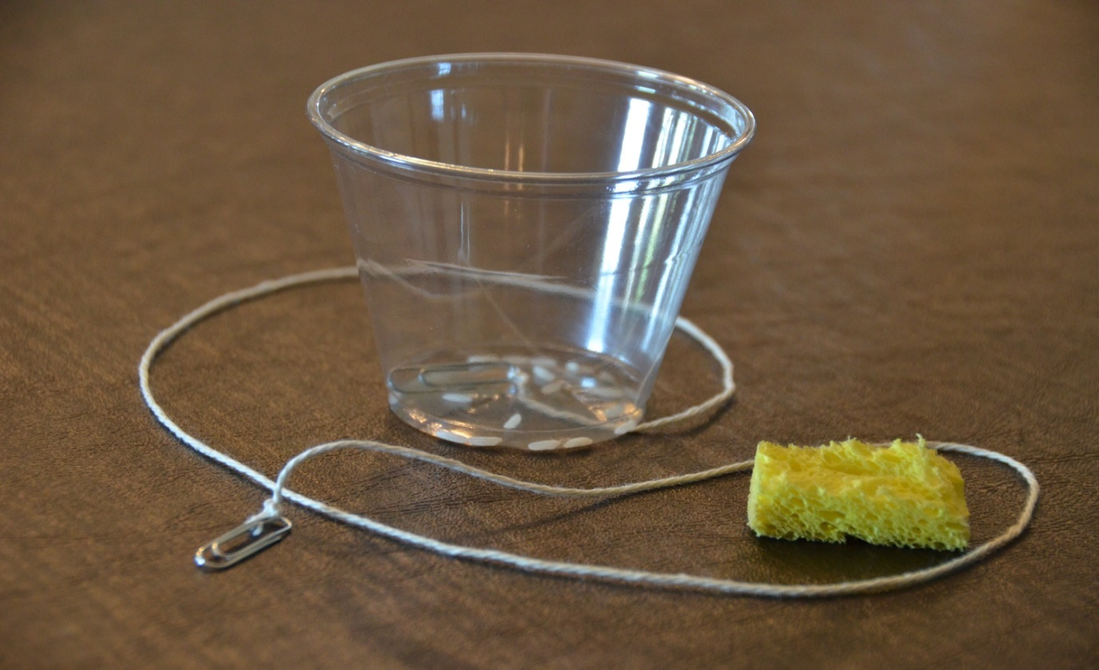
Rice in a Clucker
What happened to the rice when the clucker made a sound?
Photo courtesy of BSCS

Slide 5
Turn and Talk
What is vibrating in the space between the tuning fork and our ears?
What happens here?
Images courtesy of BSCS

Slide 6
Investigation: What Is in the Space?
Let’s find out what is in the space between the tuning fork and our ears.
What is in this space?
Images courtesy of BSCS

Slide 7
Our Focus Questions
How does sound move from a soundmaker to our ears? What is our evidence?
Share your ideas with an elbow partner using what you’ve learned about air in today’s lesson.
Write your answers in your science notebook.
Try to use the words vibrate and vibrations in your explanations.
Be prepared to share your ideas with the class.

Slide 8
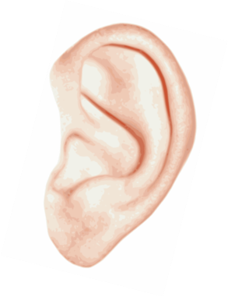
Our Drawings from Last Time
What happens here?
Images courtesy of BSCS

Slide 9
Let’s Revise Our Drawings
What’s missing from your drawing?
What would you change or add to make it better?
Images courtesy of BSCS

Slide 10
Key Science Ideas
Today we learned that air is in the space between a soundmaker and our ears.
When soundmakers vibrate, the vibrations travel through the air to our ears, and we hear sound.

Slide 11
Next Time
What happens to the air between the tuning fork and our ears when the tuning fork vibrates? We’ll find out next time!
What happens to the air?
Images courtesy of BSCS

