Slide 1
Sound Lesson 5b
When Something Makes a Sound, Where Does the Sound Go? What Is Our Evidence?

Slide 2
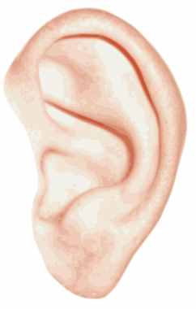
Review: Where Did the Sound Go?
What happened when I rang the bell?
Where did the sound go?
Images courtesy of BSCS

Slide 3
Today’s Focus Questions
When something makes a sound, where does the sound go? What is our evidence?

Slide 4
Draw Your Prediction
Courtesy of BSCS

Slide 5
What Did You Predict?
When the bell rings, where do you think the sound will go?
Courtesy of BSCS

Slide 6
What Happened?
Did everyone hear the bell ring?
Where could you hear the sound this time? Where did it go?
Images courtesy of BSCS

Slide 7
Let’s Revise Our Drawings
What’s missing from your drawing?
What would you change or add to make it better?

Slide 8
Share Your Drawing
Share your drawing with an elbow partner. (Take turns!)
Talk about all of the places where you could hear the sound of the bell.
Use this sentence starter:
When something makes a sound, the sound goes ________. My evidence is _________.
Be prepared to share your ideas and evidence with the class.

Slide 9
Where Did the Sound Go?
Courtesy of BSCS

Slide 10
Our Focus Questions
When something makes a sound, where does the sound go? What is our evidence?
What did we discover today about where sound can go?

Slide 11
Key Science Ideas
All soundmakers vibrate and make the air around them vibrate.
These vibrations move in waves through the air to our ears.
Our eardrums send a message to our brains, and we hear sound.
Sound travels in all directions. It doesn’t just travel from a soundmaker to one person’s ears.
Today we discovered that sounds can travel up, down, and farther away.

Slide 12
Next Time
In our next lesson, we’ll explore how our ears help us hear sound.
What ideas do you have?
Courtesy of BSCS

