Slide 1
Sound Lesson 6a
How Do Our Ears Help Us Hear Sound?

Slide 2
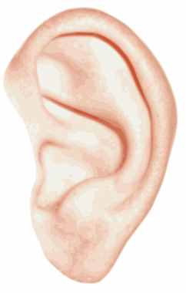
Review: How Does Sound Move?
What did you learn last time about how sound travels to our ears?
Images courtesy of BSCS

Slide 3
Key Science Ideas
All soundmakers vibrate and make the air around them vibrate.
These vibrations travel through the air to our ears, and we hear sound.

Slide 4
Today’s Focus Question
How do our ears help us hear sound?
Courtesy of BSCS

Slide 5
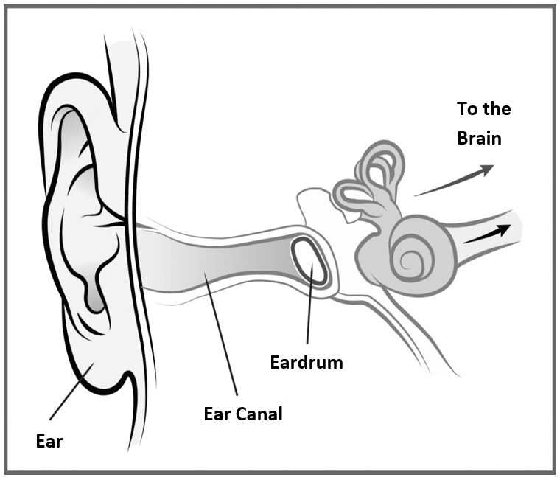
What the Ear Looks Like Inside
Courtesy of BSCS

Slide 6
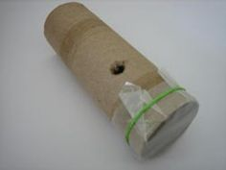
A New Soundmaker
Photo courtesy of BSCS

Slide 7
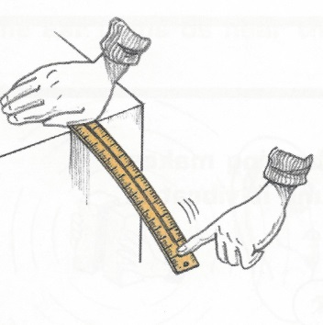
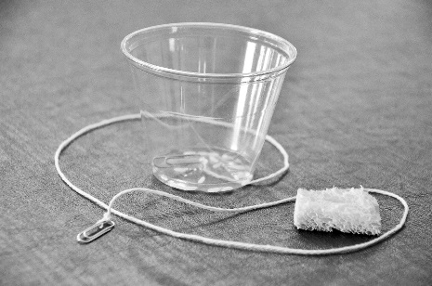
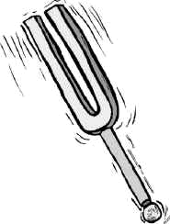
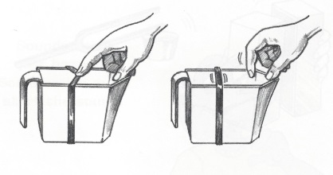
Review: How Did We Detect Sound?
Images courtesy of BSCS

Slide 8
Kazoos and Eardrums
What part of the kazoo is like an eardrum?
What part of the ear is like the tube of the kazoo?
Photo courtesy of BSCS
Courtesy of BSCS

Slide 9
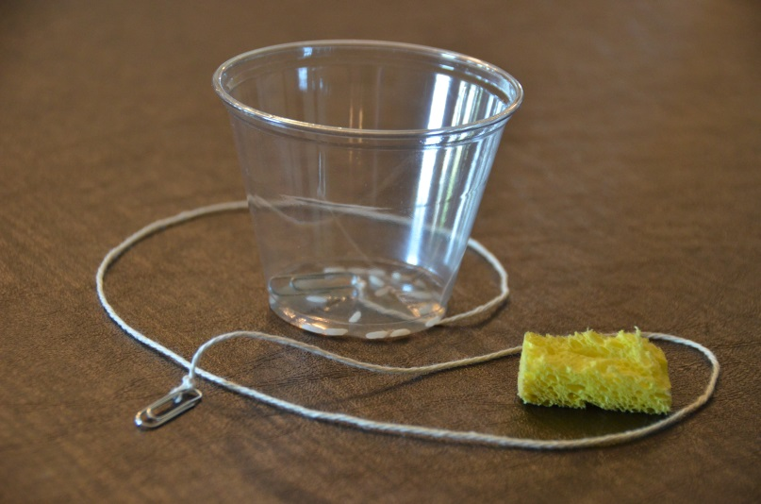
What Will Happen?
Photo courtesy of BSCS
Photo courtesy of BSCS

Slide 10
What Do You Predict?
What do you think will happen to the rice on the wax paper when I make a sound with the clucker?
Share your predictions with an elbow partner.
Use this sentence starter:
I predict the rice will _____ because _____.
Be prepared to share your predictions and reasons with the class.

Slide 11
Does the Wax Paper Vibrate?
Use your kazoo to make a sound like an owl.
Put the open end of the cardboard-paper roll against your mouth and say, “Hooo! Hooo!”
What do you hear?
Photo courtesy of BSCS

Slide 12
Does the Wax Paper Vibrate?
Pair up with an elbow partner and take turns making a “Hooo! Hooo!” sound with your kazoos.
Have your partner gently touch the wax paper when you make the sound.
Does the wax paper vibrate?
Photo courtesy of BSCS

Slide 13
What the Ear Looks Like Inside
Courtesy of BSCS

Slide 14
Our Kazoo Model
Models help us understand how things work in real life.
Our kazoo model helps us understand how our ears hear sound.
The paper tube is a model of our ear canals.
The wax paper is a model of our eardrums.
Photo courtesy of BSCS

Slide 15
Our Focus Question
How do our ears help us hear sound?
Courtesy of BSCS

Slide 16
Turn and Talk
What happens when sound vibrations reach our ears?
Courtesy of BSCS

Slide 17
Next Time
The kazoo model we used today helped us explore how our ears help us hear sound.
We’ll learn more about this next time.
We’ll also read a story about a sad little soundmaker named Dingy and find out how we can make her happy.

