Slide 1
Sound Lesson 6b
How Do Our Ears Help Us Hear Sound?

Slide 2
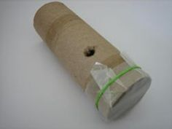
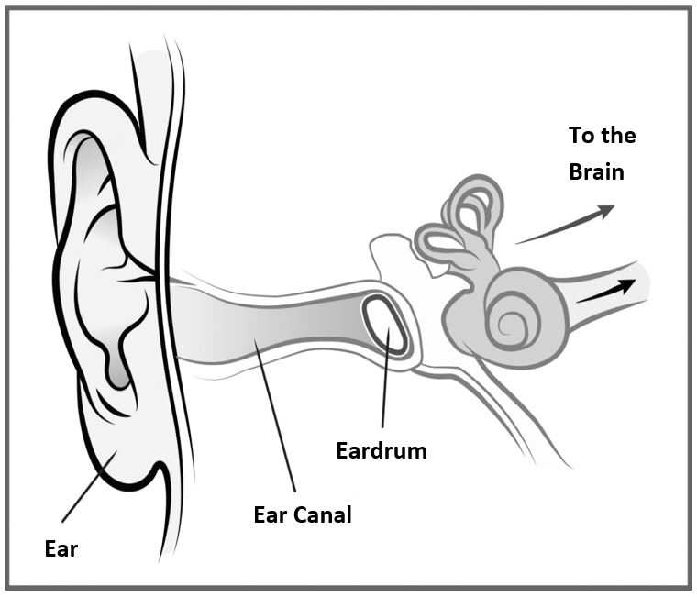
Review: How Do We Hear Sound?
What did we discover about ears last time?
What did we learn from our kazoo model? How is it like our ears?
Photo courtesy of BSCS
Courtesy of BSCS

Slide 3
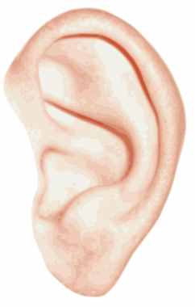
Today’s Focus Question
How do our ears help us hear sound?
Courtesy of BSCS

Slide 4
A Little Bell Named Dingy
Courtesy of BSCS

Slide 5
Make a Prediction
Do you think a bell would make a sound if no one was there to hear it?
Share your prediction with an elbow partner.
Be prepared to share your ideas and reasons with the class.
Courtesy of BSCS

Slide 6
Dingy’s Story
Today’s story will help us understand more about how our ears help us hear sound.
You’ll help illustrate the story by acting out different roles:
A bell
Air
Eardrums
A brain
Courtesy of BSCS

Slide 7
Dingy’s Story
As I read the story, listen carefully for your word on the card (bell, air, eardrum, brain).
When I read your word, stand up and act out what the story tells you to do.
Example: If you’re the bell, stand up when I say the word bell. When the story says that “Dingy the bell began to ring and ring,” start vibrating back and forth.
Courtesy of BSCS

Slide 8
Dingy Is Heard!
As you’ll see, Dingy is a sad little bell.
Let’s find out why Dingy is so sad and what will make her happy again!
Courtesy of BSCS

Slide 9
What Do You Think Now?
Do you think a bell would make a sound if no one was there to hear it?
Courtesy of BSCS

Slide 10
Is There a Sound?
Draw a picture of Dingy the bell in your notebook.
Show what you think happens Dingy rings her bell in the forest, but no one is around to hear her.
Next to your picture, explain why you think there is or isn’t a sound when Dingy rings her bell.
Courtesy of BSCS

Slide 11
Let’s Revise Our Class Drawing
What happens when sound vibrations reach our ears?
Courtesy of BSCS

Slide 12
Let’s Summarize!
Our focus question: How do our ears help us hear sound?
Share your ideas with an elbow partner.
Use this sentence starter:
Our ears help us hear sound by _______. My evidence is _______.
Include evidence from Dingy’s story and our investigations in other lessons.

Slide 13
Next Time
Today we read a story about Dingy the bell and learned more about how our ears help us hear sound.
Next time, we’ll explore different kinds of materials we could use to build our own soundmakers.
What ideas do you have?

