Slide 1
Sound Lesson 7b
Why Do We Hear Sound?

Slide 2
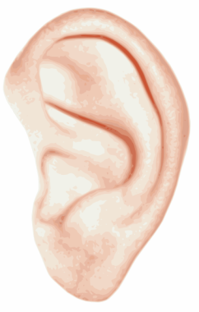
Our Unit Central Question
Why do we hear sound?
Images courtesy of BSCS

Slide 3
Why Do We Hear Sound?
When a soundmaker vibrates, the air around it vibrates.
These vibrations travel through the air to our ears and make our eardrums vibrate.
Our eardrums send a message to our brains that these vibrations are sound.
This is why we hear sound.
Courtesy of BSCS
Courtesy of BSCS

Slide 4
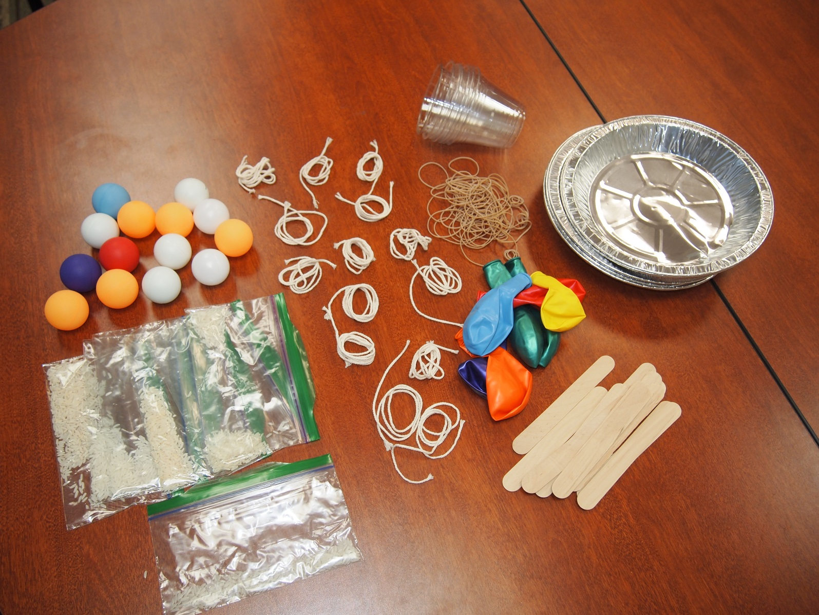
Build Your Own Soundmaker
Photo courtesy of Cal Poly Pomona

Slide 5
Build Your Own Soundmaker
Draw a picture of your soundmaker that shows how you’ll use the materials you chose.
Write a sentence that describes how your soundmaker will make a sound.
Be ready to share your drawings and descriptions with the class.
Photo courtesy of Cal Poly Pomona

Slide 6
Build Your Own Soundmaker
Photo courtesy of Cal Poly Pomona

Slide 7
Build Your Own Soundmaker
As you build your soundmaker, think about these questions:
How could you explain your soundmaker to someone else?
What would you tell that person about how your soundmaker works?
What would you say about how you can hear the sound it makes?

Slide 8
Create a Sound Story
Create a story about your soundmaker that explains how it works and how you can hear the sound it makes.
Use these words in your story:
Soundmaker
Sound
Vibrate or vibrations
You can also draw pictures to illustrate your story.
Air
Eardrum(s)

Slide 9
Tell Your Sound Story
Take turns sharing your sound stories.
If you’re sharing: Explain how your soundmaker works and how you can hear the sound. Use these words:
Soundmaker
Sound
Vibrate or vibrations
If you’re listening: Pay attention to what your partner says and be ready to ask questions.
Air
Eardrum(s)

Slide 10
Tell Your Sound Story
When you get home, tell your story to a family member or friend.
Explain how your soundmaker works and how you can hear the sound.
Use these words in your explanation:
Soundmaker
Sound
Vibrate or vibrations
Air
Eardrum(s)

