Slide 1
Variations in plants and animals Lesson 1c
How Are Birds Alike and Different? What Differences in a Trait Can They Have?

Slide 2
Review: Birds and Plants
What science word did we learn that describes the characteristics that living things of the same kind share?
How are birds alike?
How are plants alike?

Slide 3
Review: Birds and Plants
Living things of the same kind share many of the same traits, like birds or people or plants.
Traits help us know what something is, like a bird or a plant or a person.

Slide 4
Unit Central Question
How do differences (variations) in plants or animals of the same kind help them survive so they can produce young (babies or seeds)?

Slide 5
Today’s Focus Questions
How are birds alike and different? What differences in a trait can they have?

Slide 6
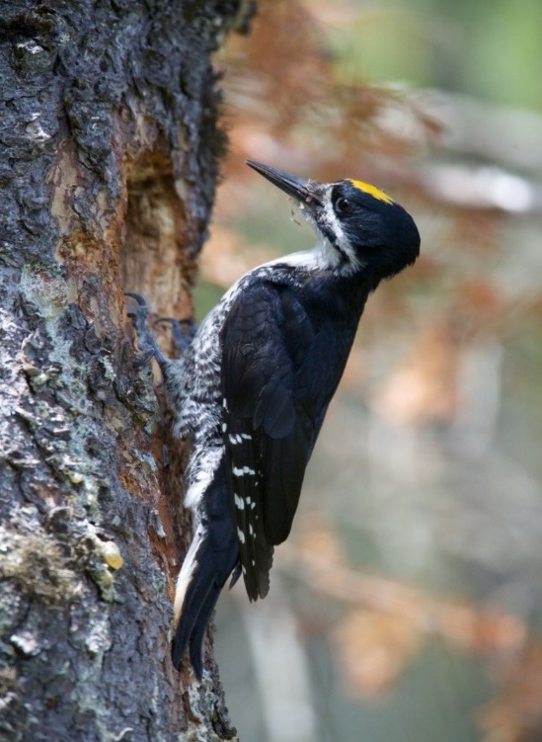
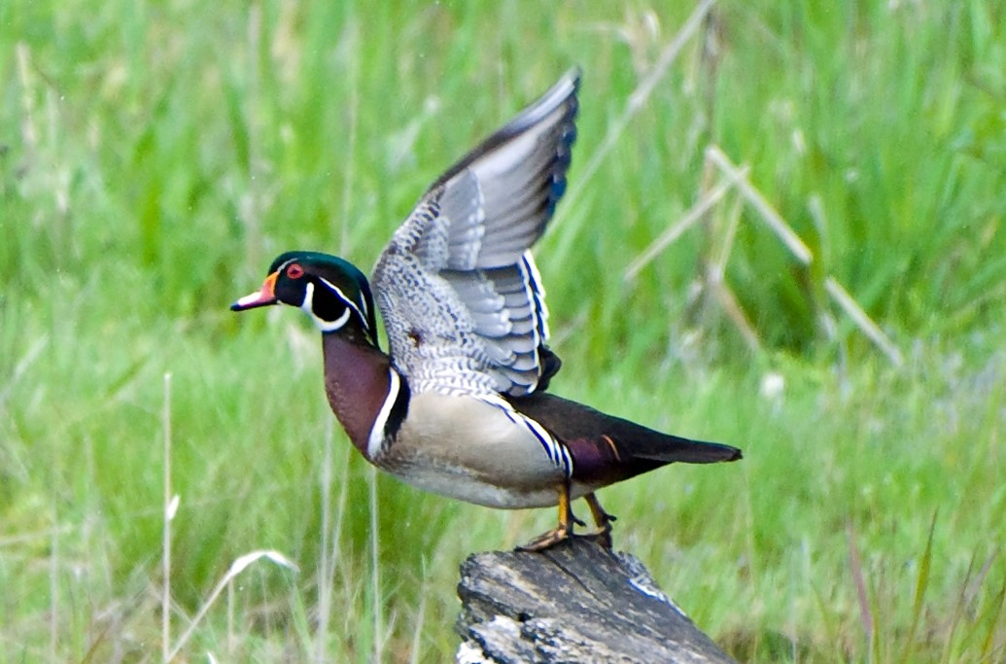
How Are Birds Alike and Different?
How do we know these are birds? What traits do they share?
What differences do you notice?
Photos courtesy of U.S. Fish and Wildlife Service

Slide 7
A New Science Word
Differences in the traits of living things of the same kind are called variations.
Photos courtesy of U.S. Fish and Wildlife Service

Slide 8
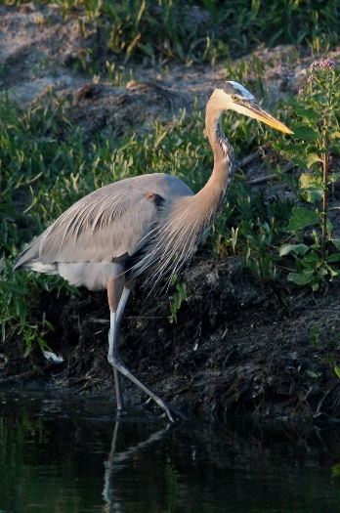
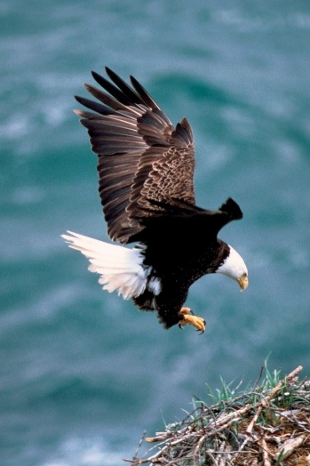
How Are Birds Different?
Pairs:
Look at your two bird photos and talk about how the birds are different from each other.
What variations do they have for the same traits?
Record these differences in your notebook.
Photos courtesy of U.S. Fish and Wildlife Service & pixabay.com

Slide 9
What Variations Did You Find?
Share your pictures and observations with the other pair in your group.
Tell them about the differences or variations you noticed in the birds’ traits.
Photos courtesy of U.S. Fish and Wildlife Service & pixabay.com

Slide 10
Bird Traits and Variations
Let’s review the traits and variations we found in our bird investigation.
Think about this question: How might differences or variations in traits help birds survive where they live?
Photos courtesy of U.S. Fish and Wildlife Service & pixabay.com

Slide 11
Let’s Summarize!
Our focus questions: How are birds alike and different? What differences in a trait can they have?
Think about what you learned from our bird investigation today.
How are birds alike? How are they different?
What differences in traits can they have?

Slide 12
Let’s Summarize!
Look at the bird traits on our class chart and pick one trait. Write that trait on your handout.
Then choose two variations of that trait to write about.
You can also draw pictures to show your ideas.
Photo courtesy of U.S. Fish and Wildlife Service

Slide 13
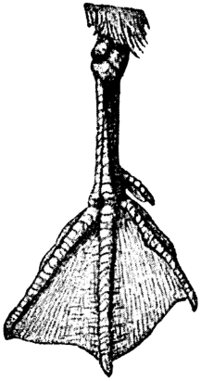
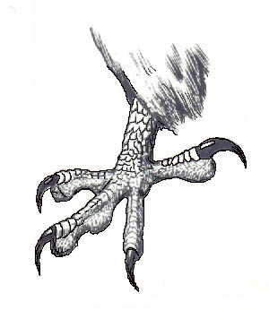
Let’s Summarize!
A trait that birds have: feet
Two variations of that trait:
Webbed feet
Claws
Photo courtesy of Nordisk familjebok/Wikimedia Commons
Photo courtesy of Emlok/Wikimedia Commons

Slide 14
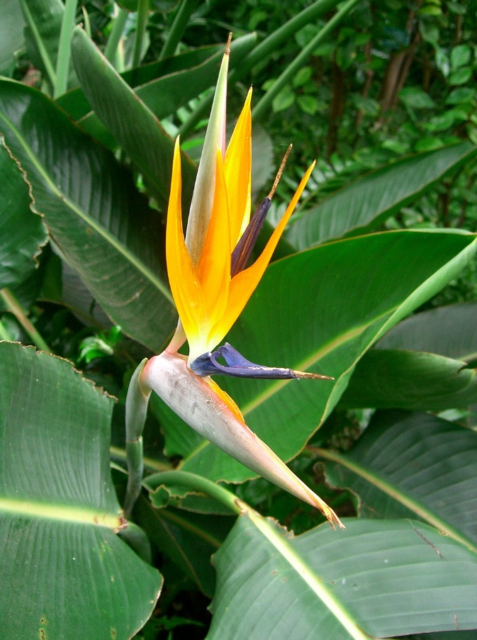
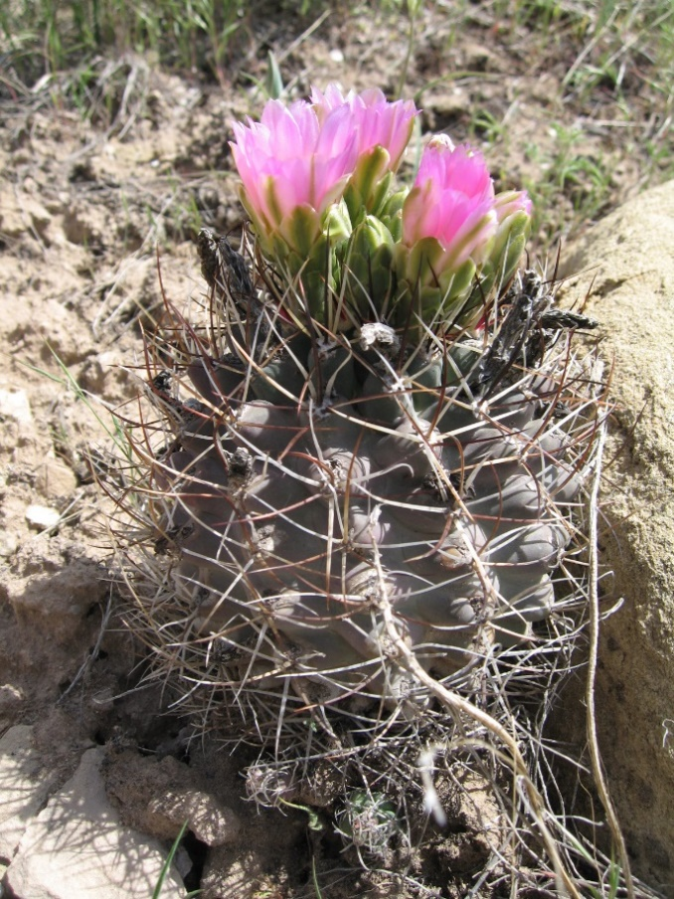
Next Time
How are plants alike and different?
What differences in traits can they have?
Photo courtesy of Pixabay.com
Photo courtesy of Pixnio.com

