Slide 1
Variations in plants and animals Lesson 2a
How Are Sunflowers Alike and Different? What Traits and Variations Do They Have?

Slide 2
Review: Bird and Plant Traits
What is one trait that birds share?
What are two traits that plants share?
Hint: Look at our class charts if you need a reminder.
Make sure to use the word trait in your answers.

Slide 3
Review: Variations in Traits
What does the word variation mean?
What are two variations of a bird trait?
What are two variations of a plant trait?
Sentence starter:
One trait we looked at was ________. Two variations in this trait were ______.

Slide 4
Today’s Focus Questions
How are sunflowers alike and different? What traits and variations do they have?

Slide 5
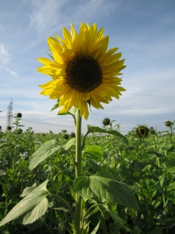
How Are Sunflowers Alike and Different?
Photo courtesy of AnRo0002/Wikimedia Commons
Photo courtesy of Pixabay.com

Slide 6
How Are Sunflowers Alike and Different?
Pairs:
Look at your two cut sunflowers and talk about how they’re alike.
On your sunflower handout, draw a circle around each trait you observed.
Then look at your sunflowers again and talk about how they’re different.
On your sunflower handout, draw a line pointing to each difference or variation you observed. Then write a label that describes the variation.

Slide 7
Today’s Focus Questions
How are sunflowers alike and different? What traits and variations do they have?

Slide 8
How Are Sunflowers Alike and Different?
Traits of Sunflowers | How Sunflowers Are Different (Variations in Sunflower Traits)

Slide 9
Key Ideas about Sunflowers
Sunflowers share many of the same traits that plants have.
For example, all sunflowers have leaves, seeds, flowers, and a stem. They also have roots.
But all sunflowers aren’t exactly the same.
They have many differences or variations in their traits too.

Slide 10
Let’s Summarize!
Look at the sunflower traits on our class chart and pick one trait. Write that trait on your handout.
Then choose two variations of that trait to write about.
You can also draw pictures to show your ideas.
Photo courtesy of Pixabay.com

Slide 11
Key Science Ideas
Traits are characteristics that living things of the same group share.
Birds share the same basic traits, like wings and feathers. But they aren’t exactly alike. Birds can have variations in a trait, like wings of different colors.
Plants share the same basic traits, like leaves and flowers. But they aren’t exactly alike. Plants can have variations in a trait, like flowers of different colors.

Slide 12
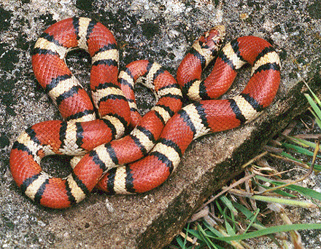
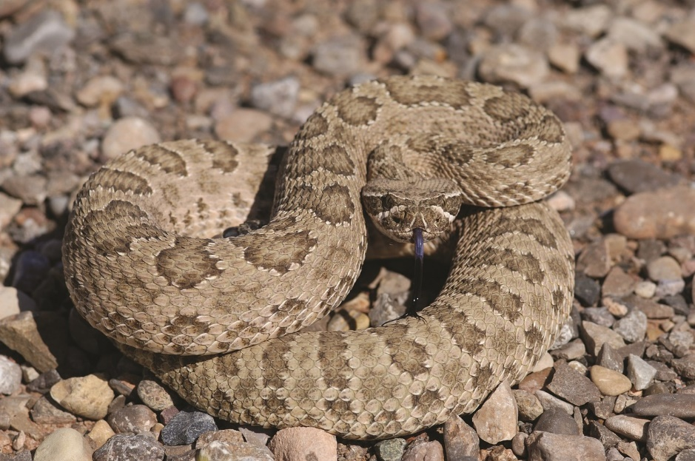
Next Time
How are snakes alike and different?
How might variations in their traits help them survive so they can have baby snakes?
Photograph by Mike Pingleton/Wikimedia Commons
Photo courtesy of Pixabay.com

Slide 13
Next Time
In our next lesson, we’ll measure different sunflower traits. Then we’ll compare variations in those traits.
Photo courtesy of Pixabay.com

