Slide 1
Variations in plants and animals Lesson 2b
How Are Snakes Alike and Different? What Traits and Variations Do They Have? How Could Variations in a Trait Help Them Survive and Produce Young (Babies)?

Slide 2
Review: Traits and Variations
What is a trait?
What is a variation?

Slide 3
Review: Bird Traits and Variations
Look at our class chart of traits and variations in birds.
What is one trait that birds share?
What are two variations of that trait?
Remember: Use the words trait and variations in your examples.

Slide 4
Review: Plant Traits and Variations
Look at our class chart of traits and variations in plants.
What is one trait that plants share?
What are two variations of that trait?
Remember: Use the words trait and variations in your examples.

Slide 5
Today’s Focus Questions
How are snakes alike and different?
What traits and variations do they have?
How could variations in a trait help them survive and produce young (babies)?

Slide 6
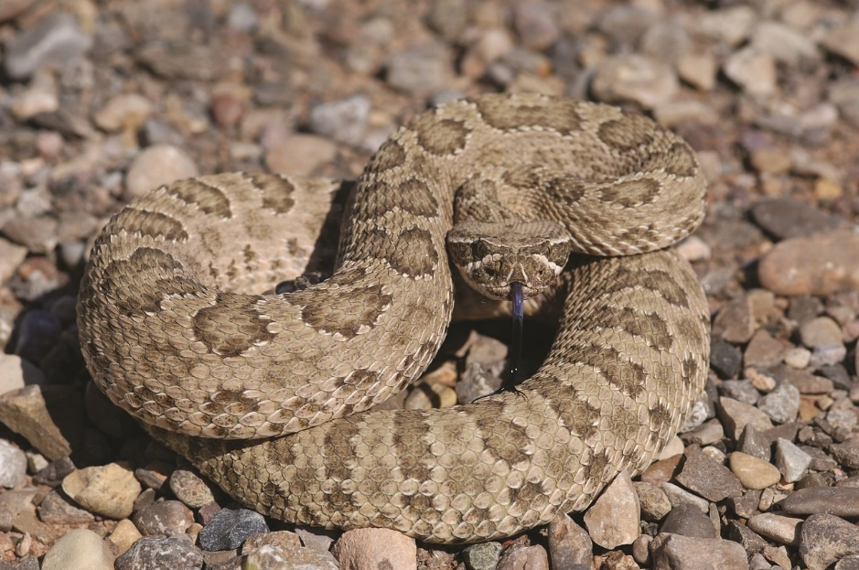
How Are Snakes Alike?
Photograph by Mike Pingleton/Wikimedia Commons
Photo courtesy of Pixabay.com

Slide 7
How Are Snakes Alike and Different?
Traits of Snakes | How Snakes Are Different (Variations in Snake Traits)

Slide 8
How Are Snakes Different?
Photograph by Mike Pingleton/Wikimedia Commons
Photo courtesy of Pixabay.com

Slide 9
Our Focus Questions
How are snakes alike? What traits do they share?
How are snakes different? What variations in traits do they have?
How could variations in a trait help them survive and produce young (babies)?

Slide 10
Where Do These Snakes Live?
Photograph by Mike Pingleton/Wikimedia Commons
Photo courtesy of Pixabay.com

Slide 11
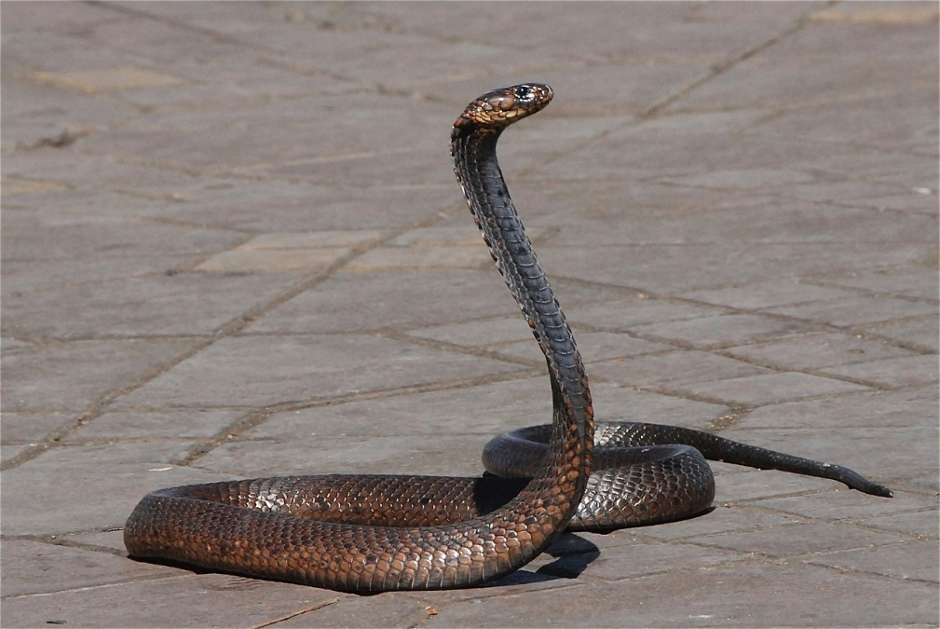
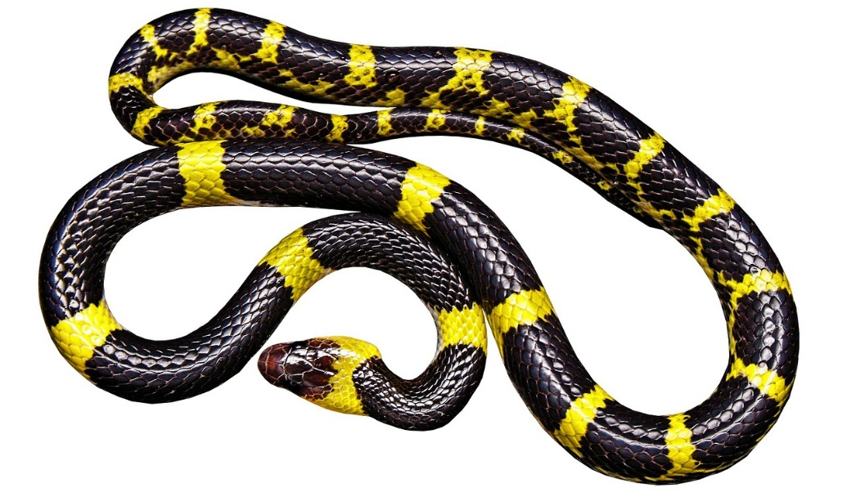
How Are Snakes Alike and Different?
Photos courtesy of Pixabay.com

Slide 12
How Are Snakes Alike and Different?
Look at your two snakes photos. What is one trait they share?
On your handout, draw a circle around this trait. Then write a word that describes the trait.
Then look for two differences or variations in this trait.
On your handout, draw a line pointing to each difference or variation. Then write a word that describes the variation.

Slide 13
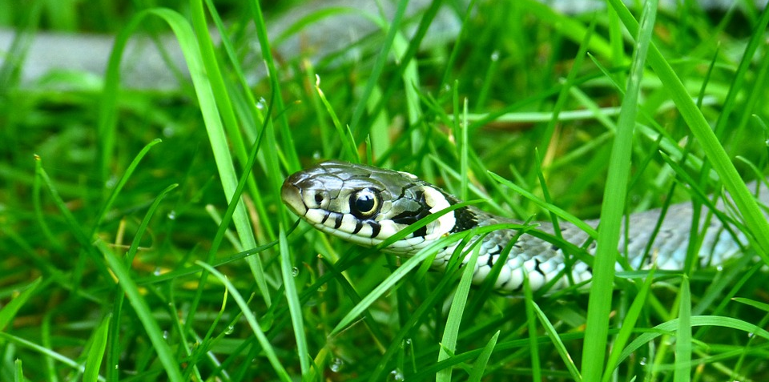
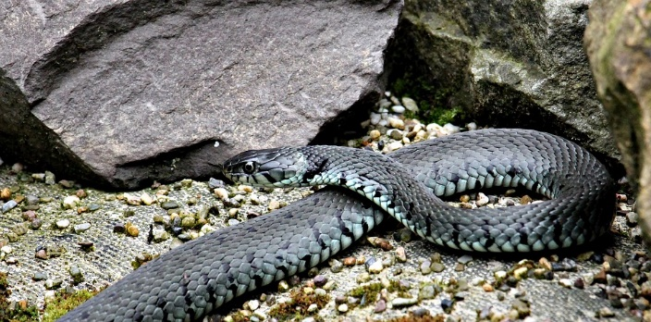
Let’s Think about Survival!
How might the color of a snake help it survive in a grassy area?
How might the color of a snake help it survive on a gray rock?
Photos courtesy of Pixabay.com

Slide 14
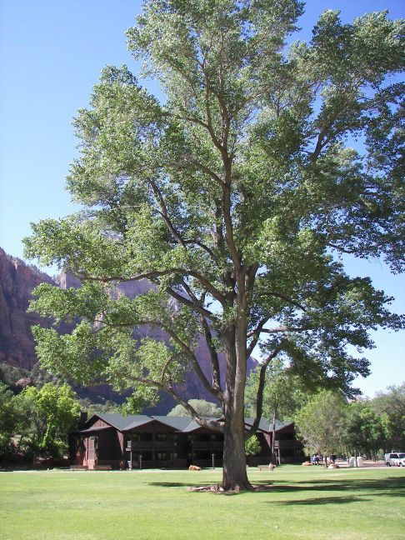
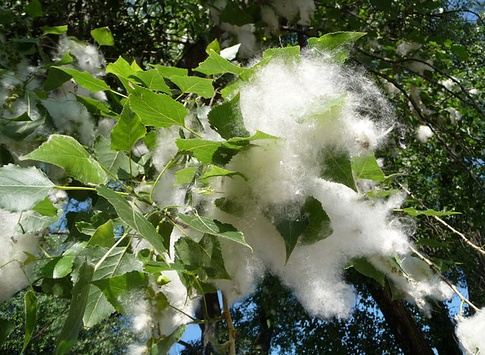
Next Time
How might variations in a trait help cottonwood-tree seeds survive?
Photograph by Amy Gaiennie/Wikimedia Commons
Photograph by George Chernilevsky/Wikimedia Commons

