Slide 1
Variations in plants and animals Lesson 3b
Will Bigger or Smaller Cottonwood-Tree Seeds Be More Likely to Survive and Grow When the Wind Carries Them Away? Why Do You Think So?

Slide 2
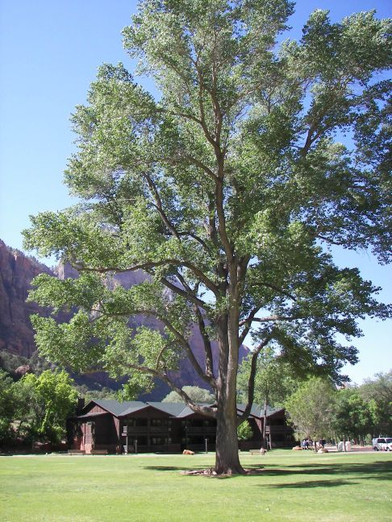
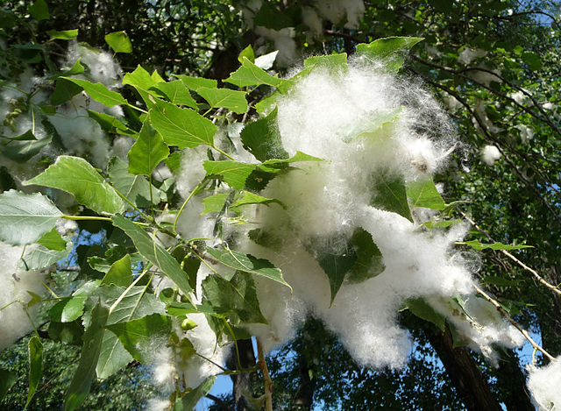
Review: Cottonwood Trees
What did we learn about cottonwood trees and their seeds?
What traits and variations did we talk about?
Photograph by George Chernilevsky/Wikimedia Commons
Photograph by Amy Gaiennie/Wikimedia Commons

Slide 3
Today’s Focus Questions
Will bigger or smaller cottonwood-tree seeds be more likely to survive and grow after the wind carries them away? Why do you think so?

Slide 4
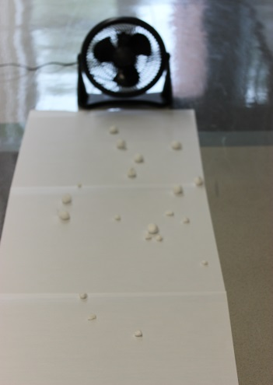
Our Cottonwood-Seed Model
What does the fan represent?
What do the cotton balls represent?
What does the paper on the floor represent?
What does the line on the paper marked “Tree” represent?
Photo courtesy of BSCS

Slide 5
Our Cottonwood-Seed Model
What are we using our model to investigate today?
Why are we using a model instead of using real things?
Photo courtesy of BSCS

Slide 6
What Did You Predict?
Will the bigger or smaller cotton balls (cottonwood seeds) travel farther when the wind blows them? Why do you think so?
I predict the [bigger or smaller] cotton balls will travel farther on the wind because …

Slide 7
How Far Will the Cotton Balls Fly?
Photo courtesy of BSCS

Slide 8
Let’s Talk about Our Results!
What did we find out about our cotton balls?
What does our data or evidence show us?
How did we collect our evidence?
Photo courtesy of BSCS

Slide 9
Our Cottonwood-Seed Data
Think about this question: Do bigger or smaller cottonwood-tree seeds travel farther in the wind?
Where did most or all of the bigger cotton balls land? Did they land closer to the tree or farther away?
What about the smaller cotton balls? Did they land closer to the tree or farther away?

Slide 10
Our Cottonwood-Seed Data
How does our evidence help us answer this question: Do bigger or smaller cottonwood-tree seeds travel farther in the wind?
What does our evidence show us about where the bigger cotton balls landed? Why do you think they landed where they did?
What does our evidence show us about where the smaller cotton balls landed? Why do you think they landed where they did?

Slide 11
Does the Distance Make a Difference?
Does it matter how far a cottonwood seed travels from the parent tree? Does it make a difference in whether a seed survives or not?
What do all seeds need to survive and grow?
Do you think the seeds would get what they need to survive and grow if they land closer to the tree or farther away from the tree? Why do you think so?

Slide 12
Which Seeds Will Survive and Grow?
If a cottonwood seed is more likely to get what it needs to grow if it’s farther away from the parent tree, will the bigger or smaller seeds have a better chance of surviving and growing?
What does our evidence tell us?
Photograph by George Chernilevsky/Wikimedia Commons

Slide 13
Let’s Summarize!
Our focus questions: Will bigger or smaller cottonwood-tree seeds be more likely to survive and grow after the wind carries them away? Why do you think so?
Think about the results of our investigation. Then complete this sentence in your science notebook:
I think [bigger or smaller] cottonwood-tree seeds are more likely to survive and grow into new cottonwood trees because …

Slide 14
Key Science Ideas
Evidence from our investigation shows us that the wind blows smaller cottonwood seeds farther away from the parent tree.
Smaller seeds are more likely to survive and grow into new cottonwood trees because they can get more space, sunlight, and rain farther away from the parent tree.
Bigger seeds land closer to the parent tree because they’re heavier. They’re less likely to survive because they may not get enough space, sunlight, or rain.

Slide 15
Next Time
In our next lesson, we’ll think about the kinds of places that might help cottonwood seeds survive and grow into new cottonwood trees.
Is the place where a cottonwood seed lands important for its survival?
Photograph by George Chernilevsky/Wikimedia Commons

Slide 16
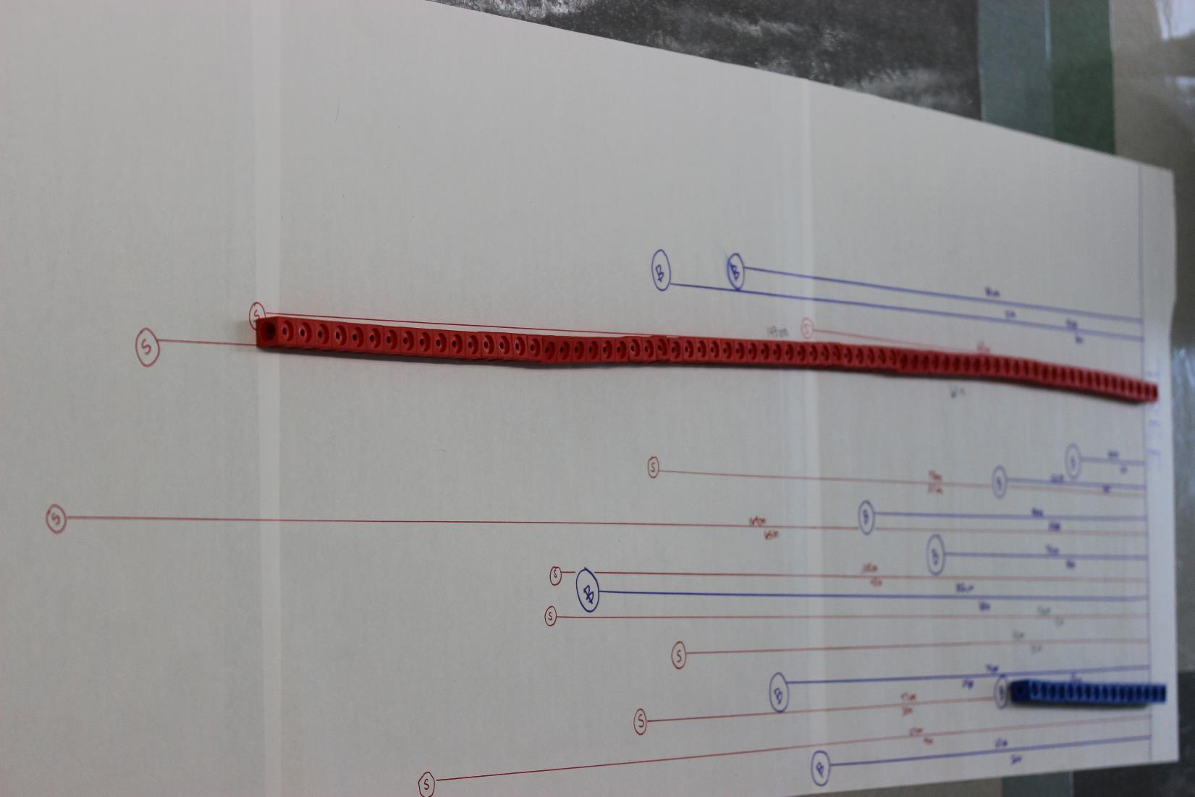
Photo courtesy of BSCS
Notes:
Example of the butcher-paper data/markup methods.

Slide 17
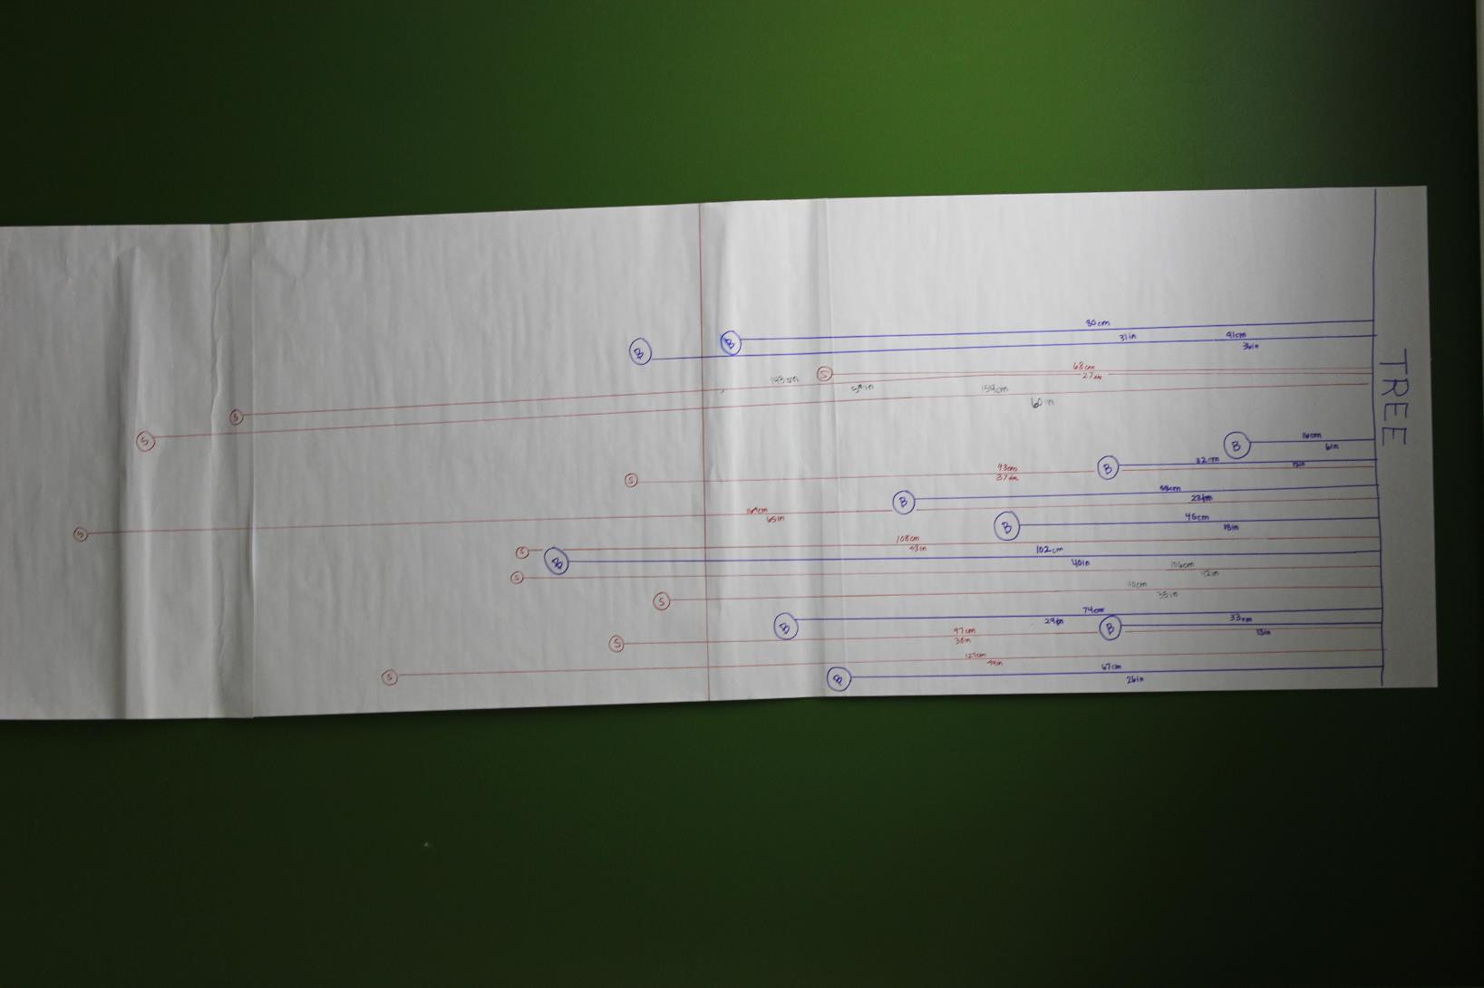
Photo courtesy of BSCS
Notes:
Example of the butcher-paper data/markup methods.

