Slide 1
Variations in plants and animals Lesson 4a
What Helps Some Cottonwood-Tree Seeds Survive and Grow While Others Don’t?

Slide 2
Review: Our Cottonwood-Seed Model
What did we use to represent the cottonwood-tree seeds?
What trait did we investigate?
What variations in this trait did we explore?
What size variation do you think might help cottonwood-tree seeds survive and grow into big cottonwood trees?

Slide 3
Today’s Focus Question
What helps some cottonwood-tree seeds survive and grow while others don’t?

Slide 4
Unit Central Question
How do differences (variations) in living things of the same kind help them survive so they can produce young (babies or seeds)?

Slide 5
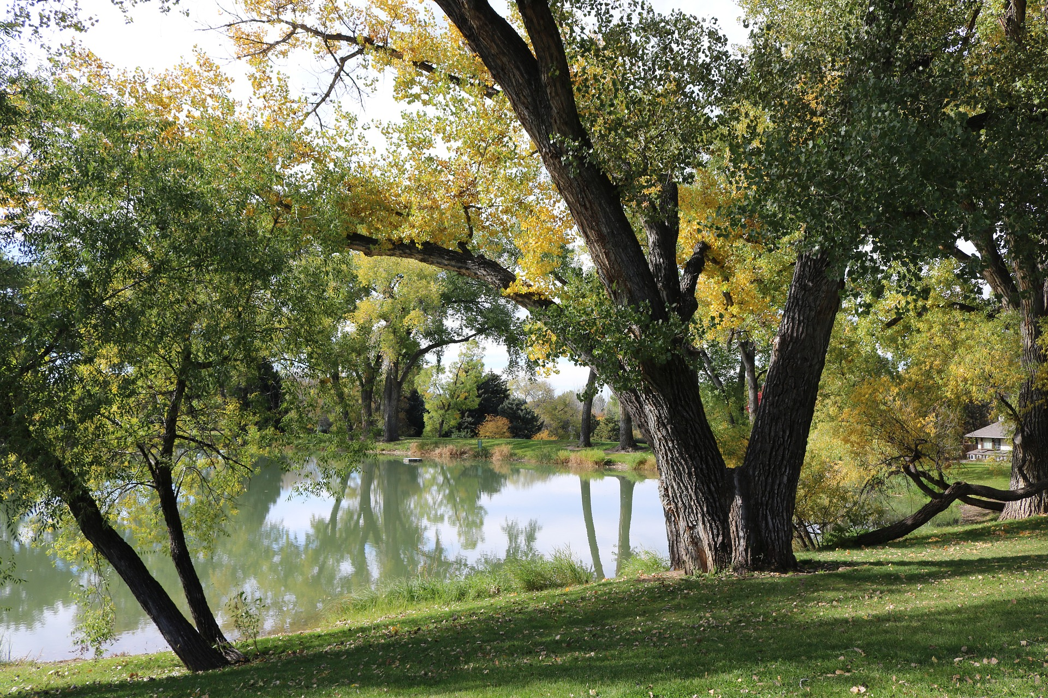
Cottonwood Trees and Where They Live
Photo courtesy of Megan McBride-Kennedy/Pixabay.com

Slide 6
What Is an Environment?
Photo courtesy of Megan McBride-Kennedy/Pixabay.com

Slide 7
What Is an Environment?
An environment includes everything that surrounds a living thing. The land, air, water, and other living and nonliving things are all part of the environment.
Photo courtesy of Megan McBride-Kennedy/Pixabay.com

Slide 8
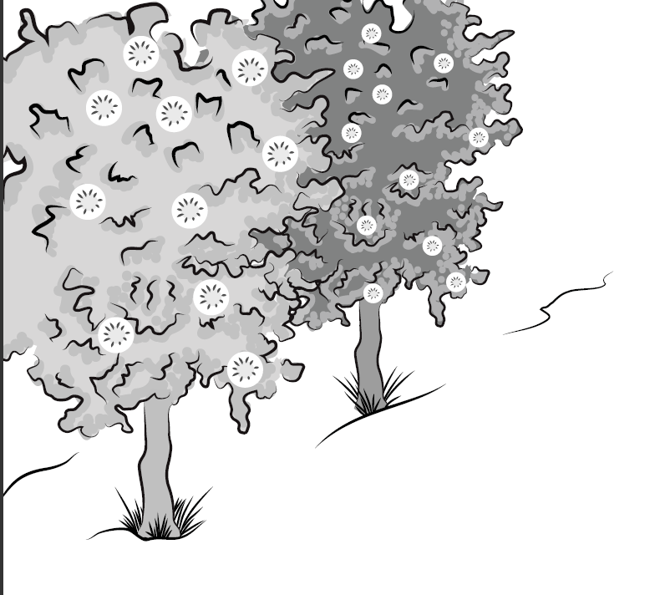
A Story about Two Cottonwood Trees
Courtesy of BSCS

Slide 9
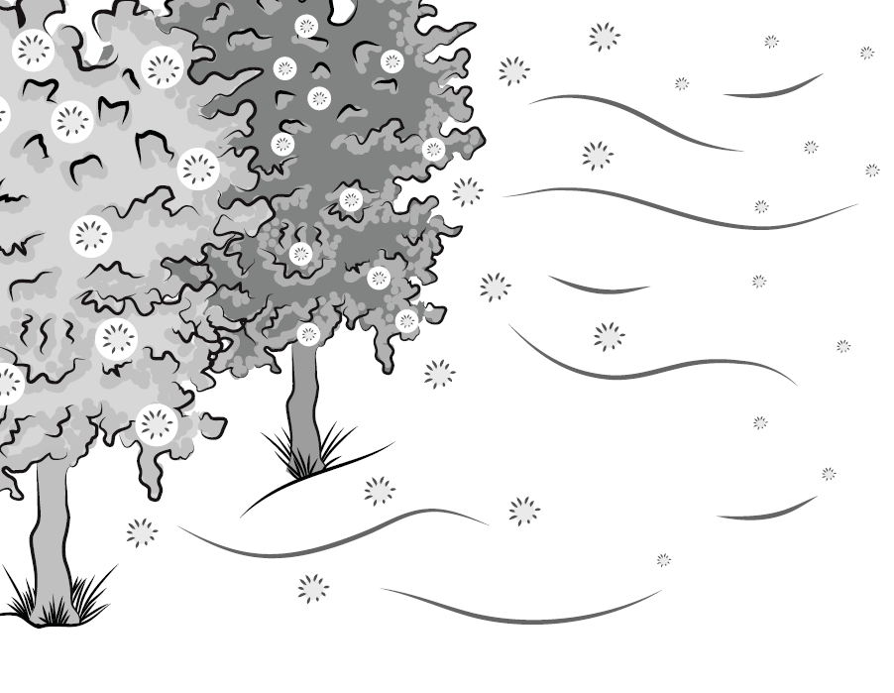
The Wind Starts to Blow!
Courtesy of BSCS

Slide 10
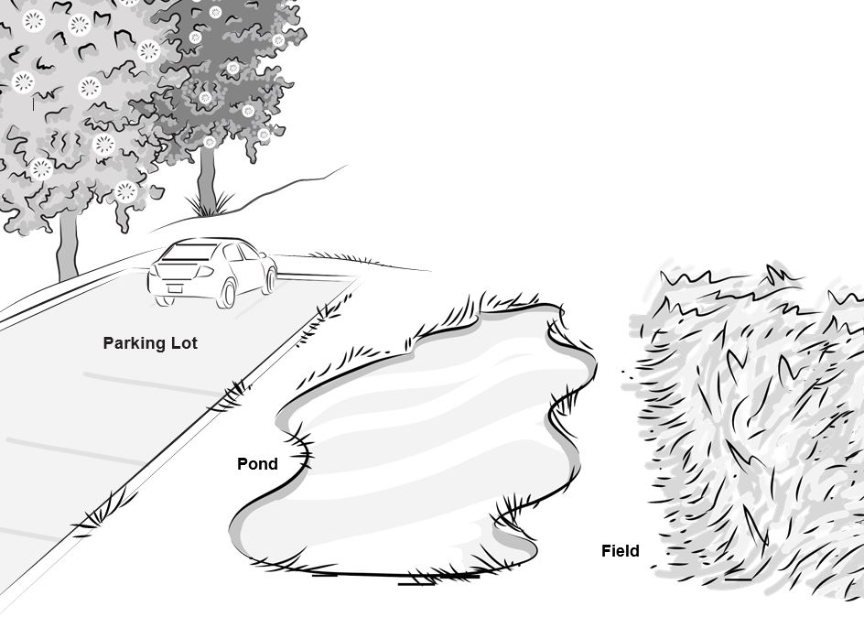
Where Will the Cottonwood Seeds Land?
Courtesy of BSCS

Slide 11
Where Will the Cottonwood Seeds Land?
Where do you think the big cottonwood seeds will land (the parking lot, the pond, or the field)?
Use the “B” sticky notes on the handout to show where you think the big seeds will land.
Where do you think the small cottonwood seeds will land?
Use the “S” sticky notes on the handout to show where you think the small seeds will land.

Slide 12
Which Seeds Will Survive and Grow?
Do you think the bigger cottonwood seeds or the smaller seeds are more likely to survive and grow in their environment?
Turn and Talk: Talk about this question with your partner. Then complete the sentence on your handout:
I predict that more of the [bigger or smaller] cottonwood-tree seeds will survive and grow because ______________.

Slide 13
What Did You Predict?
I predict that more of the [bigger or smaller] cottonwood-tree seeds will survive and grow because ______________.

Slide 14
Two Cottonwood Trees and Their Seeds
Courtesy of BSCS

Slide 15
Let’s Summarize!
Our focus question: What helps some cottonwood-tree seeds survive and grow while others don’t?

Slide 16
Next Time
In our next lesson, we’ll look at some data scientists collected that will show where the cottonwood-tree seeds landed.
Do you think your predictions will match the scientists’ data?

