Slide 1
Variations in plants and animals Lesson 4b
What Helps Some Cottonwood-Tree Seeds Survive and Grow While Others Don’t?

Slide 2
Key Science Words
Trait
Variations
Survive
Environment

Slide 3
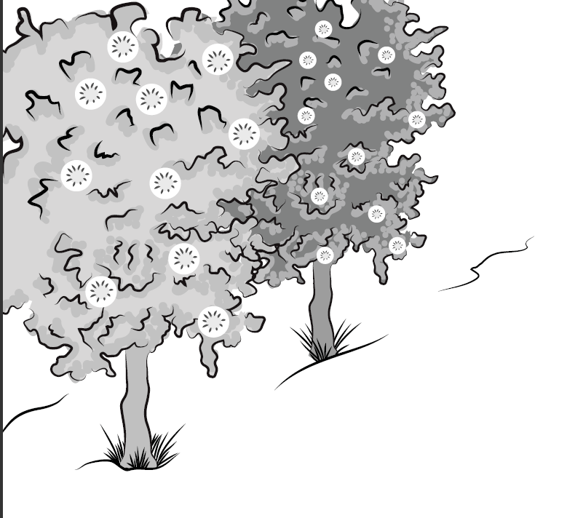
Review: What Was Our Story About?
Courtesy of BSCS

Slide 4
Today’s Focus Question
What helps some cottonwood-tree seeds survive and grow while others don’t?

Slide 5
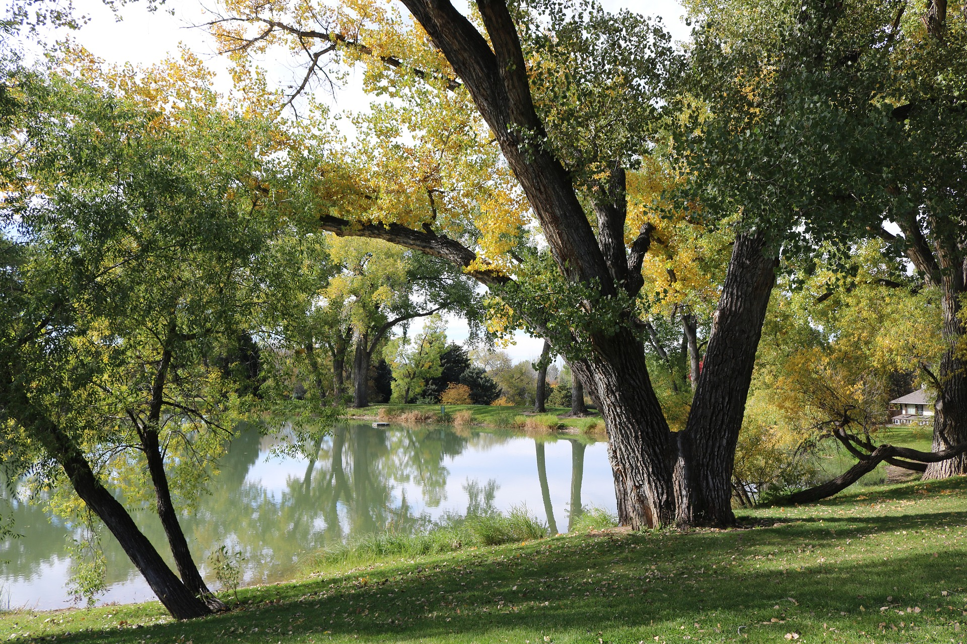
Review: What Is an Environment?
Photo courtesy of Megan McBride-Kennedy/Pixabay.com

Slide 6
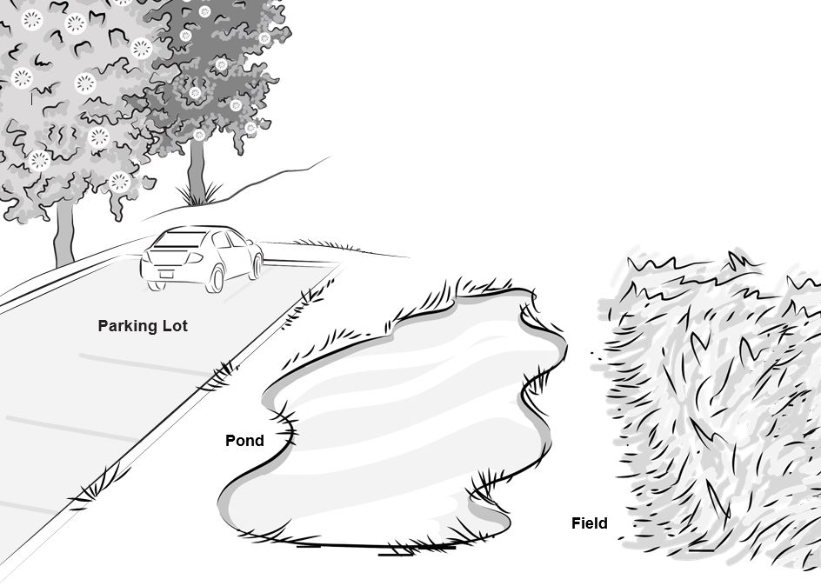
Where Will the Cottonwood Seeds Land?
What did you predict on your handouts?
Courtesy of BSCS

Slide 7
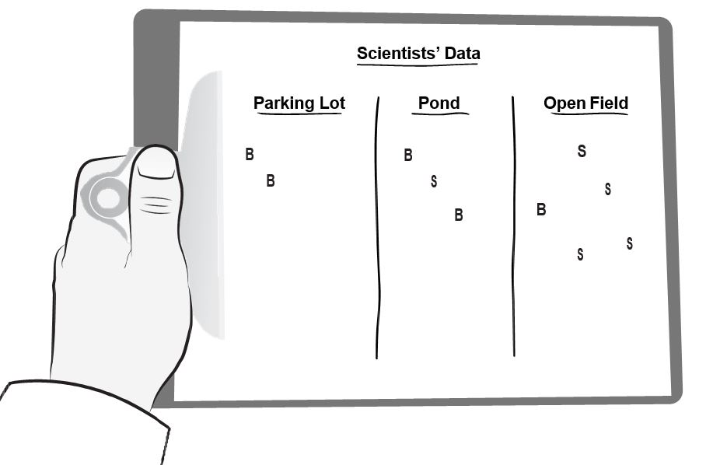
Here’s What Scientists Found!
Courtesy of BSCS

Slide 8
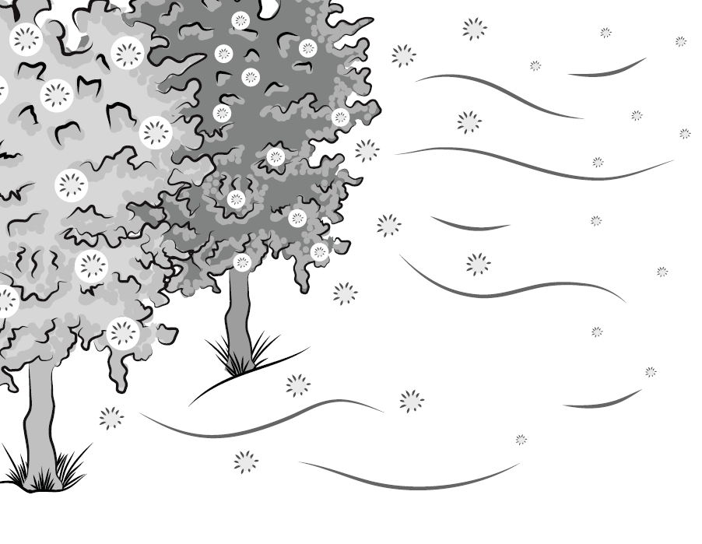
When the Wind Blows …
Do the bigger or smaller cottonwood seeds travel the greatest distance? Why?
Courtesy of BSCS

Slide 9
What’s Different about This Picture?
Courtesy of BSCS

Slide 10
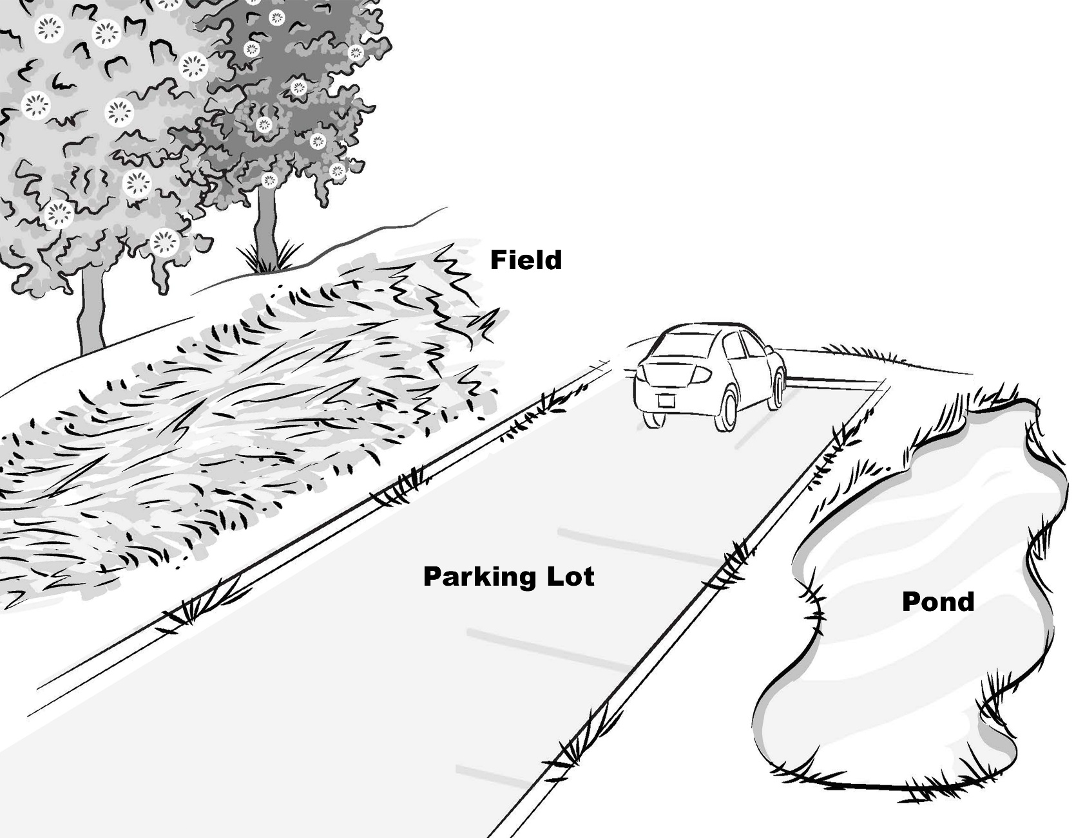
Where Will the Seeds Land This Time?
Courtesy of BSCS

Slide 11
Key Science Ideas
The size of cottonwood seeds is important for their survival.
Smaller seeds have a better chance of surviving because they can travel farther from the parent tree.
But the seeds also need a good environment to survive and grow.
So both trait variation and the environment are important for seeds to survive and grow!

Slide 12
Our Focus Question
What helps some cottonwood-tree seeds survive and grow while others don’t?

Slide 13
Let’s Summarize!
Imagine you’re a cottonwood-tree seed.
What size would you choose to be: big or small?
Where would you want to land: in a parking lot, a pond, or a field?
Draw and write your ideas in your notebook. Use these sentence starters:
I would choose to be a [big/small] cottonwood-tree seed because _______________.
I would want to land in a [parking lot/pond/field] because ______________.

Slide 14
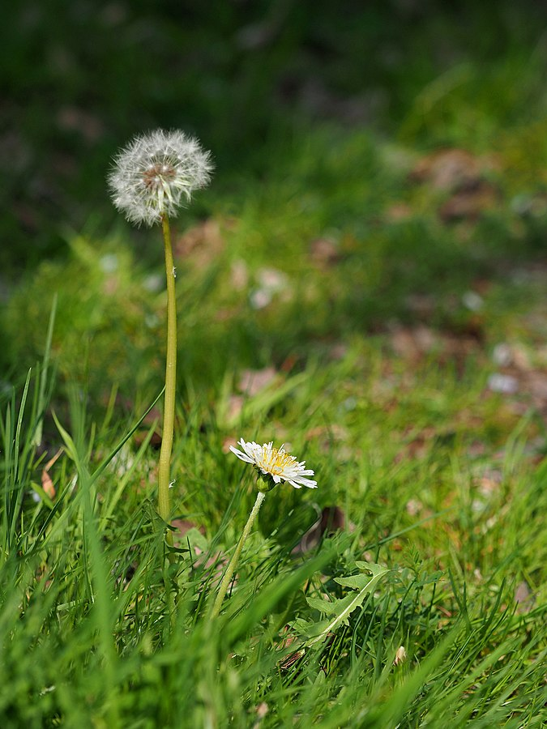
Next Time
In our next lesson, we’ll use what we’ve learned so far to figure out which traits and variations will help dandelions survive in a city park.
Photograph by Greg Peterson/Wikimedia Commons

