Slide 1
Variations in plants and animals Lesson 5a
How Do Differences (Variations) in the Traits of Dandelions Help Them Survive So They Can Produce Young (Seeds)?

Slide 2
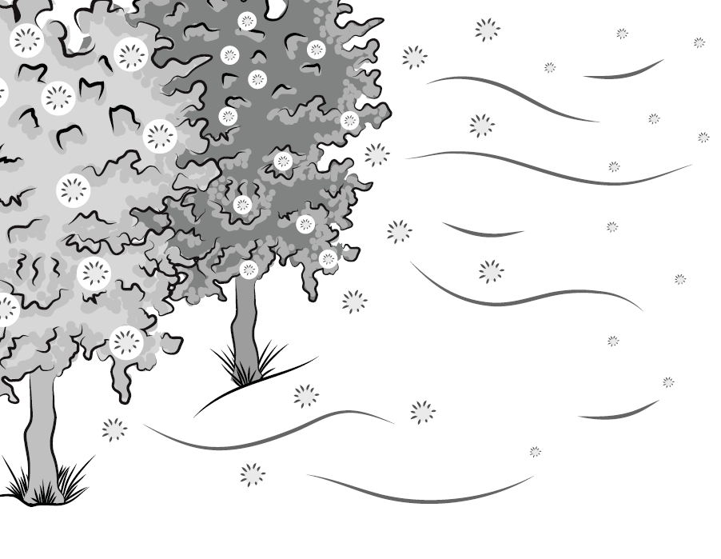
Review: Variations in a Trait
What trait of cottonwood-trees seeds did we look at?
What were the variations in this trait?
Courtesy of BSCS

Slide 3
Review: Variations in a Trait
Where did the smaller cottonwood seeds land?
Where did bigger seeds land?
Courtesy of BSCS

Slide 4
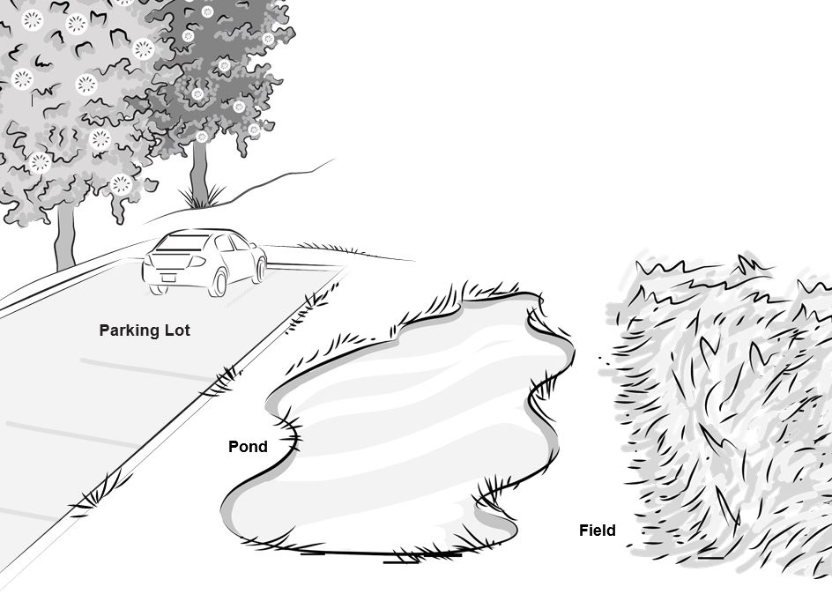
Review: Where Did the Seeds Land?
Courtesy of BSCS

Slide 5
Review: Where Did the Seeds Land This Time?
Courtesy of BSCS

Slide 6
Key Science Ideas
Smaller seeds have a better chance of surviving because they can travel farther from the parent tree than larger seeds.
But seeds also need a good environment to survive and grow.
So both trait variation and the environment are important for seeds to survive and grow!

Slide 7
Today’s Focus Question
How do differences (variations) in the traits of dandelions help them survive so they can produce young (seeds)?

Slide 8
Dandelions in a City Park
Photo courtesy of Pixabay.com

Slide 9
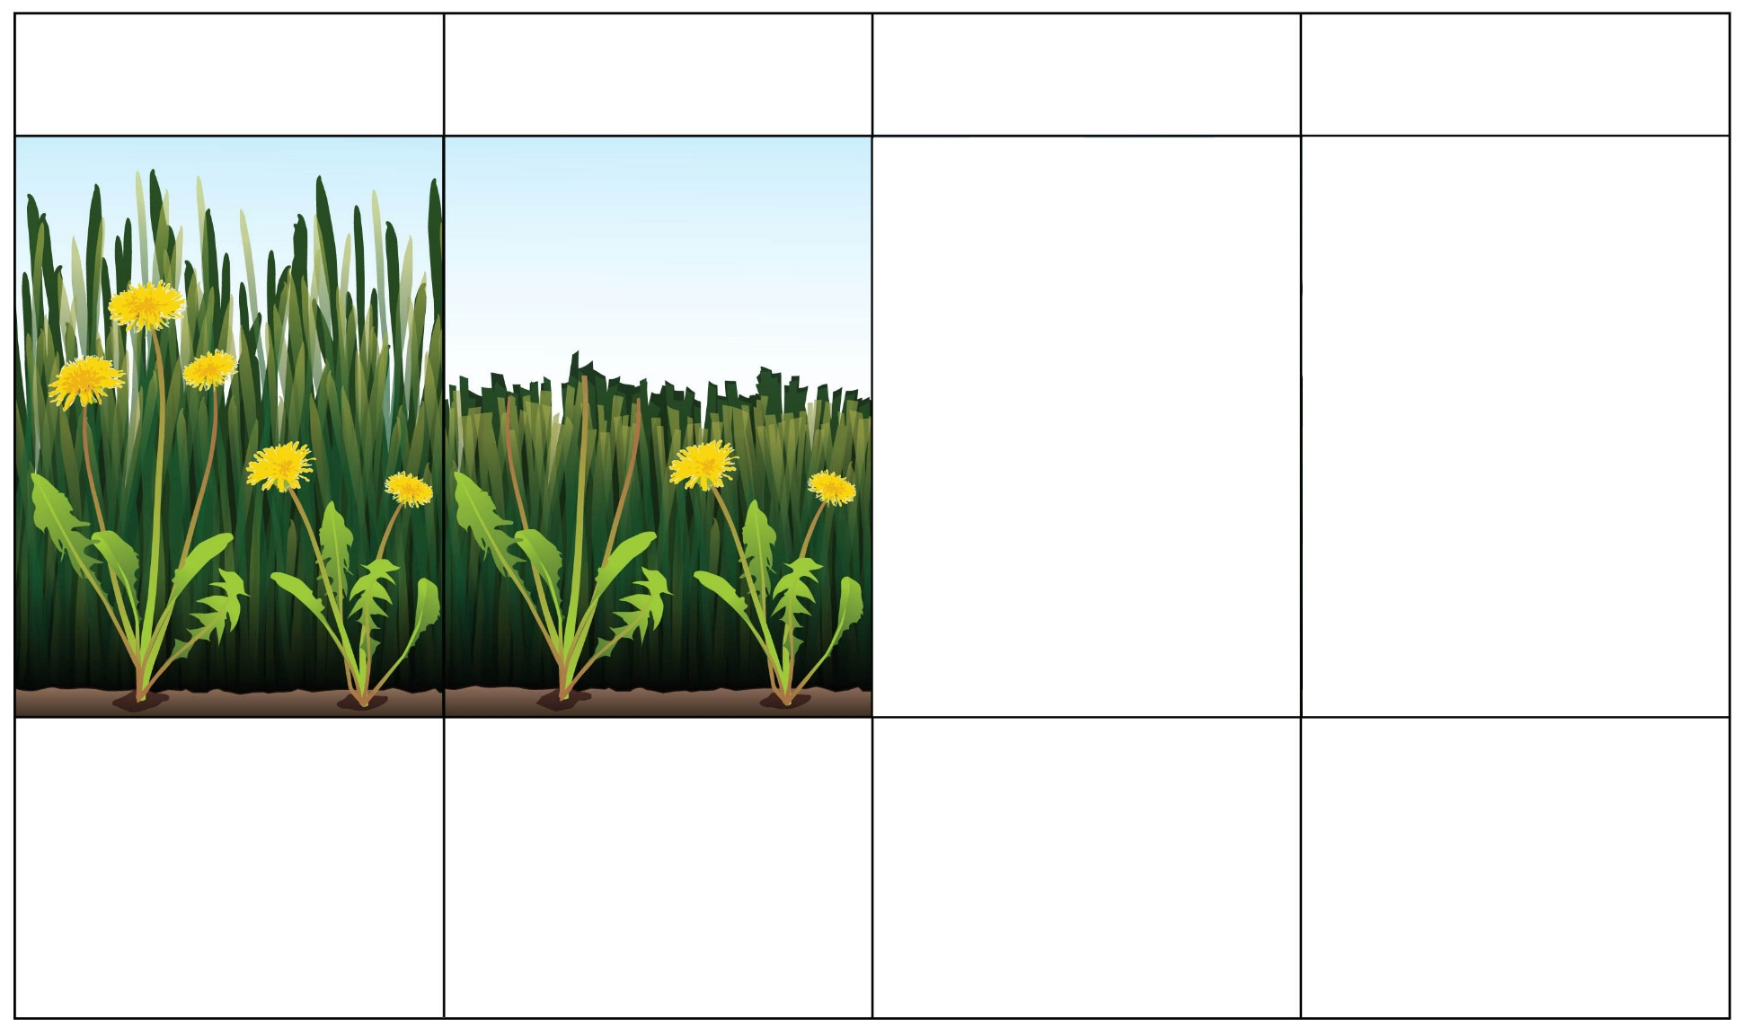
What Will Happen to the Dandelions?
Box 1
Box 2
Box 3
Box 4
Dandelions in the Park—before Mowing
Dandelions in the Park—after Mowing
Dandelions make new seeds.
Next year: What do the dandelion plants look like?
Courtesy of BSCS

Slide 10
What Will Happen to the Dandelions?
What do you think will happen to the dandelions when the lawn mower mows down the grass?
Talk about this question with an elbow partner.
Then draw two pictures on your handout to show what you think will happen to the dandelions.
In box 3, draw a picture showing which dandelions make new seeds.
In box 4, draw what you think the dandelions will look like in the park next year.
Be ready to share your drawings and ideas.

Slide 11
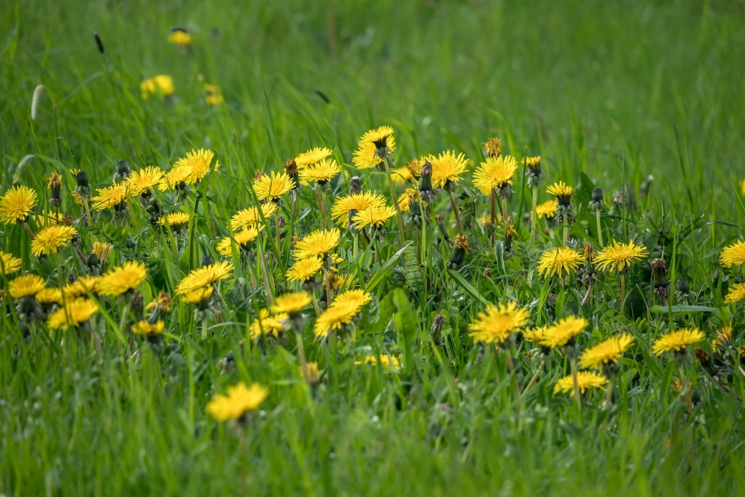
Traits and Variations in Dandelions
What dandelion trait did we investigate today?
What variations in this trait did we look at?
Which dandelions survived?
Which dandelions are more likely to make seeds?
Photo courtesy of Pixabay.com

Slide 12
Traits and Variations in Dandelions
What do you think will happen to the dandelion seeds that the shorter plants make?
If the seeds grow into new dandelion plants, what do you think the new plants will look like?
Do you think we’ll see more dandelions with long stems or short stems in the park next year?
Photo courtesy of Pixabay.com

Slide 13
Here’s What Happened to the Dandelions
Courtesy of BSCS
Notes:
It’s not necessarily true that the same place in the park would now only have smaller plants. If the taller dandelion plant put out new buds, which dandelions do fairly quickly after mowing, then there might be taller plants in that space too. Mowing cut down the taller plant but didn’t kill it, so it would put out more flowers and seeds during the summer, and those would grow the next year.

Slide 14
Let’s Summarize!
Our focus question: How do differences (variations) in the traits of dandelions help them survive so they can produce young (seeds)?
Look at the dandelions on your handout.
Circle the dandelions you think will survive and make seeds that will grow into new plants.
Under the pictures, write a sentence explaining why you think these dandelions will survive and make seeds. Be ready to share your ideas.

Slide 15
Let’s Summarize!
Photo courtesy of Pixabay.com

Slide 16
Next Time
What are the animals in this picture?
In our next lesson, we’ll explore how variations in one of their traits can help them survive in their environment.
Photo courtesy of Pixabay.com

