Slide 1
Variations in plants and animals Lesson 5b
How Do Differences (Variations) in the Traits of Giraffes Help Them Survive So They Can Produce Young (Babies)?

Slide 2
Review: Dandelions in a City Park
Photo courtesy of Pixabay.com

Slide 3
Today’s Focus Question
How do differences (variations) in the traits of giraffes help them survive so they can produce young (babies)?

Slide 4
Giraffes in the Wild
Photo courtesy of Pixabay.com

Slide 5
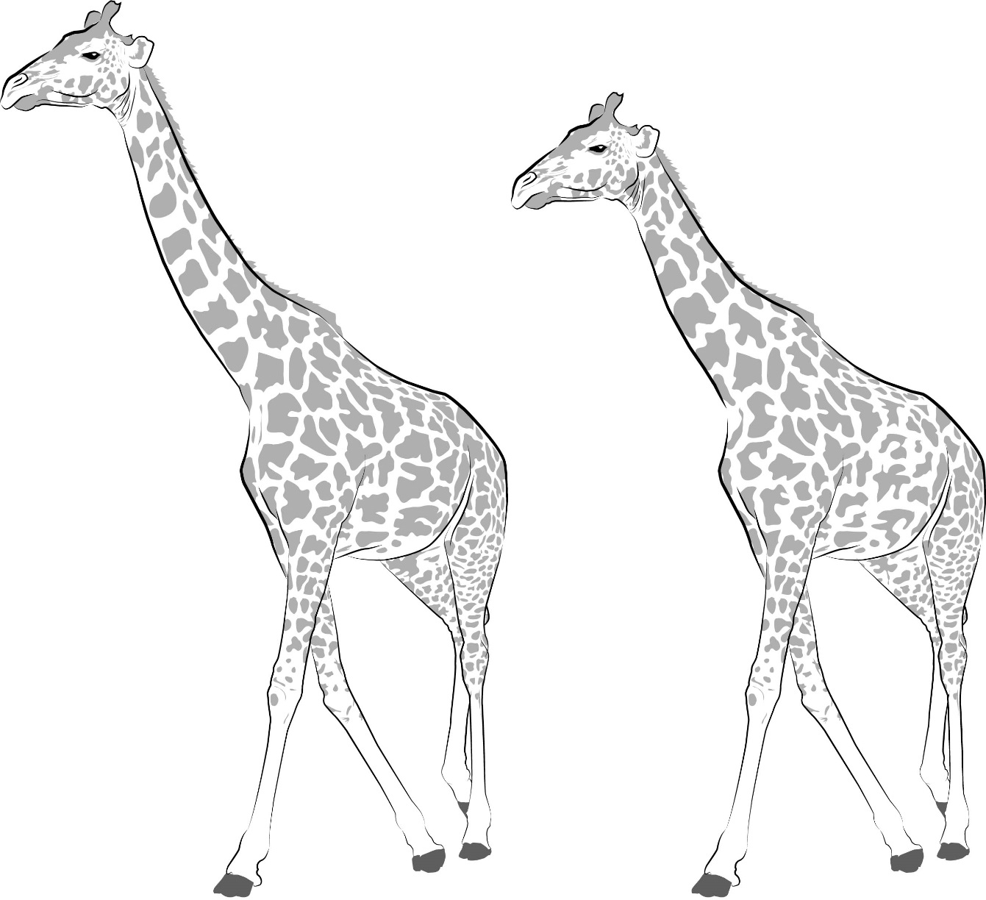
Traits and Variations in Giraffes
Courtesy of BSCS

Slide 6
Traits and Variations in Giraffes
Do you think giraffes with longer necks or shorter necks have a better chance of finding enough food to survive in their environment?
Talk about this question with an elbow partner.
Then draw a circle around the giraffe you think has a better chance of finding enough food to survive. Write longer neck or shorter neck to show which giraffe you circled.
Be ready to share your ideas and reasons with another pair of students.

Slide 7
Traits and Variations in Giraffes
Look at the giraffe you circled. If this giraffe survives and has a baby, what do you think the baby will look like?
Draw a baby giraffe next to the giraffe you circled. Decide whether to give it a longer neck or a shorter neck.
Be ready to share your picture with your partner and explain why you gave the baby giraffe a longer or shorter neck.

Slide 8
Traits and Variations in Giraffes
What giraffe trait did we investigate today?
What variations in this trait did we look at?
Which giraffe did you circle on the handout?
Why do you think that giraffe has a better chance of finding enough food to survive?
Courtesy of BSCS

Slide 9
Traits and Variations in Giraffes
Which giraffe has a better chance of surviving in its environment?
Which giraffes are more likely to have babies—giraffes with longer necks or shorter necks? Why do you think so?
Courtesy of BSCS

Slide 10
Traits and Variations in Giraffes
Do you think we’ll see more giraffes with longer necks or shorter necks in this environment next year?
Which variation in this trait will we be more likely to see?
Courtesy of BSCS

Slide 11
Let’s Summarize!
Our focus question: How do differences (variations) in the traits of giraffes help them survive so they can produce young (babies)?
Which variation in neck length gives giraffes a better chance of surviving and having babies? Why?
How does the environment affect whether giraffes with longer or shorter necks will survive and have babies?

Slide 12
Key Science Ideas
Trait variations, like longer necks, can give giraffes a better chance of surviving and having babies.
But giraffes also need a good environment to survive and grow.
So trait variations and the environment are both important for giraffes to survive!

Slide 13
Next Time
In our final lesson of this unit, we’ll use everything we’ve learned about traits and variations in plants and animals to answer our unit central question:
How do differences (variations) in plants or animals of the same kind help them survive so they can produce young (babies or seeds)?
Are you ready to show what you know?

