Slide 1
Variations in plants and animals Supplemental Math Lesson 1
How Can We Use Evidence to Show That Sunflowers Are Not All Alike Even Though They’re All Sunflowers?

Slide 2
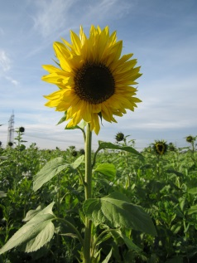
How Are Sunflowers Alike and Different?
Photo courtesy of AnRo0002/Wikimedia Commons
Photo courtesy of Pixabay.com

Slide 3
Showing Variations in Sunflower Traits
How could we show variations in sunflower traits in a more scientific way?
What might a scientist do to learn more about the differences or variations in sunflower traits?
Photo courtesy of AnRo0002/Wikimedia Commons
Photo courtesy of Pixabay.com

Slide 4
Today’s Focus Question
How can we use evidence to show that sunflowers are not all alike even though they’re all sunflowers?

Slide 5
Sunflower Seeds
Photo courtesy of Pixabay.com

Slide 6
How Are Sunflower Seeds Alike and Different?
Pour the bag of sunflower seeds on a sheet of notebook paper and look at them closely.
How are the seeds alike? How are they different?
Share your observations with your partner. Then write them in your science notebook.
Photo courtesy of Pixabay.com

Slide 7
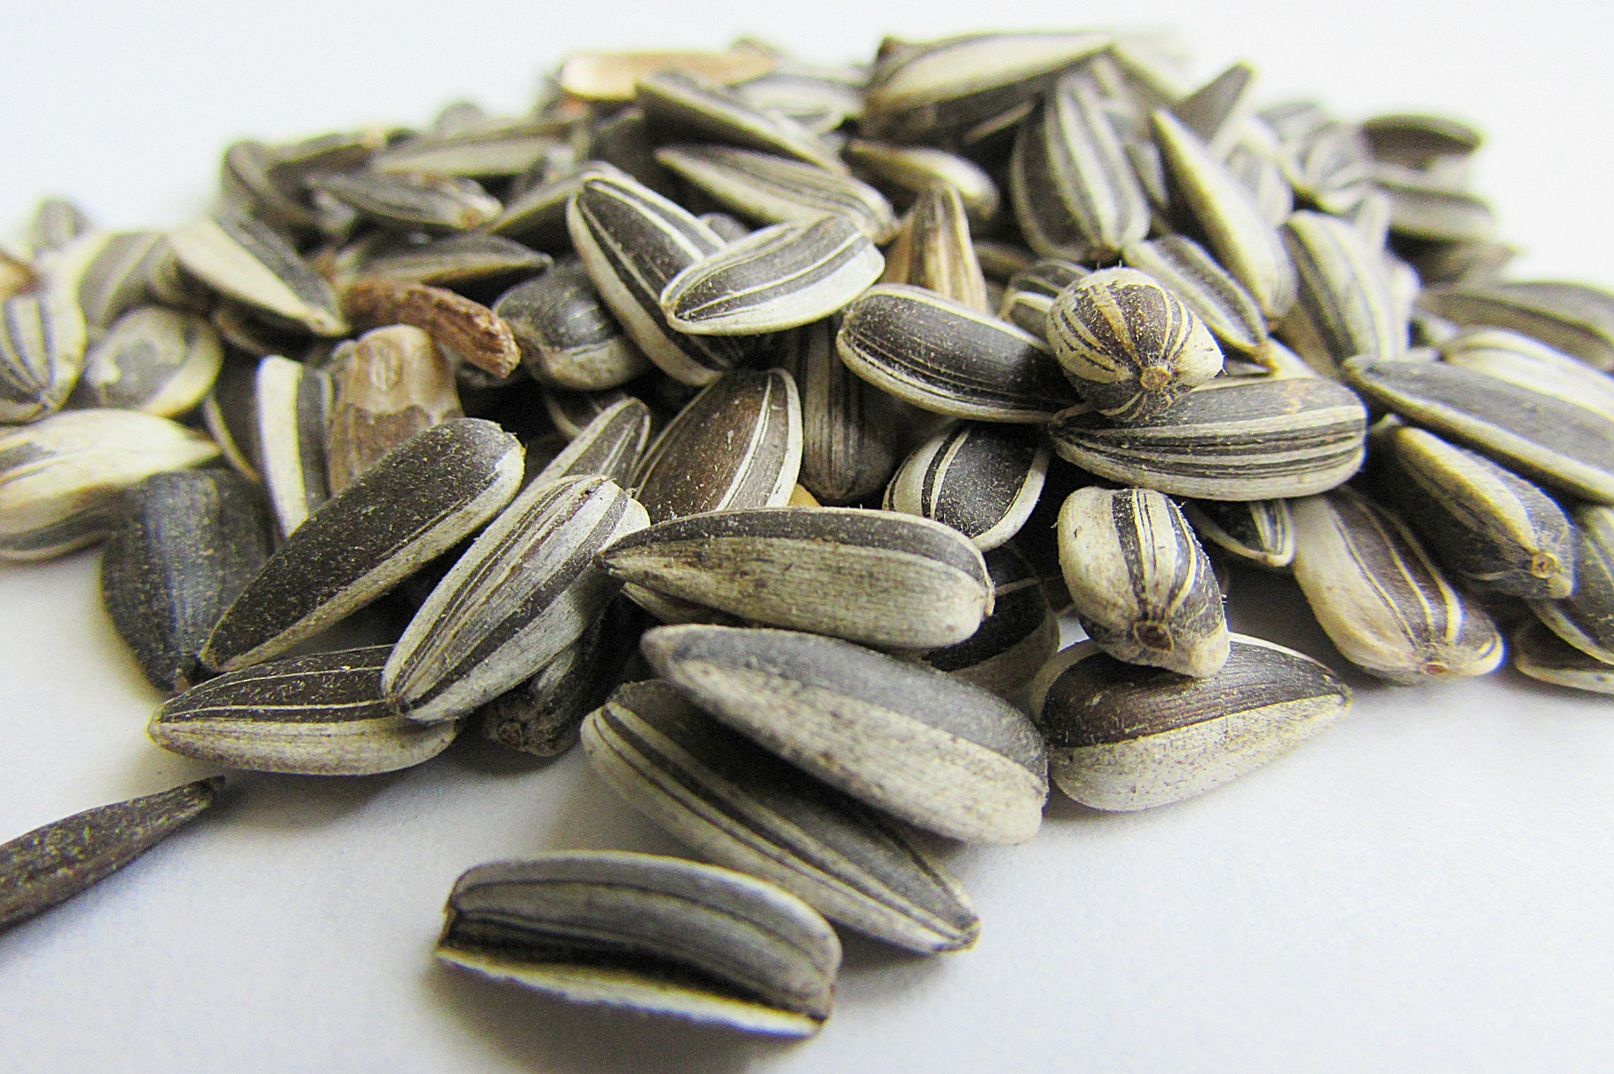
Sunflower Seeds
How could you show that some seeds are bigger and some are smaller?
Photo courtesy of Pixabay.com

Slide 8
Ways to Gather Evidence
Comparing and measuring traits are two ways we can gather evidence of variations.
We can be more accurate if we measure a trait.
Photo courtesy of Pixabay.com

Slide 9
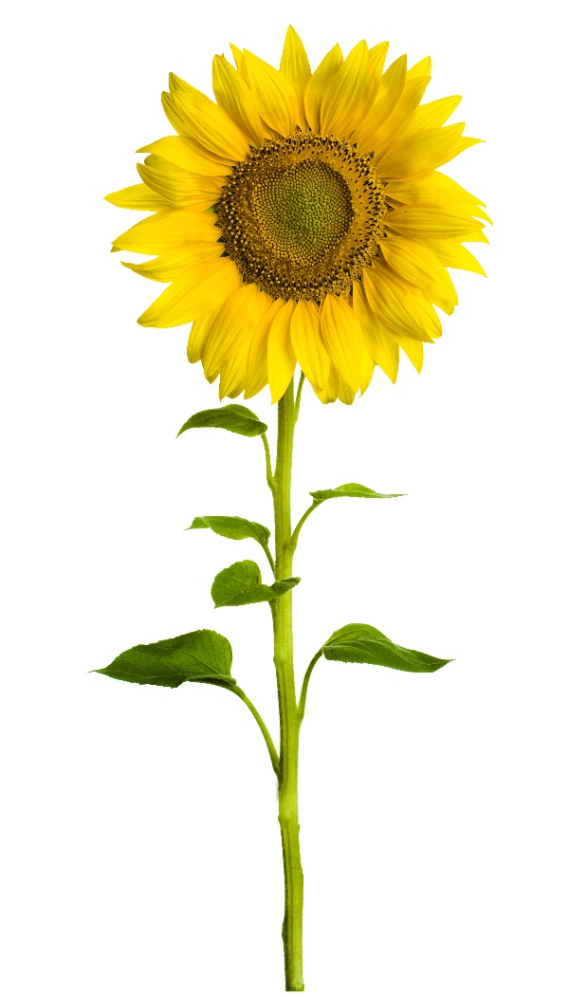
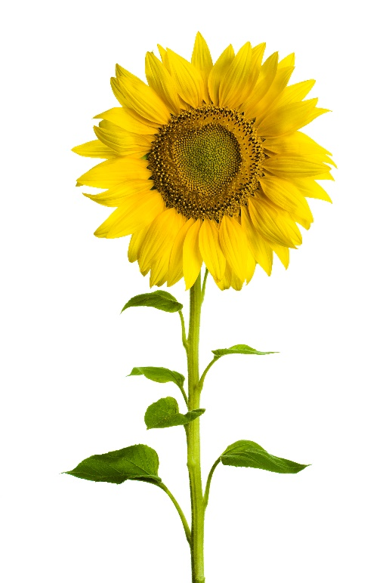
How Could We Compare These Plants?
Photos courtesy of Stock.Adobe.com

Slide 10
Measure Your Sunflowers
Pairs:
Use your measuring tool to measure the height of your sunflower plant (the length of the stem).
Measure at least twice to make sure your measurement is correct.
Record your measurement on your handout under the correct column. Example: If you’re measuring Sunflower 1, record your data in the column that says “Sunflower 1.”

Slide 11
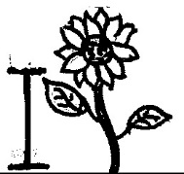
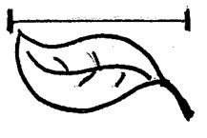
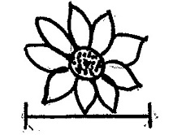
Let’s Record Our Sunflower Data!
 | Sunflower 1 | Sunflower 2 | Sunflower 3
How tall is the plant?
How long is the leaf?
How wide is the flower?

Slide 12
Are These Sunflowers Real?
Photos courtesy of Stock.Adobe.com

Slide 13
Why Do Scientists Use Models?
Photos courtesy of Stock.Adobe.com

Slide 14
Why Do Scientists Use Models?
Models represent real things, but they aren’t the real things.
Scientists use models to learn about things that are too difficult or dangerous to study up close, or maybe because the real thing is too hard to find.
Sometimes an object is too far away to study, like a planet. Or it might be too small, like a drop of water.
We used a sunflower model because real sunflowers would be hard to find and would wilt.

Slide 15
Our Sunflower Measurements
What do you notice about our measurements?
What do our measurements tell us about the stem-length (height) trait of the sunflower plants?
Photo courtesy of Stock.Adobe.com

Slide 16
Our Sunflower Measurements
Complete these sentences:
The height of Sunflower 1 is [more than/less than] the height of Sunflower 2.
The height of Sunflower 2 is [more than/less than] the height of Sunflower 3.
The height of Sunflower 3 is [more than/less than] the height of Sunflower 1.
Photo courtesy of Stock.Adobe.com

Slide 17
Which Plant Is More Likely to Survive?
Do you think that variations in the stem-length (height) trait give a sunflower a better chance of surviving in its environment?
Will a taller sunflower be more likely to survive than a shorter one? Why or why not?
Photo courtesy of Stock.Adobe.com

Slide 18
Variations in Sunflower Seeds
Think of a trait you observed in the sunflower seeds.
Then draw two variations of that trait in your science notebook.
Make sure to label the trait and the variations.
Photo courtesy of Pixabay.com

Slide 19
Let’s Summarize!
Our focus question: How can we use evidence to show that sunflowers are not all alike even though they’re all sunflowers?
How did we show that sunflowers aren’t exactly alike even though they’re all sunflowers? What evidence did we use?

Slide 20
Key Science Ideas
Sunflowers share many traits, like seeds and stems. But they aren’t exactly alike.
Sunflowers also have many differences in their traits, like the size of their seeds and the height (or length) of their stems.
These differences are called variations.

Slide 21
Next Time
In our next lesson, we’ll construct a bar graph to help us compare and describe the data (evidence) we collected on variations in sunflower traits.

