Slide 1
Variations in plants and animals Supplemental Math Lesson 2
How Can We Use Evidence to Show That Sunflowers Are Not All Alike Even Though They’re All Sunflowers?

Slide 2
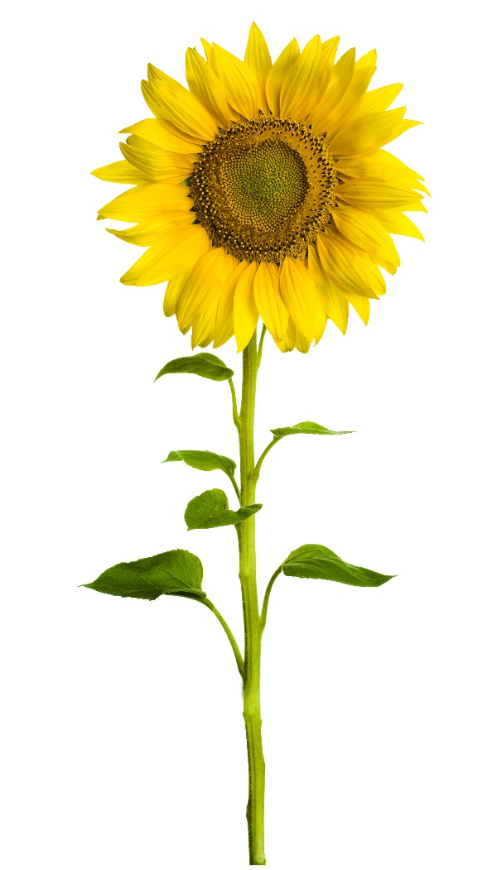
Review: Sunflower Traits and Variations
What sunflower trait did we measure last time?
What variations did we find in that trait?
Photo courtesy of Stock.Adobe.com

Slide 3
Today’s Focus Question
How can we use evidence to show that sunflowers are not all alike even though they’re all sunflowers?

Slide 4
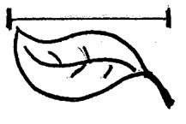
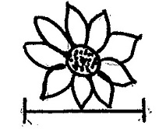
Let’s Review Our Sunflower Data!
 | Sunflower 1 | Sunflower 2 | Sunflower 3
How tall is the plant?
How long is the leaf?
How wide is the flower?

Slide 5
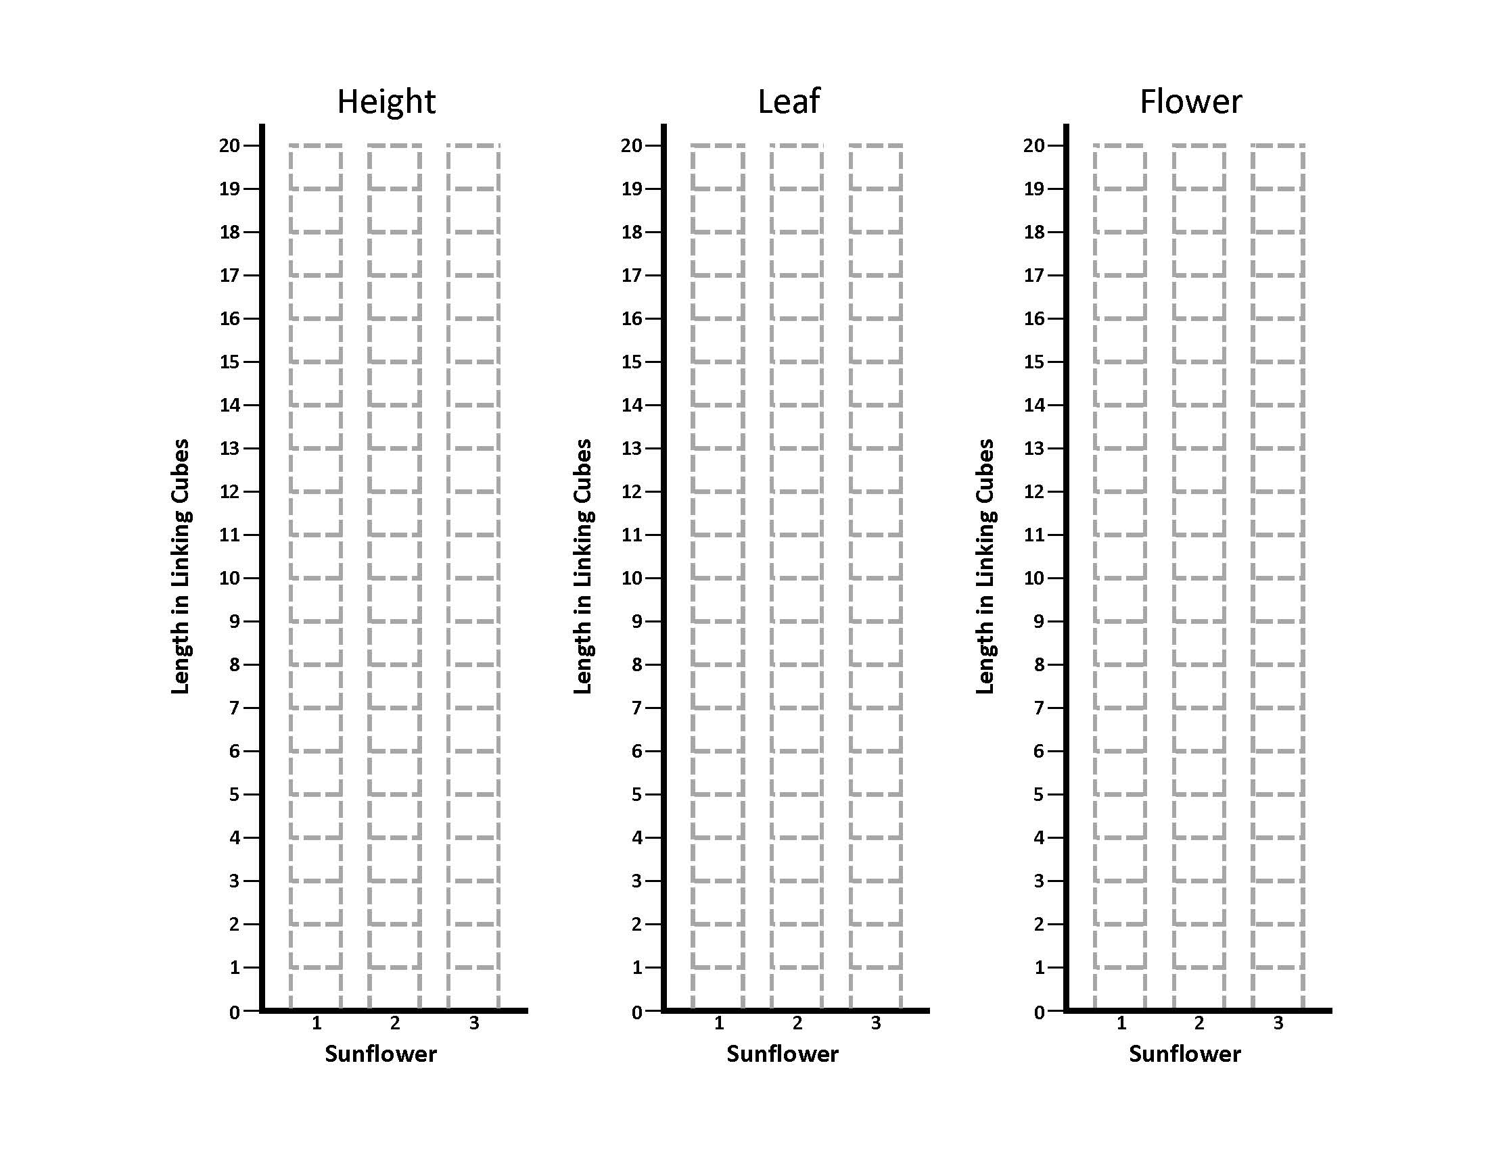
Sunflower Bar Graphs

Slide 6
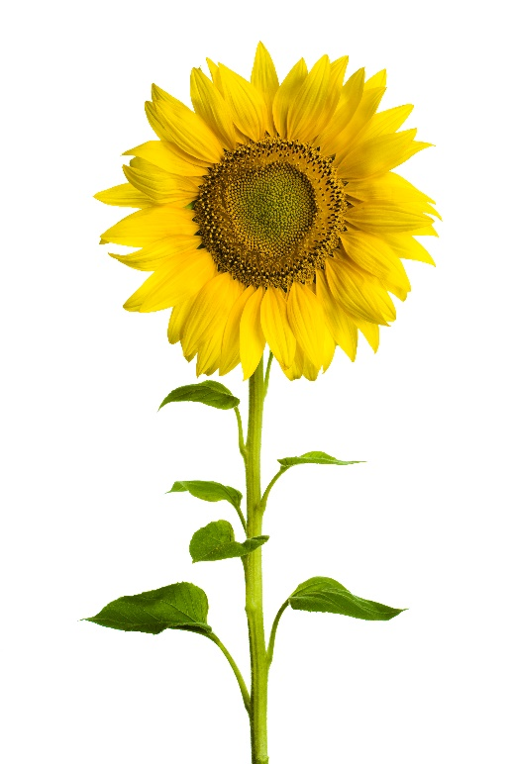
Traits and Variations in Sunflowers
Photos courtesy of Stock.Adobe.com

Slide 7
What Does Our Bar Graph Show?
What do the bars on our graph show us?
What evidence does the bar graph provide?
Photo courtesy of Stock.Adobe.com

Slide 8
What Does Our Bar Graph Show?
What does the graph tell us about the variations in the height of the sunflowers?
Exactly how tall is each sunflower plant?
How does the height of each sunflower compare to the heights of the other sunflowers?
Photo courtesy of Stock.Adobe.com

Slide 9
What Does Our Bar Graph Show?
Is it more accurate to say that Sunflower 2 is taller than Sunflower 1 or that Sunflower 2 is exactly X number of units taller than Sunflower 1?
How does our bar graph help us describe variations in a trait more accurately?
Photo courtesy of Stock.Adobe.com

Slide 10
Draw This Chart in Your Notebook
Sunflower Trait | Variations in This Sunflower Trait
Height (stem length)

Slide 11
Example: Label and Describe Your Drawings
Sunflower Trait | Variations in This Sunflower Trait
Height (stem length) | Sunflower 2 is [X units] taller than Sunflower 1. Sunflower 2 is [X units] taller than Sunflower 3. My drawing shows that the three sunflowers have variations in the trait of height. They aren’t exactly alike even though they’re all sunflowers.

Slide 12
Let’s Summarize!
Our focus question: How can we use evidence to show that sunflowers are not all alike even though they’re all sunflowers?
What evidence did we collect to show that sunflowers aren’t exactly alike?
How did we display our evidence? What two ways did we show the variations in our three sunflowers?
How did the bar graph help us show variations in the height trait of the sunflowers?

Slide 13
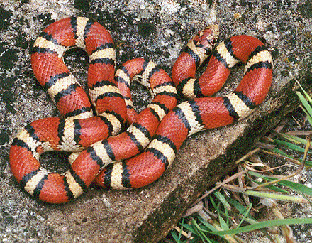
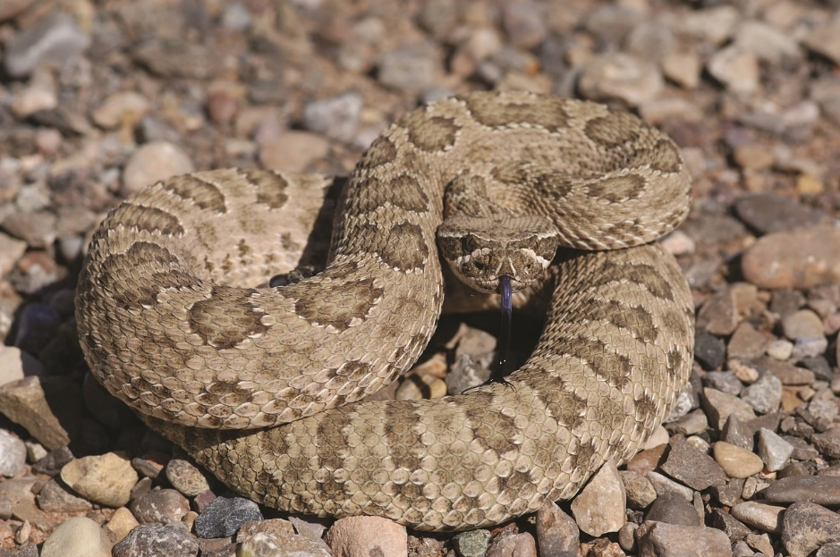
Next Time
How are snakes alike and different?
How might variations in their traits help them survive so they can have baby snakes?
Photograph by Mike Pingleton/Wikimedia Commons
Photo courtesy of Pixabay.com

