Slide 1
Earth’s Changing Surface Lesson 1A
What Does the Surface of Earth Look Like?

Slide 2
Unit Central Questions
What does the surface of Earth look like? Does it ever change?

Slide 3
What Is a Surface?
What is the surface of your hand?
What is the surface of your head?
How is the surface of your head different from the inside of your head?
Notes:
Write student ideas on the board.

Slide 4
What Is a Surface?
What do you think Earth’s surface is?
Photo courtesy of Pixabay.com
Notes:
Write student ideas on the board.

Slide 5
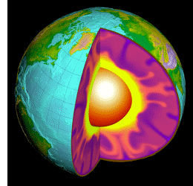
What Is a Surface?
Where is Earth’s surface in this diagram?
Courtesy of USGS.gov

Slide 6
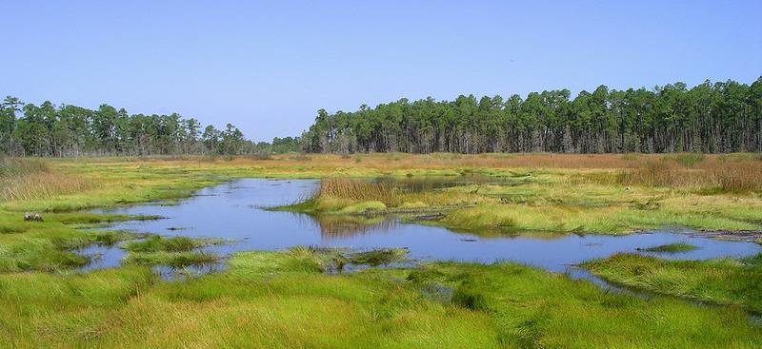
Describe the Surface of Earth
Photo courtesy of Pexels.com
Photo courtesy of Gretchen L. Grammer/Flickr

Slide 7
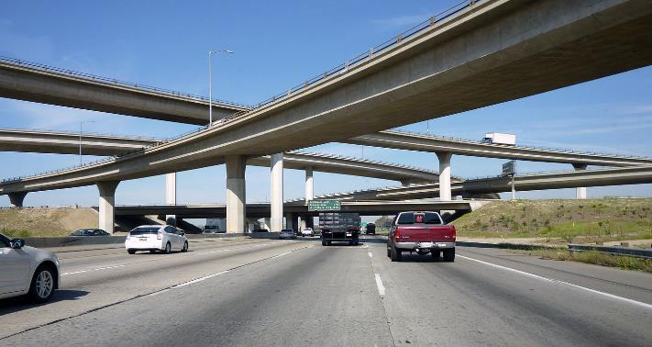
Describe the Surface of Earth
Photo courtesy of Andy Arthur/Wikimedia Commons
Photo courtesy of Coolcaesar/Wikipedia Commons
Photo courtesy of Daquella Manera/Wikimedia Commons

Slide 8
Today’s Focus Question
What does the surface of Earth look like?

Slide 9
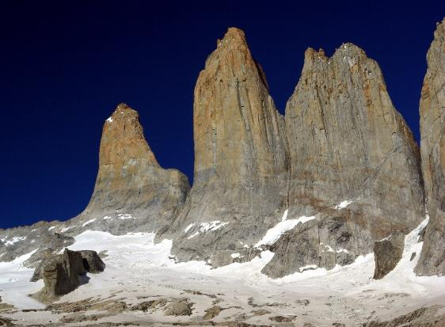
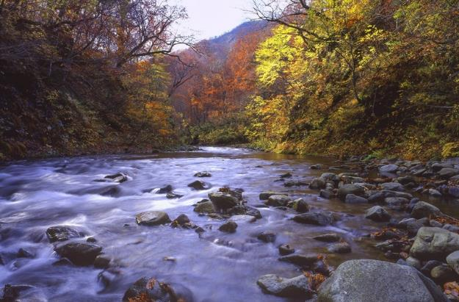
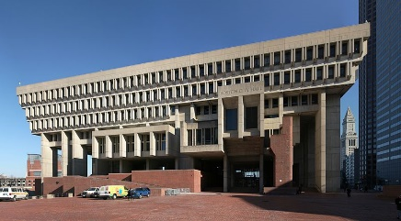
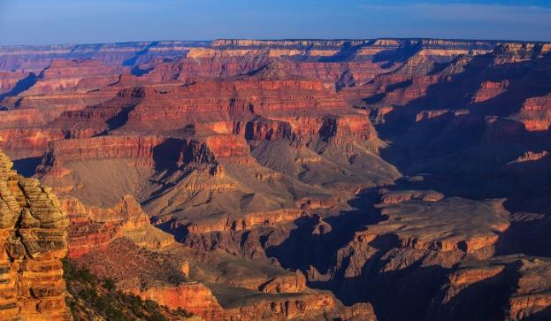
Is it Natural or Did Someone Make It?
Photo courtesy of Steve Bennett/Wikipedia Commons
Photo courtesy of Pxhere.com
Photo courtesy of Daniel Schwen/Wikipedia Commons
Photo courtesy of Murray Foubister/Wikipedia Commons

Slide 10
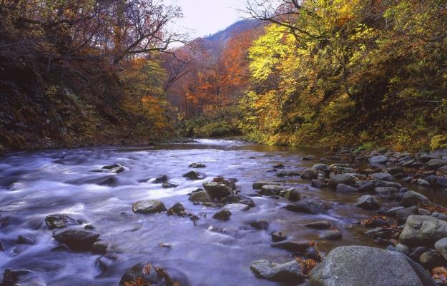
What Are Landforms?
Photo courtesy of Pxhere.com
Photo courtesy of Steve Bennett/Wikipedia Commons
Photo courtesy of Murray Foubister/Wikipedia Commons

Slide 11
What Are Landforms?
Scientists call the natural features of the land landforms.
A landform is something natural formed out of the land.
Landforms are the shape of Earth’s surface.
Mountains are one example of a landform.
The things people build are not landforms.
Things that grown on the land are not landforms.

Slide 12
Different Kinds of Landforms
Mountain
Hill
Plain
Valley
Canyon
Plateau
River
Lake
Delta
How would you describe each landform? What shape does it have?
What ideas do you have for building each landform out of sand?

Slide 13
Landforms in Our Community
Have you seen any of these landforms in our community?
In your science notebook, sketch two of the landforms you’ve seen near your home or school.
Use colored pencils or crayons.
Make sure to label your drawings!

Slide 14
Let’s Summarize!
Our focus question: What does the surface of Earth look like?
Share your ideas with an elbow partner.
Think about your landform drawings and all of the pictures we looked at today.

Slide 15
Key Science Ideas
Earth’s surface has many different shapes or features called landforms.
Some landforms rise high above Earth’s surface, and others cut deep into the surface.
The things people make and the things that grow on the land are not landforms.

Slide 16
Next Time
In our next lesson, we’ll use ideas about landforms to build models out of sand.
Tonight, see if you can come up with some new ideas for making all of these different landform shapes!

