Slide 1
Earth’s Changing Surface Lesson 1b
How Can We Make Models out of Sand to Show the Shapes of Different Landforms?

Slide 2
Our Unit Central Questions
What does the surface of Earth look like? Does it ever change?

Slide 3
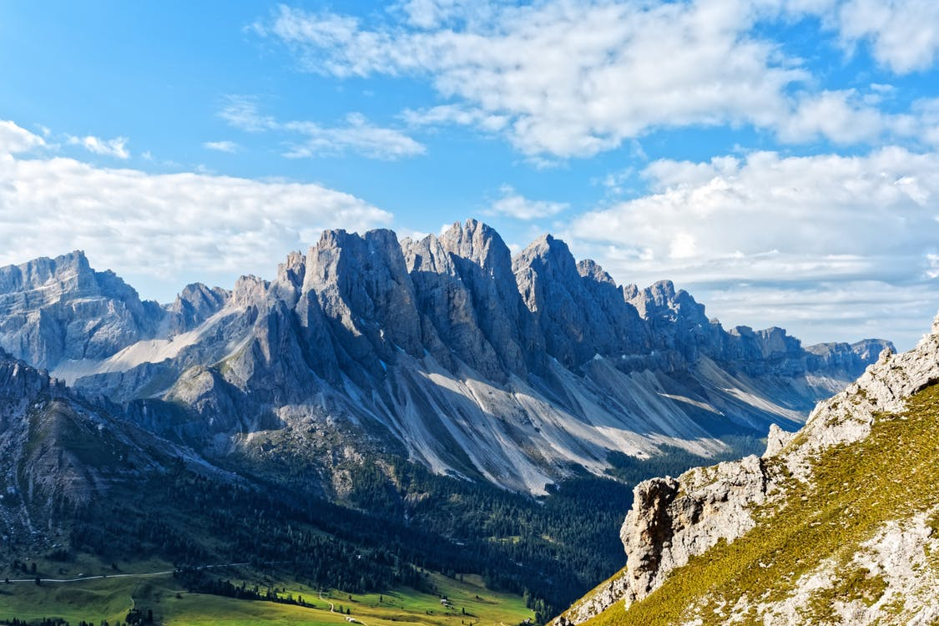
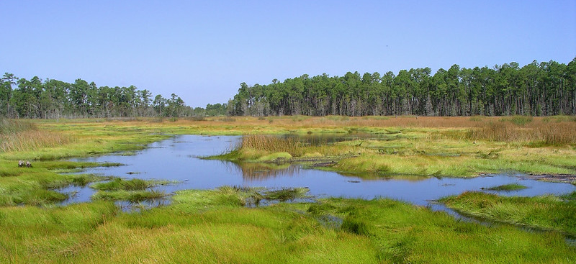
What Landforms Do You See?
Photo courtesy of Pexels.com
Photo courtesy of Gretchen L. Grammer/Flickr

Slide 4
Today’s Focus Question
How can we make models out of sand to show the shapes of different landforms?

Slide 5
Landforms
What is a landform?
What landforms can you name?
How could we make landform models out of sand?
Photo courtesy of Pixabay.com

Slide 6
Let’s Build Landforms!
Look at your group’s landform picture cards and decide which landform each of you will make. (Each group member will make only one landform.)
Use the sand on your table to build your landform model. Shape the sand with your hands.
Use your landform picture card as a guide to help you make your landform.
Put the correct label (name) on your landform.
After everyone has finished their models, compare your model with the other models in your group.

Slide 7
Let’s Share Our Landform Models
What landform did you make?
How did you make it with the sand?
Describe the shape of your landform.

Slide 8
Let’s Summarize!
Our focus question: How can we make models out of sand to show the shapes of different landforms?
What did we do today that helped us answer this question?
What different landform models did you make out of sand?
How did you make your model?
Notes:
.

Slide 9
Next Time
Are landforms the same everywhere, or are they different in different places?
We’ll think about this question next time.

