Slide 1
Earth’s Changing Surface Lesson 2a
How Does the Land on Earth’s Surface Look Different in Different Places? How Can Representations Like Maps Help Us Find Different Landforms in the United States?

Slide 2
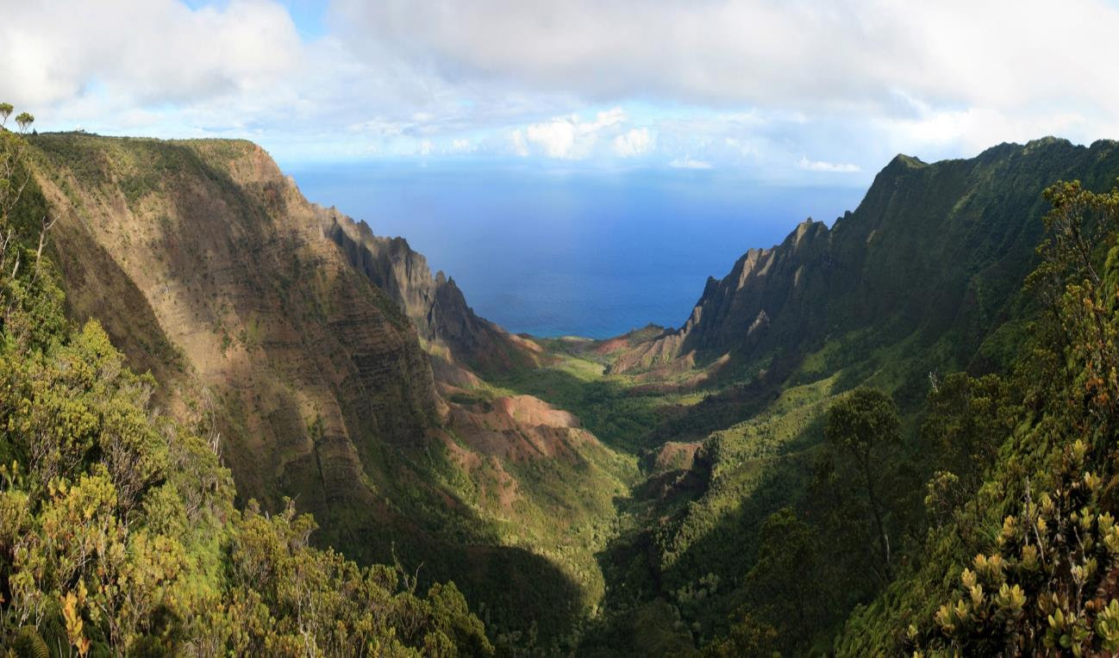
Is This a Landform? Why or Why Not?
Photo courtesy of Gh5046 /Wikimedia Commons

Slide 3
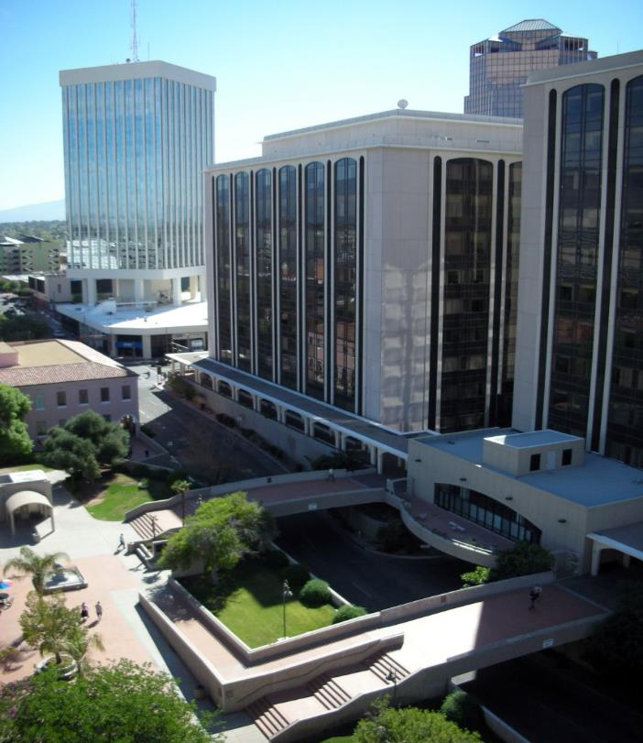
Is This a Landform? Why or Why Not?
Photo courtesy of Daquella Manera/Wikimedia Commons
Notes:
Note: No landforms appear in this picture.

Slide 4
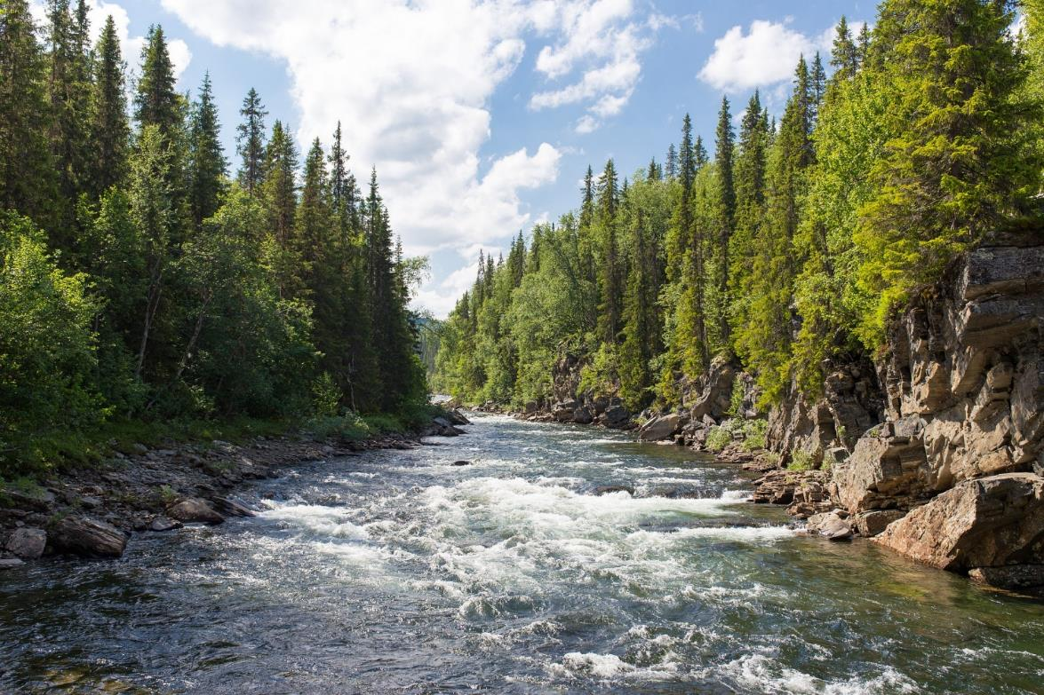
Is This a Landform? Why Or Why Not?
Photo courtesy of Pixabay.com

Slide 5
Today’s Focus Questions
How does the land on Earth’s surface look different in different places?
How can representations like maps help us find different landforms in the United States?

Slide 6
What Is a Relief Map?
Scientists use special maps to find landforms in different places. These maps are called relief maps.
Relief maps show how high or low or flat the land is in different places. Another word scientist use for this is elevation.
A high elevation means the land rises high above Earth’s surface. A low elevation means the land is low or flat or at sea level.

Slide 7
Let’s Be Land Detectives!
We’re going to investigate landforms in two places on our relief maps: Seattle and Atlanta.
Make sure to touch the map to help you find the landforms in each place.
What landforms does each place have?
Think about how the landforms in both places are similar or different.
Look for 2 pieces of evidence that can help us answer the focus question on the handout. Your evidence can include examples of landforms.

Slide 8
The Same or Different?
Let’s answer these questions using evidence from our relief maps and Venn diagrams:
How is the land in Seattle and Atlanta the same?
How is it different?

Slide 9
Our Focus Questions
How does the land on Earth’s surface look different in different places?
How can representations like maps help us find different landforms in the United States?

Slide 10
Let’s Summarize!
Use evidence from your relief map and Venn diagram to complete this sentence in your science notebook:
I think the land on Earth’s surface [does/does not] look different in different places because ______________.
Circle either does or does not to show which answer you’ve chosen.

Slide 11
Key Science Ideas
Some places on Earth have landforms like mountains, hills, or plateaus that rise high above the surface.
Other places have valleys and canyons that cut deep into Earth’s surface.
Some places are flat with very little change in elevation, like plains.
Some places have many bodies of water, like rivers and lakes, and other places don’t.

Slide 12
Next Time
Here’s what we know so far:
Earth’s surface has many types of landforms.
Landforms look different in different places.
Next time, we’ll investigate landforms in Chicago, Illinois, and Salt Lake City, Utah.
Are you ready to be land detectives again?

