Slide 1
Earth’s Changing Surface Lesson 4a
What Causes Landforms to Change? What Is Our Evidence?

Slide 2
The Grand Canyon
Photo courtesy of W. Tyson Joye/NPS
Notes:
Grand Canyon National Park: View from Rim Trail east of Mather Point

Slide 3
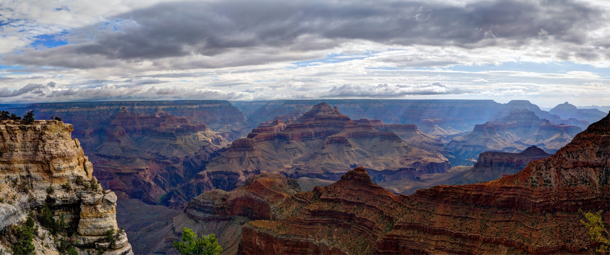
What Might Cause the Changes?
Photo courtesy of W. Tyson Joye/NPS

Slide 4
Clue Review
The Grand Canyon is slowly getting deeper. It’s 2 centimeters deeper today than it was 50 years ago!
The Colorado River carries loose soil and rock with it as it flows through the canyon.
This soil and rock are carried to Lake Mead, where they’re filling up the lake.
What does all of this evidence mean?
Landforms can change!

Slide 5
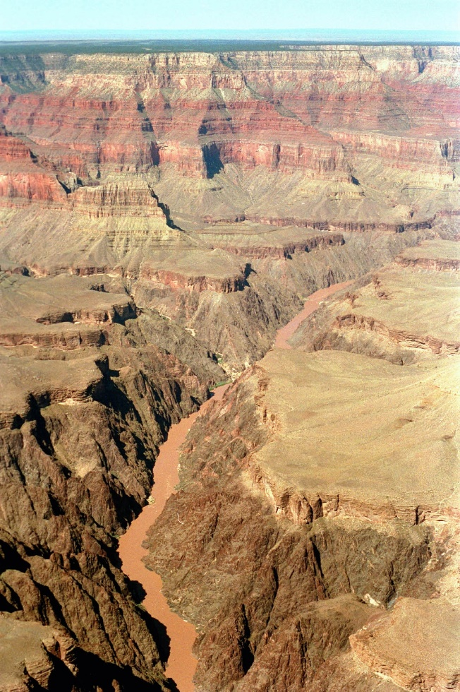
Our Questions and Wonderings
What questions or wonderings do you have about what might be causing the Grand Canyon to change?
Photo courtesy of NPS.gov

Slide 6
Today’s Focus Questions
What causes landforms to change? What is our evidence?

Slide 7
What Is a Model?
What is a model in science?
What do scientists use models for?

Slide 8
What Is a Model?
Models are representations of things that happen in the real world.
Scientists use models to help them understand things that are too small, too big, too far away, or too dangerous to study directly.

Slide 9
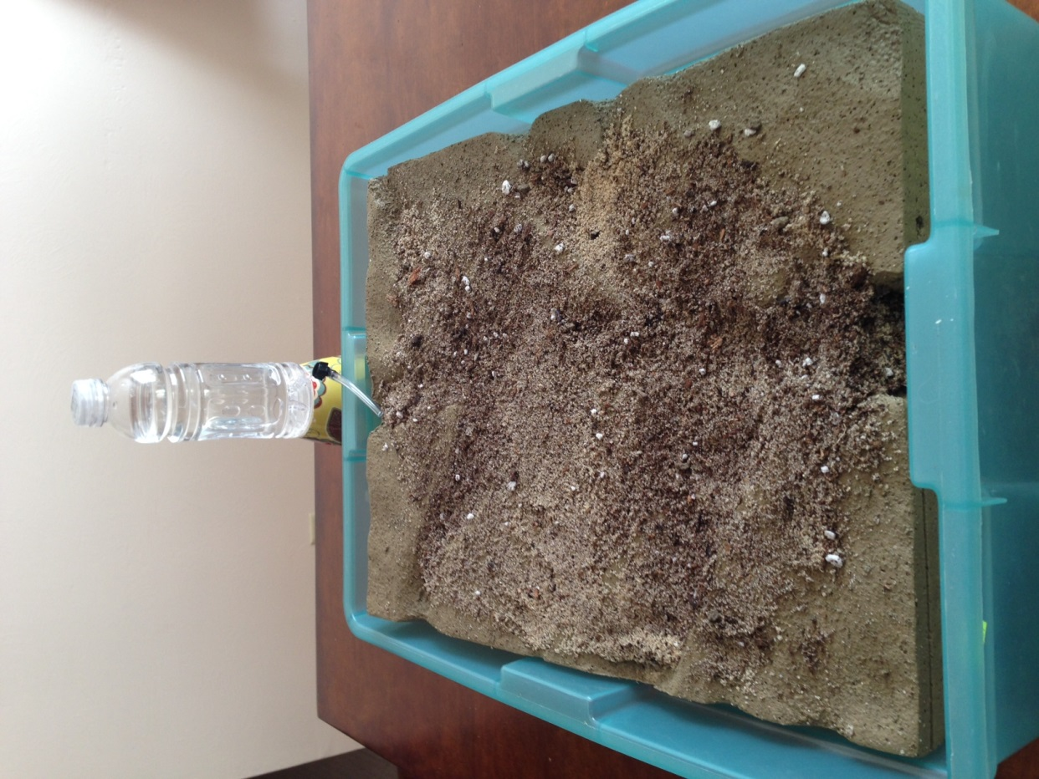
What Does This Model Look Like?
Photos courtesy of BSCS

Slide 10
Our Canyon Model
What do you think the brown stuff represents on the model?
What do you think the spray bottles represent?
What do you observe about the model?
What landforms can you identify?

Slide 11
What Do You Predict?
What do you think will happen if a lot of rain falls on our model?
Write your prediction on page 2 of your handout.

Slide 12
What Happened?
What do you think will happen if a lot of rain falls on our model?
What happened when it rained on our model?
Is this what you predicted would happen?

Slide 13
Let’s Summarize!
Our focus questions: What causes landforms to change? What is our evidence?
What new ideas did our model give us for answering these questions?
Share your ideas and evidence with an elbow partner.
Be prepared to share your ideas with the class.

Slide 14
Next Time
Today we saw what happened when rain fell on our model. Little streams formed and carried some of the soil and sand to the bottom of the model.
What do you think might happen if a river flows through our model?
We’ll find out next time!

