Slide 1
Properties of Matter Lesson 2a
What Causes Matter to Change from a Solid to a Liquid or from a Liquid to a Solid?

Slide 2
Review: How Can Matter Change?
Look at our class data from Stations 1–4.
What do you notice about how you described the changes in matter you observed?
Are some of the changes similar to other changes you observed?
Do you see any patterns in the ways matter can change? Do any of the changes seem to go together?

Slide 3
Unit Central Questions
What is matter made of? How can matter change?

Slide 4
Today’s Focus Question
What causes matter to change from a solid to a liquid or from a liquid to a solid?

Slide 5
Why Does Matter Change?
Scenario 1: An ice cube melts when it’s sitting on a table.
Turn and Talk question:
Why do you think an ice cube changes to a liquid, or melts, when it’s sitting on a table?

Slide 6
Why Does Matter Change?
Scenario 2: Imagine that you’re holding a piece of chocolate in your hand.
Turn and Talk questions:
What do you think will happen to the chocolate in your hand?
Would the same thing happen if the chocolate sat on a table? Why or why not?

Slide 7
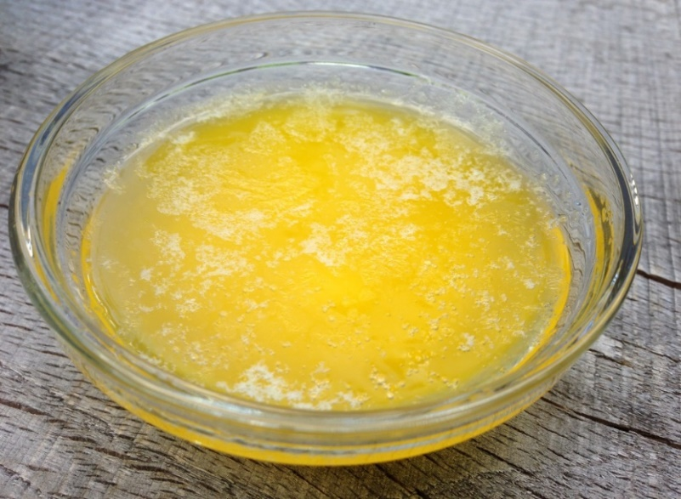
Why Does Matter Change?
Scenario 3: In lesson 1, we saw butter melt, or become a liquid, when we added heat. Then we saw the liquid butter become a solid again when we took it off the heat.
Turn and Talk question:
Why do you think the melted butter changed back to solid butter when we took away the heat?
Photo courtesy of BSCS

Slide 8
Heating and Cooling Matter
Each of the three beakers contains a different substance: ice, chocolate chips, and crayon pieces.
What do you think will happen to the matter when I place the beakers on a griddle and turn on the heat?
What do you think will happen to the matter when I remove the beakers from the heat?

Slide 9
Our Data Table: Heating and Cooling Matter
Substance (Kind of Matter) | What Happened When the Solid Matter Was Heated? | What Happened When the Liquid Matter Was Removed from the Heat?
Ice
Chocolate
Crayon Pieces

Slide 10
Heating and Cooling Matter
Why do you think the water didn’t turn back to a solid, but the chocolate and crayon wax did?
What’s different about the water?
When the three substances changed to liquids, do you think they also changed into a different kind of matter? Or are they still the same kind of matter?

Slide 11
Let’s Summarize!
Our focus question: What causes matter to change from a solid to a liquid or from a liquid to a solid?
What have we learned so far about what causes matter to change?

Slide 12
Key Science Ideas about Matter
Each kind of matter (the ice, chocolate chips, and crayon pieces) became a liquid when we heated it.
Each kind of matter melted at a different rate.
Some kinds of matter changed back to a solid when we took them off the heat, and some didn’t. The chocolate and crayon wax changed back to solid matter, but the water didn’t.
Each kind of matter stayed the same even though it changed from a solid form to a liquid form. The water was still water. The chocolate was still chocolate. And the crayons were still crayons. Only the form changed!

Slide 13
Next Time
In our next lesson, we’ll explore another way to show how matter can change from a solid to a liquid and then back to a solid again.
Stay tuned!

