Slide 1
RESPeCT PD pROGRAM
Day 7
RESPeCT Summer Institute
Notes:
5 min
a. Take care of any housekeeping issues.

Slide 2
Agenda for Day 7
Day-6 reflections
Focus questions
Introducing SCSL strategy D
Sample analysis of content representations
Lesson analysis: SCSL strategy D
Lunch
Content deepening: Earth’s changing surface
Summary, homework, and reflections
Notes:
5 min
a. Talk through the agenda for the day.

Slide 3
Trends in Reflections
Lesson Analysis | Science Content Learning
Notes:
5 min
a. Give participants time to review your feedback on their reflections from day 6 and offer reactions, comments, or follow-up questions.

Slide 4
Norms for Working Together: The Basics
Purpose: Build trust and develop a productive study group for all participants.
The Basics
Arrive prepared and on time; stay for the duration; return from breaks on time.
Remain attentive, thoughtful, and respectful; engage and be present.
Eliminate interruptions (turn off cell phones, email, and other electronic devices; avoid sidebar conversations).
Make room for everyone to participate (monitor your floor time).
Notes:
2 min
a. Review the norms and ask participants to think about areas where they could improve individually or as a group.
b. “How do you think we’re doing individually and as a group applying these norms? Do you have any comments or suggestions about areas where we could improve?”

Slide 5
Norms for Working Together: The Heart
Purpose: Build trust and develop a productive study group for all participants.
The Heart of RESPeCT Lesson Analysis and Content Deepening
Keep the goal in mind: analysis of teaching to improve student learning.
Share your ideas, uncertainties, confusion, disagreements, questions, and good humor. All points of view are welcome.
Expect and ask questions to deepen everyone’s learning; be constructively challenging.
Listen carefully; seek to understand other participants’ points of view.
Notes:
5 min
a. Review the norms that are at the heart of the RESPeCT program and ask participants to think about areas where they could improve individually or as a group.
b. Emphasize: “We’re doing quite well with our norms, but as we approach the fall, I hope to see our interactions evolving so that you feel comfortable interacting less through your PD leaders as the ‘teachers’ and direct more of your questions and comments to one another, challenging each other, piggybacking on each other’s ideas, and listening carefully to one another so that everyone is contributing to the kind of productive analysis that will help us figure out ways to strengthen our students’ science learning.”
c. Offer an opportunity for participants to comment on how the group is doing with these norms. Ask, “Are there any areas where we could improve? Any suggested changes?”

Slide 6
Today’s Focus Questions
How do you know when a content representation is appropriate and matched to the main learning goal?
How can we engage students in using content representations and models in meaningful ways?
How quickly or slowly do landforms change over time? How do we know?
Can we explain how landforms change in our area?
Notes:
1 min
a. Introduce the focus questions on the slide.

Slide 7
Notes:
2 min
a. “We’ll be focusing on STeLLA strategy D today. Notice that this SCSL strategy has two parts. The first part—select content representations and models matched to the learning goal—sounds similar to strategy C—select activities that are matched to the learning goal. The second part focuses on engaging students in the use of content representations. This ensures that students aren’t just looking at diagrams or models but are actively engaging with them.”

Slide 8
Lesson Analysis: Focus Question 1
How do you know when a content representation is appropriate and matched to the main learning goal?
Notes:
Less than 1 min
a. “Now let’s explore the first part of strategy D and our first focus question.”
b. Read the focus question on the slide.

Slide 9
SCSL Strategy D: Purpose and Key Features
What are the purpose and key features of this strategy?
Cite ideas and examples from the STeLLA strategies booklet and your SCSL Z-fold summary chart.
Notes:
25 min
a. Small groups (13 min): Divide participants into two groups and have each group make a chart identifying the purpose and key features of strategy D described in their SCSL Z-fold summary charts and the STeLLA strategies booklet.
b. Whole group (12 min): Have groups report out. Then ask, “What differences do you notice between the two charts?”
Key ideas:
Content representations can help students envision things that are too big or too small for them to see firsthand in the classroom, or processes that take place too quickly or slowly for them to perceive.
Content representations give students access to different ways of making sense of key science ideas.
If content representations or models are closely matched to the main learning goal, they can be especially useful in helping students see how the science content storyline fits together.
There are many different types of content representations (analogies, metaphors, and visual representations, such as diagrams, charts, graphs, concept maps, models, and role-plays).
Content representations can reveal and challenge student thinking if students are involved in creating, modifying, and analyzing the representations (instead of just listening to the teacher explain them).

Slide 10
Strategy D: Discussion Questions
How is this strategy similar to or different from selecting activities matched to the learning goal (strategy C)?
How might good content representations be especially helpful for English language learners?
Notes:
10 min
a. Whole group: Discuss the questions on the slide.
Key ideas:
Slide question 1: Both strategy C and strategy D emphasize that all activities must be matched to the main learning goal. Strategy D, however, emphasizes a very important kind of activity: content representations. It also emphasizes that teachers should actively engage students in creating, modifying, and using content representations.
Slide question 2: Good content representations can benefit all students, but they especially benefit ELL students because they present science ideas in pictures, images, and other visual formats in addition to words.

Slide 11
Analysis Guide for Strategy D
Read through Analysis Guide D (handout 7.1 in your PD program binder).
Keep this question in mind: What do you notice about how this guide is organized?
Notes:
6 min
a. Have participants locate Analysis Guide D in their PD program binders (handout 7.1).
b. Individuals : “As you read the analysis guide, keep in mind the discussion question on the slide.”
c. Whole group: Discuss the question on the slide.
Key ideas:
This analysis guide focuses on the main learning goal by having participants write that down first.
The guide is divided into three parts. Part 1 focuses on how well matched the content representation is to the main learning goal. Part 2 focuses on how well engaged students are in using the content representation.
The guide ends with identifying ways to improve the content representation and its use in a lesson (part 3).

Slide 12
Content Representation 1: Photograph of Valley Landscape
Read the main learning goal and the description of the content representation in Analysis Guide D1 (page 1 of handout 7.1).
Notes:
2 min
a. Set the context: “Now we’re going to analyze a content representation to see how well it’s matched to the learning goal stated on the slide.”
b. Have participants read the main learning goal and the description of the content representation in Analysis Guide D1 (page 1 of handout 7.1).

Slide 13
Content Representation 1: Photograph of Valley Landscape
Photo courtesy of Gh5046/Wikimedia Commons
Notes:
8 min
a. Individuals: Have participants work independently on part 1 of Analysis Guide D1.
b. Pairs: “Now pair up and discuss your answers to the analysis questions.”

Slide 14
Does Content Representation 1 Match the Main Learning Goal?
How did you answer these questions from part 1 of Analysis Guide D1?
Is the content representation scientifically accurate?
Is it closely matched to the main learning goal?
Does it present science ideas to students in comprehensible ways?
Does it reinforce/introduce any misconceptions?
Does it address common misconceptions?
Does it contain distracting details?
Notes:
10 min
a. Whole group: Discuss participants’ responses to the questions in part 1 of Analysis Guide D1. (See ideal responses below.)
b. Ask: “How might this content representation be improved? Would you use it with your students?”
Ideal responses for Analysis Guide D1 (part 1):
Question 1: This photograph accurately shows landforms on Earth.
Question 2: This content representation is closely matched to the learning goal. The picture shows different types of landforms (valley, hills, cliffs, mountains) and a body of water (lake or ocean). A river may also run through the valley.
Question 3: Although the picture is comprehensible, it could confuse students because it illustrates other landforms and bodies of water in addition to the valley landscape (e.g., mountains or hills, an ocean, and possibly a river or canyon at the lowest part of the valley).
Question 4: This content representation is unlikely to introduce misconceptions, but it might reinforce the idea that all valleys look like the one in the photo and are always located away from cities and towns. The teacher could emphasize that valleys can be much broader than the one in the photo and can be located in urban areas (e.g., the San Fernando Valley).
Question 5: This representation could be used to address the common student misconception that trees, plants, and grass are landforms.
Question 6: This image was purposefully chosen to reduce distracting details (such as urban features) so that students will focus on the shape of the land.
Key idea: While landforms have specific or distinct names, they aren’t separate from one another in the real world. Landforms are always connected, and the land is contiguous from one landform to another. Mountains give way to valleys and rivers, and canyons are sometimes carved into mountains. When using images or models of landforms, it’s important to understand that multiple landforms will always be present, so the teacher will need to highlight the landform(s) in focus.
Take-home message: Trying to address all six criteria in the analysis guide is a balancing act or trade-off. To make complex science ideas meaningful and comprehensible to students, the content representation needs to be simplified, but simplifications can sometimes be misleading in terms of scientific accuracy. The important thing is for teachers to be aware of such problems so they can be addressed.

Slide 15
Content Representation 2: Raised Relief Map
Read the main learning goal and the description of the content representation in Analysis Guide D2 (page 2 of handout 7.1).
Notes:
5 min
a. Set the context for analyzing another content representation.
b. Have participants turn to Analysis Guide D2 (page 2 of handout 7.1) and read the main learning goal and description of the content representation.

Slide 16
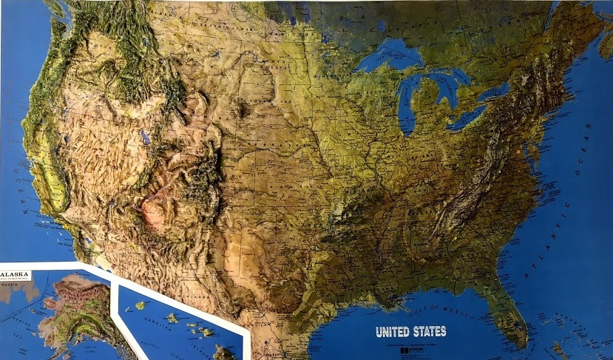
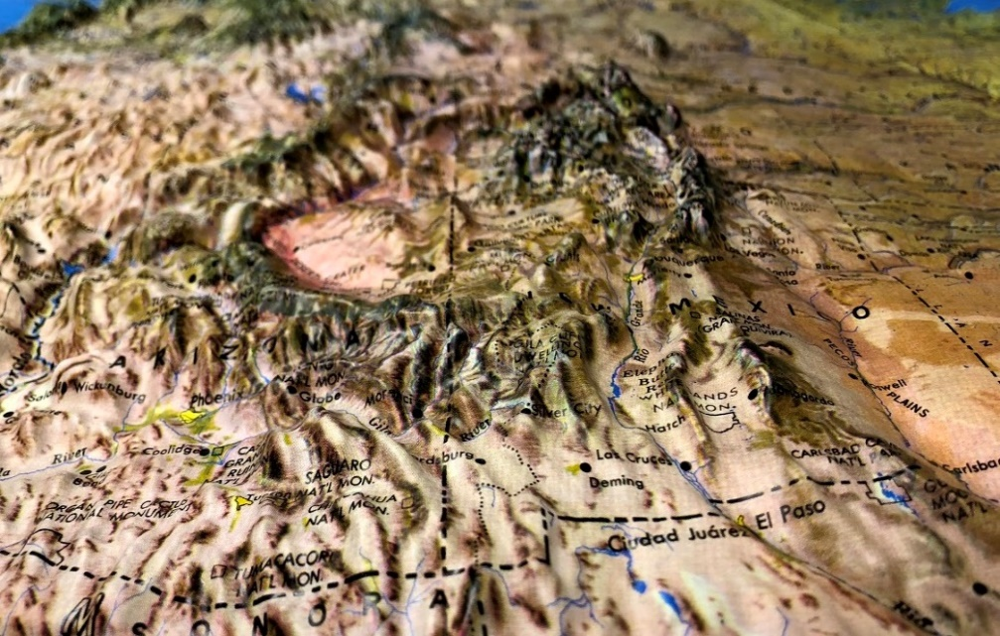
Content Representation 2: Raised Relief Map
Photos courtesy of Cal Poly Pomona
Notes:
7 min
a. Individuals: Have participants work independently on part 1 of Analysis Guide D2.
Note: If time is short, just do partner work.
b. Pairs: “Now pair up and discuss your answers to the analysis questions.”

Slide 17
Does Content Representation 2 Match the Main Learning Goal?
How did you answer these questions from part 1 of Analysis Guide D2?
Is the content representation scientifically accurate?
Is it closely matched to the main learning goal?
Does it present science ideas to students in comprehensible ways?
Does it reinforce/introduce any misconceptions?
Does it address common misconceptions?
Does it contain distracting details?
Notes:
10 min
a. Whole group: Discuss participants’ responses to the questions in part 1 of Analysis Guide D2. (See ideal responses below.)
b. Ask: “How might this content representation be improved? Would you use it with your students?”
Ideal responses for Analysis Guide D2 (part 1):
Question 1: Raised relief maps aren’t scientifically accurate because they use exaggerated vertical scaling to illustrate changes in the terrain more effectively. Consequently, mountains on a relief map don’t accurately reflect the scale or elevation of real mountains.
Question 2: This content representation is closely matched to the main learning goal and is a good choice for illustrating how the land is different in different places.
Question 3: Most 2nd graders are familiar with maps but may never have used a raised relief map, so they’ll need some support in understanding what the map is showing and perhaps some assistance identifying the types of landforms from a different perspective. So far, students have seen pictures of landforms and built models out of sand, but now they’re observing landforms from a bird’s-eye view. Some students do well transitioning from a portrait view (looking at a picture from eye level) to a bird’s-eye view (looking at a picture from above), but some students will need help.
Question 4: This map isn’t likely to reinforce any student misconceptions. Even though it exaggerates the vertical scale of landforms, the rest of the map is highly accurate, and the variety of landforms is very close to what people see in the real world from one place to another.
Question 5: Using a relief map can help students with limited firsthand experience of landforms in other locations understand how landforms can vary from one place to another. It can also help them distinguish between the shape of the land itself and structures that humans have built on the land.
Question 6: This map was purposefully chosen to help students focus on the shape of the land (physical features). To avoid distracting details, the map excludes most human-made structures (small towns, roads), with the exception of some major cities.
Take-home message: Trying to address all six criteria in the analysis guide is a balancing act or trade-off. To make complex science ideas meaningful and comprehensible to students, the content representation needs to be simplified, but simplifications can sometimes be misleading in terms of scientific accuracy. The important thing is for teachers to be aware of such problems so they can be addressed.

Slide 18
Content Representation 3: Stream-Table Model
Read the main learning goal and the description of the content representation in Analysis Guide D3 (page 3 of handout 7.1).
Notes:
5 min
Note: If time is running short, this content representation can be skipped.
a. Set the context for analyzing one more content representation.
b. Have participants turn to Analysis Guide D3 (page 3 of handout 7.1) and read the main learning goal and description of the content representation.

Slide 19
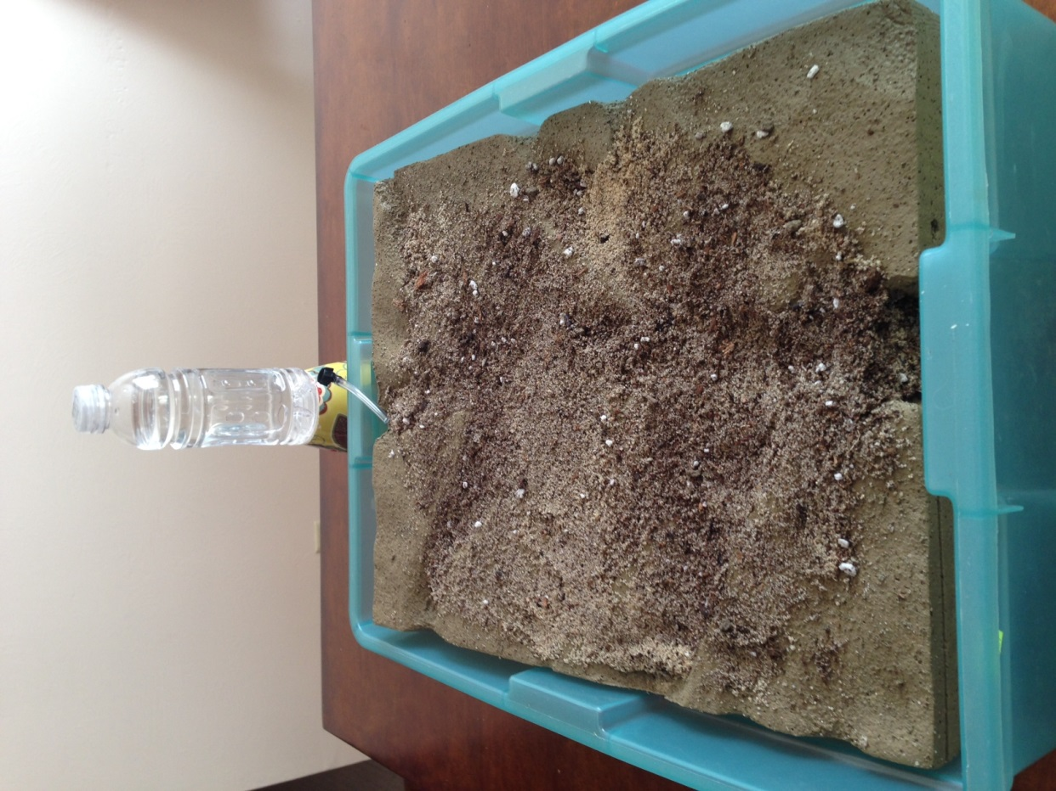
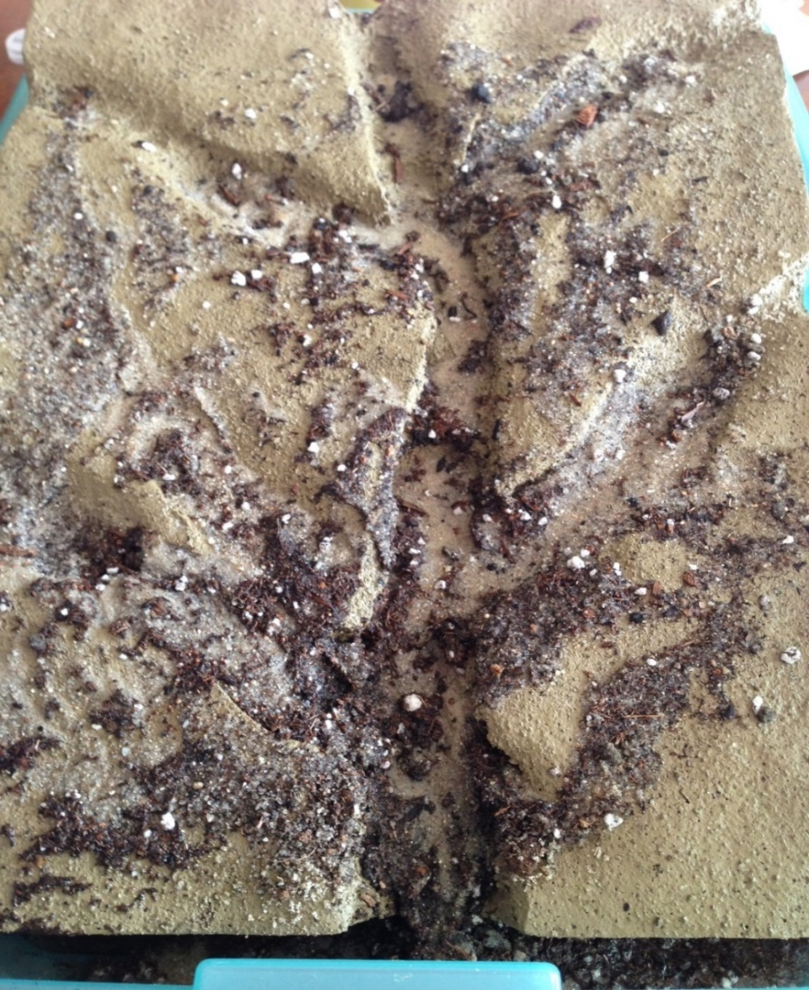
Content Representation 3: Stream-Table Model
Photos courtesy of BSCS
Notes:
7 min
a. Individuals: Have participants work independently on part 1 of Analysis Guide D3.
Note: If time is short, just do partner work.
b. Pairs: “Now pair up and discuss your answers to the analysis questions.”

Slide 20
Does Content Representation 3 Match the Main Learning Goal?
How did you answer these questions from part 1 of Analysis Guide D3?
Is the content representation scientifically accurate?
Is it closely matched to the main learning goal?
Does it present science ideas to students in comprehensible ways?
Does it reinforce/introduce any misconceptions?
Does it address common misconceptions?
Does it contain distracting details?
Notes:
10 min
a. Whole group: Discuss participants’ responses to the questions in part 1 of Analysis Guide D3. (See ideal responses below.)
b. Ask: “How might this content representation be improved? Would you use it with your students?”
Ideal responses for Analysis Guide D3 (part 1):
Question 1: This content representation isn’t very accurate from a scientific standpoint. Stream tables model erosion and deposition at much quicker rates than in nature and don’t account for how long different materials take to break down or the force necessary to move them. A stream table also depicts only a small, simple snapshot of a much larger, more complicated system. However, they do a good job illustrating how water can move soil and rock from one place to another.
Question 2: The stream-table model closely matches the main learning goal by showing how water can carry soil and rock from one place to another. But it’s a highly simplified version of the real-world process.
Question 3: The model is comprehensible to students, since they’re able to observe the flow of water and the movement of soil and rock. The difficult part for students is translating what happens in the model to what happens in the real world.
Question 4: Stream tables can sometimes reinforce the student misconception that land only changes during floods (i.e., if water is flowing quickly). Using such a small-scale model can also make it difficult for students to wrap their heads around the large scale at which erosion happens or imagine how water can carve out an enormous landform like the Grand Canyon.
Question 5: Stream-table models address and challenge the common student idea that the land essentially stays the same. By showing how water is powerful enough to carry dirt and rock from one place to another, stream tables help students understand how the land can change.
Question 6: Creating rain with the spray bottles might distract students from focusing on the river as the primary mechanism for carving out the Grand Canyon. Although rain is one source of the water that flows through the canyon and is therefore a contributing factor in forming the canyon, the Colorado River is the primary mechanism.
Take-home message: Trying to address all six criteria in the analysis guide is a balancing act or trade-off. To make complex science ideas meaningful and comprehensible to students, the content representation needs to be simplified, but simplifications can sometimes be misleading in terms of scientific accuracy. The important thing is for teachers to be aware of such problems so they can be addressed.

Slide 21
Lesson Analysis: Focus Question 2
How can we engage students in using content representations in meaningful ways?
Notes:
Less than 1 min
a. Transition slide: “Next we’ll watch two video clips of strategy D in use in an ECS lesson. For this analysis, we’ll focus on parts 2 and 3 of the analysis guide: How well engaged are students in using the content representation? And what suggestions do you have for improving the content representation and its use with students?”
Note: Participants have already analyzed the content representations in these clips (relief map and stream-table model) using part 1 of Analysis Guide D.

Slide 22
Lesson Analysis 1: Strategy D
Review the main learning goal and the description of the content representation at the top of Analysis Guide D2.
Read the context for the first video clip at the top of the transcript (handout 7.2).
Watch the video clip, keeping in mind the criteria for strategy D (part 1 of the analysis guide).
Review your responses to the questions in part 1 of the analysis guide.
Link to video clip: 7.1_mspcp_gr.2_ecs_poulsen_L2_c5
Notes:
10 min
a. Have participants take out Analysis Guide D2 and review the main learning goal and description of the content representation.
b. Then ask participants to read the context for the first video clip at the top of the transcript (handout 7.2 in PD binder).
c. Show the video clip.
d. Have participants’ review their responses to the questions in part 1 of the analysis guide before moving on to parts 2 and 3.

Slide 23
Lesson Analysis 1: Strategy D
Analysis Guide D2
Part 2
Are students engaged in modifying or creating the content representation?
Are students engaged in analyzing the meaning of the content representation?
Are students engaged in critiquing the content representation?
Part 3
What did you learn from watching the video clip that might suggest ways to improve the content representation?
Notes:
35 min
a. “Now let’s turn our attention to part 2 of strategy D, which engages students in using content representations. We’ll also consider ways the content representation could be improved.”
b. Individuals: “Study the video transcript and think about parts 2 and 3 of Analysis Guide D2. Be ready to share evidence that supports your conclusions.”
c. Pairs: “Now pair up with an elbow partner and compare your conclusions about student engagement with the content representation.”
d. Whole group: Review participants’ responses to parts 2 and 3 of the analysis guide. Challenge participants to support their answers with evidence from the video transcript.
e. If it didn’t come up in the discussion, ask participants, “How might the teacher have engaged these students in analyzing or critiquing the representation?”
Ideal responses for Analysis Guide D2:
Part 2:
In this video clip, students focus on analyzing the meaning of the content representation rather than creating, modifying, or critiquing it. Students are engaged in trying to understand what the relief map is showing them and where landforms are located on the map.
Part 3:
As students engage with this content representation, they mostly describe what they see on the relief map. Some students connect the bumpy or rough features of the map to landforms.
There is a missed opportunity to probe student thinking about why they said the map looks “real.” For example, the teacher could have asked students, “What do you mean by “real”? and “How is this map different from the real world?” [Answer: The landforms on the map are much, much smaller than real landforms, but they can help us student the shape of the land.]
The teacher could improve her introduction by having students point out specific features on the relief map (e.g., “Where do you see mountains?” “What about this flat area? What would we call this?” “Where are we located on the map?” “What do you see around our area?”).

Slide 24
Lesson Analysis 2: Strategy D
Review the main learning goal and the description of the content representation at the top of Analysis Guide D3.
Read the context for the first video clip at the top of the transcript (handout 7.3).
Watch the video clip, keeping in mind the criteria for strategy D (part 1 of the analysis guide).
Pairs: Review your responses to the questions in part 1 of the analysis guide. Then complete parts 2 and 3.
Link to video clip: 7.2_mspcp_gr.2_ecs_poulsen_L5_c5
Notes:
25 min
a. Have participants take out Analysis Guide D3 and review the main learning goal and description of the content representation.
b. Then ask participants to read the context for the second video clip at the top of the transcript (handout 7.3 in PD binder).
c. “Next, we’ll watch a new classroom video and examine how students are (or are not) engaged in using the content representation. Like our last analysis, we’ll focus only on parts 2 and 3 of the analysis guide.”
d. Show the video clip.
e. Pairs: Have participants pair up and review their responses to the questions in part 1 of the analysis guide before completing parts 2 and 3.

Slide 25
Lesson Analysis 2: Strategy D
Analysis Guide D3
Part 2
Are students engaged in modifying or creating the content representation?
Are students engaged in analyzing the meaning of the content representation?
Are students engaged in critiquing the content representation?
Part 3
What did you learn from watching the video clip that might suggest ways to improve the content representation?
Notes:
20 min
a. Whole group: Discuss participants’ responses to parts 2 and 3 of Analysis Guide D3. Challenge participants to support their answers with evidence from the video transcript.
b. If it didn’t already come up in the discussion, ask participants, “How might the teacher have engaged these students in analyzing or critiquing the representation?”
Ideal responses for Analysis Guide D3:
Part 2:
In this video clip, students focus on analyzing the meaning of the content representation rather than creating, modifying, or critiquing it. Students are engaged in making observations about the stream-table model before the demonstration begins. The teacher uses questioning strategies to help students understand what different parts of the model represent in the real world and connect the model to what they’re learning about the Grand Canyon.
Part 3:
There are missed opportunities to probe students’ observations of the model to find out what they see (e.g., grass, mountains, Grand Canyon). It’s hard to tell what students see, since the model starts off as a flat surface (a plain). One solution might be to ask students to point out specific landforms on the model before and after the demonstration.
Students seem to think they’re observing a model of the Grand Canyon because it’s been discussed in previous lessons. The teacher could challenge students to describe the Grand Canyon and compare that description to the model. Students should realize that since the model has a flat surface before the demonstration, it doesn’t represent the Grand Canyon. The demonstration shows how canyons, like the Grand Canyon, are formed.

Slide 26
Strategy D: Synthesize and Summarize
What new ideas do you have about these aspects of today’s lesson analysis work?
How to select content representations
How to engage students in using content representations
Did our content-representation work give you any new insights about Earth’s surface and how it changes over time?
Notes:
10 min
a. Individuals (5 min): Have participants work on the slide questions. Encourage them to use their resources (e.g., the strategies booklet, their Z-fold summary charts, the content background document, notes they’ve taken).
b. Whole group (5 min): Have participants share their new ideas for each question in a round-robin format, if time allows. Otherwise, have a couple of volunteers share their ideas for each question.

Slide 27
Earth’s Changing Surface
SCIENCE CONTENT DEEPENING Grade 2
Notes:
Less than 1 min
a. Transition: This slide marks the transition to content deepening work.
Note: Throughout this content deepening phase, refer as needed to the content background document and Common Student Ideas about Earth’s Changing Surface.

Slide 28
Unit Central Questions
What does the surface of Earth look like? Does it ever change?
Notes:
Less than 1 min
a. Review the unit central questions on the slide.
b. Remind participants that these questions will guide student learning throughout the entire ECS unit.

Slide 29
Content Deepening Focus Questions
How quickly or slowly do landforms change over time? How do we know?
Can we explain how landforms change in our area?
Notes:
Less than 1 min
a. Review the content deepening focus questions on the slide.

Slide 30
Earth’s
Changing
Surface
Content
Deepening
Developed by
Dr. Jeff Marshall
Geological Sciences
Cal Poly Pomona
Used by permission
Photo courtesy of Visible Earth
Notes:
Less than 1 min
a. “Today’s content deepening work will focus on science ideas about Earth’s changing surface from ECS lessons 5 and 6.”

Slide 31
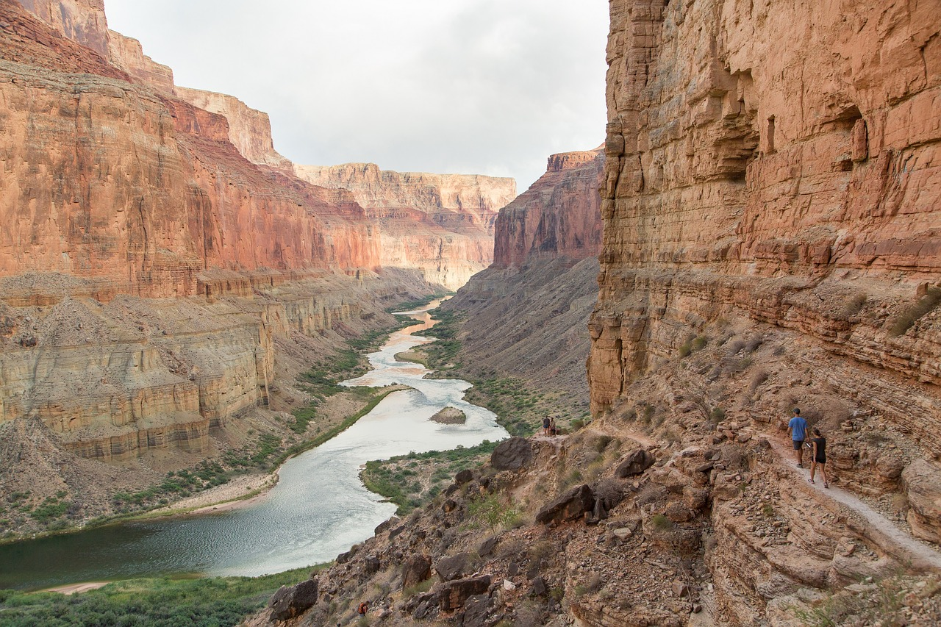
River Erosion and Deposition
Photo courtesy of Pixabay.com
Notes:
Less than 1 min
a. “Let’s review some key science ideas about erosion and deposition.”
b. “This slide shows the Colorado River flowing through the Grand Canyon. It’s a familiar example of a river eroding its bed and cutting through hard rock to carve out a canyon. The flowing water erodes the rock and carries sediment away to be deposited somewhere else downstream, such as behind a dam or in the Colorado River delta at the Gulf of California.”

Slide 32
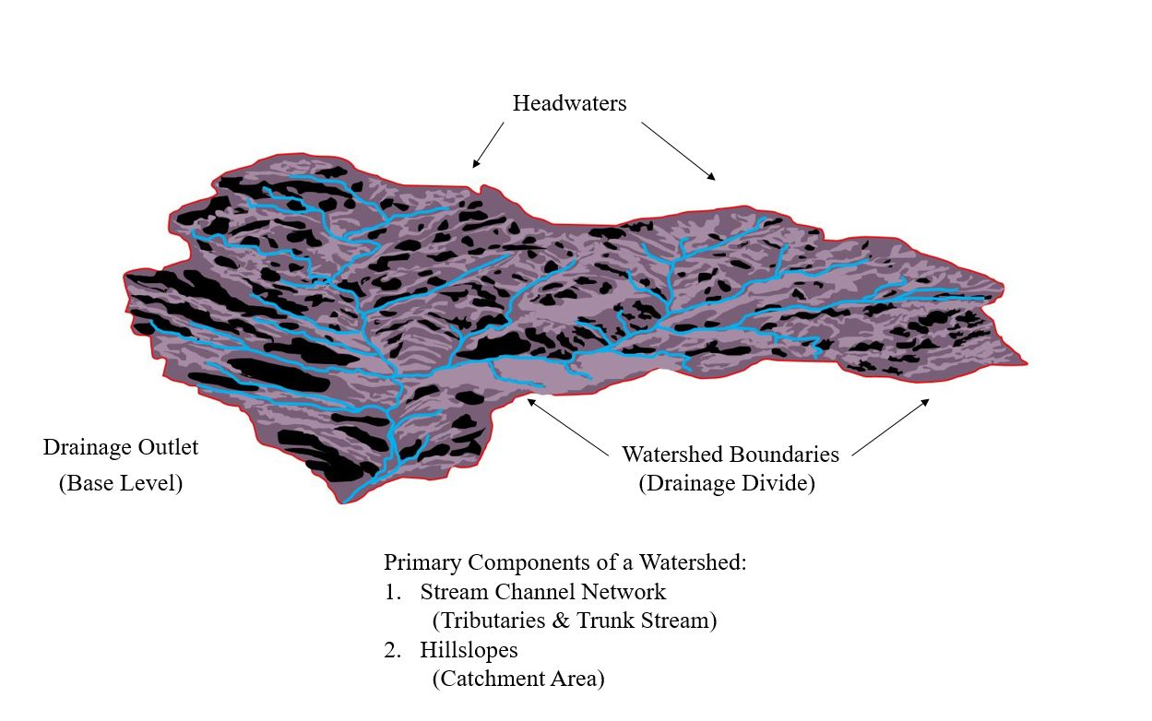
Watersheds
Courtesy of Cal Poly Pomona
Notes:
3 min
a. “To understand river erosion and deposition, we must first understand the concept of a watershed, sometimes called a drainage basin.”
b. “A watershed is an area of Earth’s surface drained by a particular river. Drainage divides, like those on the slide, are boundaries that separate a watershed from neighboring watersheds. These divides are high points, like ridgelines, that surround a watershed.”
c. “Headwaters mark the upper end of a watershed, and the lower end is called a drainage outlet or base level. The outlet is the lowest elevation point in the watershed where the main river or stream flows out of the basin.”
d. “The main river or stream in the watershed is called the trunk river or trunk stream. Smaller streams or rivers that feed into the trunk stream are called tributaries. Together, a trunk stream and its tributaries make up a stream channel network that funnels rain runoff and sediment from the landscape into the trunk stream.”
e. “Hill slopes are located between stream channels. In this area of land, precipitation either infiltrates or soaks into the ground or flows downhill into a stream channel as runoff.”
f. “A watershed is a natural system that transports rainwater runoff and eroded sediment into the trunk stream and out of the basin at the drainage outlet for deposition elsewhere.”

Slide 33
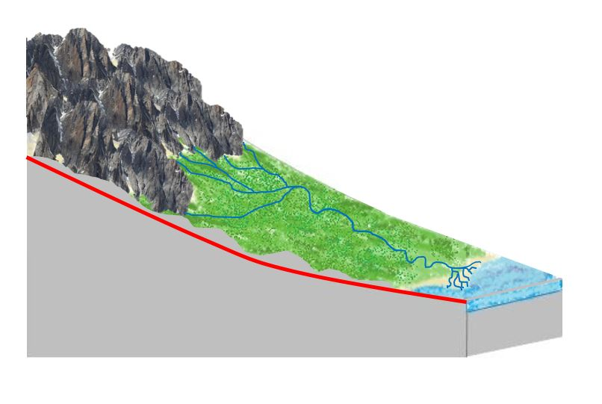
River Longitudinal Profile
Courtesy of Cal Poly Pomona
Notes:
1 min
a. “This slide shows a longitudinal profile of a river.”
b. “Natural rivers typically develop a profile along their length that curves upward like a dish. This is called a concave-up longitudinal profile because the concavity in the curve faces upward. This curve is steepest at its upper end near the headwaters and flattest at its lower end near the drainage outlet.”
c. “This concave shape forms because of the interaction between gravity and the mass of flowing water and sediment. It reflects the fact that the small headwater tributaries carry less water and sediment and thus require a steeper slope to move that small mass downhill. On the other hand, a large trunk stream carries much more water and sediment in the lower basin and thus only requires a gentle slope to move that greater mass downhill toward the outlet.”

Slide 34
Types of River Channels
Bedrock
Channel
Alluvial
Channel
Courtesy of Cal Poly Pomona
Notes:
1 min
a. “Most rivers begin their journey in the mountainous headwaters area of a watershed and flow downward into a valley that leads to a drainage outlet at an ocean, a lake, or another bigger river.”
b. “As rivers erode their profile, they may either cut their beds downward into hard rock or build their beds upward by depositing sediment. This results in two different types of river channels: a bedrock channel, where a river cuts a canyon in the hard rock of a mountain, or an alluvial channel, where a river builds up its bed by depositing sediment across a floodplain.”

Slide 35
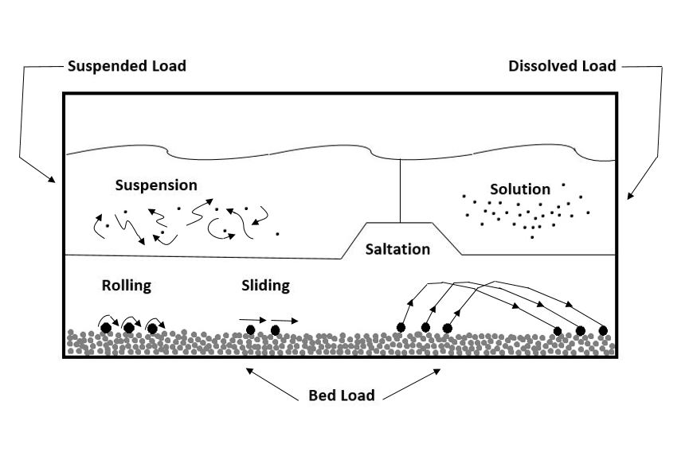
Types of Sediment Load
Courtesy of Cal Poly Pomona
Notes:
3 min
a. “This slide shows various types of sediment load.”
b. “River channels carry both water and sediment. The sediment consists of broken particles of weathered rock that have eroded from the surface of the watershed. Fast-flowing river water carries the sediment down a channel and deposits it in another location where the water flow is slower.”
c. “The sediment load of a river is defined as ‘the volume or mass of material a river transports in a given amount of time.’”
d. “There are three different types of sediment load in a river: (1) suspended load, (2) bed load, and (3) dissolved load.”
e. “A suspended load consists of small grains that are carried aloft by turbulence in the flowing water. These small silt or sand grains turn river water brown during a flood.”
f. “A bed load consists of larger, heavier grains that roll, slide, or bounce along the bed as the flowing water carries them along. These are the pebbles and boulders we see on the bottom of a streambed when it’s dry.”
g. “A dissolved load consists of ions that dissolve in the flowing water. The chemical weathering of rocks and minerals upstream produce these ions.”
h. “The physical particles of rock in suspended and bed loads are visible, but the chemical ions of a dissolved load are part of the flowing water and can’t be seen with the naked eye.”

Slide 36
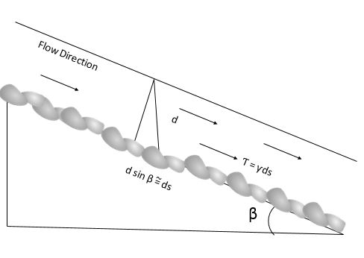
Stream-Channel Erosion: Part 1
Courtesy of Cal Poly Pomona
Bed shear stress is a function of
water depth, channel slope, and flow velocity.
Notes:
2 min
a. “The equation on this slide illustrates stream-channel erosion.”
b. “Rivers erode their beds by either removing sediment grains that have accumulated on the bed or by cutting directly into the hard bedrock beneath the sediment. Both of these processes require sufficient sideways force or shear stress exerted by the column of flowing water. This bed shear stress is proportional to the water depth, or mass, and the steepness, or slope, of the stream channel.”
c. “With greater water flow, water depth increases, which means that more mass is pressing down on the streambed. With a steeper stream channel, more of that mass is directed downhill, increasing the sideways force or shear stress on the streambed. So more water and/or a steeper streambed increase erosion.”
d. “We’ll test these ideas later using a stream-table model. This type of model can show us how increasing or decreasing water flow and/or changing the tilt of the stream table affect erosion and deposition.”

Slide 37
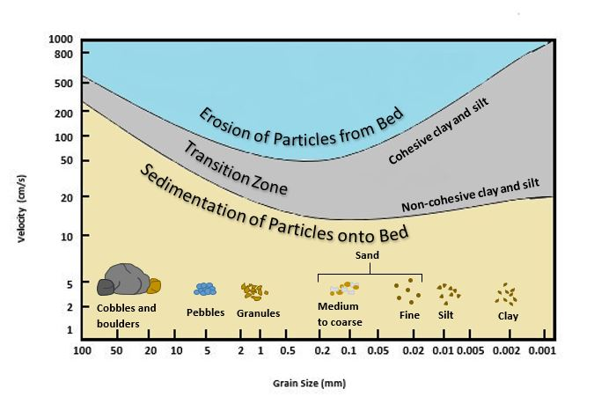
Stream-Channel Erosion: Part 2
Courtesy of Cal Poly Pomona
Notes:
2 min
a. “Water depth and channel steepness determine the speed at which river water flows. So flow velocity is also related to a river’s ability to erode its bed.”
b. “The graph on this slide plots water velocity versus the size of sediment grains that can be lifted off the bed.”
c. “On the left side of the graph, faster water flow, with deeper water and a steeper channel, is required to move large sediment grains like cobbles and boulders. In the middle, smaller grains, such as grains of sand, can be moved with slower velocities of water, shallower water, and a gentler slope. But on the right side, faster velocities of water are required to move the smallest grains of silt and clay because those grains are sticky or cohesive.”
d. “So it’s hardest for a stream to erode big boulders and sticky clay from its bed, and it’s easiest to move small, loose grains of sand.”

Slide 38
Dynamic
Equilibrium
and
the
Graded
River
3000
2000
1000
0
Altitude above Sea Level (m)
0 200 400 600 800 1000 1200
Source
Distance from Headwaters of River (km)
Mouth
Courtesy of Cal Poly Pomona
Notes:
2 min
a. “To better understand river erosion and deposition, we need to understand the important concept of dynamic equilibrium.”
b. “According to this concept, rivers are dynamic systems that respond to changing conditions within the watershed. As plate tectonics build up Earth’s surface and erosion wears it down, rivers respond by adjusting their profile to achieve a balance between opposing forces. If any characteristic of a river changes, such as its channel shape or the flow of water and sediment, other characteristics will adjust to achieve a new balance or equilibrium. The dish-shaped profile we discussed earlier is an expression of dynamic equilibrium.”
c. “Geomorphologists refer to this balanced form as a graded river profile. A graded river is a river in equilibrium or balance with the prevailing conditions in the watershed.”

Slide 39
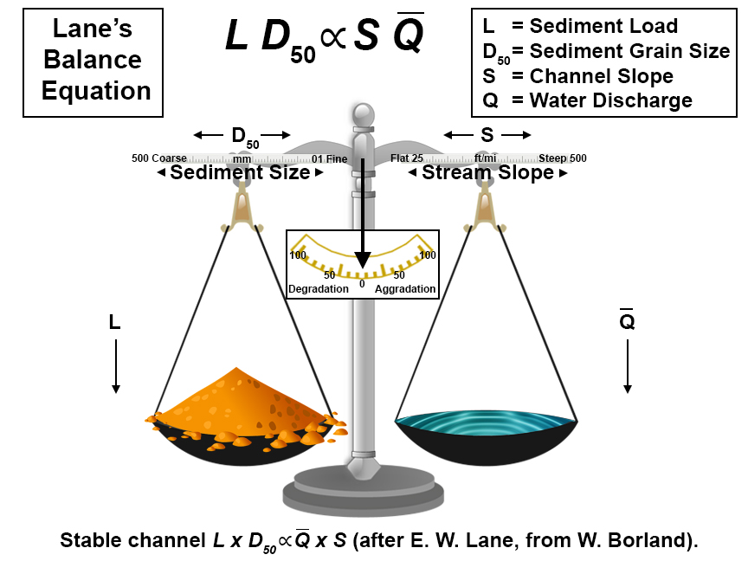
Courtesy of Cal Poly Pomona
Notes:
1 min
a. “Four basic parameters control river equilibrium: (1) sediment load (L), (2) average sediment grain size (D₅₀), (3) channel slope (S), and (4) water flow or discharge (Q).”
b. “The equation on the slide, called Lane’s balance, is a mathematical relationship that expresses this equilibrium. L x D₅₀ is proportional to S x Q.”
c. “If any of these four parameters is altered, the other three will adjust to achieve a new balance or equilibrium.”

Slide 40
Graded River Profile
Photo courtesy of Marli Miller/Geologypics.com
Notes:
1 min
a. “This photo of Death Valley, California, is an excellent example of a graded stream. The stream channel follows a concave-up graded profile from its head on the mountainside to its base on the alluvial fan.”
b. “Scarps, or steep slopes, are visible at the base of the hill, and with repeated earthquakes on the mountain-front fault, the mountain block rises and the valley bottom drops down. To maintain an equilibrium-graded profile, the stream erodes its bed upstream, cutting a deeper canyon into the rock, and deposits sediment downstream, building up its bed on the alluvial fan.”
c. “Think about how this relates to your observations during our stream-table investigation.”

Slide 41
Graded River Profile
Grand Canyon,
Northern Arizona
Photo courtesy of Pixabay.com
Notes:
1 min
a. “This photo of the Grand Canyon, which we saw earlier, shows a segment of the Colorado River following a graded profile through the canyon.”
b. “The river has cut downward into the solid rock on the sides of the canyon to maintain a gradual concave up-graded profile extending from its headwaters in the Rocky Mountains to the river mouth at the Gulf of California.”
c. “Again, think about how this shape relates to your observations during our stream-table investigation last time.”

Slide 42
Earth’s Changing Surface
Lesson 5a
Photo courtesy of Visible Earth
Notes:
Less than 1 min
a. “Next, we’ll explore ideas about Earth’s changing surface from lesson 5a.”

Slide 43
Content Deepening: Focus Question 1
How quickly or slowly do landforms change over time? How do we know?
Notes:
Less than 1 min
a. Read the two-part focus question on the slide.
b. Emphasize that these questions will guide student learning throughout ECS lesson 5a.
c. Have participants write the questions in their science notebooks and draw a box around them.

Slide 44
Can We See Landforms Change?
Do you think someone could watch the Grand Canyon change? How long would it take?
Photo courtesy of W. Tyson Joyce/NPS
Notes:
7 min
a. Read the questions on the slide.
b. Pairs: “Discuss these questions with an elbow partner and work together to come up with answers.”
c. Whole group: Invite pairs to share their answers and reasoning with the group. Record key ideas on chart paper.
d. Elicit differing points of view during this discussion and probe participants’ responses (e.g., “Can you say more about that?”). Encourage participants to agree, disagree, ask questions, or add to the ideas others share. Work toward a consensus.

Slide 45
What Is a Delta?
Photo courtesy of Arthur Belala/Wikimedia Commons
Notes:
8 min
a. Read the question on the slide.
b. Elicit ideas from the group and record them on chart paper.
c. Ask participants the following questions:
Have you ever seen a delta?
Where would you have to go to see one?
Do deltas form only at the mouth of a big river like the Mississippi River, or can they appear in other locations?
d. During this discussion, encourage participants to ask any questions they may have about deltas.
e. Work together to develop a definition of a delta. When the group reaches a consensus, record the definition on chart paper and have participants write it in their science notebooks.

Slide 46
How Quickly or Slowly Do Landforms Change?
Work in pairs to investigate two landforms :
The Grand Canyon
The Mississippi River delta
Read the information on the handouts and study the photos and maps.
Decide whether these landforms are changing quickly or slowly.
Look for evidence in the readings to support your ideas.
Be ready to share your ideas and evidence.
Notes:
10 min
a. “In our first investigation, we’ll learn about deltas and the Grand Canyon and use this information to consider how quickly these landforms change over time.”
b. Have participants locate handouts 5.1 (The Grand Canyon) and 5.2 (Deltas) in their lesson plans binders.
c. Pairs: “Pair up with an elbow partner and work together to complete the tasks on the slide.”
d. Whole-group share-out: “So what did you decide about each landform based on the information and maps you studied? Do you think these landforms are changing quickly or slowly? What’s your evidence?”
e. As participants share their ideas and evidence, record them on chart paper.

Slide 47
Reflect: Content Deepening Focus Question 1
How quickly or slowly do landforms change over time? How do we know?
Answer these questions in your notebook using this sentence starter:
I think landforms change [slowly/quickly/both]. My evidence is __________________.
Circle one of the options (slowly, quickly, or both). Make sure to use evidence from today’s readings to support your ideas.
Notes:
7 min
a. Review the two-part focus question on the slide.
b. Individuals: Ask participants to write their initial ideas in their science notebooks using the sentence starter on the slide.
c. Whole-group share-out: Invite participants to share their ideas and evidence with the group. Challenge them to respond in complete sentences using science ideas from the handouts to support their answers. As participants share their ideas, record them on chart paper and probe participants’ thinking.
d. Following the share-out, review the key ideas you recorded on chart paper and ask participants, “Do you have anything you’d like to add or correct?”

Slide 48
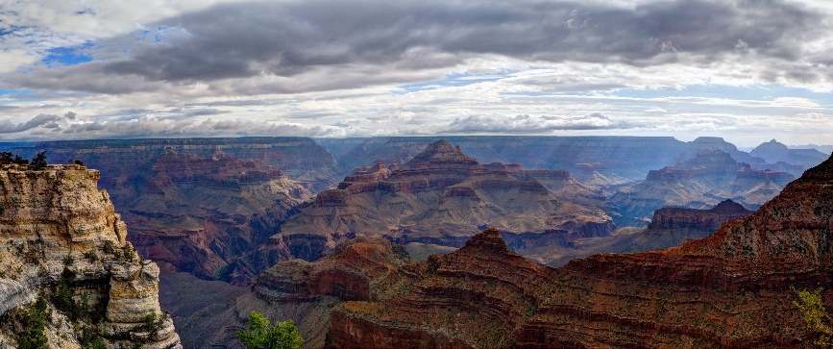
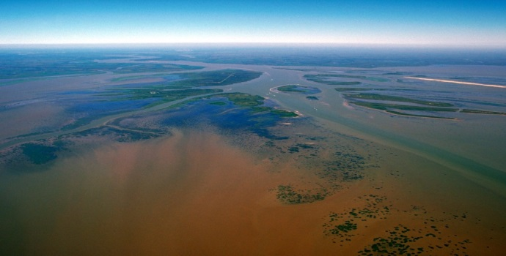
Key Science Ideas
Landforms change over time.
Some changes happen quickly, like during a flood.
Some changes happen very slowly over time, like when deltas or canyons form.
We can’t always see these changes happening.
Photo courtesy of W. Tyson Joyce/NPS
Photo courtesy of Arthur Belala/Wikimedia Commons
Notes:
Less than 1 min
a. Review the key science ideas on the slide.

Slide 49
Earth’s Changing Surface
Lesson 5b
Photo courtesy of Visible Earth
Notes:
Less than 1 min
a. “Next, let’s explore ideas about Earth’s changing surface from lesson 5b.”

Slide 50
Content Deepening: Focus Question 1
How quickly or slowly do landforms change over time? How do we know?
Notes:
Less than 1 min
a. Review the two-part focus question on the slide.
b. Emphasize that these questions from ECS lesson 5a will guide student learning throughout lesson 5b as well.

Slide 51
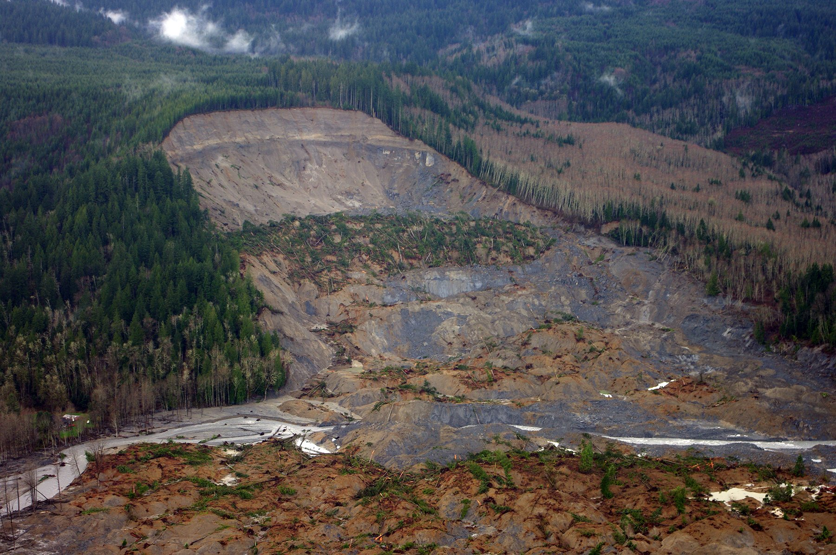
What Is a Landslide?
Photo courtesy of Jonathan Godt/USGS
Notes:
7 min
a. Read the question on the slide.
b. Elicit ideas from the group and record them on chart paper.
c. Ask participants, “What questions and misconceptions might your students have about landslides?”
d. Work together to develop a definition of a landslide. When the group reaches a consensus, record the definition on chart paper and have participants write it in their science notebooks.

Slide 52
How Quickly or Slowly Do Landforms Change?
Work with your partner from last time and read about landslides on the handout. Then study the photo.
Compare the landslide example with the Grand Canyon and delta examples from last time. Decide how fast or slow the land changes.
Arrange your landform examples in order from the slowest change to the fastest change.
Look for evidence in the readings to support your decisions.
Notes:
10 min
a. “Next, we’ll learn about landslides and consider whether these changes happen quickly or slowly. Then we’ll compare our landslide example with our other landform examples and arrange them in order of slowest to fastest change.”
b. Have participants locate handout 5.3 (Landslides) in their lesson plans binders. They’ll also need handouts 5.1 (The Grand Canyon) and 5.2 (Deltas) from the previous investigation.
c. Pairs: “Work with the same partner to complete the tasks on the slide.”
d. Whole-group share-out: “So based on the information and maps you studied, do you think landslides happen quickly or slowly? In what order did you arrange the three landforms, and what evidence did you use to reach these decisions?”
e. As participants share their decisions and evidence, record them on chart paper.
f. Ask participants, “What challenges did this sequencing task pose for you? What challenges might it pose for your students?”

Slide 53
Let’s Compare Our Landform Examples
Think about our three landform examples:
The Grand Canyon
Deltas
Landslides
What’s the same about these examples? What do all of them have in common?
What’s different about these examples?
Notes:
10 min
a. Read the statement and questions on the slide.
b. Turn and Talk (3 min): “Share your ideas with an elbow partner and work together to develop an answer for these questions.”
c. While pairs are working on the task, create a two-column data table on chart paper. For the first column, write the heading “What’s the Same?” and for the second column, write the heading “What’s Different?”
d. Whole-group discussion (2 min): Invite pairs to share their answers to the questions. Record key similarities and differences on the data table.
e. Follow-up question: “In a previous session, we talked about processes that build up and wear down Earth’s surface. Tectonics is a process that builds up the surface, and erosion is a process that wears it down? Which process or processes do you think are involved in our three landform examples?
Expected response: Both processes are involved in all three landform examples. The land is worn down in one place as dirt and rock are carried away, and the land is built up in another place where the dirt and rock are deposited.

Slide 54
Reflect: Content Deepening Focus Question 1
How quickly or slowly do landforms change over time? How do we know?
How would you answer these questions now? Use this sentence starter:
I think landforms change [slowly/quickly/both]. My evidence is ________.
Circle one of the options (slowly, quickly, or both). Make sure to include evidence from all three landform examples to support your ideas.
Notes:
7 min
a. Review the two-part focus question on the slide.
b. Individuals: “How would you answer these questions now, based on what we learned about our three landform examples? Write your ideas and evidence in your science notebooks, using the sentence starter on the slide.”
c. Whole-group share-out: Invite participants to share their ideas and evidence with the group. Record key ideas on chart paper and challenge any incorrect or inaccurate statements.
d. During this discussion, encourage participants to give one another feedback (agree/disagree, ask questions, add on).

Slide 55
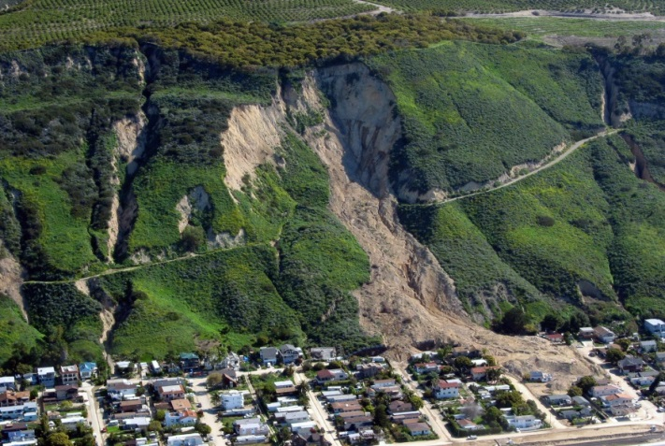
Key Science Ideas
Landforms change over time.
Some changes happen quickly, like during a flood or a landslide. We can see these changes happen.
Some changes happen very slowly over time, like when deltas or canyons form. We can’t always see them happen.
Photo courtesy of W. Tyson Joyce/NPS
Photo courtesy of Arthur Belala/Wikimedia Commons
Photo courtesy of Mark Reid/USGS
Notes:
Less than 1 min
a. Review the key science ideas on the slide.

Slide 56
Earth’s Changing Surface
Lesson 6a
Photo courtesy of Visible Earth
Notes:
Less than 1 min
a. “Next, we’ll explore ideas about Earth’s changing surface from lesson 6a.”

Slide 57
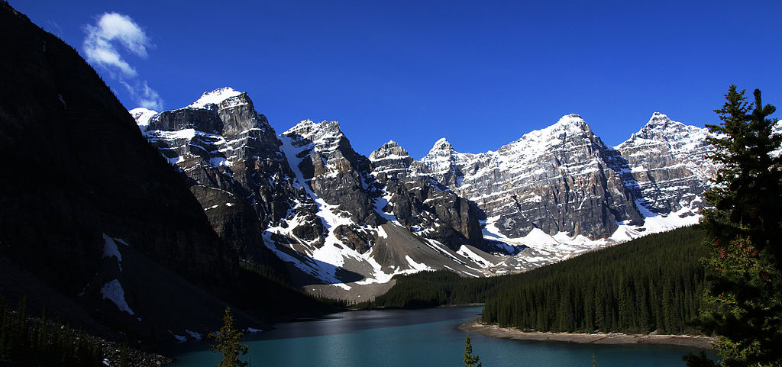
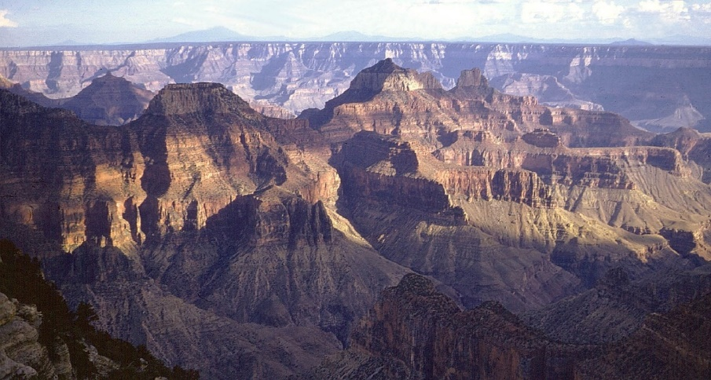
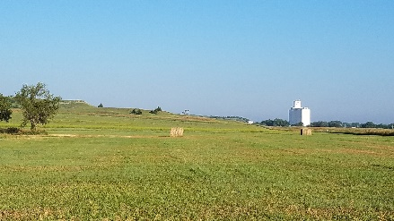
Let’s Review What We’ve Learned!
Earth’s surface has many types of landforms. What types of landforms do you see below?
Photo courtesy of Bede735/Wikimedia Commons
Photo courtesy of Pixabay.com
Photo courtesy of IveGoneAway/Wikimedia Commons
Notes:
5 min
a. “Let’s begin this segment of our content deepening work with a review of what we’ve learned about landforms so far.”
b. “During this review, think about what you ideally want your students to say in response to each of the questions and what might cause confusion for them.”
c. Read the key science idea and question on the slide.
d. Ask participants to brainstorm ideal student responses to this question and share possible difficulties or confusion students might experience related to this content.

Slide 58
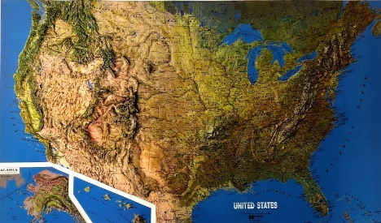
Let’s Review What We’ve Learned!
Landforms in one place can be different from landforms in another place. What helped us identify landforms in different places?
Photo courtesy of Cal Poly Pomona
Notes:
5 min
a. Read the key science idea and question on the slide.
b. Ask participants to brainstorm ideal student responses to this question and share possible difficulties or confusion students might experience related to this content.

Slide 59
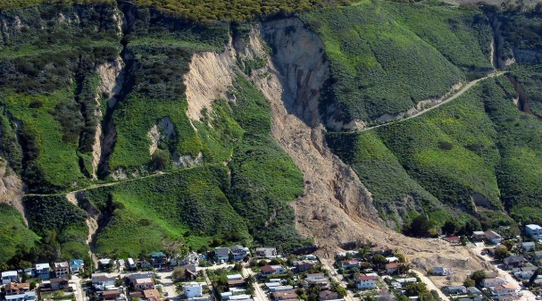
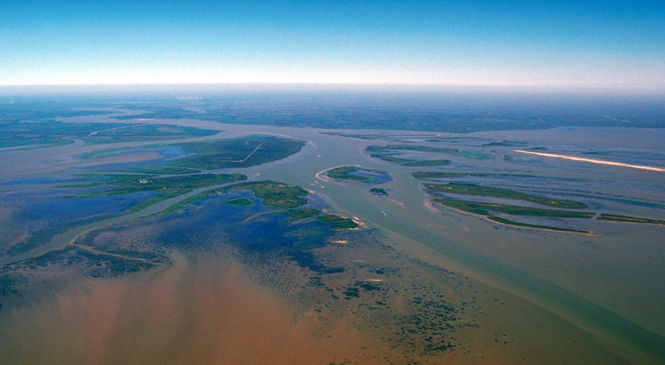
Let’s Review What We’ve Learned!
Landforms change over time. What’s one example of a landform that’s changing?
Photo courtesy of Mark Reid/USGS
Photo courtesy of Arthur Belala/Wikimedia Commons
Photo courtesy of W. Tyson Joye/NPS
Notes:
5 min
a. Read the key science ideas and question on the slide.
b. Ask participants to brainstorm ideal student responses to this question and share possible difficulties or confusion students might experience related to this content.

Slide 60
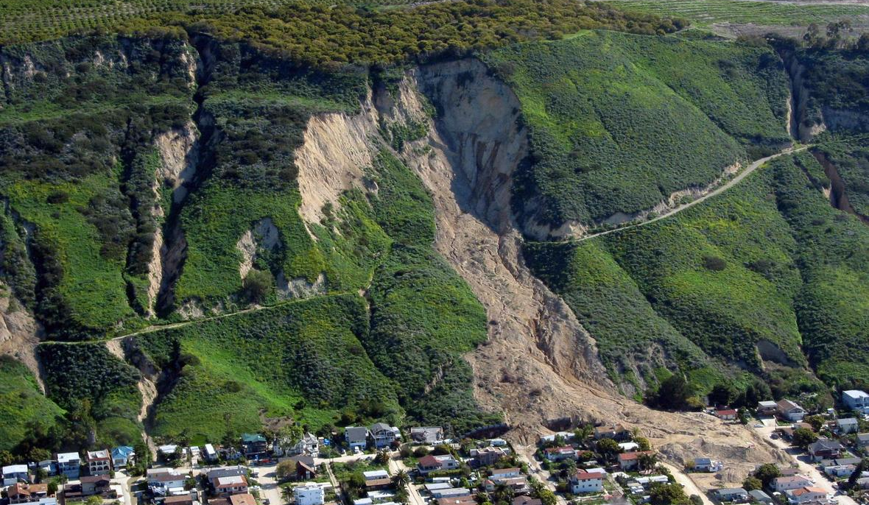
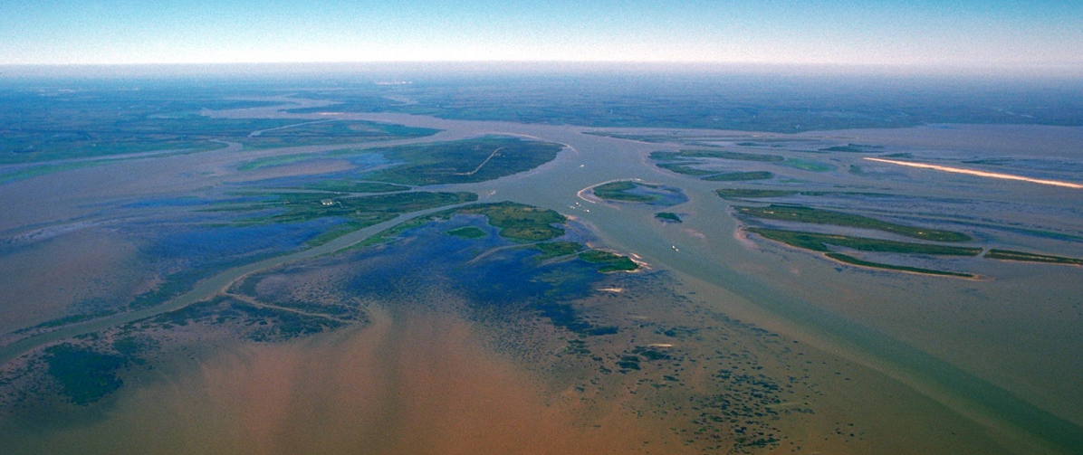
Let’s Review What We’ve Learned!
What causes landforms to change?
Photo courtesy of W. Tyson Joye/NPS
Photo courtesy of Mark Reid/USGS
Photo courtesy of Arthur Belala/Wikimedia Commons
Notes:
5 min
a. Read the key science ideas and question on the slide.
b. Ask participants to brainstorm ideal student responses to this question and share possible difficulties or confusion students might experience related to this content.

Slide 61
Content Deepening: Focus Question 2
Can we explain how landforms change in our area?
Notes:
Less than 1 min
a. Read the focus question on the slide.
b. Emphasize that this question will guide student learning throughout ECS lesson 6a.
c. Have participants write the question in their science notebooks and draw a box around it.

Slide 62
Landform Changes around Pomona
What are some examples of landform changes around Pomona?
Photo courtesy of NASA/JPL/NIMA
Notes:
8 min
a. Read the question on the slide.
b. Pairs: “Discuss this question with an elbow partner and develop an answer using descriptive terminology. Focus on the processes that caused the landform.”
c. Whole group: Invite pairs to share their landform examples with the group. Record the landforms on chart paper and include the processes involved in forming each one.
d. Ask participants, “What examples do you think your students might come up with?”

Slide 63
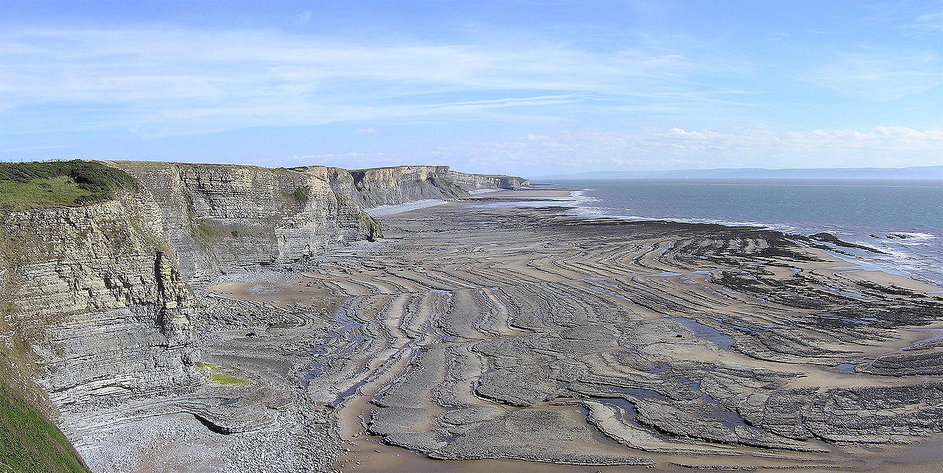
What Landforms Do You See?
Photo courtesy of Yummifruitbat/Wikimedia Commons
Notes:
5 min
a. Read the question on the slide.
b. Elicit ideas from participants and record them on chart paper. Work toward a consensus.
c. Ask participants, “Do we have landforms like this near Pomona?”

Slide 64
A Coastline Landform Challenge
Photo courtesy of Yummifruitbat / Wikimedia Commons
Pair up and discuss these questions:
Do you think the cliffs in this picture are changing or staying the same? Why or why not?
If changes are happening, what do you think is causing them?
Look for evidence to support your ideas.
Be ready to share your ideas and evidence.
Notes:
5 min
a. “Next, we’ll engage in a use-and-apply challenge using everything we’ve learned about landforms to help us determine whether the cliffs in this photo are changing.”
b. Pairs: Have participants pair up with an elbow partner and follow the instructions on the slide.

Slide 65
Coastline Landform Changes: Part 1
Questions | Your Ideas | Evidence
Do you think the cliffs are changing or staying the same? Why or why not?
If changes are happening, what do you think is causing them?
Notes:
10 min
a. Create a data table on chart paper like the one on this slide.
Note: Alternatively, you could display the data table on a document reader.
b. Read the questions on the data table and invite participants to share their ideas and evidence. Records participants’ responses in the appropriate boxes on the table.
c. During this discussion, elicit differing points of view and probe participants’ responses (e.g., “Can you say more about that?”). Encourage participants to agree, disagree, ask questions, or add to the ideas others share. Work toward a consensus.

Slide 66
Reflect: Content Deepening Focus Question 2
Can we explain how landforms change in our area?
Notes:
Less than 1 min
a. Review the focus question on the slide.
b. Individuals: Have participants answer the question in their science notebooks.
c. Whole group: Invite participants to share their answers with the group. Record key ideas and evidence on chart paper.

Slide 67
Summarizing Today’s Work
Think about the Science Content Storyline Lens strategies we’ve studied so far:
Think about your science-content-learning work today.
Reflect: What ideas or questions do you want to remember from today and refer back to?
A—Identify one main learning goal.
B—Set the purpose with a focus question or goal statement.
C—Select activities that are matched to the learning goal.
D—Select content representations and models matched to the learning goal and engage students in their use.
I—Summarize key science ideas.
Notes:
6 min
a. Individuals (4 min): Ask participants to think about the first two tasks on the slide and respond to the reflection question in their notebooks.
b. Whole group (2 min): Ask for volunteers to share an idea or question from their responses to the reflection question.

Slide 68
Homework
Read about SCSL strategies F, G, and H in the STeLLA strategies booklet and complete the Z-fold summary chart for these strategies.
Be ready to share your assigned lesson in the ECS lesson series.
Bring your calendar for the academic year so we can schedule the dates for our school-year study-group meetings!
Notes:
3 min
a. Review the homework assignment and have participants write it in their notebooks.
b. Make sure participants understand the assignment.
c. “We won’t address strategy E about sequencing science ideas and activities until the school year, since you’ll learn a lot about sequencing from teaching the RESPeCT lesson plans.”

Slide 69
Reflections on Today’s Session
What are your reactions to the strategy of selecting content representations and models that are matched to the lesson’s main learning goal?
What is something new you’ve learned about Earth’s surface and how it changes over time? Did your content-representation analyses support this learning in any way?
Provide feedback about today’s session and the PD program so far (likes, dislikes, questions, concerns, and suggestions).
Notes:
6 min
a. Allow at least 5 minutes for participants to think about today’s session and write their reflections and feedback on the Daily Reflections sheet (handout 7.4 in PD program binder).

Slide 70
Norms for Working Together: The Basics
Purpose: Build trust and develop a productive study group for all participants.
The Basics
Arrive prepared and on time; stay for the duration; return from breaks on time.
Remain attentive, thoughtful, and respectful; engage and be present.
Eliminate interruptions (turn off cell phones, email, and other electronic devices; avoid sidebar conversations).
Make room for everyone to participate (monitor your floor time).
Notes:
Hidden slide—available for use as needed.

Slide 71
Norms for Working Together: The Heart
Purpose: Build trust and develop a productive study group for all participants.
The Heart of RESPeCT Lesson Analysis and Content Deepening
Keep the goal in mind: analysis of teaching to improve student learning.
Share your ideas, uncertainties, confusion, disagreements, questions, and good humor. All points of view are welcome.
Expect and ask questions to deepen everyone’s learning; be constructively challenging.
Listen carefully; seek to understand other participants’ points of view.
Notes:
Hidden slide—available for use as needed.

