Slide 1
RESPeCT PD pROGRAM
Day 8
RESPeCT Summer Institute
Notes:
5 min
a. Take care of any housekeeping issues.

Slide 2
Agenda for Day 8
Day-7 reflections
Focus questions
Introducing SCSL strategies F, G, and H
Lesson analysis: SCSL strategies F, G, and H
ECS lesson plan review
Fall overview and study-group scheduling
Lunch
Content deepening: Earth’s changing surface
Wrap-up and celebration!
Notes:
2 min
a. Talk through today’s agenda.

Slide 3
Trends in Reflections
Lesson Analysis | Science Content Learning
Notes:
5 min
a. Give participants time to review your feedback on their reflections from day 7 and offer reactions, comments, or follow-up questions.

Slide 4
Today’s Focus Questions
How can science content storyline coherence be enhanced by explicitly implementing STeLLA strategy F (Make explicit links between science ideas and activities), strategy G (Link science ideas to other science ideas), and strategy H (Highlight key science ideas and focus question throughout)?
How will the Student Thinking Lens and Science Content Storyline Lens strategies help you teach the ECS lessons in the fall?
Can we predict and explain how landforms might be changing in our area?
How long do you think it would take to walk the length of the Grand Canyon floor?
How accurate are raised relief maps as content representations?
Notes:
2 min
a. Introduce the focus questions that will guide today’s work.

Slide 5
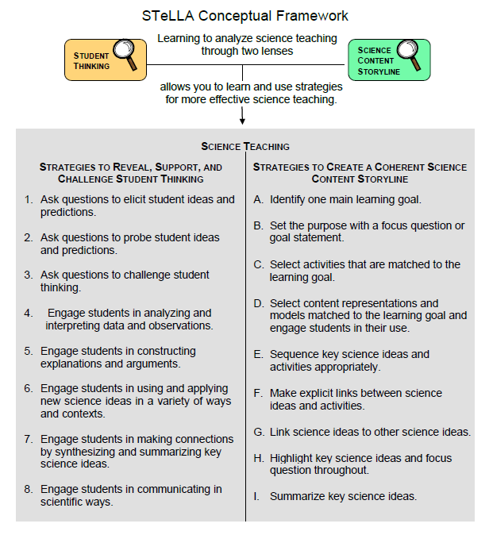
Notes:
1 min
“Today we’ll focus on three Science Content Storyline Lens strategies, all of which make explicit links to science ideas:
Strategy F explicitly links science ideas to activities that students are doing.
Strategy G explicitly links science ideas to other science ideas.
Strategy H explicitly highlights key science ideas and links them back to the focus question.”
“We won’t address strategy E about sequencing science ideas and activities until the school year, since you’ll learn a lot about sequencing from teaching the RESPeCT lesson plans.”

Slide 6
Lesson Analysis: Focus Question 1
How can science content storyline coherence be enhanced by explicitly implementing STeLLA strategy F (Make explicit links between science ideas and activities), strategy G (Link science ideas to other science ideas), and strategy H (Highlight key science ideas and focus question throughout)?
Notes:
Less than 1 min
a. Read the focus question on the slide.

Slide 7
SCSL Strategies F, G, and H: Purposes and Key Features
Group 1:
What are the purposes and key features of strategy F?
Why is this strategy important for science content storyline coherence?
Group 2:
What are the purposes and key features of strategy G?
Why is this strategy important for science content storyline coherence?
Group 3:
What are the purpose and key features of strategy H?
Why is this strategy important for science content storyline coherence?
Notes:
30 min
a. Small groups: Divide participants into three groups to make charts that capture the purposes and key features of strategies F, G, and H. Direct groups to refer to their Z-fold summary charts and the STeLLA strategies booklet.
b. Whole group: Have small groups share their charts with the entire group.
c. Challenge participants to imagine themselves in their Teacher Leader roles. Ask them, “How would you explain these strategies to the teachers you’re leading?”

Slide 8
SCSL Strategies F, G, and H: Discussion Question
What’s similar and different about these three strategies?
Notes:
10 min
Note: This slide may be skipped if similarities and differences were addressed in the previous discussion.
Individuals (3 min): “Look at your three strategy charts, your Z-fold summary charts, and the strategies booklet as you think about the question on the slide.”
Whole group: Have participants share their ideas about the three strategies.
Key ideas about strategies F, G, and H:
1. Similarities:
These strategies are all focused on linking complete sentence-length science ideas: Strategy F links science ideas to activities, strategy G links science ideas to other science ideas, and strategy H highlights key science ideas and links them to the focus question throughout the lesson.
All of these strategies emphasize making the links explicit, not just assuming that students will see the intended links.
All of these strategies can and should occur throughout the lesson.
2. Differences:
Strategy F explicitly links science ideas to student activities.
Strategy G explicitly links science ideas to other science ideas.
Strategy H explicitly highlights key science ideas and links them back to the focus question.

Slide 9
Preparing for Video-based Lesson Analysis
Read Analysis Guide F, part 1.
What is the difference between the main learning goal and supporting science ideas?
What is similar about the main learning goal and supporting science ideas?
Notes:
5 min
a. “Next we’re going to watch a series of four classroom video clips from one ECS lesson. The first clip takes place before students begin an activity on how particular landforms change over time. The second clip shows students while they’re working on the activity. And the third and fourth clips show the teacher following up with students after the activity.”
b. Have participants locate Analysis Guide F (handout 8.1) in their PD program binders.
c. Tell participants that part 1 of the guide provides the context for the video clips.
d. Individuals: “Read part 1 of the analysis guide and be prepared to discuss the two questions on the slide.”
e. Whole group:
Discuss the questions on the slide.
Ask whether participants have any questions about the activity they’ll be observing in the video clips.
Key ideas:
Difference between the main learning goal and supporting science ideas: The main learning goal is the big idea that is the focus of the lesson. Supporting science ideas are smaller, connected ideas that build upon each other to support the main learning goal.
Similarity between the main learning goal and supporting science ideas: The main learning goal and supporting science ideas are all expressed as complete-sentence science ideas (not as topics, phrases, or activities).

Slide 10
Lesson Analysis: Strategy F
For each of the video clips, read the context at the top of the transcript and then watch the clip:
Video clip 1: setup for the activity
Video clip 2: during the activity
Video clips 3 and 4: follow-up to the activity
For each clip, use the criteria in part 2 of Analysis Guide F to analyze how well science ideas were linked to the activity.
Link to video clips: 8.1_mspcp_gr.2_ecs_poulsen_L3_c4;
8.2_mspcp_gr.2_ecs_poulsen_L3_c3;
8.3_mspcp_gr.2_ecs_poulsen_L3_c6;
8.4_mspcp_gr.2_ecs_poulsen_L3_c7-c8
Notes:
60 min (20 min/clip)
a. Have participants review part 2 of Analysis Guide F. After they watch each video clip, ask them to study the corresponding transcript, answer the questions in part 2 of the analysis guide, and then analyze the links between science ideas and activities that were (or were not) made before, during, or after the activity.
b. Have participants read the context for video clip 1 at the top of the transcript (handout 8.2 in PD program binder).
c. Show video clip 1. Then guide participants through these tasks:
Individuals: “Study the video transcript and then complete part 2, section 1 of the analysis guide, Setup for the Activity.”
Whole group: Ask participants to share their analyses of the video clip.
d. Have participants read the context for video clip 2 at the top of the transcript (handout 8.3 in PD binder).
e. Show video clip 2 and then guide participants through these tasks:
Individuals: “Study the video transcript and then complete part 2, section 2 of the analysis guide, During the Activity.”
Whole group: Ask participants to share their analyses of the video clip.
f. Have participants read the context for video clips 3 and 4 at the top of the transcripts (handouts 8.4 and 8.5 in PD binder).
g. Show video clips 3 and 4; then guide participants through these tasks:
Individuals: “Study the video transcripts and complete part 2, section 3 of the analysis guide, Follow-up to the Activity.”
Whole group: Ask participants to share their analyses of the video clips.
Sample analysis for video clip 1:
In this lesson-setup clip, the teacher doesn’t introduce a focus question or goal statement. In video segment 0:00:03, the teacher prompts students to think about four types of landforms and then clearly states that “we’re only gonna talk about mountains and hills and rivers and deltas today” (segment 0:00:11). This is the only statement indicating what the lesson will be about, but the teacher doesn’t tell students why they’re going to talk about the four types of landforms or explicitly state that they’ll be talking about how these landforms change.
The teacher reminds students of earlier predictions they made about how a mountain or hill might change and then asks students, “How might a river or delta change?” (segments 0:02:07–02:17). This suggests that the lesson/activity might be about changes in the four landforms, but it’s never explicitly stated.
Science ideas are discussed in the clip, but they’re never explicitly linked to the activity. In fact, it isn’t clear what the activity is going to be.
The setup would be clearer if the teacher
explicitly introduced a focus question or goal statement;
told students about the activity and helped them link science ideas to the activity; and
focused less on having students describe what they know about landforms and more on their ideas about how landforms change, what causes them to change, and how fast these changes might happen.
Sample analysis for video clip 2:
In this clip, students are thinking about science ideas during the activity (e.g., how water forms a delta by carrying rocks and soil and depositing them at the ocean).
The teacher engages students in linking science ideas to the activity by directing them to the text to find ideas to support their explanations (video segment 0:00:24), asking questions about the text (segments 0:00:44–00:47; 0:00:54), summarizing key ideas (segment 0:01:06), pointing them to the maps and making sure they understand what they show (segments 0:01:11–02:10), and asking questions about the maps and map data (segments 0:02:11; 0:02:24; 0:02:46; 0:02:56).
Students link science ideas to the activity by trying to explain the map and map data (video segments 0:02:22; 0:02:48; 0:03:09), but only with heavy scaffolding from the teacher does one student begin to use the goal idea to make sense of the maps (see segments 0:02:59–0:03:31).
Students make explicit links to science ideas at video segments 0:00:52, 0:00:57, 0:02:13, 0:02:30, and 00:03:09.
At video segment 0:02:48, one student draws from experience to explain the maps rather than using science ideas.
Sample analyses of video clips 3 and 4:
In clip 3, the teacher asks questions to help students develop science ideas by drawing from the activity (video segments 0:00:31–0:01:51). At segments 0:01:30–01:41, one student shows a strong understanding of how rocks pile up over time to form a delta.
In clip 3, students are involved in making links by answering the teacher’s questions. In clip 4, the teacher engages students in a writing assignment in which they summarize their understandings of big ideas from the activity and cite evidence to support their claims.
Missed opportunity: In clip 3, one student has an interesting claim that could have been productively probed. At segment 0:00:51, he states that deltas get smaller after floods. Was he thinking about erosion? If so, this is awesome thinking and closely tied to the learning goal about changes in landforms!

Slide 11
Lesson Analysis: Strategies F, G, and H
Strategy F:
Find examples in the video transcripts where students are linking science ideas to a lesson activity.
Suggest one specific way to strengthen strategy F in this lesson.
Strategy G:
Find examples where two or more science ideas are being linked together.
Suggest one specific way to strengthen strategy G in this lesson.
Strategy H:
Find an example where the teacher is highlighting key science ideas or referring back to the focus question.
Suggest one specific way to strengthen strategy H in this lesson.
Notes:
20 min
Note: If time is running short, have participants work only on part A of their assigned tasks.
a. Assign participants one of the strategies (F, G, or H) to analyze for this activity and then go over the directions on the slide. Emphasize the importance of using the STeLLA strategies booklet and strategy charts as resources.
b. Individuals: “Study the transcripts for video clips 1–4 and search for examples of your assigned strategy being used during the lesson. Be ready to share your ideas with the group, and make sure to support your answers with evidence.”
c. Whole group: Have participants share their findings. Encourage listeners to agree or disagree, ask clarification questions, and add on.
Examples of strategies in the video clips:
Strategy F: See sample analysis for clips 1–4 on slide 10.
Strategy G: In clips 2 and 3, links are made between the idea that land changes and the idea that these changes occur slowly (clip 2, 0:02:13 ; clip 3, 0:01:30–01:41; 0:02:07–02:35).In clip 4, the teacher challenges students to provide two pieces of evidence to support the idea that landforms change. It appears that she wants them to make links between fast changes, such as landslides, and slow changes, such as delta build-up.
Strategy H: In clip 2, the teacher summarizes a key science idea (video segment 0:01:06). In clip 4, the teacher returns to the lesson focus question (segment 0:00:10).

Slide 12
Summary: Strategies F, G, and H
Use linking strategies to make the science ideas explicit to the whole class (strategies F and G).
Engage students in linking science ideas to activities before, during, and after an activity (strategy F).
Engage students in linking science ideas to other science ideas (strategy G).
Highlight key science ideas throughout the lesson (strategy H).
Keep returning to the focus question throughout and at the end of the lesson (strategy H).
Notes:
Less than 1 min
a. Read the summary statements on the slide or give participants time to read them silently.
b. Ask participants whether they have a brief comment or question about the summary.

Slide 13
Lesson Analysis: Focus Question 2
How will the Student Thinking Lens and Science Content Storyline Lens strategies help you teach the ECS lessons in the fall?
Notes:
Less than 1 min
a. Read the focus question on the slide.

Slide 14
ECS Lesson Plan Conversation
The science content storyline across lessons
Review the main learning goal for each lesson sequentially.
The science content storyline within lessons (5–7 min for each two-part lesson)
How does this lesson fit into the arc of all the lessons?
What are the main learning goal and focus question?
Describe the main activity (or activities).
How will the activity help students better understand the learning goal for the day?
What STeLLA strategy/strategies are highlighted in this activity?
What concerns or suggestions do you have about this activity?
Practical issues and questions
Notes:
60 min (in conjunction with next two slides)
Note: Create charts like the samples on the next two slides so that participants can view both as they report out.
Timing note: Make sure you limit the time for each lesson conversation so you can get through them all. Aim for 5–7 minutes for each lesson.
a. Give a brief overview of the science content storyline across lessons and then begin the lesson conversation.
b. For step 1 on the slide, review the main learning goal for each lesson sequentially and how it connects to the lesson before and after it. (5 min)
c. For steps 2 and 3, ask each participant to report on her/his two-part lesson, which was assigned on day 5.
Note: Encourage participants to present the big picture using the questions in step 2 on the slide, not to walk through every step in their lesson plans. They should bring up details only when they have some concern, question, or suggestion about a modification.
d. As participants give their reports, fill in the charts you’ve created, checking off the main strategies highlighted in each lesson. (See the chart format on next two slides.)
Note: Encourage participants to pick just one or two Student Thinking Lens strategies and one or two Science Content Storyline Lens strategies that are actually highlighted in the lesson. (Each lesson uses several strategies.)
Ideal pattern to highlight for the Student Thinking Lens strategies:
Lesson 1 should highlight elicit and probe questions. The lesson focuses on eliciting students’ initial ideas.
Lesson 2 begins challenging student thinking to move forward, so in addition to elicit and probe questions, challenge questions become important. Students’ ideas are challenged in the context of analyzing and interpreting data and observations (strategy 4).
Lessons 3–5 include STL strategies 1–5.
Lesson 6 focuses on strategy 6 (using and applying new science ideas in a variety of ways and contexts).
Ideal pattern to highlight for the Science Content Storyline Lens strategies:
The lessons don’t follow a progressive pattern for SCSL strategies the way they did for the STL strategies.
All of the lessons include strategies A, B, C, H, and I.
Some of the lessons are better examples of strategy D (content representations), such as lessons 2 and 4.
All of the lessons should include strategies F, G, and H to some extent. However, strategies F and G become more apparent in the later lessons as the teacher and students have more opportunities to highlight key science ideas (strategy H) and link science ideas to the activities (strategy F) and other science ideas (strategy G).

Slide 15
STL Strategies Highlighted in the ECS Lessons
 | 1a | 1b | 2a | 2b | 3a | 3b | 4a | 4b | 5a | 5b | 6a | 6b
1. Elicit
2. Probe
3. Challenge
4. Analyze/ Interpret
5. Explain/ Argue
6. Use/Apply
Notes:
a. As participants report out, complete the chart, indicating with check marks the STL strategies highlighted in the ECS lessons.
b. Discuss the reasons certain strategies appear at specific times in the lesson sequence. (See ideal patterns on slide 14 and refer to the summary charts in the STeLLA strategies booklet as needed.)

Slide 16
SCSL Strategies Highlighted in the ECS Lessons
Lesson | 1a | 1b | 2a | 2b | 3a | 3b | 4a | 4b | 5a | 5b | 6a | 6b
A. Identify Main Learning Goal
B. Set Purpose and Focus Question
C. Match Activity to MLG
D. Match Content Reps to MLG
F. Link Activity to Science Ideas
G. Link Science Ideas
H. Highlight Key Science Ideas and Focus Question
I. Summarize Key Science Ideas
Notes:
a. As participants report out, complete this chart, indicating with check marks the SCSL strategies highlighted in the lessons.
b. Discuss the reasons certain strategies appear at specific times in the lesson sequence. (See ideal patterns on slide 14 and refer to the summary charts in the STeLLA strategies booklet as needed.)

Slide 17
Overview of Study-Group Sessions
Purpose: To practice, analyze, and learn from the use of the STeLLA strategies in your science teaching.
Review the focus of each study-group session:
What is the main focus for fall study-group sessions 1–3?
What is the purpose of the 2-hour meeting in December/January?
What is the main focus for spring study-group sessions 4–6?
Notes:
5 min
a. Have participants locate handout 8.6—Overview of School-Year RESPeCT Study Groups—in their PD program binders.
b. Emphasize: The purpose of the study-group sessions is to practice, analyze, and learn from using the STeLLA strategies in your teaching of the Earth’s Changing Surface lessons in the fall and the Properties of Matter lessons in the spring.
c. Talk participants through Study Groups 1–3 on the handout.
d. Pause for questions and a summary task. Ask participants, “What is the main focus for fall study-group sessions 1–3?”
e. Talk participants through the 2-hour meeting in December/January and Study Groups 4–6 on the handout.
f. Pause for questions and a summary task. Ask participants, “What is the purpose of the 2-hour meeting in December/January?” and “What is the main focus for spring study-group sessions 4–6?”

Slide 18
Teaching the Earth’s Changing Surface Lessons
Before teaching lesson 1, give your students the classroom pretest.
Teach all the lessons and have one lesson video recorded.
Give your students the classroom posttest.
Hold on to your students’ pre-post tests! You’ll analyze them in preparation for Study Group 3.
Notes:
10 min
a. Before going over this slide, have participants locate the ECS classroom pre-post test in their lesson plans binders (pretabs section).
The classroom pre-post test: “This test is in your lesson plans binder. After you administer the test to your students, you’ll need to save all of them, since you’ll be analyzing them as part of our study-group work in the fall.”
b. Review the steps on the slide.
c. Emphasize: “It’s very important to follow these steps in order and save all of your classroom pre-post tests. Don’t return them to students until after Study Group 3.

Slide 19
Scheduling School-Year Study Groups
Proposed meeting day/time: Wednesdays 2:00–6:00 p.m.
Meeting place: In our classrooms, rotating from school to school
Possible dates for our study-group sessions:
Study Group 1: [insert possible date]
Study Group 2: [insert possible date]
Study Group 3: [insert possible date]
2-hour meeting to review Properties of Matter lessons: [insert possible date]
Study Group 4: [insert possible date]
Study Group 5: [insert possible date]
Study Group 6: [insert possible date]
Notes:
15 min
Note: Include on this slide some possible dates for six 4-hour study-group meetings and the 2-hour meeting that occurs between Study Groups 3 and 4.
a. Suggest possible dates for the study-group sessions, starting with the Wednesday afternoon slot from 2:00 to 6:00 p.m.
Note: As you schedule the meetings, keep in mind that you’ll need some time between the end of the school day and the beginning of the meeting to get to the location and set up everything.
Study Group 1: Early October. Round-1 teachers should have their classroom video recordings completed at least three weeks before this session. You will need three weeks to watch the classroom video(s), select the ones you’ll use during the study groups, and prepare the video-clip selections and transcripts.
Study Group 2: Mid-November. Round-2 teachers should have their classroom video recordings completed at least three weeks before this session. You will need three weeks to watch the classroom video(s), select the ones you’ll use during the study groups, and prepare the video-clip selections and transcripts.
Study Group 3: Early December. This session can occur anytime after Study Group 2 and before the holiday break.
2-hour meeting: December/January. The purpose of this meeting is to review the Properties of Matter lesson plans in preparation for teaching them.
Study Group 4: Early February. Round-1 teachers should have their classroom video recordings completed at least three weeks before this session. You will need three weeks to watch the classroom video(s), select the ones you’ll use during the study groups, and prepare the video-clip selections and transcripts.
Study Group 5: March. Round-2 teachers should have their classroom video recordings completed at least three weeks before this session. You will need three weeks to watch the classroom video(s), select the ones you’ll use during the study groups, and prepare the video-clip selections and transcripts.
Study Group 6. April. This session can occur anytime after, but preferably within a month of, Study Group 5.

Slide 20
Earth’s Changing Surface
SCIENCE CONTENT DEEPENING Grade 2
Notes:
Less than 1 min
a. “Now we’ll engage in some science content deepening to strengthen our understandings of Earth’s changing surface.”
Note: Throughout this content deepening phase, refer as needed to the Earth’s Changing Surface Content Background Document and Common Student Ideas about Earth’s Changing Surface.

Slide 21
Unit Central Questions
What does the surface of Earth look like? Does it ever change?
Notes:
Less than 1 min
a. Review the unit central questions on the slide.
b. Remind participants that these questions guide student learning throughout the entire ECS unit.
c. “Today we’ll use everything we’ve learned about Earth’s changing surface to answer these questions.”

Slide 22
Content Deepening Focus Questions
Can we predict and explain how landforms might be changing in our area?
How long do you think it might take to walk the length of the Grand Canyon floor?
How accurate are raised relief maps as content representations?
Notes:
Less than 1 min
a. Review the content deepening focus questions on the slide.

Slide 23
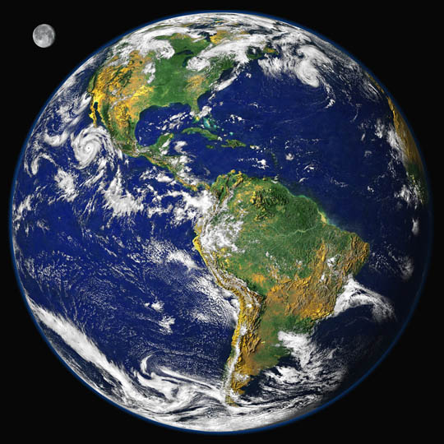
Earth’s
Changing
Surface
Content
Deepening
Developed by
Dr. Jeff Marshall
Geological Sciences
Cal Poly Pomona
Used by permission
Photo courtesy of Visible Earth
Notes:
Less than 1 min
a. “Today we’ll use and apply key science ideas about Earth’s changing surface from the ECS lessons.”

Slide 24
Coastline Landform Changes: Part 1
Questions | Your Ideas | Evidence
Do you think the cliffs are changing or staying the same? Why or why not?
If changes are happening, what do you think is causing them?
Notes:
4 min
Note: Make sure the data table from day 7 (Coastline Landform Changes: Part 1) is displayed where everyone can see it.
a. “First, let’s review the data table we created last time to answer questions about coastline landform changes.”
b. Invite different participants to recap the ideas and evidence for each question on the table.
c. During this review, ask questions to probe participants’ thinking.

Slide 25
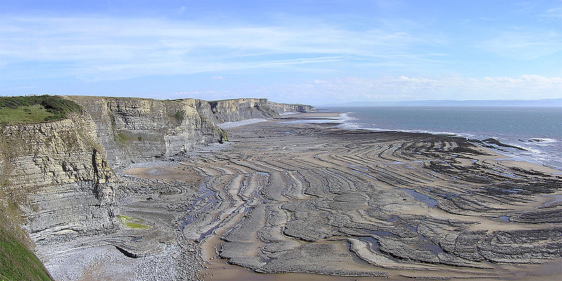
Let’s Share Our Ideas!
What’s happening to the cliffs and the beach in the photo below?
What do you think is causing these changes?
Do you think these changes are happening quickly or slowly over time? What is your evidence?
Photo courtesy of Yummifruitbat / Wikimedia Commons
Notes:
7 min
a. Read the questions on the slide.
b. Pairs: Have participants pair up with an elbow partner and use ideas and evidence from the data table to answer these questions.
c. Whole group: Invite pairs to share their responses. Record key ideas on chart paper and/or highlight them on the data table.

Slide 26
Earth’s Changing Surface
Lesson 6b
Photo courtesy of Visible Earth
Notes:
Less than 1 min
a. “Now let’s explore science ideas about Earth’s changing surface from lesson 6b.”

Slide 27
Content Deepening: Focus Question 1
Can we predict and explain how landforms might be changing in our area?
Notes:
Less than 1 min
a. Read the focus question on the slide.
b. Emphasize that this question will guide student learning throughout ECS lesson 6b.
c. Have participants write the question in their science notebooks and draw a box around it.

Slide 28
Key Science Ideas
Earths surface has many types of landforms.
The landforms in one place can look different from the landforms in another place.
Landforms change over time.
Some changes happen very slowly, like when canyons or deltas form, and other changes happen quickly, like during floods or landslides.
Flowing water can change landforms by moving rocks and soil from one place to another.
Notes:
5 min
a. Review the key science ideas on the slide and assign one idea to each participant.
b. Individuals: Ask participants to think of evidence from previous investigations that supports their assigned idea. Participants may use available resources (handouts, notes, readings) to help them with this task.
c. Whole group: Invite participants to share evidence that support their assigned idea. Record the evidence on chart paper.
d. During this review, encourage participants to agree or disagree with others’ ideas and evidence, ask question, or add on.

Slide 29
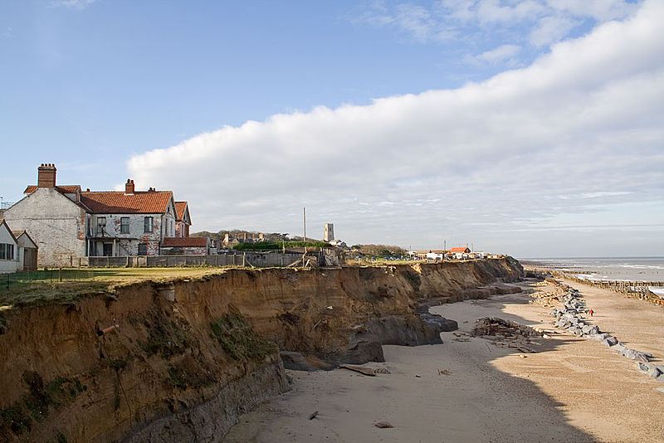
More Cliffs along the Coastline
What do think might happen to these cliffs over time? Why do you think so?
What do you think might happen to the houses near the cliffs? Why do you think so?
Photograph by Andrew Dunn/Wikimedia Commons
Notes:
4 min
a. Read the questions on the slide.
b. Invite participants to share their predictions and reasoning. Record key ideas on chart paper.
c. Probe participants’ thinking and encourage others to agree or disagree, ask questions, or add on.

Slide 30
A New Landform Challenge!
Discuss these questions with a partner and write your answers in your science notebook:
Do you think the land is changing? Why or why not?
If you think the land is changing, what might be causing the change?
Support your ideas with evidence and be prepared to share your ideas and evidence with the group.
Photograph by Andrew Dunn/Wikimedia Commons
Notes:
8 min
a. Read the instructions on the slide.
b. Have participants pair up and work together on the challenge questions.

Slide 31
Coastline Landform Changes: Part 2
Questions | Your Ideas | Evidence
What do you predict might happen to the cliffs over time? Why do you think so?
What do you think might happen to the houses near the cliffs? Why do you think so?
Notes:
10 min
a. If you haven’t done so already, create a data table on chart paper like the one on this slide.
Note: Alternatively, you could display the data table on a document reader.
b. Read the questions on the data table and invite participants to share their ideas and evidence. Records participants’ responses in the appropriate boxes on the table.
c. During this discussion, elicit differing points of view and probe participants’ responses (e.g., “Can you say more about that?”). Encourage participants to agree, disagree, ask questions, or add to the ideas others share. Work toward a consensus.

Slide 32
Reflect: Content Deepening Focus Question 1
Can we predict and explain how landforms might be changing in our area?
Notes:
Less than 1 min
a. Review the focus question on the slide.
b. Individuals: Ask participants to answer the question in their science notebooks using evidence from today’s landform challenge and the challenge from the previous content deepening session.
c. Whole group: Invite participants to share their ideas and evidence with the group. Record their responses on chart paper.

Slide 33
Unit Central Questions
What does the surface of Earth look like? Does it ever change?
Notes:
2 min
a. “As we wrap up our science content deepening work, let’s revisit our unit central questions.”
b. Read the unit central questions on the slide.
c. “Take a moment to think about how you might answer these questions based on everything we’ve learned this week about Earth’s changing surface.”

Slide 34
Unit Central Questions
What does the surface of Earth look like? Does it ever change?
Does the land look the same or different from place to place? What’s your evidence?
How and why do landforms change?
Notes:
8 min
a. Pairs: “Now I’d like you to work with a partner to develop answers for our unit central questions. Make sure you include evidence from our investigations to support your ideas. Think about similarities and differences in landforms from place to place, as well as how landforms change and why. When you’ve finished discussing your ideas and evidence, record them on chart paper; then display them on the wall. Afterward, we’ll have a gallery walk to review each other’s ideas.”
Note: Give each pair of participants a sheet of chart paper and markers.
b. Gallery walk (2–3 min): When all the charts have been posted on the wall, have participants take a gallery walk, rotating from chart to chart so that everyone has a chance to review one another’s work.

Slide 35
Key Science Ideas
Earths surface has many types of landforms.
The landforms in one place can look different from the landforms in another place.
Landforms change over time.
Some changes happen very slowly, like when canyons or deltas form, and other changes happen quickly, like during floods or landslides.
Flowing water can change landforms by moving rocks and soil from one place to another.
Notes:
Less than 1 min
a. Highlight the key science ideas on the slide that summarize the content deepening work participants engaged in this week.

Slide 36
Earth’s Changing Surface
MATH CONTENT DEEPENING Grade 2
Notes:
Less than 1 min
Transition slide: This slide marks the transition to math content deepening.
a. “Now let’s dig into some math content deepening that will help us make sense of distance and scale.”

Slide 37
Content Deepening: Focus Question 2
How long do you think it might take to walk the length of the Grand Canyon floor?
Notes:
Less than 1 min
a. Read the focus question on the slide.

Slide 38
Warm-Up Challenge
Think of a place away from home that you visit or travel to often. Examples:
Your place of work
The home of a friend or relative
The beach
The grocery store
On your sticky note, write down the following:
The first place that comes to mind
How far away it is
Notes:
10 min
a. Introduce the warm-up challenge on the slide. Then give each participant a sticky note.
b. Direct participants to write down the first place that comes to mind and then describe how far away it is from their home.
c. As participants work on the task, create a two-column chart with the headings “Type 1” and “Type 2.”
Note: It may be tempting to use the headings “Distance” and “Time,” but generic headings will avoid biased responses.
d. Collect the sticky notes from participants and arrange them on the chart according to the following criteria:
If participants used units of length to describe how far away the location is (e.g., 5 miles), place the sticky note in the Type 1 column.
If participants used units of time to describe how far away the location is (e.g., “About 1 hour away”), place the sticky note in the Type 2 column.
e. Ask participants whether they thought about time or factored it into their descriptions even if they ultimately used units of length. If they did, move their sticky notes to the Type 2 column.
Note: Even if participants described distance using units of length, they may also have been thinking about time (e.g., “I said 60 miles because it takes about an hour to get there on the freeway, and we drive at 65 miles per hour.”)
f. Emphasize: “Although we measure distances in units of length, we often make sense of distance in terms of the amount of time it takes to travel from one place to another at a specific rate of speed.”

Slide 39
Making Sense of Large Distances and Slow Rates of Change
Photo courtesy of Pixabay.com
Notes:
1 min
a. “Landforms like the Grand Canyon can be very large, spanning great distances. They also can change at incredibly slow rates. How can we make sense of such vast distances and slow rates of change? More specifically, how can we help 2nd graders make sense of them?”

Slide 40
The Grand Canyon
The Colorado River winds 277 miles along the floor of the Grand Canyon, from a dam near Page, Arizona, to Lake Mead, near Las Vegas, Nevada.
Our focus question: How long do you think it might take to walk the length of the Grand Canyon floor?
Notes:
8 min
a. Read the fact about the Colorado River on the slide.
b. Individuals: Have participants write an initial answer for the focus question in their science notebooks.
c. While participants are working on the task, create a chart with the heading “Estimated Time to Walk the Canyon Floor.”
d. Pairs: “Now pair up with an elbow partner and share your time estimates and the reasoning you used to obtain them.”
e. Whole group: Invite participants to share their time estimates with the group. Record their responses in specific units of time on the chart (e.g., about 70 hours, about 3 days).
f. Challenge the accuracy of participants’ estimates (e.g., 70 straight hours of walking? No breaks? No pit stops?).

Slide 41
Reckoning Problem 1
How wide is the room in feet?
How long does it take to comfortably walk across the room?
Notes:
5 min
a. “The Grand Canyon question we just considered is called a reckoning problem. A powerful way to solve such problems is to start with simple things we know and use relationships we’re familiar with to build up to an answer for something we don’t know. To demonstrate this, let’s solve some reckoning problems.”
b. Read the questions on the slide.
c. Help participants answer the questions by stepping off the distance (width) across the room while one participant times your movement using a stopwatch or smartphone timer. Then have someone use a ruler to measure the length of your stride in feet (round to the nearest whole foot to keep the arithmetic simple). Instead of multiplying the number of feet per stride by the number of strides it took to cross the room, demonstrate skip counting to achieve the desired number.
d. Direct participants to record these estimates in their science notebooks.
Ideal responses:
Question 1: It takes about 12 steps to cross the room. If each stride is about 2 feet, that means the room is about 24 or 25 feet across. Round to 25 so the next step is easier to calculate.
Question 2: It takes about 6 seconds to comfortably walk across the room.

Slide 42
Reckoning Problem 2
How long would it take to walk the length of a building with 10 such rooms in a row, and how far would we travel?
Notes:
4 min
a. “Now that we know how long it takes to walk across one room, let’s estimate how long it would take to walk the length of a building with 10 such rooms in a row, and how far we’d travel.”
b. Elicit ideas from the group and use probe and challenge questions to clarify participants’ reasoning.
c. Emphasize that skip counting can be used instead of multiplication to complete the calculations. The graphic on the slide illustrates this. Skip counting by the length of the room 10 times is the same as measuring the length of 10 identical rooms end to end. Similarly, one can use skip counting to compute the time needed to walk the length of 10 rooms (6 seconds, 12, 18, 24, and so on).
Ideal response:
It would take about 60 seconds or 1 minute (based on skip counting) to walk the length of the building, and the distance traveled would be 250 feet.

Slide 43
Reckoning Problem 3
How long would it take to walk the length of four such buildings in a row, and how far would we travel?
Notes:
4 min
a. “So we know how long it would take to walk the length of one building and how far we’d travel. How long would it take to walk the length of four such buildings in a row, and how far would we travel?”
b. Elicit ideas from the group and use probe and challenge questions to clarify participants’ reasoning.
c. “Once again, skip counting can be used instead of multiplication to complete the calculations. The graphic on the slide can help us visualize this. Skip counting four times by the length of the building is the same as measuring the length of four identical buildings end to end. Similarly, we can use skip counting to compute the time needed to walk the length of four buildings (1, 2, 3, 4 minutes).”
d. Direct participants to record their estimates in their science notebooks.
Ideal response:
It would take about 4 minutes to walk the length of four buildings (1 min × 4), and we’d travel 1,000 feet (250 ft × 4).

Slide 44
Reckoning Problem 4
How long would it take to walk 1 mile?
Notes:
5 min
a. “Based on our estimates so far, how long would it take to walk 1 mile?”
b. Elicit ideas from the group and use probe and challenge questions to clarify participants’ reasoning.
c. Remind participants that skip counting can be used instead of multiplication to complete the calculations. Skip counting by the length of four buildings a number of times up to about 1 mile is the same as measuring the length of four identical buildings end to end to cover a mile. Similarly, skip counting can be used to estimate the time needed to walk a mile.
d. Direct participants to record their estimates in their science notebooks.
Ideal response:
It would take about 17 minutes to cover 5,250 feet (16 minutes to cover 5,000 feet plus another minute to cover 250 feet), which is about 5,280 feet or 1 mile.

Slide 45
Building up to 277 Miles
How long would it take to walk 10 miles?
How long would it take to walk 100 miles?
How long would it take to walk 200 miles?
How long would it take to walk 277 miles?
Notes:
8 min
a. “Our original goal was to estimate how long it might take to walk the length of the Grand Canyon floor, which is 277 miles long. So let’s use the estimates we’ve calculated so far to build up to this final estimate.”
b. Read the questions on the slide.
c. Pairs: “Work with an elbow partner to answer each of these questions by applying our previous estimates and reasoning. Then write your estimates in your science notebooks.”
d. Circulate around the room as pairs work on these calculations. Challenge participants to avoid using a calculator and stick to skip counting to build up to their answers mentally, or use pencil-and-paper calculations. At this point, participants should focus only on the time spent walking and not include rest periods or other factors. Certainly, when distances exceed 10 miles, other factors need to be considered, but for these estimates, have participants focus only on the walking time.
e. Whole group: Invite pairs to share their answers with the group. As participants share their estimates, record them on chart paper. Ask probe and challenge questions to make their reasoning visible. When necessary, challenge participants to use grade-appropriate mathematics to justify their answers.
Ideal responses:
It would take about 170 minutes to walk 10 miles, which is about 180 minutes or 3 hours.
It would take about 30 hours to walk 100 miles, which is about 1 day and 6 hours.
It would take about 2 days and 12 hours to walk 200 miles.
It would take about 3 days and 12 hours of straight walking to cover 277 miles on the floor of the Grand Canyon.

Slide 46
Basic Reckoning Skills
We started with a familiar scale (length of room in feet) and unit of time (seconds).
We used skip counting to add up, keeping track of time and distance for progressively larger groups (1 room, 10 rooms, 4 buildings, 1 mile).
We performed addition with base-10 notation for numbers up to the thousands (e.g., 5,280 ft = 1 mi).
We used common units of distance and time (feet and seconds, miles and hours)
Key point: Changing the units of measurement kept the numbers manageable and within our ability to interpret.
Notes:
1 min
a. “It’s important to recognize the basic skills we used in solving our reckoning problems.”
b. “First, we started with a familiar scale (the length of the room in feet) and unit of time (seconds).”
c. “Then we used skip counting to add up, keeping track of time and distance for progressively larger groups (one room, 10 rooms, four buildings, 1 mile).”
d. “This required us to perform addition with base-10 notation for numbers up to the thousands (e.g., adding up to 5,280 feet or 1 mile).”
e. “In fact, we changed units of measurement along the way—seconds to minutes to hours and rooms to buildings to miles—to keep the numbers we were working with under 1,000 (e.g., 2 miles instead of 10,560 feet; 1 day instead of 86,400 seconds).”
f. “This kept the numbers manageable and within our ability to interpret.”

Slide 47
Use and Apply: Planning an Expedition
How long could you walk before you’d need to rest, drink some water, or make a pit stop?
How long could you walk between meals?
How many breaks would you need, and how long?
How would your time estimate change if you had to carry your own food and water for each day or the entire trip? How many meals would you need to carry in your backpack?
How might the weight of your backpack or fatigue affect your pace?
Notes:
2 min
a. “To help our students connect math lessons to science lessons, we could engage them in a use-and-apply activity planning an expedition along the floor of the Grand Canyon. We already have a time estimate for walking the length of the canyon, so beginning with this estimate, students could answer questions like these:
How long could you walk before you’d need to rest, drink some water, or make a pit stop?
How long could you walk between meals?
How many breaks would you need, and how long?
How would your time estimate change if you had to carry your own food and water for each day or the entire trip? How many meals would you need to carry in your backpack?
How might the weight of your backpack or fatigue affect your pace?”
b. “Planning a trip like this would give our students an opportunity to apply grade-appropriate mathematical skills to a real-life scenario.”

Slide 48
Common Core Math Standards: Grade 2
Instructional time should focus on four critical areas:
Extending understanding of base-ten notation
Building fluency with addition and subtraction
Using standard units of measure
Describing and analyzing shapes
Key point: We can use base-10 notation, fluency with addition, and standard units of measure to make sense of the distances involved in describing landforms and landscapes.
Notes:
Less than 1 min
a. “The Common Core State Standards for 2nd-grade math stipulate that mathematics instruction ‘should focus on four critical areas: (1) extending understanding of base-ten notation; (2) building fluency with addition and subtraction; (3) using standard units of measure; and (4) describing and analyzing shapes.’”
b. “These critical areas are exactly what we can use to make sense of the distances involved in describing landforms and landscapes like the Grand Canyon.”

Slide 49
Reflect: Content Deepening Focus Question 2
How long do you think it might take to walk the length of the Grand Canyon floor?
Remember: The Colorado River winds 277 miles along the floor of the Grand Canyon, from a dam near Page, Arizona, to Lake Mead, near Las Vegas, Nevada.
Notes:
4 min
a. Review the focus question on the slide.
b. Individuals: Have participants write a new answer for this question in their science notebooks. Make sure they explain their estimates.
c. Whole group: Invite participants to share their estimates and reasoning with the group. Record the answers on chart paper and ask probe questions to clarify participants’ reasoning.
d. During this share-out, encourage participants to agree or disagree, ask questions, and add on to others’ ideas.

Slide 50
Content Deepening: Focus Question 3
How accurate are raised relief maps as content representations?
Notes:
Less than 1 min
a. Hold up a raised relief map for everyone to see. Then lay it flat on the table so that the raised relief is evident.
b. Read the focus question on the slide.
c. “Next, we’ll analyze the raised relief maps used in the ECS lessons and determine how accurate they are as topographical representations of Earth’s surface across the contiguous United States.”

Slide 51
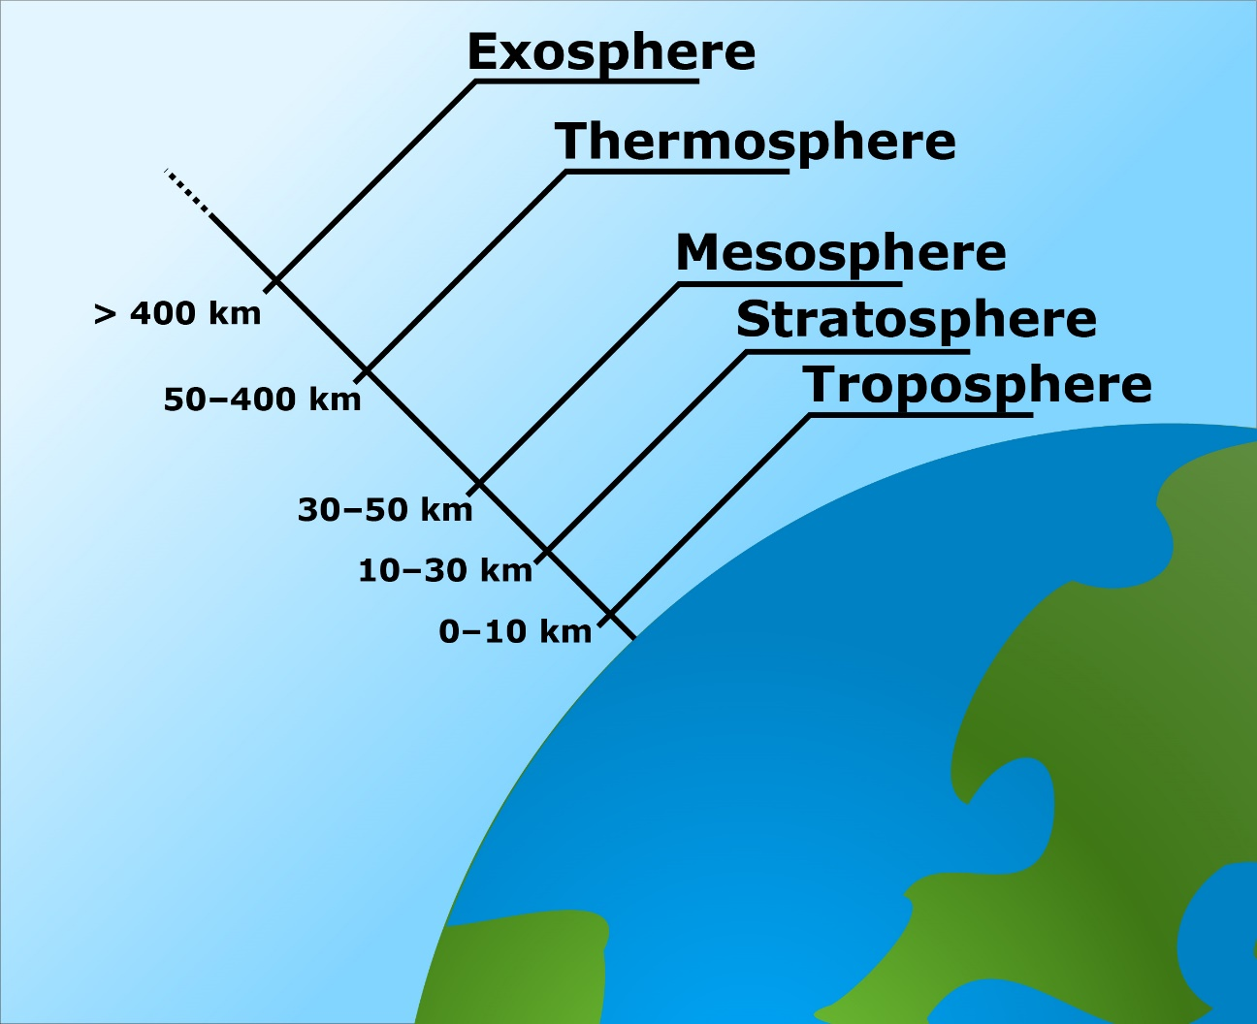
Vertical vs. Horizontal Scales
Earth’s surface is the boundary of interaction between Earth’s interior (tectonic movement) and the atmosphere (weather).
Courtesy of Bredk/Wikimedia Commons
Notes:
1 min
a. “Earth’s surface is the boundary of interaction between two systems: Earth’s interior and Earth’s atmosphere. Convection in Earth’s mantle drives the movement of tectonic plates and the creation and destruction of the crust. In Earth’s atmosphere, solar heating and cooling drive the complex movements of air and water.”
b. “As the altitude above Earth’s surface increases, temperatures typically decrease. But at an altitude of approximately 20 kilometers, this trend reverses, and temperatures begin to increase. This change marks the end of the troposphere and the beginning of the stratosphere. The troposphere is the range of altitudes where most aircraft operate and most of the world’s weather occurs. The stratosphere is the range of altitudes where weather balloons hang out.”
c. “Above the stratosphere, temperature trends change again and again, signaling the transition between other regions of the atmosphere extending into space.”
d. Highlight the various regions of Earth’s atmosphere on the slide diagram. Emphasize that in the diagram, the scale of these regions is greatly exaggerated. The diameter of Earth is about 12,000 kilometers, and the troposphere is only 20 kilometers thick, but in the diagram it’s about one quarter the diameter of Earth. That’s 3,000 times too big!

Slide 52
Vertical vs. Horizontal Scales
Vertical |  | Horizontal
Radius of Earth | 3,959 mi | Distance from Cal Poly Pomona to Mt. San Antonio College | 2 mi
Depth of the Mariana Trench | 7 mi | Distance from Pomona to Santa Monica | 45 mi
Elevation of Mount Everest | 5.5 mi | Length of the Grand Canyon | 277 mi
Average thickness of Earth’s crust | 17 mi | Length of the Mississippi River | 2,350 mi
Average altitude of the base of the stratosphere | 7 mi | Distance from Pomona to Cape Town, South Africa | 9,990 mi
Notes:
2 min
a. Distribute handout 8.7 (Vertical vs. Horizontal Scales).
b. “This handout shows some familiar vertical and horizontal distances measured in miles. Most people are able to attach meaning to these numbers because they range from single digits to four digits.”
c. “The distances in the left column are vertical because they’re measured up and down in our frame of reference. The radius of Earth, for example, is measured from the center point of Earth upward to the point just below our feet.”
d. “The distances in the right column are horizontal because we measure them laterally along the surface of Earth or as the crow flies. For example, the distance from Pomona to Cape Town, South Africa, is measured along a great circle on the sphere, which is the shortest route a long-haul aircraft would fly from one location to another.”
e. “We’ll use proportional reasoning to compare these distances in our next activity.”

Slide 53
Fill in the Blanks
Use your handout and any mathematical method you know to complete these statements:
The radius of Earth is about ____ times larger than the elevation of Mount Everest, the tallest mountain on Earth.
The radius of Earth is about ____ times larger than the depth of the Mariana Trench.
The Grand Canyon is about ____ times longer than the elevation of Mount Everest.
The highest point on the relief map is about ____ times higher than it should be.
Notes:
10 min
a. Orient participants to the activity.
b. Pairs: Have participants work with an elbow partner to complete each statement using their handouts and any mathematical method they know.
c. As pairs work on these tasks, circulate around the room and provide support as needed. Ask elicit and probe questions to reveal participants’ reasoning.
Examples of reasoning:
The radius of Earth is about 560 times larger than the depth of the Mariana Trench because 7 times 500 is 3,500 (by skip counting), and 7 times 60 is 420, and 3,500 plus 420 is 3,920, which is close to 3,953.
Other answers are possible, of course, depending on what participants mean by “about.” Another 5 copies of 7 miles would add another 35 miles, bringing the total to 3,955, which is closer to 3,953. So it’s also correct to say, “The radius of Earth is about 565 times larger than the depth of the Mariana Trench.”
Ideal responses for the first three statements:
The radius of Earth is about 718 times larger than the elevation of Mount Everest, the tallest mountain on Earth.
The radius of Earth is about 567 times larger than the depth of the Mariana Trench.
The Grand Canyon is about 50 times longer than the elevation of Mount Everest.
d. Participants will probably have trouble with the last question on the slide. Have a volunteer use a ruler standing on end to estimate the height of the tallest mountain on the relief map in inches (or centimeters) and then measure the distance from Los Angeles to San Francisco on the map in inches (or centimeters, consistent with the other measurement).
e. “It’s about 350 miles from Los Angeles to San Francisco, and the tallest mountain in the contiguous United States is Mount Whitney in the Sierras at 14,505 feet. If we say that Mount Whitney is about 3 miles high (3 miles × 5,280 feet in a mile = 15,840 feet), then the distance from Los Angeles to San Francisco is about 116 times greater than the height of Mount Whitney. How many times greater is the height of the tallest mountain on the relief map than the distance on the map from Los Angeles to San Francisco?”
f. Help participants answer this question and then direct them to use the result to answer the last question on the slide, applying similar reasoning. The answer is quite surprising. The vertical scale of the map is greatly exaggerated in order to make the topographical changes across the US more evident. This is helpful for illustrating the differences between landforms, such as mountains and plains, but it plays into our natural tendency to envision exaggerated vertical scales. The mountains north of Los Angeles rise to 10,000 feet and appear massive, yet this vertical height (roughly 2 miles) is many times smaller than the horizontal distance from which we typically view them. (It’s nearly 10 miles to Mount Baldy from central Pomona, so the horizontal distance is five times greater than the vertical height.)

Slide 54
Earth’s Changing Surface
Photo courtesy of Pexels.com
Notes:
Less than 1 min
a. “The focus of these lessons is Earth’s changing surface. The landforms we discuss, such as the mountains of the western United States or the Grand Canyon, seem enormous from our everyday point of reference. With proportional reasoning, however, we can see that they’re actually minuscule bumps and scratches across the broad surface of Earth. With this perspective, it’s easier to understand that landforms can change over time as a result of weathering and the movement of water and air. Just as we can smooth out the bumps on a wooden ball using sandpaper, the relentless movement of air across the surface of Earth can wear down the mountains. And just as we can carve a scratch into the surface of a ball by repeatedly drawing along the same path with a firm pen, the relentless flow of water can slowly carve canyons out of the landscape.”

Slide 55
Reflect: Content Deepening Focus Question 3
How accurate are raised relief maps as content representations?
Notes:
5 min
a. Review the focus question on the slide.
b. Individuals: Direct participants to answer the question in their science notebooks. Ask them to include their ideas about the advantages and disadvantages of using exaggerated relief maps as content representations in the ECS lessons.
c. Whole group: Invite participants to share their answers with the group. Record key ideas on chart paper and encourage participants to communicate in scientific ways during this share-out.

Slide 56
Today’s Focus Questions
How can science content storyline coherence be enhanced by explicitly implementing STeLLA strategy F (Make explicit links between science ideas and activities), strategy G (Link science ideas to other science ideas), and strategy H (Highlight key science ideas and focus question throughout)?
How will the Student Thinking Lens and Science Content Storyline Lens strategies help you teach the ECS lessons in the fall?
Can we predict and explain how landforms might be changing in our area?
How long do you think it would take to walk the length of the Grand Canyon floor?
How accurate are raised relief maps as content representations?
Notes:
5 min
a. Give participants a couple of minutes to think about today’s focus questions and then answer them in their notebooks.
b. If time allows, have a share-out of ideas.

Slide 57
Summarizing Science Content Storyline Lens Strategies
What does the organization of the summary chart in the STeLLA strategies booklet highlight about the Science Content Storyline Lens strategies?
Do you want to make any revisions or additions to our chart on effective science teaching?
Notes:
10 min
Note: Display one question at a time on the slide.
a. “This week we focused on the Science Content Storyline Lens and strategies. Let’s synthesize and summarize our learning by looking at the summary chart in your strategies booklet—Summary of the STeLLA Science Content Storyline Lens Strategies.”
Note: Participants may also refer to their SCSL Z-fold summary charts for this activity.
b. Individuals: “Look at this summary chart and how it’s organized. What do you think the organization highlights? Write your observations in your notebooks.”
c. Whole group: “What did you notice about the organization of this chart? What does it highlight about the science content storyline strategies?”
d. Reveal the second discussion question on the slide and invite participants to suggest additions or changes to the Effective Science Teaching chart.
Key ideas:
Many of the SCSL strategies must be completed during the lesson planning stage. For example, the main learning goal and activities that match them must be selected ahead of time.
Strategies B, F, G, H, and I are moves the teacher makes while teaching the lesson, but planning and anticipating how these strategies will help develop the lesson is critical to success.
The RESPeCT lesson plans provide examples of how strategies B, F, G, H, and I might be used during the lessons.
Strategies F, G, and H should be applied throughout the lesson. Strategy B is used at the beginning of a lesson, and strategy I is used at the end.
Each strategy has its own distinct purpose(s), but all of them contribute to creating a coherent science content storyline.

Slide 58
Let’s Celebrate!
Design your own end-of-program celebration and insert any comments or instructions here.
Notes:
15 min
a. Decide how you’ll celebrate the end of the RESPeCT PD program, and modify the slide accordingly. Here are a few ideas:
Have refreshments and toast the group’s success with a bubbly, nonalcoholic drink.
Have everyone write on an index card a “golden nugget” that represents something they’re taking away from the Summer Institute experience. Pass around a bowl filled with chocolates wrapped in gold paper, and have participants take a piece of chocolate when they drop their cards in the bowl. After the bowl is passed around, share the golden nuggets with the group.
Take a group photo.

Slide 59
Thank You!
Thank you for participating in the RESPeCT PD program!
Notes:
Less than 1 min
a. Before dismissing participants, thank them for participating in the RESPeCT PD program.

