Slide 1
Forces Lesson 1a
What Makes Something Start to Move?

Slide 2
Unit Central Questions
What makes something start to move? What makes something stop moving or change direction?

Slide 3
Today’s Focus Question
What makes something start to move?

Slide 4
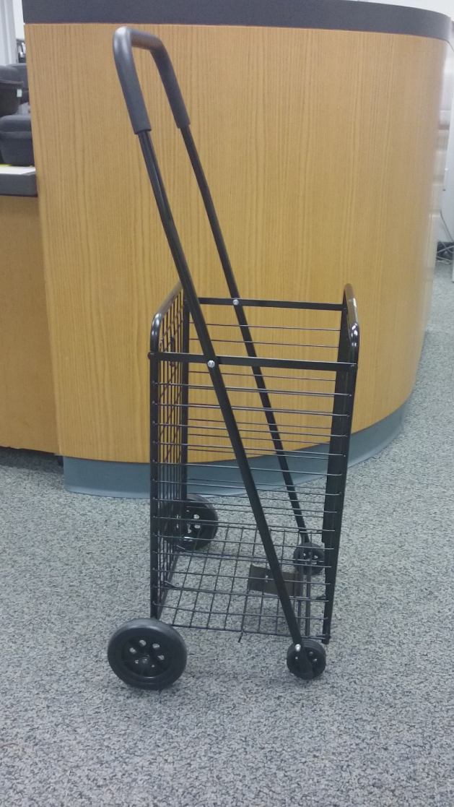
What Makes Something Move?
What do you think can make this cart start moving?
Photo courtesy of Cal Poly Pomona

Slide 5
Investigation: What Makes Something Move?
Directions for each group member:
Choose an object on the tray to investigate.
Explore different ways to make the object move.
On the tree map, circle the name of the object you’re investigating. Then answer these questions using action words like push and pull:
What other object caused the object to move?
What action caused the motion?
What action caused the object to speed up, slow down, change direction, or stop?

Slide 6
Investigation: What Makes Something Move?
Be specific when you answer the handout questions.
Use words like push and pull to describe actions.
Ask questions like these as you examine the object:
What’s moving?
What other object is touching (pushing or pulling) this object and causing it to move?
What action is causing a change in the object’s motion or making it stop?
Does the object ever move without anything else touching it?

Slide 7
Share Your Objects and Tree Maps
Each group member should select a different object to share with the group.
State the name of your object and then share your descriptions from the tree map:
What other object caused the object to move? (What pushed or pulled it?)
What action caused the motion?
What action caused the object to speed up, slow down, change, direction, or stop?

Slide 8
Share Your Objects and Tree Maps
Example:
My object is the cart.
My hand (the other object) caused the cart to start moving.
Pushing the cart (the action) caused the motion.
Pulling the cart (action) with my hand (other object) made it change direction.

Slide 9
Let’s Summarize!
Today’s focus question: What makes something start to move?
Answer this question in your science notebook using this sentence starter:
My object, [name of object], started to move because ____________________.
Look at your tree map as needed. Use any or all of these action words in your answer: push, pull, fall, drop.

Slide 10
Next Time
In our next lesson, we’ll learn some important words that scientists use to describe the pushing and pulling that make an object move.
Do you have any ideas about what those words might be?

