Slide 1
Forces Lesson 3A
Why Do Moving Objects Slow Down and Eventually Stop?

Slide 2
Review: Representing Forces
What two things do arrows show about a force acting on an object?

Slide 3
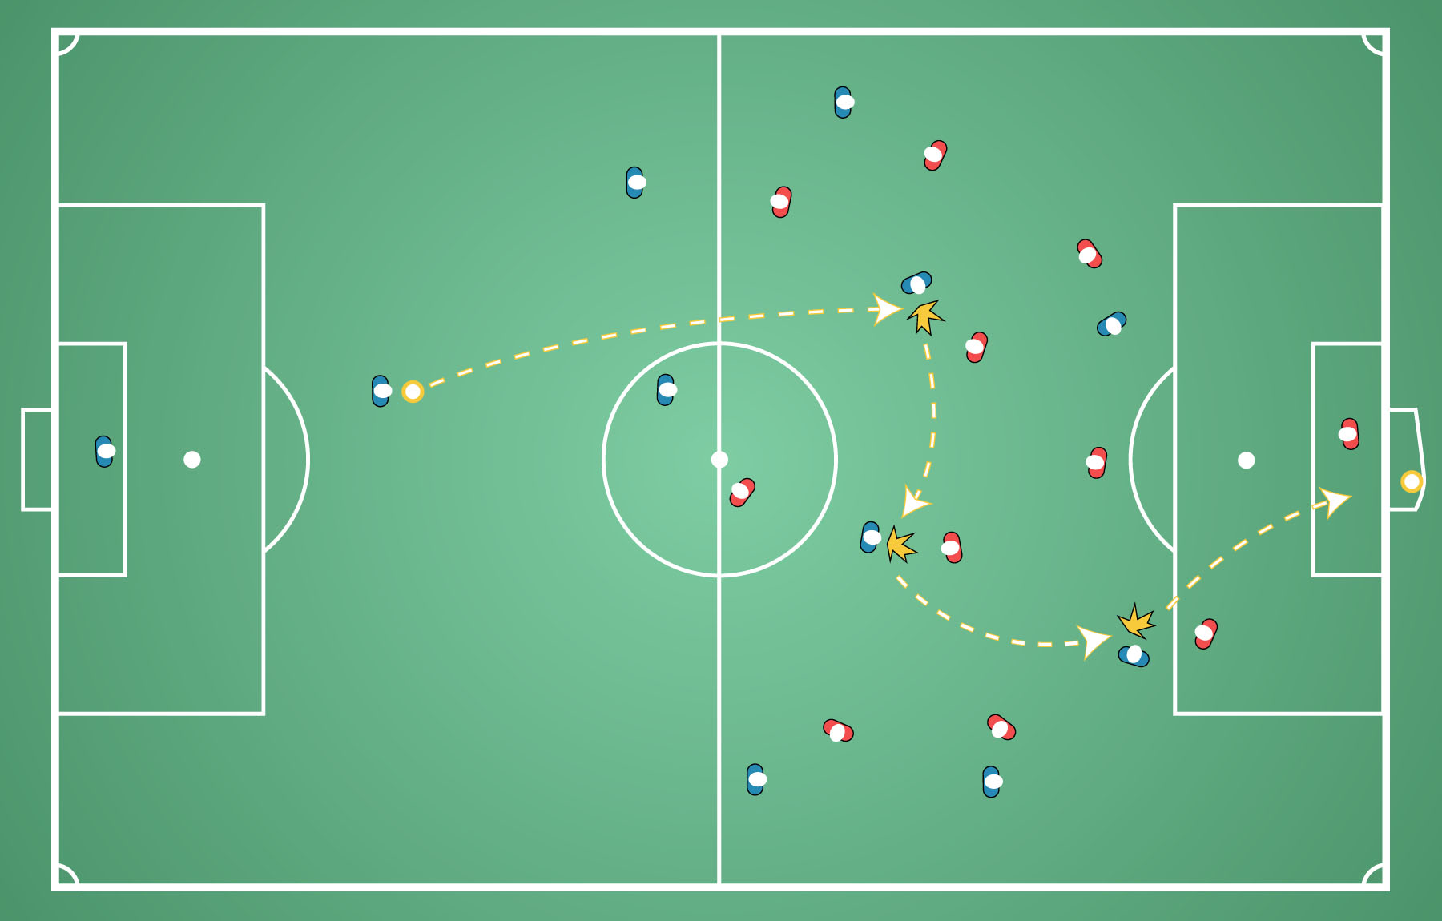
What Are the Forces?
What arrows would you draw to represent the forces acting on the soccer ball as it moves down the field?
Courtesy of BSCS

Slide 4
What Are the Forces?
What arrows would you draw to represent the forces necessary to score a goal?
What object is being pushed or pulled?
What object is exerting a force?
What is the direction of each arrow that represents a force acting on an object?
What is the length of each arrow?
What does the length of each arrow represent?

Slide 5
What Are the Forces?
What arrows would you draw to represent the forces necessary to score a goal?
Courtesy of BSCS

Slide 6
Unit Central Questions
What makes something start to move? What makes something stop moving or change direction?

Slide 7
Today’s Focus Question
Why do moving objects slow down and eventually stop?

Slide 8
Why Do Moving Objects Stop?
If you kick a soccer ball on a field, why do you think the ball will eventually stop?

Slide 9
Why Do Moving Objects Stop?
Complete this sentence in your science notebook:
I think the soccer ball I kick on a field will eventually stop because _______.

Slide 10
Investigation: Does the Surface Matter?
Think about this scenario: Students rolled a soccer ball over three different surfaces:
Grass
Blacktop on the playground
Tile flooring in the school hallway
The students tried to use the same force each time. Then they measured how far the ball rolled.
Question: Do you think the ball traveled the same distance on all three surfaces? Why or why not?

Slide 11
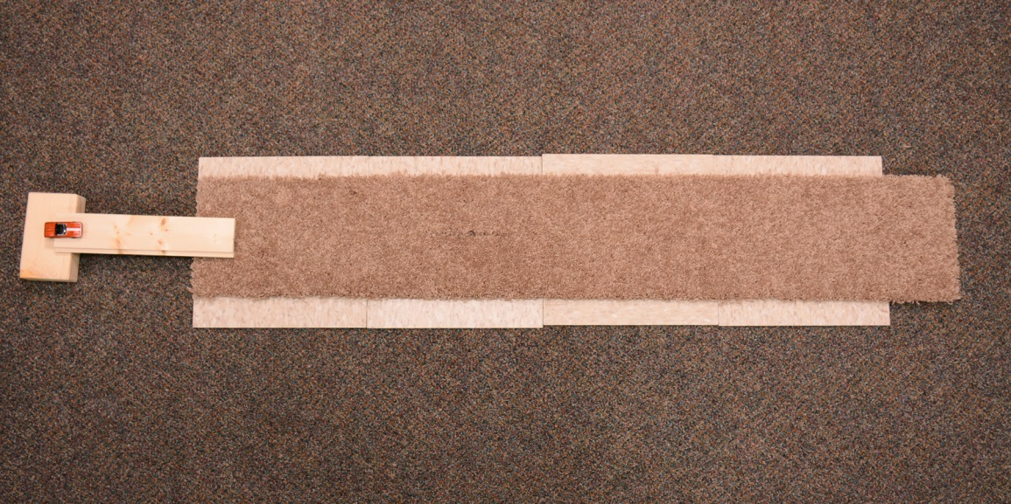
Investigation: Does the Surface Matter?
Carpet
Car
Ramp
Meter Stick
Photo courtesy of BSCS
Notes:
Picture of experiment setup

Slide 12
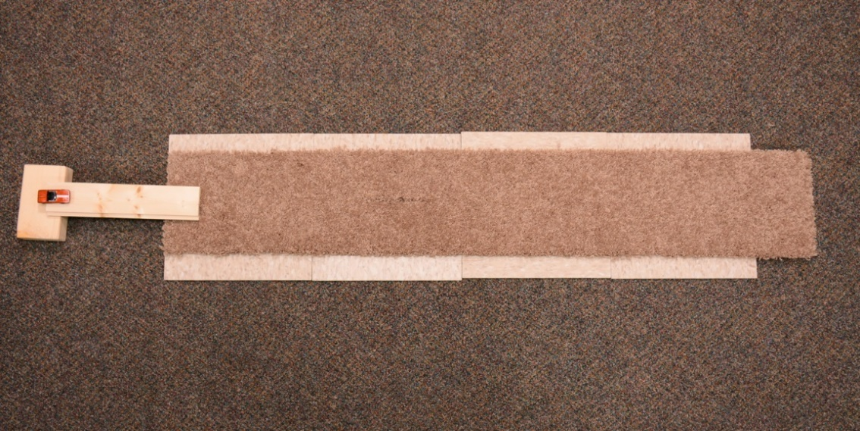
Make Your Predictions
Read about the investigation at the top of the handout (Does the Surface Matter?). Then answer the questions:
Do you think the car will travel the same distance over all three surfaces? Why do you think this will or won’t happen?
Photo courtesy of BSCS

Slide 13
Share Your Predictions
Will the car travel the same distance over all three surfaces? Why do you think this will or won’t happen?
Share your prediction with an elbow partner.
If you revise your prediction, don’t erase your original ideas. Just lightly cross through it and write your new ideas in a different color underneath or on the back of your handout.

Slide 14
Let’s Summarize!
Our focus question: Why do moving objects slow down and eventually stop?
Earlier today you completed this sentence:
I think the soccer ball I kick on a field will eventually stop because _____________.
Find this sentence in your notebook and revise it based on the ideas we explored today.

Slide 15
Next Time
Today we predicted whether a toy car rolling down a ramp will travel the same distance over three different surfaces.
Next time, we’ll test our predictions and collect some data to help us figure out why moving objects slow down and eventually stop.

