Slide 1
Forces Lesson 3b
Why Do Moving Objects Slow Down and Eventually Stop?

Slide 2
Last Time
How did you revise this sentence at the end of our last lesson?
I think the soccer ball I kick on a field will eventually stop because _______.

Slide 3
Today’s Focus Question
Why do moving objects slow down and eventually stop?

Slide 4
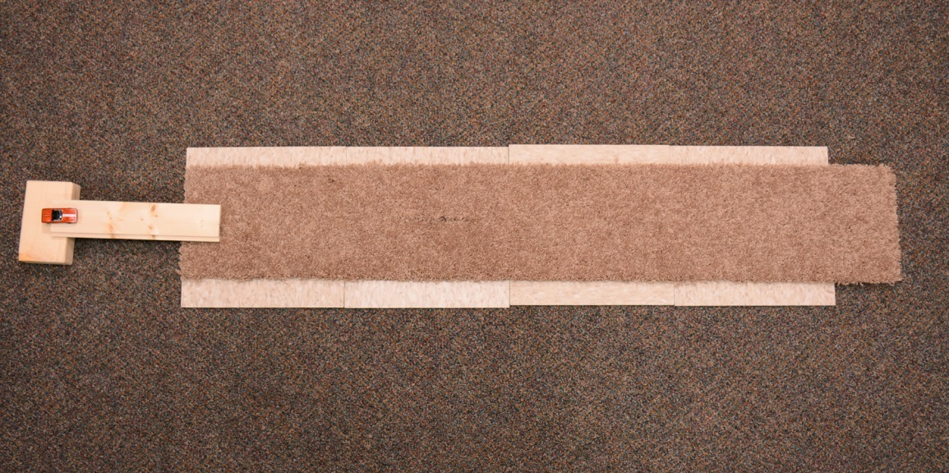
Investigation: Does the Surface Matter?
Carpet
Car
Ramp
Meter Stick
Photo courtesy of BSCS
Notes:
Picture of experiment setup

Slide 5
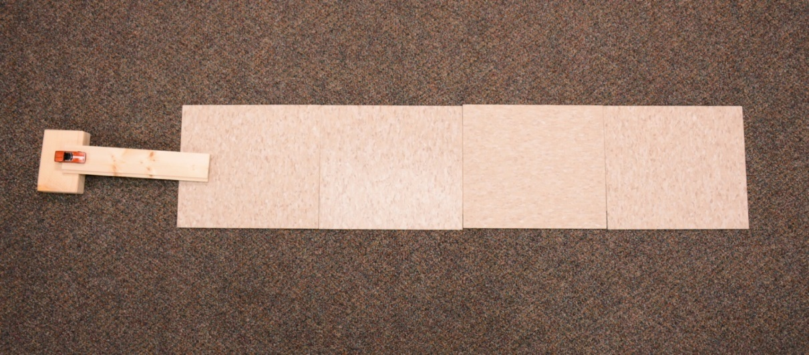
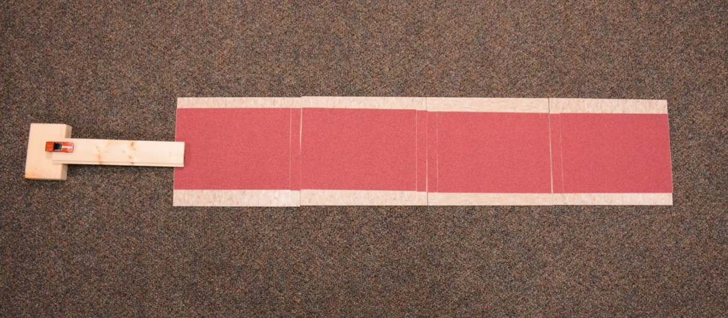
Investigation: Does the Surface Matter?
Photo courtesy of BSCS
Photo courtesy of BSCS

Slide 6
Investigation: Does the Surface Matter?
Record your distance measurements on this data table in the handout.
Surface | Distance Trial 1 | Distance Trial 2 | Distance Trial 3 | Middle Distance
Carpet
Tile
Sandpaper

Slide 7
Class Data Table
Record your team’s Middle Distance measurement on the class data table.
Surface | Team 1 | Team 2 | Team 3 | Team 4 | Team 5 | Team 6 | Team 7
Carpet
Tile
Sandpaper

Slide 8
Looking for Patterns in the Data
What patterns do you see in the class data?
Do these results match your predictions?

Slide 9
Explain Your Ideas
Question 1: Why do you think the car traveled different distances over the three surfaces?
Write your explanation on the handout.
Make sure to support your ideas with evidence from the data table and our investigation.

Slide 10
Let’s Summarize!
Question 2: If forces make an object start to move, do they also have something to do with making an object stop moving?
Turn and Talk: Talk about this question with an elbow partner. Then complete this sentence on the handout:
I think forces [do/do not] have something to do with making an object stop moving because __________________________.
Use evidence from your investigation to explain your answer.

Slide 11
Today’s Focus Question
Why do moving objects slow down and eventually stop?

Slide 12
Next Time
In our next lesson, we’ll continue thinking about why objects slow down and eventually stop.
At home tonight, find out how your family would answer the last question on our handout:
If forces make an object start to move, do they also have something to do with making an object stop moving?

