Slide 1
Forces Lesson 5A
What Happens If More Than One Force Pushes or Pulls an Object?

Slide 2
Review: Ideas about Friction
What is friction and how does it work?
Are there bumps anywhere else besides the surface an object moves across?
Give an example of friction from your everyday life.

Slide 3
Today’s Focus Question
What happens if more than one force pushes or pulls an object?

Slide 4
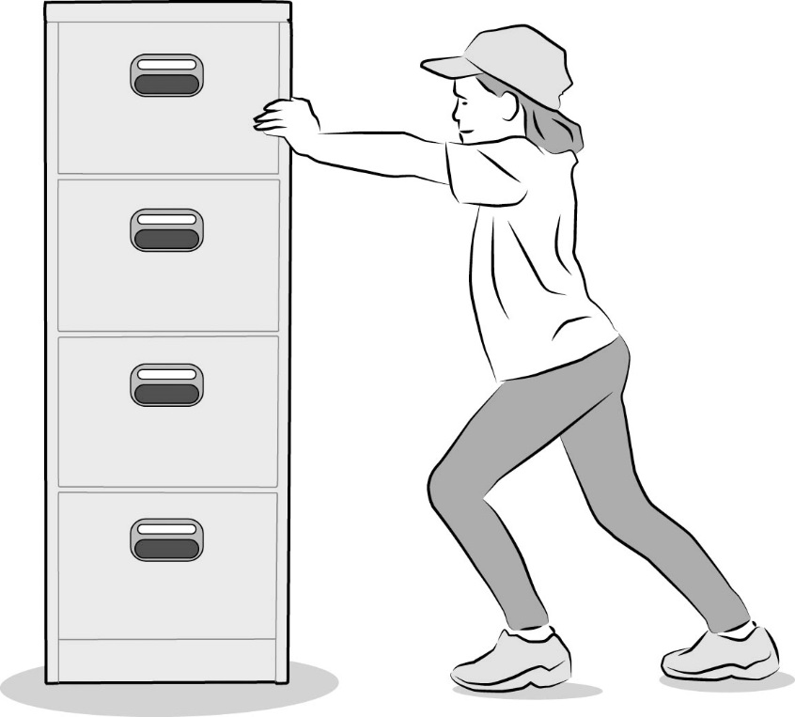
Scenario: Pushing a File Cabinet
A student is trying to move a heavy file cabinet across a carpeted floor, but the cabinet doesn’t move.
Turn and Talk: Why do you think the cabinet won’t move? Could forces have something to do with it? If so, how?

Slide 5
Investigation: Describe the Forces
Use one foam arrow to represent the pushing force our volunteer is exerting on the file cabinet.
Use two arrows to represent the direction and strength of each force that is pushing on the cabinet.

Slide 6
Investigation: Describe the Forces
Try to imagine the tiny bumps on the bottom surface of the file cabinet and the surface of the floor.
How could we use our hand-strip model to show how the bumps on these surfaces interact or push against one another?

Slide 7
Investigation: Describe the Forces
When we tried to push the heavy cabinet across the floor, how do you think the bumps on the cabinet and the floor interacted?
Use the hand strips to show this interaction.

Slide 8
Investigation: Describe the Forces
If we tried to push an empty cabinet across the floor, how do you think the bumps on the cabinet and the floor would interact?
Use the hand strips to show this interaction.

Slide 9
Investigation: Describe the Forces
How strong are the forces acting on the cabinet?
Are they stronger if the bumps on both surfaces are pushing close together or if they aren’t touching as much?

Slide 10
Investigation: Describe the Forces
Complete part 1 of handout 5.1 (Describe the Forces) on your own.
Read each scenario and work on the tasks.
Make sure to include science ideas about forces in your explanations.
When you’re finished, share your drawings and explanations with an elbow partner.

Slide 11
Follow-Up: Describe the Forces
Listen carefully as your classmate explains what happened with the file cabinet in the three scenarios.
Be prepared to agree or disagree, ask questions, or add on. Let’s communicate in scientific ways!
Think about this question: How is the force of friction involved in each scenario?

Slide 12
Today’s Focus Question
What happens if more than one force pushes or pulls an object?

Slide 13
Let’s Summarize: Key Science Ideas
A force is a push or a pull that makes an object start to move.
Forces have a strength and direction we can represent using arrows of different lengths and directions.
Friction is a force that’s created when tiny bumps on the surfaces of two objects push against one another.
The pushing force of friction makes a moving object slow down and eventually stop.

Slide 14
Let’s Summarize: Key Science Ideas
More than one force can push or pull an object at the same time. One of those forces can be friction.
If forces of equal strength are pushing or pulling an object in opposite directions, the object won’t move.
If forces of unequal strength are pushing or pulling an object in opposite directions, the object will move in the direction of the stronger force.

Slide 15
Next Time
In our next lesson, we’ll continue exploring what happens when more than one force acts on an object. We’ll also think about how gravity can be involved.
Think about this question tonight:
Are any forces acting on a pencil that’s lying still on a table?
We’ll talk about your ideas next time!

