Slide 1
Forces Lesson 5b
What Happens If More Than One Force Pushes or Pulls an Object?

Slide 2
Review: Three Scenarios
What happened when the force that friction exerted on the file cabinet and the force Sarah exerted were equal (the same)?
What happened when the force that friction exerted on the file cabinet and the force Sarah exerted were unequal (not the same)?
In which scenario(s) did the cabinet move?

Slide 3
Today’s Focus Question
What happens if more than one force pushes or pulls an object?

Slide 4
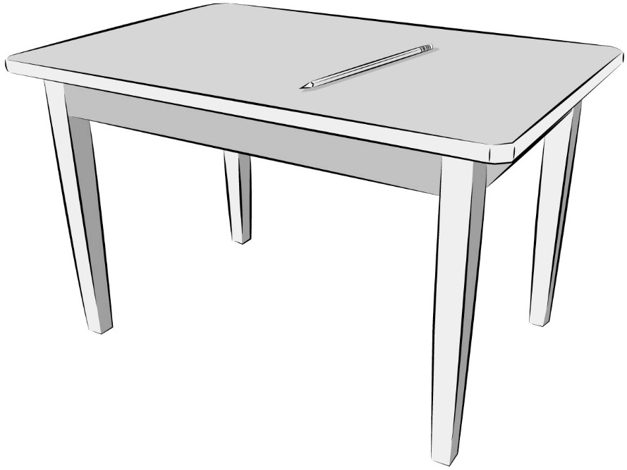
A Pencil on a Table
A pencil is sitting perfectly still on a table. Do you think any forces are acting on the pencil?

Slide 5
A Pencil on a Table
A pencil is sitting perfectly still on a table. Do you think any forces are acting on the pencil?
Gravity

Slide 6
Investigation: Describe the Forces
Complete part 2 of handout 5.1 (Describe the Forces).
Complete the tasks for the first scenario (the pencil on a table) based on our discussion.
Then work on the final scenario (the tree fort). You may discuss the scenario with a partner, but complete the handout tasks on your own.
Think about how gravity is involved in each scenario and make sure to include science ideas about forces in your explanations.

Slide 7
Follow-Up: Describe the Forces
Listen carefully as your classmate explains what happened with the file cabinet in the three scenarios.
Be prepared to agree or disagree, ask questions, or add on. Let’s communicate in scientific ways!
Think about this question: How is the force of gravity involved in each scenario?

Slide 8
Let’s Summarize!
Today’s focus question: What happens if more than one force pushes or pulls an object?
Think about each scenario on our handout. For each scenario, you drew more than one arrow to represent the forces acting on an object.
What happened with the arrows (forces) in the scenarios where an object didn’t move?
What happened with the arrows (forces) in the scenarios where an object did move?

Slide 9
Let’s Summarize!
Today’s focus question: What happens if more than one force pushes or pulls an object?
Use these sentence starters to answer the focus question in your science notebook:
If forces of equal (the same) strength are pushing or pulling an object in opposite directions, the object will ____________.
If forces of unequal (not the same) strength are pushing or pulling an object in opposite directions, the object will ____________.

Slide 10
Next Time
In our next lesson, you’ll use everything you’ve learned about forces and motion to predict and explain the motion of objects in real life.
Are you ready to show what you know?

